Slide 1
Introduction to EIC Yellow Report Tracking Working Group
1st EIC Yellow Report Workshop @ Temple University
Kondo Gnanvo
University of Virginia

Slide 2
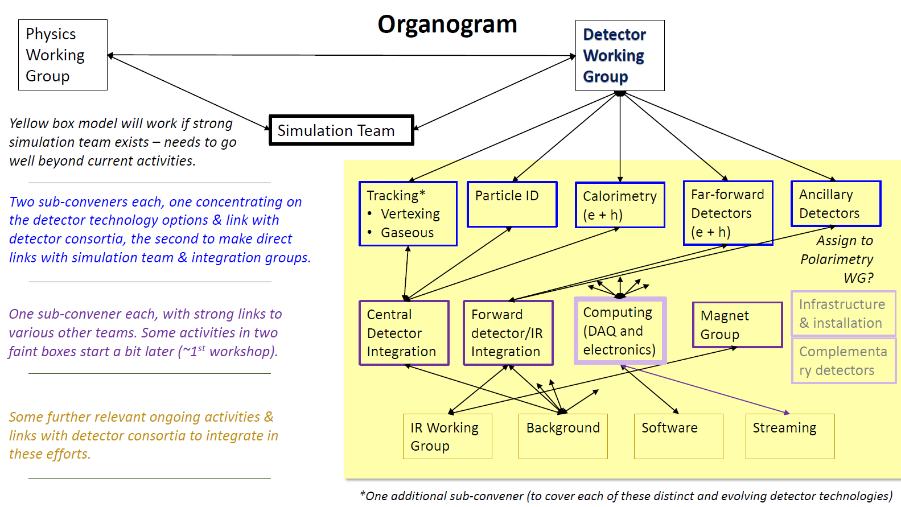
Introduction to YR-Tracking Working Group
Yellow Report:
Kick-off Meeting @ MIT Dec 2019
3 Main Working Groups
Physics Working Group
Detector Working Group
Accelerator Working Group
Tracking Working Group: In charge of the Tracking Technologies in both Barrel and the End Caps regions (i.e. not Far Forward / Backward)
Convener: Peter Jones (University of Birmingham):
sub conveners:
Annalisa Mastroserio & Domenico Elia (INFN Bari) ⇨ Simulation and Integration Coordination
Kondo Gnanvo (University of Virginia) ⇨ Gaseous Detectors
Leo Greiner (UC Berkeley) ⇨ Silicon Detectors
eRD6 and eRD22 link to YR-Tracking-WG: Matt Posik (Temple University)

Slide 3
Main Goals for the YR-Tracking-WG
Courtesy Peter Jones

Slide 4
Participating Institutions & Expressed Interest
 | Hardware oriented | Software oriented
eRD6: BNL, INFN Trieste, Florida Tech. Stony Brook U., UVa, Temple U., UVa, Yale U. | Central Tracker (gaseous): TPC with MPGD readout; Fast Signal Cylindrical µRWELL Layer End Cap Tracker (gaseous): Planar MPGD (GEMs, µRWells); | Central and End Cap Tracking (Gaseous)
eRD22: JLab, Temple U., UVa | End Cap Tracker (gaseous): GEM-based Transition Radiation Detector (GEM-TRD) | Central and End Cap Tracking (Gaseous)
CEA Saclay (France) | Central Tracker (gaseous): Cylindrical Micromegas End Cap Tracker (gaseous): Planar Micromegas | Central tracking
eRD18: University of Birmingham (UK) | Vertex Tracker (silicon): Si tracker – vertex (MAPS) | Central tracking
STFC-RAL (UK) | Si- tracker | X
LANL | Central Tracker (silicon): Monolithic Active Pixel Sensor (MAPS). End Cap Tracker(silicon): Forward-rapidity silicon (MAPS + other) | Central and End Cap Tracking
UC Berkeley / LBNL | Central and Forward Tracker (silicon): + optimization of barrel-forward layout with all-Si and hybrid (Si+TPC) tracker concepts | Central and End Cap Tracking
INFN Bari | Central Silicon Tracker | Central Si-tracker
BNL ASICs | Si-Tracker | X
Currently 71 members joined YR-Tracking-WG
With an attendance of ~ 25 to 30 to the Weekly Meeting

Slide 5
Deliverable for this 1st YR Workshop @ Temple U.
Email from Peter
Baseline detector concept: I’d hoped we come away from Temple with a baseline detector concept from which optimization studies could start/continue. This could be BeAST imported into G4E/eJana and Fun4All. This would include an understanding of the baseline detector technologies (MAPS for the silicon and TPC+GEM readout (?) for the outer tracker). It would be great if interested simulation groups would volunteer effort to make this happen. This would be a good step forward.
Definition of the Magnet: One thing to consider is that Fun4All simulations for s/ePHENIX are quite detailed. This is built around an existing small bore 1.5 T magnet, just as were BeAST simulations in EicROOT. Clearly, there will be a community pretty fixed on this geometry and field setting. For me, the biggest question is the magnet. Once that is defined, the envelope for everything else is defined. In the new magnet case, we should evaluate the potential advantages/disadvantages of running with a 3 T magnetic field.
Complementary Detector: Finally, there is the complementary detector issue. I don’t have a clear steer on this. It will be interesting to see what comes out of the discussion on complementary detectors.
Baseline Detector Technologies: On the technology side, it would be good to come away with a clear understanding of the baseline technologies and the potential advantages/disadvantages of any alternative technologies and also their technology readiness level.

Slide 6
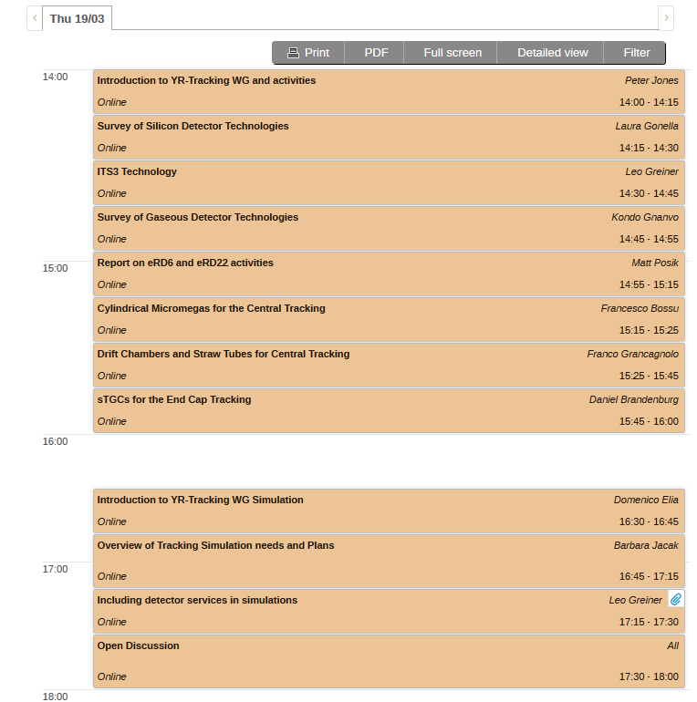
Today’s agenda
https://indico.bnl.gov/event/7449/sessions/3672/attachments/27103/41316/go

Slide 7
Useful links for YR-Tracking-WG
Mailing list: Currently 71 members
eicug-yr-detector-tracking@eicug.org
Google groups: Currently 71 members
https://groups.google.com/a/eicug.org/forum/?hl=en#!forum/eicug-yr-detector-tracking
Weekly Meeting: Every Thursday @ 12pm EDT (EST)
Indico page: https://indico.bnl.gov/category/276/
Bluejeans link: https://bluejeans.com/215438302
Electron-Ion Collider Detector Requirements and R&D Handbook
http://eicug.org/web/sites/default/files/EIC_HANDBOOK_v1.1.pdf

