Slide 1
Survey of Gaseous Detector Technologies
1st EIC Yellow Report Workshop @ Temple University
Kondo Gnanvo
University of Virginia

Slide 2
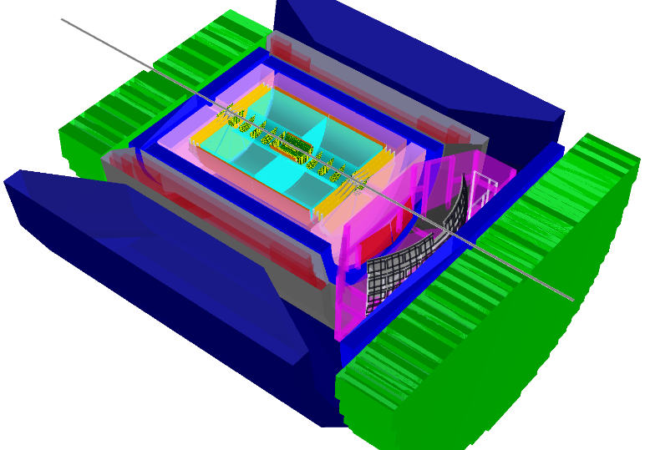
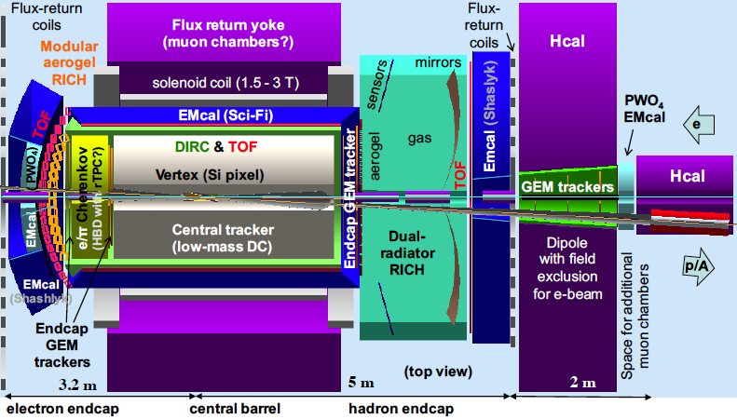
EIC Detectors Concepts
Many baseline EIC detector designs involved various gaseous detectors technologies for tracking in the central as well as end cap region
BeAST @ eRHIC
hadronic calorimeters
e/m calorimeters
RICH detectors
JLEIC Design
EIC User Group Meeting ANL 2016
Alexander Kiselev
ePHENIX @ eRHIC
EIC User Group Meeting ANL 2016
Rik Yoshida
EIC User Group Meeting ANL 2016
Kenneth N. Barish
magnet yoke
hadrons
electrons
silicon trackers
TPC
GEMs
Micromegas
3T solenoid

Slide 3
EIC Detectors Tracking requirements
Barrel Main Tracker
Hermetic coverage, close to 4π acceptance
  pseudo-rapidity range up to +/-1)
  Large area detectors
Low material budget on the level of 3-5% of X₀/X for the central tracker region
  Gaseous detectors
Tracking momentum resolution in few % range
End cap Trackers
Coverage in the end cap
  pseudo-rapidity range up to +/-1 to +/-3.5
  Large area detectors
Low material budget specially for the electron endcap
  Gaseous detectors
Tracking momentum resolution in few % range
  50 µm space point resolution desirable for high P (> 50 GeV) in the hadron end cap
http://eicug.org/web/sites/default/files/EIC_HANDBOOK_v1.1.pdf

Slide 4
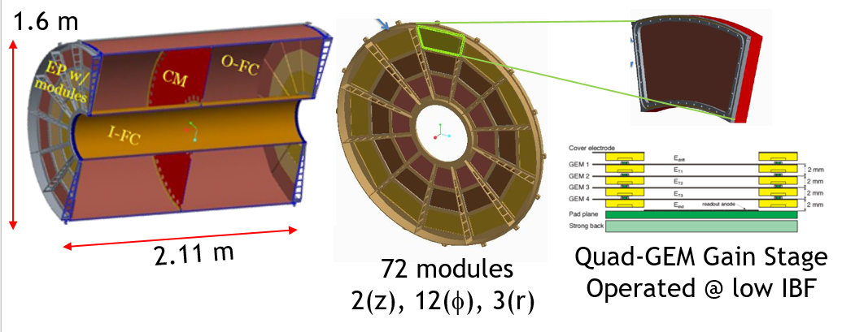
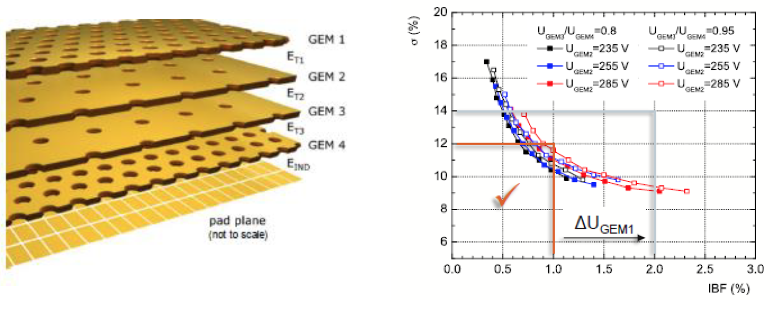
Central Tracking: TPC with MPGD-based readout structure
PROs
Cost effective way to instrument large volume
High tracking efficiency in high backgrounds
Minimize material (X0) including new ideas on endcap construction
Works nice in large B-field (drift || B)
Good V0 detection and reconstruction
Good dE/dx for particle ID
Continues readout option (no gating grid) with MPGD as a gain stage -> high rate detector ( but "needs" fast tracking detectors in front and behind (in R))
Good charge particle momentum reconstruction (But if Space Charge Distortions can be minimized and "calibrated")
A lot of experiences in construction and utilization (ALICE TPCs …)
CONs
Electron drift time ⇨ A lot of events overlap
Ions Back Flow ⇨Space Charge Distortions
TPC Readout ⇨ Lots of materials (mechanical structures, electronics, cables, cooling) in Endcap
Needs Laser to calibrate & control some crucial parameters.
Minimization of ion back flow with quad-GEM (ALICE TPC)
See eRD6 talk in this session
M. Posik

Slide 5
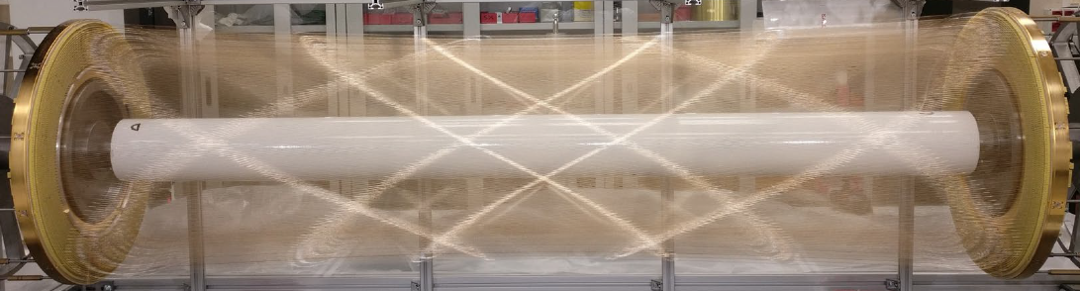
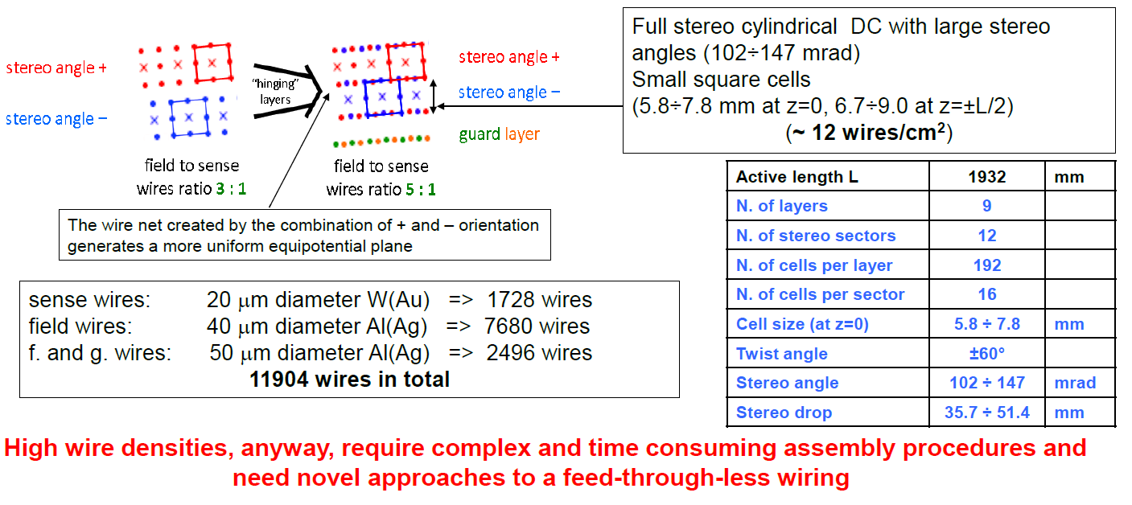
Central Tracking: Drift Chambers
MEGII Drift Chamber
PROs
Cost effective way to instrument large volume
Good 1D spatial resolution in the radial-to-wire direction (~150 μm)
Small overall material budget (X0)
Good dE/dx for particle ID capability
Good charge particle momentum reconstruction capabilities
Experiences in construction and utilization (MEGII Drift Chambers)
CONs
Poor spatial resolution along the wire direction
Issue with mechanical stabilities of the wires and impact on the operation of the detectors
Large material budget in the End Cap region
See talk on Drift Chambers and Straw Tube in this session
F. Grancagnolo
Giovanni Francesco TASSIELLI, INSTR20, Feb 24, 3030 Novosibirsk

Slide 6
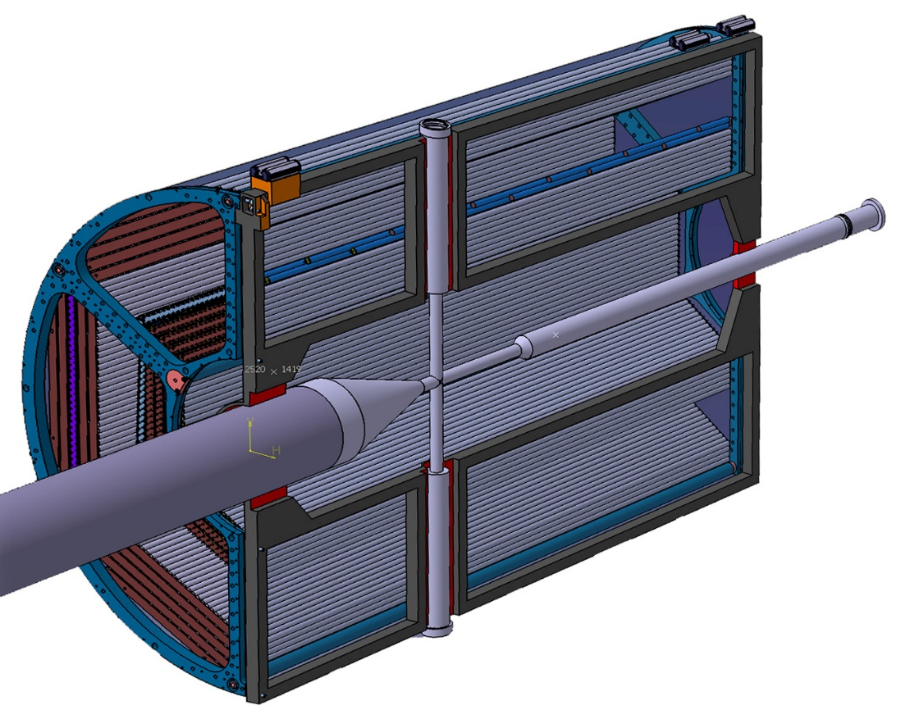
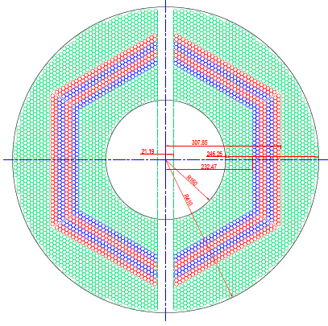
Central Tracking: Straw Tubes
PROs
Cost effective way to instrument large volume
Good 1D spatial resolution in the radial-to-wire direction (~150 μm)
Small overall material budget (X0)
Good dE/dx for particle ID capability in high pressure operation mode
U-V straw tubes layers configuration improve resolution in beam direction and /or mitigate the left and right ambiguity
Good charge particle momentum reconstruction capabilities
Experiences in construction and utilization (PANDA @ FAIR, or GLUeX@ JLab)
CONs
Left and wire ambiguity issues
Poor spatial resolution along the wire direction (~ 1cm)
Need for U-V layers configuration limitation on the geometric acceptance of the detector (so lower geometric efficiency)
See talk on Drift Chambers and Straw Tube in this session
F. Grancagnolo

Slide 7
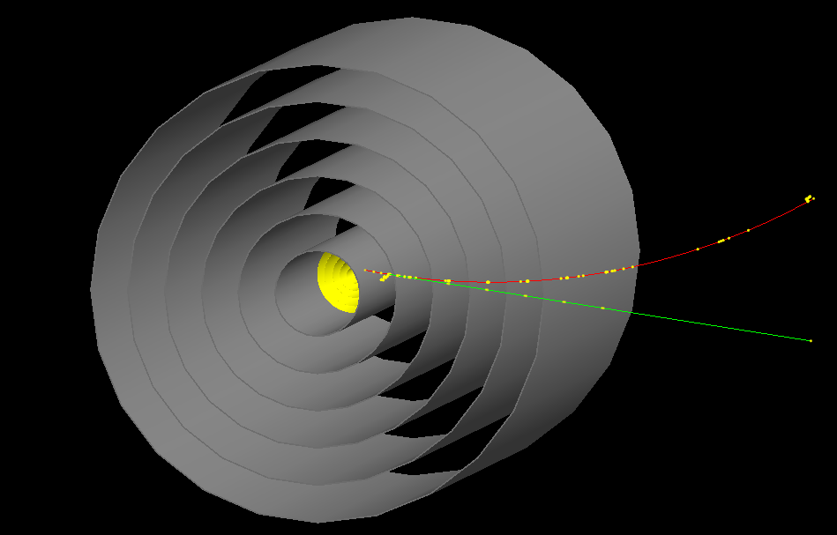
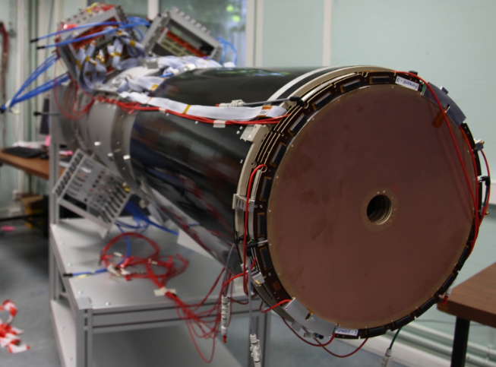
Central Tracking: Cylindrical MPGDs (µRWELL, Micromegas)
Cyl. MPGDs
PROs
Cost effective way to instrument large volume
High tracking efficiency in high backgrounds and High rate capabilities
Typical 2D space point resolution 100 µm achievable
Works nice even in large B-field
No issues with Ion Back Flow
Good charge particle momentum reconstruction possible in µTPC (or mini-drift) operation mode
Minimization of the material budget in the End Cap region
Ideal as fast signal tracking layer the Si + TPC central tracking option
Experiences in construction and operation with CLAS12 Micromegas vertex Tracker
CONs
Require several layers (6 layers) to achieve the required momentum resolution
Overall material budget will be higher than other options
Construction on large volume (2 m diameter) is challenging
Not obvious to have good dE/dx capability
Cyl. Micromegas – MVT CLAS12 (Hall B, JLab)
M. Vandenbroucke, MPGD2015 Trieste, Italy
See talk on Cylindrical Micromegas in this session
F. Bossu

Slide 8
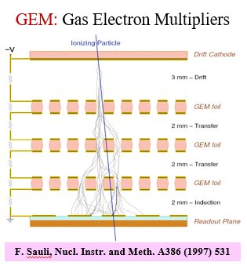
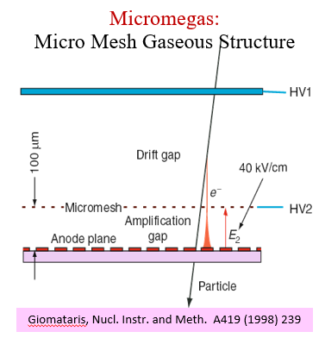
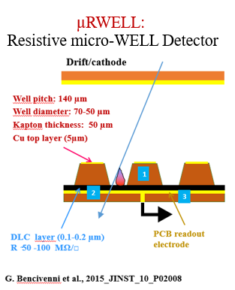
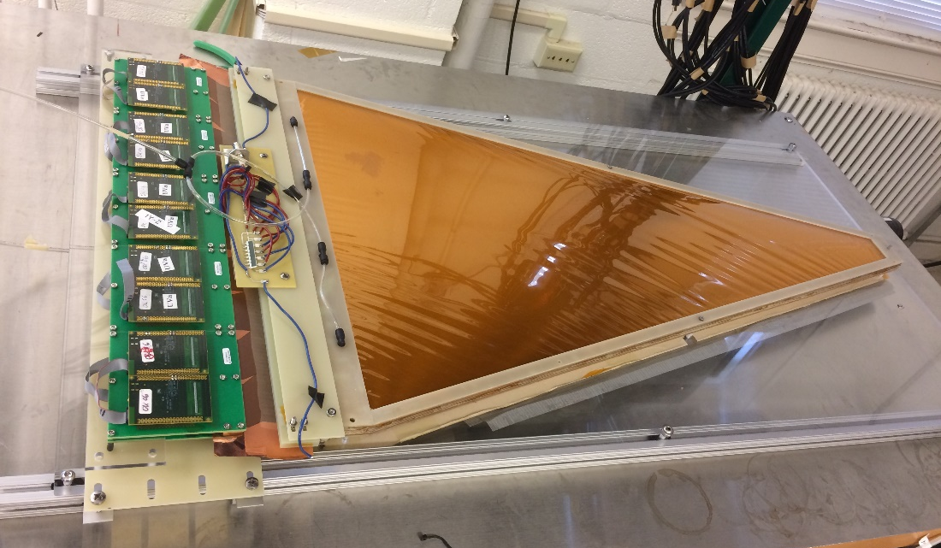
End Cap Tracking: MPGDs (GEMs, µRWELL, Micromegas)
See eRD6 talk in this session
M. Posik
PROs
Several MPGD technologies are mature enough
Cost effective for large area coverage in the end cap region
Excellent space point resolution (~ 50 to 100 µm)
High rate capability (MHz /cm² )
Good timing performances (15 ns) fast signal detector
Minimize material (X/X0 ~ 0.4%)
Robustness of the technologies (spark free detector with resistive layer technologies)
MPGD-based TRD to provide tracking and e/π PID in End Cap region
Vast experiences in construction and utilization (LHC detector upgrade, JLab, BNL experiments ..) But Some R&D still needed for Resistive MPGDs technologies (uRWELL, Micromegas)
CONs
Not so much really for EIC End Cap Trackers
eRD6: Large & Low Mass End Cap GEM prototype

Slide 9
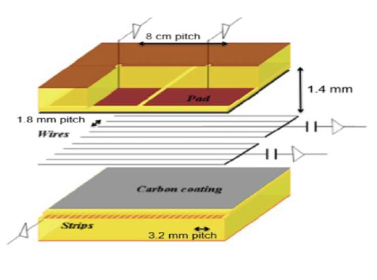
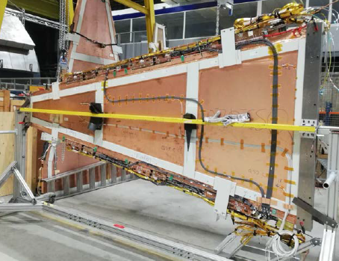
End Cap Tracking: Small-Strip Thin Gap Chambers (sTGCs)
PROs
Cost effective for large area coverage in the end cap region
Good space point resolution (~ 100 µm)
High rate capability (100kHz /cm² )
Good timing performances (15 ns)
Experiences in construction and utilization (ATLAS small Wheel Detector and STAR Forward Tracker.)
CONs
Material budget higher than MPGDs
Spatial resolution not as good as MPGDs
Denis Pudhza, INSTR20, Feb 25, 3030 Novosibirsk
See talk on sTGCs in this session
D. Brandenburg

Slide 10
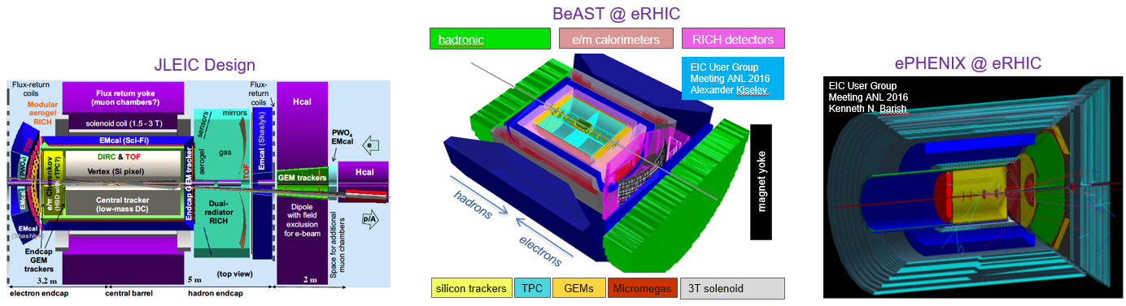
Summary
Many baseline EIC detector designs involved various gaseous detectors technologies for tracking in the central as well as end cap region
A few technologies are mature for EIC Detectors and would require only limited R&D
Some of these technologies seems more natural options for some subdetectors
There is still a need for small level of R&D to fully satisfy the EIC requirements
The anticipated simulation work within Tracking WG will help select the best technologies for EIC

