Slide 1
Introduction to the EIC-YR Tracking WG Simulation
Domenico Elia & Annalisa Mastroserio
INFN Bari

Slide 2
Simulation and Integration
Main goal:
integrate tracking detectors in the EIC simulation framework
define detector layout and performance (tracking and vertexing capabilities):
momentum and pointing resolution vs momentum
tracking efficiency in a wide momentum and pseudorapidity range
Connections:
TECHNOLOGY → survey within the Tracking WG, current R&D status etc
PHYSICS WG → input on the expected/required performance
SOFTWARE WG → crucial help in approaching EIC simulation framework
INTEGRATION WG → close link for integration issues

Slide 3
Tracking and vertexing for EIC
Central tracking system:
main tracker
silicon vertex tracker
forward and backward trackers
Roman Pots
Target:
hermetic coverage
tracking resolution < few %
low material budget ~ 3-5%
http://eicug.org/web/sites/default/files/EIC_HANDBOOK_v1.1.pdf

Slide 4
Tracking and vertexing performance
Tracking:
efficiency in a wide momentum and pseudorapidity range
relative momentum resolution
to be studied as a function of momentum, for different combinations:
combined gaseous and silicon trackers
silicon tracking standalone for low momentum
Vertexing:
primary vertex resolution
impact parameter resolution:
to convolute with primary vertex resolution (→ pointing resolution)
relevant for some measurements (eg reconstruction of HF decays)

Slide 5
Simulation software
Fast simulation:
EIC common tool available (via docker): https://eic.gitlab.io/documents/quickstart/
other tools also available in some groups, welcome at this initial stage
semi-analytical simulations, approximate geometry, average material etc
suitable for optimization of the layout, cross-check with first full simulation results
Full simulation:
EIC framework simulations (centrally managed): Fun4All and G4E/eJANA
allow to implement detailed geometry, include full simulation and reconstruction
performance studies as in fast sim, but more reliable (and less optimistic)
Full simulation tutorial by the Software WG (with slides and videos):
https://indico.bnl.gov/event/7281/

Slide 6
Meetings and expressed interest
Tracking WG meetings:
weekly held (on Thursday), started on 13/2
collected interest from participating groups (next slide)
recently dedicated to simulation issues
27/2: https://indico.bnl.gov/event/7689/
presentation on framework simulation tools (fast and full) by the SWG (Markus)
detailed presentations on G4E/eJANA (Dmitry, Yulia, Nathan) and Fun4All (Chris)
12/3: https://indico.bnl.gov/event/7885/
question / answer session on Fun4All with Chris (and participating groups)
plan to have next meeting with q/a session on G4E/eJANA
follow up developments and steer direction

Slide 7
Meetings and expressed interest
Tracking WG meetings:
weekly held (on Thursday), started on 13/2
collected interest from participating groups:
Participating Institutes | Software oriented interest
eRD6: BNL, INFN Trieste, Florida Tech. Stony Brook U., Temple U., UVa, Yale U. | Central and forward tracking (gaseous)
eRD22: Jlab, Temple U., UVa | Central and forward tracking (gaseous)
CEA Saclay (France) | Central tracking
eRD18: University of Birmingham (UK) | Central tracking
LANL | Central and forward tracking
UC Berkeley / LBNL | Central and forward tracking
INFN Bari | Central tracking (silicon)

Slide 8
Concluding remarks
Basic workplan:
optimize detector layout via fast simulation (eg silicon barrel layers)
besides optimizations, proceed with integration in full simulation:
define baseline detector concept (BeAST? 1.5/3 T magnet? see Peter’s suggestion)
keep working on both frameworks Fun4All and G4E
implement realistic material and services, connection to integration issues
study track finding algorithms, connection to physics benchmarks

Slide 9
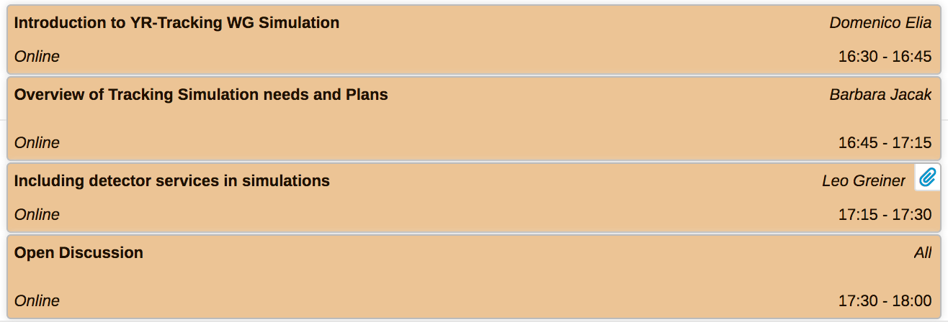
Concluding remarks
Basic workplan:
optimize detector layout via fast simulation (eg silicon barrel layers)
besides optimizations, proceed with integration in full simulation:
define baseline detector concept (BeAST? 1.5/3 T magnet? see Peter’s suggestion)
keep working on both frameworks Fun4All and G4E
implement realistic material and services, connection to integration issues
study track finding algorithms, connection to physics benchmarks
more in the Barbara’s talk
This session’s agenda →

