Slide 1

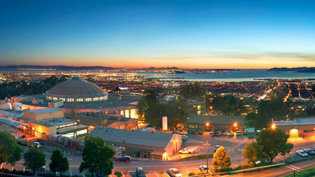
Summary of tracking simulations
Silicon vertex detector + TPC
All-silicon tracker
Neither
Barbara Jacak, UC Berkeley & LBNL
March 19, 2020

Slide 2
First, a few caveats
There are mistakes, misunderstanding & ignorance Those are all mine!
Many thanks to everyone for proving slides
  I’ve tried to synthesize from those where we stand
  I’ve omitted some things due to time limitations
  I’ve combined with some summary of conclusions
Summary material is to inform discussions
  Next steps
  How to split up the work among us
  How best to collaborate toward optimized tracking

Slide 3
Gas tracker simulations
eRD6
Micromegas tracker
I will come back to these

Slide 4
All- silicon tracker studies
Bari, Birmingham (eRD18), LBNL + UC Berkeley (eRD16)
  All-silicon trackers: barrel & endcaps
  Alpide-type MAPS sensors, several pixel sizes
  1.5T or 3T solenoidal field
  5, 10, 6 barrel layers, respectively
  Outer radii = 18cm, 80cm, 43cm, respectively
  Layer thicknesses vary from 0.2% – 0.8% radiation length
Physics
  Groups have simulated: charmed mesons (barrel), heavy flavor (~1< η< 2), heavy flavor jets (~0.5< η< 2), DIS jets (~0< η< -2)
  Tracker must enable ALL EIC physics goals!
Fast smearing and/or full GEANT using EICRoot (to date)
  Transition to G4E/eJana and/or Fun4all underway

Slide 5
INFN Bari tracking simulation studies
 | R (cm) | X/X0 (%) | Cell size (um²)
Beam pipe | 1.80 | 0.2
SPL #1 | 2.34 | 0.3 | 20 x 20
SPL #2 | 4.68 | 0.3 | 20 x 20
SPL #3 | 8.76 | 0.8 | 20 x 20
SPL #4 | 13.38 | 0.8 | 20 x 20
SPL #5 | 18.00 | 0.8 | 20 x 20
NB: uses ALICE ITS design simulation code; 1.5T field
conclusion – need barrel pixel layers or gas tracker at larger radius for resolution goal

Slide 6
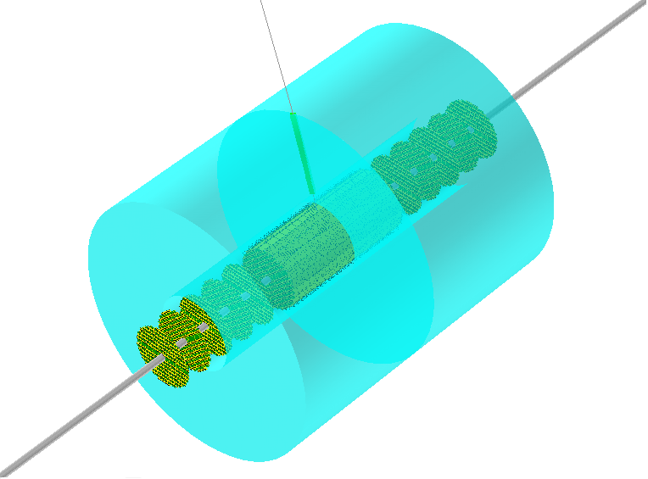
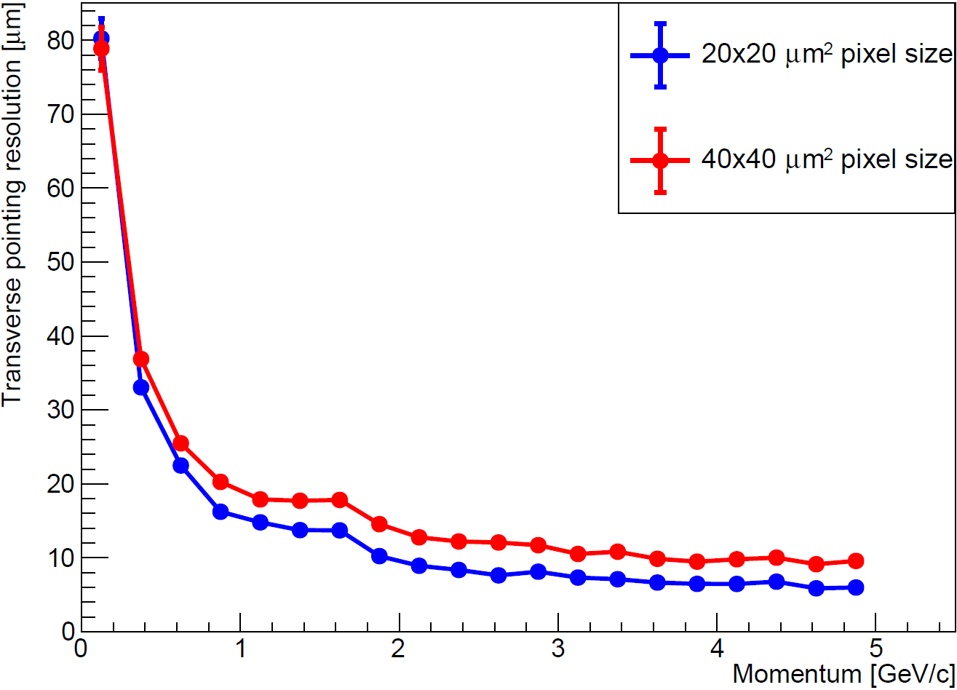
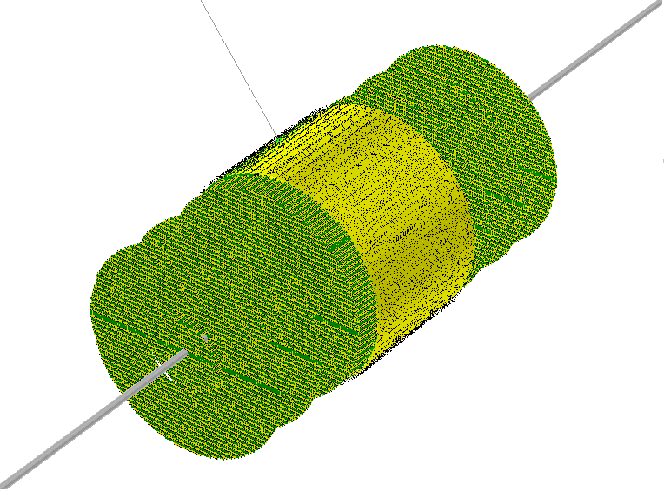
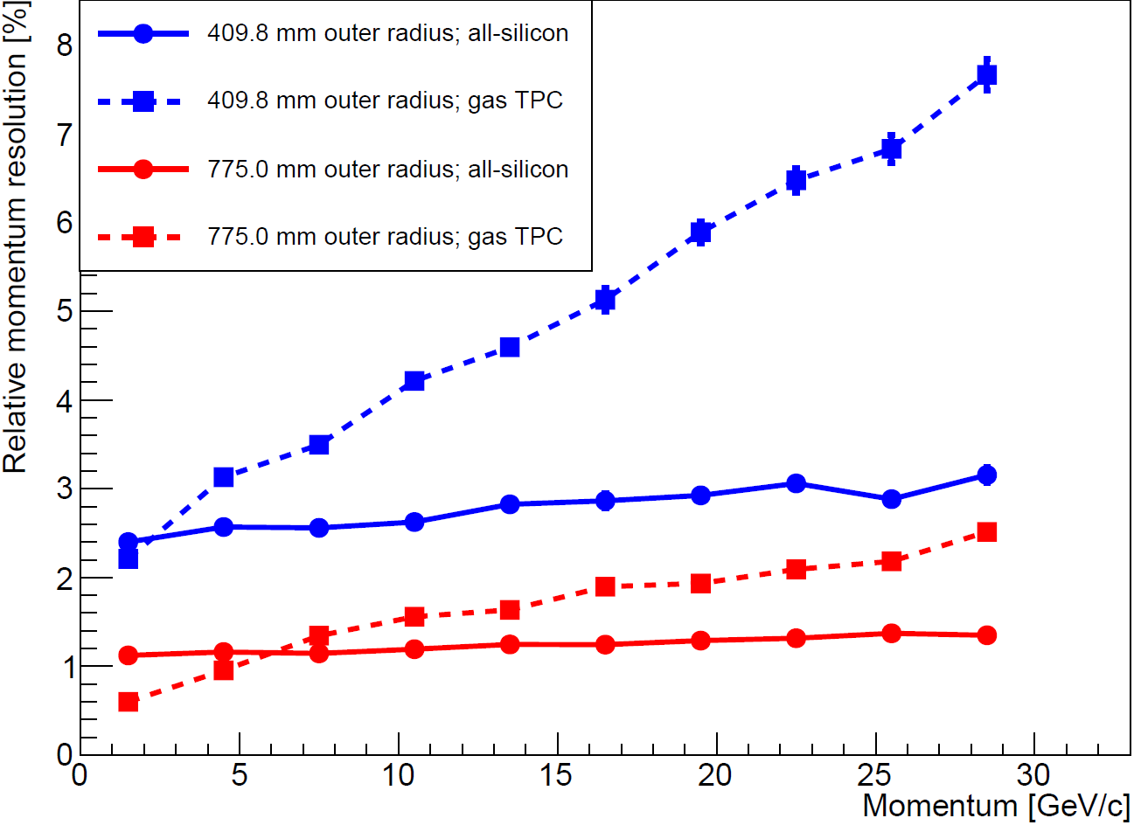
Simulation examples
Birmingham Simulations:
1.5T field, R_{out}=77.5cm, 10 layers
Transverse pointing resolution, different silicon pixel sizes.
Silicon+gas
Details and full list of simulations can be found in report: https://indico.bnl.gov/event/7689/contributions/35412/attachments/26828/40846/Simulation_report_Feb2020.pdf
All-silicon
Relative momentum resolution, different outer radii, comparing all-silicon with Si+gas.
Conclusions:
Smaller pixel size improves resolution (currently 20x20 µm² or smaller considered optimal)
Two layers close to the beampipe are beneficial
All-silicon prefered if more compact tracker desired
BVJ: all-Si outperforms TPC for p>6 GeV/c

Slide 7
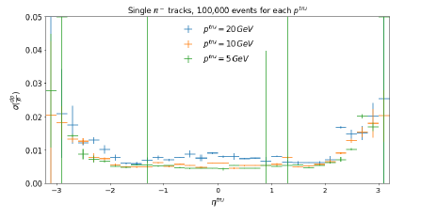
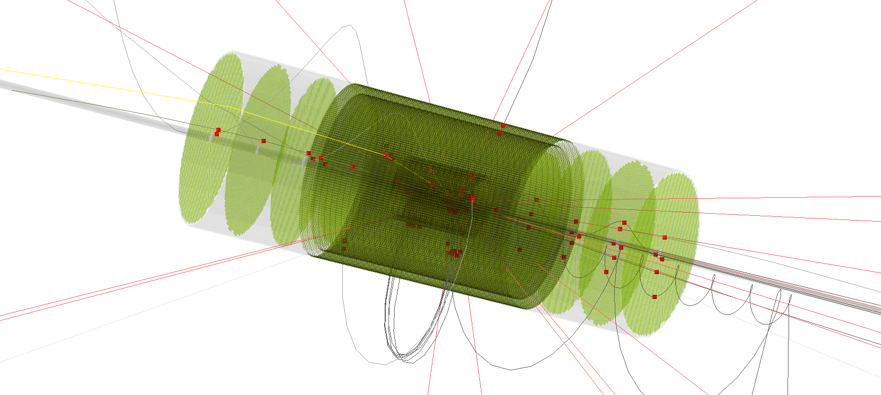
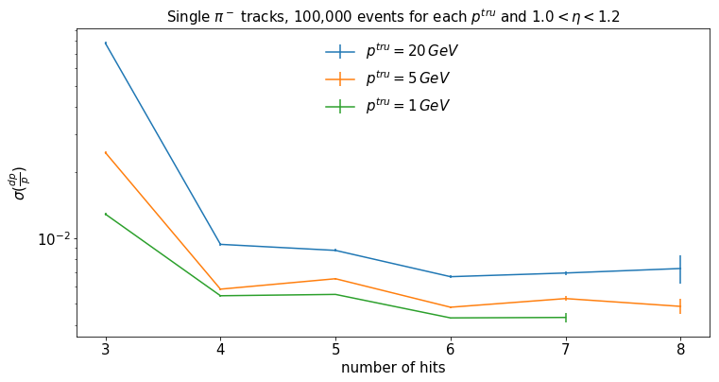
Berkeley: 6 layers @ 2.3,4.7,14, 16, 34, 43 cm
3T field
Study transition region between barrel & 6 layer endcaps
support cone, services modeled as 5mm Al
Fewer hits per track in transition region
Need >3 hits for resolution & reconstruction efficiency
(~18% efficiency loss – OK?)
Resolution degrades at large η due to insufficient Bdl
Barrel z-extent is paramount for forward and backward dp/p

Slide 8
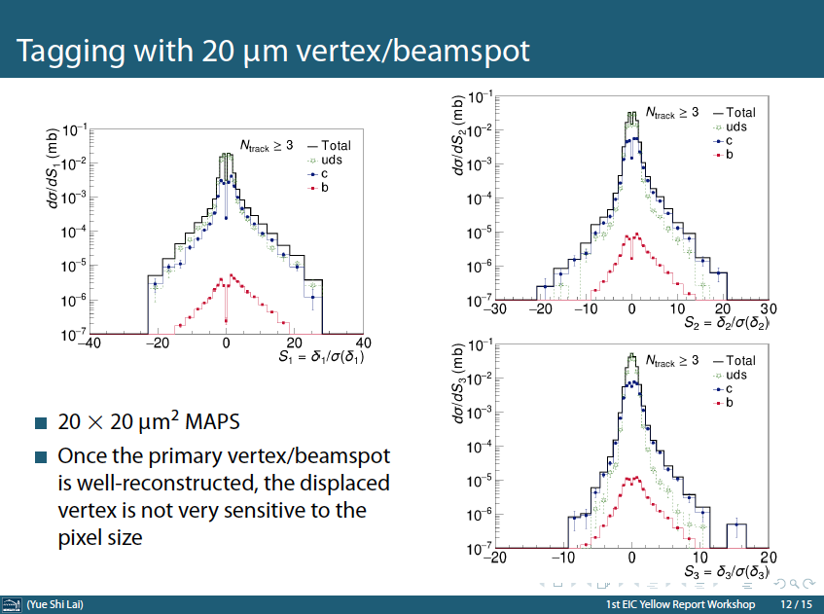
Reconstructed di-jets
~ 0.5 < η < 2.0
Compact all-Si matches Si+TPC

Slide 9
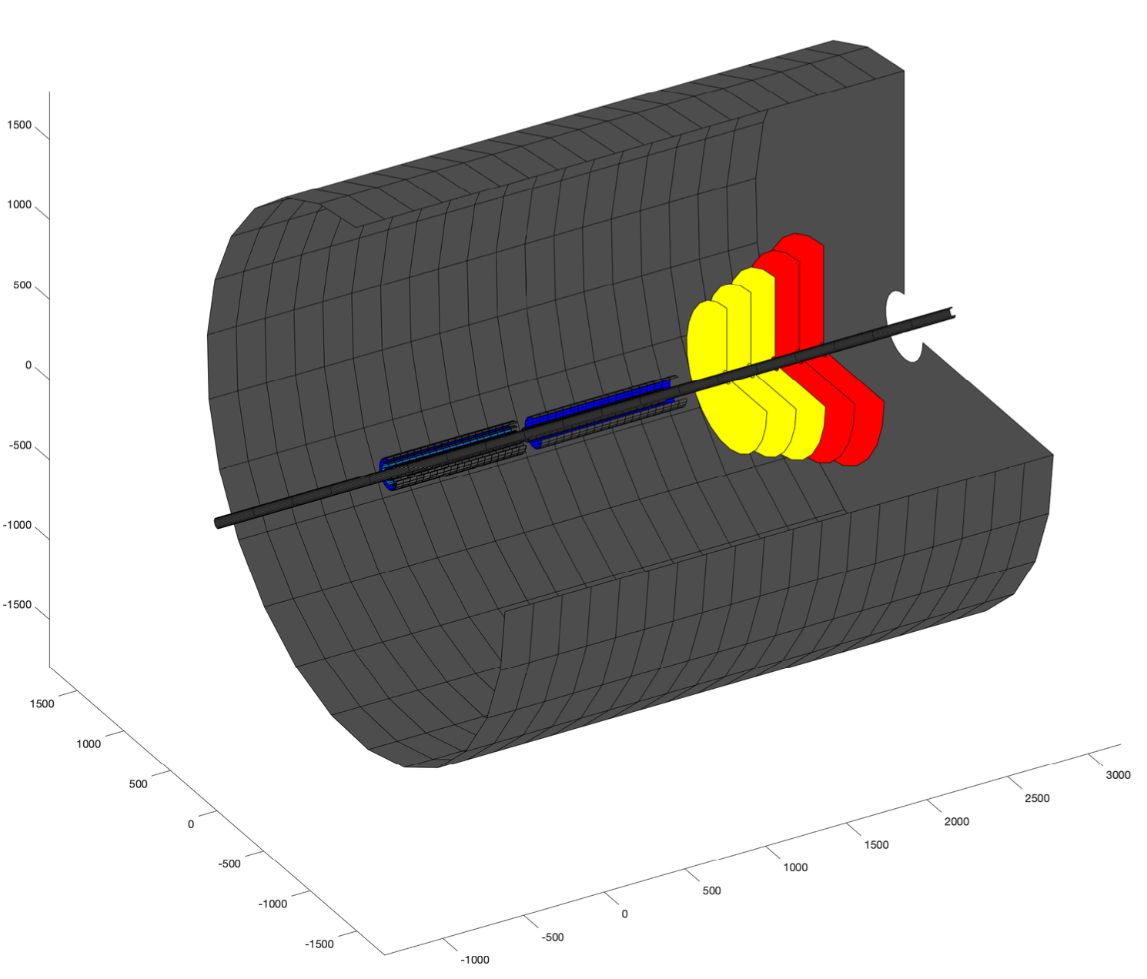
LANL EIC tracking simulation status
3T field
Initial detector design in fast simulation (LDT package):
  Mid-rapidity silicon vertex detector: 3-barrel layers of Monolithic Active Pixel Sensor (MAPS) type detector.
  Forward-rapidity silicon tracking detector (FST): 2-barrel layers of MAPS + other silicon detector and 5 forward planes of MAPS + other silicon detector.
arXiv: 2002.05880
Y axis (mm)
Work in progress
Work in progress
X axis (mm)
Z axis (mm)
≠p
Tracking performances are better than or consistent with the forward tracking requirements from the EIC detector handbook.

Slide 10
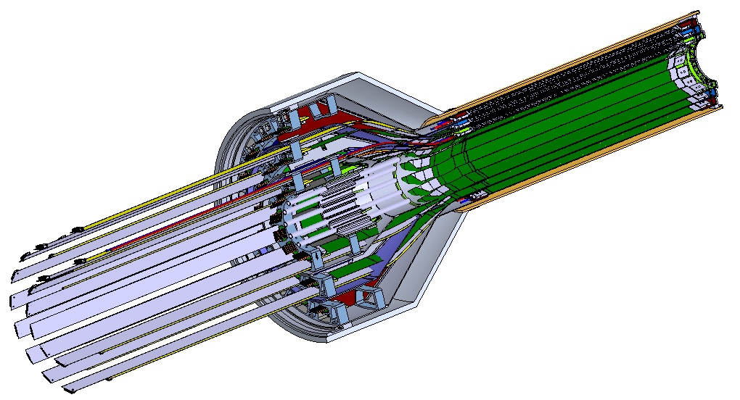
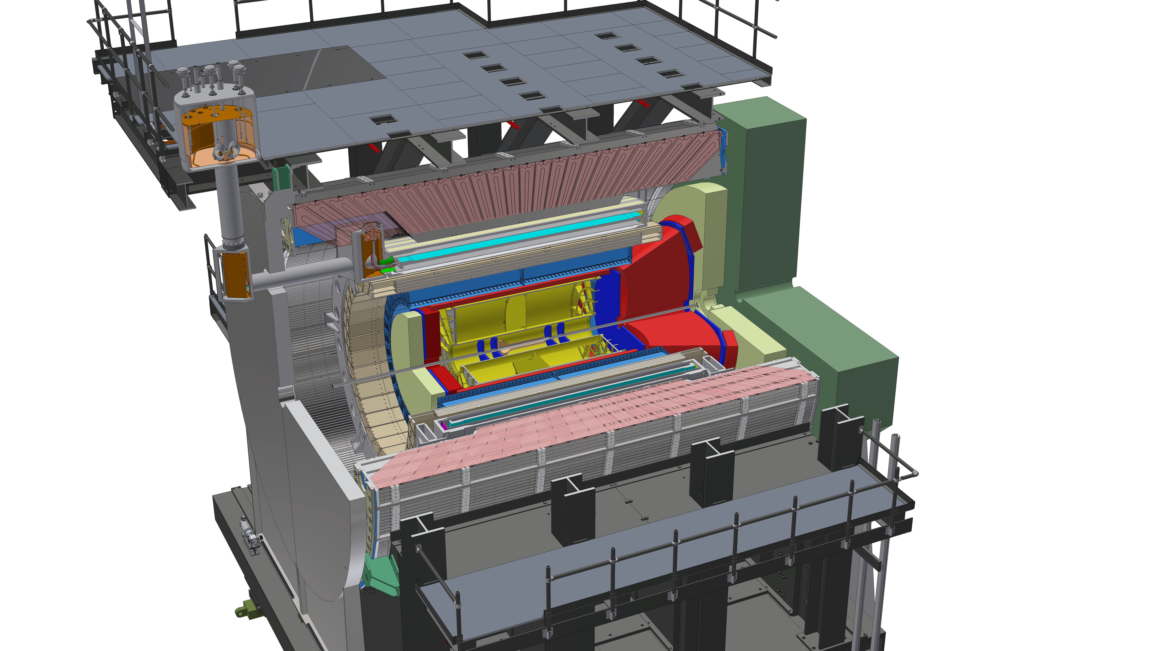
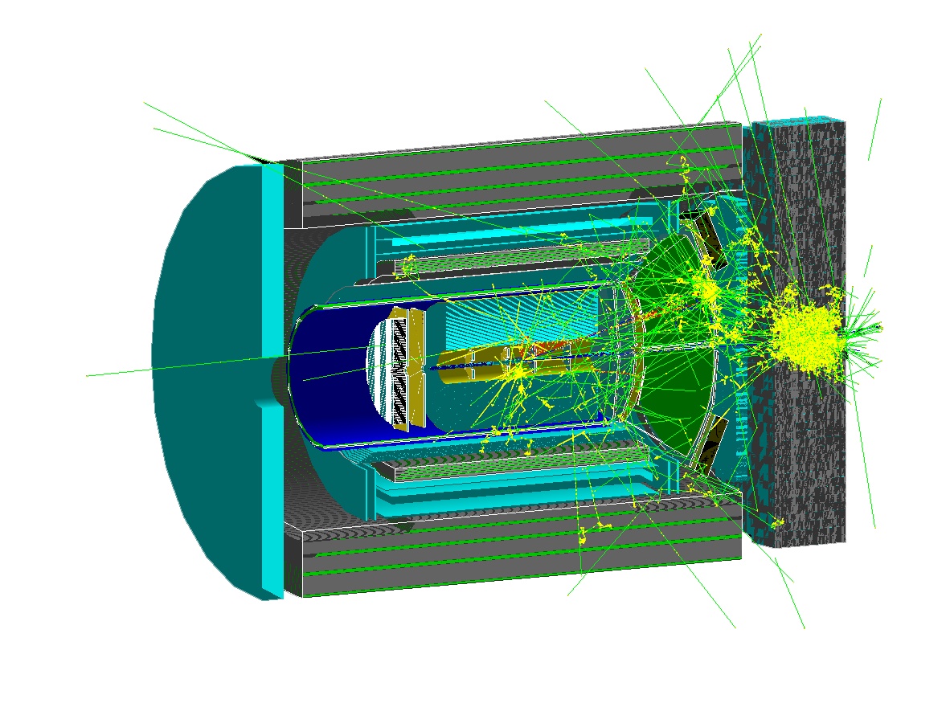
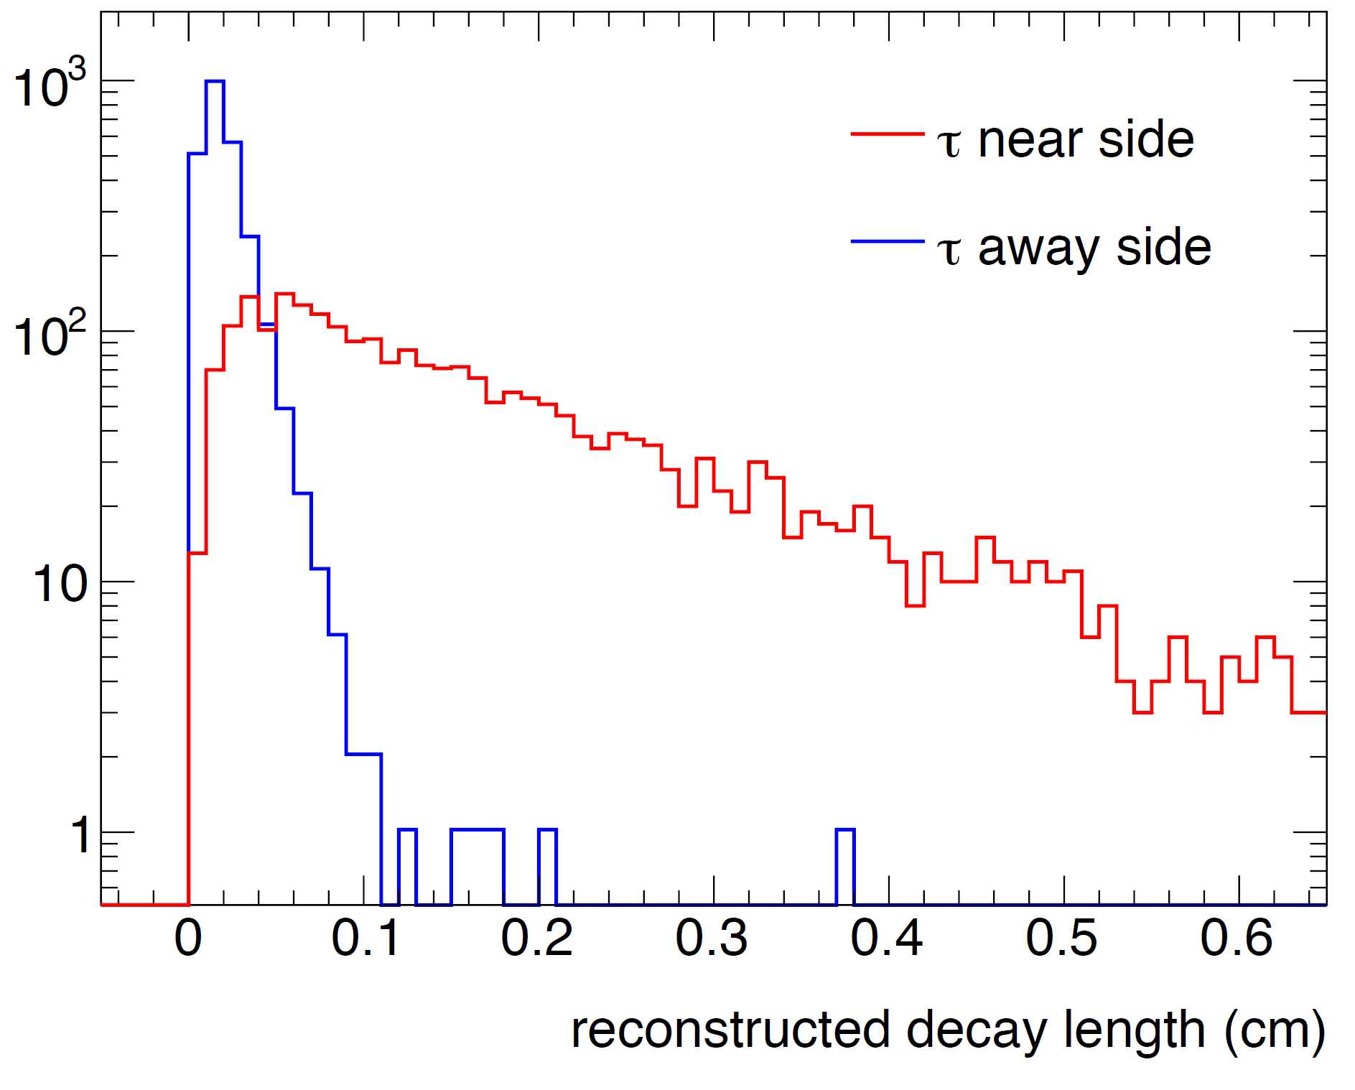
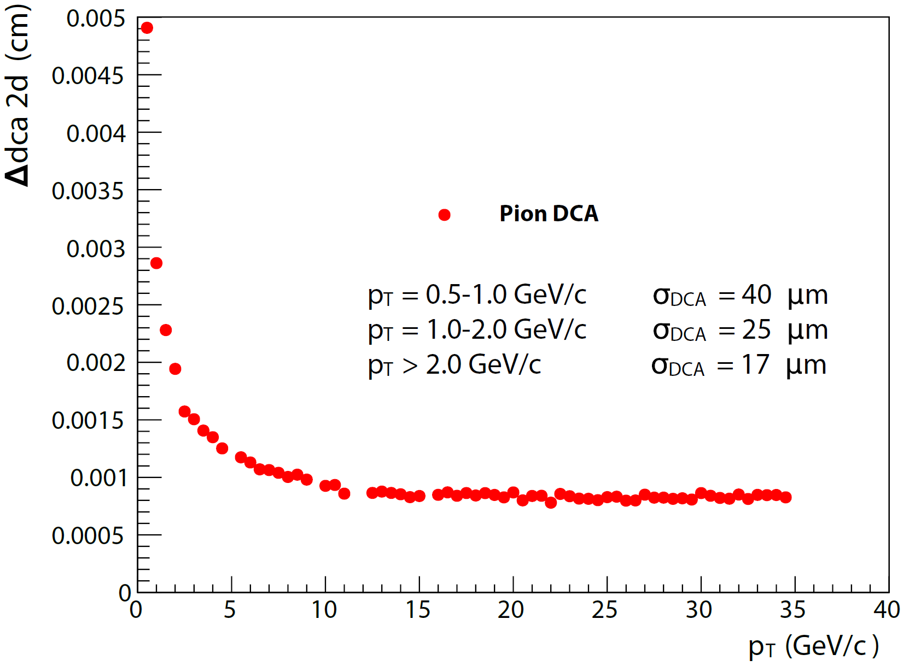
Full chain simulation and reconstruction
1.5T field
Hybrid tracker
MAPS-based vertex tracker
[ALICE ITS, sPHENIX MVTX]
In collaboration with LANL, LBNL, MIT, et al.
Early EIC detector concept [arXiv:1402.1209]
LQGENEP 1.0, e+p 20x250 GeV/c
G4
Secondary vertex in τ-jet vs q-jet
In collaboration with SBU, UMass
Single track DCA resolution
[sPHENIX MVTX CDR]
Reco
Analysis
Geant4 simulation and
reconstruction in Fun4All
[Tutorial] https://eic-detector.github.io/
[sPH-cQCD-2018-001] https://indico.bnl.gov/event/5283

Slide 11
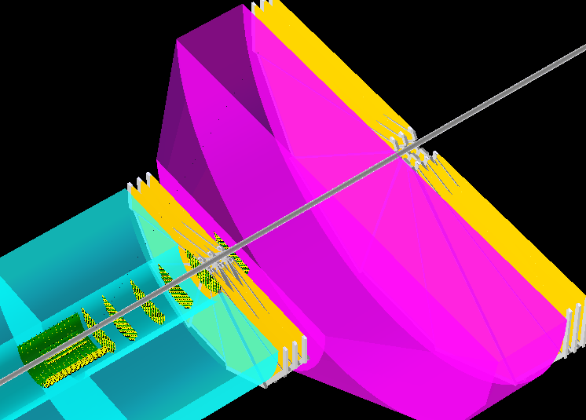







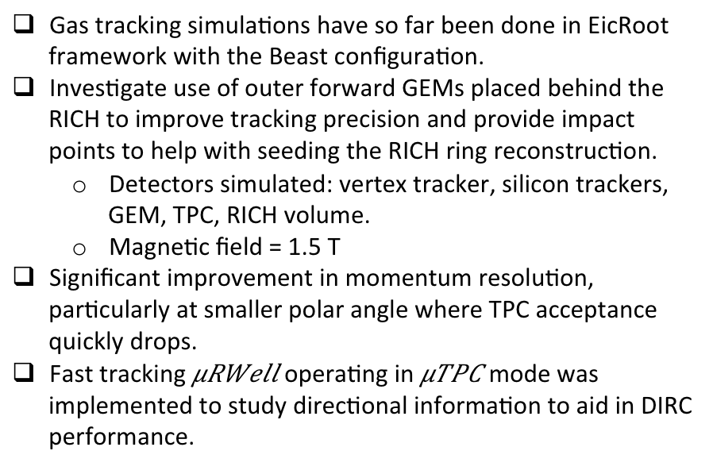

Gas Tracking Simulation Results (eRD6)
Gas tracking simulations have so far been done in EicRoot framework with the Beast configuration.
Investigate use of outer forward GEMs placed behind the RICH to improve tracking precision and provide impact points to help with seeding the RICH ring reconstruction.
  Detectors simulated: vertex tracker, silicon trackers, GEM, TPC, RICH volume.
  Magnetic field = 1.5 T
Significant improvement in momentum resolution, particularly at smaller polar angle where TPC acceptance quickly drops.
Fast tracking operating in mode was implemented to study directional information to aid in DIRC performance.
Outer
forward
GEMs
Inner
forward
GEMs
TPC
RICH
Vertex detector
Si tracker
EIC handbook recommendation
for
Θ range covered by outer forward GEMS
11

Slide 12
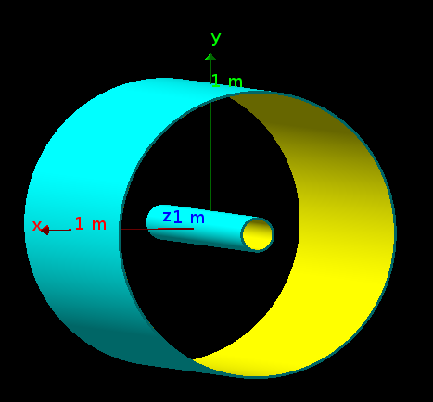
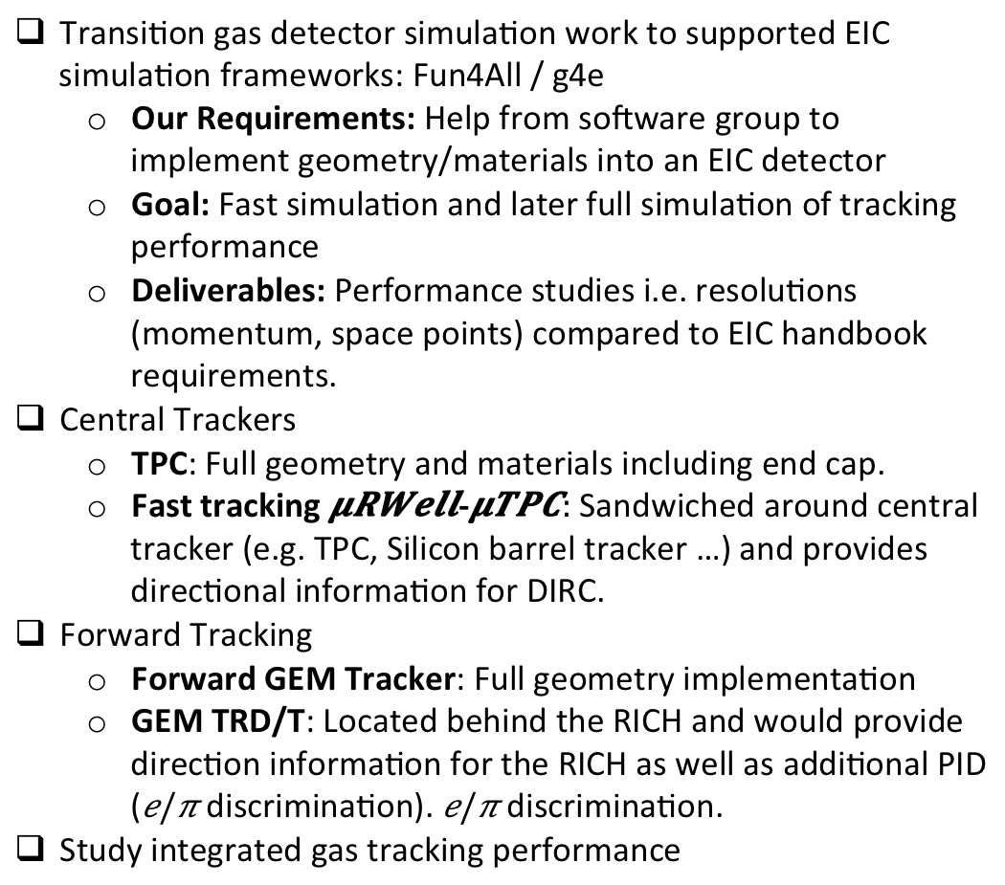
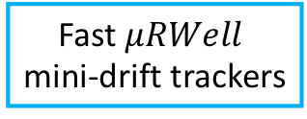
Gas Tracking Simulation Next Steps
Transition gas detector simulation work to supported EIC simulation frameworks: Fun4All / g4e
  Our Requirements: Help from software group to implement geometry/materials into an EIC detector
  Goal: Fast simulation and later full simulation of tracking performance
  Deliverables: Performance studies i.e. resolutions (momentum, space points) compared to EIC handbook requirements.
Central Trackers
  TPC: Full geometry and materials including end cap.
  Fast tracking - Sandwiched around central tracker (e.g. TPC, Silicon barrel tracker …) and provides directional information for DIRC.
Forward Tracking
  Forward GEM Tracker: Full geometry implementation
  GEM TRD/T: Located behind the RICH and would provide direction information for the RICH as well as additional PID ( discrimination). discrimination.
Study integrated gas tracking performance
Favorite central tracking detector
TPC, Silicon, …
Fast
mini-drift trackers
12

Slide 13
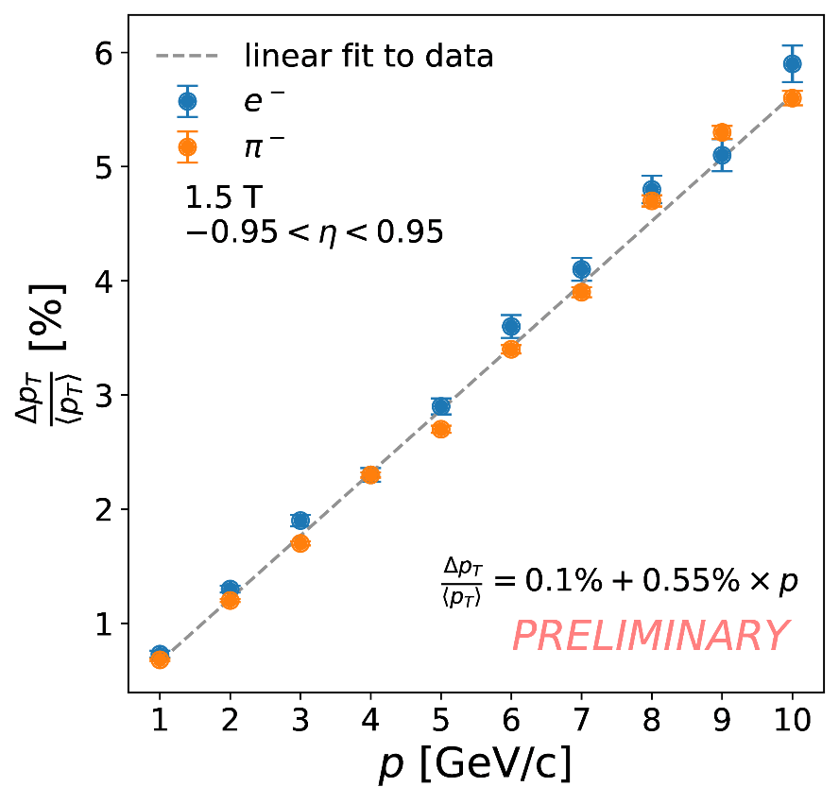
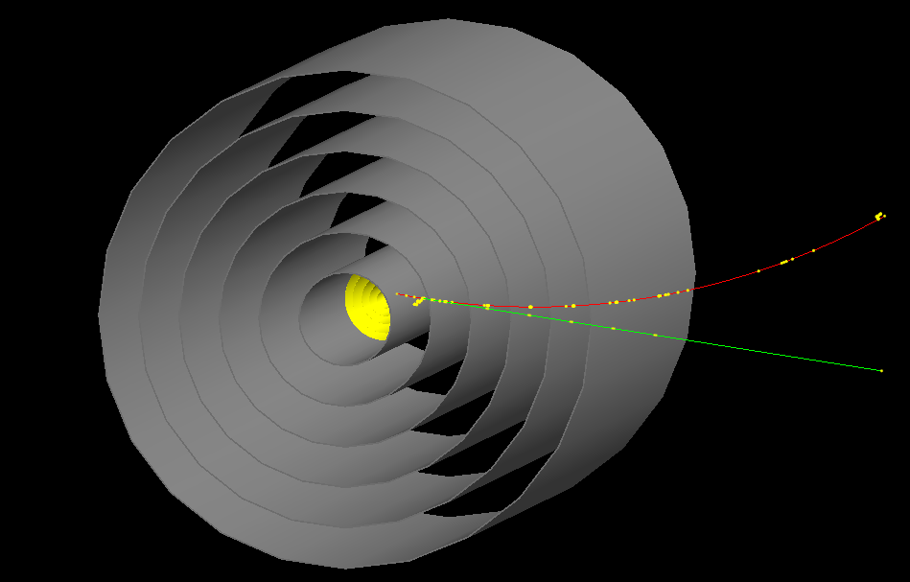
EIC tracking simulation at CEA-Saclay
Current focus on the curved Micromegas (MM) tracker:
  Curved tiles and low material budget
  Technology is being used in CLAS12
Current status of the simulation
  A first demonstration with Fun4All has been set up
  A preliminary estimation of the corresponding momentum resolution

Slide 14
We now know
There are complementary ways to address general tracking
  But we do need silicon for vertexing
All-silicon tracker can match or exceed performance of hybrid silicon/gas tracking system
Some fast tracking layers may be important to best utilize DIRCs
  Needs some work to specify
For silicon tracker
  20 micron x 20 micron pixels will do the job
  All-silicon barrel must extend to R ≥ 45 cm, needs 5 or 6 layers
  Endcaps need more optimization & hardware specification

Slide 15
Questions driving next steps
Magnetic field? How to get sufficient forward Bdl?
Optimum technology mix for tracking?
Effect of thinner silicon (0.05% vs. 0.3% X/X₀)?
What is the impact of more realistic mechanical infrastructure?
Finish optimizing Si tracker layer placement (barrel & endcap both)
Symmetric endcap trackers?
How to optimize forward tracker?
  Higher Bdl vs higher spatial resolution?
  What will be affordable?
Interaction between tracking and PID?
What are the requirements for fast tracking layers?

Slide 16
Plans by groups (coming into the workshop)
Everyone is switching to full simulations; benchmark fast-smear
  G4E/eJana and/or Fun4All (individual decision OK?!)
Study gas tracker options (eRD6, Saclay)
Implement more realistic material (Si , services) (Bari, Berkeley)
Optimize Si barrel layout (Bari, Birmingham)
Optimize Si endcap layout (LANL, Berkeley)
Study jet efficiency & resolution, jet substructure (Berkeley, LANL, BNL)
Move to non-ideal (from MC truth seeded) track finding (BNL, Berkeley)
Tracker requirements driven by PID (BNL, eRD6)
⇧

Slide 17
To enable splitting up the work
Can we agree on 1.5 or 3 T magnetic field?
Can we agree on one master detector?
  Majority use either BeAST or ePHENIX… ?
  Simulating just one will allow sharing work to optimize layout and quantify tracker performance
  If other master chosen, then adapt our optimized solution to it
Could we pick a strawman Si vertex barrel tracker?
  Uniform assumption to allow optimization of outer tracking
Let’s make a list of design parameters and agree on splitting up studies for them (do in the discussion session); e.g.
  TPC – micromegas; how to drive technology choice?
  Track pointing & speed requirements from PID detectors
  Digitization code for each detector technology
  Impact of realistic material thicknesses
  Quantify improvements from thinner Si
  Optimization of forward tracking w/ 1 or 2 Bdl assumptions
Suggestion: make a list, split up the work, aim for ≤ 2 strawman trackers; then everyone can study their physics. Next workshop?

