Slide 1
A possible method for adding services load to the EIC simulations
Services (power, signal, configuration, cooling, etc.) are expected to be a dominant part of the material in the large acceptance of the EIC central detector region.
Unlike the support pieces, which need to change according to the detector configuration and would be difficult to parametrize, the services load can be scaled with reasonable accuracy to the silicon surface area.
The parameters of this then method can then be adjusted to different sensor technologies showing performance differences from the services load standpoint.
The physical volumes required at the end of staves/discs can also be added to the simulation models to allow for more realistic geometries.

Slide 2
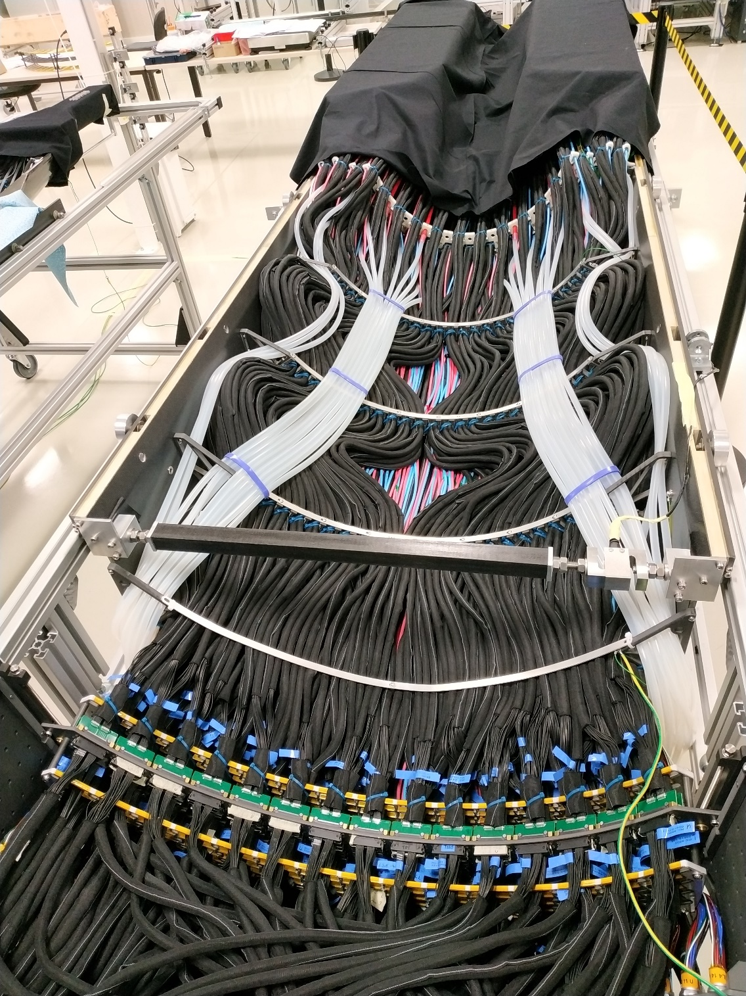
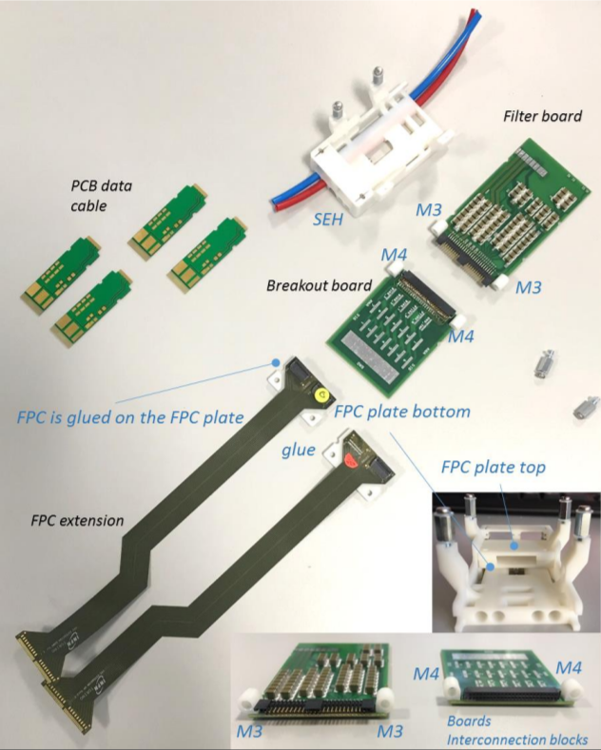
Example: Services for existing technology (ALPIDE sensor) in ALICE ITS upgrade services for outer half-barrel layers
Material at end of each stave
Power, signal, cooling
Patch panel
(usually required for all detectors)

Slide 3
Approach to separate pieces of parameterized services
stave
Usually with the average radiation length of the layer implemented in the stave model
Easiest attribute to work with is surface area
Stave
transition
Parametrized as a block of particular dimensions and averaged X/X0
services
These blocks should be represented as a function of silicon surface area in stave with different values based on technology/configuration
Parametrized as a square tube with particular dimensions and averaged X/X0
Patch panel
Parametrized as a block of particular dimensions and averaged X/X0 (usually arranged to be out of the acceptance)

Slide 4
Approach to separate pieces of parameterized services
Method –
Sum the material composition and homogenize to average X/X0 for given mechanical cross section.
Check that the specified sizes make mechanical sense and scale appropriately. This allows for reasonable mechanical integration in simulation.
Example:
ITS ALPIDE staves (layers 3-6)
Stave
transition
Parametrized as a block of particular dimensions and averaged X/X0
Excel Spreadsheet
Combine to get averaged radiation length
Combine with known physical size and scale radiation length to new volume

Slide 5
Approach to separate pieces of parameterized services
stave
If we use ALPIDE (existing technology) we can estimate services as below
Average of 0.7-0.8 % X/X0 in simulation
Stave
transition
Area of (63 cm^2) of sensor requires 3 cm^3 material with an X/X0 of 0.0383 per traversed cm.
services
This should also work for discs
Area of (63 cm^2) of sensor requires a cross section of 1 cm^2 with a X/X0 of 0.007861 per traversed cm of length.
Patch panel
Area of (63 cm^2) of sensor requires a block of 2cm x 1 cm x 1 cm with 0.03423 X/X0 per traversed cm.

Slide 6
Some Comments
The starting point of this exercise is an ALPIDE like sensor as this is what is often used in the simulations.
This approach allows us to integrate the radiation length and the services volume and to add then to the simulation.
In the ITS upgrade, we did not make heroic measures to minimize the services mass as it was mostly out of the tracking acceptance. This will be less true for the EIC.
This method may be used as a starting point to assess the effect on the physics of using an ALICE ITS services load.
If this is found to unacceptably affect the physics (I suspect it will) we can then attempt to ameliorate this by:
moving to an ITS3 type sensor that has inherently lower service requirements
targeted R&D to minimize services
ideally we do both.
This estimate is also valid for discs. I will work on parameterizations for the inner vertex layers and an estimate for what can be expected for an ITS3 type sensor.

