Slide 1

Work on SIDIS for EIC
Relevant Papers all published in PRD:
Helicity PDFs: arXiv:1206.6014 CC: arXiv:1309.5327
Electron Ion Collider

Slide 2
Outlook
Review of the physics goal,
  Unravel the polarized flavor structure of nuclei
  Gluon and quark contributions to the spin of the proton
progress and current status of simulation;
Some important details including kinematical coverage and integrated luminosity as well the software and generator, etc;
Money plots which can be shown in the YR;
Detector requirements;
Current issues (challenges if there are any) and plans for the next step.

Slide 3
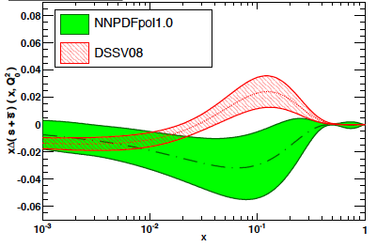
Why is separating quark flavors important?
Why is separating quark flavors important?
nuclear structure is encoded in parton distribution functions
understand dynamics of the quark-antiquark fluctuations
flavor asymmetry in the light quark sea in the proton
unpolarized: ubar < dbar Helicity: Δubar > Δdbar TMDs: ?????
shape of polarized sea-quark PDFs critical for quark contribution to spin
ΔΣ does not converge at low x
due to current constrains put in the fits
strangeness was identified to be one of the least known quantities
  both unpolarized and polarized
from
SIDIS
K-data
SIDIS
data
indirect
from
inclusive
DIS-data
1st moment
constrained
by 3F-D

Slide 4
progress and current status of simulation
Available polarized generators:
  PEPSI: NC proton and neutron, D and He-3 needs a bit of work
  Djangoh: NC and CC proton and neutron including radiative corrections
Following PEPSI Data are available
  Proton: NC: 5 GeV x 100 GeV and 20 GeV x 250 GeV
  Neutron: NC simulate effective neutron beam either from Deuterium or He-3
  does the different kinematic coverage make a difference
  He-3: 20 GeV x 166 GeV miss 5 GeV x 100 GeV
  D: missing 20 GeV x 135 GeV and 5 GeV x 100 GeV
  want to finalize this next week
Following DJANGOH Data are available
  Proton and Neutron: CC 20 GeV x 250 GeV 20 x 166 GeV should be adapted to current energies
all plots ever done are for an integrated Lumi of 10 fb⁻¹ and a Polarization of 100% account for it in analysis

Slide 5
Kinematics and Method
Kinematics:
Rapidity coverage: -4 to 4
Binning: 5 bins per decade in x and 4 bins per decade in Q²
Cuts: W²>10 GeV Depol> 0.1 0.01 < y < 0.95 0.2 < z < 0.8 p> 1 GeV
Method:
analyze simulated events to get A|| and its statistical uncertainty
give this information to Rodolfo et al.
generate new pseudo data with central value according to DSSV NLO with fluctuations according to statistical uncertainty
δA|| same as from MC
use these pseudo data in global fit

Slide 6
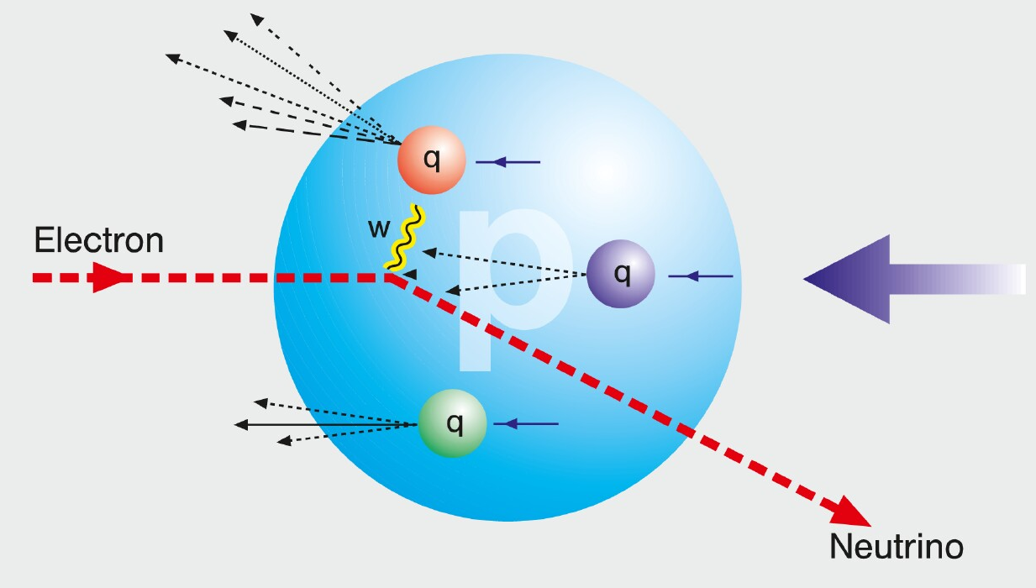
Observables: Charge Current in ep and eA
W-exchange:
direct access to the quark flavor
Ws are maximally parity violating
→ Ws couple only to one parton helicity
Complementary to SIDIS:
high Q²-scale: > 100 GeV²
best way to measure at very high x
extremely clean theoretically
No Fragmentation function
stringent test on theory
approach for SIDIS
UNIVERSALITY of PDFs
EIC:
first time charge current physics
in polarized ep and eA collisions
effective neutron target:
(un)polarized Deuterium or /and He-3
through tagging the spectator proton(s)
85% acceptance for spectator protons
for details see A. Jentsch talk in
IR WG

Slide 7
Observables: Charge Current in ep
EIC has a large kinematic coverage for charge current events ( )

Slide 8
Observables: Charge Current in polarized ep
Polarized CC cross section
Approximate behavior of the LO single spin asymmetry
y → 0
y = 1/2
y → 1
similar to what is seen in
W production in polarized pp
Details: Th. Burton, T. Martini, H. Spiesberger, M. Stratmann, ECA, arXiv:13095327 PRD 88 (2013) 114025

Slide 9
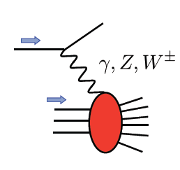
Polarized EW PHYSICS
ν
e
W^{+/-}
More Details: arXiv:1309.5327
QCD
fit

Slide 10
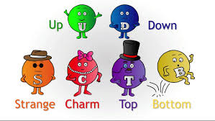
Access the Flavor Structure: SIDIS

Slide 11
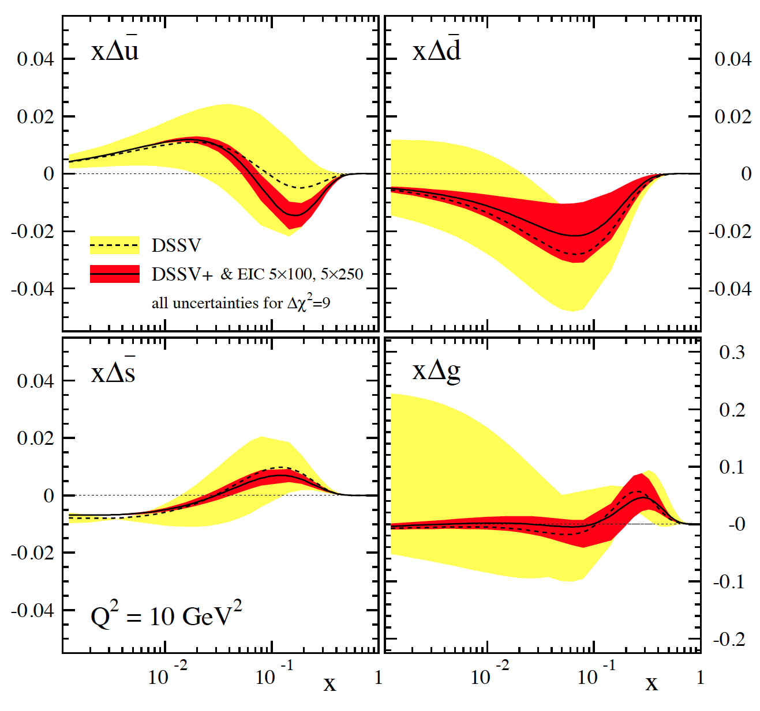
SIDIS@EIC: HELICITY PDFs
Can cover the same kinematics for g₁^{π,K} as for g₁
→ will constrain Δq
yet, small x behavior completely
unconstrained
→ determines x-integral,
which enters proton spin sum
includes data for
√s=45 GeV & 70 GeV
can be pushed to x=10⁻⁴ with
√s=140 GeV data
Lox x-behavior for Δs is artificial
due to constrains put in the fits
3F-D
→ EIC can remove all constrains
“issues”:
(SI)DIS @ EIC limited by
systematic uncertainties
need to control rel. lumi,
polarimetry, PID performance,
… very well

Slide 12
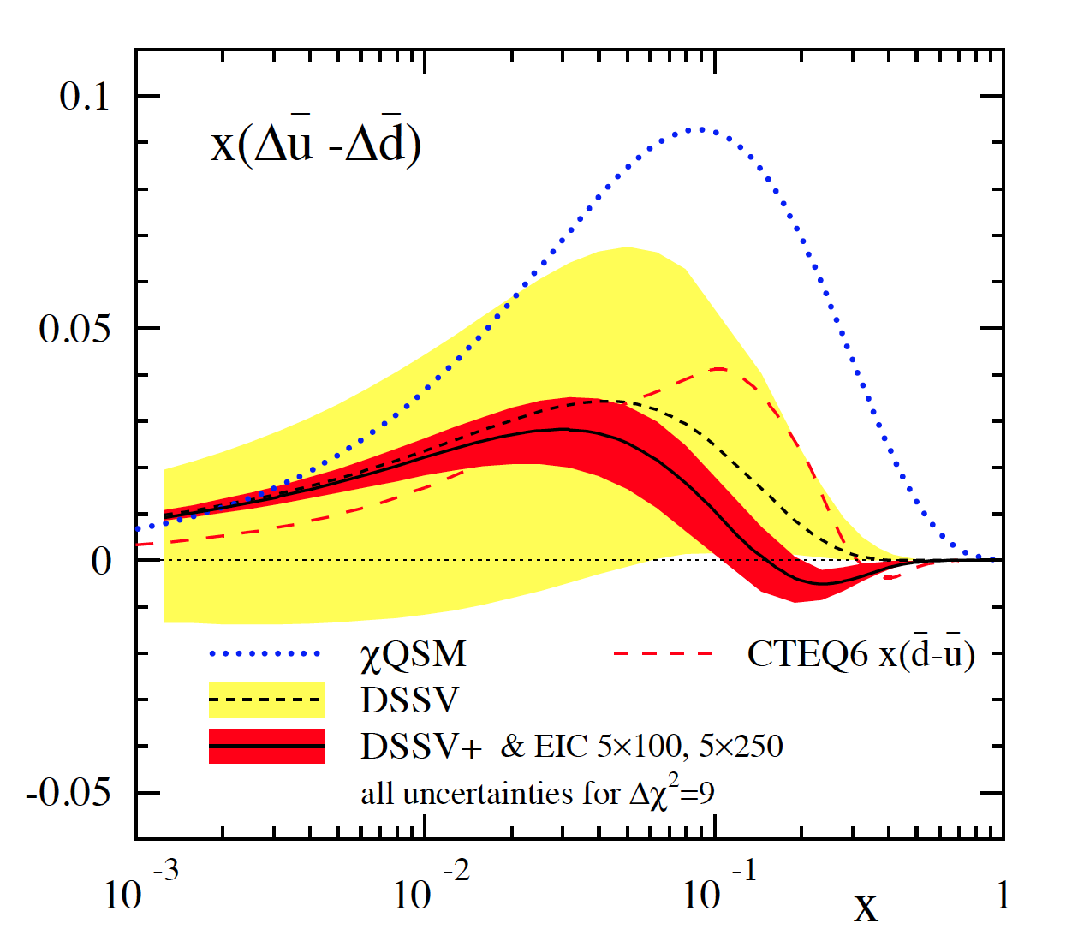
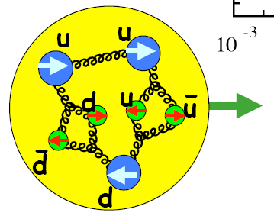
probing a possible asymmetry in the polarized sea
current SIDIS data not sensitive to (known to be sizable for unpol. PDFs)
many models predict sizable asymmetry [large N_{C} , chiral quark soliton, meson cloud, Pauli blocking]
Thomas, Signal, Cao; Holtmann, Speth, Fassler;
Diakonov, Polyakov, Weiss; Schafer, Fries; Kumano;
Wakamatsu; Gluck, Reya; Bourrely, Soffer, …
can be easily studied at an EIC
main effect expected to be at not too small x
→ can test x dependence
can try to look into a possible
with K^{+/-} SIDIS data

Slide 13
Most recent Results
Recent results based on NC: 5 GeV x 100 GeV and 5 GeV x 250 GeV and 20 GeV x 250 GeV

Slide 14
Most recent Results
Recent results based on NC: 5 GeV x 100 GeV and 5 GeV x 250 GeV and 20 GeV x 250 GeV
x 250 Data have large impact
Need to include neutron data
compare impact difference between D and He-3
study can we release 3F-D assumption

Slide 15
What is missing and Next Steps
Need to study detector effects, can be done using the smearing generator
  but need consistent parametrization for tracking and PID
Next Steps:
  finalize MC samples
  adjust cuts to our recent understanding
  do analysis of data with and without detector effect
  hand information to Rodolfo et al. and do impact fits
    and yes, I love to continue my successful and fun 20+ year collaboration with my friends from DSSV

Slide 16


