Slide 1
Jets and Heavy Flavor WG
Heavy Quark Measurements & Physics Goals
Heavy Quark probes are an essential part of the core EIC physics program; charm structure functions; deeply-virtual J/psi production, diffractive J/psi production, and hadronization and transport / ”energy loss” in electron-nucleon collisions.
Several measurement categories, in parts overlapping, and physics goals (not exhaustive, c.f. proposed table of ”Golden” and “Silver” JHQ measurements):
Production cross-sections
  x, Q²
  p_{T}
Production (double-)ratios; e+A, e+N
  fragmentation z,
  Q², ν, and k_{T}
HQ in jets and HQ-tagged jets
Quarkonia
(Spin) structure functions
Gluon PDFs, (- GPDs)
Fragmentation / Hadronization
Cold-Nuclear-Matter effects
Transport / “energy loss”

Slide 2
Detector Considerations
Although we do not yet have detailed performance requirements driven by physics goals, some general considerations and needs can be stated:
  The charm to DIS cross-section, for example, is 2—3% at Bjorken-x ~0.1,
  Many heavy-quark decay channels are multi-particle;
    Low measurement thresholds (typically at least decay-particle is “soft”)
    Minimize acceptance gaps
    (PID purity)
  Wide charged particle tracking acceptance -4 < η < 4
  Positive and robust PID; η > - 1, wide p
  Precision vertexing up to 2.5—3.5 in η; 20x20 µm pixels appear reasonable
  Spin measurements, in particular, suffer from background subtractions
A few points on vertexing:
  Displacements can be 2-dimensional or 3-dimensional
  Use a beam-line constraint or reconstructed primary vertex
Some questions / discussion points:
  Trade-offs between measurement thresholds and momentum resolution (B)
  Trade-offs between innermost barrel-length and disk positions,
  PID in higher density particle environment(s), e.g. forward e+A,
  Muon chambers (?)

Slide 3
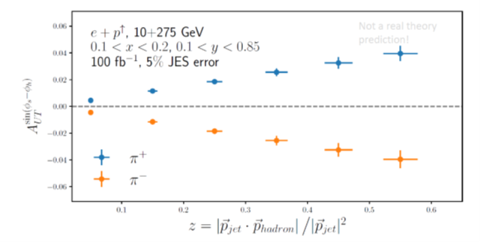
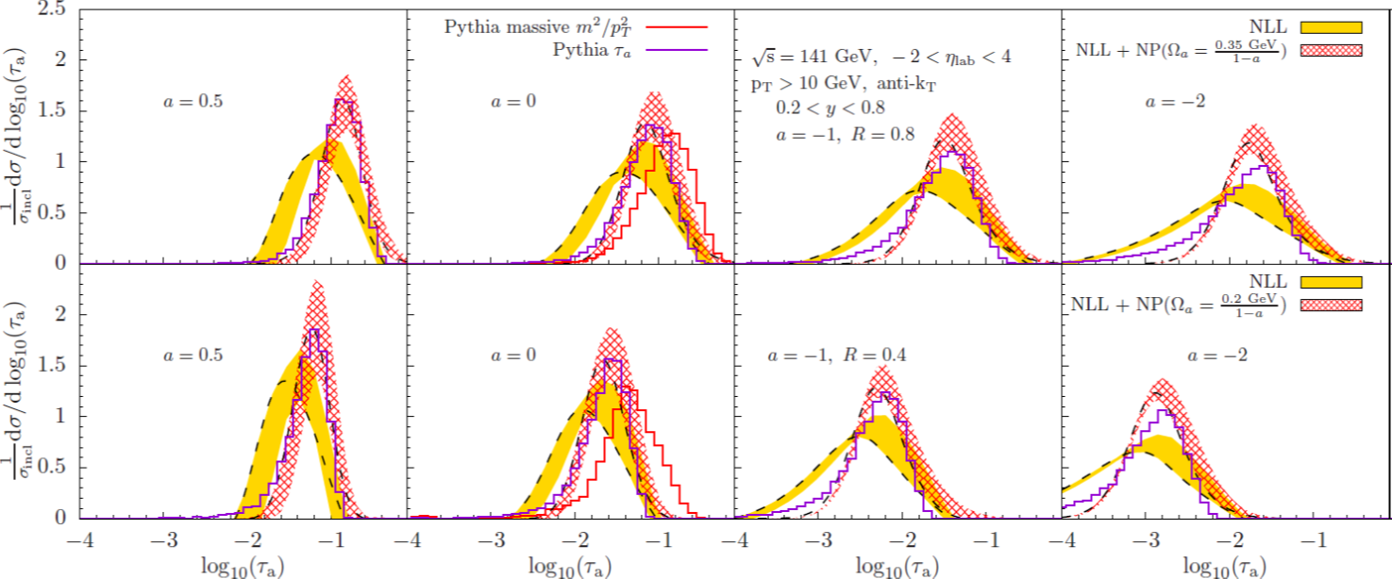
Jet Measurements - Examples
Dijet A_{LL}
Hadron-in-Jet
Lepton-Jet Correlations
Jet Substructure

Slide 4
Jet Measurements & Physics Goals
Jets have the potential to address a wide range of physics topics, often in ways complimentary to inclusive or SIDIS based approaches
Several categories of measurements roughly organized by increasing demands on detector and some associated physics goals (not exhaustive – see Table of Measurements for more detail)
Inclusive measures:
  Cross Sections
  Spin Asymmetries
Correlation measures:
  Dijet Azimuthal Correlations
  Lepton-Jet Azimuthal Correlations
Energy Distributions:
  Substructure
  Hadron-in-Jet
Helicity Distributions
PDFs
TMDs – Quark / Gluon Sivers
Nuclear Broadening
Fragmentation / Hadronization
CNM Effects
Collins Fragmentation
Transversity

Slide 5
Detector Considerations
Although we do not yet have detailed performance requirements driven by physics goals, some general needs can be stated:
  Tracking and calorimeter (electromagnetic and hadronic) coverage in range -4 < η < 4
  Minimize acceptance gaps
  Robust PID for particles in jet
There are a number of points to keep in mind about jets at an EIC:
  These will be low momentum/energy objects – tracking resolution will always be superior to hadron calorimetry
  Jets will be relatively sparse, containing roughly 10-12 particles in R=1.0 at highest p_{T}
Some questions / discussion starters for the detector experts:
  What is the tradeoff between B-field strength (low momentum particle acceptance) and momentum resolution
  What kind of position resolution is achievable in calorimeters and how does that relate to granularity
  What are realistic resolutions for hadron calorimeters
  What level of PID (degree of separation between pion, kaon, proton) is achievable in jet environment

Slide 6
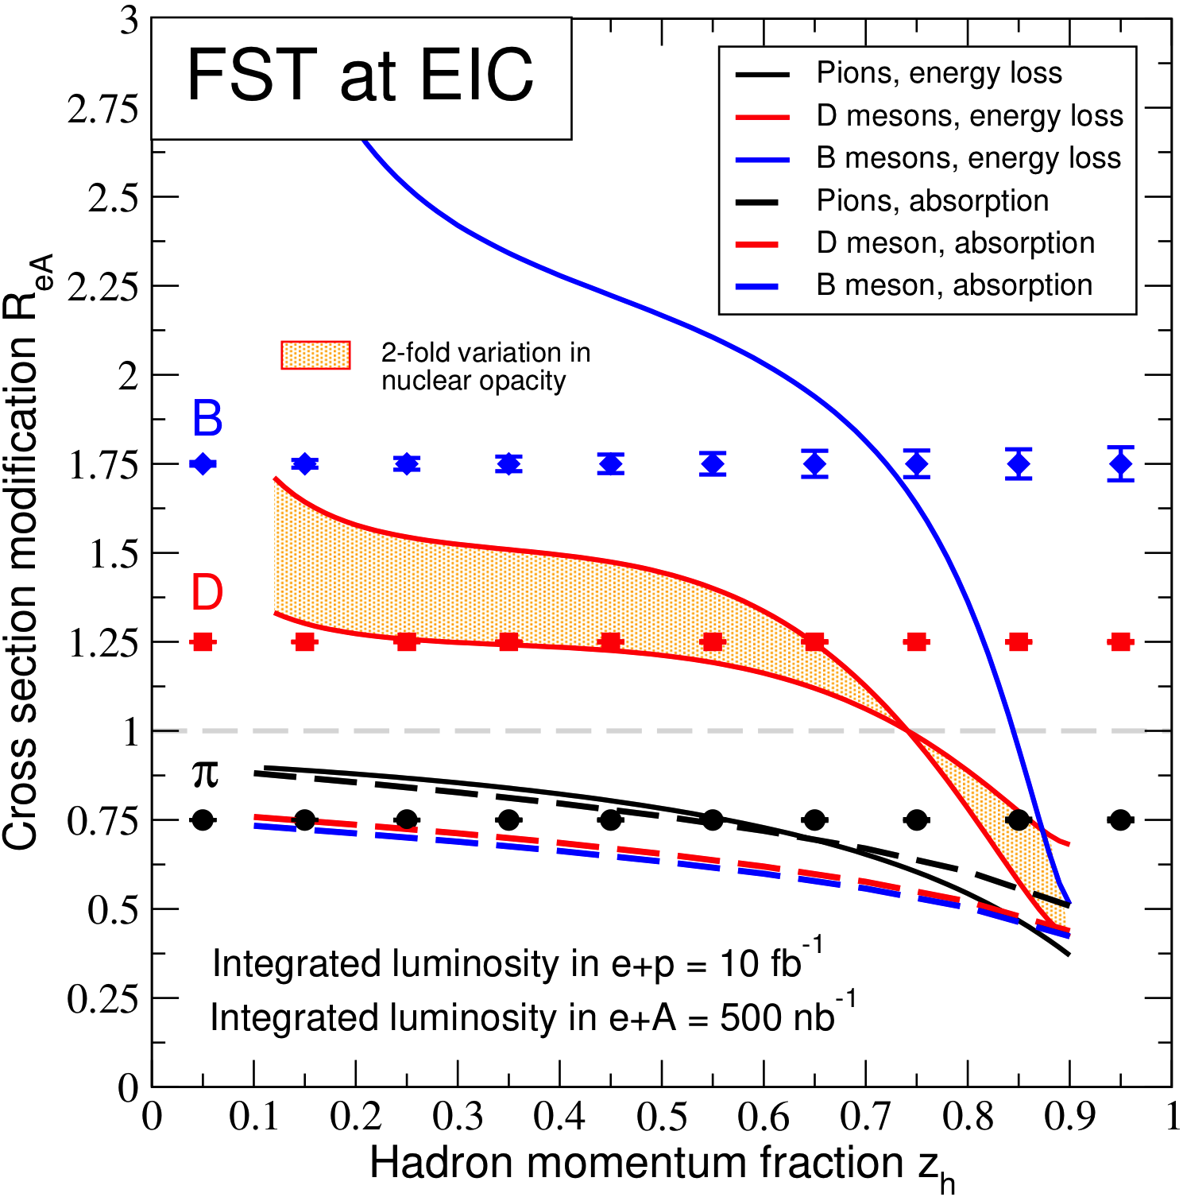
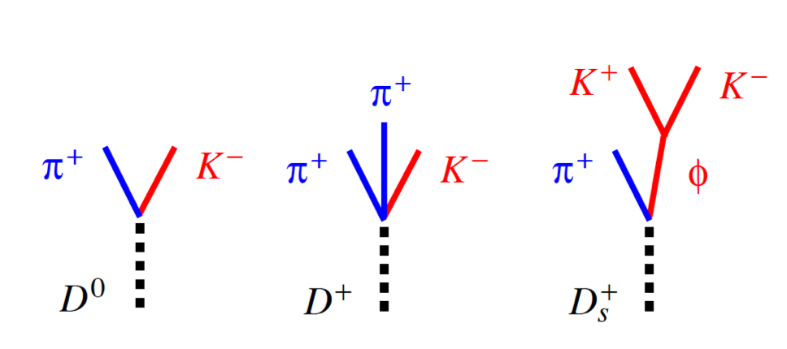
Example
Workflow
arXiv:2002.05880
  Start with a physics question: differentiate between hadronization inside nuclear matter (dashed lines) and energy loss of partons, hadronization outside (solid lines). Constrain the transport properties of large nuclei
  Theory framework and phenomenological studies – the right observable, cm energy, kinematic coverage, sensitivity
  Not discussed here, for the example see talk by Z. Liu in the joint J&HF and SIDIS session
Focus on D-mesons
Q² > 25 GeV²
1<η<4
Optimized stand-alone detector
CM energy 69 GeV (slightly higher)

Slide 7
Identifying and reconstructing the final states
  Mass peak reconstruction –> momentum resolution -> material budget
  Decay length -> vertex resolution - > pixel pitch size and detector design (# of layers)
  Collision frequency -> trigger integration times
  Kinematic coverage optimized – hadronization and charm content of example, more forward rapidity
Material budget has larger effect than pixel size
First have detector concept to optimize
  The full analysis framework which includes the event generation (PYTHIA8), detector response in fast simulation, beam remnant interaction background embedding, and hadron reconstruction have been set up
~ 50 micron or better transverse resolution

Slide 8
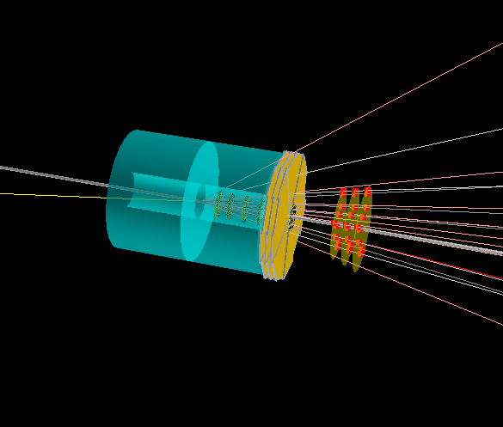
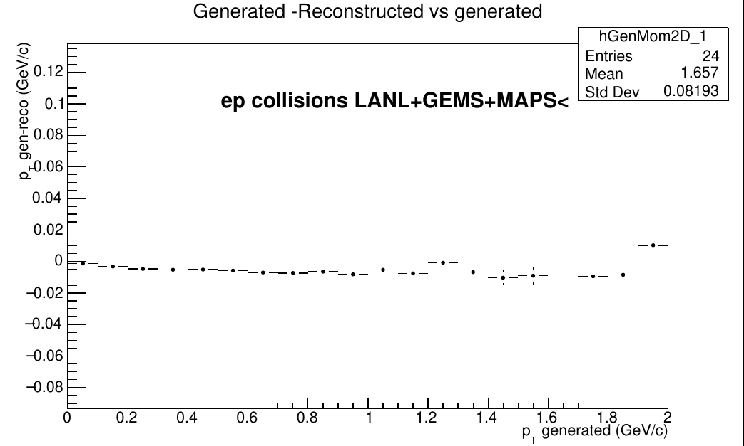
Full simulation / current status
Electron-Cu event
Full simulation: example EICROOT, BABAR magnet configuration, BEAST integration forward detectors highlighted
- for our group we have to see what additional requirements e+A might impose
LANL FST + GEMS +MAPS
ePythia:
  Electron (20 GeV), proton (250 GeV).
  Q²>0.8 GeV/c² , no radiative corrections.
DpmJetHybrid:
  Electron (10 GeV), proton (100 GeV).
  Q²>1 GeV/c² , no radiative corrections.
Get better that 1% momentum resolution
Full simulation: feedback to fast simulation if needed

