Slide 1
PID Working Group T. Hemmick & P. Rossi
In order to move forward on in a coherent and effective way we had two requests for this meeting:
1) Come to the meeting with a simple performance code implemented and ready to share with colleagues (where “applicable”) [https://indico.bnl.gov/event/7792/]
2) Presentations should cover the following points (where “applicable”)
Technology used: spell out clearly any risk associated, if any
Momentum range covered: p versus theta and Nsigma vs. p
Robustness of the design (e.g. sensitivity to magnetic field) and has a prototype been built?
Are the electronics considerations clear (channel count, data size, rate, background)
Time needed to complete the R&D and available workforce
Status of Simulation and Reconstruction
What we want to achieve at the end of this meeting:
Deliverables for the next quarterly meeting
Meetings schedule: we think that the “quarterly” meetings are not enough to track the progress of the work. It might be best to have monthly (or biweekly?) meetings between the major quarterly ones.

Slide 2
PID Working Group
Thursday 3/19: 14:30 -18:30
36 (29) people attended
9 presentations in total (7: 10+10 min ; 2: 8+7 min))
AGENDA:
Introduction (T. Hemmick/P.Rossi)
High-Resolution ps TOF for PID at the EIC (M. Chiu)
Evaluation of small photo‐sensors in high magnetic fields for EIC PID detectors (Y. Ilieva)
Development of MCP-PMT/LAPPD and exploring their application for PID (J. Xie)
A LGAD-based Time-of-Flight System for EIC - leveraging experience from the HL-LHC upgrade (W. Li)
Dual Ring Imaging Cherenkov status (E. Cisbani/M. Contalbrigo)
The high-performance DIRC detector for the EIC detector (G. Kalicy)
mRICH for EIC - past, present and future (X. He)
Quintuple-GEM Based RICH Detector for EIC (K. Dehmelt)
High Momentum PID at EIC (in 10 years from now)
Friday 3/20: 8:30 -10:30
25 people attended
General discussion on the working plan
:

Slide 3
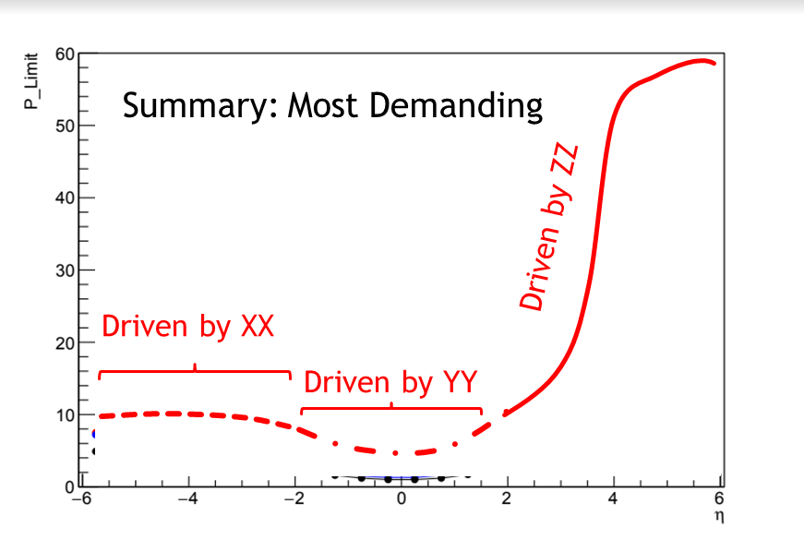
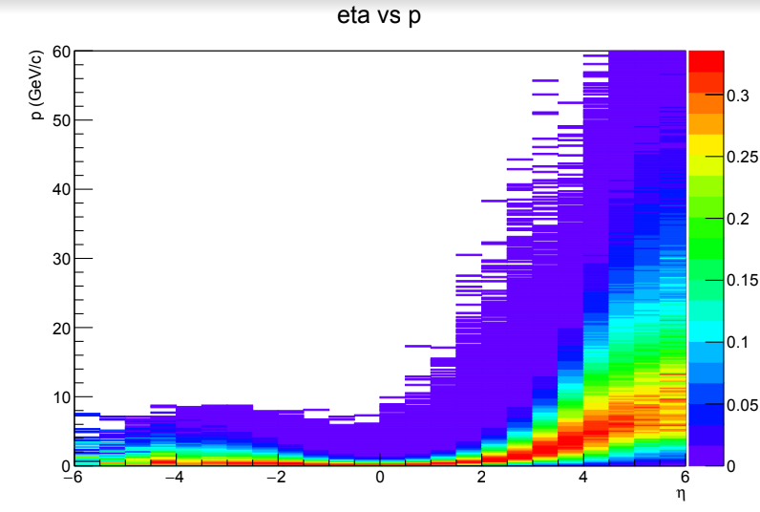
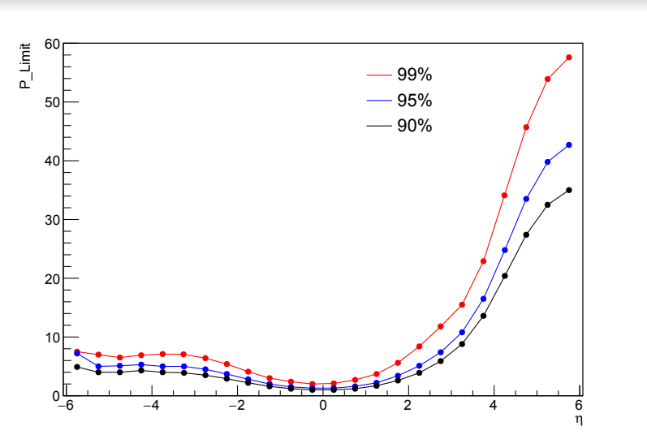
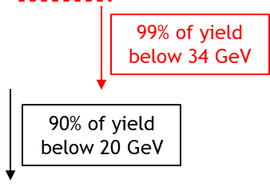
Needs vs. Performance: Designed Workflow
reduce
combine
compare
Yields
(subset of physics)
Limits
(max p)
Workflow Designed for:
Interface between PWD and DWG.
Apples-to-apples among detector technologies.
Status:
Well received in joint session with PWG…clear achievable deliverable.
Implemented already in most cases for detector proponents.

Slide 4
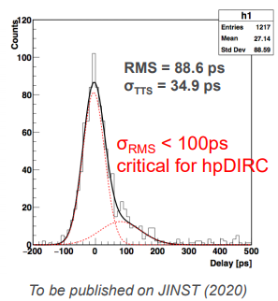
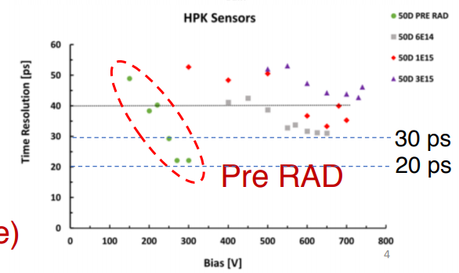
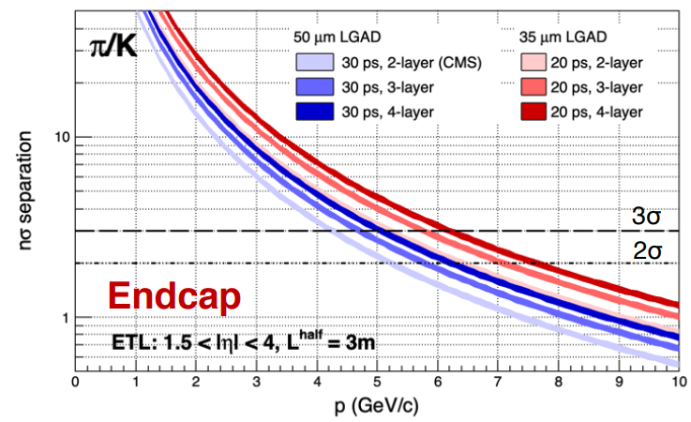
TOF Discussion (High Momentum)
Simple to encode PI performance since this measure is less coupled to other detector deliverables.
Options in some cases are limited by sensitivity to magnetic field orientation.

Slide 5
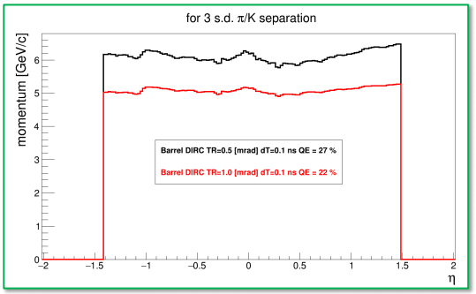
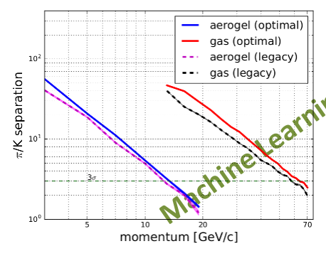
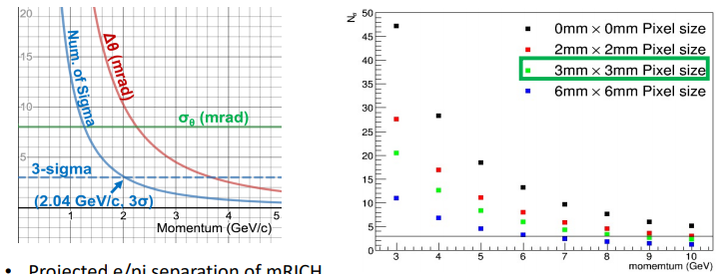
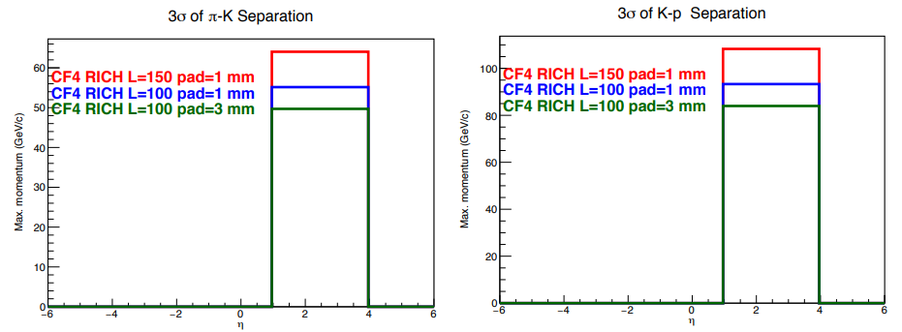
Cherenkov Plots (high p and very high p)
dual RICH
modular RICH
DIRC
CF₄ RICH
High and Very High P
Valid concern:
Gas RICH must be sensitive to future environmantal Limits
C_{n}F_{m} → high pressure gas
Developing photon det choices.

Slide 6
Sketches
DIRC
Dual RICH
Gas RICH
TRD
B-tolerant TOF
mRICH
mRICH
TOF
e-pi
(HBD)
TOF
(dE/dx from tracking)
principally assists barrel
Arrows indicate competing options.
Some readout options can intrinsically contain TOF capability.
(Actually eID)
Spatial tension with gas RICH

Slide 7
The Game:
Detector #1: The “xxxxxx” Detector
dE/dx from tracking
dE/dx from tracking
Move the stars
Detector #2: The “yyyyyy” Detector
Stars indicate choices possibilities.
This game depends directly upon “xxx/yyy” (time scale; $\sqrt{s}$; rate; physics…)

Slide 8
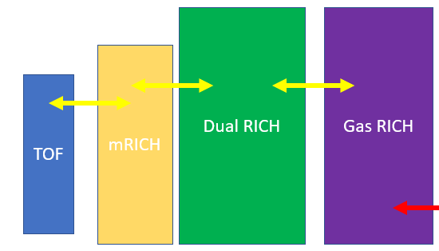
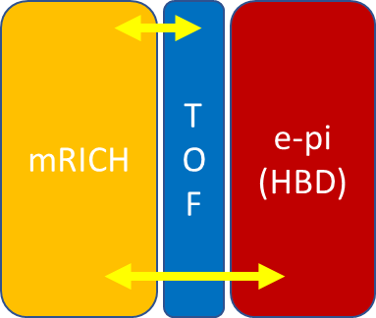
Comparison Matrices (in progress)
 | Pro | Con | Comment
DIRC
B-tolerant
Both
 | Pro | Con | Comment
dRICH
dRICH & TOF
mRICH & gas
TOF & gas
More…
 | Pro | Con | Comment
mRICH
TOF
HBD

Slide 9
Moving Forward (less diagonal, more real)
Interaction region assumptions?
Real Estate, crossing angle, background radiation levels.
Can we shift the collision point (more room for Cherenkov and HCAL) and how much?
Luminosity target (full white paper…true for both “complementary” detectors).
B-field limits (reused magnets?)
Space required.
Internal performance assumptions
Response to high particle density.
External performance assumptions
Momentum resolution.
Material budget
Can we make a standard or request/requirement?
Space used by external systems (magnet/tracking/asymmetry)
Time for completely new ideas?
CD1 and Yellow Report:
Show plausible options using existing or close tech.
Include further reaching ideas shown as options to enhance/improve baseline.
Response from PID to 1 vs. 2 interaction regions (crossing angle differences)
Information required from other working groups made as specific requests.
Performance requirements “harvested” from the physics groups.
Re-coupling discussions between now and the next YR meeting.
Considerations about providing a trigger.

