Slide 1
Roman Pots at the LHC
Roman pots have been used at the LHC by the TOTEM and AFP groups to study QCD physics such as total cross section and searches for exotic states
The PPS and AFP efforts within CMS and ATLAS are using diffraction to search for physics beyond the standard model at both low and high mass.
These efforts exploit the fact that if one can reconstruct the scattered protons the initial kinematics are very well constrained and one can make a background free measurement of rare processes.
Such programs require complete integration into the experiments and fast timing to reject pileup
EIC Temple Meeting
Michael Murray 20th March 2020

Slide 2
ATLAS Forward Protons

Slide 3
AFP performance in 2016

Slide 4
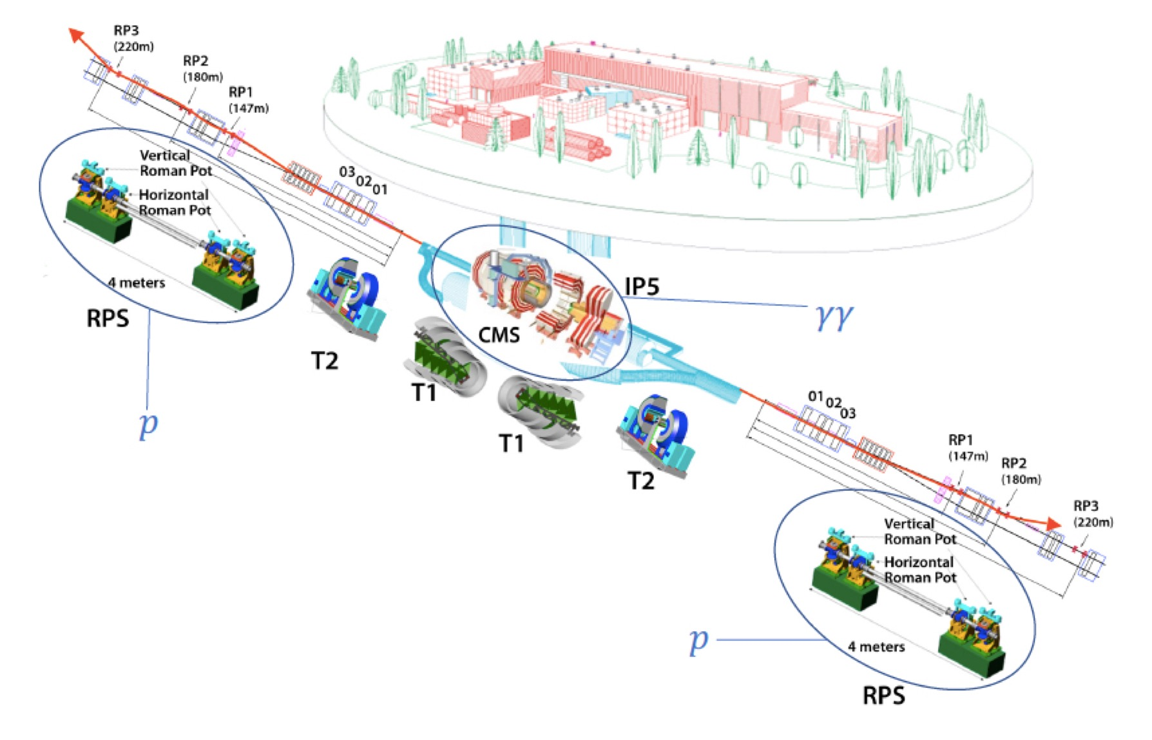
TOTEM, PPS and CMS

Slide 5
Layout of CT-PPS
For high luminosity LHC CMS will have a vertical crossing angle and there may be more stations.

Slide 6
Schematic of PPS and TOTEM
Tracking, Si Strips
Timing, diamond
Totem

Slide 7
Event Synchronization
PPS is completely integrated into CMS streaming DAQ
Digitization is done every 25ns
Latency is long enough for RP data to get to event builders
Event alignment can be done using triggers distributed randomly in time and then matching bunch filling pattern.
Typically done at start of year with a few bunches

Slide 8
PPS takes almost all CMS lumi

Slide 9
PPS Alignment
Absolute alignment: Use elastic pp → pp events in a special low luminosity fill. Bring horizontal and vertical roman pots within 5𝛔 of the beam.
Stop when there is a spike in the beam loss monitors
Align pots with respect to each other using inclusive events
Relative alignment: For each physics fill use inclusive sample of protons triggered by CMS and match distributions of proton track positions to that of alignment runs

Slide 10
Absolute Alignment
Align with collimators – before data-taking collimators are set to scrape the beam to have a sharp edge and each RP is slowly brought towards the beam until the beam-loss monitors downstream spike.
RP is then at the same distance as the collimator
Relative alignment between RPs is achieved by minimizing residuals between hits and fitted tracks. This method exploits overlap between the horizontal and vertical RPs,
Finally absolute alignment wrt. the beam is performed with a sample of elastic-scattering events tagged by the vertical RPs. Due to the azimuthal symmetry of the process, the position of the beam can be derived from the observed hit distributions.

Slide 11
1 Alignment with collimators + beam
Collimators
Define beam
Position of Pots (mm)
Beam Loss

Slide 12
2 Relative alignment among RPs
Displacements and rotations between different stations are determined by minimizing residuals between hits and track segments.

Slide 13
3 Absolute Alignment to Beam
Use elastic protons tagged in the vertical pots
210 m Station Left
Y (mm)
X far (mm)
Cuts
X near (mm)
X (mm)

Slide 14
Vertical alignment
Mean y is fitted as a function of X and extrapolated to x=0

Slide 15
Check of optics
Study correlation of momentum loss distributions in near and far detectors on both sides

Slide 16
Aligning Physics Runs
For physics runs distributions are scaled to alignment fill
Match scaled X distributions Match width in y
Final uncertainty is 150 μm

Slide 17
Summary
At LHC Roman Pots have been operated in very hostile environments.
Integration with central detectors and fast timing opens up a wide physics program
Alignment procedures are difficult but robust.

Slide 18
Backup

Slide 19
Aligning Physics Runs
Uncertainty
Is 150 μm

Slide 20
AFP Fiber Detectors
Crossing angle is vertical
Main Detector
Overlap
Detectors
Scintillating
Fibers

