Slide 1
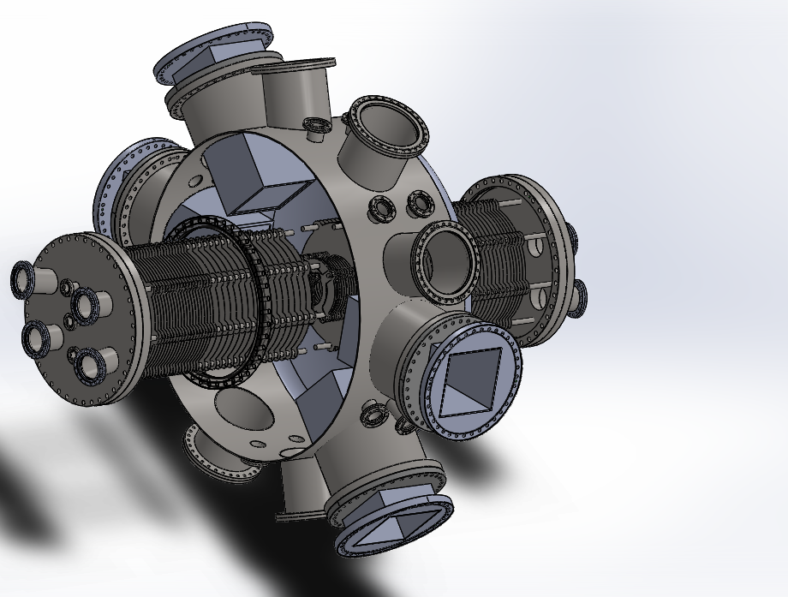
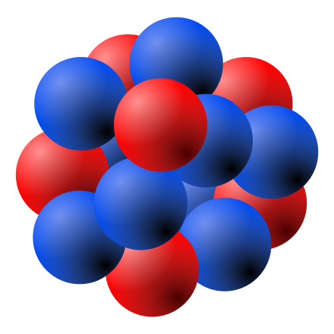
The HUNTER Sterile Neutrino Search
3) 54 eV Auger e⁻
4) 33 eV Auger e⁻
Temple University:
C.J. Martoff, F. Granato,
B. Lamichhane, X. Yu
UCLA:
P.F Smith, E.R. Hudson,
P. Hamilton, C. Schneider, E. Chang
University of Houston:
A. Renshaw, F. Malatino
Princeton University:
P.D. Meyers
Funding from the
W.M. Keck Foundation
P
O
2,3
1
N
4,5
2,3
1
2) 34.43 keV x-ray
M
L
K
1) K-capture
¹³¹Cs →¹³¹Xe + ν

Slide 2


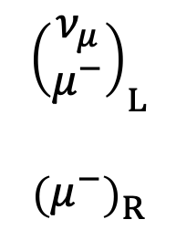


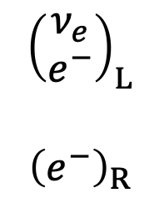



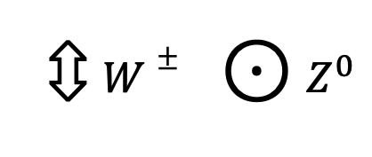


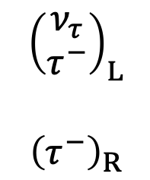


Leptons in the Standard Model
massless ν
$$μ^{−}→e^{−}ν_{μ}{\overline{ν}}_{e}$$
$$μ^{−}$$
$$ν_{μ}$$
$${\left(\begin{matrix}ν_{e} \\ e^{−}\end{matrix}\right)}_{L}$$
$${\left(\begin{matrix}e^{−}\end{matrix}\right)}_{R}$$
$${\left(\begin{matrix}ν_{μ} \\ μ^{−}\end{matrix}\right)}_{L}$$
$${\left(\begin{matrix}μ^{−}\end{matrix}\right)}_{R}$$
$${\left(\begin{matrix}ν_{τ} \\ τ^{−}\end{matrix}\right)}_{L}$$
$${\left(\begin{matrix}τ^{−}\end{matrix}\right)}_{R}$$
⇳ $W±$ $⊙$ $Z^{0}$
$$W^{−}$$
$$e^{−}$$
$${\overline{ν}}_{e}$$
and not
$$μ^{−}$$
$$e^{−}$$
singlet: no weak interaction
$$Z^{0}$$
$$ν_{μ}$$
Weak interactions are “flavor conserving”
$${\overline{ν}}_{e}$$

Slide 3
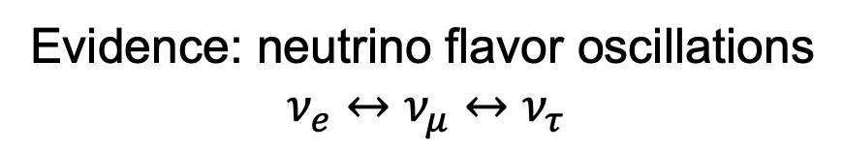
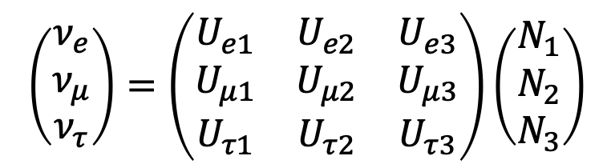

Real World
Leptons in the Standard Model
Flavor (weak) eigenstates ≠
Mass eigenstates
massless ν
$${\left(\begin{matrix}ν_{e} \\ e^{−}\end{matrix}\right)}_{L}$$
$${\left(\begin{matrix}e^{−}\end{matrix}\right)}_{R}$$
$${\left(\begin{matrix}ν_{μ} \\ μ^{−}\end{matrix}\right)}_{L}$$
$${\left(\begin{matrix}μ^{−}\end{matrix}\right)}_{R}$$
$${\left(\begin{matrix}ν_{τ} \\ τ^{−}\end{matrix}\right)}_{L}$$
$${\left(\begin{matrix}τ^{−}\end{matrix}\right)}_{R}$$
$$ν_{l=e,μ,τ}=\sum_{α=1,2,3}{U_{lα}N_{α}}$$
PMNS* matrix
singlet: no weak interaction
$$\left(\begin{matrix}ν_{e} \\ ν_{μ} \\ ν_{τ}\end{matrix}\right)=\left(\begin{matrix}U_{e1} & U_{e2} & U_{e3} \\ U_{μ1} & U_{μ2} & U_{μ3} \\ U_{τ1} & U_{τ2} & U_{τ3}\end{matrix}\right)\left(\begin{matrix}N_{1} \\ N_{2} \\ N_{3}\end{matrix}\right)$$
Evidence: neutrino flavor oscillations
$$ν_{e}↔ν_{μ}↔ν_{τ}$$
*Pontecorvo-Maki-Nakagawa-Sakata

Slide 4
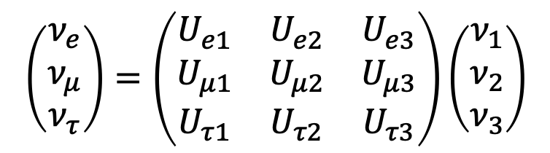
Leptons in the Standard Model
$${\left(\begin{matrix}ν_{e} \\ e^{−}\end{matrix}\right)}_{L}$$
$${\left(\begin{matrix}e^{−}\end{matrix}\right)}_{R}$$
$${\left(\begin{matrix}ν_{μ} \\ μ^{−}\end{matrix}\right)}_{L}$$
$${\left(\begin{matrix}μ^{−}\end{matrix}\right)}_{R}$$
$${\left(\begin{matrix}ν_{τ} \\ τ^{−}\end{matrix}\right)}_{L}$$
$${\left(\begin{matrix}τ^{−}\end{matrix}\right)}_{R}$$
PMNS* matrix
singlet: no weak interaction
$$\left(\begin{matrix}ν_{e} \\ ν_{μ} \\ ν_{τ}\end{matrix}\right)=\left(\begin{matrix}U_{e1} & U_{e2} & U_{e3} \\ U_{μ1} & U_{μ2} & U_{μ3} \\ U_{τ1} & U_{τ2} & U_{τ3}\end{matrix}\right)\left(\begin{matrix}ν_{1} \\ ν_{2} \\ ν_{3}\end{matrix}\right)$$
*Pontecorvo-Maki-Nakagawa-Sakata

Slide 5
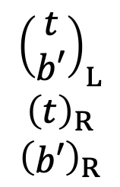


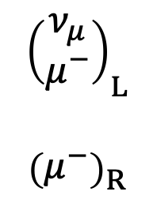

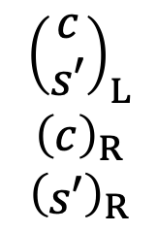


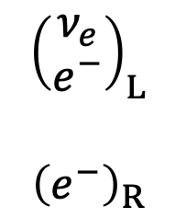


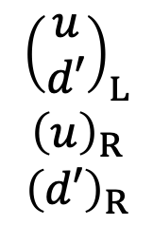

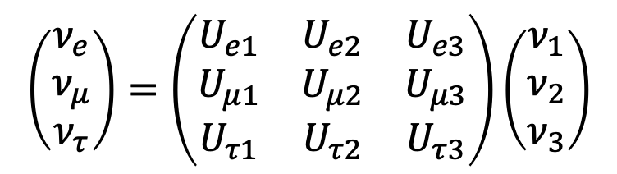



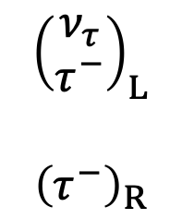
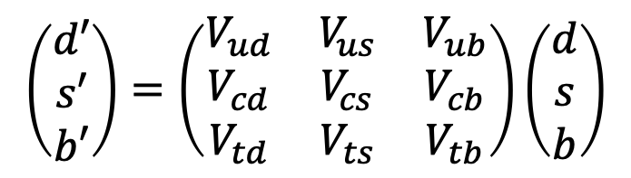

A lot like quarks!
PMNS* matrix
$$\left(\begin{matrix}ν_{e} \\ ν_{μ} \\ ν_{τ}\end{matrix}\right)=\left(\begin{matrix}U_{e1} & U_{e2} & U_{e3} \\ U_{μ1} & U_{μ2} & U_{μ3} \\ U_{τ1} & U_{τ2} & U_{τ3}\end{matrix}\right)\left(\begin{matrix}ν_{1} \\ ν_{2} \\ ν_{3}\end{matrix}\right)$$
$${\left(\begin{matrix}ν_{e} \\ e^{−}\end{matrix}\right)}_{L}$$
$${\left(\begin{matrix}e^{−}\end{matrix}\right)}_{R}$$
$${\left(\begin{matrix}ν_{μ} \\ μ^{−}\end{matrix}\right)}_{L}$$
$${\left(\begin{matrix}μ^{−}\end{matrix}\right)}_{R}$$
$${\left(\begin{matrix}ν_{τ} \\ τ^{−}\end{matrix}\right)}_{L}$$
$${\left(\begin{matrix}τ^{−}\end{matrix}\right)}_{R}$$
$$μ^{−}$$
$$ν_{μ}$$
$μ$ decay
$$W^{−}$$
$$e^{−}$$
singlet: no weak interaction
$${\overline{ν}}_{e}$$
CKM** matrix
$${\left(\begin{matrix}u \\ d′\end{matrix}\right)}_{L}$$
$${\left(u\right)}_{R}$$
$${\left(d′\right)}_{R}$$
$${\left(\begin{matrix}c \\ s′\end{matrix}\right)}_{L}$$
$${\left(c\right)}_{R}$$
$${\left(\begin{matrix}s′\end{matrix}\right)}_{R}$$
$${\left(\begin{matrix}t \\ b′\end{matrix}\right)}_{L}$$
$${\left(t\right)}_{R}$$
$${\left(\begin{matrix}b′\end{matrix}\right)}_{R}$$
$$\left(\begin{matrix}d′ \\ s′ \\ b′\end{matrix}\right)=\left(\begin{matrix}V_{ud} & V_{us} & V_{ub} \\ V_{cd} & V_{cs} & V_{cb} \\ V_{td} & V_{ts} & V_{tb}\end{matrix}\right)\left(\begin{matrix}d \\ s \\ b\end{matrix}\right)$$
$$u$$
$$d′$$
$β$ decay
$$W^{−}$$
$$e^{−}$$
singlets: no weak interaction
$${\overline{ν}}_{e}$$
*Pontecorvo-Maki-Nakagawa-Sakata
**Cabibbo-Kobayashi-Maskawa

Slide 6
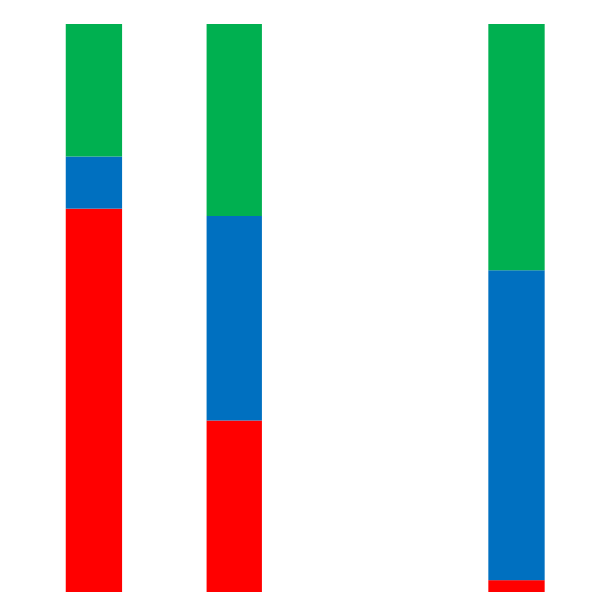



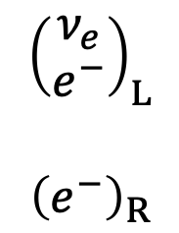






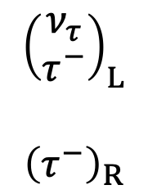



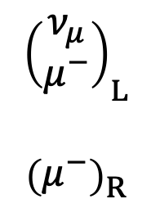

mass eigenstates
$$N_{1}$$
$$N_{2}$$
$$N_{3}$$
A lot like quarks...with some exceptions
$$ν_{τ}$$
$${\left(\begin{matrix}ν_{e} \\ e^{−}\end{matrix}\right)}_{L}$$
$${\left(\begin{matrix}e^{−}\end{matrix}\right)}_{R}$$
$${\left(\begin{matrix}ν_{μ} \\ μ^{−}\end{matrix}\right)}_{L}$$
$${\left(\begin{matrix}μ^{−}\end{matrix}\right)}_{R}$$
$${\left(\begin{matrix}ν_{τ} \\ τ^{−}\end{matrix}\right)}_{L}$$
$${\left(\begin{matrix}τ^{−}\end{matrix}\right)}_{R}$$
$$ν_{μ}$$
? ? ?
flavor eigenstates
$$ν_{e}$$
singlet: no weak interaction
$$d$$
$$s$$
$$b$$
$${\left(\begin{matrix}u \\ d′\end{matrix}\right)}_{L}$$
$${\left(u\right)}_{R}$$
$${\left(d′\right)}_{R}$$
$${\left(\begin{matrix}c \\ s′\end{matrix}\right)}_{L}$$
$${\left(c\right)}_{R}$$
$${\left(\begin{matrix}s′\end{matrix}\right)}_{R}$$
$${\left(\begin{matrix}t \\ b′\end{matrix}\right)}_{L}$$
$${\left(t\right)}_{R}$$
$${\left(\begin{matrix}b′\end{matrix}\right)}_{R}$$
$$d′$$
$$s′$$
$$b′$$
flavor eigenstates
singlets: no weak interaction

Slide 7
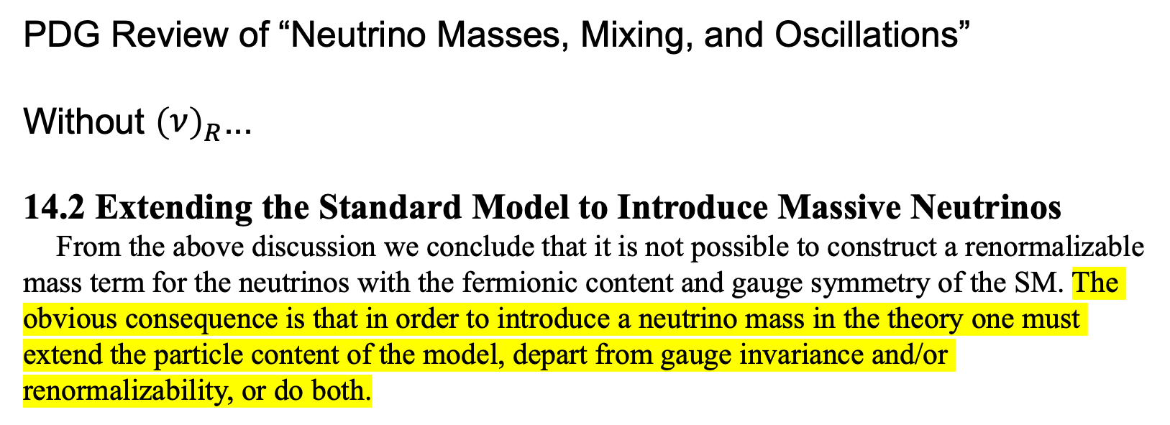
PDG Review of “Neutrino Masses, Mixing, and Oscillations”
Without ${\left(\begin{matrix}ν\end{matrix}\right)}_{R}$...
14.2 Extending the Standard Model to Introduce Massive Neutrinos
From the above discussion we conclude that it is not possible to construct a renormalizable mass term for the neutrinos with the fermionic content and gauge symmetry of the SM. The obvious consequence is that in order to introduce a neutrino mass in the theory one must extend the particle content of the model, depart from gauge invariance and/or renormalizability, or do both.

Slide 8
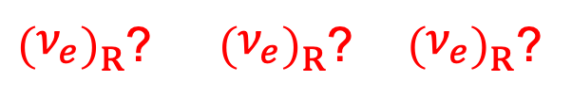
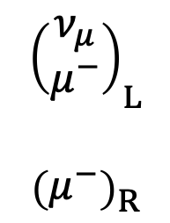
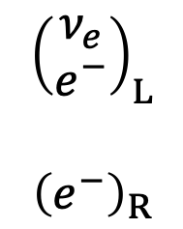
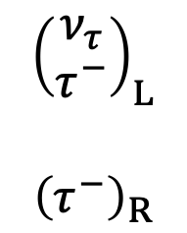
A lot like quarks...with some exceptions
$${\left(\begin{matrix}ν_{e} \\ e^{−}\end{matrix}\right)}_{L}$$
$${\left(\begin{matrix}e^{−}\end{matrix}\right)}_{R}$$
$${\left(\begin{matrix}ν_{μ} \\ μ^{−}\end{matrix}\right)}_{L}$$
$${\left(\begin{matrix}μ^{−}\end{matrix}\right)}_{R}$$
$${\left(\begin{matrix}ν_{τ} \\ τ^{−}\end{matrix}\right)}_{L}$$
$${\left(\begin{matrix}τ^{−}\end{matrix}\right)}_{R}$$
weak
EM, weak
${\left(\begin{matrix}ν_{e}\end{matrix}\right)}_{R}$? ${\left(\begin{matrix}ν_{e}\end{matrix}\right)}_{R}$? ${\left(\begin{matrix}ν_{e}\end{matrix}\right)}_{R}$?
strong, EM, weak
“Sterile neutrinos”
EM
singlet: no weak interaction
$${\left(\begin{matrix}u \\ d′\end{matrix}\right)}_{L}$$
$${\left(u\right)}_{R}$$
$${\left(d′\right)}_{R}$$
$${\left(\begin{matrix}c \\ s′\end{matrix}\right)}_{L}$$
$${\left(c\right)}_{R}$$
$${\left(\begin{matrix}s′\end{matrix}\right)}_{R}$$
$${\left(\begin{matrix}t \\ b′\end{matrix}\right)}_{L}$$
$${\left(t\right)}_{R}$$
$${\left(\begin{matrix}b′\end{matrix}\right)}_{R}$$
strong, EM, weak
strong, EM
singlets: no weak interaction

Slide 9
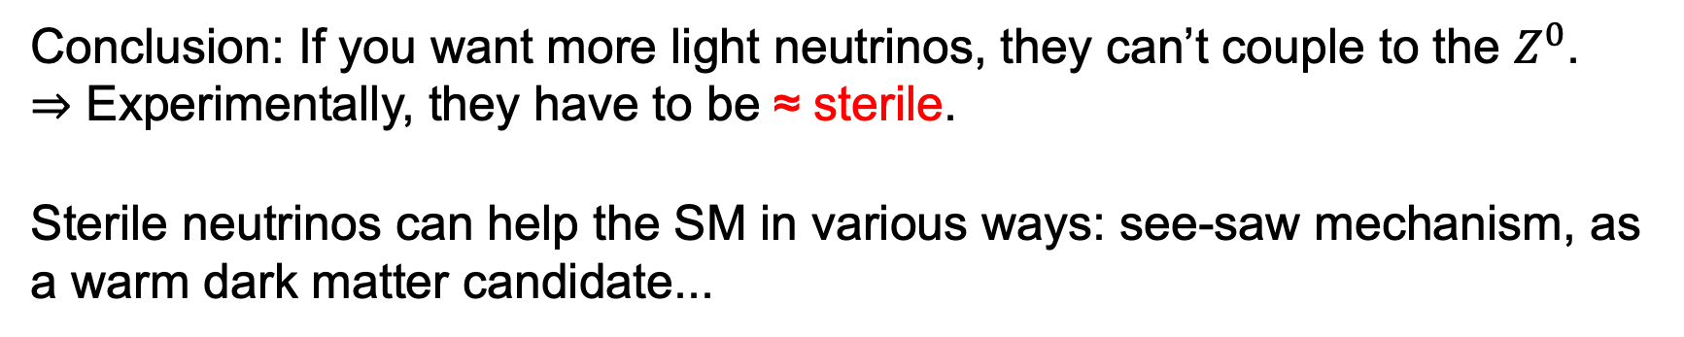
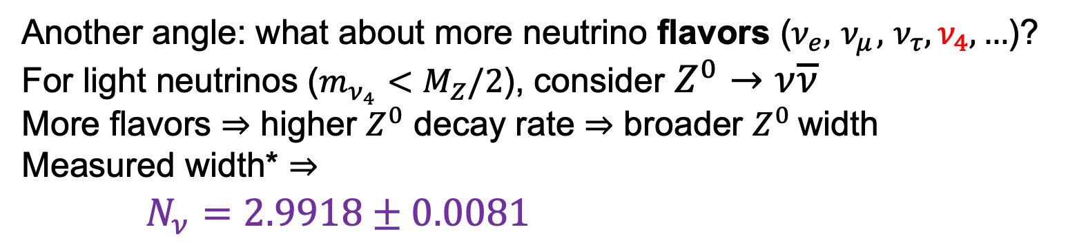
Another angle: what about more neutrino flavors ($ν_{e},{ ν}_{μ},$ $ν_{τ},ν_{4},…$)?
For light neutrinos ($m_{ν_{4}}<M_{Z}/2$), consider $Z^{0}→ν\overline{ν}$
More flavors ⇒ higher $Z^{0}$ decay rate ⇒ broader $Z^{0}$width
Measured width* ⇒
$N_{ν}=2.9918±0.0081$
Conclusion: If you want more light neutrinos, they can’t couple to the $Z^{0}$.
⇒ Experimentally, they have to be ≈ sterile.
Sterile neutrinos can help the SM in various ways: see-saw mechanism, as a warm dark matter candidate...
Takeaway: sterile neutrinos are a plausible extension
to the Standard Model.
So let’s look for them.
But how?
* arXiv:1908.01704

Slide 10
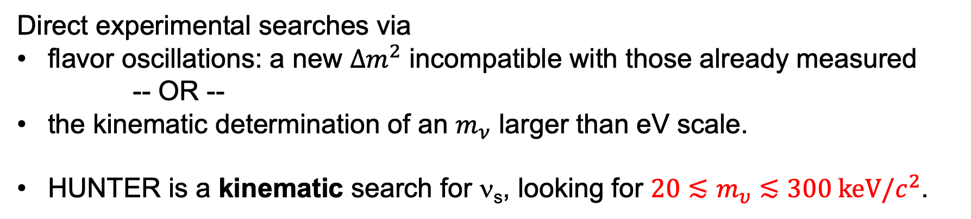
Sterile, but not reclusive: ν_{s} mixes with active flavors.
Direct experimental searches via
flavor oscillations: a new $Δm^{2}$ incompatible with those already measured
-- OR --
the kinematic determination of an $m_{ν}$ larger than eV scale.
HUNTER is a kinematic search for ν_{s}, looking for $20≲m_{υ}≲300 \text{keV}/c^{2}$.

Slide 11
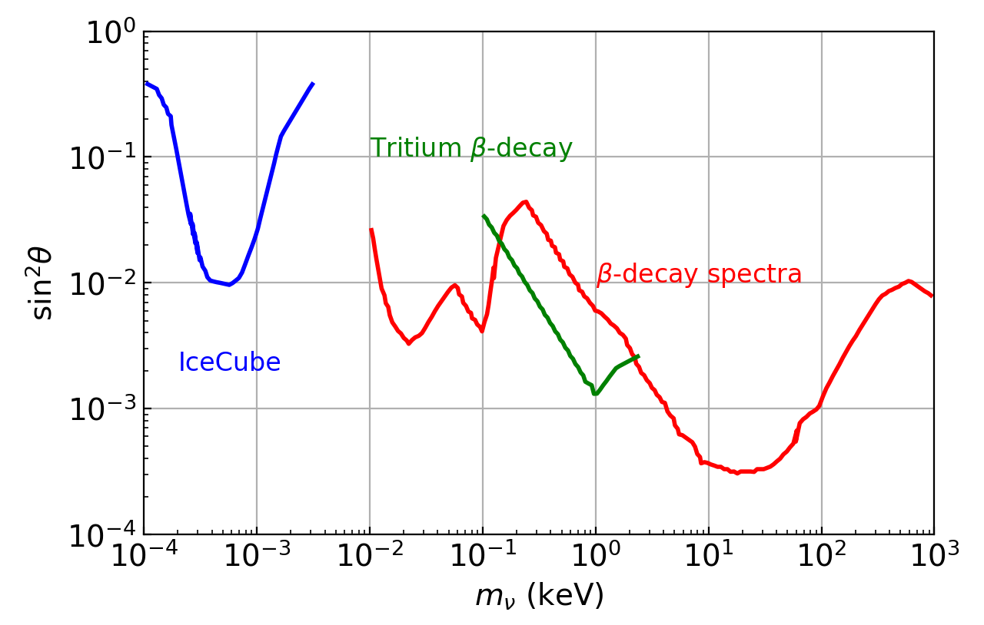
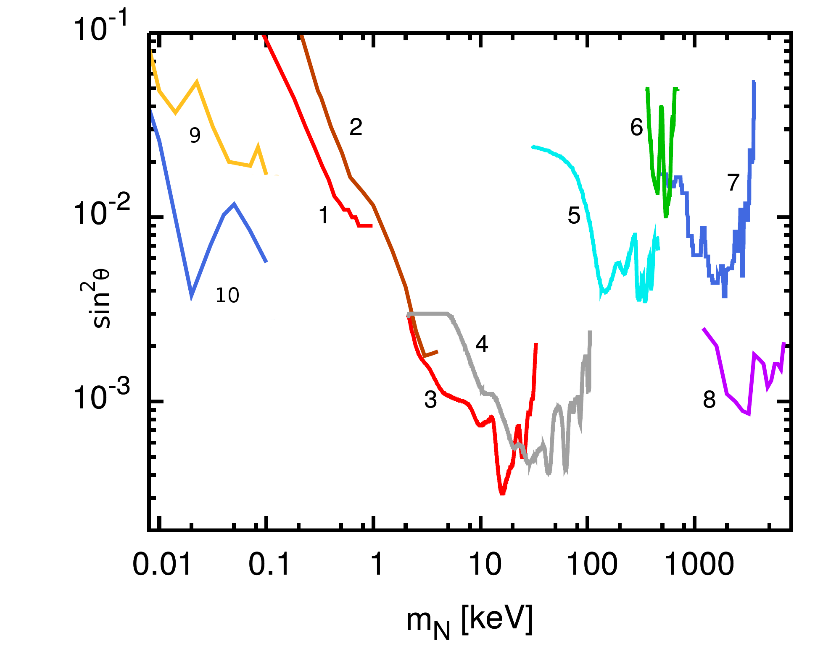
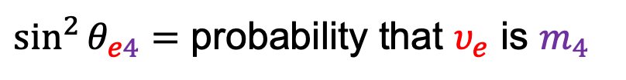

Existing experimental upper limits
$\sin^{2}{θ_{e4}=}$ probability that $υ_{e}$ is $m_{4}$
Kinematic searches
β - decay spectra from many experiments...
HUNTER
mass range
Oscillation search
Fine print: IceCube results forced into the plot by plotting $\sin^{2}{θ_{μ4}}$ vs. $Δm^{2}$.
Notes:
HUNTER mass range ~IceCube or H-3 beta decay

Slide 12
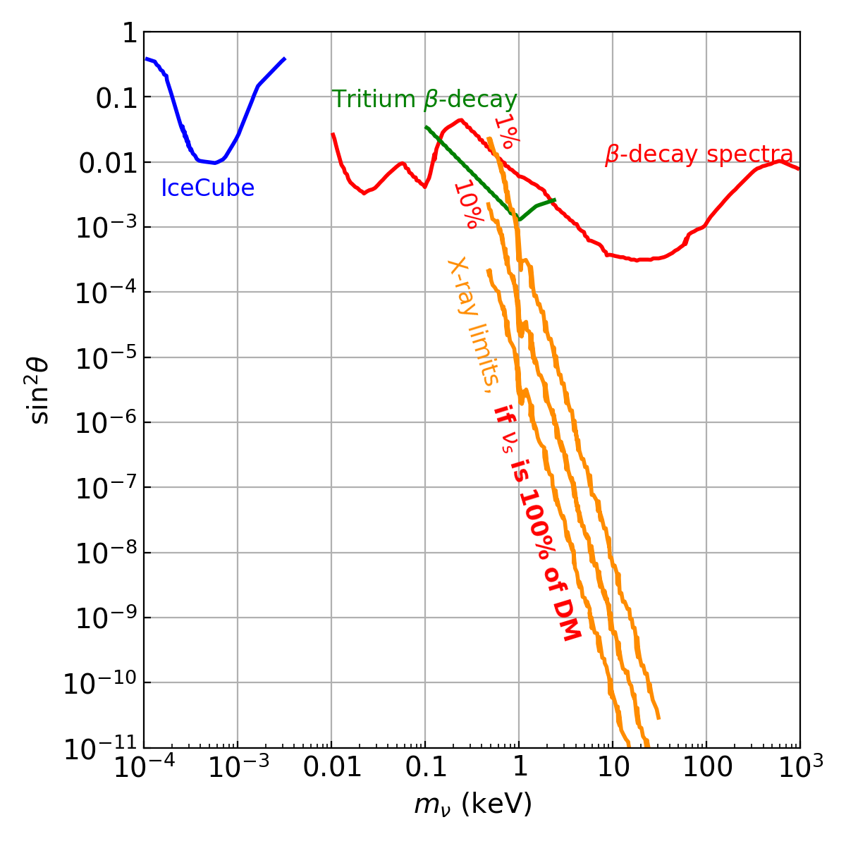
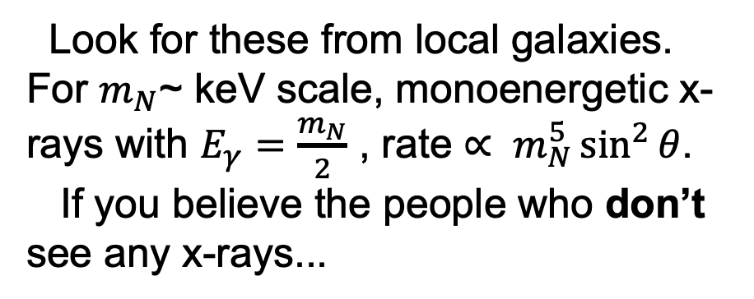
Sterile, but not reclusive: ν_{s} mixes with active flavors.
If some of the dark matter in galaxies is sterile neutrinos: Indirect experimental searches via radiative decays
Look for these from local galaxies. For $m_{N}$~ keV scale, monoenergetic x-rays with $E_{γ}=\frac{m_{N}}{2}$ , rate $∝ m_{N}^{5}\sin^{2}{θ}$.
If you believe the people who don’t see any x-rays...

Slide 13
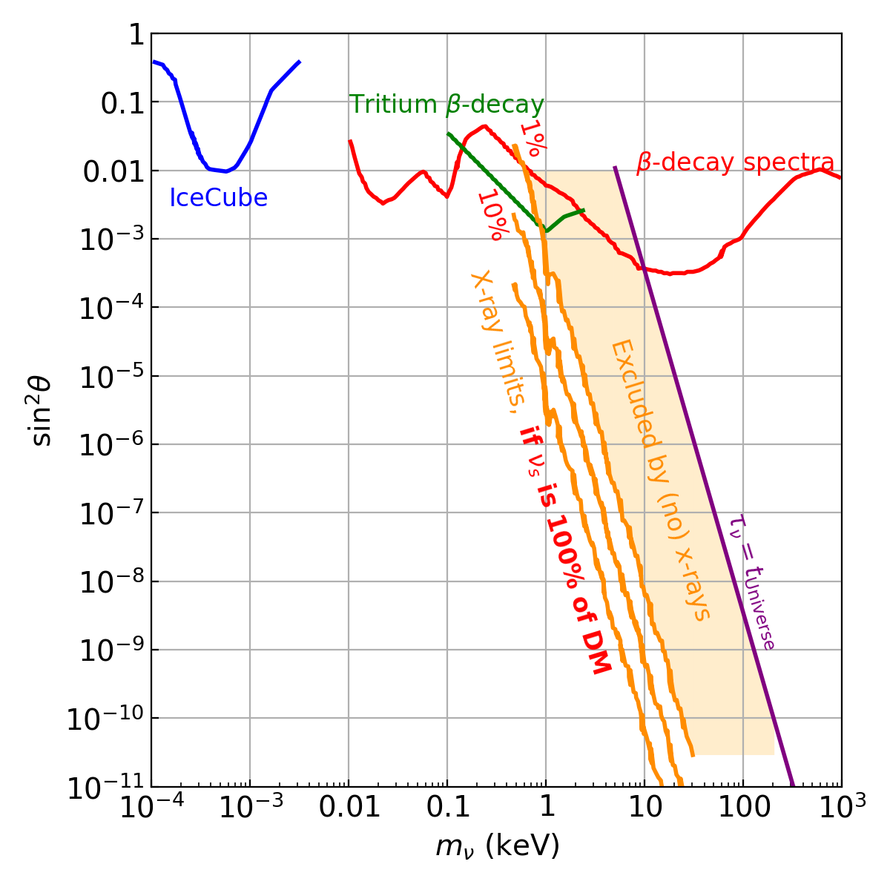

But, to be galactic dark matter, you have to still be around...
Radiative decay is not the dominant mode (BR ~ 1%). Lifetime determined by the invisible decay:
HUNTER
mass range
Again, the rate $∝ m_{N}^{5}\sin^{2}{θ}$
An interesting purely particle physics window for HUNTER

Slide 14
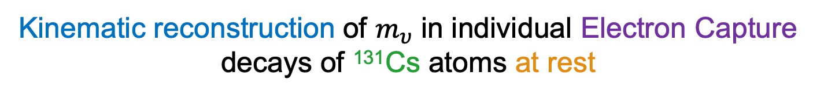
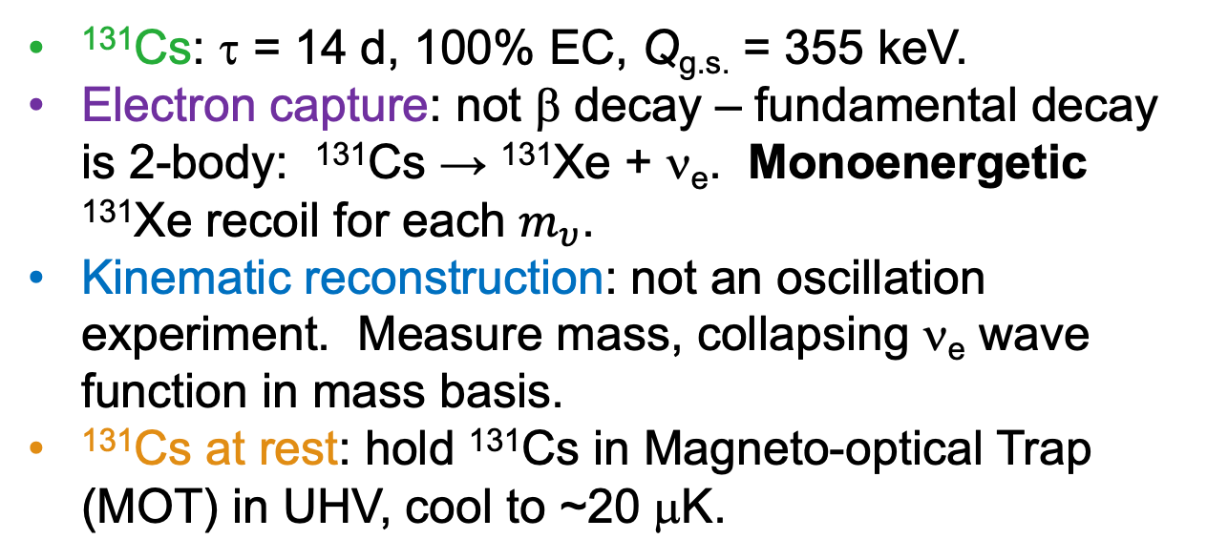
HUNTER:
Heavy Unseen Neutrinos by Total Energy-momentum Reconstruction
Kinematic reconstruction of $m_{υ}$ in individual Electron Capture decays of ¹³¹Cs atoms at rest
¹³¹Cs: τ = 14 d, 100% EC, Q_{g.s.} = 355 keV.
Electron capture: not β decay – fundamental decay is 2-body: ¹³¹Cs → ¹³¹Xe + ν_{e}. Monoenergetic ¹³¹Xe recoil for each $m_{υ}$.
Kinematic reconstruction: not an oscillation experiment. Measure mass, collapsing ν_{e} wave function in mass basis.
¹³¹Cs at rest: hold ¹³¹Cs in Magneto-optical Trap (MOT) in UHV, cool to ~20 μK.
Notes:
EC: peak, not distortion in continuous spectrum and only low-E electrons

Slide 15
HUNTER is agnostic about
whether or not ν_{s} is dark matter
any particular theory

Slide 16
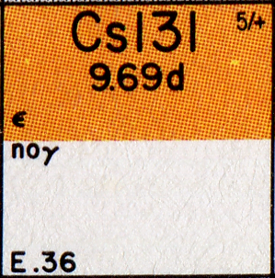
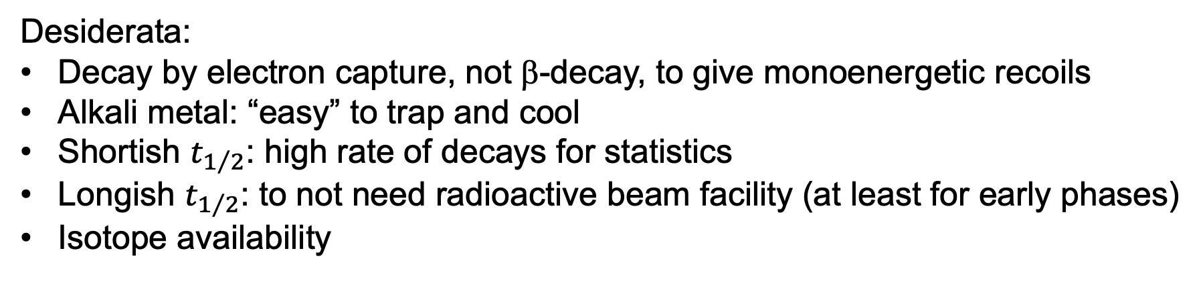
Choice of isotope
Desiderata:
Decay by electron capture, not β-decay, to give monoenergetic recoils
Alkali metal: “easy” to trap and cool
Shortish $t_{1/2}$: high rate of decays for statistics
Longish $t_{1/2}$: to not need radioactive beam facility (at least for early phases)
Isotope availability
¹³¹Cs is the best candidate:
100% EC to nuclear ground state of daughter ¹³¹Xe
No penetrating radiation from decay
Stable daughter
Commercially available (used for medical brachytherapy)
There are runners-up that could be used to confirm a signal

Slide 17
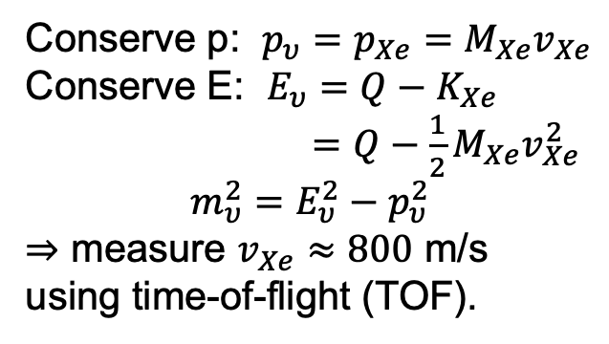
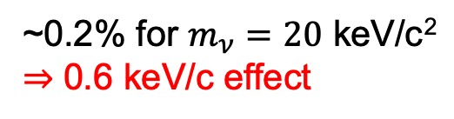
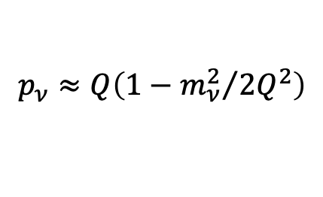

Ideal
Actual
3) 54 eV Auger e⁻ (7 keV/c)
4) 33 eV Auger e⁻ (6 keV/c)
EC leaves ¹³¹Xe in excited atomic state
The kicks to Xe from de-excitations are important
P
¹³¹Cs
O
2,3
1
¹³¹Xe
$$υ$$
N
4,5
One of many de-excitation paths
2,3
Conserve p: $p_{υ}=p_{Xe}=M_{Xe}v_{Xe}$
Conserve E: $E_{υ}=Q−K_{Xe}$
$=Q−\frac{1}{2}M_{Xe}v_{Xe}^{2}$
$$m_{υ}^{2}=E_{υ}^{2}−p_{υ}^{2}$$
⇒ measure $v_{Xe}≈800$ m/s using time-of-flight (TOF).
1
2) 34.43 keV x-ray
M
L
In the case shown,
¹³¹Cs →¹³¹Xe* + ν
becomes
¹³¹Cs →¹³¹Xe⁺⁺ + γ + 2e⁻ + ν
in ≪ picoseconds.
K
$$p_{ν}≈Q\left(1−{m_{ν}^{2}}/{2Q^{2}}\right)$$
1) K-capture
~0.2% for $m_{ν}=20$ keV/c²
⇒ 0.6 keV/c effect

Slide 18











¹³¹Cs
$$υ$$
Xe**
$$e$$
$$p_{e1}$$
$$p_{υ}$$
$$p_{+}$$
Xe*
$$p_{∗}$$
Xe⁺⁺
$$p_{∗∗}$$
Xe⁺
$$p_{++}$$
$$p_{γ}$$
$$e$$
$$p_{e2}$$
x-ray
$$m_{υ}^{2}={\left(Q_{++}−E_{++}−E_{γ}−E_{e1}−E_{e2}\right)}^{2}−{\left(p_{++}+p_{γ}+p_{e1}+p_{e2}\right)}^{2}$$
Downside:
Must measure vector momenta of all particles.
Upside:
X-ray is a good trigger for the experiment, good “start” for TOF.
Xe ends up an ion: can accelerate, focus, and detect.

Slide 19
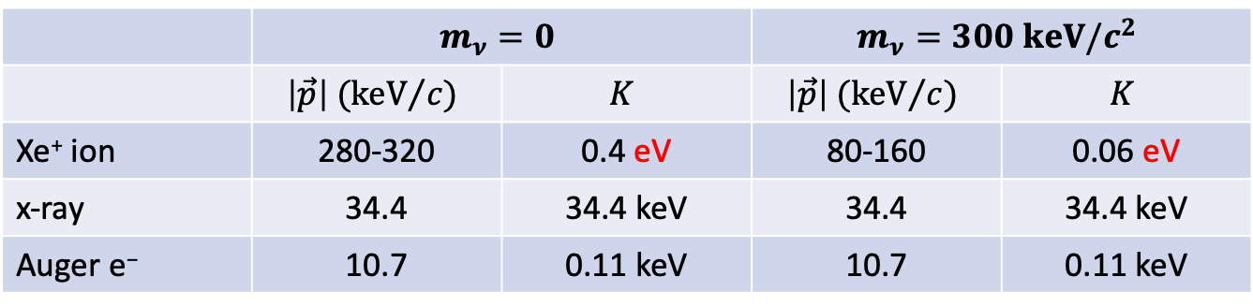
For reference: kinematics of a single-Auger event
 | $$m_{ν}=0$$ |  | $$m_{ν}=300 keV/c^{2}$$
 | $$\left|\vec{p}\right| ({keV}/{c)}$$ | $$K$$ | $$\left|\vec{p}\right| ({keV}/{c)}$$ | $$K$$
Xe⁺ ion | 280-320 | 0.4 eV | 80-160 | 0.06 eV
x-ray | 34.4 | 34.4 keV | 34.4 | 34.4 keV
Auger e⁻ | 10.7 | 0.11 keV | 10.7 | 0.11 keV

Slide 20
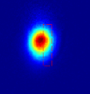
Magneto-optical Trap
0.2% effect on ~300 keV/c momentum ⇒ need to cool to <10 mK
MOT: off-resonance lasers along 3 axes
Doppler-driven absorption ⇒ 3D cooling
Zeeman-driven absorption in B gradients ⇒ 3D confinement
HUNTER Phase 1 goals:
20 μK, 10⁸ ¹³¹Cs atoms in ~1-mm MOT
HUNTER UCLA group
CCD image of 10⁹ cesium atoms
at 20 µK
Cesium MOTs >10¹⁰ atoms demonstrated.
Further techniques possible to reach 3 µK.

Slide 21
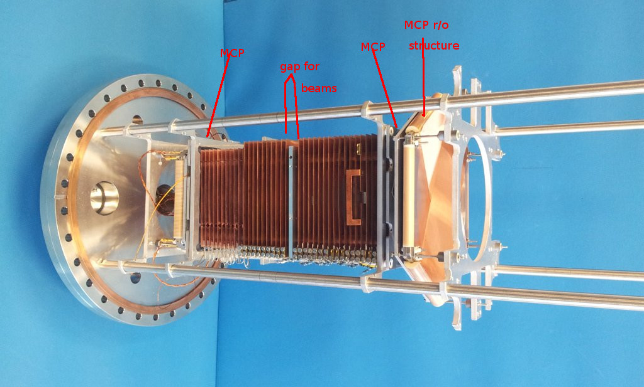
Moshammer (2003)
Ion and Electron Spectrometers
MOT + Reaction Ion Microscope Spectrometers: MOTRIMS
An established technology for molecular physics – spectrometers commercially available. We have to scale it up a bit...
Static magnetic and electric fields focus and accelerate ions and electrons onto Microchannel Plate detectors.
High acceptance for ions and electrons.
Commercial MCPs have the required spatial (100 μm) and time (0.2 ns) resolution and multi-hit capability.
~10 cm
Roentdek spectrometer

Slide 22
Ion spectrometer
Longitudinal momentum from TOF to MCP
Transverse momentum from radial position on MCP and TOF
Electrostatic acceleration can give 4π acceptance, capturing even ions with initial momentum away from MCP
~0.1% momentum resolution needed
Size of MOT (e.g., ΔTOF across 1-mm-scale MOT) not negligible!

Slide 23
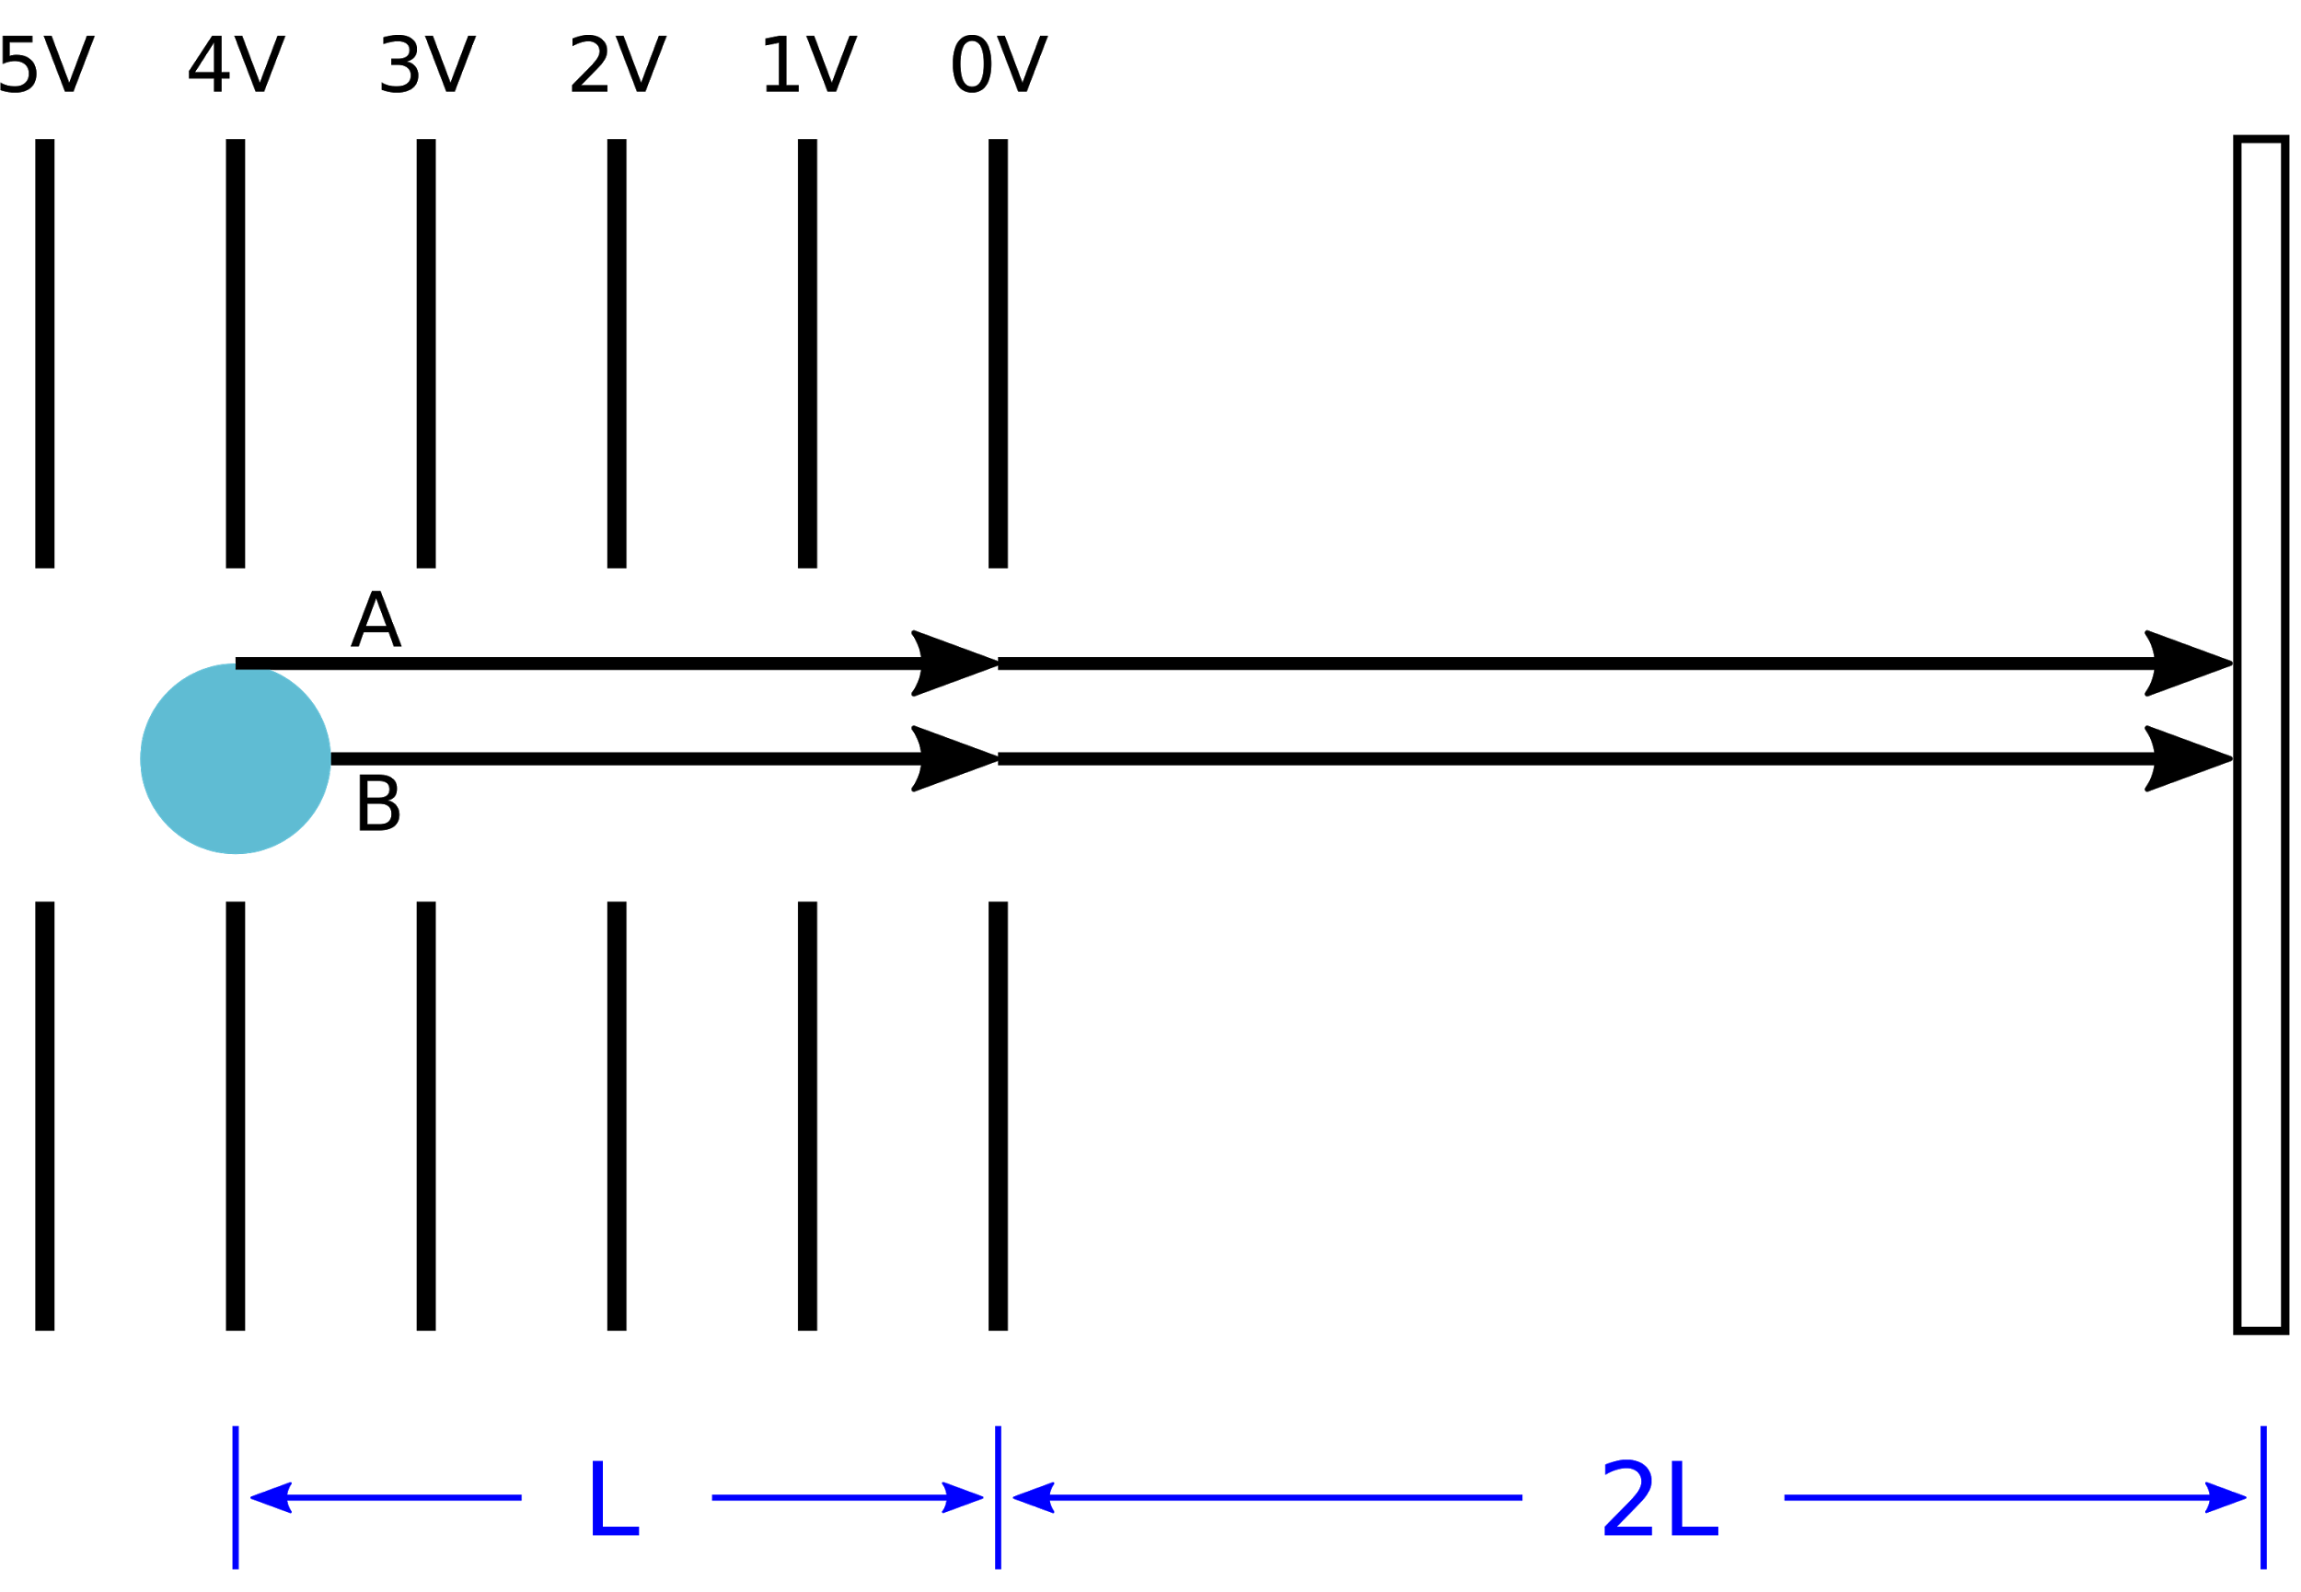
Consider two decays giving the same longitudinal momentum:
A comes from the center of the MOT, B from the edge
Electrodes give uniform E
across MOT
A must go farther than B, but it is also accelerated more. Some algebra: TOF_{A} = TOF_{B} if drift length is 2×acceleration length: “time focusing”.
Ion MCP
Zero-field
drift region
MOT
Notes:
skip if short on time

Slide 24
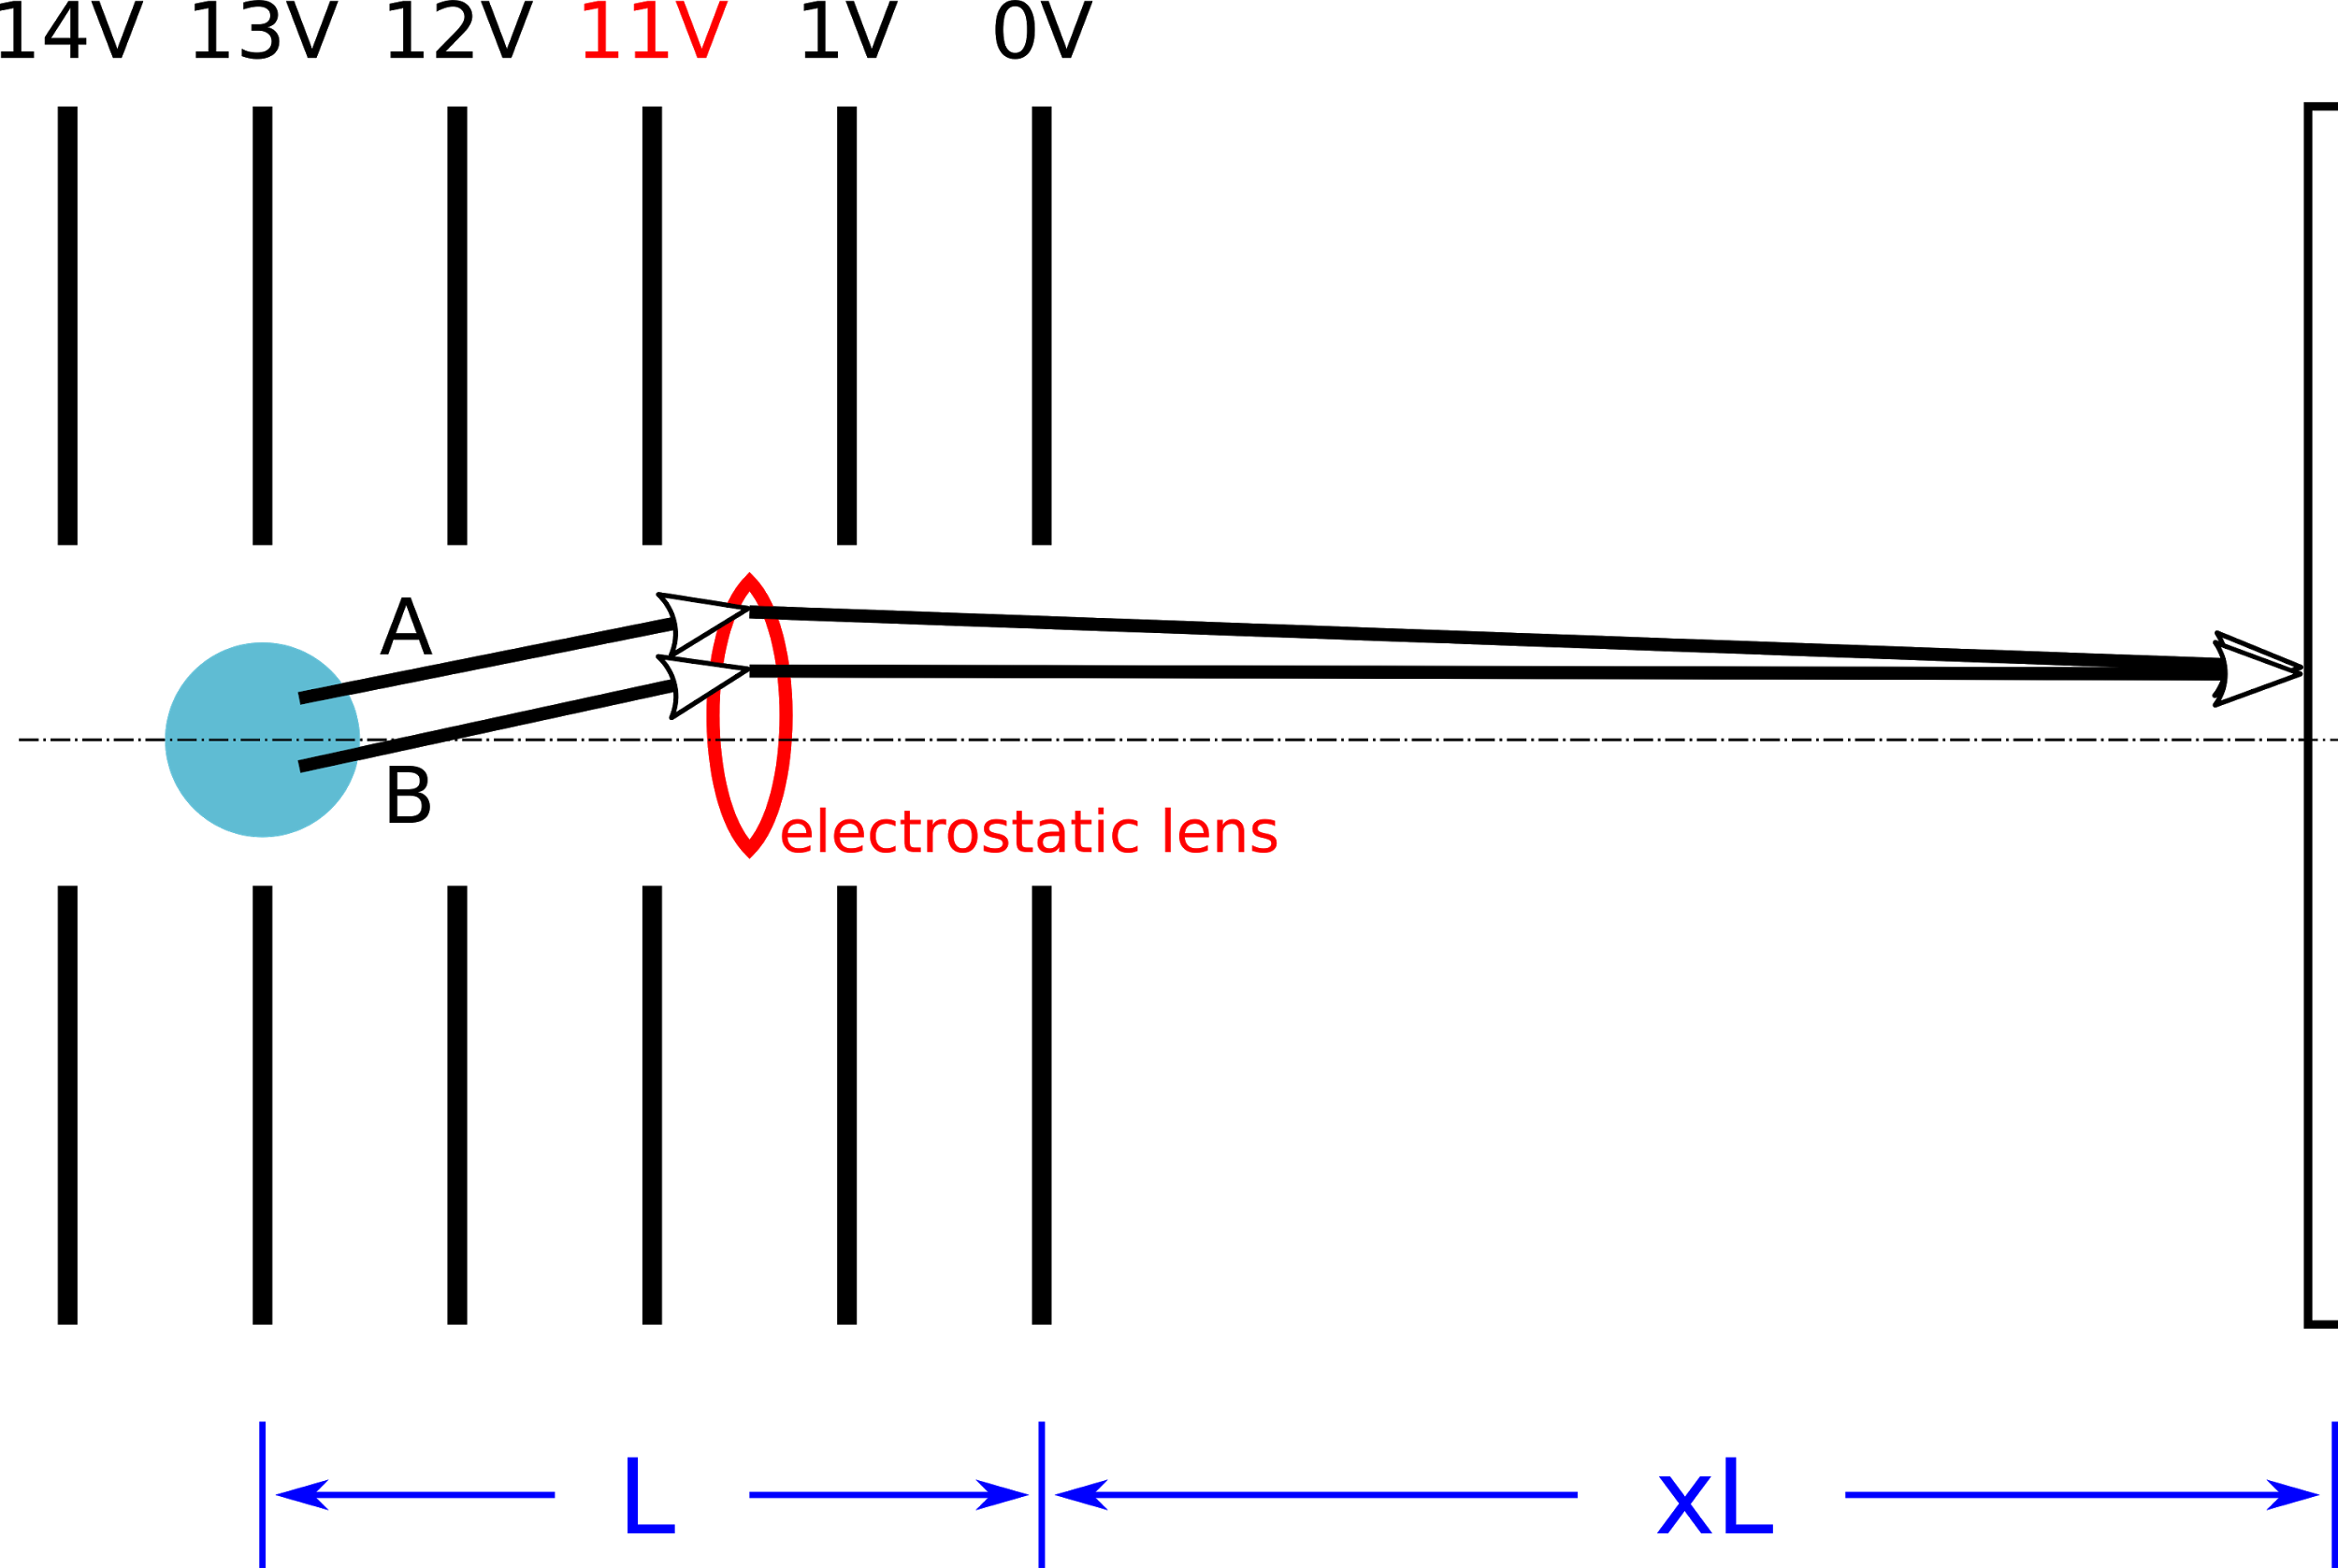
Consider two decays giving the same transverse momentum and TOF:
A and B from different transverse positions in MOT
Focusing gives same transverse position on MCP for A and B: “position focusing”.
Optimization gives values of x and step ΔV that achieve time and position focusing together in realistic model of full spectrometer.
Large step in V makes
“electrostatic lens”
Ion MCP
Zero-field
drift region
MOT

Slide 25
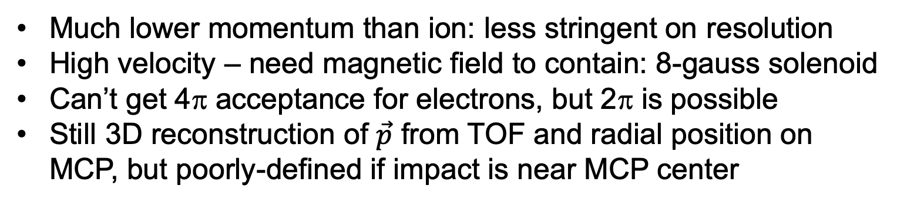
Electron spectrometer
Much lower momentum than ion: less stringent on resolution
High velocity – need magnetic field to contain: 8-gauss solenoid
Can’t get 4π acceptance for electrons, but 2π is possible
Still 3D reconstruction of $\vec{p}$ from TOF and radial position on MCP, but poorly-defined if impact is near MCP center

Slide 26
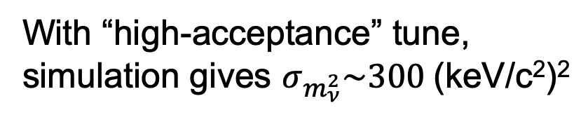
With “high-acceptance” tune, simulation gives $σ_{m_{ν}^{2}}\sim 300$(keV/c²)²

Slide 27
X-ray panels
LYSO scintillator with SiPM sensors and PetSYS DAQ
All off-the-shelf commercial
Initially 4 panels, together covering ~12% of 4π
In re-entrant vacuum boxes to protect UHV
x-ray panel (1 of 4)
LYSO: ~35 photons/keV
τ = 35 ns
KETEK SiPM: PDE ~ 40%
⇒ Estimated resolution:
σ_{t} < 0.8 ns, σ_{xy} < 0.3 mm, σ_{E} ≈ 1-2 keV
⇒ Identify x-rays, then use known energies
LYSO – SiPM tile

Slide 28
1 m
A table-top neutrino experiment! (OK, a large table)

Slide 29
We will accept decays with:
Higher-E x-ray (for better timing resolution)
All Auger electrons with low energies (for containment)
Only 1 or 2 Augers (for sanity)
We initially choose events with:
K-capture (85%)
34.4-keV x-ray from N_{2,3} fill of K vacancy (2.9% of K-captures).
These N-vacancies give:
one 100-120 eV e⁻ (25%) – or –
two 20-70 eV e⁻ (75%)
3) 110 eV Auger
3) 54 eV Auger e⁻ (7 keV/c)
4) 33 eV Auger e⁻ (6 keV/c)
P
P
O
2,3
O
2,3
1
1
N
4,5
N
4,5
2,3
2,3
1
1
M
M
2) 34.43 keV x-ray
2) 34.43 keV x-ray
L
L
K
K
1) K-capture
1) K-capture

Slide 30
Event sequence
x-ray detected ⇒ trigger,
corrected by x-ray TOF to decay time ≡ 0
single-Auger e⁻ detected
double-Auger e⁻’s detected
0 100 200 300 400 500 ns
Xe⁺⁺ detected
Xe⁺ detected
≈
0 10 180 190 200 210 μs

Slide 31

Rates, acceptance, efficiency
Continuously feed ¹³¹Cs to MOT:
10⁸ atoms, τ = 14d ⇒ 80 Hz of decays ⇒ 0.85×80 = 68 Hz of K-captures
Particle | Probability | Geometrical acceptance | Detector efficiency | Reconstruction efficiency | Success fraction
N x-ray | 0.029 | 0.12 | ~1 | 1.0 | 0.0035
Ion | 1.0 | 1.0 | 0.55 | 1.0 | 0.55
Single Auger | 0.25 | 0.28* | 0.7 | 0.62† | 0.25×0.12 + 0.75×0.22² = 0.066
Double Auger (each) | 0.75 | 0.5** | 0.7 | 0.62†
No extra e^{−‡} | 0.55 |  |  |  | 0.55
* 56% of forward hemisphere
** 100% of forward hemisphere
† Loss of hits near MCP center
‡ “Shake-off” from Cs ⟶ Xe atomic physics
$$68 Hz ×0.0035×0.55×0.066×0.55=0.0047 Hz$$
$⟹\sim 150000$events per year of livetime

Slide 32
Backgrounds
Physics backgrounds
Scattering of recoil ions or Auger electrons as they leave the MOT
Mis-ID of a different decay (say a different x-ray or missed Augers)
Radiative K-capture, giving an additional undetected photon
Scattering of ions or Auger electrons from residual gas
Emission of a second photon instead of an Auger electron
Cosmic ray muons
Radioactivity in walls and component materials
Accidental backgrounds
MOT decays with missed particles mimicked by near-coincident decays of escaped ¹³¹Cs atoms on detectors and other surfaces
Electrons knocked from surfaces by near-coincident x-rays from source atoms, mimicking Augers

Slide 33

Background mitigation tactics
Missed monoenergetic particles, mis-id’d decays, ... do NOT give peaks in $m_{ν}^{2}$
Ionization state (Xe⁺, Xe⁺⁺,...) unambiguously measured by TOF
Ionization state must match number of detected Augers
Limited TOF windows for ions and Augers of chosen decay schemes

Slide 34

Background mitigation tactics
Missed monoenergetic particles, mis-id’d decays, ... do NOT give peaks in $m_{ν}^{2}$
Reconstructed energy is exactly correct (not a coincidence...)
$p_{ν}$ is wrong ⇒ wrong reconstructed $m_{ν}^{2}$
But: missing ${\vec{p}}_{γ}$ is isotropic with respect to rest of event
Upshot: broad, continuous spectrum around $m_{ν}^{2}=0.$
3) 110 eV Auger
3) SAME Auger
P
P
O
2,3
O
2,3
1
1
2′) 0.85 keV x-ray (missed)
NOT
THIS:
N
4,5
BUT
THIS:
4,5
N
2,3
2,3
1
1
M
M
L
2) 34.43 keV x-ray
L
2) 33.6 keV x-ray analyzed as 34.43 keV
K
K
1) K-capture
1) K-capture

Slide 35

Primary Backgrounds
¹³¹Cs escape from MOT, straight drift to surfaces
MOT’s are leaky –typical trapping time of 100’s of seconds. Escaped ¹³¹Cs atoms end up on surfaces and decay. Main accidental background:
¹³¹Cs decay in MOT with desired channel
X-ray is missed (coverage only 12%)
Accidental coincidence with x-ray from decay on x-ray panel
X-ray has exactly correct energy, but wrong vector momentum and timing, changing ion and e⁻ TOFs
Mitigated by:
Limited windows for valid TOFs
Periodically clean panels using UV Light Induced Atomic Desorption
Coincident decays from MOT (gives ion and e⁻) and x-ray panel (gives x-ray)

Slide 36


Primary Backgrounds
Dominant physics background: Scattering of ¹³¹Xe ion by induced electric dipole moment of trapped ¹³¹Cs atoms in MOT.
Potential is 1/r⁴ – fun!
Forward peak at small angles: smears zero-mass peak in $m_{ν}^{2}$ spectrum.
At small impact parameter, get Langevin scattering with orbiting behavior, becomes ~isotropic in CM: gives ~flat background in $m_{ν}^{2}$ spectrum.

Slide 37





Simulated discovery spectrum with 40 sterile neutrino events giving a 5σ peak at $m_{ν}=60$ keV/c² with $\sin^{2}{θ=3×{10}^{−4}}$, using the best estimates of backgrounds and a 1-year-livetime data sample.
accidental background
accid + ion-atom scattering
backgrounds + $m_{ν}=60$ keV/c²,
$\sin^{2}{θ=3×{10}^{−4}}$signal
with spectrometer and
reconstruction resolution
HUNTER: $20≲m_{υ}≲300 \text{keV}/c^{2}$
(optimistic) ultimate resolution
Q of ¹³¹Cs decay ~ 320 keV
$m_{υ}≈45$keV/c²

Slide 38


HUNTER Phase 1 is a proof-of-principle, but it has predicted performance that gives sensitivity improved by a factor of 2-50 over existing limits in
$$50≲m_{υ}≲300 \text{keV}/c^{2}$$

Slide 39

If Phase 1 proves its principles, start on upgrades:
Phase 2:
Increase MOT population
Increase x-ray coverage
Increase MCP diameter
Phase 3:
Further increases in MOT population and x-ray coverage
Multiple MCPs improving resolution and e⁻ acceptance
Inclusion of more decay channels

Slide 40
Status:
Vacuum vessel being fabricated by vendor. ETA at UCLA: late May.
Many vacuum components (pumps, gate valves,...) received.
About ready to start fabricating spectrometer parts.
Oven for ¹³¹Cs source built and being tested.
Laser system for main 3D MOT assembled.
Radioprotection protocol certified by UCLA .
Tests of LYSO+KETEK SiPM + PetSYS readout underway.

Slide 41

Not yet finalized:
Re-entrant vessels for vacuum isolation of x-ray panels.
Solenoid system and magnetic shielding (all external).
Overall trigger and DAQ organization.
Plan:
Assemble in summer 2020
Commission MOT with stable Cs
Photoionization studies with stable Cs
Commission with ¹³¹Cs
Photo taken yesterday

Slide 42
Extra

