Slide 1
PMG Agenda
Management Issues including INTT
Project Status
Technical Status including EMCal
Status of contracts
Status of milestones and actual date of accomplishment
Cost information for MIE, I&F, MVTX

Slide 2
Where BNL Management Can Help sPHENIX
We may need help getting the capital account open quickly for the IHCal instrumentation. I’ve submitted all of the paperwork to Kelly Carroll. It involves David Bacon approval, etc. The MVTX accounts took over 1 month to open.
The length of RHIC Run2022 as presented at the Feb Budget Briefing. The sPHENIX project would like this as short as possible while still having a viable physics run.
We have built a 16 week time window for the 2022 RHIC run into the sPHENIX RLS. During this time there is no access to the IR for sPHENIX installation. The project plan assumes IR access after the 16 week lock out period.
The multi-year spreadsheet shown by Susan at the Budget Briefing practice this week showed a 24 week run. That would translate into an extra 8 week delay for sPHENIX installation.
We have two reqs submitted to hire replacements for people that have either retired or left the group: I-5/7 software professional, TW-4 designer
To guarantee meeting the early completion date we are looking at the possibility of bringing on additional labor resources for techs, engineers and designers. Resources from CAD would be great but I expect they will become scarce soon. We’ll look inside the lab first (NSLSII, IO, SMD) and then look at job shoppers or term hires.
We’ll likely have to use MIE contingency to pay but it would be a good trade in order to stay on schedule.
Staring at the end of the spring semester sPHENIX expects to start to get an influx of students for testing and assembly. We are starting to get requests for visitor funds (housing & per diem) for students.
Can we use Ops funds?

Slide 3
Can BNL Management Help with the INTT ?
Overview:
The INTT mechanical engineering design and prototyping is going well. RIKEN + BNL (Rachid Nouicer) are doing a good job with prototyping. RIKEN has paid for time of BNL Mechanical engineers (PO and IO) to complete the mechanical design which is advanced. The sPHENIX OSI has be diligent in integrating the INTT mechanical mounting structure into sPHENIX, there is space set aside for services, racks, etc, and an installation plan exists.
However: The INTT needs a full time DAQ/readout expert or postdoc experienced in detector readout. The INTT readout electronics was designed by LANL 10 years ago and right now it is an orphan.
We are looking for someone with the skill set of Joe Mead, Jack Freed, Ed Desmond, Eric Mannel...
The person is probably needed 75-80% time for 1.5 years and 25-50% time after that.
It is not clear if RIKEN can or will pay, but the sPHENIX MIE can not pay.
The collaboration is looking for volunteers at outside institutions.
Any suggestions on who or how this can be solved?

Slide 4
Project Status
Monthly EVMS process continues on the MIE and I&F. It shows good cost and schedule performance in December.
December SPI and CPI are both close to 1 for MIE and I&F
Estimate Uncertainty and Risks regularly updated. Completed tasks and retired risks are removed from the bottom-up contingency calculation as project progresses.
Partial deliveries for all LLP orders continue to arrive.
Placing PD-3 orders and monitor procurements.
Management is paying close attention to Milestones on Critical Path.
Continue with hires to replace retirements and those that have left the group
Near-term internal reviews
TPC GEM modules and frames Dec 2019
TPC DAM PRR in February 2020

Slide 5
sPHENIX MIE Overview
TPC | Project Director | Last CD Achieved | % Complete | CPI | SPI
$27.0M | Edward O’Brien | PD-2/3 | 36.3% BCWP/BAC @ 12/31/2019 | 0.99 | 1.01
Scope
Detector systems produced, tested and ready for installation: Time Projection Chamber w/ electronics, Electromagnetic Calorimeter w/ electronics, Hadronic Calorimeter w/ electronics, DAQ/Trigger, Minimum Bias Detector, Project Management
Not in scope
SC-Magnet, Bldg/Det Infrastructure, Installation and System Commissioning
Schedule
CD-0 received Sept 2016
CD-1/3A received Aug 2018
PD-2/3 received Sept 2019
Early completion Oct 2021 (14 months float to PD-4)
PD-4 Dec 2022
Cost
$27.0M AY TPC 34.5% contingency on BCWR

Slide 6
sPHENIX Technical Accomplishments
LLP-1 order: 93% of SiPMs arrived at Univ. of Michigan. LLP-2 order: 38% of scintillating fibers have arrived at UIUC. LLP-3 order: 25% of scintillating tiles have arrived at GSU (additional 15% ready to ship from vendor). LLP-4 order: 50% of tungsten powder at UIUC (funds being transferred to SBU to buy 2nd half of order)
SAMPA v5 (TPC ASIC) engineering run has produced wafers. Four wafers diced and being packaged. Testing at USP in Feb.
Two first article TPC DAM boards (FELIX) being assembled and ready for testing Jan 31. If tested good, 8 additional preproduction DAM boards will be assembled.
Tests of the TPC laser calibration system underway
HV test of TPC Inner field cage prototype at SBU w/I two weeks
EMCal preproduction Sector 0 complete (will not be installed). Using Sector 0 for small design tweeks to cooling manifold.
EMCal Sector 1 assembly has started at BNL(will be installed). Sector 2-12 block fab continues at UIUC.
1st OHCal sector fully instrumented and reading out cosmic-ray events. 6/32 OHCal sectors instrumented with scintillating tiles.
MBD Prototype Discriminator/Shaper Board completed at Nevis Labs. It meets timing performance criteria. However intrinsic calibration features need to be added to the board design. At BNL for further testing.
R&D work progressing on all sPHENIX detector components.

Slide 7
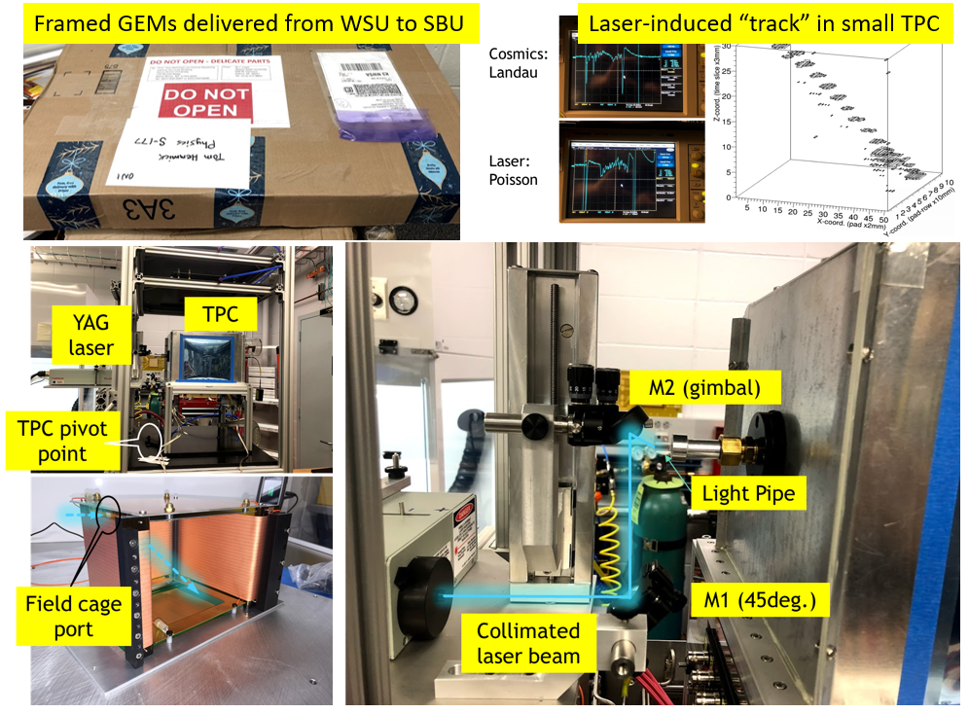
TPC Progress
Framed GEMs arriving at SBU from WSU
Results from laser excitation of the gas in the small prototype TPC at BNL
Laser equipment used in BNL/TPC testing facility
Various components of the TPC laser-test set-up

Slide 8
EMCal Block Production at UIUC
Block production and fiber filling at UIUC
UIUC (96 blocks/sector)
Block production at for Sectors 1 -12 is on or close to schedule. As of the end of December:
282 blocks produced
200 blocks tested
144 blocks shipped to BNL
Fiber filling for Sectors 13-64 is ahead of schedule.
Block production is on schedule
Sufficient supply of tungsten powder to build blocks for sectors 1 – 38 received at UIUC Balance of tungsten powder to be ordered by UIUC Feb/March 2020

Slide 9
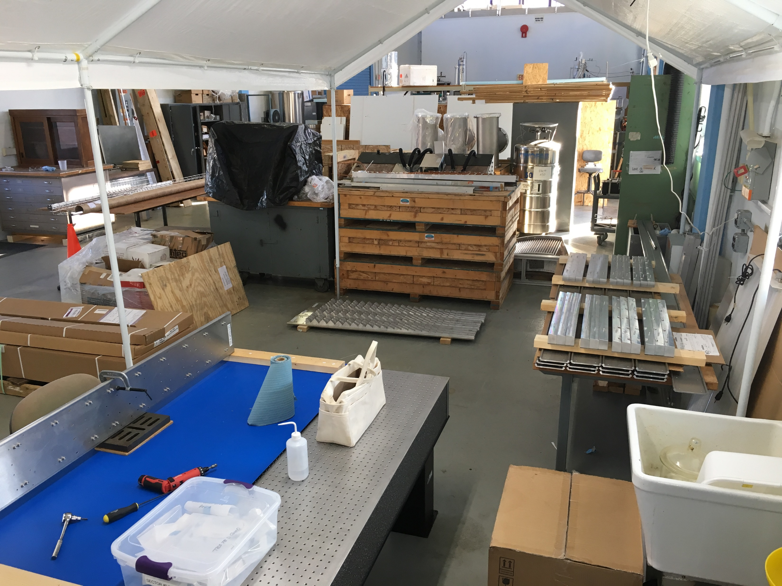
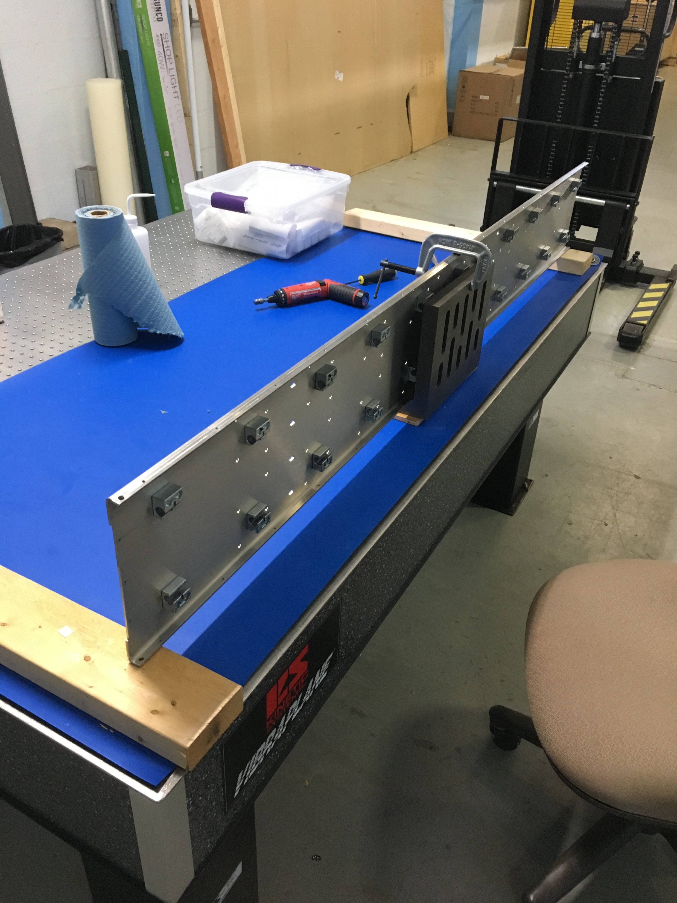
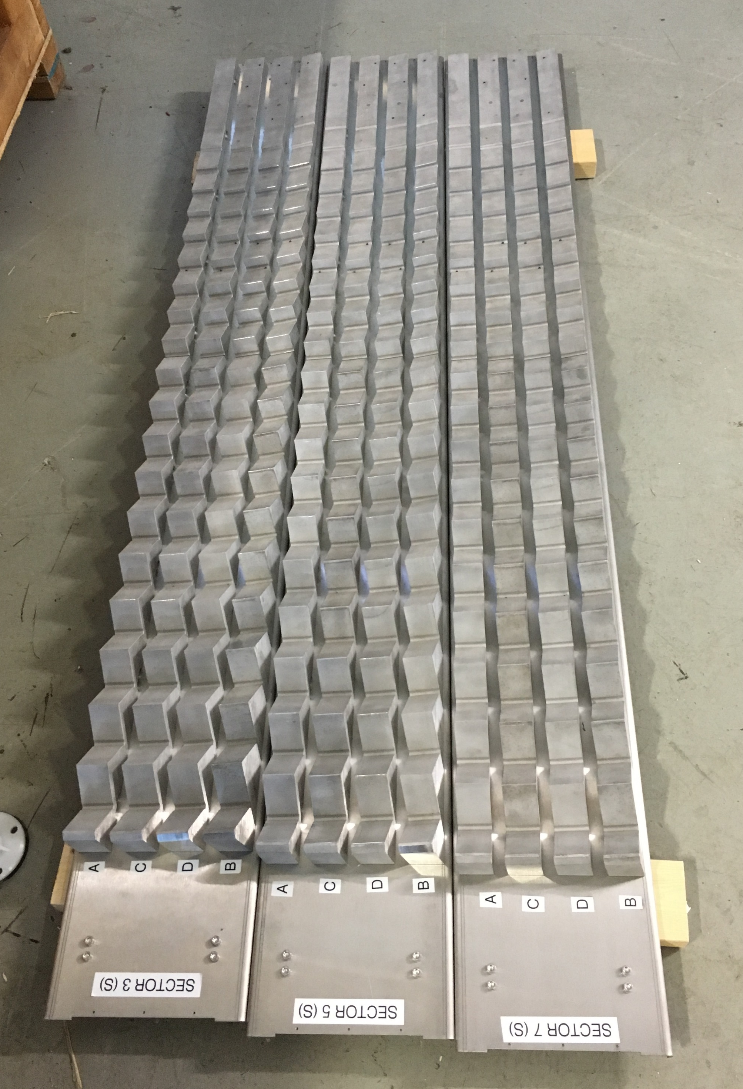
EMCal Sectors 1-12 Assembly at BNL
BNL Mechanical assembly area
South sawteeth/strongback assemblies (enough for 6 sectors)
North sawteeth being produced in SBU shops

Slide 10
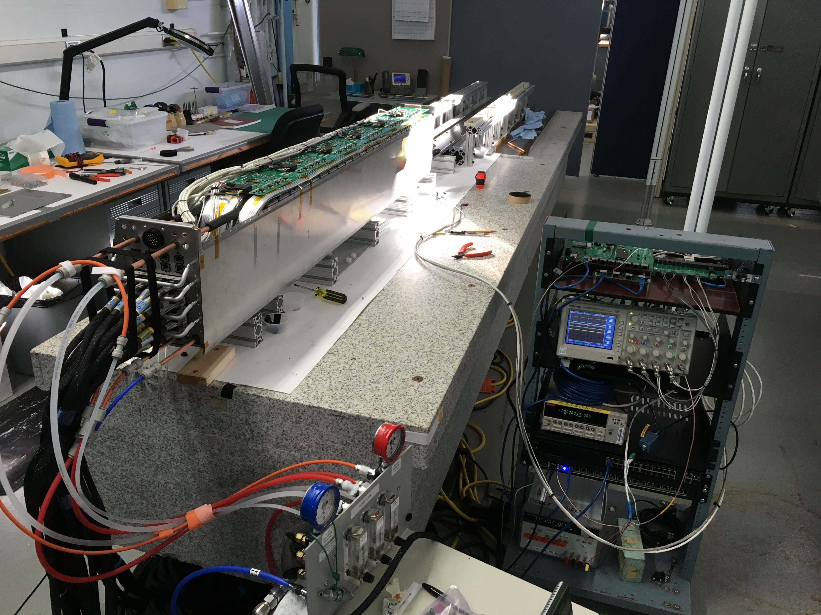
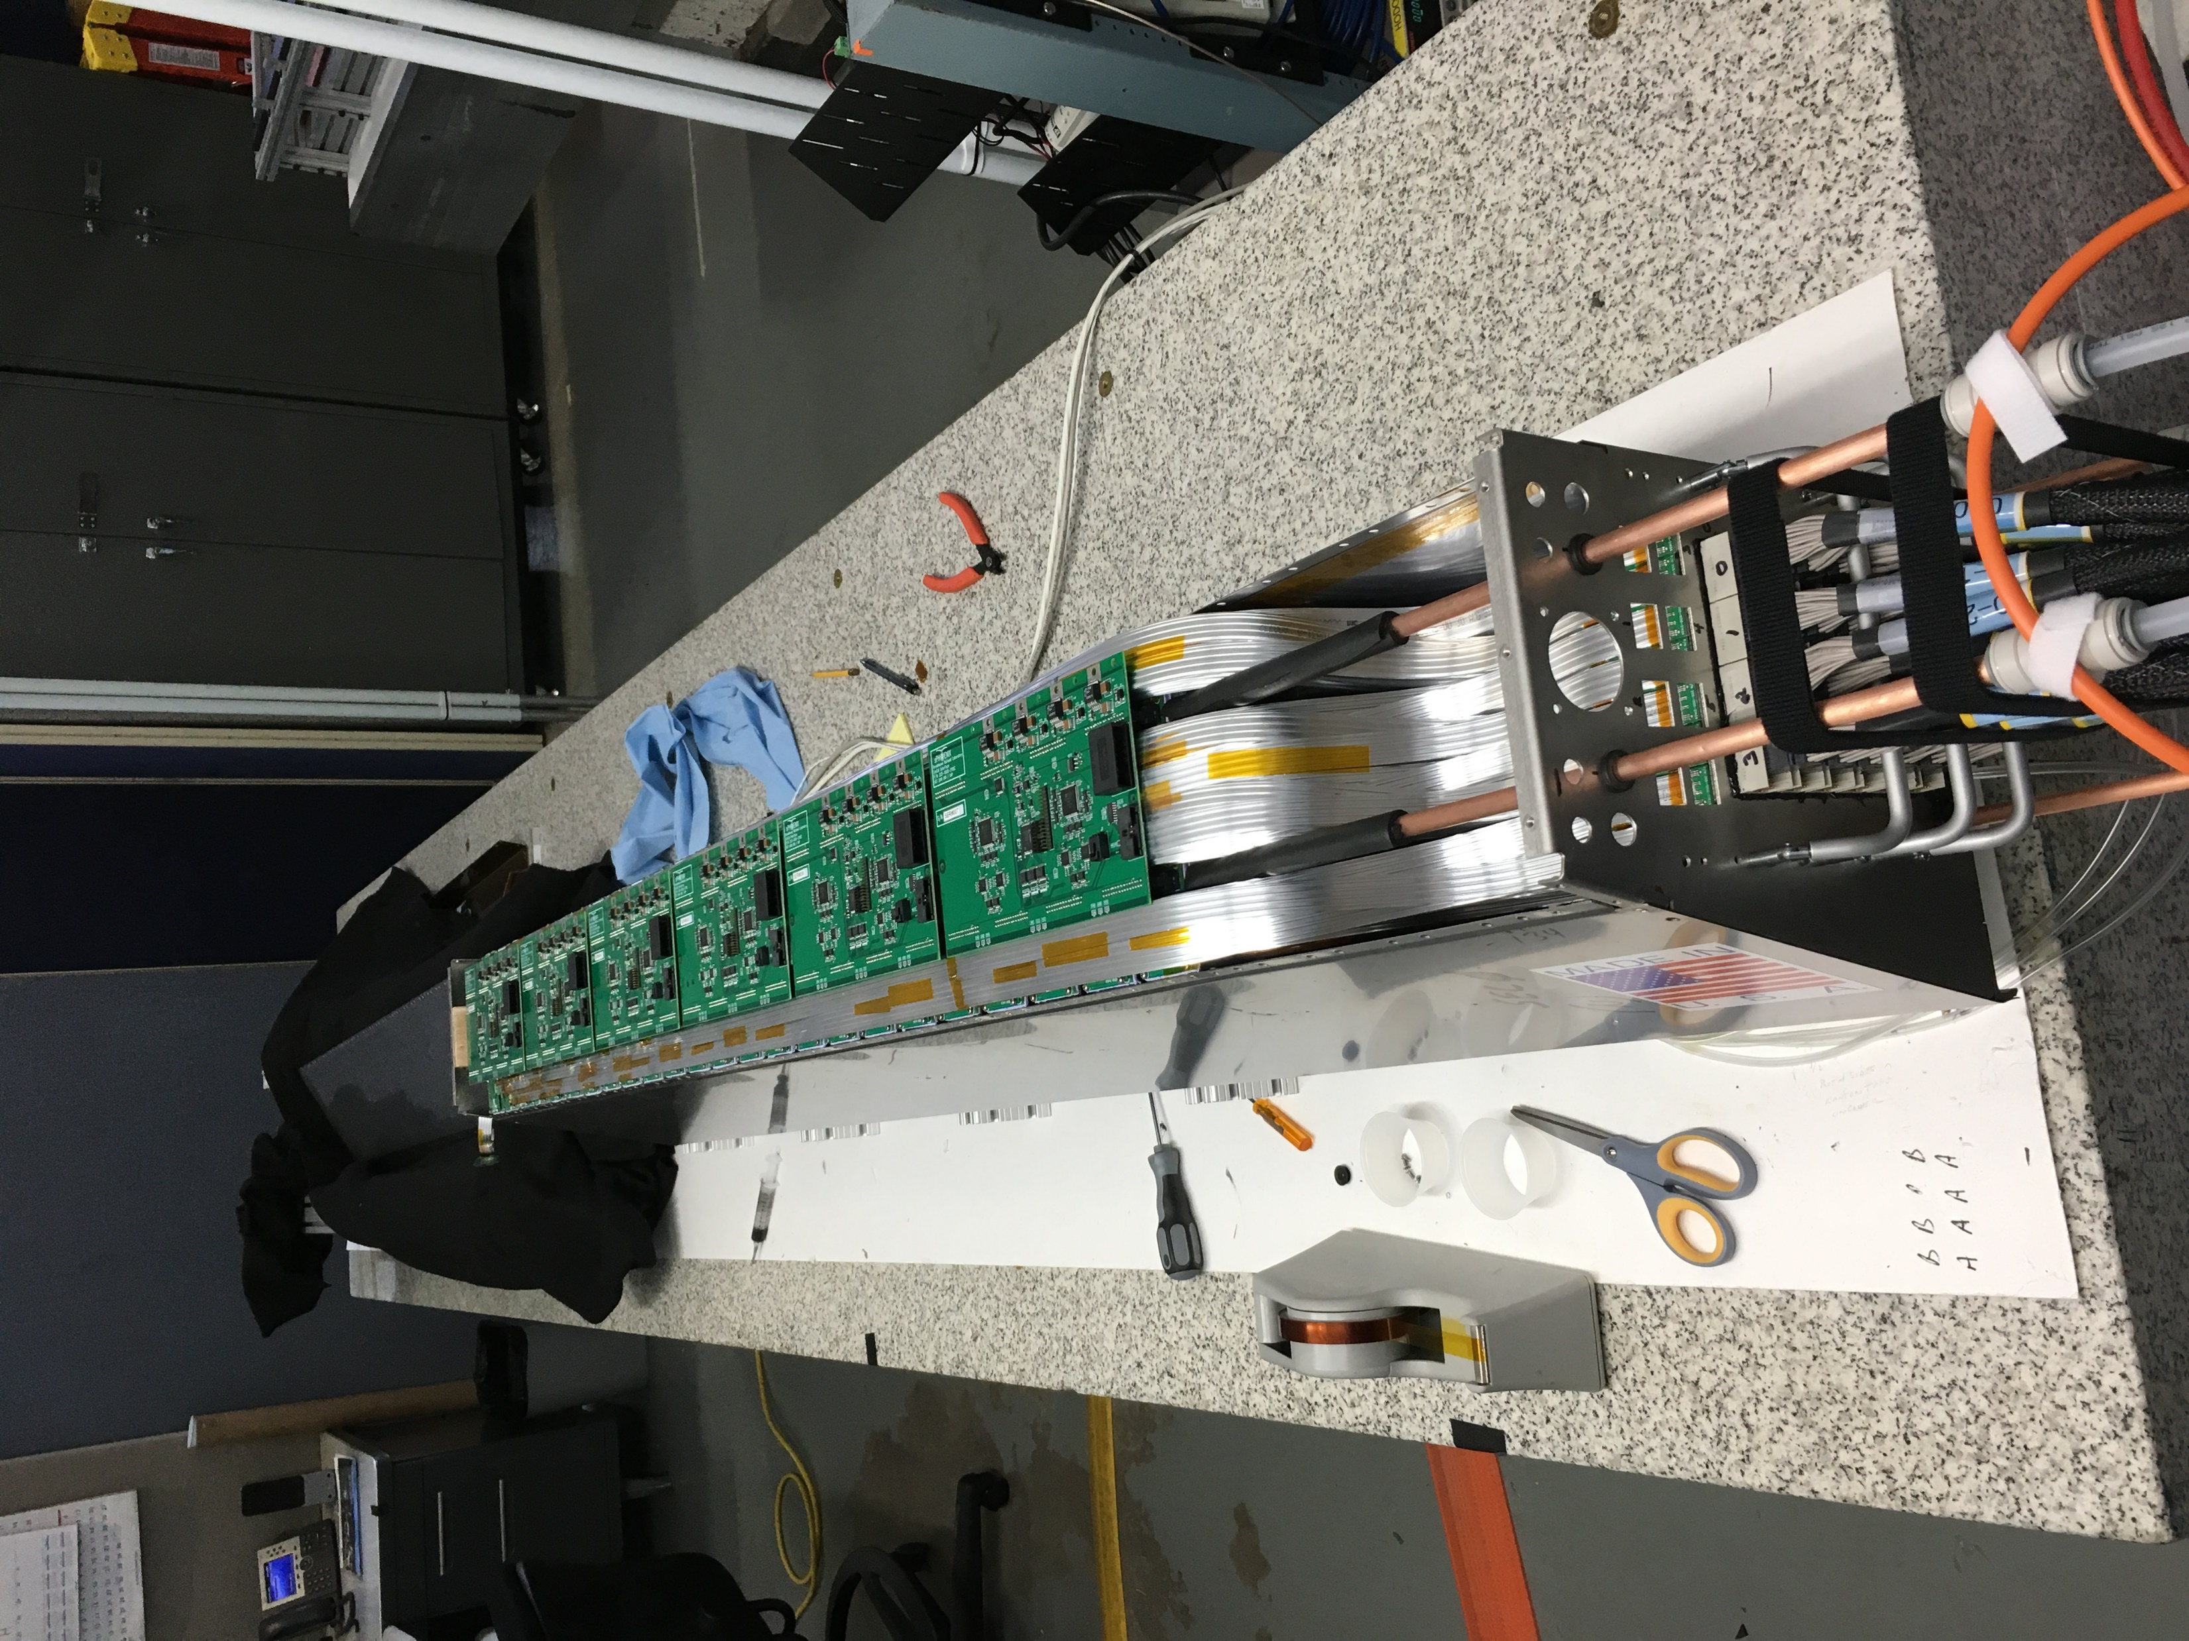
EMCal Sector Testing
Sector 0 Update
Sector 0 reassembled with new cables, cooling, and insulation – installing / checking electronics.
Checked LED/ TestPulse/ thermocouple readouts during installation – signals were present 100%. 1 bad thermocouple readout.
Assembly is very labor intensive. It needs to be streamlined to meet the sector assembly schedule.

Slide 11
sPHENIX Procurement Priorities
Orders pending in PPM
2nd half of W powder (awarded pending paperwork from UIUC)
Carriage/Cradle
UIUC FY20 University contract
MVTX contract with LANL
Orders getting approval in the Physics Department
EMCal production light guides
Orders with documents being prepared
EMCal SiPM daughter cards (sectors 2-12)
MVTX contracts with MIT, LBNL and UT-A
iHCal scintillating tiles
HCal Splice plates and high strength steel HCal sector end plates
EMCal external cables
TPC production FELIX (DAM) cards
EMCal Production electronics
iHCal Frame
HCal production electronics
Production DAQ/Trigger Boards

Slide 12
FY20 Milestones Status
WBS | Milestone Name | Target Milestone Date | Forecast | Actual Finish | Variance (in work days)
1.01.01 | Approve Project Baseline and Construction PD2/3 | 30-Sep-19 | 20-Sep-19 A | 20-Sep-19 | 6
1.02.02.02 | Production Readiness Review - TPC Module Factories | 31-Dec-19 | 2-Dec-19 | 17-Dec-19 | 19
1.03.02.03.02 | EMCal Preproduction Sector 0 Assembled | 31-Dec-19 | 25-Nov-19 A | 25-Nov-19 | 23
1.02.06.02 | Production Readiness Review - TPC DAM | 28-Feb-20
1.05.02.03 | HCal Preproduction FEE Complete | 30-Apr-20
1.05.02.01 | EMCal Electronics Preproduction Complete | 29-May-20
1.03.01.03.01 | EMCal W Powder Acquisition Complete | 30-Jun-20
1.03.02.03.03 | EMCal Prod Readiness Review Blocks/Modules/Sectors Complete | 31-Jul-20
1.02.05.03 | SAMPA ASIC Performance Accepted | 30-Sep-20

Slide 13
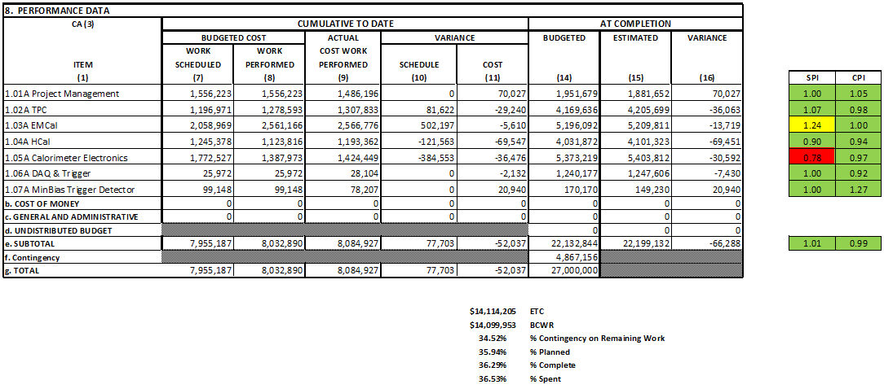
Cost Performance Report (CPR) – sPHENIX MIE. Dec 2019
DOE SPI or CPI Value Thresholds
0.90 to 1.15
0.85 to 0.89 or 1.16 to 1.25
<0.85 or >1.25

Slide 14
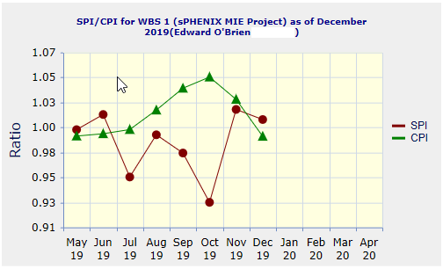
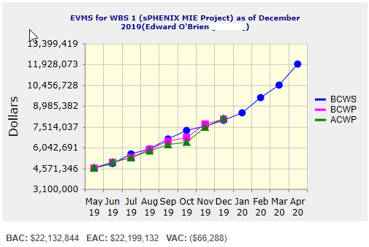
Performance Indices – sPHENIX MIE
Cumulative SPI | Cumulative CPI
1.01 | 0.99
Cumulative BCWS (Scheduled) | $7,955,187
Cumulative BCWP (Performed) | $8,032,890
Cumulative ACWP (Actual) | $8,084,927
DOE SPI or CPI Value Thresholds
0.90 to 1.15
0.85 to 0.89 or 1.16 to 1.25
<0.85 or >1.25

Slide 15
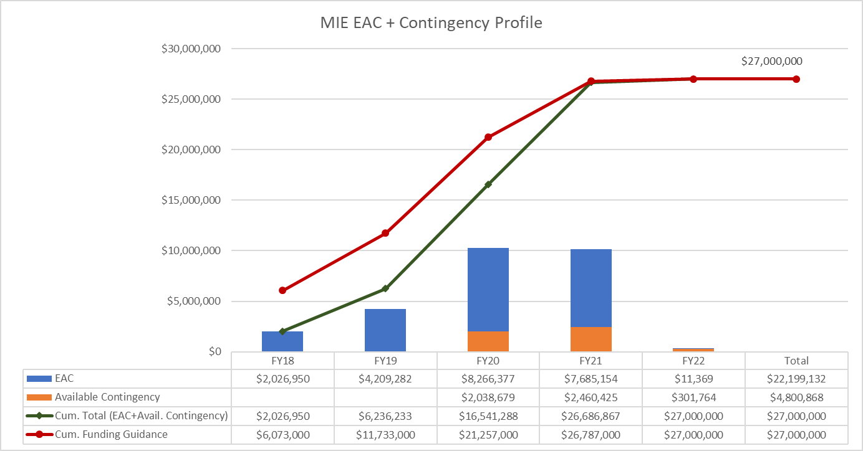
EAC and Contingency Profile – sPHENIX MIE

Slide 16
Baseline/Contingency Log - MIE

Slide 17
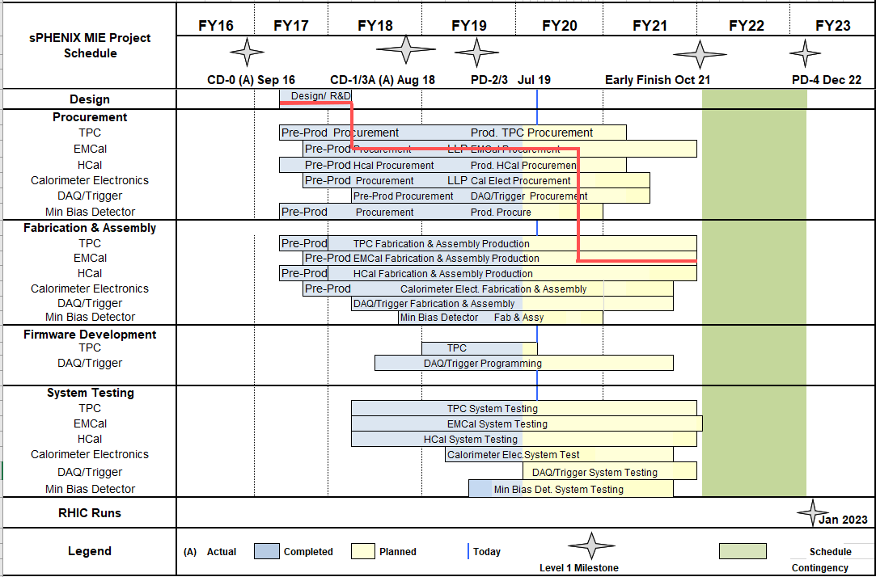
MIE Schedule w/ Critical Path

Slide 18
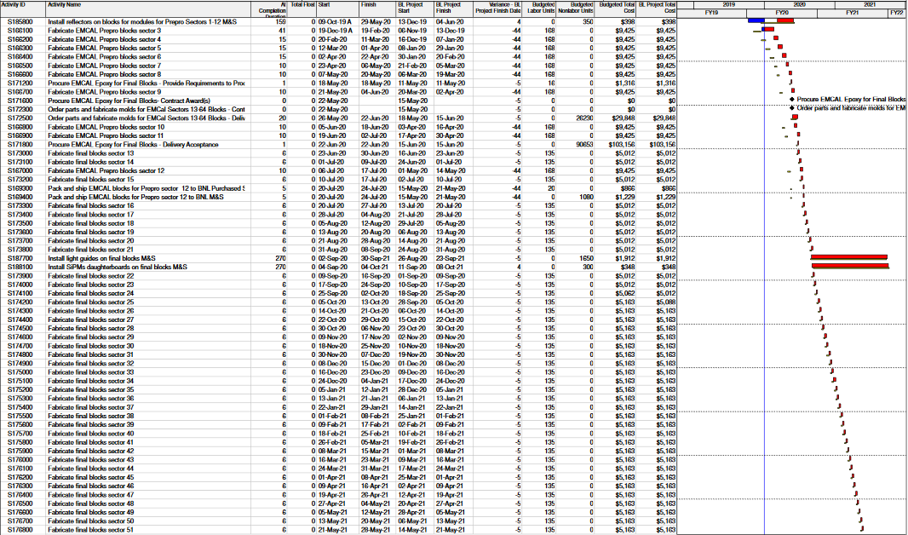
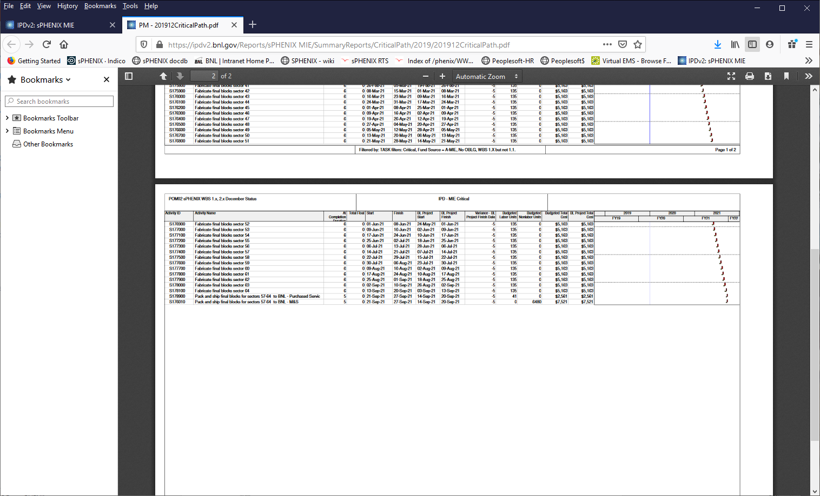
Task-based MIE Critical Path
Critical path goes through
EMCal fabrication

Slide 19
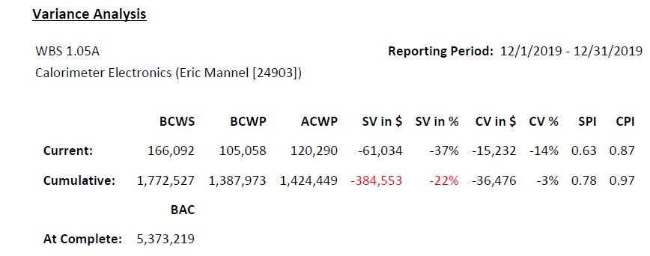
Variance Report WBS 1.05
Explanation
WBS 1.5.1 SiPMs - The eleventh batch of SiPMs was not delivered. This causes -$70K of SV.
WBS 1.5.2 Calorimeter Electronics - SiPM Daughtercards - The SiPM daughtercards for EMCal sectors 1-12 are not complete. This leads to -$27K of SV.
WBS 1.5.2 Calorimeter Electronics - EMCal Internal Signal Cables - The Internal signal/test/Comm/LV/Bias cables for EMCal sectors 1-12 have not all arrived. This leads to -$72K SV.
WBS 1.5.2 Calorimeter Electronics - EMCal External Signal Cables - The External LV/Bias/Signal/Comm/Test cables for EMCal sectors 1-12 have not all arrived This leads to -$60K of SV.
WBS 1.5.2 Calorimeter Electronics - EMCal LV - The Low Voltage power systems for EMCal sectors 1-12 have not all arrived. This leads to -$16K SV.
WBS 1.5.3 Calorimeter Digitizer System - The boards for the 7-crate preproduction prototype set of Calorimeter Digitizers have not arrived from the vendor, and thus have not been assembled by the assembly vendor, leading to -$134K of SV.

Slide 20
Variance Report - continued
Impact
WBS 1.5.1 SiPMs - None. The batches of SiPMs needed for the critical path of the MIE were the first 5, which are all in hand since July 2019, tested, and prepared for mounting on the SiPM Daughtercards.
WBS 1.5.2 Calorimeter Electronics - SiPM Daughtercards- The SiPM daughtercards are 10 days from the critical path. SiPM daughtercards are needed for installation on EMCal Sector 1 (the first of the twelve preproduction EMCal sectors) by mid-January 2020.
WBS 1.5.2 Calorimeter Electronics - EMCal Internal Signal Cables - The first of the twelve sets of these cables are needed by late February for installation into EMCal sector 1. Some 10 days float relative to the critical path remain as of early January. These cables are internal to a sector and must be installed prior to closing and testing a sector.
WBS 1.5.2 Calorimeter Electronics - EMCal External Signal Cables - None. These cables are planned to be ordered with the rest of the EMCal sector 1-12 equipment, as noted, but are not needed for installation until late 2021. Adequate cables sets exist at BNL to allow testing of all production EMCal sectors, as these cables are external to the sector's mechanical structure and thus can be re-used with any EMCal sector.
WBS 1.5.2 Calorimeter Electronics - EMCal LV - None. Existing LV supplies will be used to test all production EMCal sectors.
WBS 1.5.3 Calorimeter Digitizer System- The boards cannot be assembled for the 7-crate pre-production prototype of the calorimeter digitizers until the boards arrive. This does not affect other MIE work, because an adequate number of prototype calorimeter digitizers are at BNL and meet all specifications, and thus are in use to support all calorimeter detector production and testing. There are some 130 days of float in the Calorimeter Digitizer effort relative to the MIE critical path.
Corrective Action
WBS 1.5.1 SiPMs - None. The 11th batch was delivered by the vendor in January.
WBS 1.5.2 Calorimeter Electronics - SiPM Daughtercards- The initial order with the assembly house for the SiPM daughtercards is placed. First items will be tested during January 2020 in time for the above-mentioned installation on EMCal Sector 1 on schedule. Past experience with this vendor suggests acceptance yield will be better than 95%.
WBS 1.5.2 Calorimeter Electronics - EMCal Internal Signal Cables- The needed parts and cables are ordered and starting to arrive. Delivery time is 8 weeks, placing the arrival in mid-January 2020, about 6 weeks prior to the planned installation date in Sector 1 and thus allowing adequate time for testing of these cables.
WBS 1.5.2 Calorimeter Electronics - EMCal External Signal Cables- The required parts are ordered. The assembly will be done by internal BNL technician labor over the next 4 months, completing these activities.
WBS 1.5.2 Calorimeter Electronics - EMCal LV - The LV power supplies have been ordered.
WBS 1.5.3 Calorimeter Digitizer System - Continue to work with vendors to have the boards delivered, so that the boards may be assembled.

Slide 21
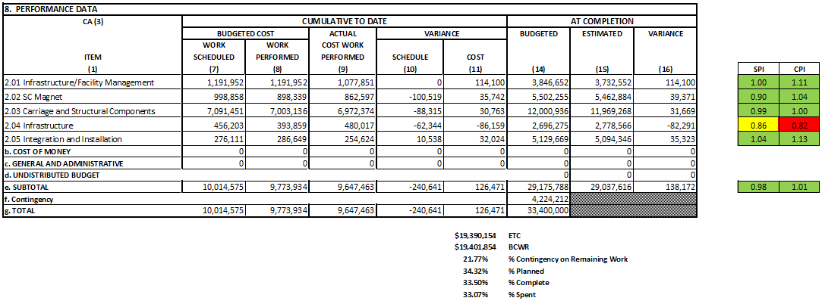
Cost Performance Report (CPR) – 1008 Infra and Facility Upgrade
Based on proposed Baseline
DOE SPI or CPI Value Thresholds
0.90 to 1.15
0.85 to 0.89 or 1.16 to 1.25
<0.85 or >1.25

Slide 22
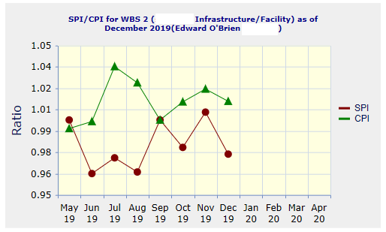
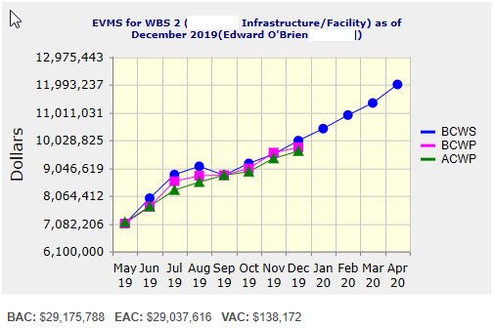
Performance Indices – 1008 Infra and Facility Upgrade
Based on proposed Baseline
Cumulative SPI | Cumulative CPI
0.98 | 1.01
Cumulative BCWS (Scheduled) | $10,014,575
Cumulative BCWP (Performed) | $9,773,934
Cumulative ACWP (Actual) | $9,647,463
DOE SPI or CPI Value Thresholds
0.90 to 1.15
0.85 to 0.89 or 1.16 to 1.25
<0.85 or >1.25

Slide 23
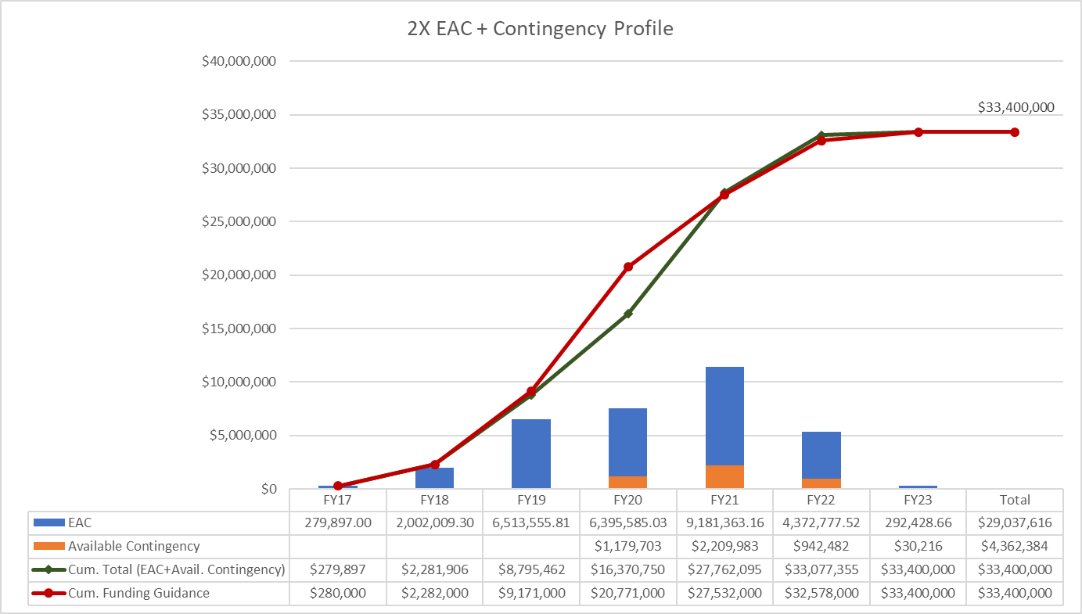
EAC and Contingency Profile – 1008 Infra and Facility Upgrade
Based on proposed Baseline

Slide 24
Baseline/Contingency Log - 1008 Infra and Facility Upgrade
Based on proposed Baseline

Slide 25
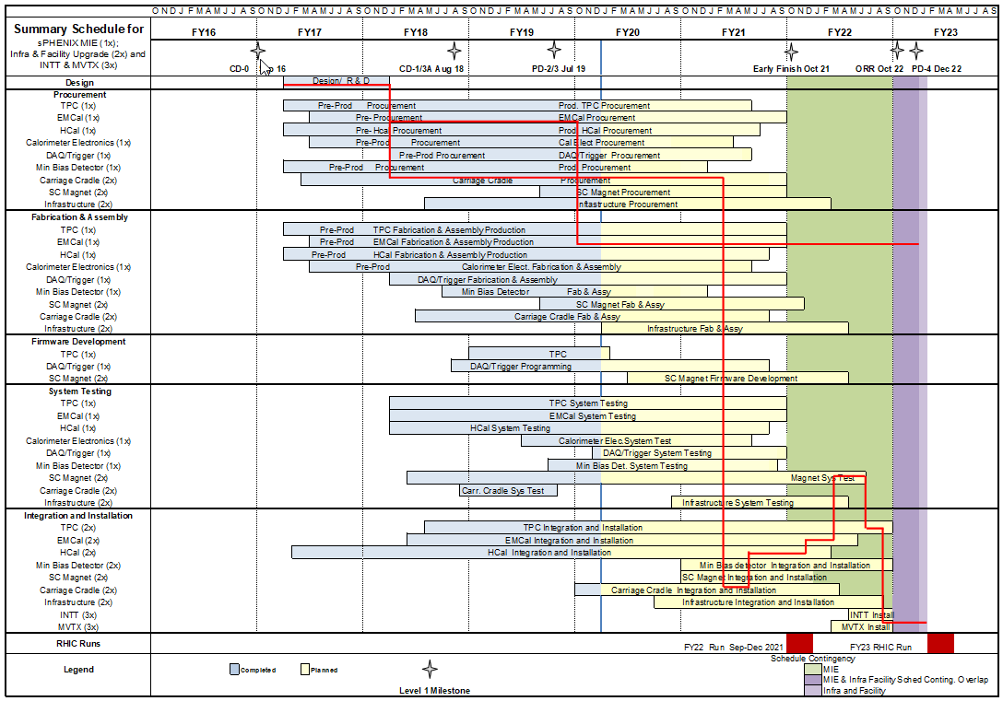
Summary Schedule – sPHENIX MIE and 1008 Infra and Facility Upgrade

Slide 26
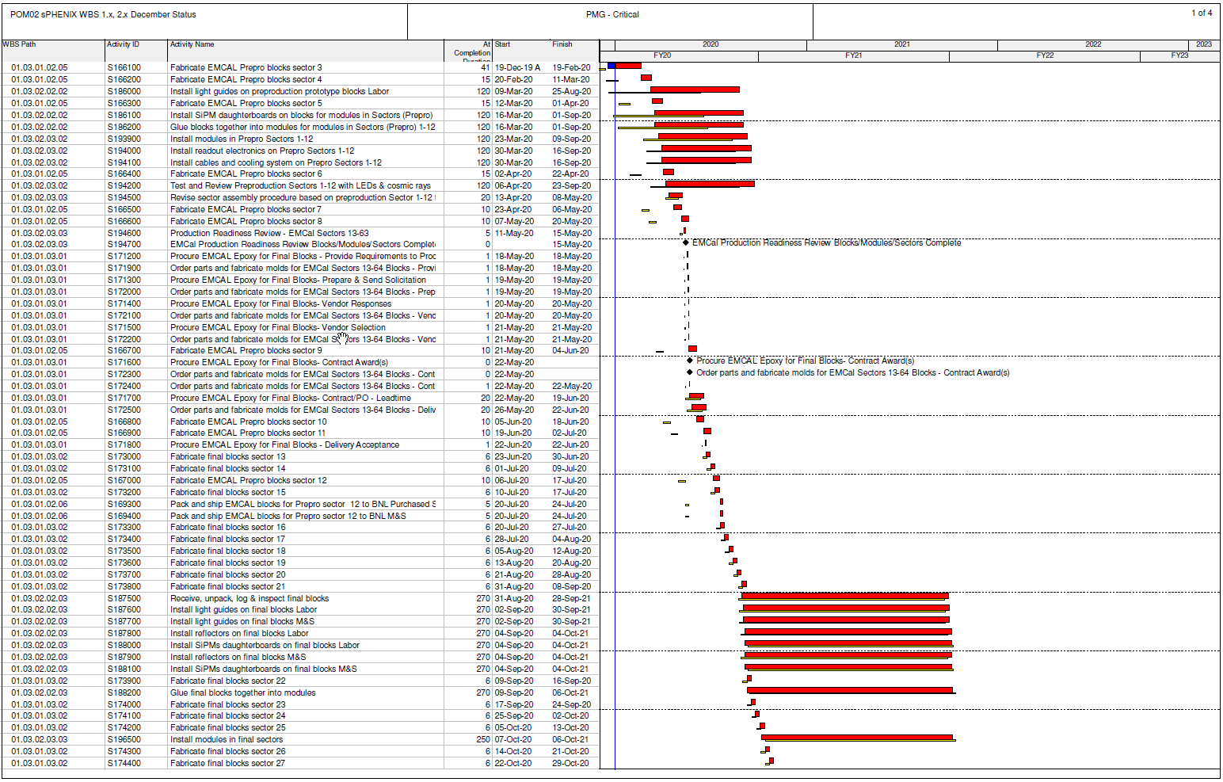
Task-based Critical Path (1x, 2x and 3x Combined)

Slide 27
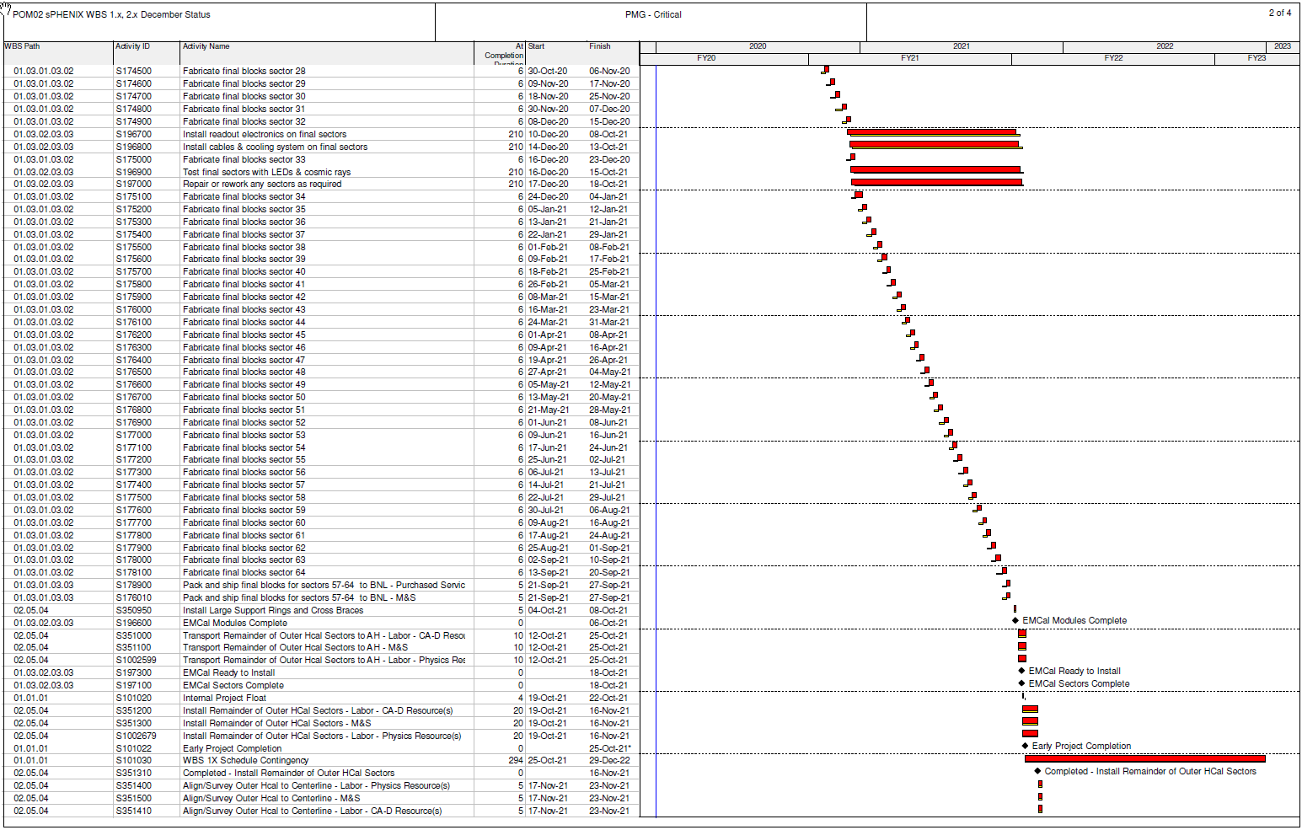
Task-based Critical Path (1x, 2x and 3x Combined)

Slide 28
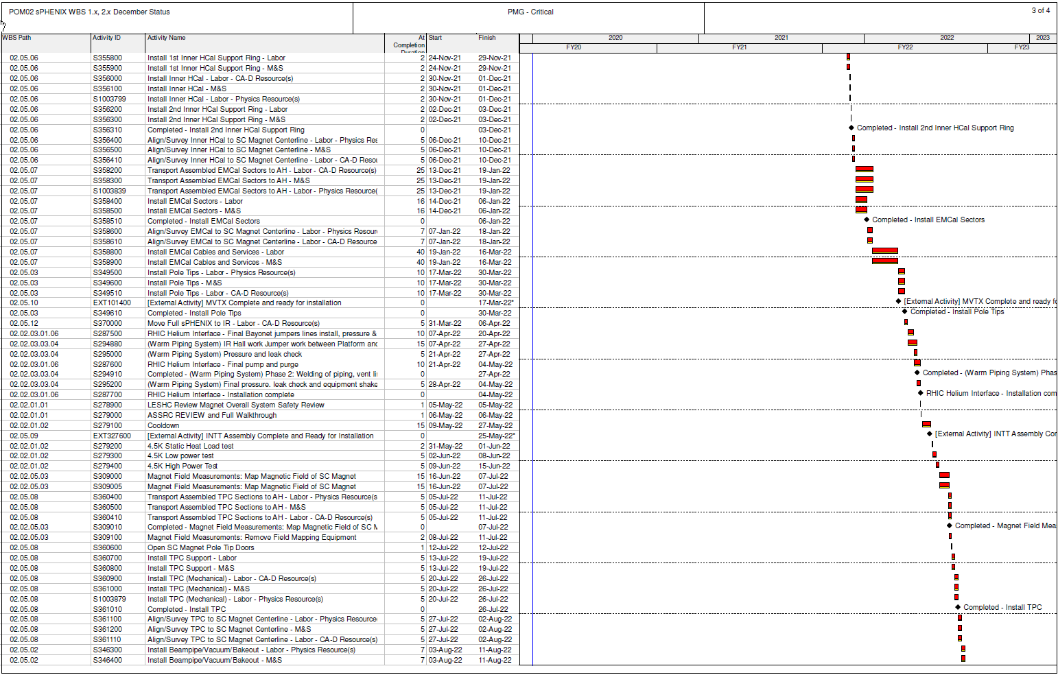
Task-based Critical Path (1x, 2x and 3x Combined)

Slide 29
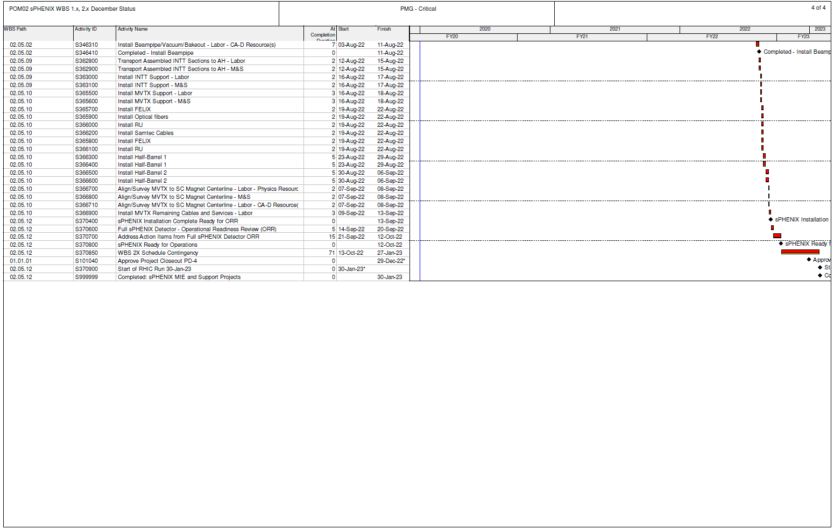
Task-based Critical Path (1x, 2x and 3x Combined)

Slide 30
Summary
sPHENIX MIE and 1008 I&F continue to have good cost and schedule performance at summary level as measured by EV. Project End Date and Critical path remain unchanged.
We are working to correct the low SPI performance of the Calorimeter electronics.
First sPHENIX production detector component, Sector 1 OHCal is complete and taking cosmic ray data. EMCal Sector 1 is being assembled.
CD-3A components continue to arrive. Orders for PD-3 components are being placed.
R&D and engineering design continues to advance.

Slide 31
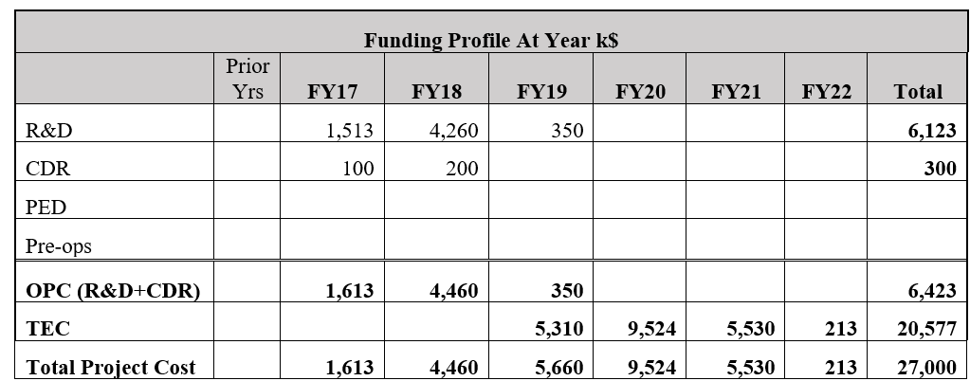
sPHENIX MIE Funding Profile

Slide 32
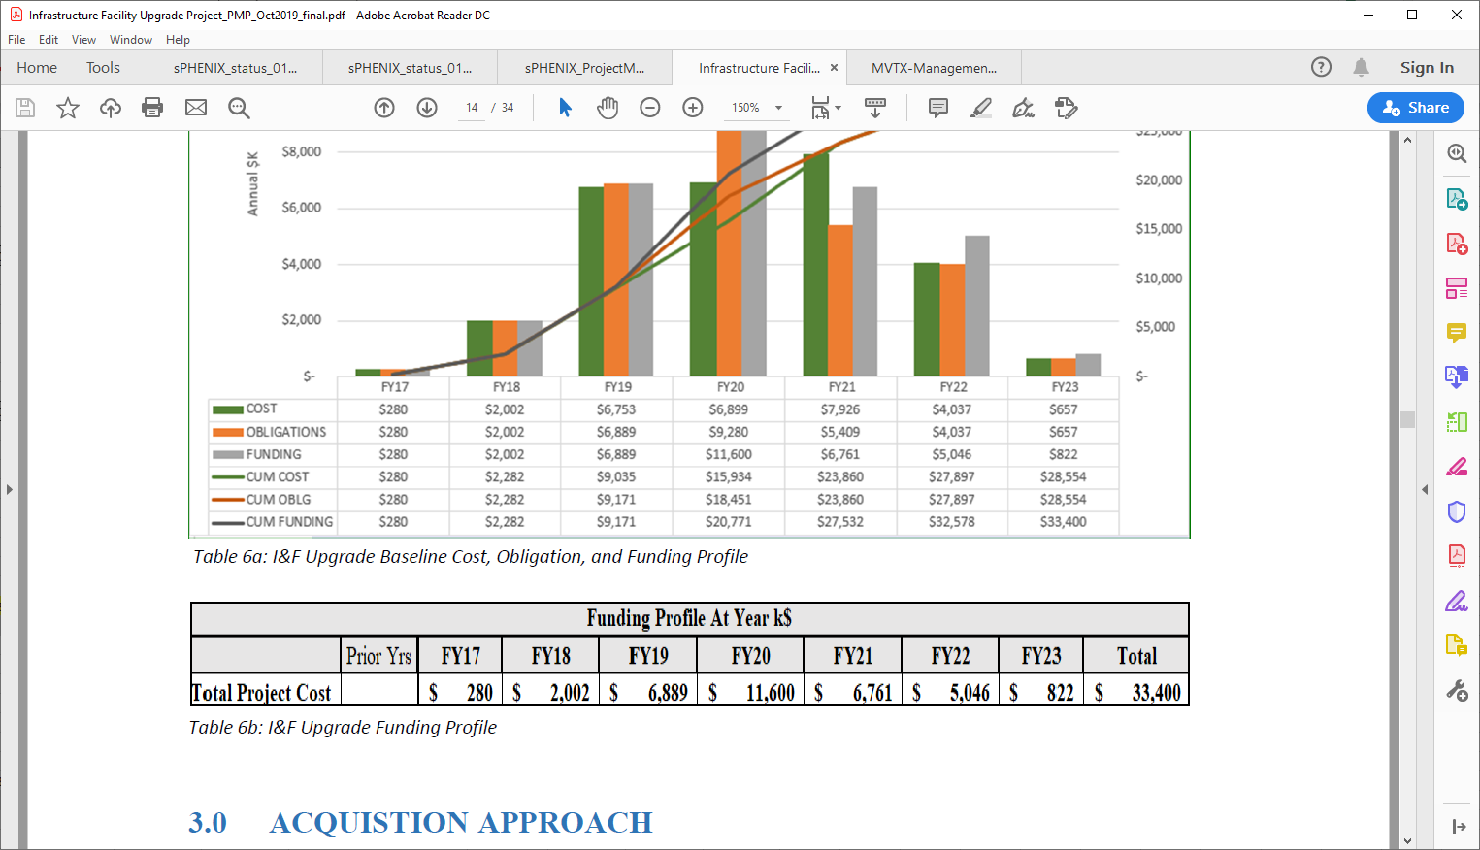
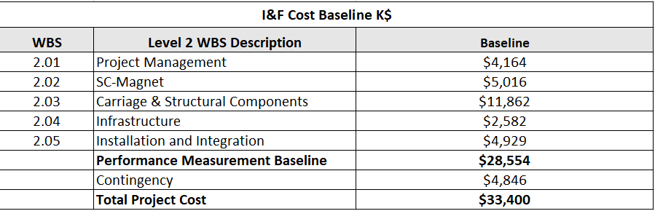
1008 I&F Funding Profile
I&F Funding Breakdown by Level 2

Slide 33
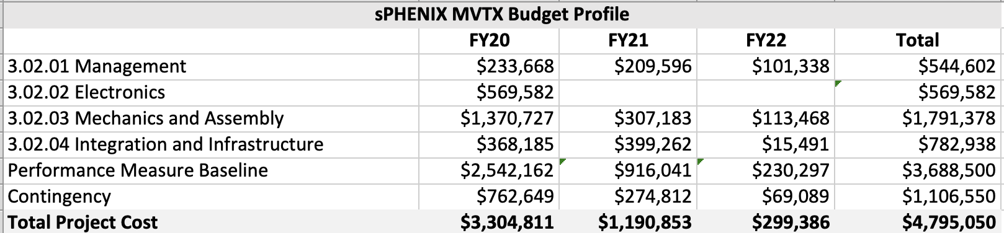
MVTX Funding Profile
MVTX PMP was approved by BNL Jan 10
No expenditures yet
The LANL contract is submitted to PPM for approval
Documentation for the MIT and LBNL contracts are being worked on prior to submitting to PPM.

