Slide 1
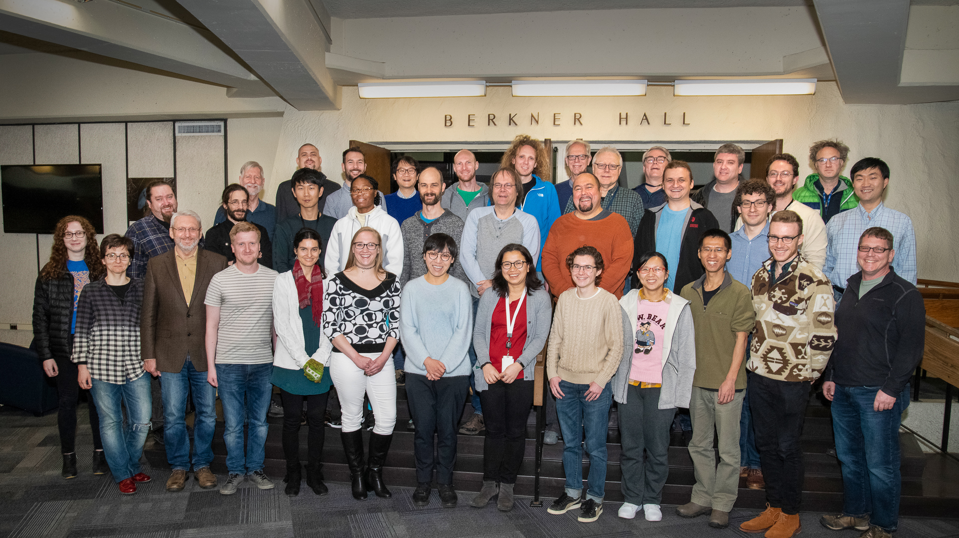
sPHENIX Software Mega-workfest
sPHENIX Software Mega-workfest

Slide 2
Track 1: Tracking

Slide 3
Track 2: Calorimeter

Slide 4
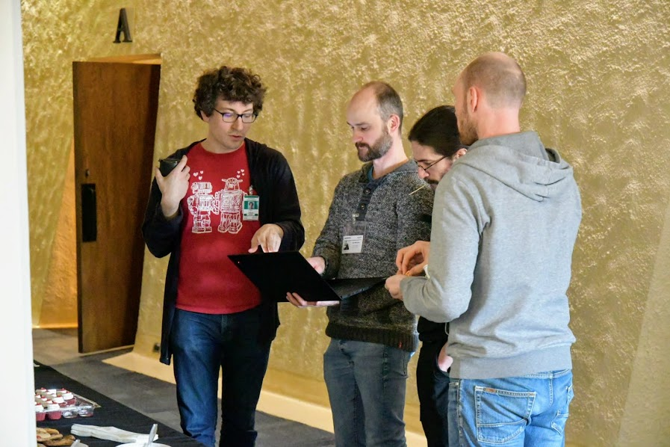

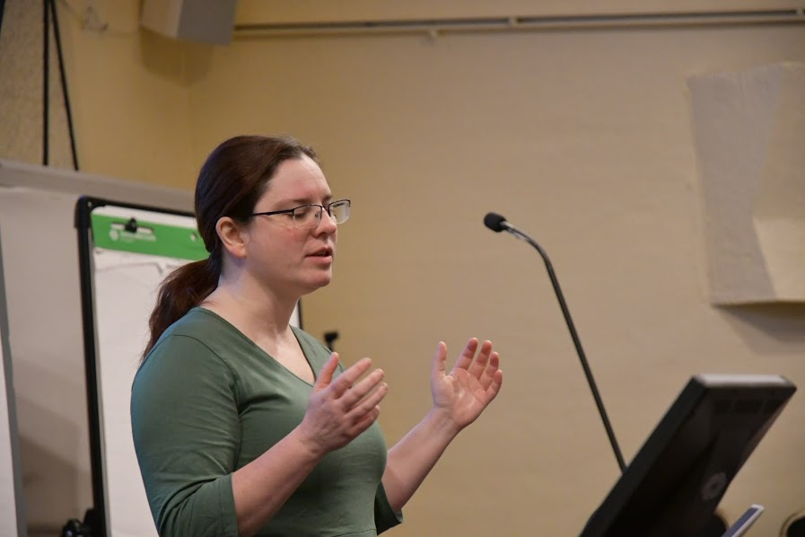
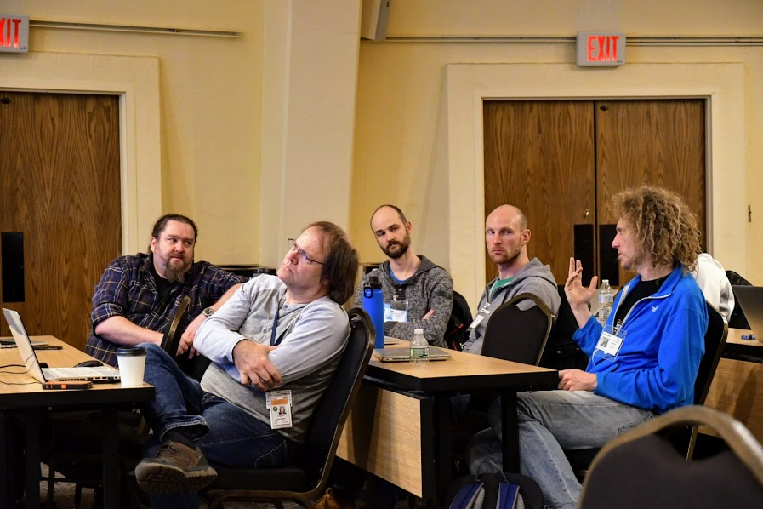


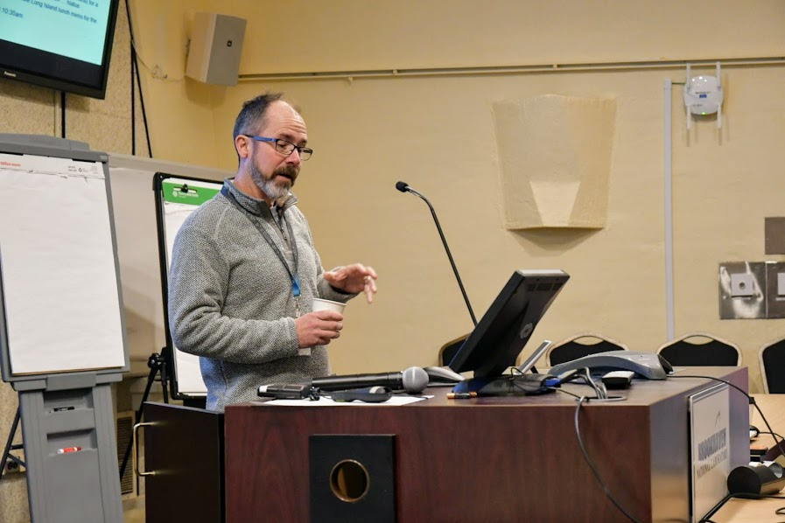


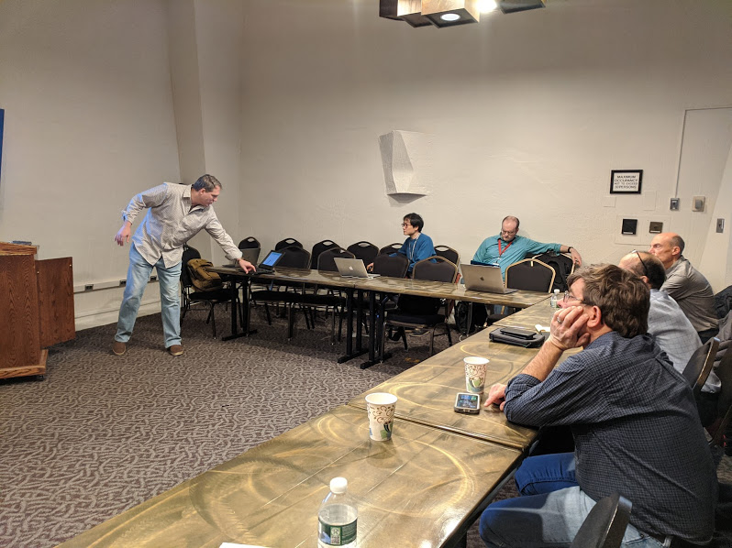
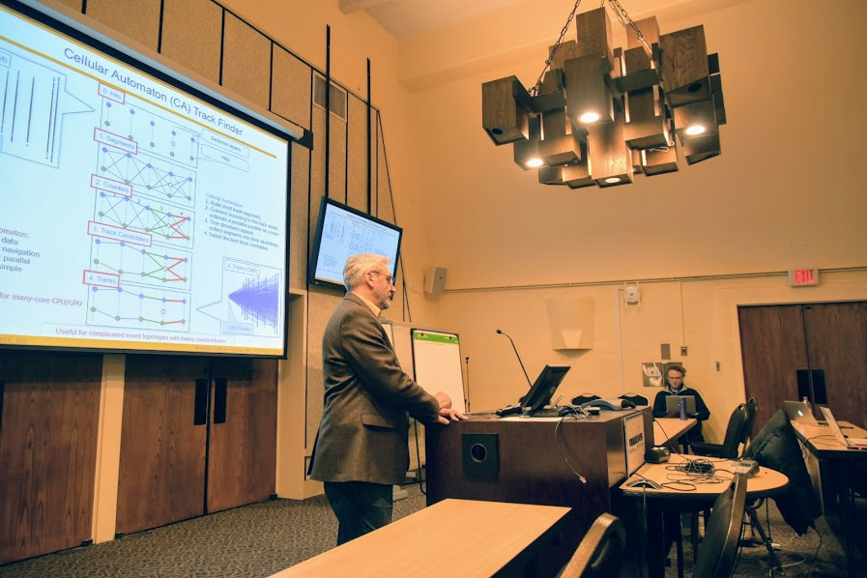
Goal: Get people to talk and get actual work done

Slide 5
Workfest accomplishments (track seeding)
Implemented CA Seeding module
Access to STAR standalone CA seeding
Implemented Simplified Kalman Filter from ALICE
Started implementing Full Kalman Filter from ALICE
Accessible through separate Seeding and Propagation modules
Implemented Track Merging scheme for iterative tracking
All Lego blocks in place to build and benchmark a new fast (TPC only) seeding/tracking scheme
  Seed in the TPC
  Track TPC using simplified KF
  Connect to inner tracking using ACTS
  Full Track fit by ACTS
This scheme should bring the track reconstruction time well below 5sec per MB event
Still needs work for finalizing the code, establishing high efficiency etc

Slide 6
KFParticle

Slide 7
ACTS

Slide 8
TPC Distortion Corrections

Slide 9
Pixel Detector (MVTX)

Slide 10
Investigating new output file formats
  TTrees are memory hogs
  TTrees do not play well with stl maps
    Need to separate storage objects from objects in memory
  ROOT files are optimized for reading single variables, not for reading complete events
    Perennial issue for gpfs where readaheads lead to tremendous network traffic without actual data transfer
  Look at Google protocol buffer type storage
    Flatbuffers as candidate identified https://google.github.io/flatbuffers/
  Jan implemented prototype https://github.com/JanCBernauer/storage
  I hacked an output manager which can be used to write those files transparently
    Input manager does not exist yet – but should not be difficult
  The “standard” DST output manager was not changed – users can still write Ttrees which are more convenient for interactive analysis

Slide 11
New Students

