Slide 1
PMG Agenda
Status of INTT DAQ/readout expert
Cradle/carriage order
Status of iHCAL accounts
Status report
Status of EMCal, Calorimeter electronics, labor
Status of labor for HCAL cabling
Status of TPC
MVTX engineering review
First thoughts on commissioning plans
AoB or concerns

Slide 2
PMG Agenda
Status of INTT DAQ/readout expert
S. Murthy from IO. RIKEN will pay part for INTT work and sPHENIX will pay part for work on TPC and other MIE components as necessary.
Cradle/carriage order
Bids due Feb 14
Status of iHCAL accounts
Not yet open
Status report
Status of EMCal, Calorimeter electronics, labor
Status of HCal, labor
Status of TPC
MVTX engineering review
First thoughts on commissioning plans
AoB or concerns

Slide 3
sPHENIX Project Calendar
CAD ESRC review of 1008 Rack protection system Jan 28
MVTX Design Review Jan 29
OHCal External structure PRR Feb 4
L2 Managers’ Meeting Feb 6
TPC DAM PRR Feb 7
2020 Budget Briefing @ DOE Feb 12
Bids due for Carriage/Cradle Feb 14
DOE-NP monthly meeting Feb 26

Slide 4
sPHENIX MIE Overview
TPC | Project Director | Last CD Achieved | % Complete | CPI | SPI
$27.0M | Edward O’Brien | PD-2/3 | 36.3% BCWP/BAC @ 12/31/2019 | 0.99 | 1.01
Scope
Detector systems produced, tested and ready for installation: Time Projection Chamber w/ electronics, Electromagnetic Calorimeter w/ electronics, Hadronic Calorimeter w/ electronics, DAQ/Trigger, Minimum Bias Detector, Project Management
Not in scope
SC-Magnet, Bldg/Det Infrastructure, Installation and System Commissioning
Schedule
CD-0 received Sept 2016
CD-1/3A received Aug 2018
PD-2/3 received Sept 2019
Early completion Oct 2021 (14 months float to PD-4)
PD-4 Dec 2022
Cost
$27.0M AY TPC 34.5% contingency on BCWR

Slide 5
1008 Infrastructure & Facility Upgrade
TPC | Project Director | % Complete | CPI (Pre-baseline) | SPI (Pre-baseline)
$33.4 M AY | Edward O’Brien | 33.5% BCWP/BAC @ 12/31/2019 | 0.98 | 1.01
Scope
SC-Magnet support including the Flux Return, Cryogenics into Bldg 1008, Detector Carriage/Cradle, other Bldg 1008 Infrastructure improvements
sPHENIX Installation, Integration and Commissioning of each Subsystem is part of the scope
Not in Scope
PreOps prior to RHIC collisions
Schedule
sPHENIX Ready for Operations Oct 2022
First RHIC run of sPHENIX Feb 1, 2023
Cost
$33.4 M AY Total Project Cost (practice baseline) with 21.8% contingency on ETC

Slide 6
Where BNL Management Can Help sPHENIX
The capital account is not yet open for the IHCal instrumentation. I’ve submitted all of the paperwork to Kelly Carroll in early January . It involves David Bacon committee approval.
We have one long lead item ($15k) that I would like to get ordered. WLS fiber for scintillating tiles. Ask to put it on Ops temporarily before transferring it to IHCal accounts once open.
We have two reqs submitted to hire replacements for people that have either retired or left the group: I-5/7 software professional, TW-4 designer
Both should be on the HR website this week
To guarantee meeting the early completion date we are looking at the possibility of bringing on additional labor resources for techs, engineers and designers. Resources from CAD would be great but I expect they will become scarce soon. We’ll look inside the lab first (NSLSII, IO, SMD) and then look at job shoppers or term hires.
We’ll likely have to use MIE contingency to pay unless labor is from inside the PPM Directorate. It would be a good trade in order to stay on schedule.
Staring at the end of the spring semester sPHENIX expects to start to get an influx of students for testing and assembly. We are starting to get requests for visitor funds (housing & per diem) for students.
Dave Morrison and I will make a request to Jamie to support visitors with Ops funds.

Slide 7
sPHENIX Accomplishments
LLP-1 orders, 93% of SiPMs arrived at Univ. of Michigan (100% w/i 2 weeks). LLP-2 orders, 44% of scintillating fibers have arrived at UIUC. LLP-3 orders, 40% of scintillating tiles have arrived at GSU. LLP-4 order 50% of tungsten powder at UIUC (funds transferred to UIUC to buy 2nd half of order)
1st OHCal sector fully instrumented and reading out cosmic-ray events. 6/32 OHCal sectors instrumented with scintillating tiles.
SAMPA v5 (TPC ASIC). Four wafers diced and being packaged. Packaged chips at USP & Lund Feb 21 for testing.
Production testing of ASICs at Lund Univ
1st two preproduction TPC Data Aggregator Module passed tests. Eight additional DAMs will be assembled and at BNL 2/21.
1st EMCal Sector being assembled at BNL. Sector 2-12 block fab continues at UIUC.
TPC full scale prototype Inner Field Cage has passed its HV tests at SBU.
sPHENIX Carriage/Cradle out to bid. Bids due mid February.
~ 10% of the sPHENIX MVTX silicon pixel staves assembled at CERN. Ready to ship to LBNL in Feb/Mar.
Fab of cryo components for Bldg 1008 begun at vendor. First parts delivery in April.
Production/ final R&D work progressing on all sPHENIX detector components.

Slide 8
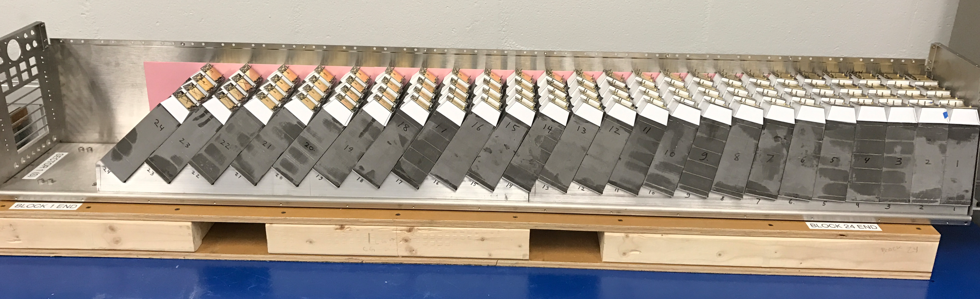
EMCal Sector 1 Dry Fit at BNL
Sector 0 is done. It is taking cosmics rays and pulser data.
Sector 1 is being assembled at BNL
Most of Sector 2 blocks at BNL
Sector 3-4 blocks being fabbed at UIUC
Block fibers being filled for Sectors 13-64 at UIUC

Slide 9
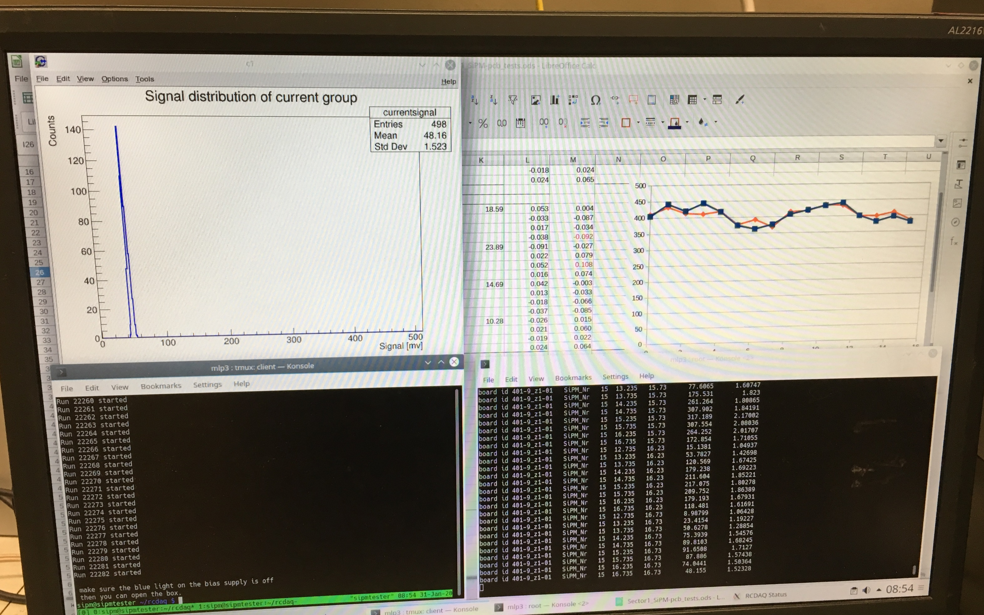
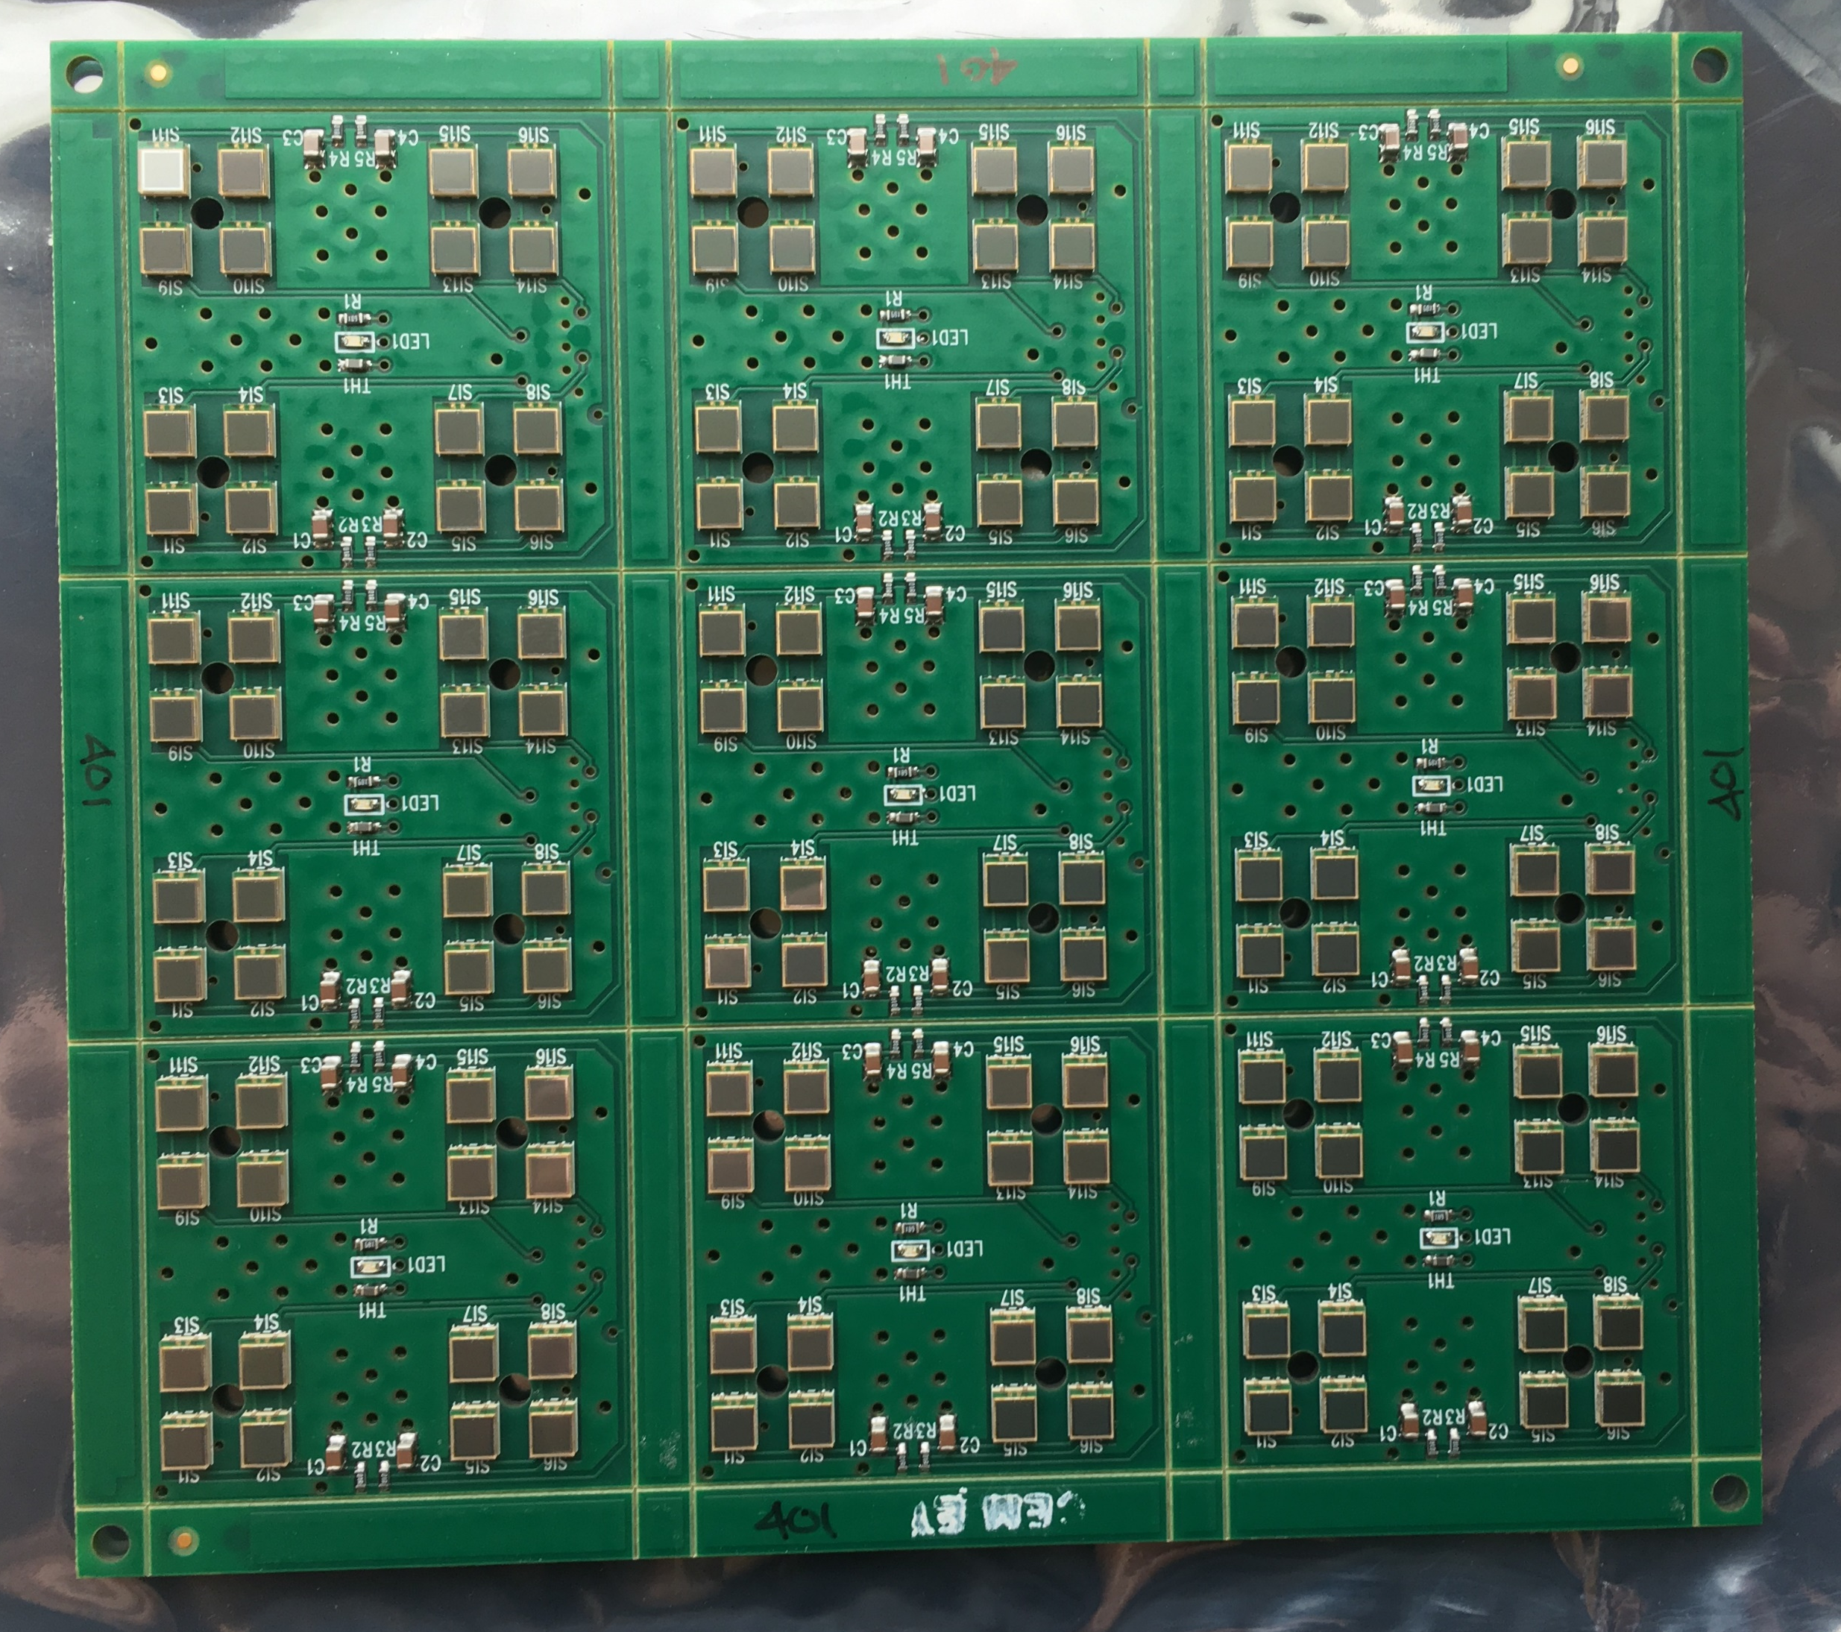
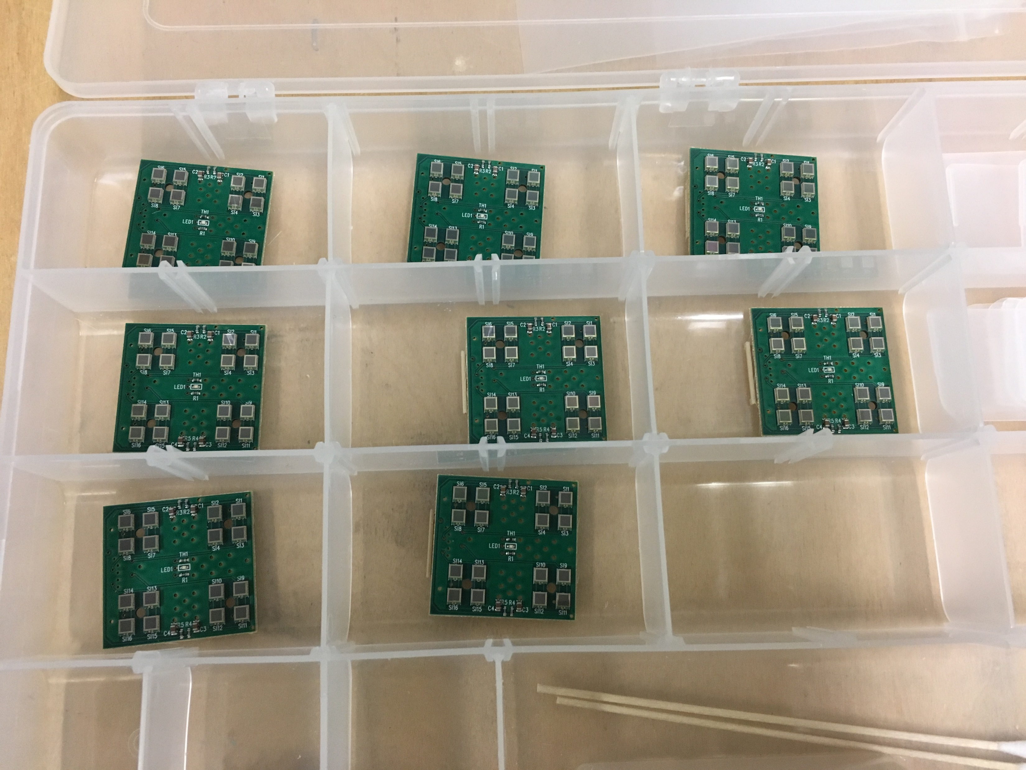
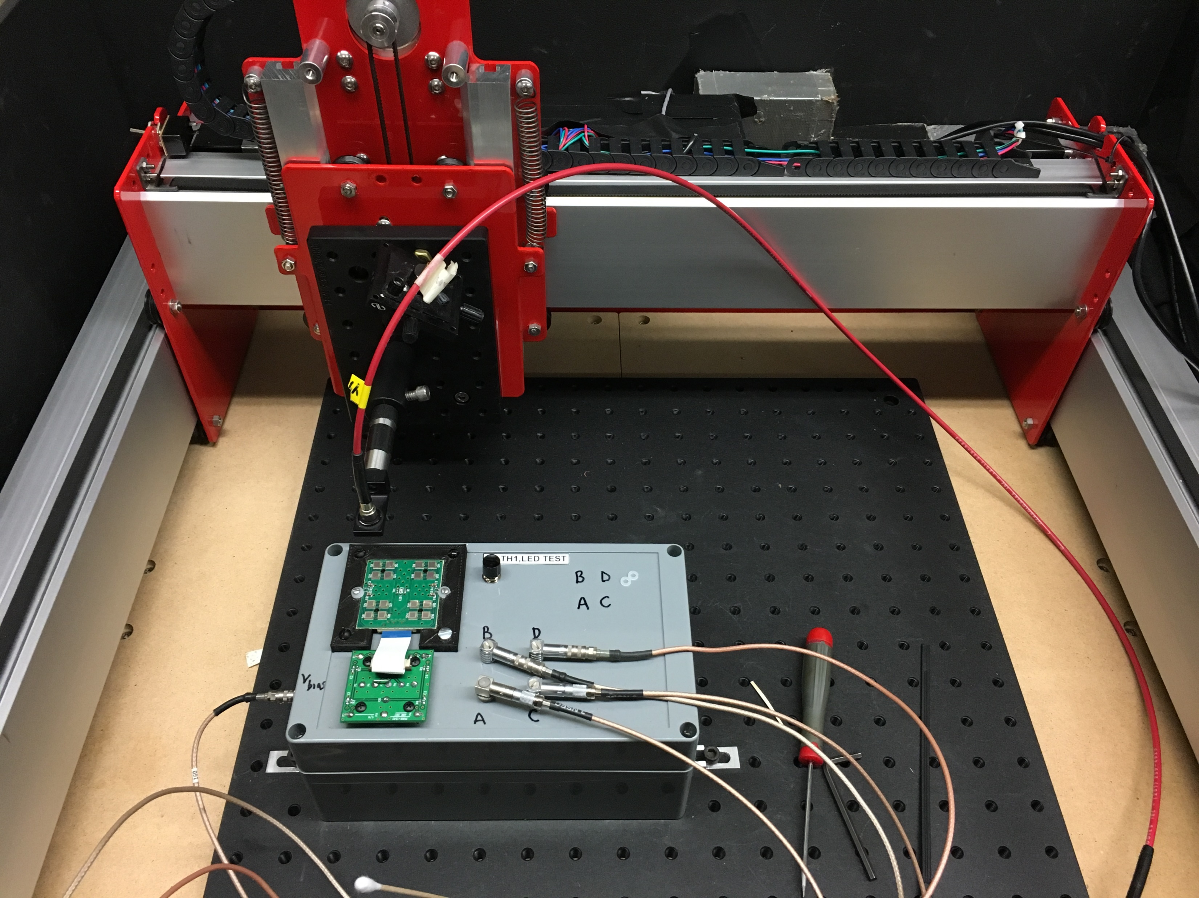
Other EMCal/Calorimeter Electronics Issues
Adding 1 FTE ET (NSLS II) to split between EMCal and HCal.
Rec’d all SiPM daughterboards for Sector 1. Testing is underway. Currently testing single boards while panel tester is getting ready.
Preamps sent to Lehigh Univ. for testing and pre-assembly of pcb+cooling plate.
Individual pcbs
Separated for testing…
SiPM daughterboards in 3x3 panel
Scanning test stand

Slide 10
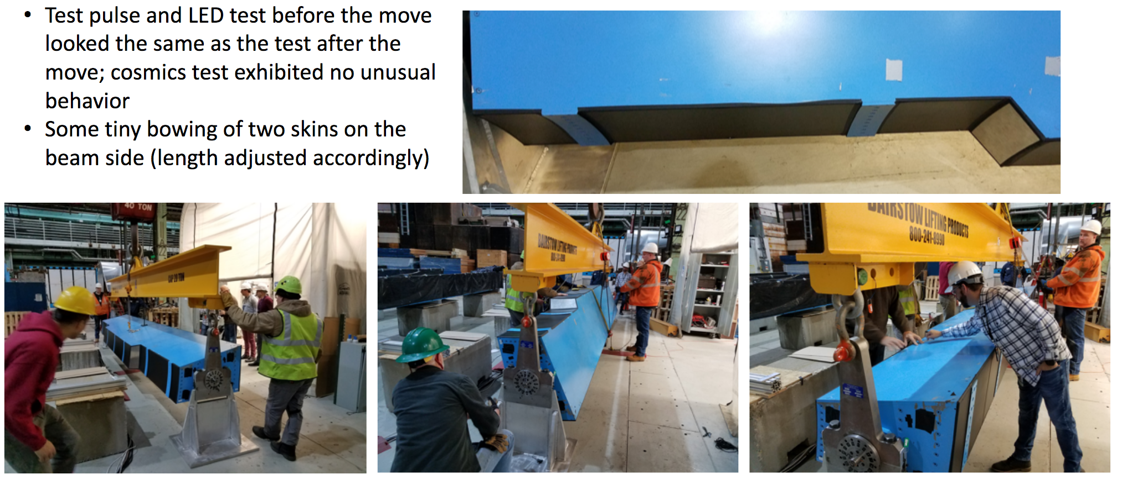
Rotation Test of 1st OHCal Sector

Slide 11
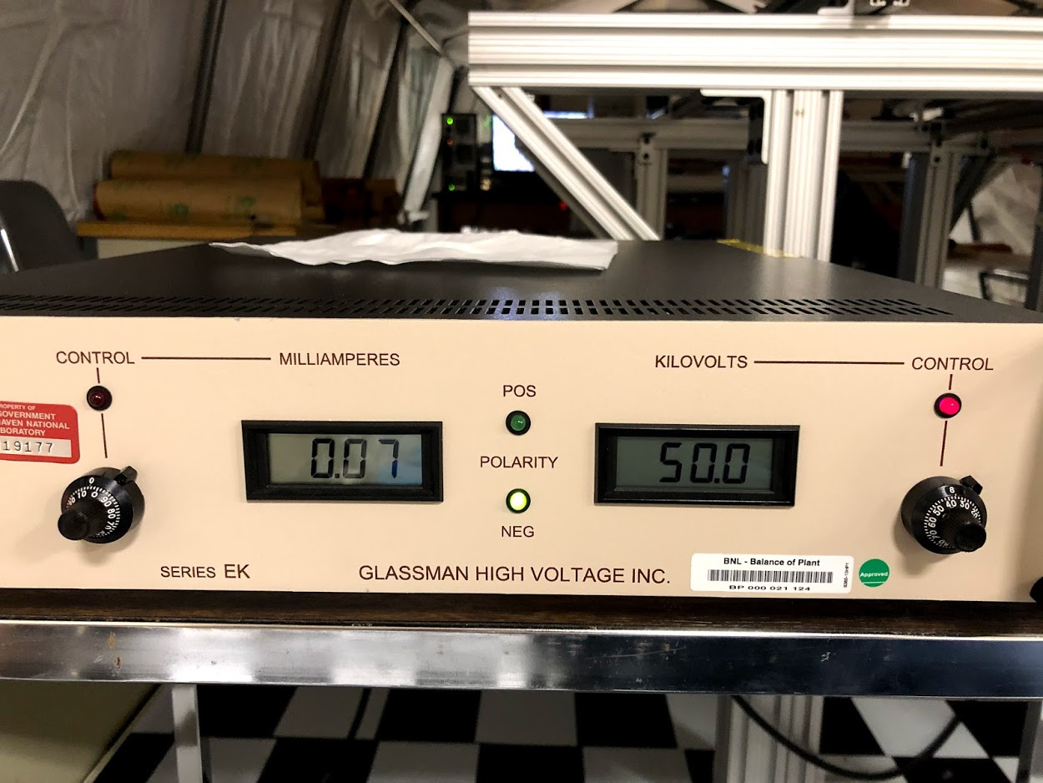
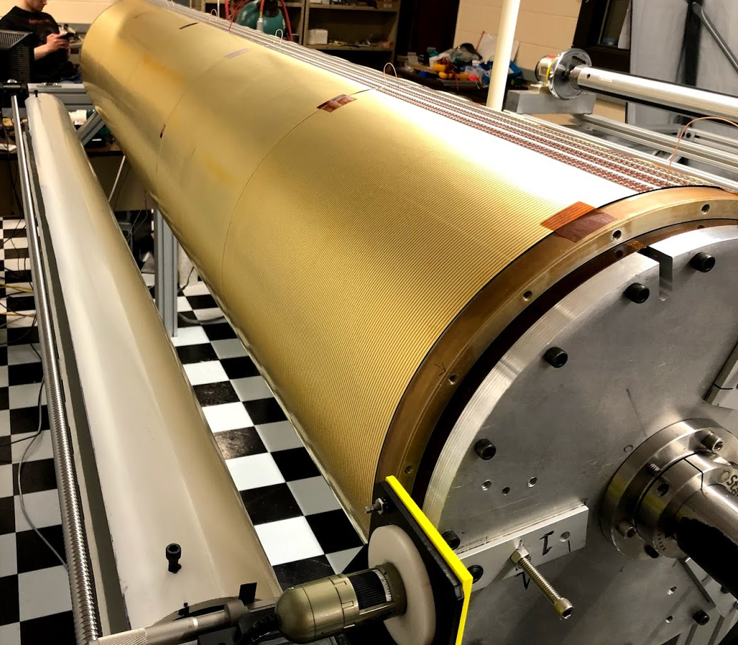
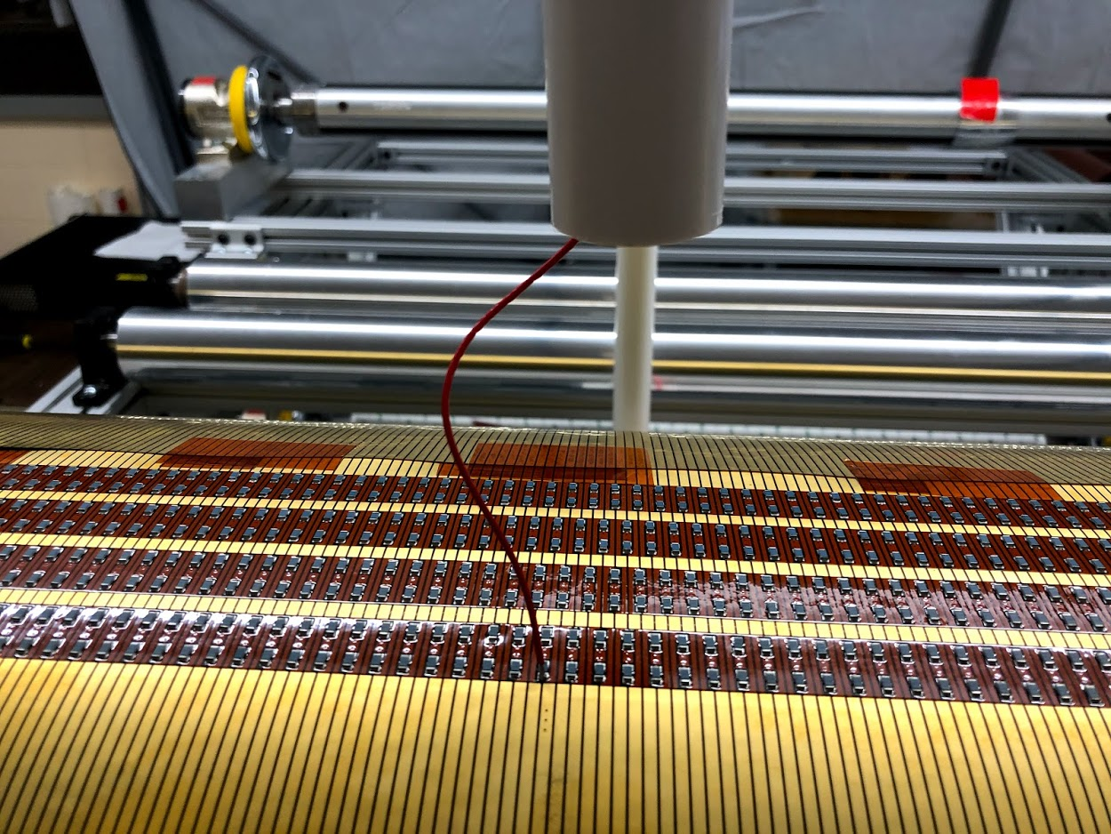
Successful TPC Inner Field Cage HV Test to 50 kV
Will operate at 40kV

Slide 12
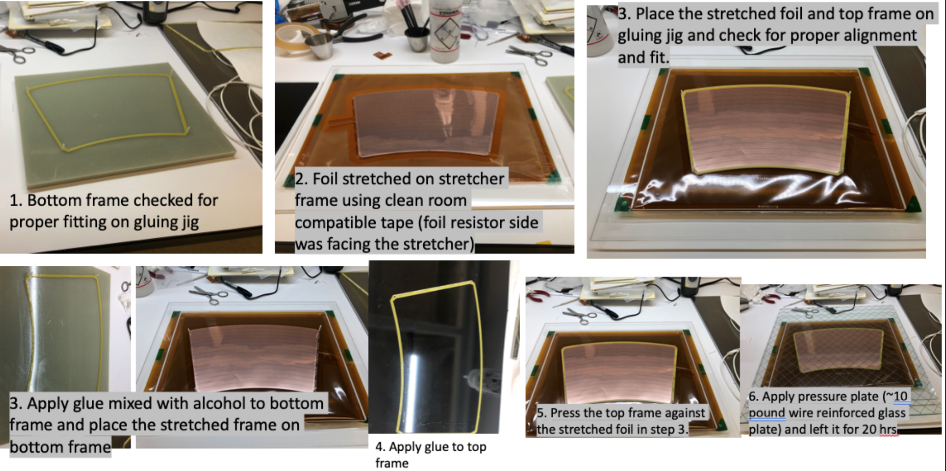
TPC GEM Module Production at Vanderbilt Univ
GEM Module production facilities are being prepared at WSU, WIS, VU and Temple U

Slide 13
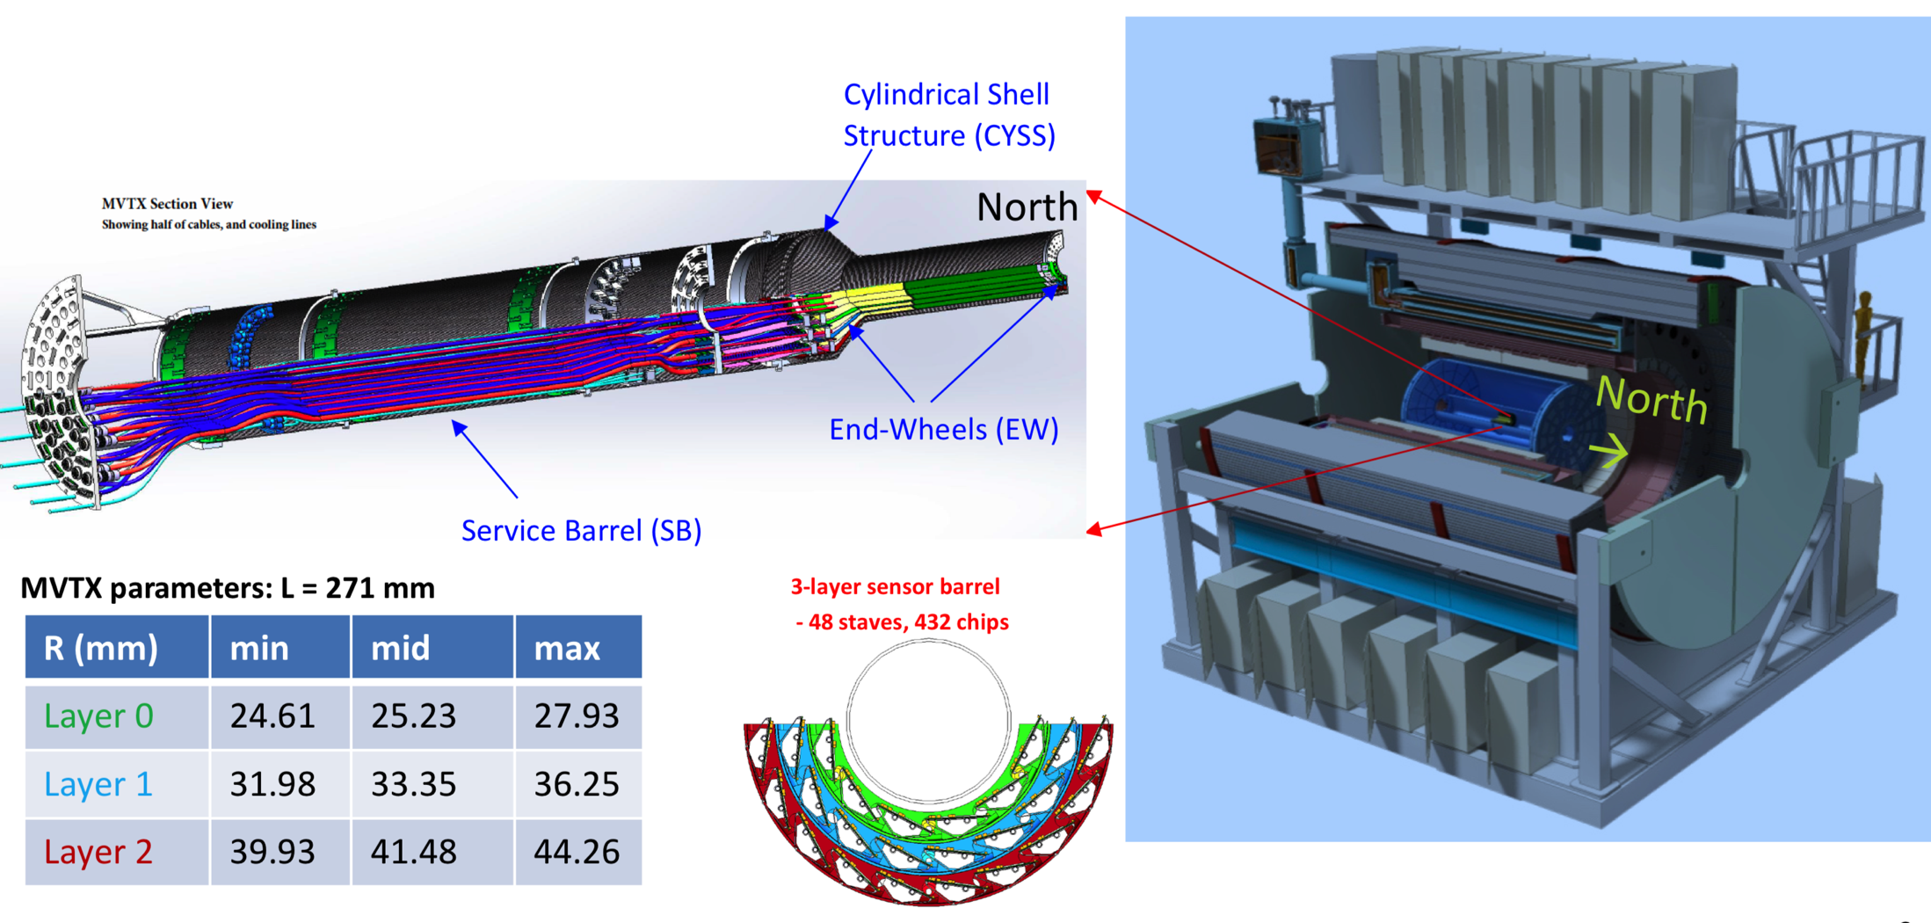
MVTX Detector –”Adapted” from ALICE ITS Design
Project Start: Dec 2019
Ready to install: June 2022
Total Project Cost $4,795k
sPHENIX

Slide 14
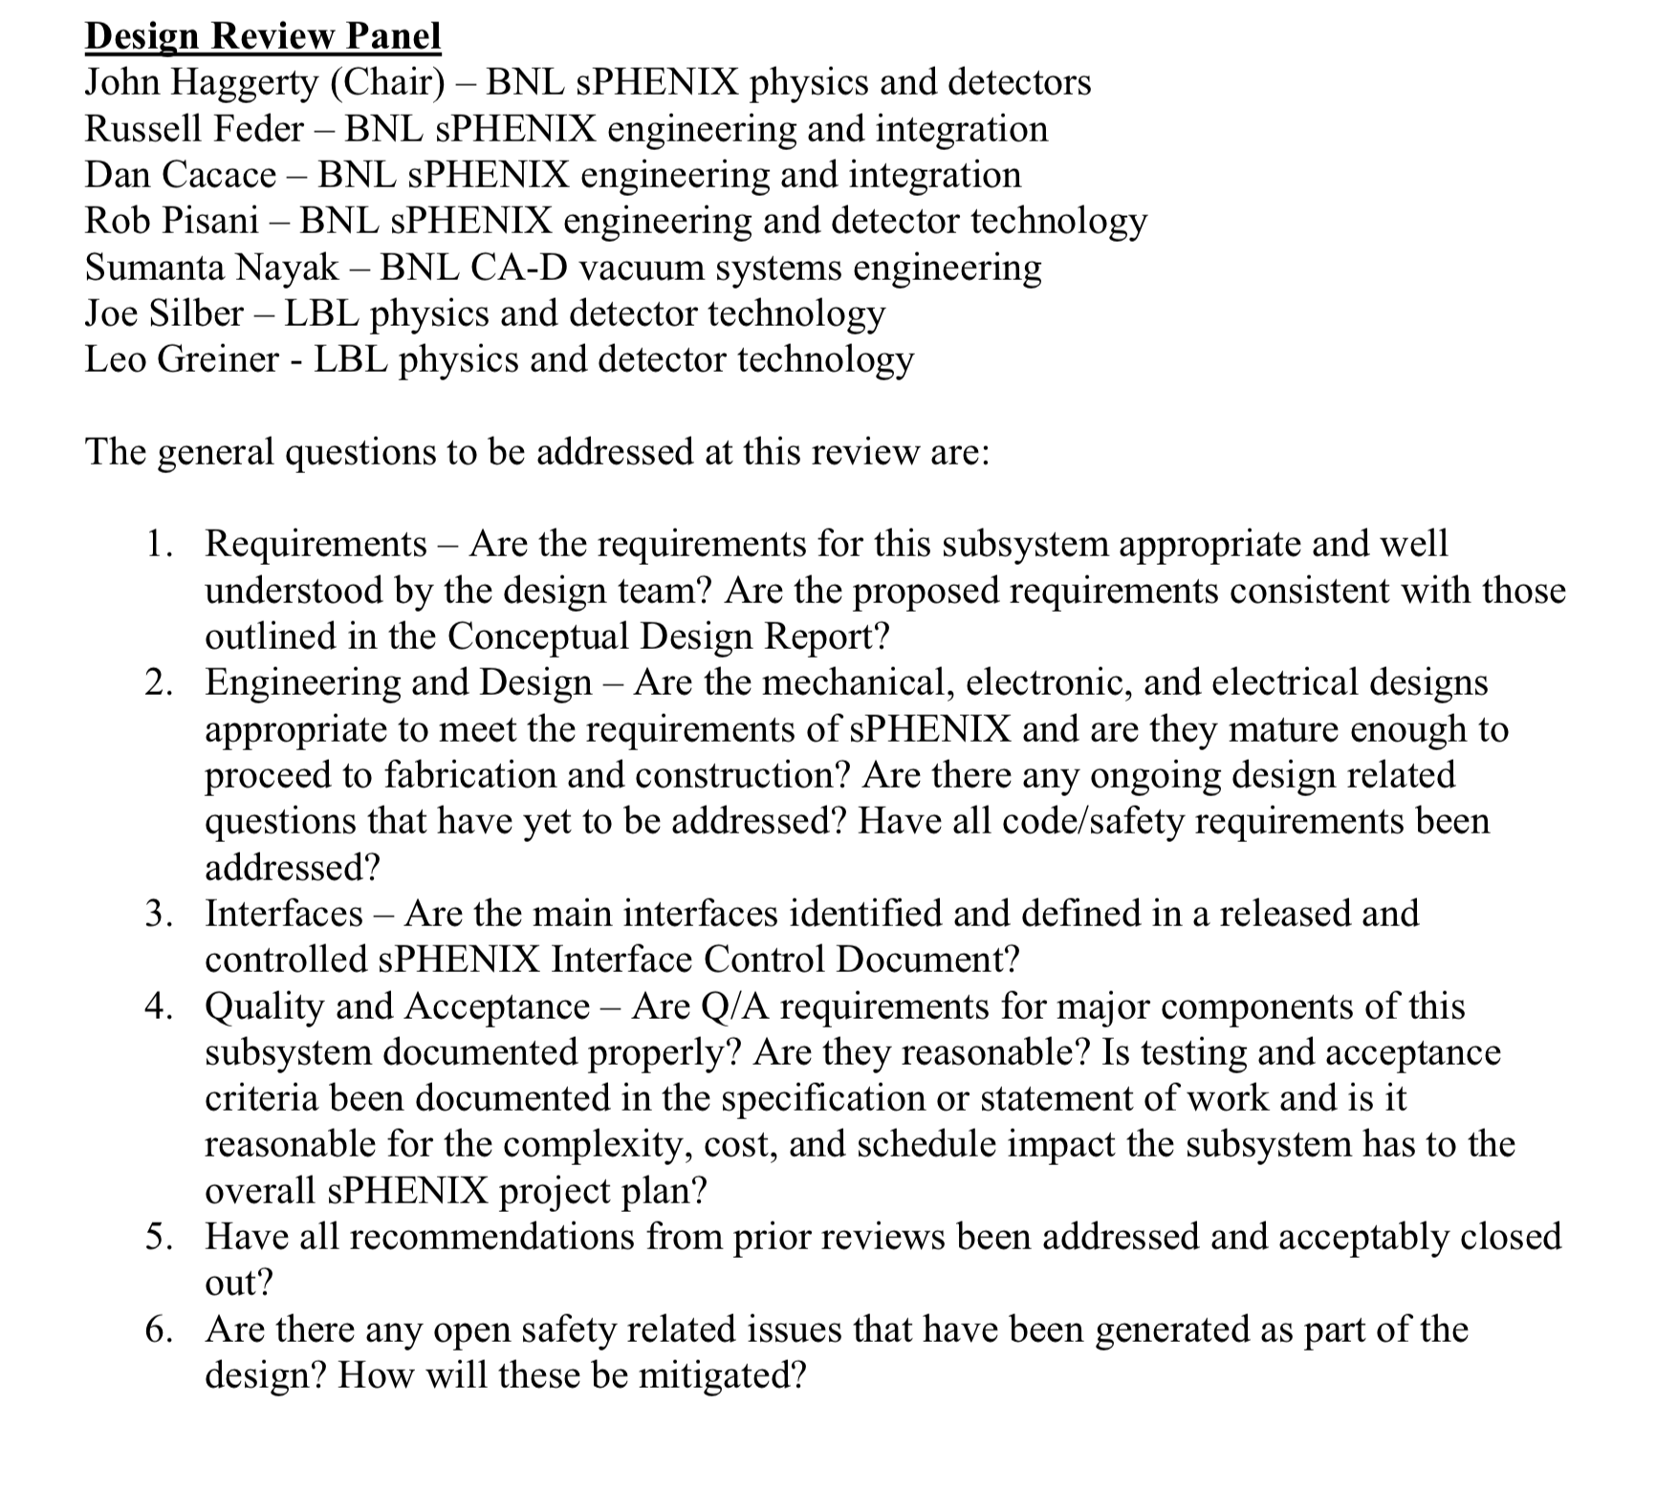
MVTX Design Review – Jan 29
https://indico.bnl.gov/event/7165/
Engineering Design is advanced thanks to:
Near complete adaptation of ALICE ITS design
LANL design studies funded by LANL LDRD
MIT and LBNL design studies funded by BNL R&D
Issues with beam pipe and MVTX insertion that need to be resolved over the next 1-3 months.
LBNL ready to receive staves once funding is available to begin shipping preparation

Slide 15
sPHENIX Commissioning Plans - I
Test components as they are being built with production electronics with gradually increasing scope:
TPC (during construction)
Fermilab beam test with half-dozen SAMPA V4 FEM’s, purchased FELIX
Preparing for one sector test (26 SAMPA V5 FEM’s) and first build of sPHENIX FELIX later this year
Testing with one or two sectors of electronics as we instrument V1 next year
TPC (during preparation for installation)
Instrument everything incrementally power as much as we can as we go (one sector?)
Calorimeters. (during construction)
EMCAL
Fermilab beam test with 64 ADC channels 2018 (IEEE paper in collaboration review)
Sector 0 (soon sector 1) testing with 384 ADC channels ongoing
Begin construction of production 4 crate rack for multiple ADC/DCM crates summer/fall
HCAL
Fermilab beam test with 16 OHCAL ADC channels last year
Sector 1 testing with 48 ADC channels ongoing (6 nearing readiness)
Calorimeters (during installation)
Test electronics (power, control, ADC) move to 1008 for prep and post installation testing

Slide 16
sPHENIX Commissioning Plans - II
Begin deployment of production servers for FELIX and DCM2 this year
Allows software development (New I-5/7 position) to start to make real progress
Multi-granule tests of even synchronization
Requires GTM and GL1 development
Lays foundation for final system in 1008
We will probably power the carriage at least partially while in 1008AH
Extra work to install temporary power, only makes sense if we can finish access platforms and complete safety reviews
Full power to detector as soon as possible after end of Run 22 followed by roll-in
Similar thinking for non-MIE detectors and MBD
TPC
HCal
EMCal

Slide 17
Milestones Status – sPHENIX MIE
WBS | Milestone Name | Target Milestone Date | Forecast | Actual Finish | Variance (in work days)
1.01.01 | Approve Project Baseline and Construction PD2/3 | 30-Sep-19 |  | 20-Sep-19 | 6
1.02.02.02 | Production Readiness Review - TPC Module Factories | 31-Dec-19 |  | 17-Dec-19 | 19
1.03.02.03.02 | EMCal Preproduction Sector 0 Assembled | 31-Dec-19 |  | 25-Nov-19 | 23
1.02.06.02 | Production Readiness Review - TPC DAM | 28-Feb-20 | 7-Feb-20 |  | 37
1.05.02.03 | HCal Preproduction FEE Complete | 30-Apr-20 |  |  | 41
1.05.02.01 | EMCal Electronics Preproduction Complete | 29-May-20 |  |  | 29
1.03.01.03.01 | EMCal W Powder Acquisition Complete | 30-Jun-20 |  |  | 115
1.03.02.03.03 | EMCal Prod Readiness Review Blocks/Modules/Sectors Complete | 31-Jul-20 |  |  | 52
1.02.05.03 | SAMPA ASIC Performance Accepted | 30-Sep-20 |  |  | 48
Closely watch this milestone

Slide 18
Summary
sPHENIX MIE and 1008 I&F continue to have good cost and schedule performance at summary level as measured by EV. Project End Date and Critical path remain unchanged
sPHENIX production components are starting to be built and tested (EMCal, HCal, TPC electronics, Calorimeter electronics)
CD-3A parts continue to arrive. PD-3 parts are being ordered.
Engineering design, R&D and preproduction prototyping continues for many subsystem.

