Slide 1
Backgrounds and detectors for Compton polarimetry
February 4th 2020
Alexandre Camsonne
Hall A Jefferson Laboratory

Slide 2
Outline
eRHIC
Compton polarimetry
Compton electron detector JLEIC
Counting rates
Diamond and fast amplifier for electron detector
Photon detection
To do list
Conclusion

Slide 3
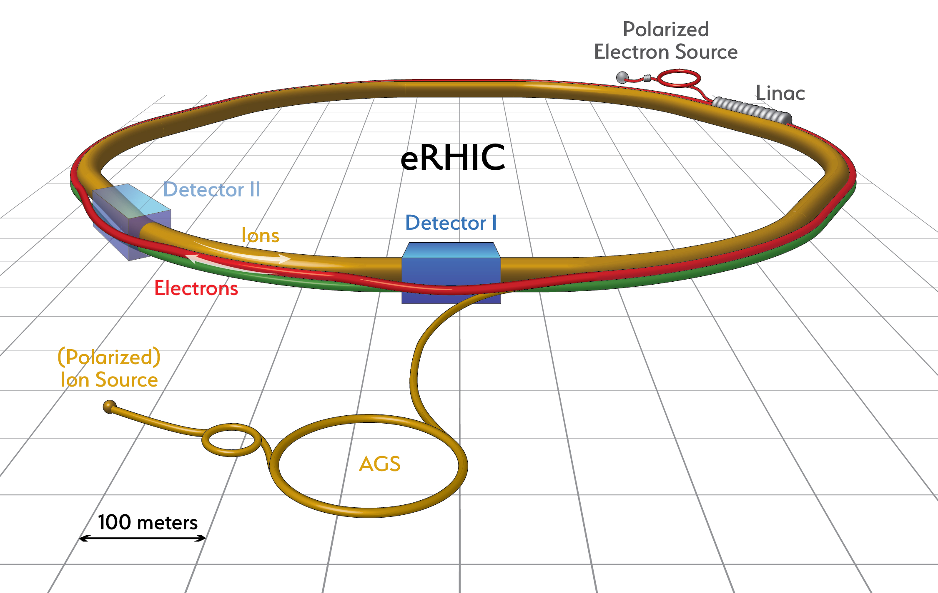
Electron Ion Collider designs
Lower luminosity
560 MHz RF
330 bunches
33 ns between bunches
Electron current up to 1.2A
Ion current up to 0.46 A
High luminosity
560 MHz RF
1320 bunches
10 ns between bunches
Electron current up to 2.4 A
Ion current up to 0.92 A
High luminosity polarized electrons on polarized and unpolarized ions
For electron beam asymmetry measurements polarization can be the dominating error.
Aiming for 1% or better electron polarization accuracy
3

Slide 4
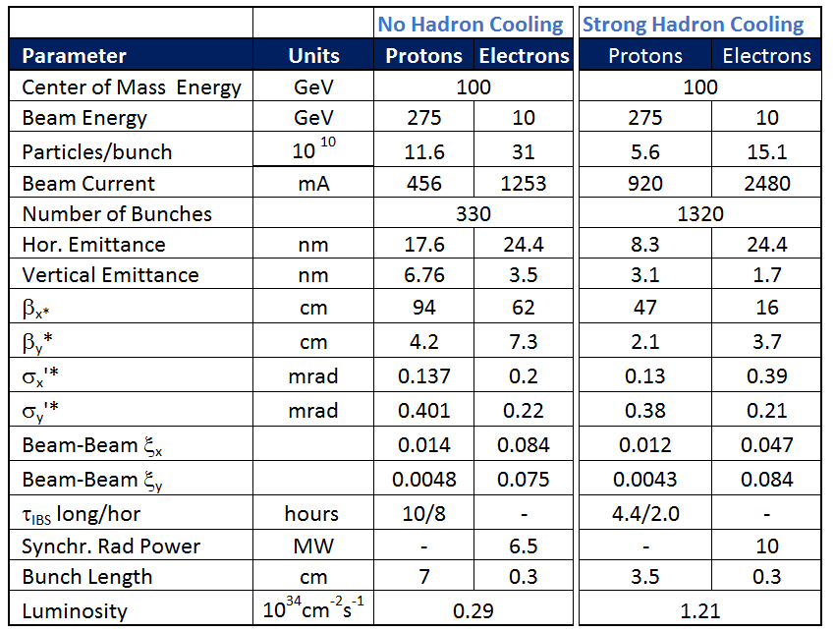
Main Parameters eRHIC ring-ring for Maximum Luminosity
E_{p} = 275 GeV, E_{e}= 10 GeV
New eRHIC ring ring design : beam interaction frequency going from initial RHIC 10 MHz to 30 MHz with 330 bunches and 100 MHz with 1320 bunches in a 3.8 km ring
4

Slide 5
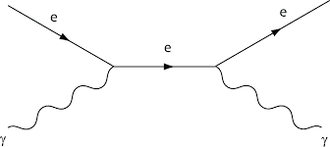
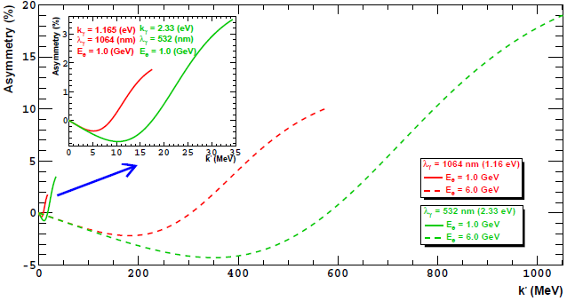





Polarized Compton effect
The polarization of the beam can be measured using the Compton effect.
$$σ\left( \vec{e}+ γ → e^{′}+ γ^{′} \right)$$
$$≠$$
$$σ\left( \overset{⃖}{e}+ γ → e^{′}+ γ^{′} \right)$$
$$A_{EXP}≡\frac{N^{+}−N^{−}}{N^{+}+N^{−}} =P_{e}∗P_{γ}∗A_{QED}(E_{e},k_{γ},k_{γ^{′}})$$
$$A_{QED} (\%)$$
Measured asymmetry
Polarization of the photons
(measurable)
Asymmetry computed using QED
$$k_{γ^{′}} (MeV)$$

Slide 6
Polarized Compton process
Longitudinal polarization asymmetry
Transverse polarization Compton asymmetry

Slide 7
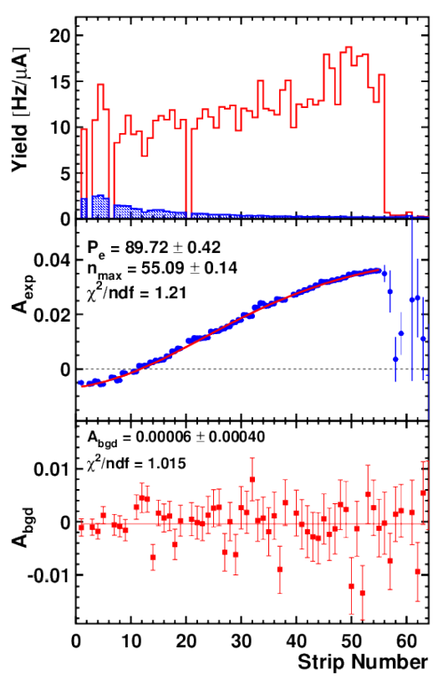
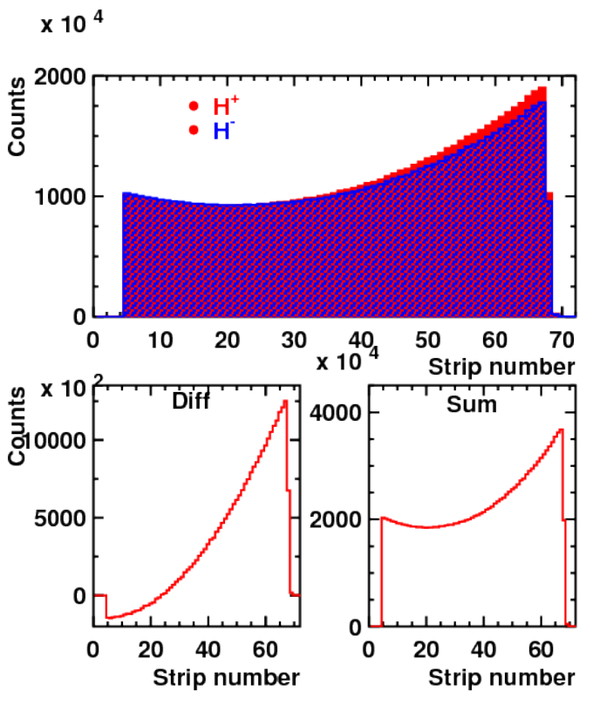


Polarized Compton process
The hit distributions are used to measure $A_{EXP}$.
LASER ON
$$N^{+}$$
$$N^{−}$$
LASER OFF
$$A_{EXP}≡\frac{N^{+}−N^{−}}{N^{+}+N^{−}}$$
COMPTON EDGE
ZERO CROSSING
Precision Electron-Beam Polarimetry using Compton Scattering at 1 GeV
(Hall C at Jefferson Lab)

Slide 8
Compton chicane
The electrons that interact lose part of their momentum, therefore they are deflected more by dipolar magnets.
Laser + Fabry Perot cavity
Compton photon
calorimeter
γ_{c}
Photon tagger
e⁻ beam to spin rotator
Compton electron
tracking detector
Luminosity monitor
e⁻ beam from IP
Photons from IP

Slide 9
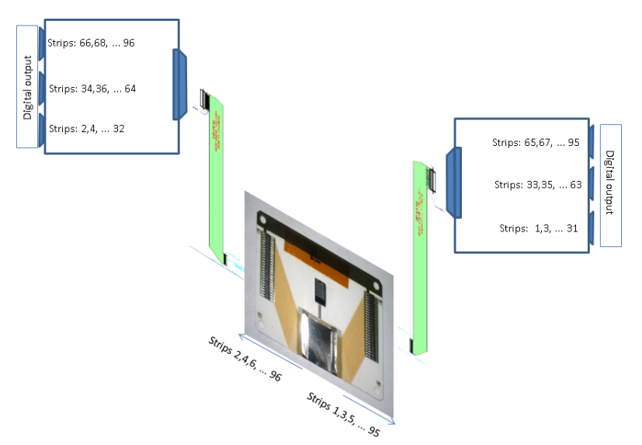
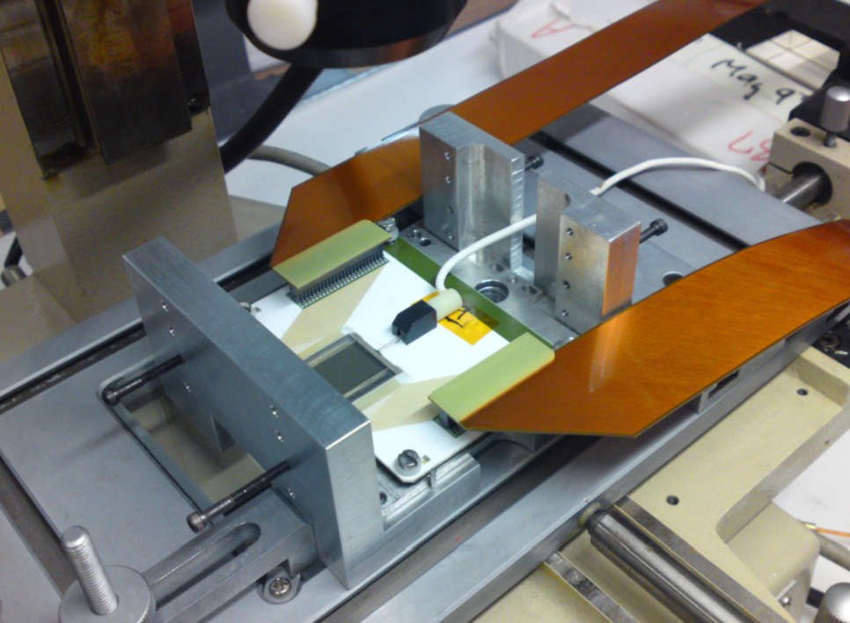
JLab Hall C Compton Electron detector
A solid state detector directly in the primary vacuum can approach the beam using a movable support.
Silicon or diamond strip detectors
About 200 to 250 strips 250 mm width
5 cm length to catch zero crossing and Compton edge
Present system used at JLAB Hall C :
electronics connected with flat cables
Bad for SNR and speed!

Slide 10
Challenges at EIC
Large beam current ( 2.4 A vs 200 uA at JLab )
  Wakefield power deposit by beam can be significant
  Synchrotron radiation ( more severe than JLab )
  Background
    Bremstrahlung
    Halo
  Detector radiation hardness

Slide 11
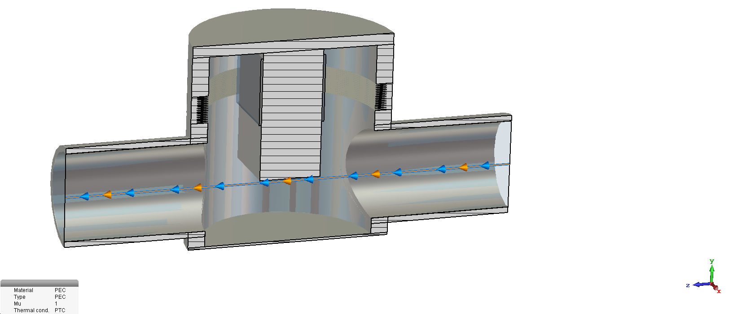
Proposed EIC Compton electron detector
Use Roman Pot for electron side too
Pros :
  Access to detector without breaking main vacuum
  Electronics can be closer to electronics ( no flex cables )
  Cooling of detector easier
Con :
  Additional material in front of detector
TOTEM Roman Pot

Slide 12
Synchrotron radiation
Compton photon
calorimeter
γ_{c}
Low-Q² tagger for low-energy electrons
Compton electron
tracking detector
Luminosity monitor
e⁻ beam to spin rotator
e⁻ beam from IP
Compton- and low-Q² electrons are kinematically separated!
Photons from IP
Electron detector not in direct view of synchrotron fan
γ_{c}
Beam pipe wall
Can see still see synchrotron X-rays
bouncing on the beam
pipe
Can add structure and
coating to reduce rate
Compton electron
tracking detector
e⁻ beam to spin rotator

Slide 13
Ante-chamber method
151 cm
Study by Mike Sullivan (PEPII)
Surface power density on the photon stop is 62 W/cm
Eliminate single bounce photons

Slide 14
Software / simulation
Stand alone Compton event generator ( currently generates LUND files )
GEMC geometry
Analysis script for polarization extraction

Slide 15
Halo background
Halo modeled by a double Gaussian distribution using beam size from PEPII
Halo rates for 1 cm (blue) and
2 cm aperture ( salmon )
Can be used to reevaluate when more realistic halo available

Slide 16
Compton Electron Rates from IP
Use Pythia event generator
Transport to Compton Detector
Preliminary rate is negligible compared to other backgrounds

Slide 17
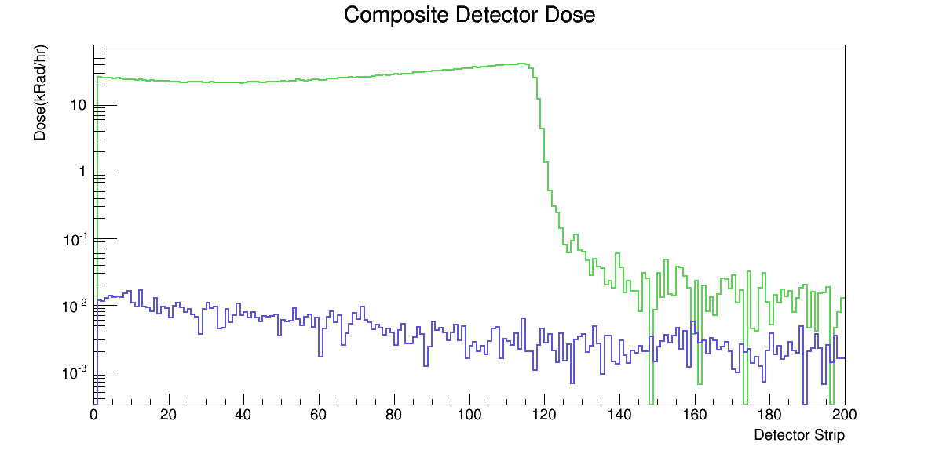
Compton Electron Det. Rates
Halo 1 cm aperture
Joshua Hoskins
10 W
1 A of beam
Green laser
Compton and Bremstrahlung
assuming 10⁻⁹ Torr
Corresponding radiation dose
for signal and background
( typical silicon SNR divided by 2 after 1 Mrad
No change for diamond after 2 Mrad from Qweak )
Bremstrahlung
Halo 2 cm aperture

Slide 18
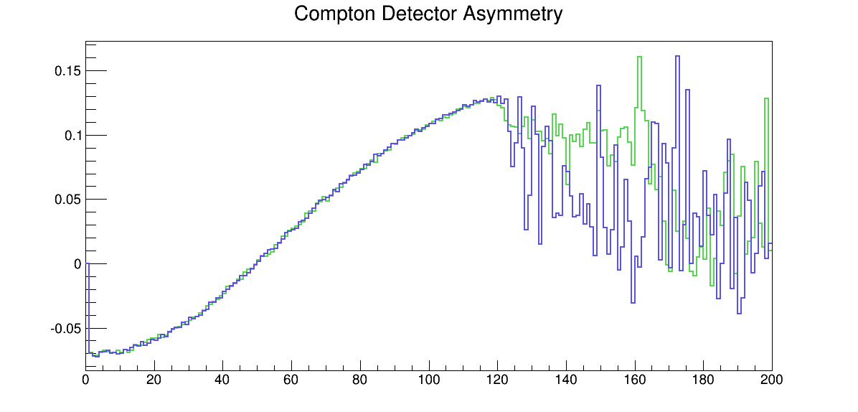
Compton asymmetry with window
500 μm window
No window
Higher statistics MC comparison

Slide 19
Compton asymmetry with window
Extracted polarization with and without window
Number consistent at 1% level
Need to study systematics with high statistics to evaluate best accuracy possible

Slide 20
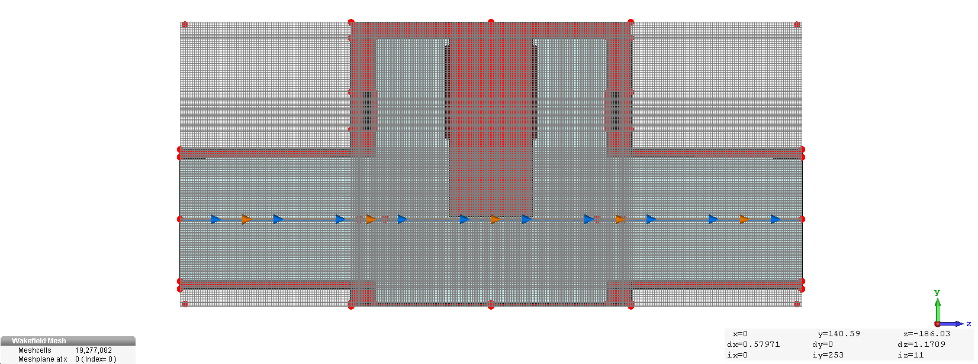
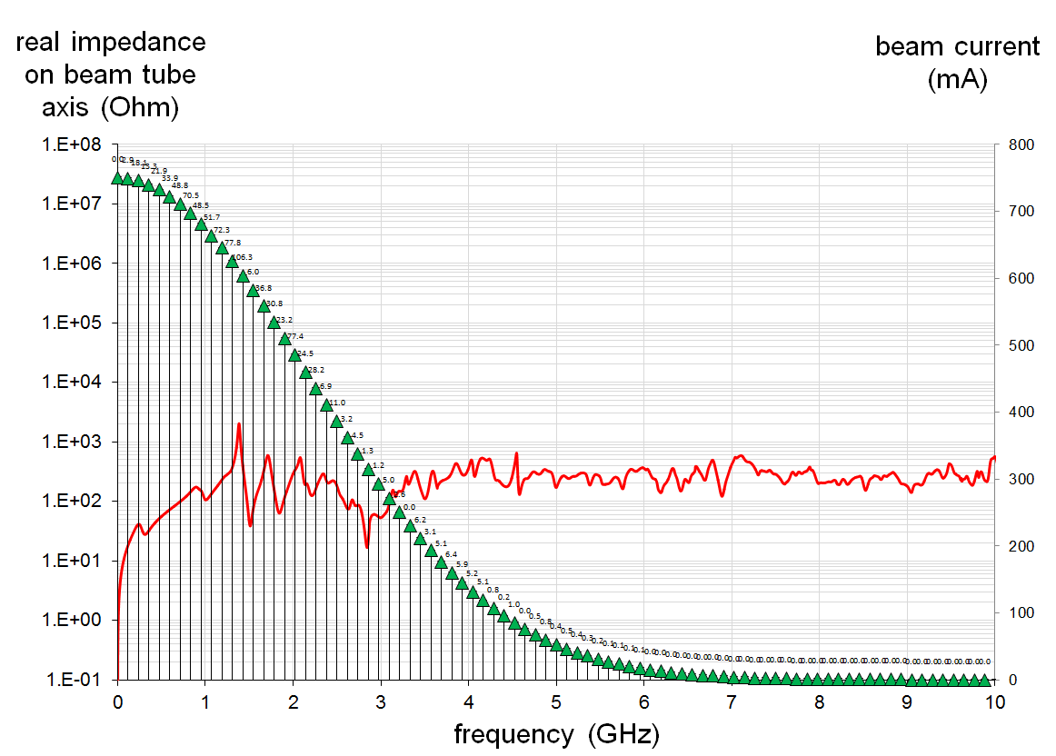
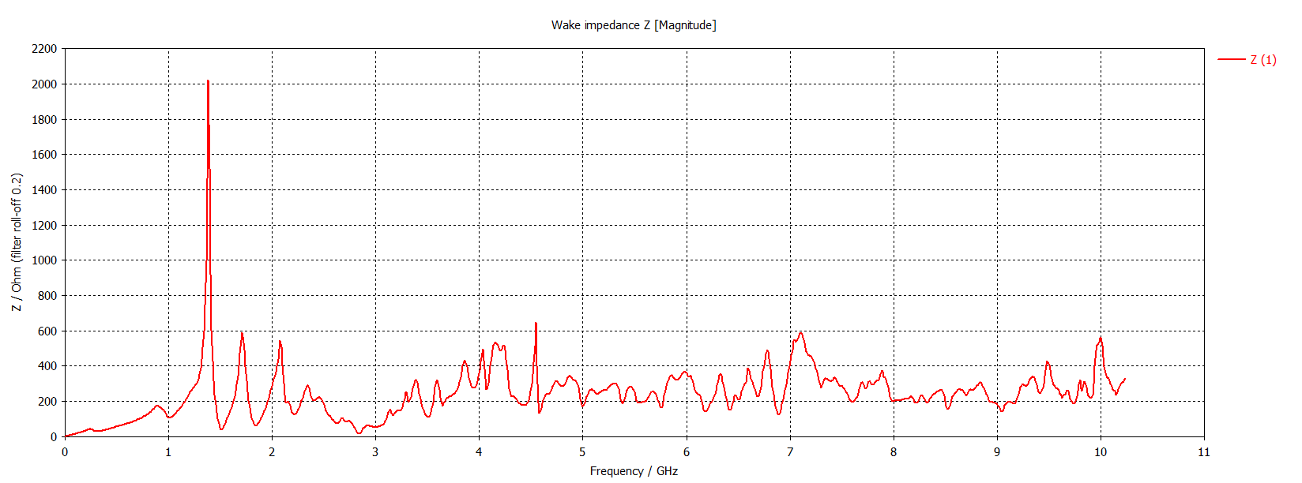
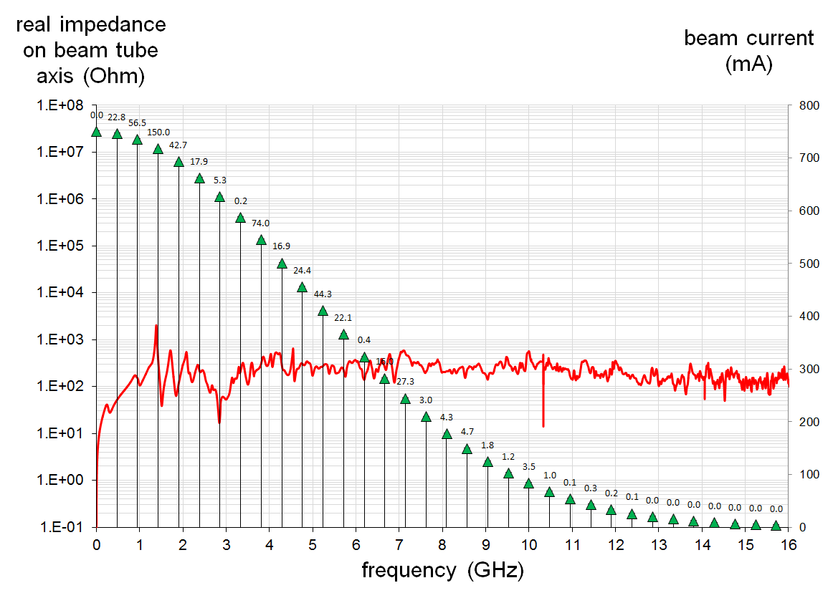
Wakefield study
Impedance after 10 days of computation
119 MHz
476 MHz
Around 2160 W at 3A at low and medium energy
And 540 W at 0.75 A for high energy
Doable and will be reduced after optimization

Slide 21
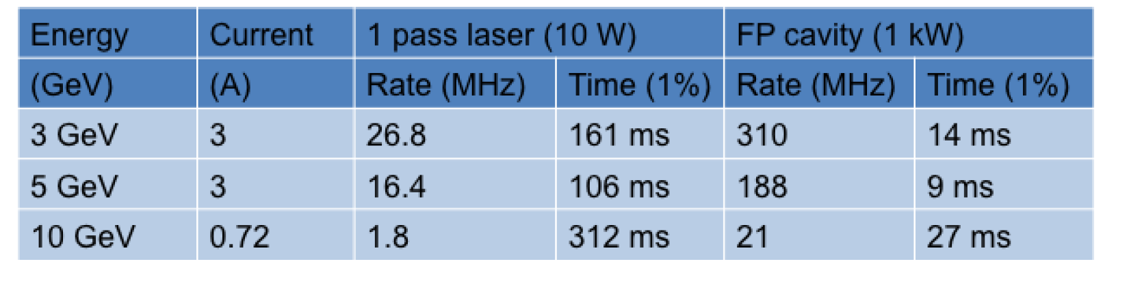
Compton counting rates
JLEIC
Only considering Compton cross-section: no background
Total average polarization in 27 ms
1320 or 330 bunches both options ok unless high background

Slide 22
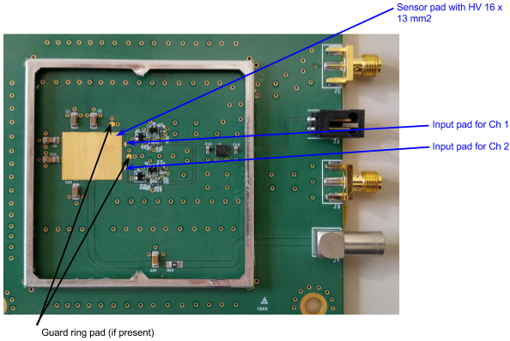
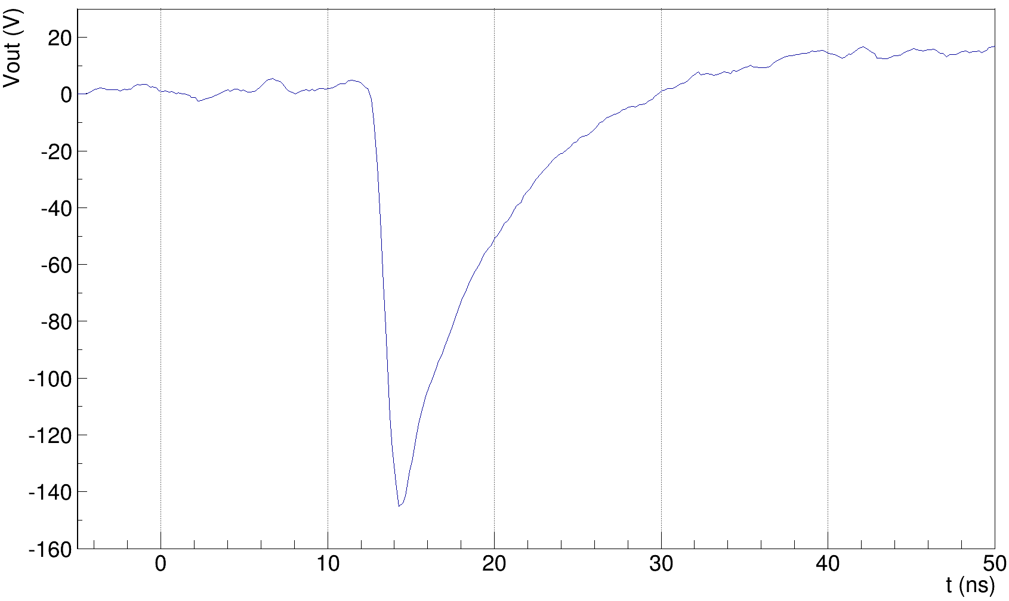
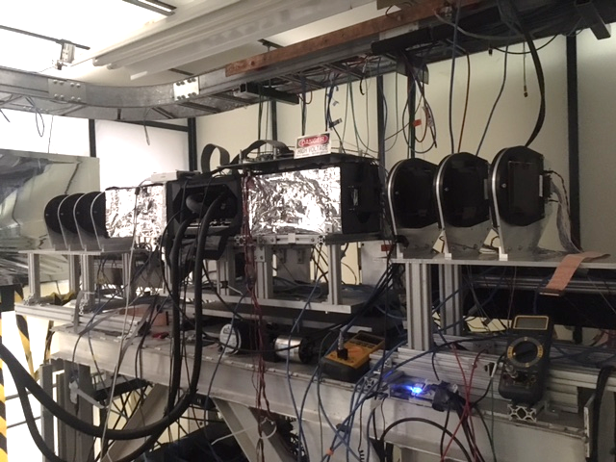
Electronics for very fast detectors
TOTEM electronics designed by Kansas University
A two channels board was designed and manufactured for the characterization of different solid state detectors.
Sensors up to 16x13 mm² can be glued and bonded.
The components can be easily adapted to accommodate:
Diamond sensors: ~1 nA bias current, both polarities, small signal
Silicon sensors: ~100 nA bias current, small signal
UFSD ~100 nA bias current, ~ larger signal
SiPM: ~ 5 uA bias current, large signal
3x3 mm² UFSD
MIP beam test @ Fermilab
The board was optimized to achieve a good time precision with different sensors, however it can be modified to have an output signal shorter (but less precise)
~40 ps measured time precision
Test of Ultra Fast Silicon Detectors for Picosecond Time Measurements with a New Multipurpose Read-Out Board

Slide 23
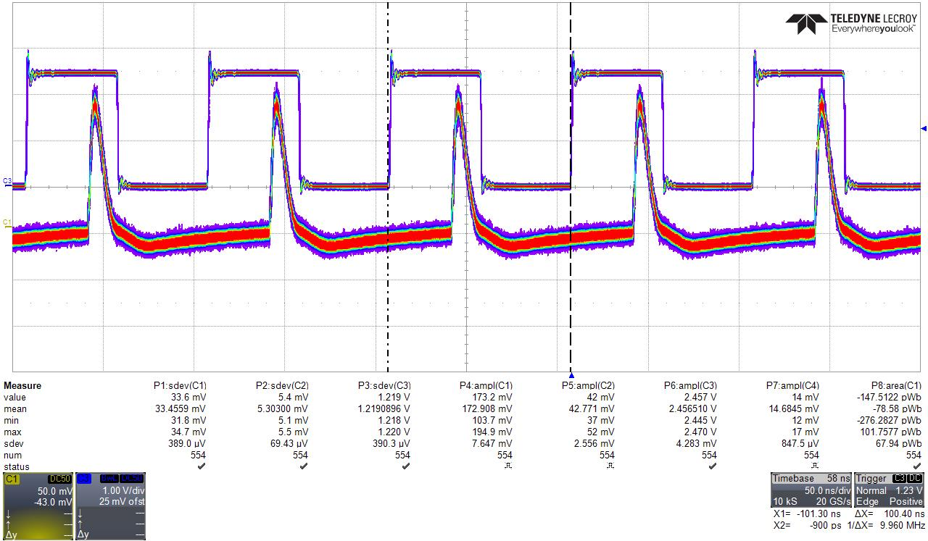
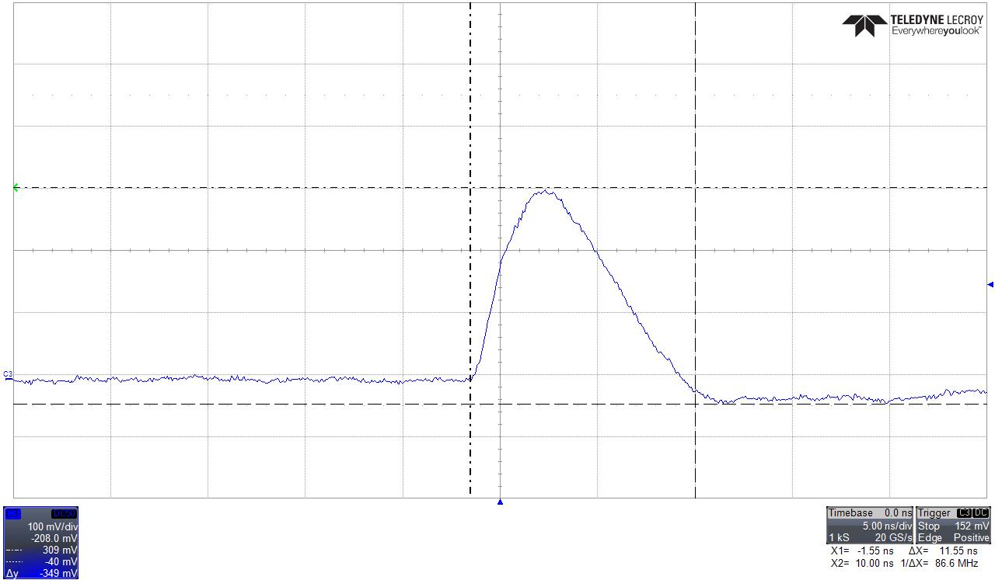
Silicon pulsed with laser at 10 MHz
100 ns
Amplifier with silicon detector fast enough to separate successive sources for eRHIC Linac Ring at 10 MHz
(New proposal for up to 476 MHz )
12 ns

Slide 24
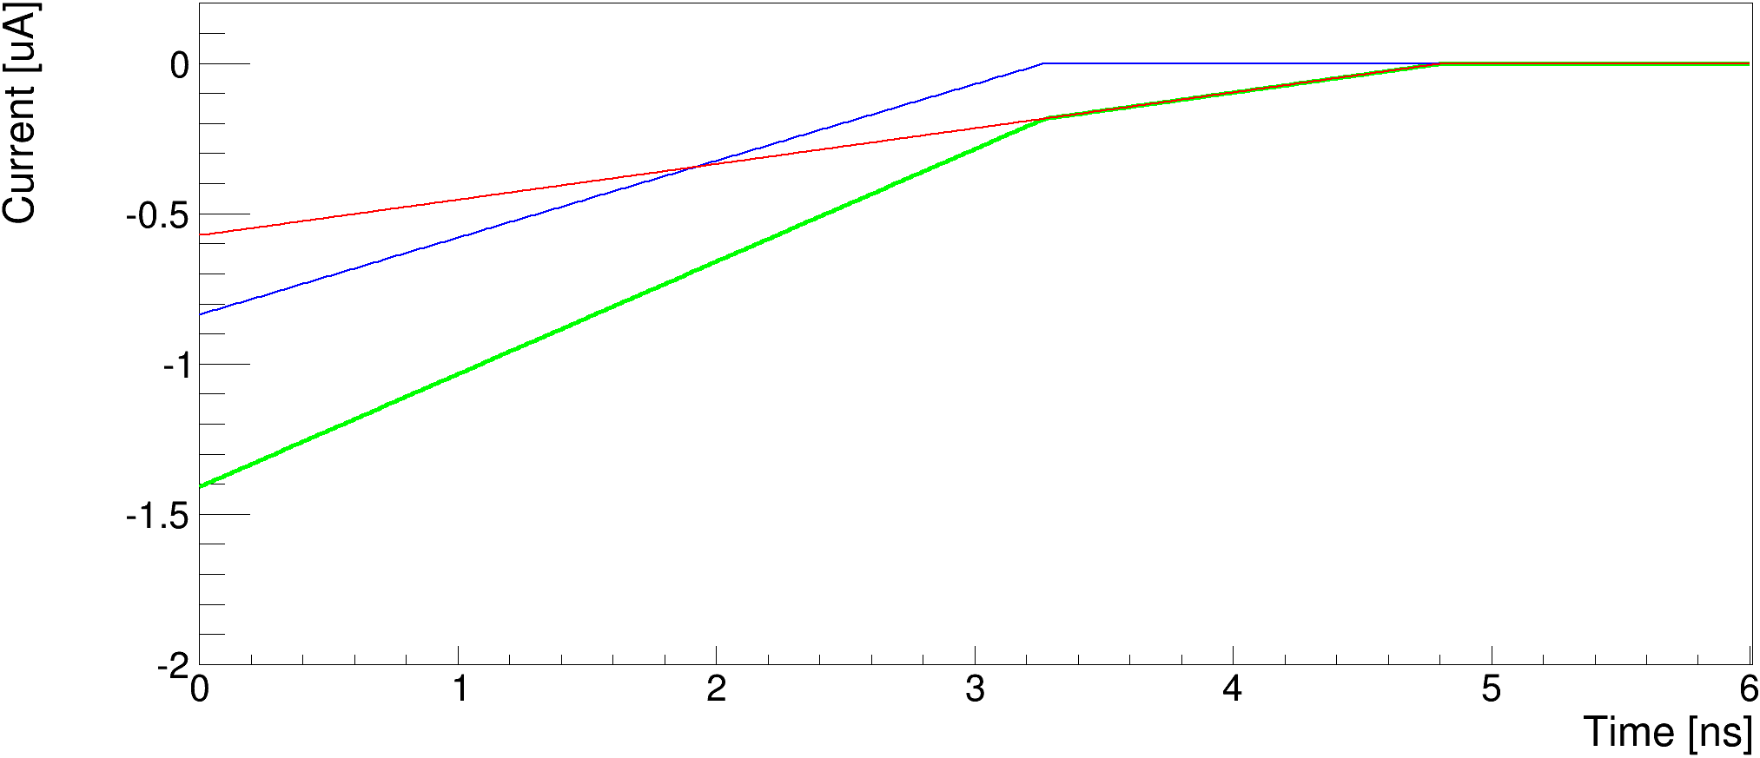
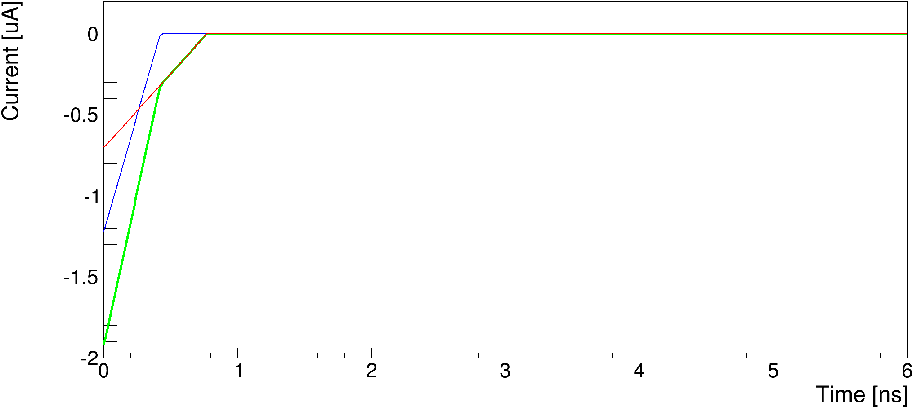
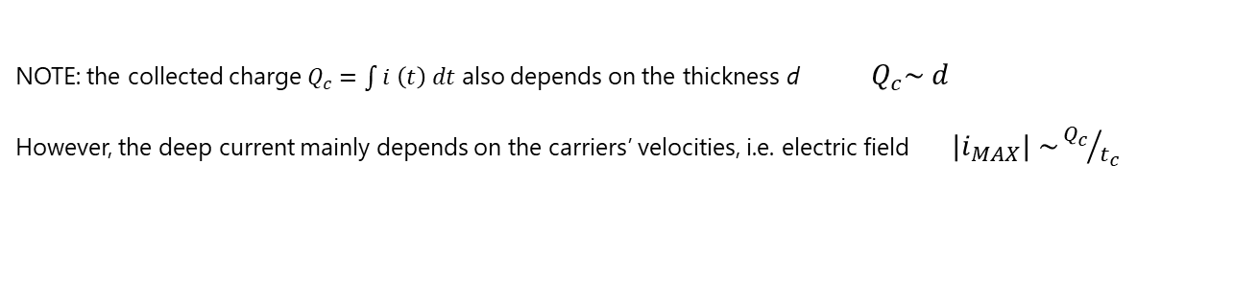

Fast detector R&D
Diamond sensors are among the fastest available
Electrons
Holes
Total
Electrons
Holes
Total
Charge collection time too long!
500 μm scCVD diamond @ 800V
80 μm scCVD diamond @ 500V
The collection time $t_{c}$ depends on the thickness d $t_{c}\sim d/{v_{s}}$
NOTE: the collected charge $Q_{c}=\int{i \left(t\right) dt}$ also depends on the thickness d $Q_{c}\sim d$
However, the deep current mainly depends on the carriers’ velocities, i.e. electric field ${|i}_{MAX}| \sim {Q_{c}}/{t_{c}}$

Slide 25
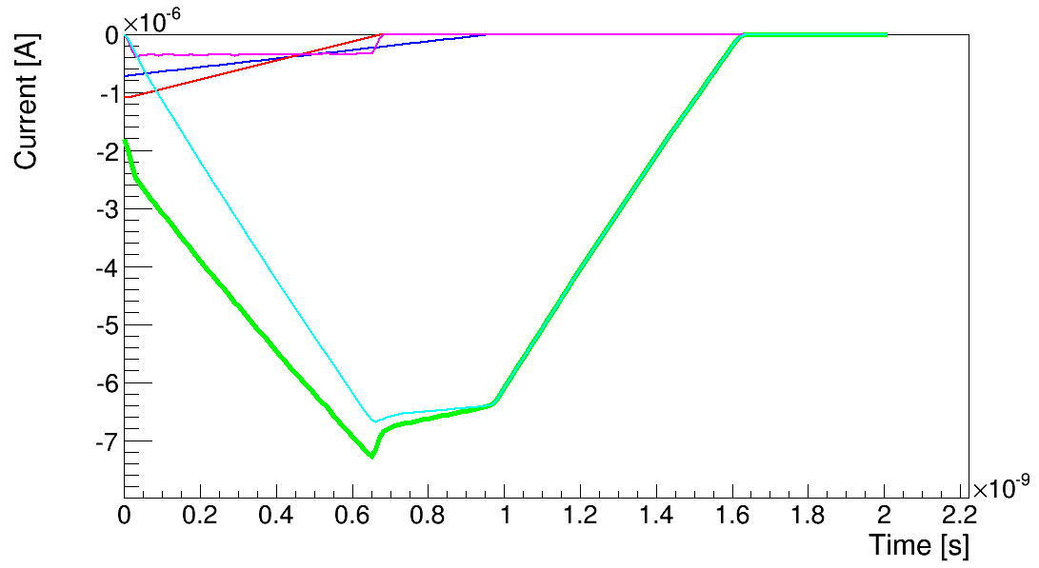
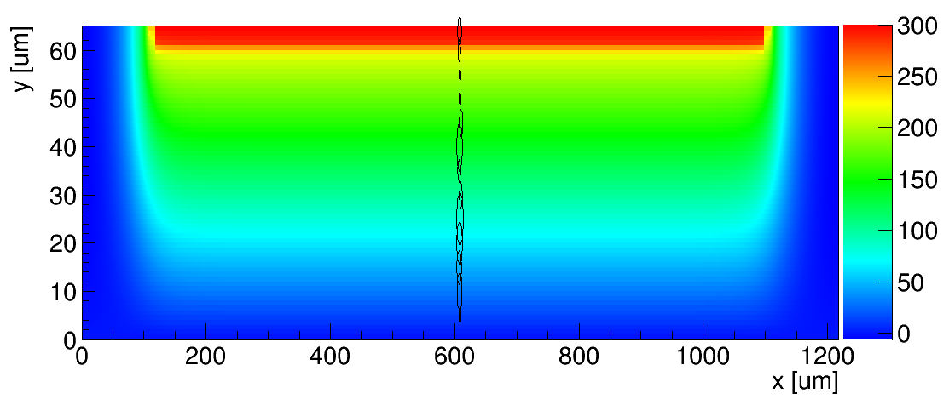
Fast detector R&D
Ultra Fast Silicon Detectors: as fast as diamond, but with a gain layer!
Gain layer
Electrons (Multiplied)
Holes (Multiplied)
Total
UFSD: 50 μm LGAD
Fast collection time (50 μm thick) and larger signals, thanks to the gain layer

Slide 26
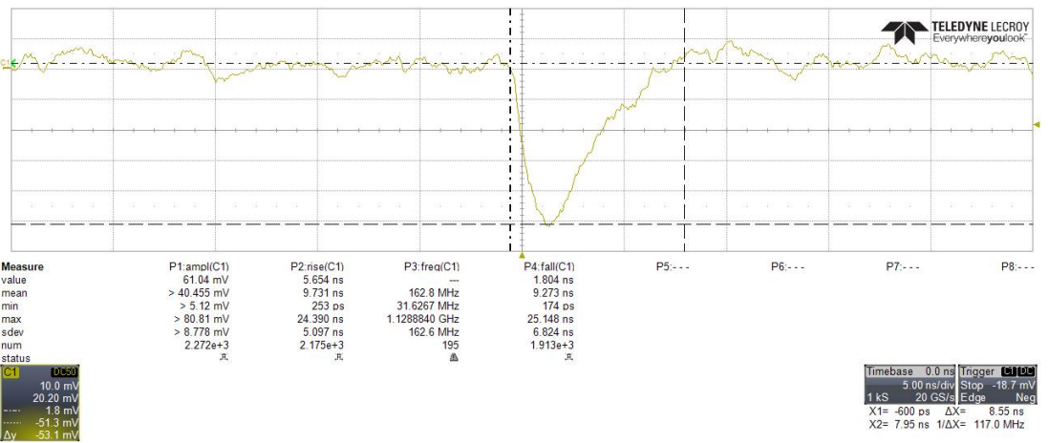
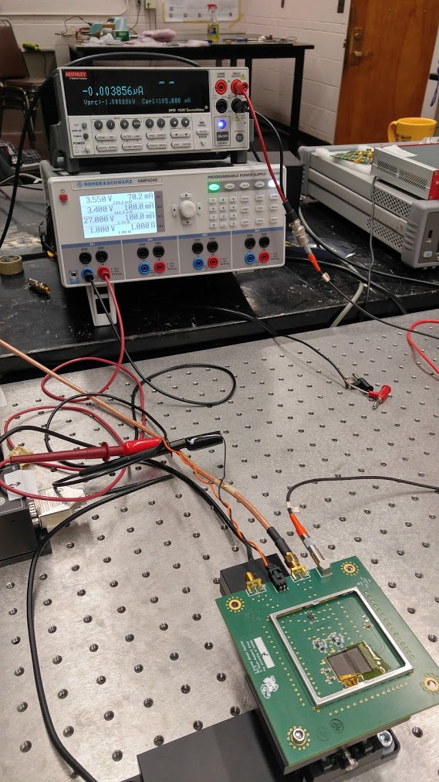
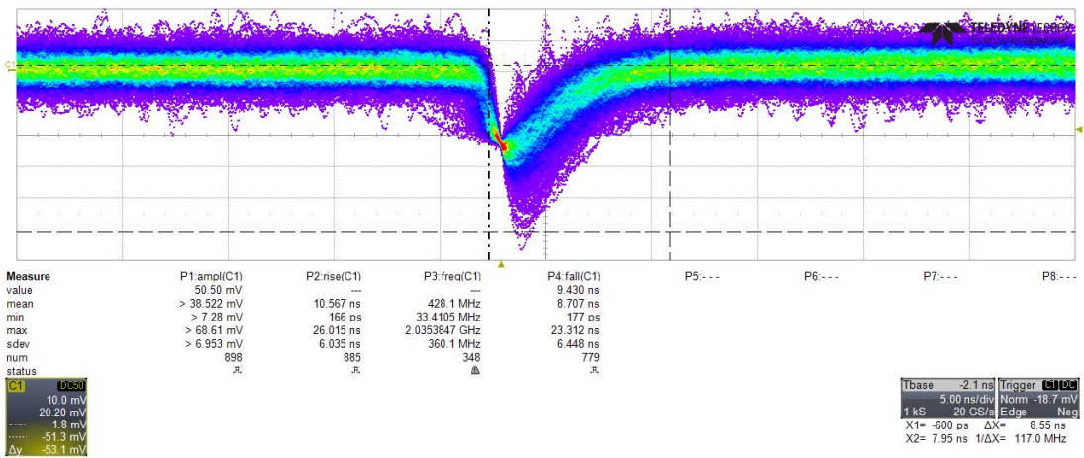
Electronics for very fast detectors
This board was also used to test the performance of a diamond sensor using a Sr⁹⁰ β⁻ source.
8.55 ns
500 μm pcCVD diamond

Slide 27
Fast detector R&D
Simulated results:
UFSD
80 μm scCVD diamond sensor
NOISE: ~1.5 mV RMS
NOISE: ~2 mV RMS
SNR ~ 25
SNR ~ 5
Study by Nicola Minafra

Slide 28
Photon detector
Same can be done with photon detector
Pro:
  Redundant measurement with electron detector
  Can measure transverse polarization
Con:
  More sensitive to synchrotron background

Slide 29
Photon detection
Segmented calorimeter
  PbWO4, PbF2
  Shashlyk
  (scinitillator or quartz fibers )
  Particle flow (?)
Pair spectrometer
Converter
Trackers : GEM or MAPS

Slide 30
Sensors
Radiation hard
Faster than 10 ns ( diamond / maps / Cerenkov + MCP PMT , thin gap GEMs )
Radiation hard where photon flux is high

Slide 31
HERA TPOL

Slide 32
HERA transverse polarimeter

Slide 33
EIC R&D eRD12
Study for eRHIC
Found adequate location
2 minutes measurement
More refined study to come ( background )

Slide 34
To do list
Location polarimeters
Include in eRHIC simulation
Look background : Brehmstrahlung
Background from halo
Beam induced background
Synchrotron
Wakefield
Effect of bunch replacement on electron detector

Slide 35
Conclusion
Pretty extensive study for JLEIC, electron detector seemed feasible, should work for eRHIC, need location after a magnet
Event generator can be reused
Detector need to be implemented in eRHIC
Redo background studies : bremsstrahlung, synchrotron, halo, beam induced
Wakefield
Need to look more at photon side
R&D for fast detectors for photon side

