Slide 1
Practice on Simulation and Signal Processing for ICARUS
Wenqiang Gu

Slide 2
Current working plan
More *: higher priority
 | Simulation | Data
Noise model (AS) | xx | -
Field response | xxx | xxx
Elec response (AS) | x | x
NF (AS, WG) | xx | xx
SP (AS, WG) | xx | x
Connection to larsoft (WG) | xxx | xxx
Test dataset (AS, WG) | - | xxx
Done by Yichen yesterday.

Slide 3
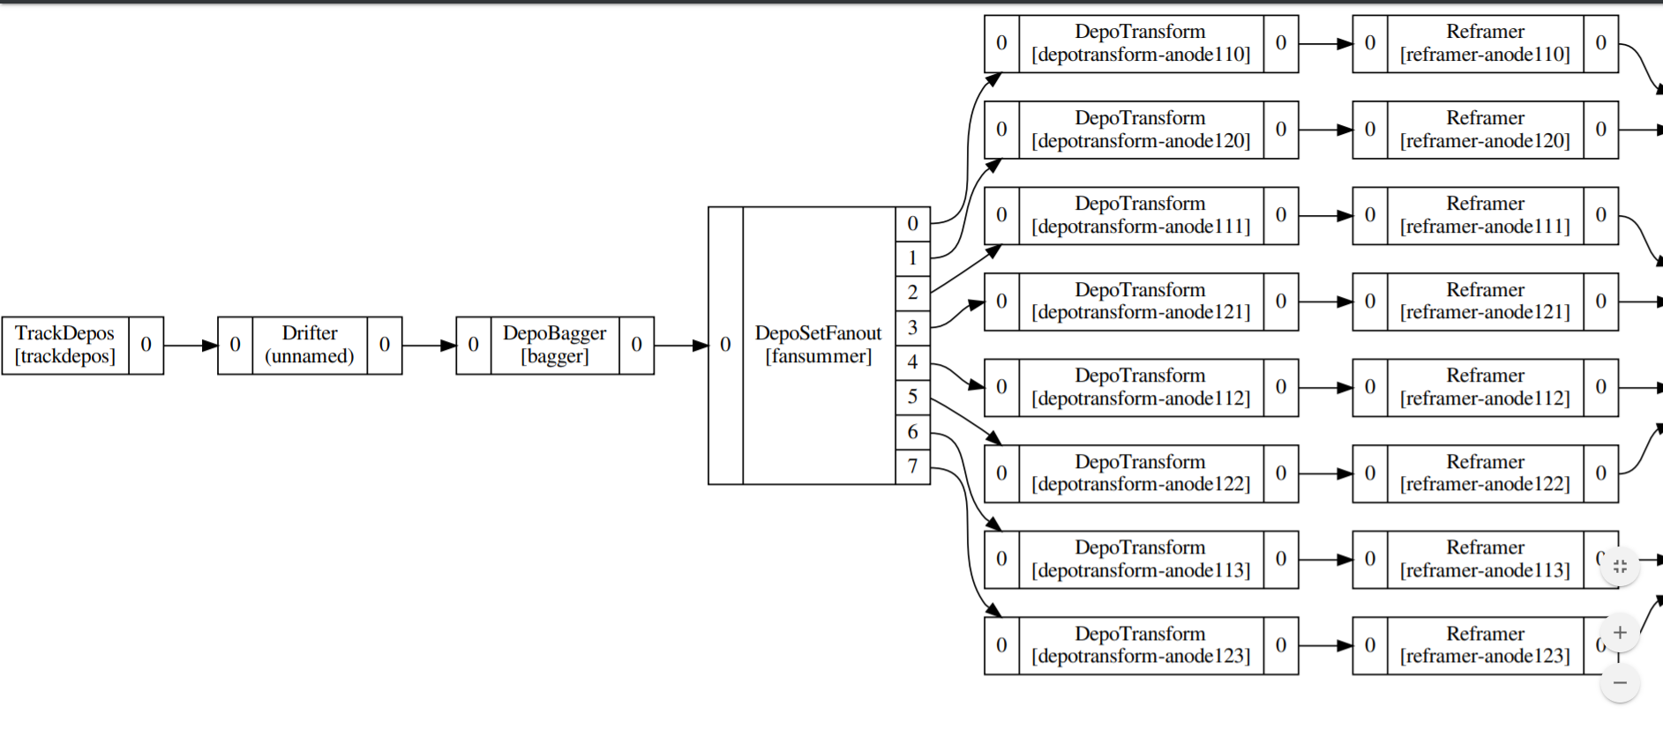
Flowchart for TPC simulation and signal processing
TPC #3
Anode “13”
1st induction (split 1)
2nd induction
collection
Anode “23”
1st induction (split 1)
2nd induction
collection
2 splits per anode

Slide 4
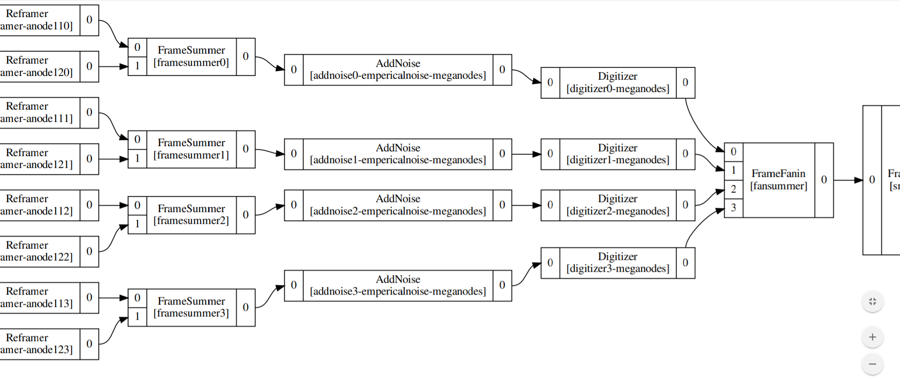
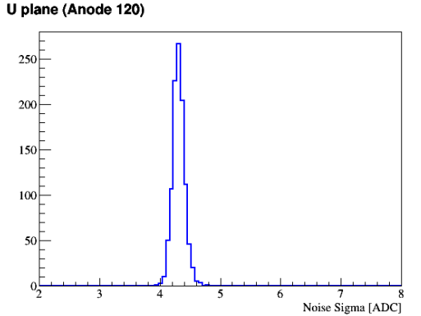
Noise RMS ~ 4ADC
Using a protoDUNE noise model
Consistent with expectation
Should add Andrea’s model next time

Slide 5
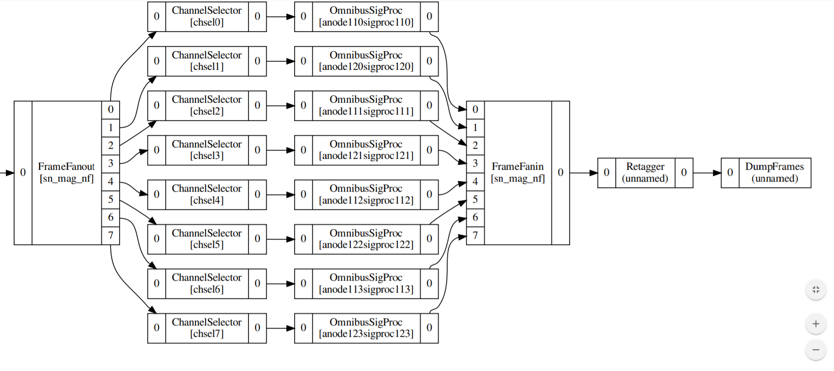
Save to LarSoft

Slide 6
Practice example
Simulate a single diagonal track crossing through the entire volume
Expect to see one track per plane

Slide 7
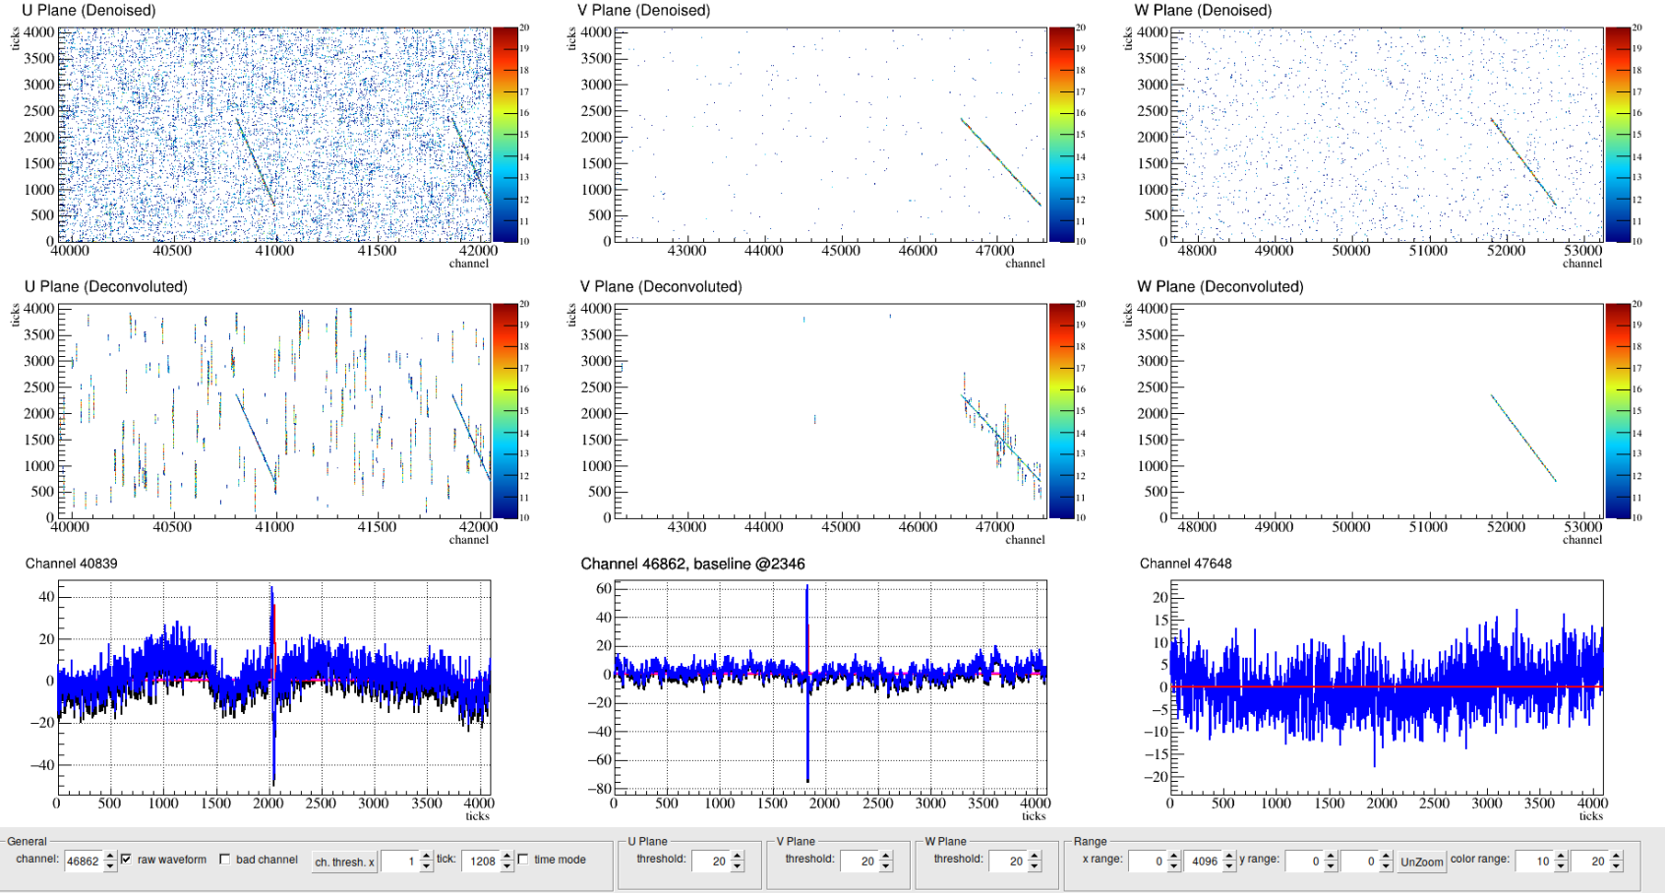
Magnify display
Why two tracks?

Slide 8
Calculation of the sensitive volume
Previously, calculate sensitive volume based on collection plane & drift distance
But in our case, the cross section of the collection plane is same for anode “11” and “12”.
Now calculate sensitive volume per plane, finally get the intersection
One TPC module
drift
Anode “11”
1st induction (split 1)
2nd induction
collection
Anode “12”
1st induction (split 1)
2nd induction
collection

Slide 9
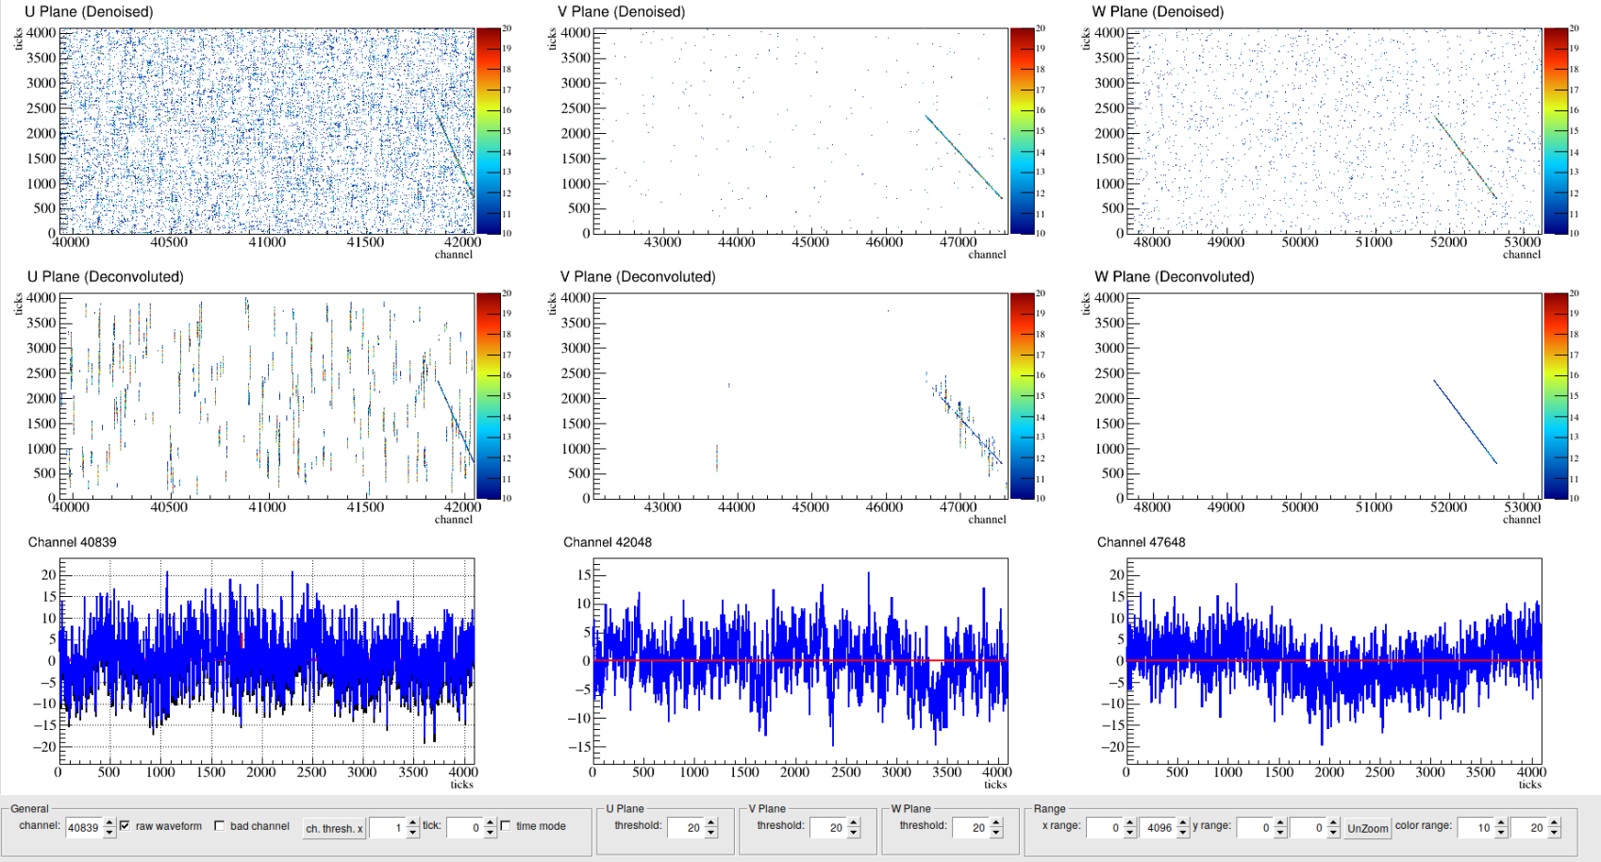

Slide 10
Some quick plots for filed response simulation

Slide 11
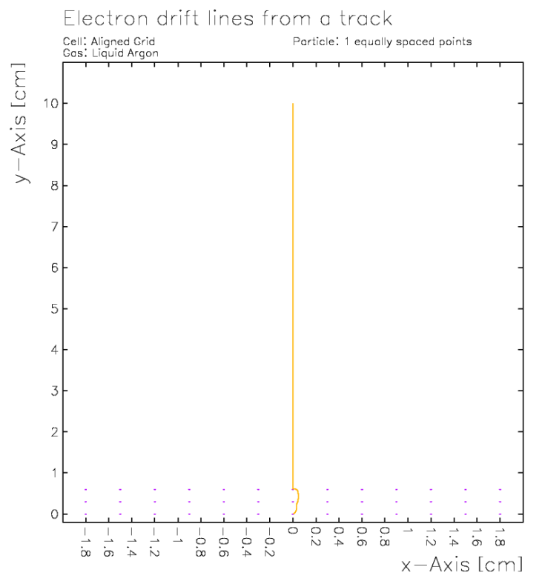
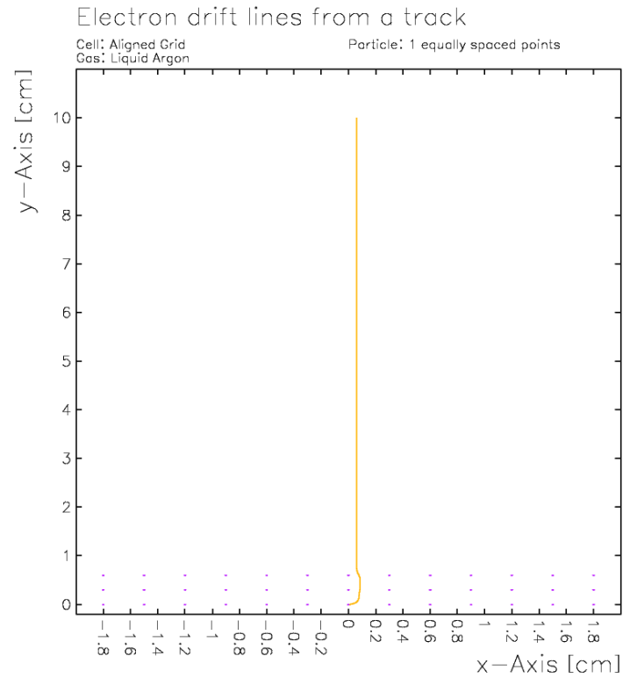
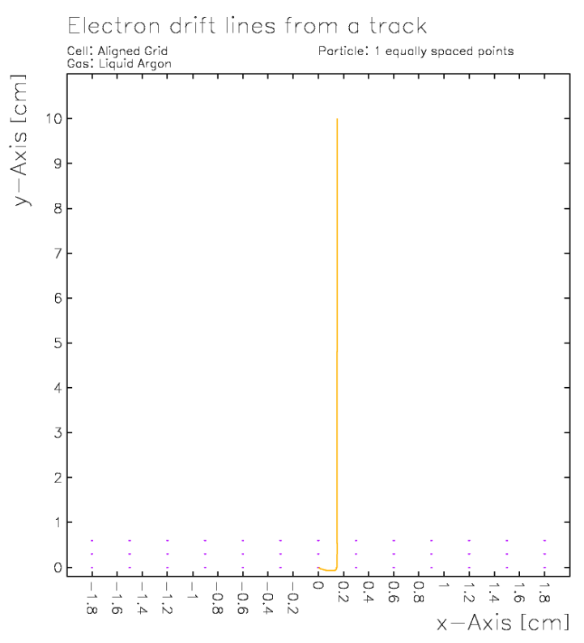
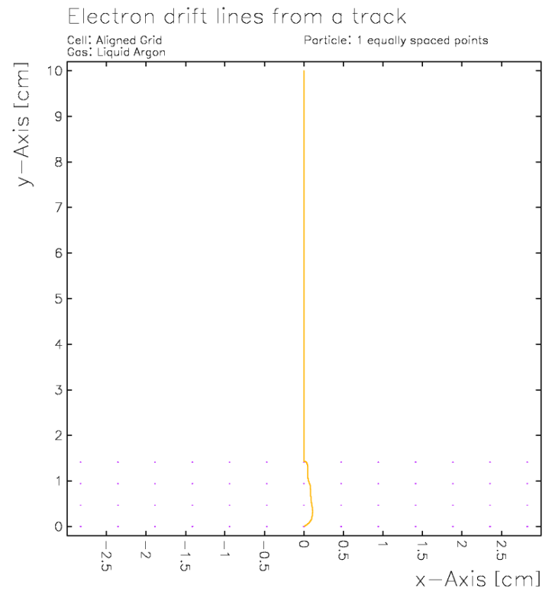
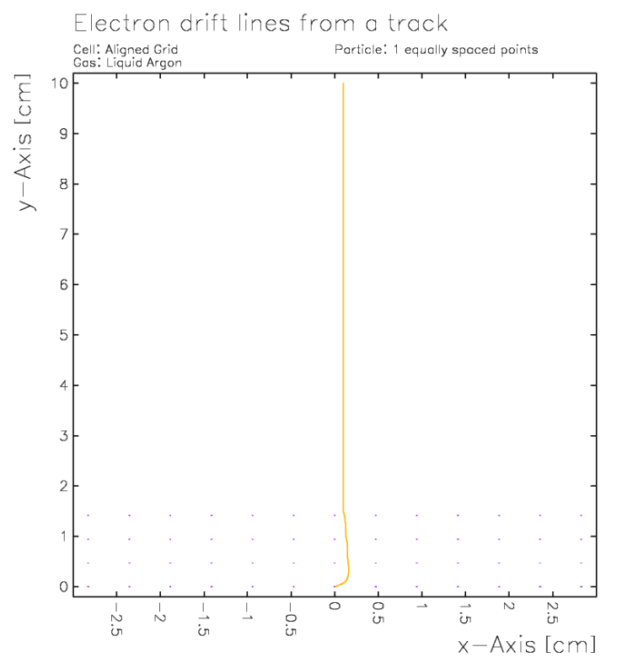
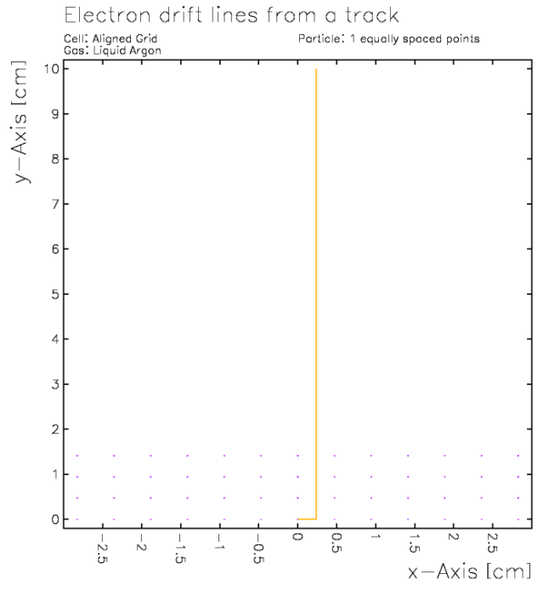
U: -240V
V: +10V
X: +260V
ICARUS
0.0 mm
0.6 mm
1.5 mm
Transparency?
DUNE
G: -665V
U: -370V
V: 0V
X: +820V
0.0 mm
0.942 mm
2.355 mm
More repulsive

Slide 12
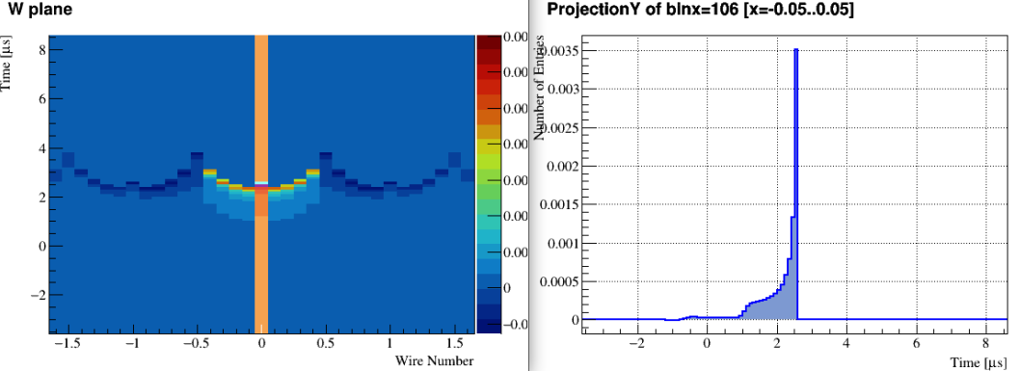
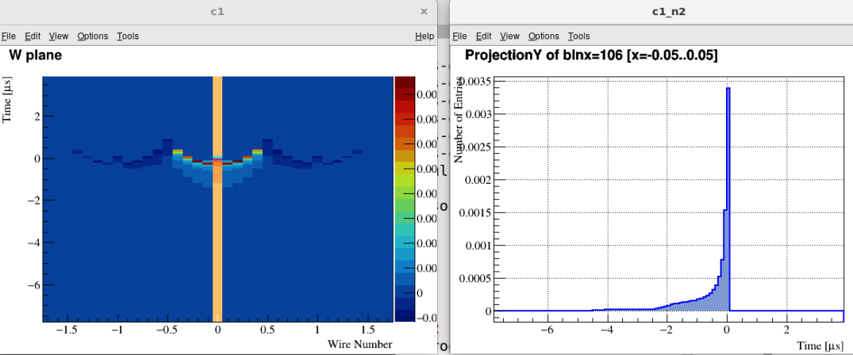
ICARUS
DUNE

Slide 13
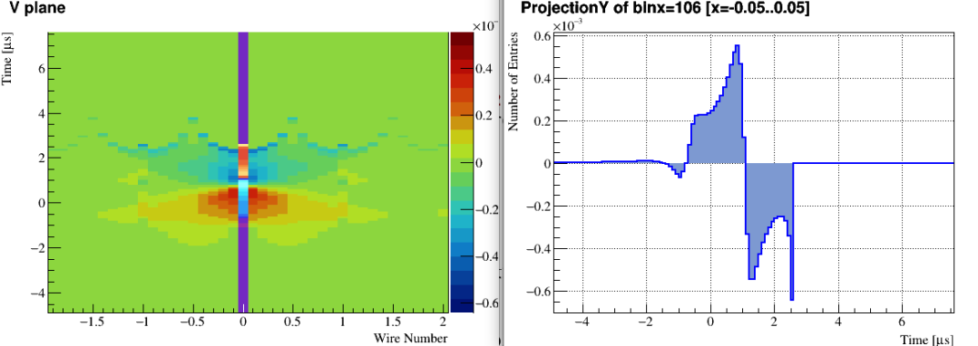
Long-range induction
Induction from the deceleration due to the collection on W plane
ICARUS
Deceleration because of U plane?

Slide 14
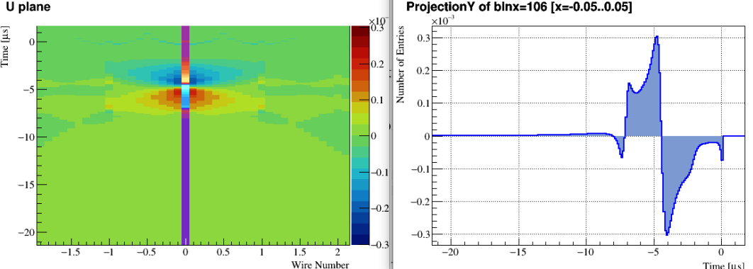
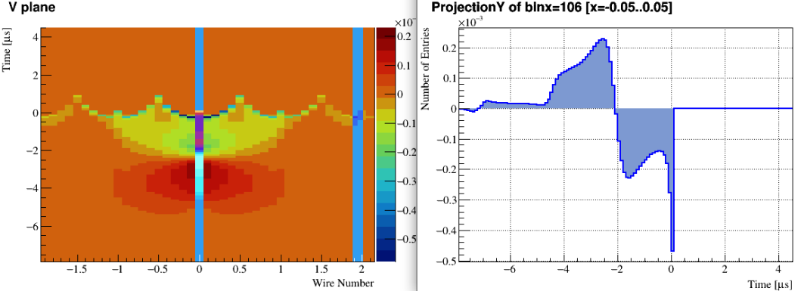
DUNE’s U plane is like V plane in ICARUS
Because of the Grid plane
DUNE

Slide 15
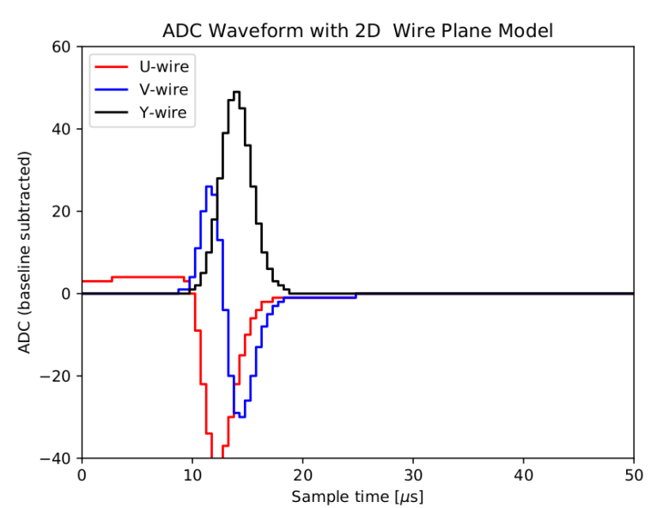
Total field response from perpendicular tracks
(FIXME) Convolved with CE response from uboone
Does the U make sense? Need to check individual electron paths.

Slide 16
Backup

Slide 17
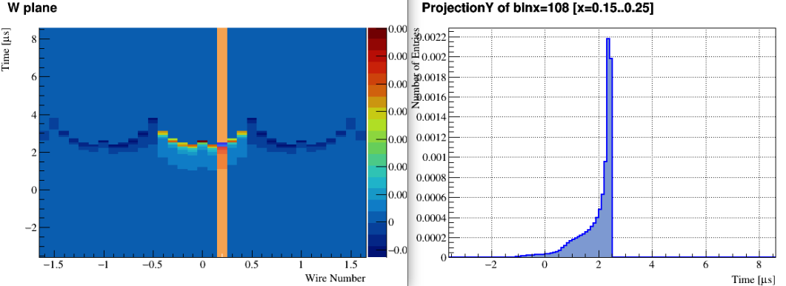
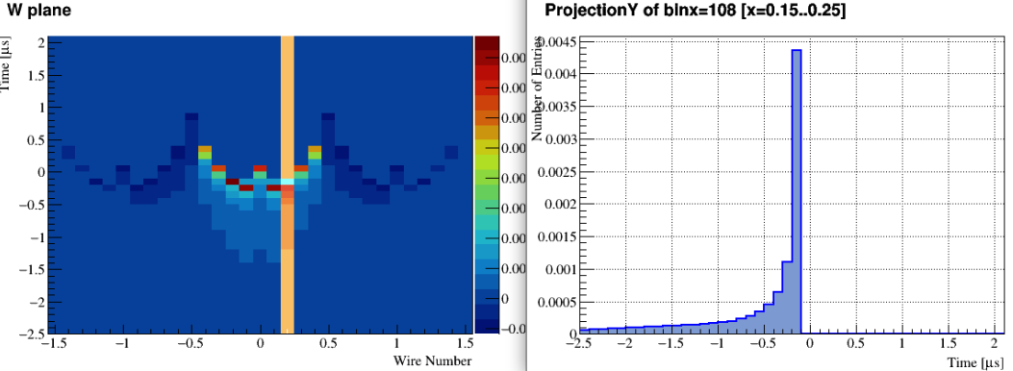
ICARUS
DUNE

Slide 18
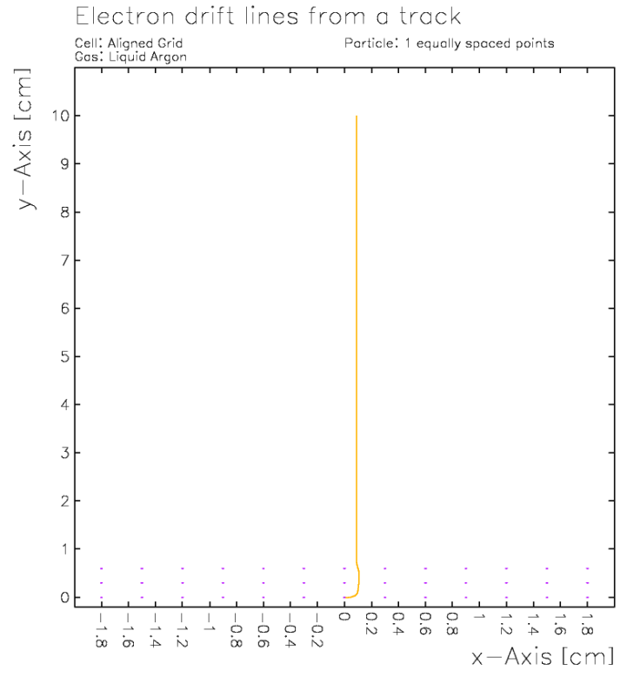
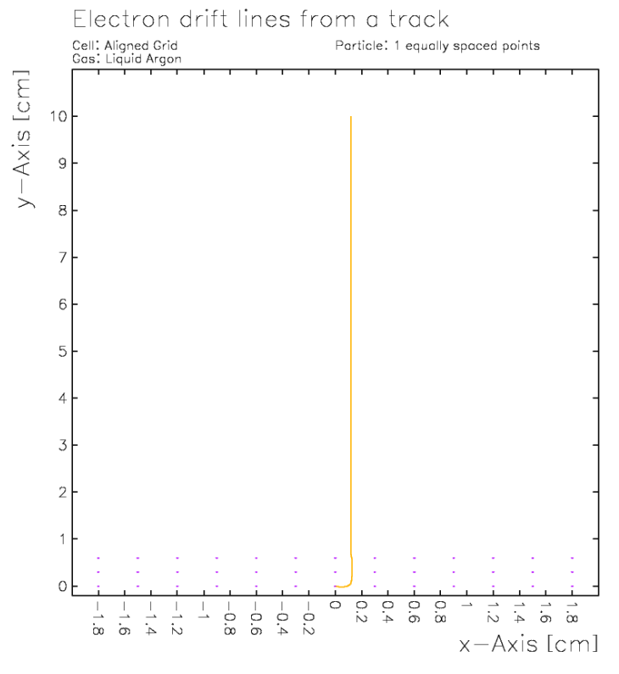
0.0 mm
0.3 mm
0.6 mm
0.9 mm
1.2 mm
1.5 mm

Slide 19
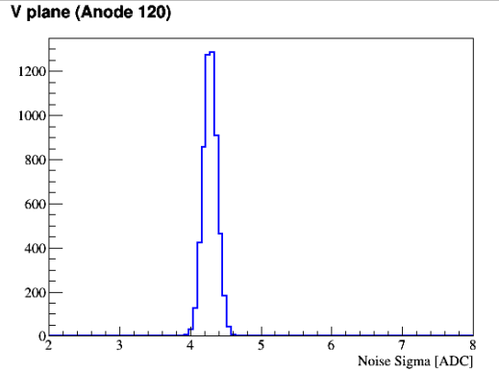
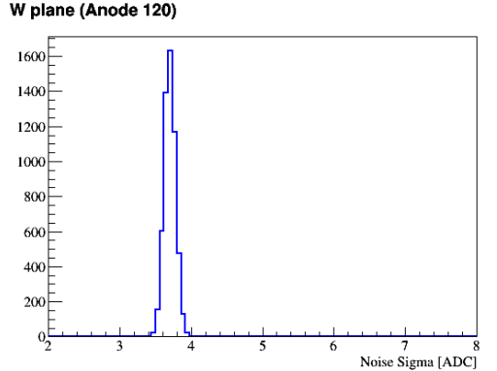
Noise after FrameSummer
Reasonable noise level from simulation
Using a protoDUNE noise model

