Slide 1
Beam Polarization and Polarimetry at EIC
Transparent Spine Mode for Polarized Beams in the EIC
Yu.N. Filatov, A.M. Kondratenko, M.A. Kondratenko
MIPT, Dolgoprudny, Russia
Ya.S. Derbenev, V.S. Morozov
Jefferson Lab, Newport News, VA, USA
26 June, 2020

Slide 2
Outline
Spin transparency mode
Polarization control scheme for deuterons at RHIC in ST mode
Polarization control scheme for protons at RHIC in ST mode
Spin tracking simulation ST mode
Summary
Yu.Filatov et al. Transparent Spine Mode for Polarized Beams in the EIC,6 June, 2020

Slide 3
Main Features of Spin Transparency Mode
Control of the polarization by weak magnetic fields not affecting the orbital dynamics,
Accelerate the beam without polarization loss,
Maintain stable polarization during an experiment,
Set any required polarization direction at any orbital location in a collider,
Change the polarization direction during an experiment,
Do frequent coherent spin flips of the beam to reduce experiment’s systematic errors,
Carry out ultra-high precision experiments.
Yu.Filatov et al. Transparent Spine Mode for Polarized Beams in the EIC,6 June, 2020

Slide 4
Spin Motion at Conventional Circular Accelerator
The spin equilibrium closed orbit
$$\vec{n}\left(z+L\right)=\vec{n}(z)$$
is a periodical axis of precession
$$\vec{S}=J⋅\vec{n}+{\vec{S}}_{⊥}, J=\vec{S}⋅\vec{n}, {\vec{S}}_{⊥}⊥\vec{n}$$
Spin vector rotates around n-axis:
If ${\vec{S}}_{0}∥ \vec{n}⇒{\vec{S}}_{0}={\vec{S}}_{L}$
If ${\vec{S}}_{0}⊥ \vec{n}⇒{\vec{S}}_{L}⊥\vec{n}, ∠\left({{\vec{S}}_{0},\vec{S}}_{L}\right)=Ψ=2πν$
$$ν$$
is a spin precession tune
Conventional accelerator
$$\vec{n}={\vec{e}}_{y}, ν=γG$$
$G=(g−2)/2$ is an anomalous part of gyromagnetic ratio
Spin mode | n-axes | Spin tune | Spin Control
Distinct Spin mode (DS mode) | periodic spin motion along the closed orbit is unique | $$\left\{ν\right\}≠0$$ | Spin Rotators based on strong magnetic fields
Spin Transparency mode (ST mode) | any spin direction repeats every particle turn | $$\left\{ν\right\}=0$$ | Spin navigators based on weak magnetic fields
Yu.Filatov et al. Transparent Spine Mode for Polarized Beams in the EIC,6 June, 2020

Slide 5
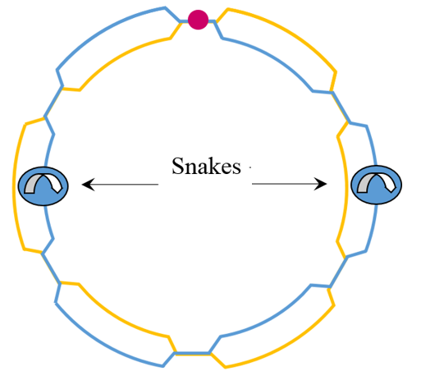
Spin Transparency Mode in RHIC at integer spin resonances
Vertical polarized beam is accelerated in RHIC up to energy which correspond to integer spin resonance
Snakes off
$$ν=γG=k$$
Discrete values of energy
Protons: $ΔE=0.523 GeV$(about of 500 energy points)
Deuterons:$ΔE=13.1 GeV$(about of 20 energy points)
Yu.Filatov et al. Transparent Spine Mode for Polarized Beams in the EIC,6 June, 2020

Slide 6
Ion polarization control using Spin Navigator
$$φ_{z1}$$
IP
$φ_{z1}$ stabilizes longitudinal spin direction before the dipole ($φ_{y}=γGα_{orb}$)
$$\vec{n}$$
$$φ_{y}$$
$$φ_{z2}$$
IP
$$\vec{n}$$
$φ_{z2}$ stabilizes longitudinal spin direction after the dipole
$$φ_{y}$$
$$φ_{z1}$$
$$φ_{z2}$$
IP
$$\vec{n}$$
Vector diagram of a spin navigator consisting of two solenoids
$$φ_{y}$$
$$x$$
$${\vec{φ}}_{z1}$$
$2πν \vec{n}$
$$z$$
$$φ_{y}$$
$$2πν \vec{n}={\vec{φ}}_{z1}+{\vec{φ}}_{z2}$$
$${\vec{φ}}_{z2}$$
$$φ_{z1}=2πν\left(n_{z}−\frac{n_{x}}{\tan{φ_{y}}}\right)$$
$${ φ}_{z2}=2πν\frac{n_{x}}{\sin{φ_{y}}}$$
$$B_{zi}L_{z}=\frac{φ_{zi} }{1+G}Bρ$$
Yu.Filatov et al. Transparent Spine Mode for Polarized Beams in the EIC,6 June, 2020

Slide 7
Integer Spin Resonance strength & Spin Stability Criterion
The total integer spin resonance strength
$$ω=ω_{coh}+ω_{emitt}, ω_{emitt}≪ω_{coh}$$ is composed of
coherent part $ω_{coh}$ due to closed orbit excursions
incoherent part $ω_{emitt}$ due to transverse and longitudinal emittances
Spin stability criterion
the spin tune induced by the spin navigator must significantly exceed the strength of the integer spin resonance
$$ν≫ω_{emitt}$$
for proton beam $ν={10}^{−2}$
for deuteron beam $ν={10}^{−4}$
Yu.Filatov et al. Transparent Spine Mode for Polarized Beams in the EIC,6 June, 2020

Slide 8
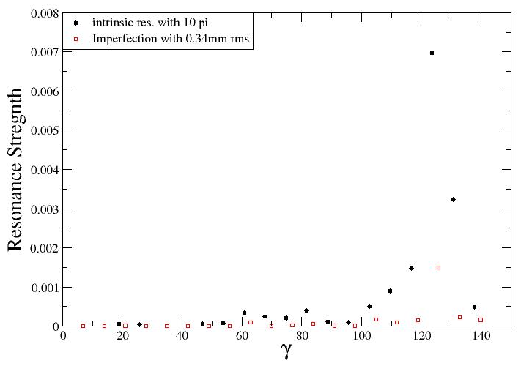
Integer resonance strengths for deuterons in RHIC
F. Lin, V. Morozov
based on presentations by H. Huang, C. Montag, V. Ptitsyn, and F. Willeke
Navigator solenoids field integral about of 6 T$⋅m$ ($ν={10}^{−3}$) is sufficient for control of deuteron polarization in RHIC collider over all energy range.
Yu.Filatov et al. Transparent Spine Mode for Polarized Beams in the EIC,6 June, 2020

Slide 9
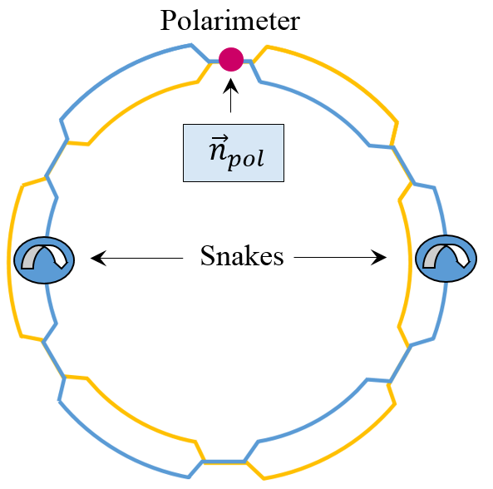
Spin Transparency Mode for protons
The spin tune is determined by the angle φ between the snake axes and the stable polarization in the collider’s arcs is vertical:
$$ν=\frac{φ}{π}, {\vec{n}}_{arc}={±\vec{e}}_{y}.$$
$$ν=0$$
The spin tune equals one half (RHIC’s regular mode of operation) if the angle between the snake axes is $π/2$.
To convert RHIC to the TS mode, when the spin tune is zero (or one), the angle between the snake axes must be set to zero (or $π$), i.e. the snakes must be identical.
Yu.Filatov et al. Transparent Spine Mode for Polarized Beams in the EIC,6 June, 2020

Slide 10
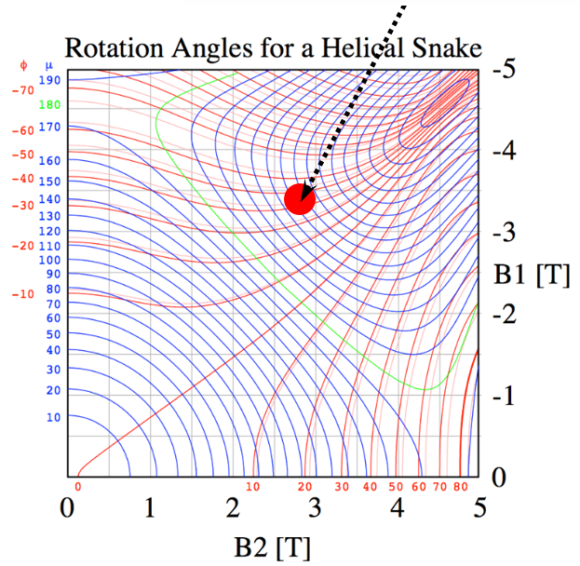
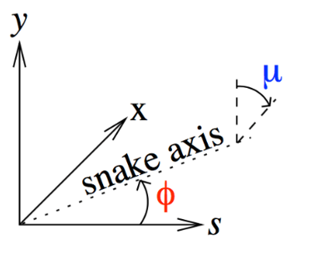
RHIC Snake Adjustment
Full snake with 0° axis
It is optimal to adjust the snake axes to 0°
Minimum field integral
Minimum orbit excursion
Yu.Filatov et al. Transparent Spine Mode for Polarized Beams in the EIC,6 June, 2020

Slide 11
Spin Navigator based on the RHIC Snakes
Polarization direction at the polarimeter ${\vec{n}}_{pol}=(n_{x}, n_{y},n_{z})$ can be controlled by adjusting a small angle $δα$ between the snake axes and small offsets $δμ_{1}$ and $δμ_{2}$ of the snakes’ spin rotation angles from $π$:
$${ ν}_{x}=\frac{δμ_{1}−δμ_{2}}{2π}\sin\left(\frac{γGπ}{2}\right), ν_{y}=\frac{δα}{π} ,$$
$$ν_{z}=−\frac{δμ_{1}+δμ_{2}}{2π}\cos\left(\frac{γGπ}{2}\right),$$
$$ν=\sqrt{ν_{x}^{2}+ν_{y}^{2}+ν_{z}^{2}} , {\vec{n}}_{pol}=\left(n_{x}, n_{y},n_{z}\right)=\frac{\left.{\left(ν\right.}_{x}, ν_{y},ν_{z}\right)}{ν}$$
Spin navigator allows one to set any 3D polarization direction at the polarimeter by small variation of the snake currents.
Exceptions are $γG=k$ points where the snake rotators allows one to set any 2D polarization orientation in the (yz) plane for even $k$ and in the (yx) plane for odd $k$.
Yu.Filatov et al. Transparent Spine Mode for Polarized Beams in the EIC,6 June, 2020

Slide 12
Setup of Spin Transparency Mode Test
RHIC is a perfect place for an experimental test of the spin transparency mode
No new hardware is needed
Make snake axes parallel at $0^{∘}$ to set RHIC in the spin transparency mode
Spin navigator
Small angle between the snake axes = vertical module
Small mismatch between the snake strengths = longitudinal module
Existing polarimeter
can test many of the features of the spin transparency mode and spin navigator
$$ν=0$$
Yu.Filatov et al. Transparent Spine Mode for Polarized Beams in the EIC,6 June, 2020

Slide 13
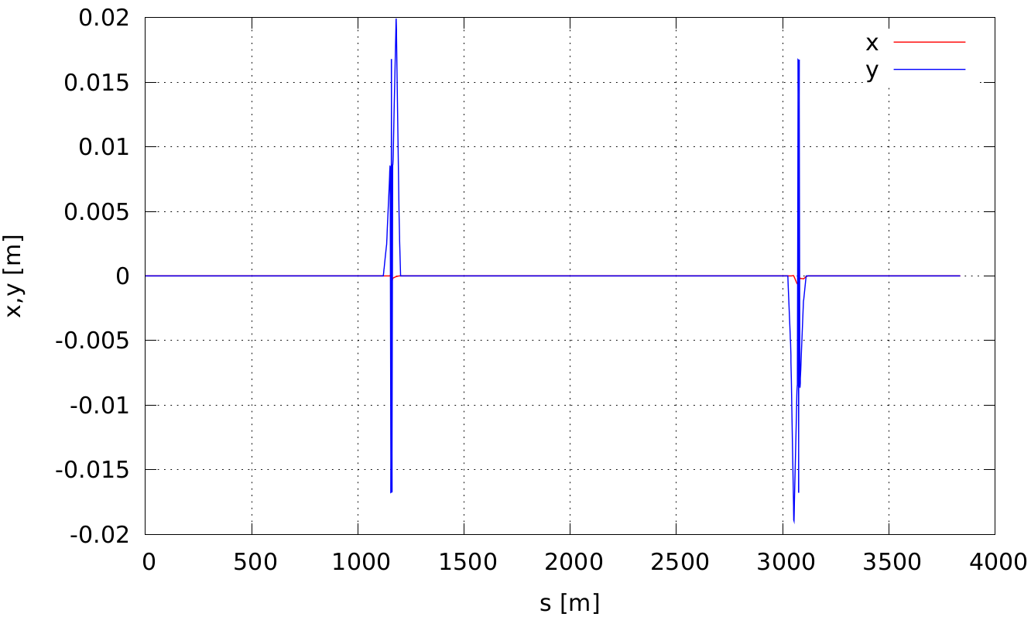
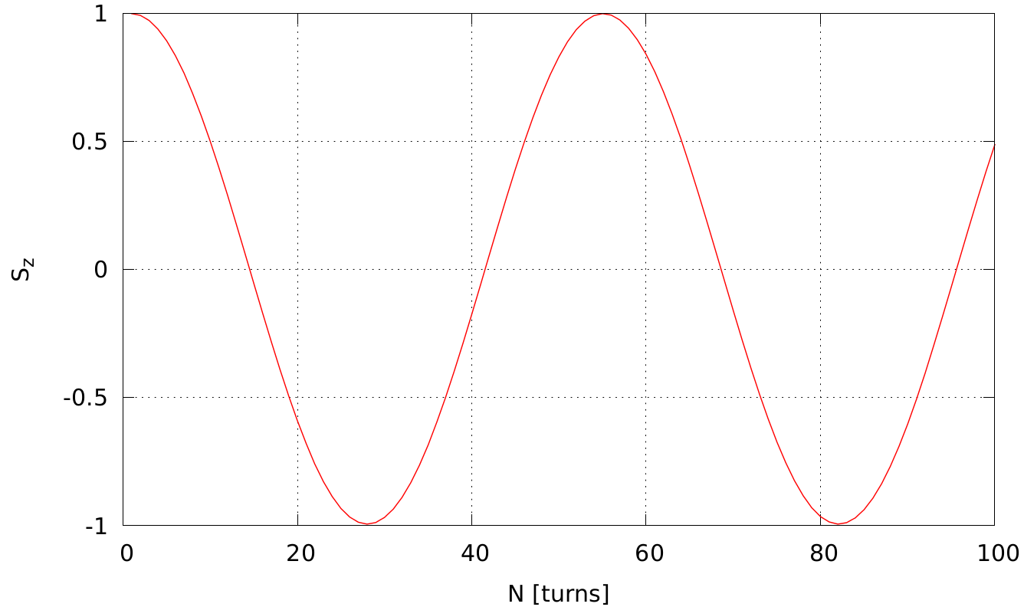
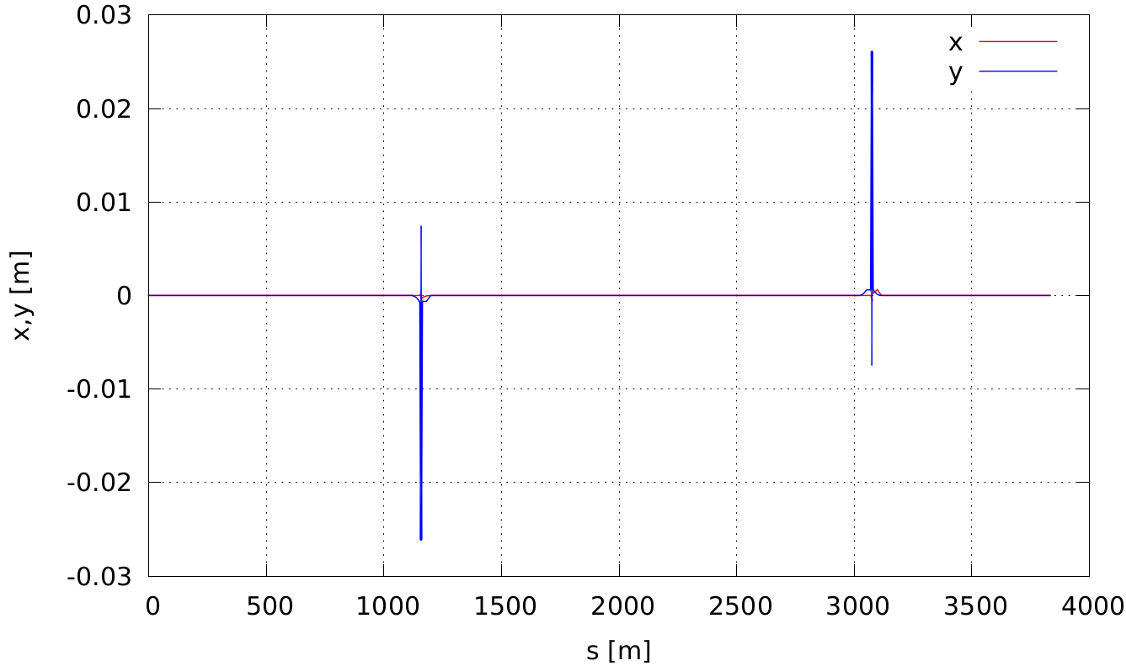
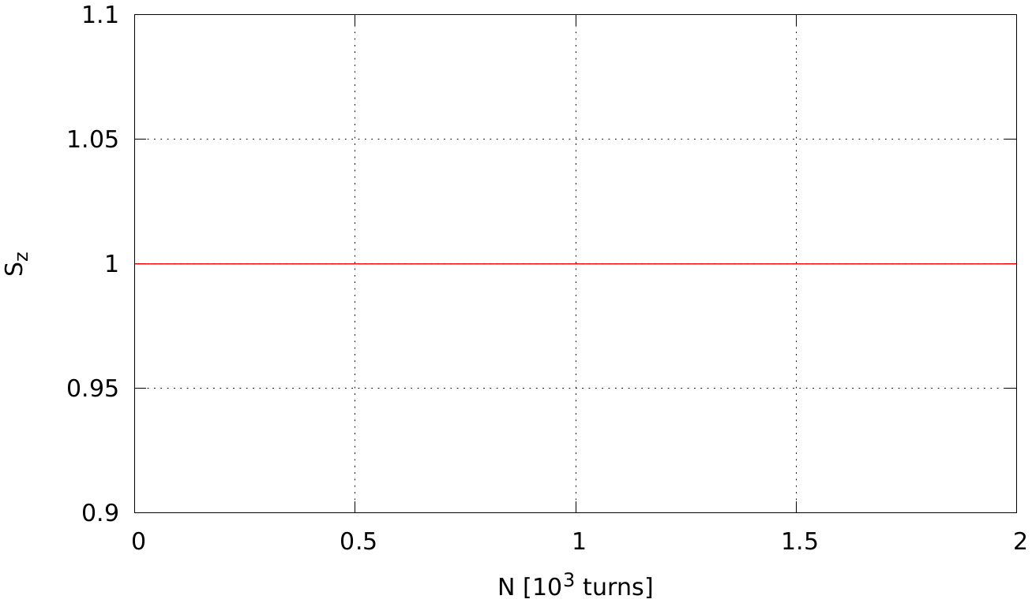
Spin tracking simulation. Adjustment of the ST mode in RHIC
Snakes modeled using field maps (ZGOUBI)
Separate optimization of snakes and orbit correction: resulting $ν_{s}≈1.85⋅{10}^{−2}$
Simultaneous adjustment of snakes and orbit correctors: $ν_{s}\sim 6⋅{10}^{−7}$
Yu.Filatov et al. Transparent Spine Mode for Polarized Beams in the EIC,6 June, 2020

Slide 14
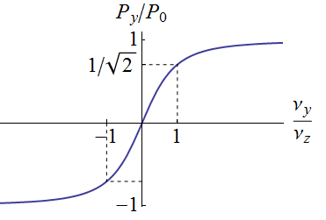
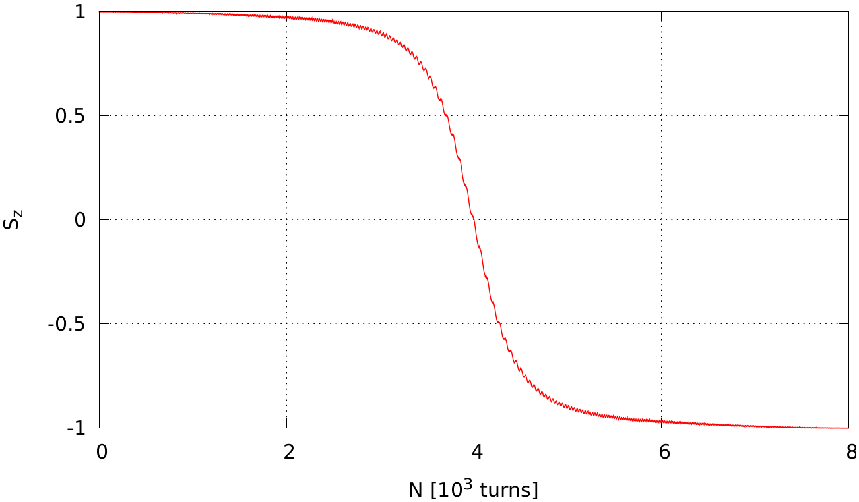
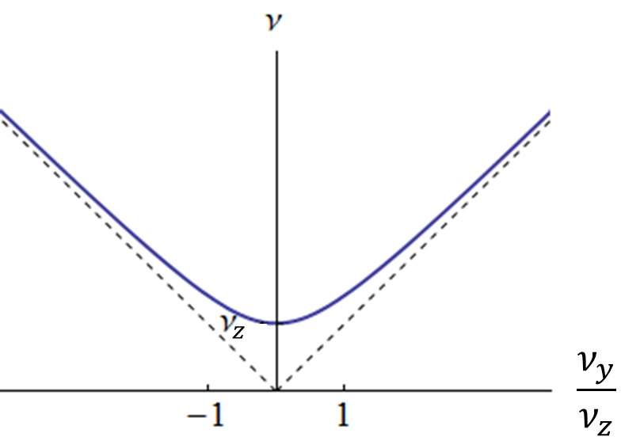
Spin tracking simulation. Adiabatic Spin Flip
Direction of Snake 1 axis adiabatically changed from $−{10}^{∘}$ to $+{10}^{∘}$
Near $0^{∘}$, spin stabilized by shifting Snake 2 spin rotation angle from ${180}^{∘}$ to ${175}^{∘}$
Analytic prediction
Zgoubi simulation
$$δα=−{10}^{∘}$$
$$δμ_{2}=0→−5^{∘}$$
$$S_{y}$$
$$δα=−{10}^{∘}→+{10}^{∘}$$
$$δμ_{2}=−5^{∘}→0$$
$${\left(n_{pol }\right)}_{y}=\frac{ν_{y}}{\sqrt{{ ν}_{y}^{2}+ν_{z}^{2}}}$$
$$δμ_{1}=δμ_{2}$$
Yu.Filatov et al. Transparent Spine Mode for Polarized Beams in the EIC,6 June, 2020

Slide 15
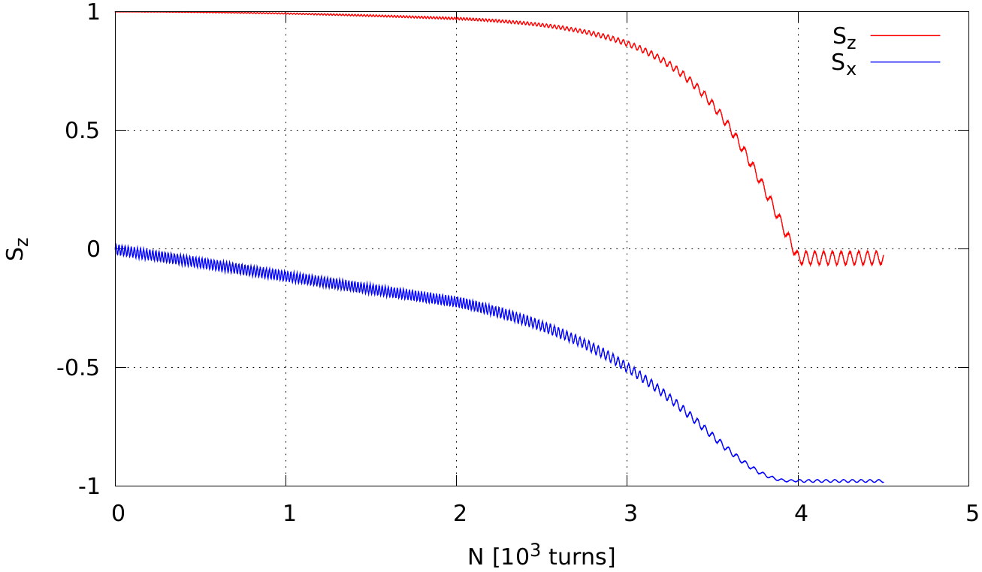
Spin tracking simulation. Adjustment of Longitudinal Polarization at IP
Adiabatic change of the spin direction by adjusting snake parameters
Initial vertical spin: $δα=−{10}^{∘}$
Final longitudinal spin: $δα=0^{∘}$, ${δμ_{1}=−5}^{∘}$, ${δμ_{2}=−5}^{∘}$
$$δα=−{10}^{∘}$$
Zgoubi simulation
$$S_{y}$$
$$S_{z}$$
$$δμ_{2}=0→−5^{∘}$$
$$δα=−{10}^{∘}→0$$
$$δμ_{1}=0→−5^{∘}$$
$$S_{y}$$
Yu.Filatov et al. Transparent Spine Mode for Polarized Beams in the EIC,6 June, 2020

Slide 16
Summary
The Spin Transparency mode allows one to significantly expand the capabilities of polarized beam experiments at the EIC.
It makes it possible for the RHIC-based EIC to manipulate the polarization during experiments in the whole energy ranges for protons and 3He, as well as for deuterons near energies corresponding to integer spin resonances.
Yu.Filatov et al. Transparent Spine Mode for Polarized Beams in the EIC,6 June, 2020

Slide 17
Thank you for your attention!

