Slide 1
Physics Drivers for polarized beams

Slide 2
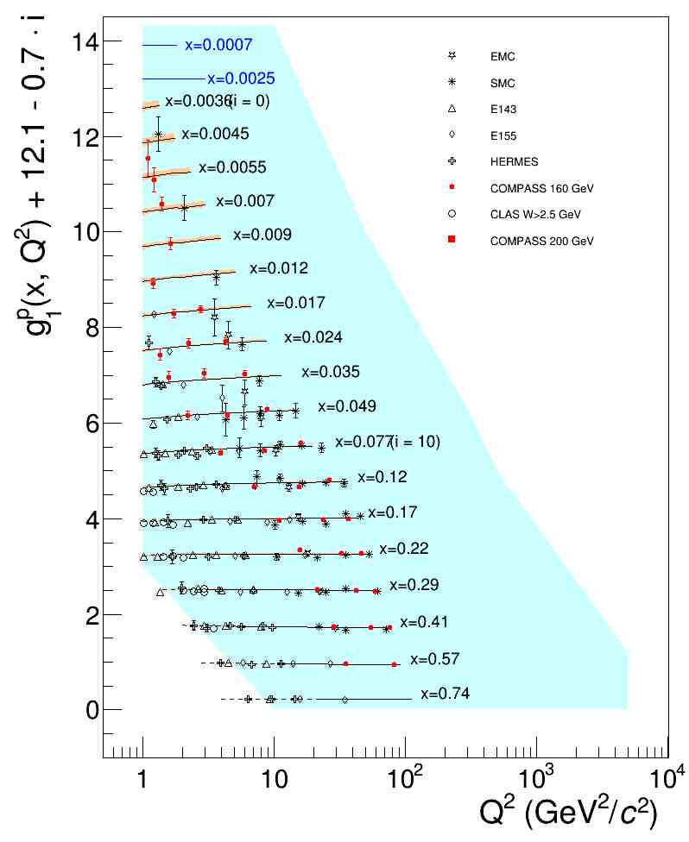
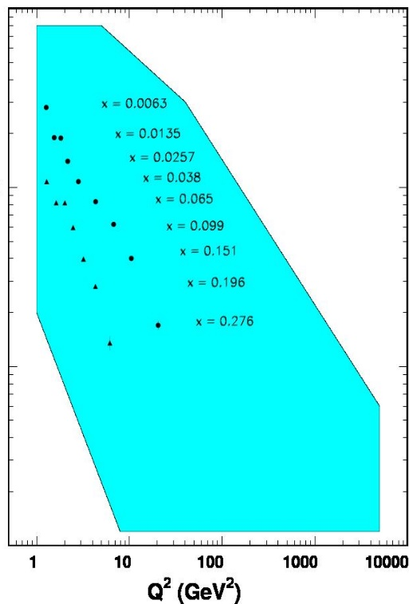



Why we need an EIC
World Data on $F_{2}^{p}$
World Data on $g_{1}^{p}$
World Data on $h_{1}^{p}$
EIC coverage
COMPASS
HERMES
transverse spin ~ angular momentum
momentum
spin

Slide 3
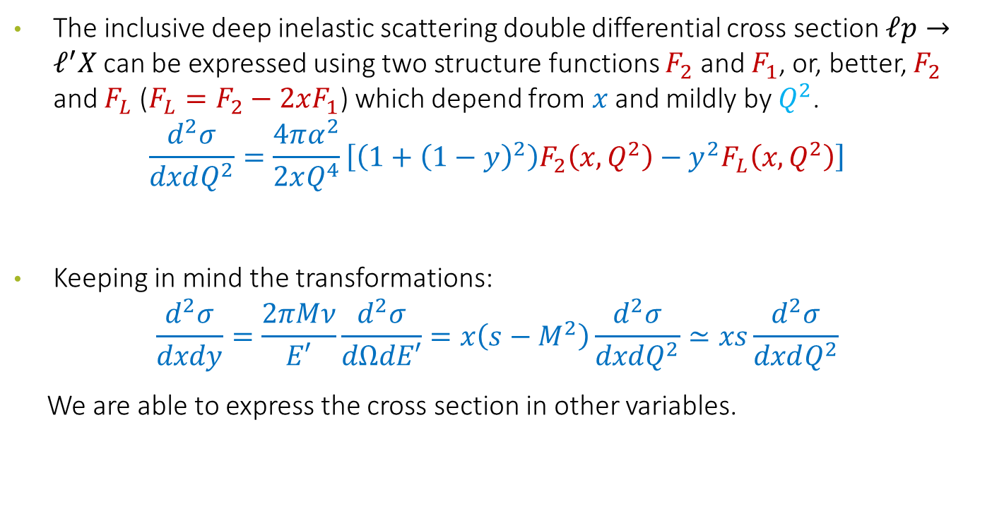
Inclusive Deep Inelastic Scattering
The inclusive deep inelastic scattering double differential cross section $ℓp→ℓ^{′}X$ can be expressed using two structure functions $F_{2}$ and $F_{1}$, or, better, $F_{2}$ and $F_{L}$ ($F_{L}=F_{2}−2xF_{1}$) which depend from $x$ and mildly by $Q^{2}$.
$$\frac{d^{2}σ}{dxdQ^{2}}=\frac{4πα^{2}}{2xQ^{4}}\left[\left(1+{\left(1−y\right)}^{2}\right)F_{2}\left(x,Q^{2}\right)−y^{2}F_{L}\left(x,Q^{2}\right)\right]$$
Keeping in mind the transformations:
$$\frac{d^{2}σ}{dxdy}=\frac{2πMν}{E′}\frac{d^{2}σ}{dΩdE′}=x\left(s−M^{2}\right)\frac{d^{2}σ}{dxdQ^{2}}≃xs\frac{d^{2}σ}{dxdQ^{2}}$$
We are able to express the cross section in other variables.

Slide 4
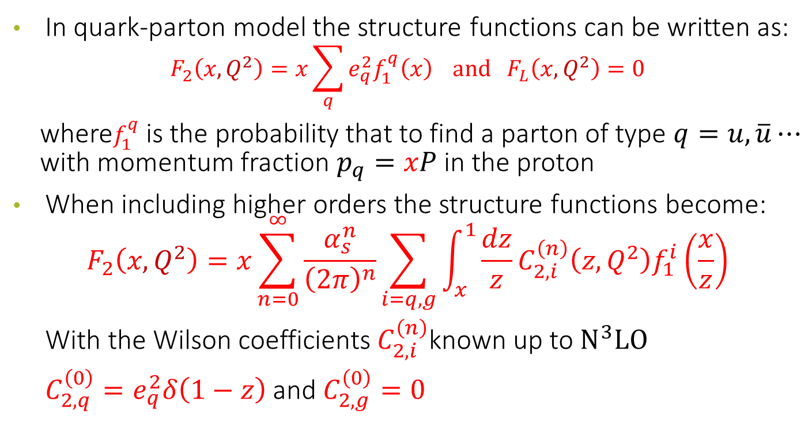
Physics content of the structure functions
In quark-parton model the structure functions can be written as:
$$F_{2}\left(x,Q^{2}\right)=x\sum_{q}{e_{q}^{2}f_{1}^{q}\left(x\right)} and F_{L}\left(x,Q^{2}\right)=0$$
where$f_{1}^{q}$ is the probability that to find a parton of type $q=u,\overline{u}⋯$ with momentum fraction $p_{q}=xP$ in the proton
When including higher orders the structure functions become:
$$F_{2}\left(x,Q^{2}\right)=x\sum_{n=0}^{∞}{\frac{α_{s}^{n}}{{\left(2π\right)}^{n}}}\sum_{i=q,g}{\int_{x}^{1}{\frac{dz}{z}}C_{2,i}^{\left(n\right)}\left(z,Q^{2}\right)f_{1}^{i}\left(\frac{x}{z}\right)}$$
With the Wilson coefficients $C_{2,i}^{\left(n\right)}$known up to $N^{3}LO$
$C_{2,q}^{\left(0\right)}=e_{q}^{2}δ\left(1−z\right)$ and $C_{2,g}^{\left(0\right)}=0$

Slide 5
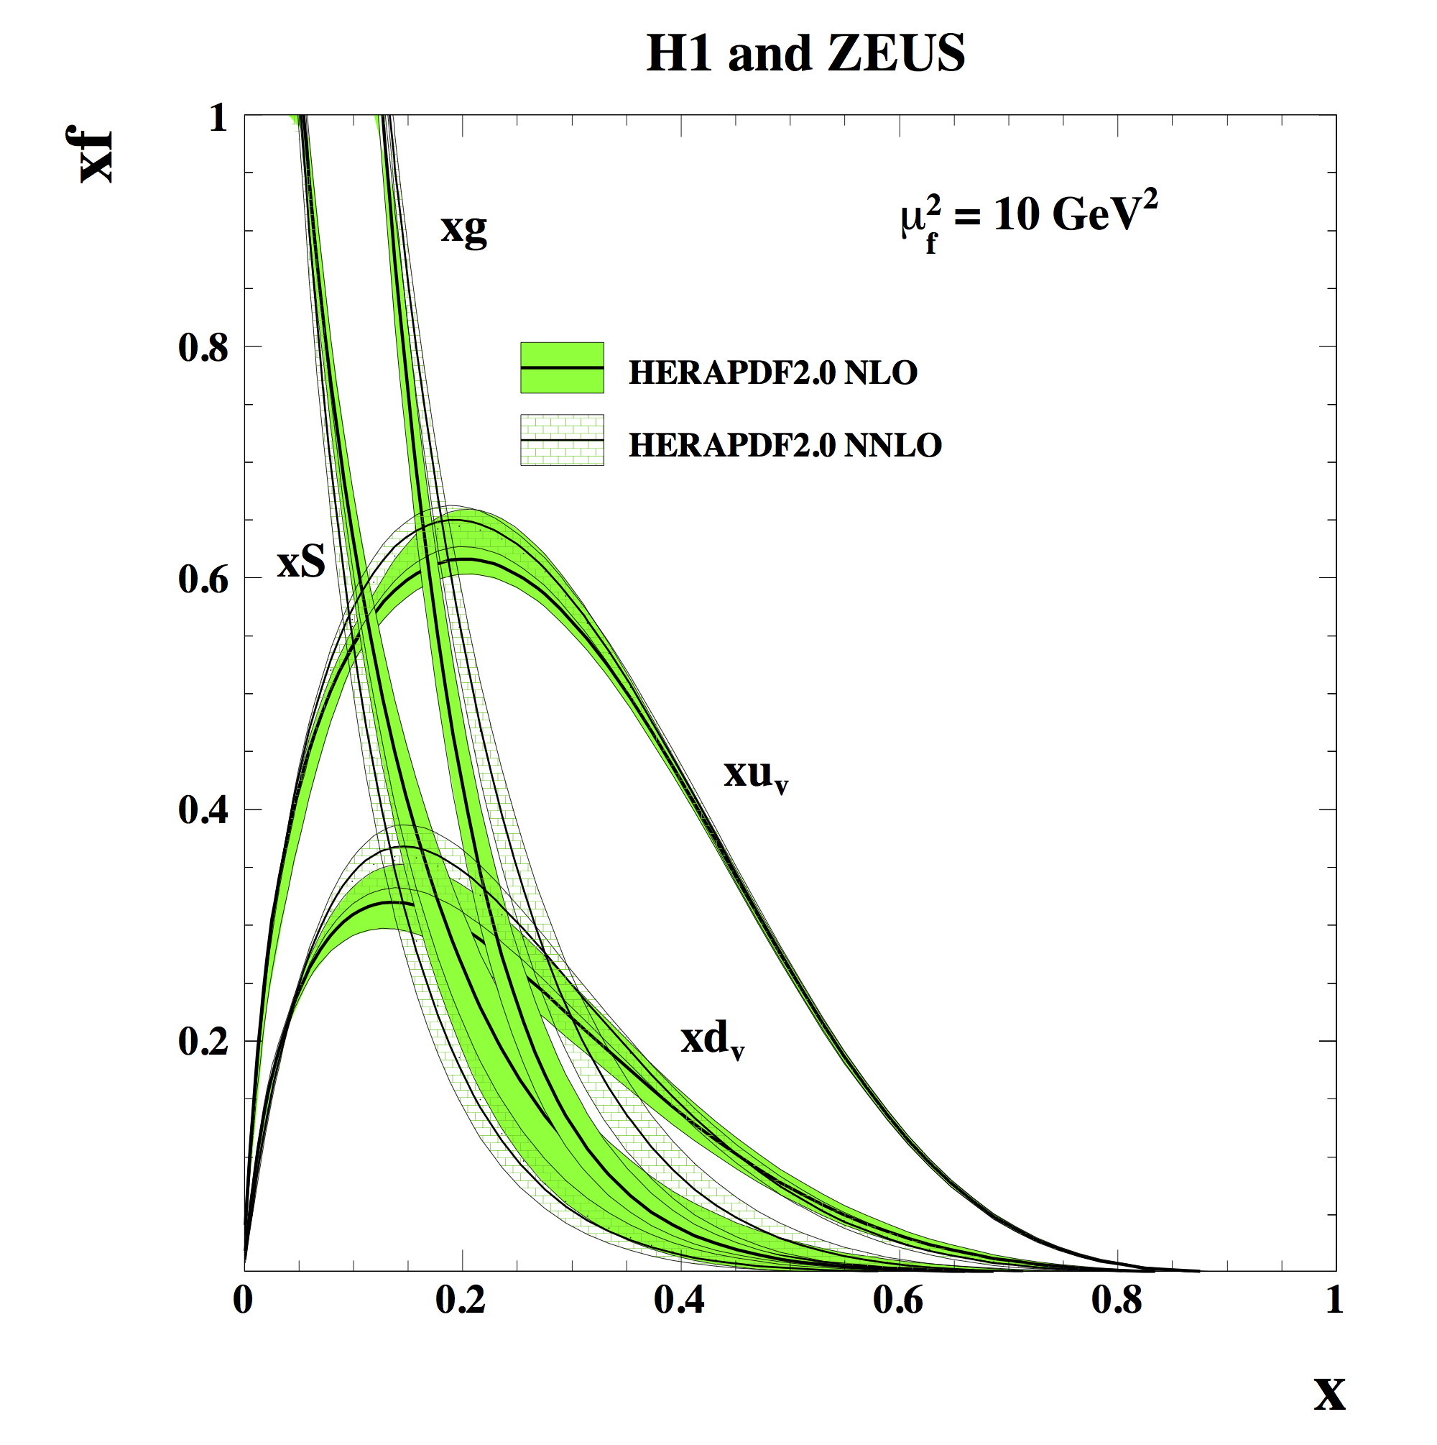
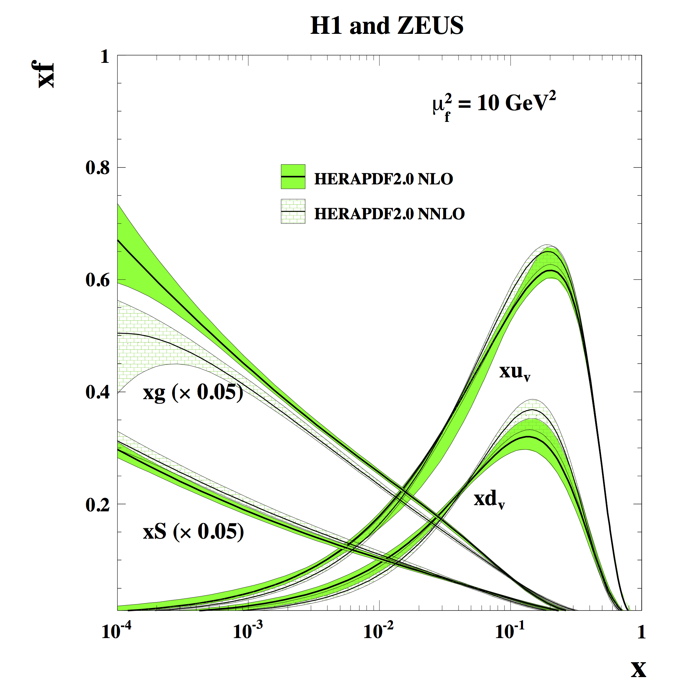

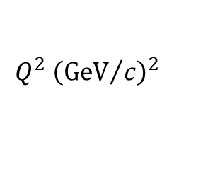
Impact of the HERA $ep$ Collider
arXiv:1506.06042
Cross Section
$$Q^{2} {\left({GeV}/c\right)}^{2}$$

Slide 6
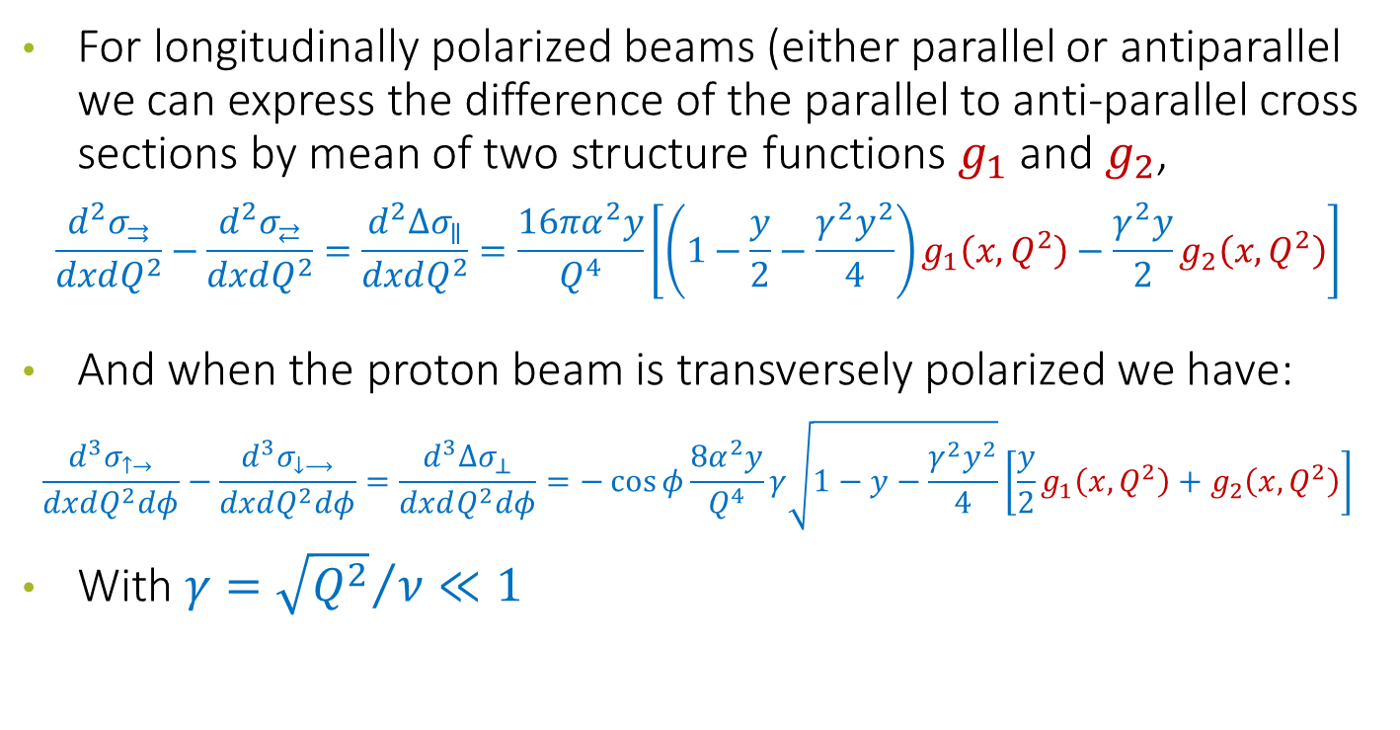
Polarized Cross Sections
For longitudinally polarized beams (either parallel or antiparallel we can express the difference of the parallel to anti-parallel cross sections by mean of two structure functions $g_{1}$ and $g_{2}$,
$$\frac{d^{2}σ_{⇉}}{dxdQ^{2}}−\frac{d^{2}σ_{⇄}}{dxdQ^{2}}=\frac{d^{2}{Δσ}_{∥}}{dxdQ^{2}}=\frac{16πα^{2}y}{Q^{4}}\left[\left(1−\frac{y}{2}−\frac{γ^{2}y^{2}}{4}\right)g_{1}\left(x,Q^{2}\right)−\frac{γ^{2}y}{2}g_{2}\left(x,Q^{2}\right)\right]$$
And when the proton beam is transversely polarized we have:
$$\frac{d^{3}σ_{↑→}}{dxdQ^{2}dφ}−\frac{d^{3}σ_{↓⟶}}{dxdQ^{2}dφ}=\frac{d^{3}{Δσ}_{⊥}}{dxdQ^{2}dφ}=−\cos{φ}\frac{8α^{2}y}{Q^{4}}γ\sqrt{1−y−\frac{γ^{2}y^{2}}{4}}\left[\frac{y}{2}g_{1}\left(x,Q^{2}\right)+g_{2}\left(x,Q^{2}\right)\right]$$
With $γ={\sqrt{Q^{2}}}/ν≪1$

Slide 7
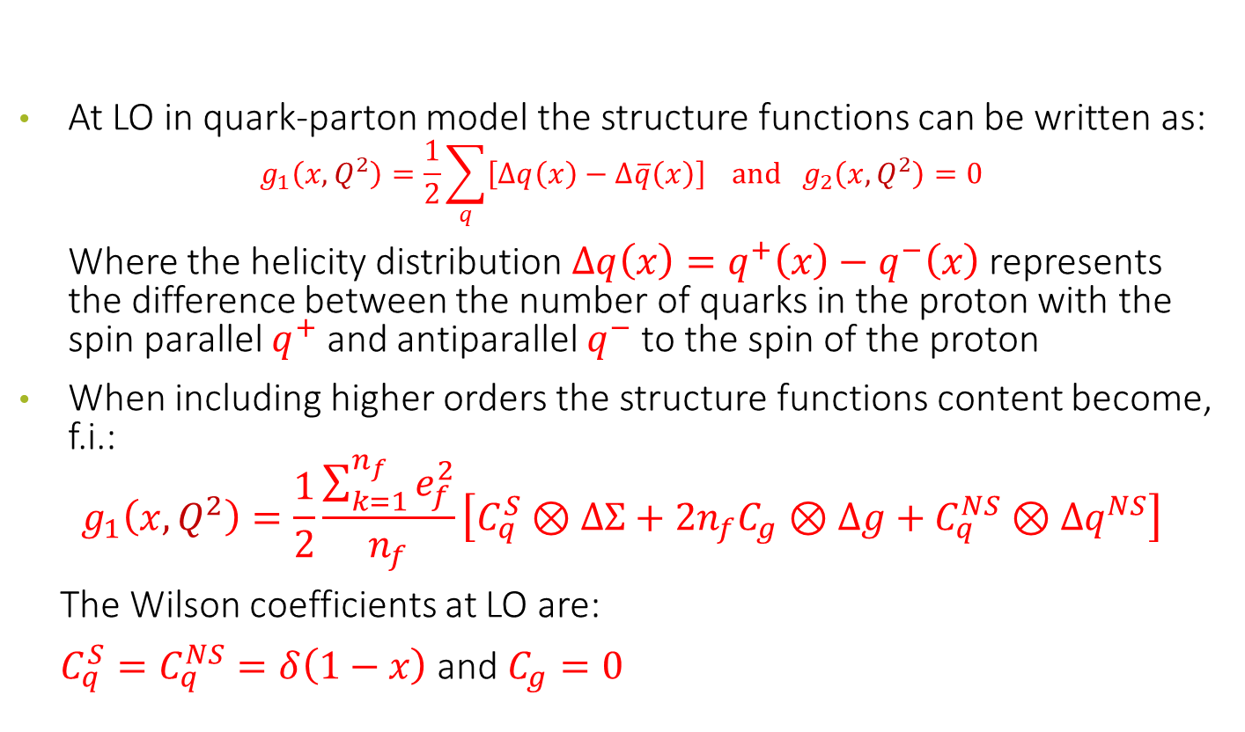
Physics content of the structure functions
At LO in quark-parton model the structure functions can be written as:
$$g_{1}\left(x,Q^{2}\right)=\frac{1}{2}\sum_{q}{\left[Δq\left(x\right)−Δ\overline{q}\left(x\right)\right]} and g_{2}\left(x,Q^{2}\right)=0$$
Where the helicity distribution $Δq\left(x\right)=q^{+}\left(x\right)−q^{−}\left(x\right)$ represents the difference between the number of quarks in the proton with the spin parallel $q^{+}$ and antiparallel $q^{−}$ to the spin of the proton
When including higher orders the structure functions content become, f.i.:
$$g_{1}\left(x,Q^{2}\right)=\frac{1}{2}\frac{\sum_{k=1}^{n_{f}}{e_{f}^{2}}}{n_{f}}\left[C_{q}^{S}⊗ΔΣ+2n_{f}C_{g}⊗Δg+C_{q}^{NS}⊗Δq^{NS}\right]$$
The Wilson coefficients at LO are:
$C_{q}^{S}=C_{q}^{NS}=δ\left(1−x\right)$ and $C_{g}=0$

Slide 8
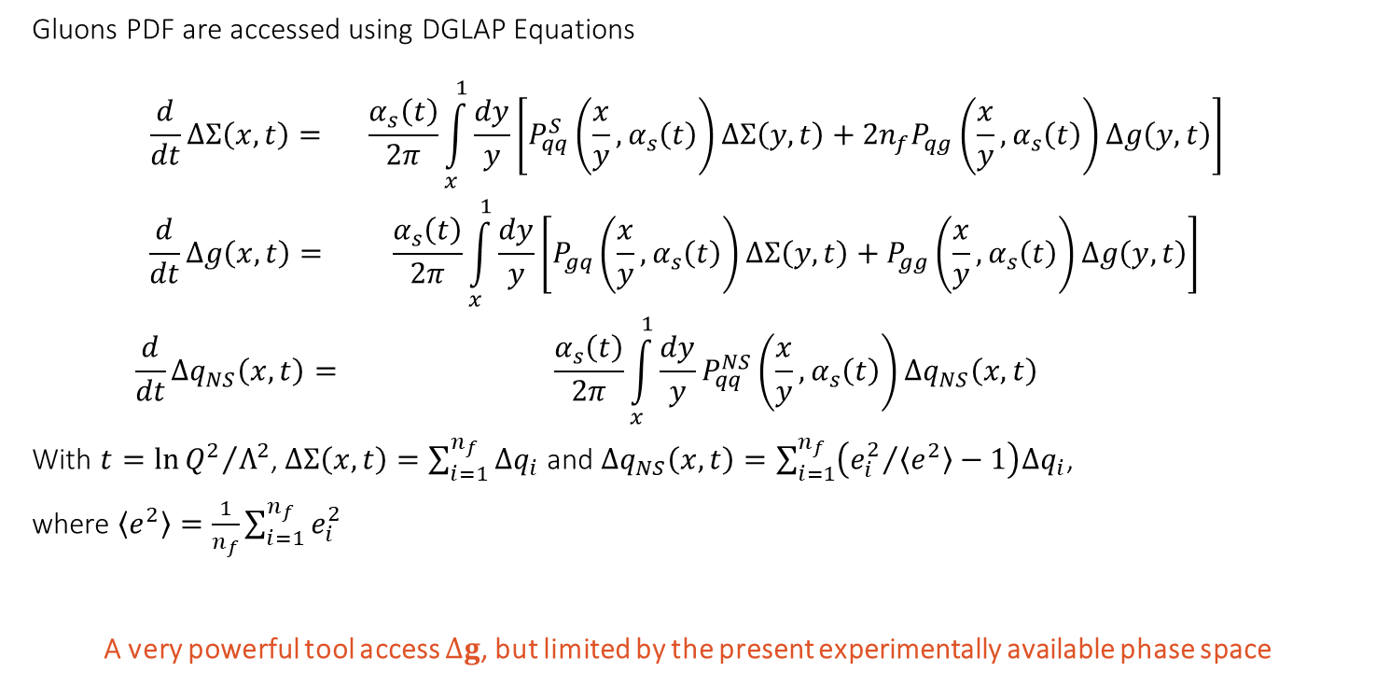
The spin content of the proton: where we stand
Gluons PDF are accessed using DGLAP Equations
$$\begin{matrix}\frac{d}{dt}∆Σ\left(x,t\right)= & \frac{α_{s}\left(t\right)}{2π}\int_{x}^{1}{\frac{dy}{y}}\left[P_{qq}^{S}\left(\frac{x}{y},α_{s}\left(t\right)\right)∆Σ\left(y,t\right)+2n_{f}P_{qg}\left(\frac{x}{y},α_{s}\left(t\right)\right)∆g\left(y,t\right)\right] \\ \frac{d}{dt}∆g\left(x,t\right)= & \frac{α_{s}\left(t\right)}{2π}\int_{x}^{1}{\frac{dy}{y}}\left[P_{gq}\left(\frac{x}{y},α_{s}\left(t\right)\right)∆Σ\left(y,t\right)+P_{gg}\left(\frac{x}{y},α_{s}\left(t\right)\right)∆g\left(y,t\right)\right] \\ \frac{d}{dt}∆q_{NS}\left(x,t\right)= & \frac{α_{s}\left(t\right)}{2π}\int_{x}^{1}{\frac{dy}{y}P_{qq}^{NS}\left(\frac{x}{y},α_{s}\left(t\right)\right)∆q_{NS}\left(x,t\right)}\end{matrix}$$
With $t=\ln{{Q^{2}}/{Λ^{2}}}$, $∆Σ\left(x,t\right)=\sum_{i=1}^{n_{f}}{Δq_{i}}$ and $∆q_{NS}\left(x,t\right)=\sum_{i=1}^{n_{f}}{\left({e_{i}^{2}}/{\left\langle e^{2}\right\rangle }−1\right)Δq_{i}}$,
where $\left\langle e^{2}\right\rangle =\frac{1}{n_{f}}\sum_{i=1}^{n_{f}}{e_{i}^{2}}$
A very powerful tool access $∆g$, but limited by the present experimentally available phase space
Notes:
Dokshitzer–Gribov–Lipatov–Altarelli–Parisi

Slide 9
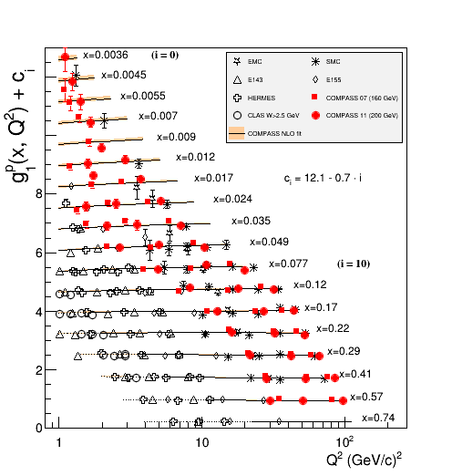
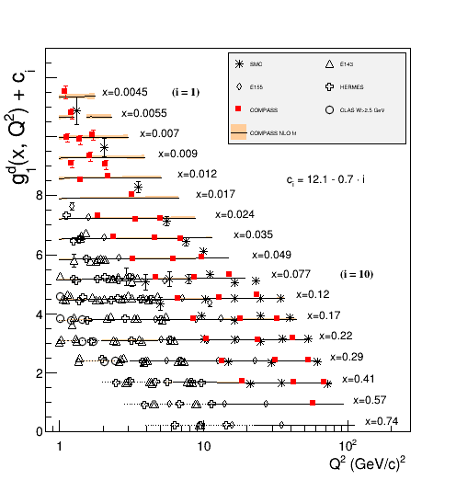



QCD fits- World data on $g_{1}^{p}$ and $g_{1}^{d}$
→ $g_{1}\left(x,Q^{2}\right)$ as input to global QCD fits for extraction of $∆q_{f}\left(x\right)$ and $∆g\left(x\right)$
$$\frac{dg_{1}}{d\ln{Q^{2}}}∝−Δg\left(x,Q^{2}\right)$$
proton
deuteron
$x$ and $Q^{2}$ coverage not yet sufficient for precise $∆g$
Can be improved by constraining from pp data (as DSSV, NNPDF…)
PLB753 (2016) 18

Slide 10
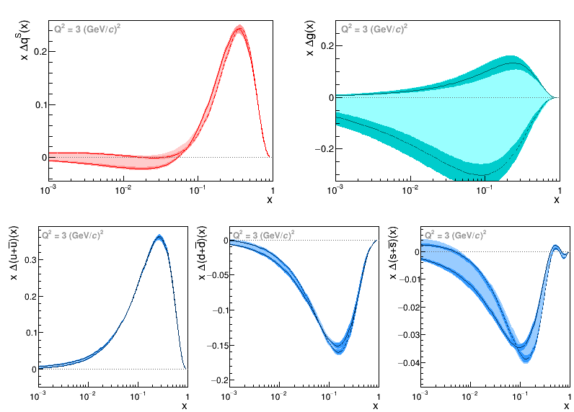


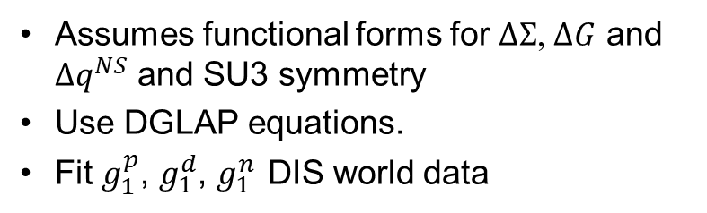


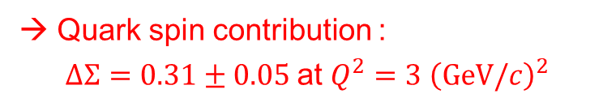



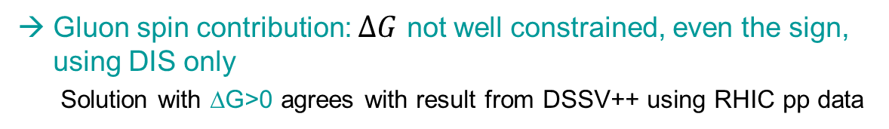


Another NLO pQCD fit to $g_{1}$ DIS world data
Assumes functional forms for $ΔΣ$, $ΔG$ and $Δq^{NS}$ and SU3 symmetry
Use DGLAP equations.
Fit $g_{1}^{p}$, $g_{1}^{d}$, $g_{1}^{n}$ DIS world data
$$ΔΣ$$
$$ΔG$$
→ Solutions ΔG>0 and ΔG<0
→ Quark spin contribution :
$ΔΣ=0.31±0.05$ at $Q^{2}=3 {\left(GeV/c\right)}^{2}$
$$Δu$$
$$Δd$$
$$Δs$$
$$0.82≤ΔU≤0.85$$
$$−0.45≤ΔD≤−0.42$$
$$−0.11≤ΔS≤−0.08$$
Uncertainties are dominated by the bad knowledge of the functional forms.
→ Gluon spin contribution: $ΔG$ not well constrained, even the sign, using DIS only
Solution with ΔG>0 agrees with result from DSSV++ using RHIC pp data
PLB 753 (2016) 18

Slide 11
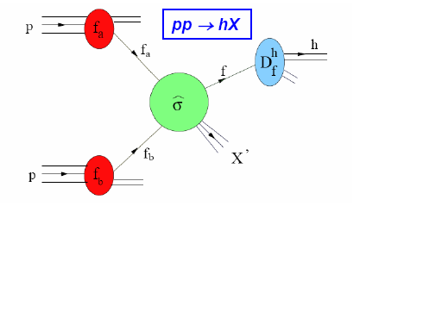
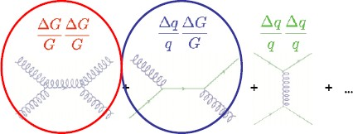
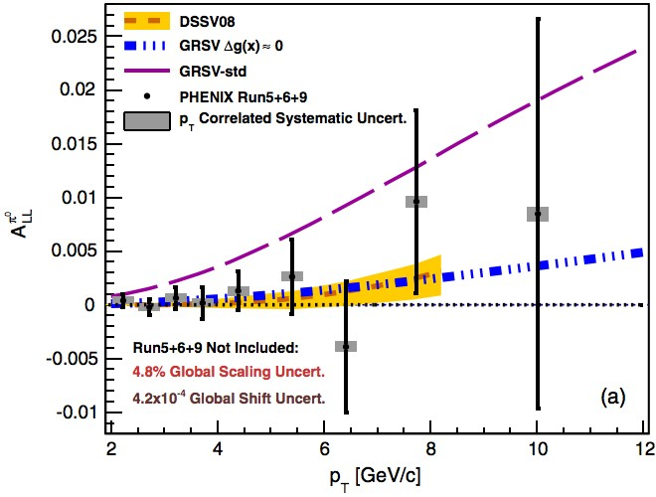
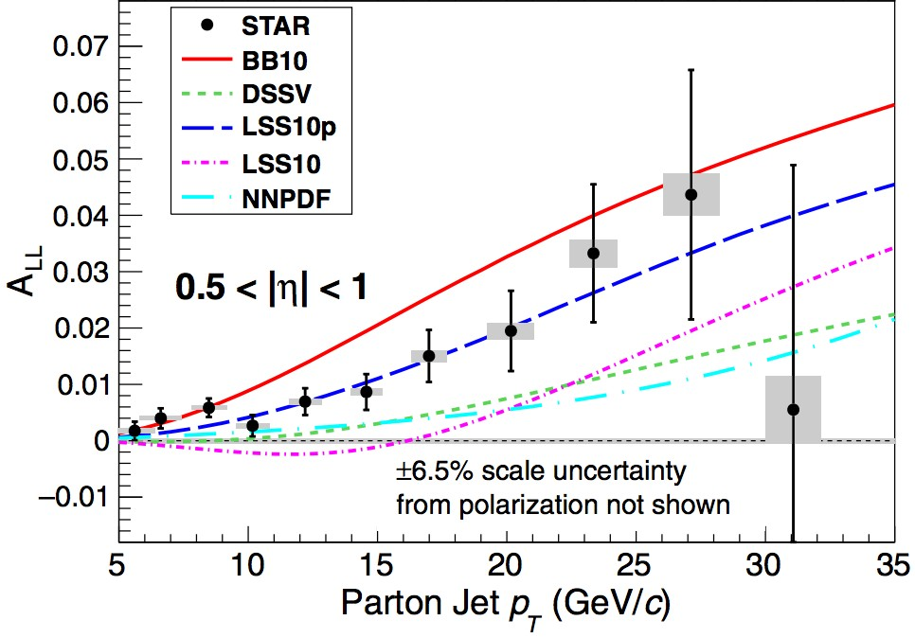



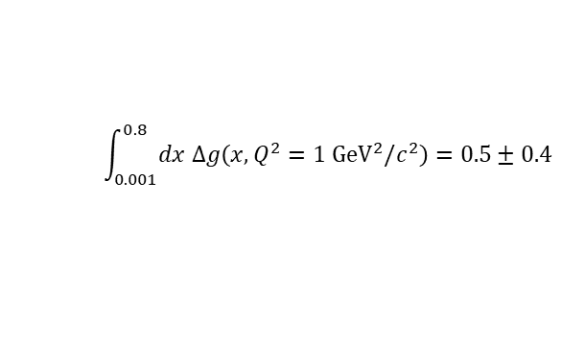

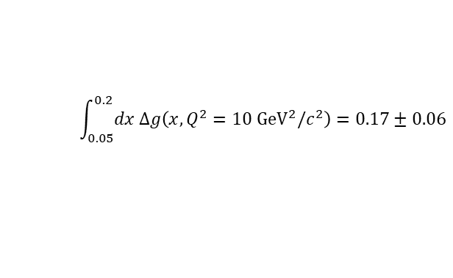
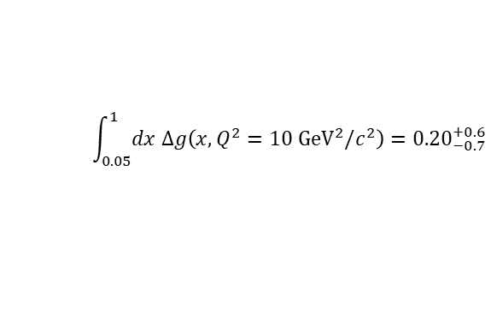
Measurement of the $∆G$ at RHIC
Dominates at low $p_{T}$
Dominates at high $p_{T}$
D. de Florian et al,
PRL 113 (2014) 012001
E. Nocera et al,
NPB 887 (2014) 276
Phys. Rev. D 90 (2014) 012007
Phys. Rev. Le]. 115 (2015) 092002
$$\int_{0.05}^{1}{dx Δg\left(x, Q^{2}=10 {GeV}^{2}/c^{2}\right)}={0.20}_{−0.7}^{+0.6}$$
$$\int_{0.05}^{0.2}{dx Δg\left(x, Q^{2}=10 {GeV}^{2}/c^{2}\right)}=0.17±0.06$$
JAM15
NNPDFpol1.1
DSSV++
$$\int_{0.001}^{0.8}{dx Δg\left(x, Q^{2}=1 {GeV}^{2}/c^{2}\right)}=0.5±0.4$$

Slide 12
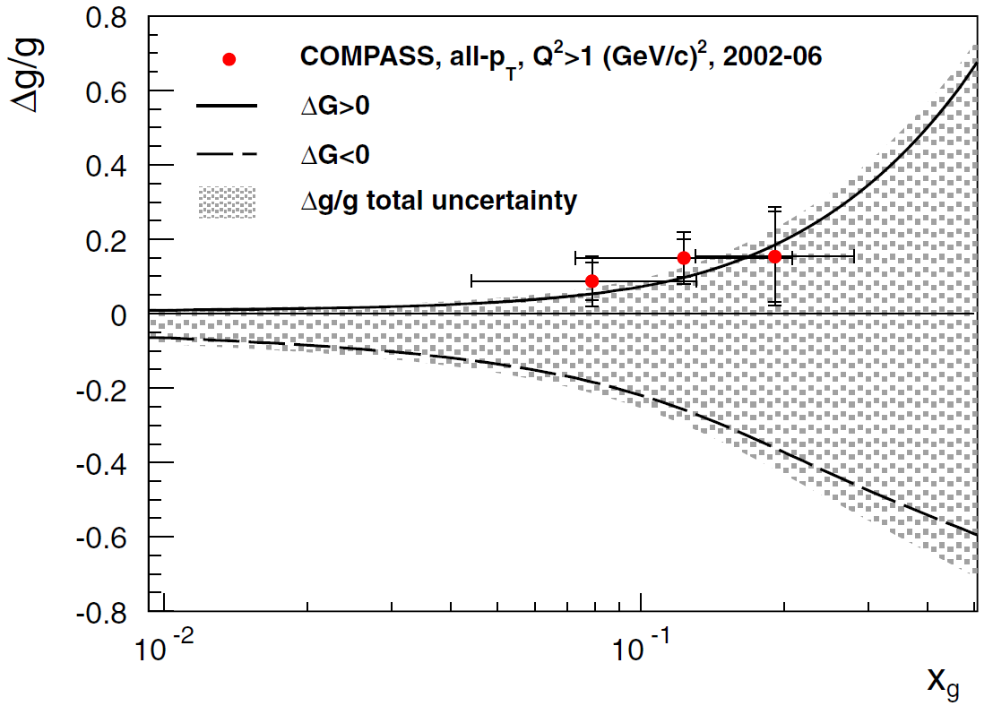
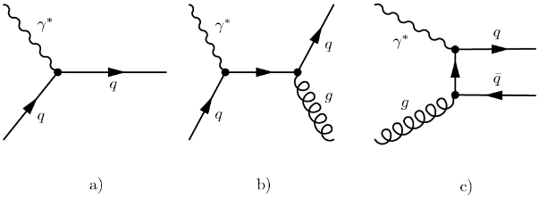

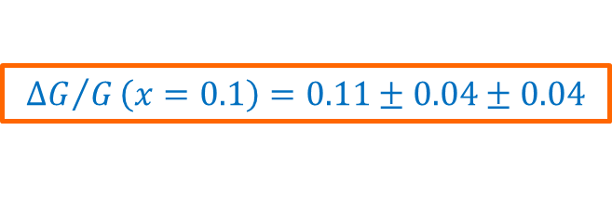

Gluon helicity ${Δg}/g$ from SIDIS
Extraction at LO:
$${ΔG}/G\left(x=0.1\right)=0.11±0.04±0.04$$
Solutions from COMPASS NLO QCD fit of g₁ world data (see later)
$$ℓ^{→}p^{⇌}⟶ℓ hhX$$
Photon Gluon Fusion
EPJC 77 (2017) 209

Slide 13
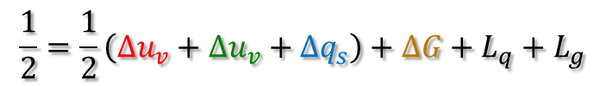
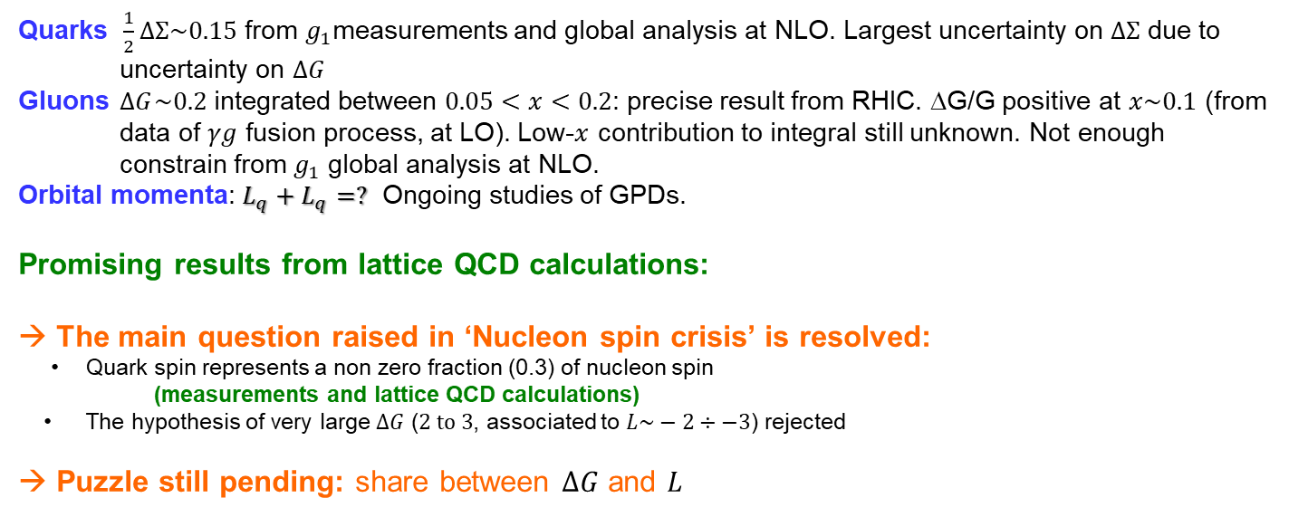
Summary on nucleon SPIN
$$\frac{1}{2}=\frac{1}{2}\left({Δu}_{v}+{Δu}_{v}+{Δq}_{s}\right)+ΔG+L_{q}+L_{g}$$
Quarks $\frac{1}{2}ΔΣ\sim 0.15$ from $g_{1}$measurements and global analysis at NLO. Largest uncertainty on $ΔΣ$ due to uncertainty on $ΔG$
Gluons $ΔG\sim 0.2$ integrated between $0.05<x<0.2$: precise result from RHIC. ΔG/G positive at $x\sim 0.1$ (from data of $γg$ fusion process, at LO). Low-$x$ contribution to integral still unknown. Not enough constrain from $g_{1}$ global analysis at NLO.
Orbital momenta: $L_{q}+L_{q}=?$ Ongoing studies of GPDs.
Promising results from lattice QCD calculations:
→ The main question raised in ‘Nucleon spin crisis’ is resolved:
  Quark spin represents a non zero fraction (0.3) of nucleon spin
  (measurements and lattice QCD calculations)
  The hypothesis of very large $ΔG$ ($2 to 3$, associated to $L\sim −2÷−3$) rejected
  → Puzzle still pending: share between $ΔG$ and $L$

Slide 14
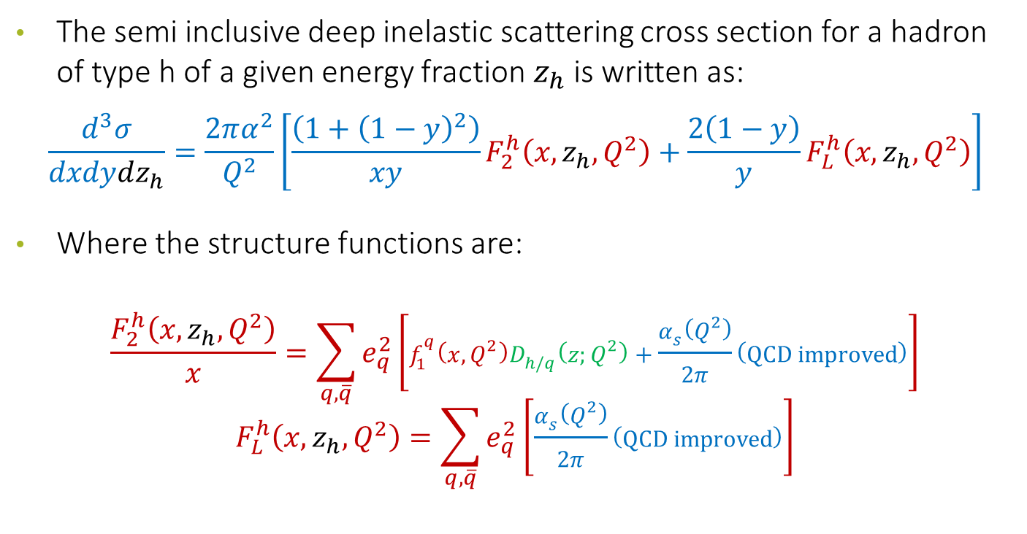
Semi Inclusive Deep Inelastic Scattering
The semi inclusive deep inelastic scattering cross section for a hadron of type h of a given energy fraction $z_{h}$ is written as:
$$\frac{d^{3}σ}{dxdydz_{h}}=\frac{2πα^{2}}{Q^{2}}\left[\frac{\left(1+{\left(1−y\right)}^{2}\right)}{xy}F_{2}^{h}\left(x,z_{h},Q^{2}\right)+\frac{2\left(1−y\right)}{y}F_{L}^{h}\left(x,z_{h},Q^{2}\right)\right]$$
Where the structure functions are:
$$\frac{F_{2}^{h}\left(x,z_{h},Q^{2}\right)}{x}=\sum_{q,\overline{q}}{e_{q}^{2}\left[f_{1}^{q}\left(x,Q^{2}\right)D_{h/q}\left(z;Q^{2}\right)+\frac{α_{s}\left(Q^{2}\right)}{2π}\left(QCD improved\right)\right]}$$
$$F_{L}^{h}\left(x,z_{h},Q^{2}\right)=\sum_{q,\overline{q}}{e_{q}^{2}\left[\frac{α_{s}\left(Q^{2}\right)}{2π}\left(QCD improved\right)\right]}$$

Slide 15
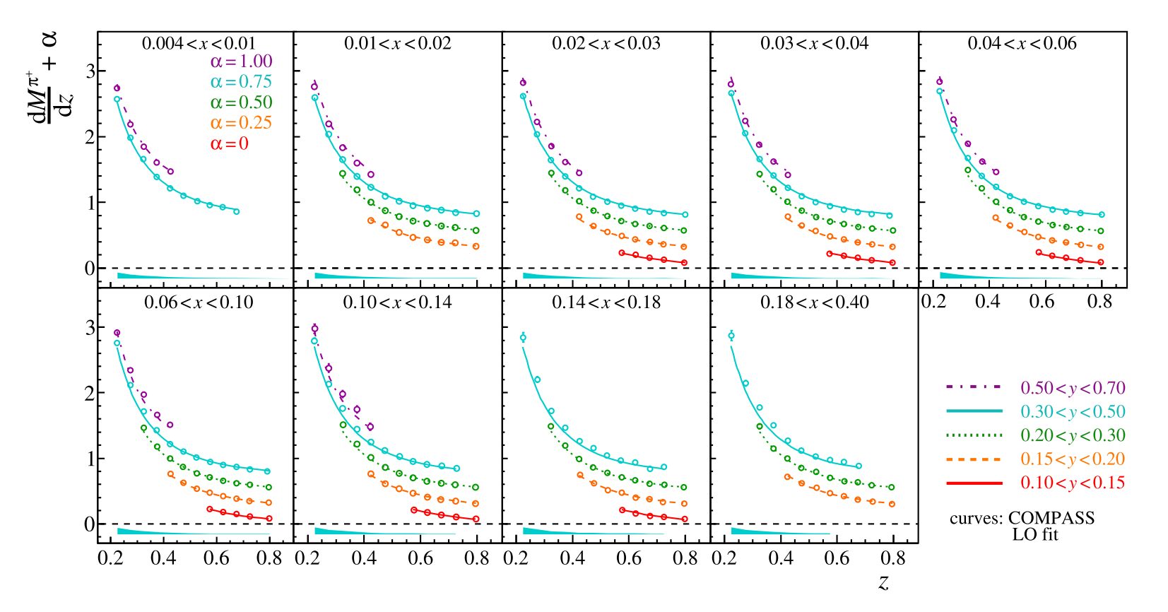
Collinear Multiplicities
hep-ex/1604.02695

Slide 16
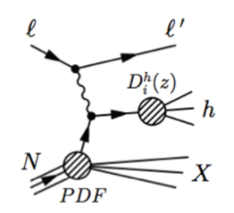


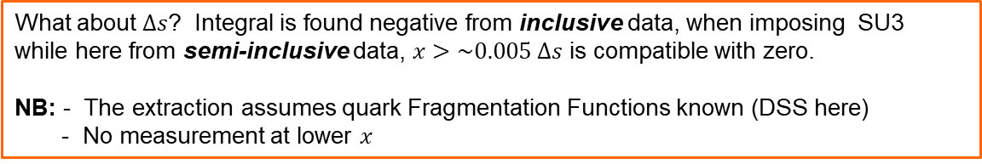
Quark helicities from semi-inclusive DIS
Leading order extraction of quark helicities from spin asymmetries:
COMPASS
PLB693(2010)227, using DSS FFs
o HERMES
PRD71(2005)012003
__ DSSV at NLO
u
u
d
$${l^{→}p}^{→}→l h^{±}X$$
s
Q²=3 (GeV/c)²
Full flavour separation → x~0.004
Sea quark distributions ~ zero
Good agreement with global fits
What about $∆s$? Integral is found negative from inclusive data, when imposing SU3
while here from semi-inclusive data, $x>\sim 0.005$ $∆s$ is compatible with zero.
NB: - The extraction assumes quark Fragmentation Functions known (DSS here)
- No measurement at lower $x$

Slide 17
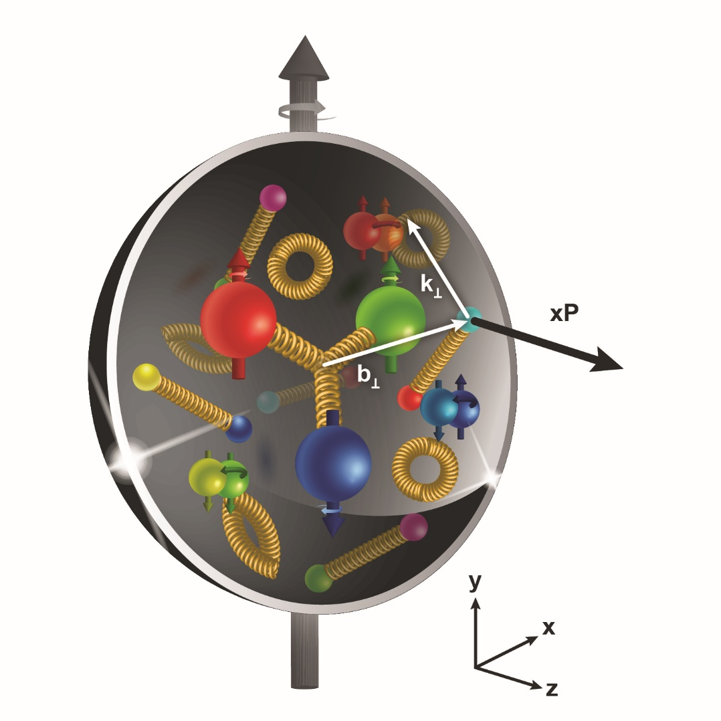
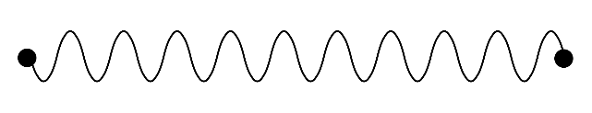
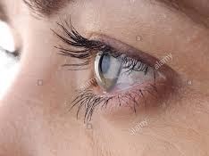
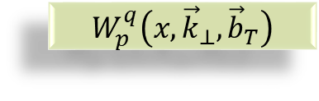


Transverse structure of the Nucleon
Confinement Scale
$$W_{p}^{q}\left(x,{\vec{k}}_{⊥},{\vec{b}}_{T}\right)$$
Transverse momentum
Longitudinal momentum
Transverse position
$$ℓ′$$
Photon Virtuality Q²
$$ℓ$$
Hard Scale
High Energy Probe

Slide 18
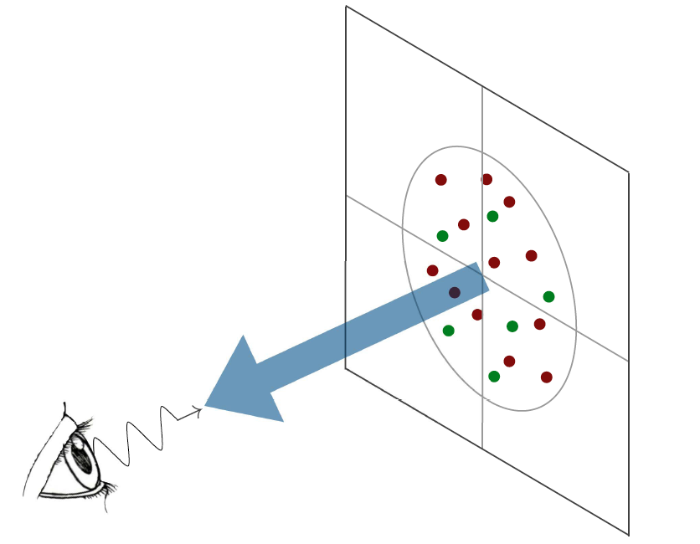

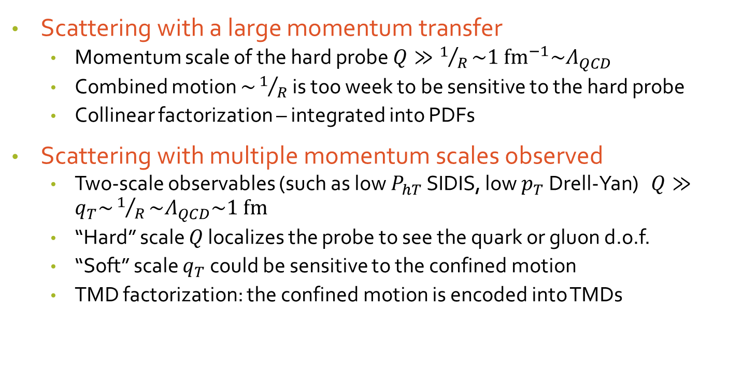

Confined parton motion in a hadron
Scattering with a large momentum transfer
  Momentum scale of the hard probe $Q≫1/R\sim {1 {fm}^{−1}\sim Λ}_{QCD}$
  Combined motion $\sim 1/R$ is too week to be sensitive to the hard probe
  Collinear factorization – integrated into PDFs
Scattering with multiple momentum scales observed
  Two-scale observables (such as low $P_{hT}$ SIDIS, low $p_{T}$ Drell-Yan) $Q≫q_{T}\sim 1/R\sim Λ_{QCD}\sim 1 fm$
  “Hard” scale $Q$ localizes the probe to see the quark or gluon d.o.f.
  “Soft” scale $q_{T}$ could be sensitive to the confined motion
  TMD factorization: the confined motion is encoded into TMDs
$${\vec{k}}_{⊥}$$
$${\vec{b}}_{T}$$

Slide 19
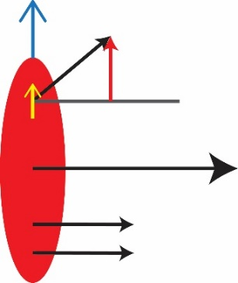
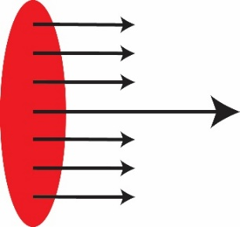

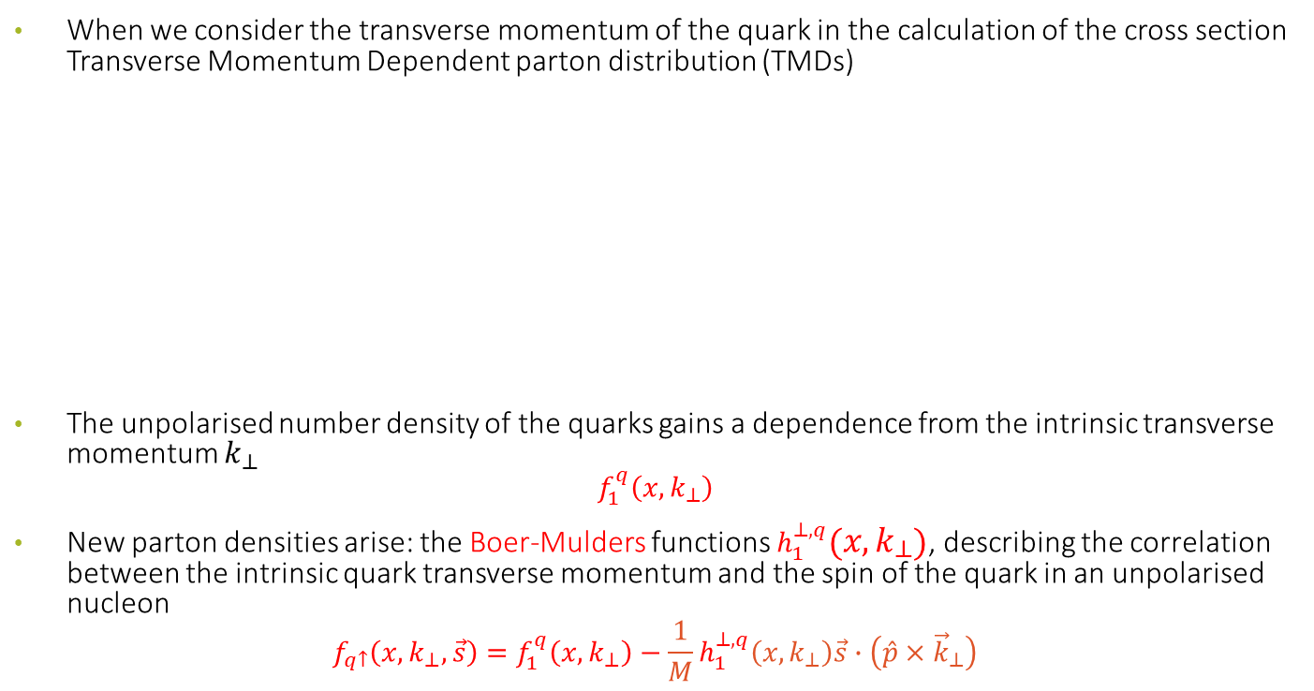



Unpolarised Transverse Momentum dependent PDFs
When we consider the transverse momentum of the quark in the calculation of the cross section Transverse Momentum Dependent parton distribution (TMDs)
The unpolarised number density of the quarks gains a dependence from the intrinsic transverse momentum $k_{⊥}$
$$f_{1}^{q}\left(x,k_{⊥}\right)$$
New parton densities arise: the Boer-Mulders functions $h_{1}^{⊥,q}\left(x,k_{⊥}\right)$, describing the correlation between the intrinsic quark transverse momentum and the spin of the quark in an unpolarised nucleon
$$f_{q↑}\left(x,k_{⊥}, \vec{s}\right)=f_{1}^{q}\left(x,k_{⊥}\right)−\frac{1}{M}h_{1}^{⊥,q}\left(x,k_{⊥}\right)\vec{s}∙\left(\hat{p}×{\vec{k}}_{⊥}\right)$$
$$k_{⊥}$$
$$p_{q}≈xP$$
$$f\left(x\right)$$
$$f\left(x,k_{⊥}\right)$$
Longitudinal motion only
Longitudinal + transverse motion

Slide 20
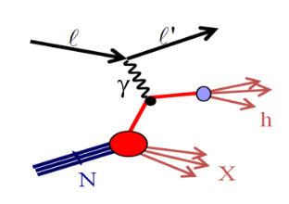
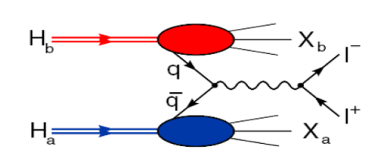


Accessing TMD PDFs and FFs
TMD factorization works in the domain where there are two observed momenta in the process, such as SIDIS, DY, $e^{+}e^{−}$. $Q≫q_{T}$: $Q$ is large to ensure the use of pQCD, $q_{T}$ is much smaller such that it is sensitive to parton’s transverse momentum
SIDIS off polarized p, d, n targets
polarised Drell-Yan
$e^{+}e^{−}→h_{1}h_{2}$
HERMES
COMPASS
JLab
future: EIC
$$σ^{ℓp→ℓ^{′}hX}\sim q\left(x\right)⊗{\hat{σ}}^{γq→q}⊗D_{q}^{h}\left(z\right)$$
COMPASS
RHIC
FNAL
future: FAIR, JPark, NICA
$$σ^{hp→μμ}\sim {\overline{q}}_{h}\left(x_{1}\right)⊗q_{p}\left(x_{2}\right)⊗{\hat{σ}}^{\overline{q}q→μμ}\left(\hat{s}\right)$$
BaBar
Belle
Bes III
$$σ^{e^{+}e^{−}→h_{1}h_{2}}\sim {\hat{σ}}^{ℓℓ→\overline{q}q}\left(\hat{s}\right)⊗D_{q}^{h_{1}}\left(z_{1}\right)⊗D_{q}^{h_{2}}\left(z_{2}\right)$$

Slide 21
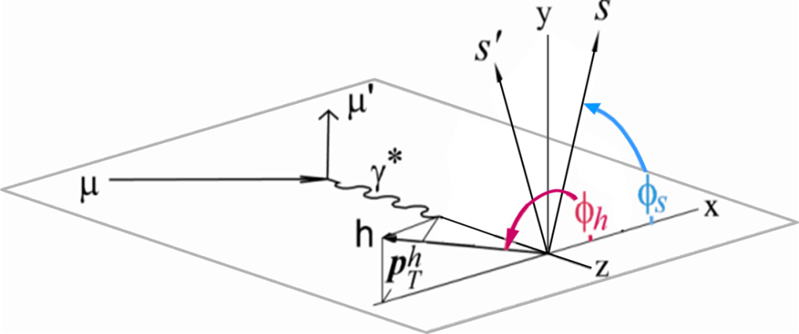
Azimuthal asymmetries in SIDIS
We look at our events in the Gamma Nucleon System (GNS), i.e. we need a perfectly reconstructed lepton kinematic.

Slide 22
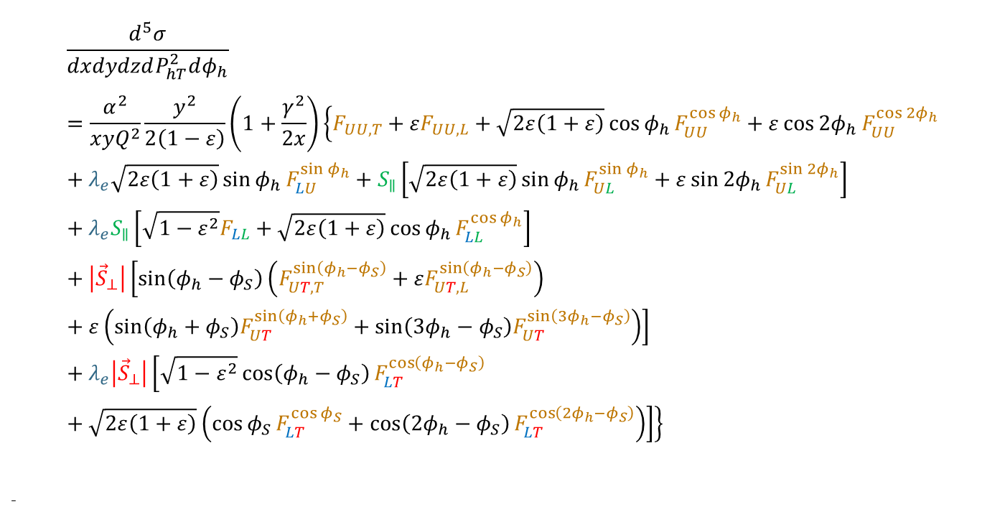
Semi Inclusive DIS full Cross Section
$$\frac{d^{5}σ}{dxdydzdP_{hT}^{2}dφ_{h}}=\frac{α^{2}}{xyQ^{2}}\frac{y^{2}}{2\left(1−ε\right)}\left(1+\frac{γ^{2}}{2x}\right)\left\{F_{UU,T}+εF_{UU,L}+\sqrt{2ε\left(1+ε\right)}\cos{φ_{h}}F_{UU}^{\cos{φ_{h}}}+ε\cos{{2φ}_{h}}F_{UU}^{\cos{{2φ}_{h}}}+λ_{e}\sqrt{2ε\left(1+ε\right)}\sin{φ_{h}}F_{LU}^{\sin{φ_{h}}}+S_{∥}\left[\sqrt{2ε\left(1+ε\right)}\sin{φ_{h}}F_{UL}^{\sin{φ_{h}}}+ε\sin{{2φ}_{h}}F_{UL}^{\sin{{2φ}_{h}}}\right]+λ_{e}S_{∥}\left[\sqrt{1−ε^{2}}F_{LL}+\sqrt{2ε\left(1+ε\right)}\cos{φ_{h}}F_{LL}^{\cos{φ_{h}}}\right]+\left|{\vec{S}}_{⊥}\right|\left[\sin\left(φ_{h}−φ_{S}\right)\left(F_{UT,T}^{\sin\left(φ_{h}−φ_{S}\right)}+εF_{UT,L}^{\sin\left(φ_{h}−φ_{S}\right)}\right)+ε\left(\sin\left(φ_{h}+φ_{S}\right)F_{UT}^{\sin\left(φ_{h}+φ_{S}\right)}+\sin\left(3φ_{h}−φ_{S}\right)F_{UT}^{\sin\left(3φ_{h}−φ_{S}\right)}\right)\right]+λ_{e}\left|{\vec{S}}_{⊥}\right|\left[\sqrt{1−ε^{2}}\cos\left(φ_{h}−φ_{S}\right)F_{LT}^{\cos\left(φ_{h}−φ_{S}\right)}+\sqrt{2ε\left(1+ε\right)}\left(\cos{φ_{S}}F_{LT}^{\cos{φ_{S}}}+\cos\left(2φ_{h}−φ_{S}\right)F_{LT}^{\cos\left(2φ_{h}−φ_{S}\right)}\right)\right]\right\}$$
-
14 independent azimuthal modulations

Slide 23
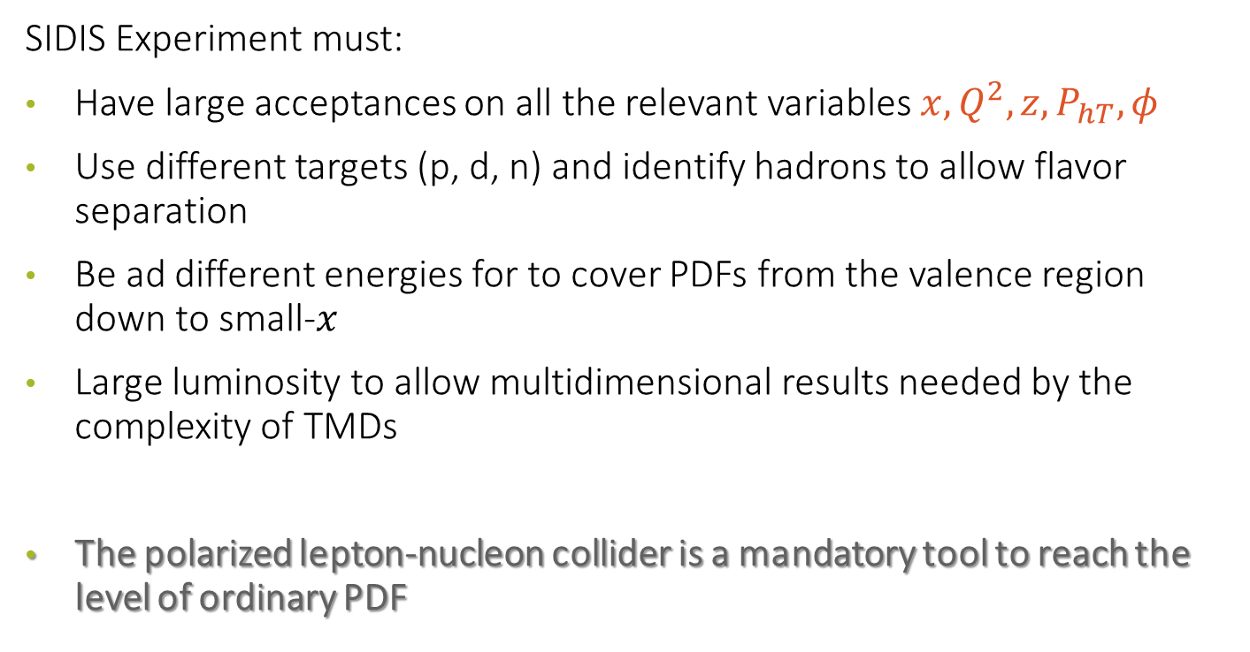
SIDIS Experiments
SIDIS Experiment must:
Have large acceptances on all the relevant variables $x, Q^{2}, z, P_{hT}, φ$
Use different targets (p, d, n) and identify hadrons to allow flavor separation
Be ad different energies for to cover PDFs from the valence region down to small-$x$
Large luminosity to allow multidimensional results needed by the complexity of TMDs
The polarized lepton-nucleon collider is a mandatory tool to reach the level of ordinary PDF

Slide 24
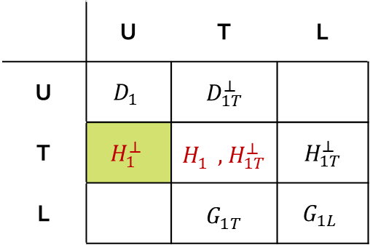
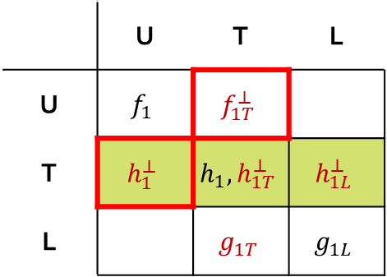


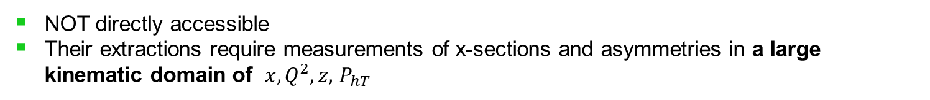
SIDIS access to TMDs
Factorization (Collins & Soper, Ji, Ma, Yuan,
Qiu & Vogelsang, Collins & Metz...)
$$σ\left(ℓp→ℓ^{′}hX\right)\sim TMDs⨂{\hat{σ}}^{γq→q}⨂TMD‒FFs$$
TMDs
TMD-FFs
chiral odd
$$\left(x,{\vec{k}}_{⊥}\right)$$
$$\left(x,{\vec{p}}_{⊥}\right)$$
Nucleon polarization
Hadron polarization
T odd
 | U | T | L
U | $$f_{1}$$ | $$f_{1T}^{⊥}$$
T | $$h_{1}^{⊥}$$ | $$h_{1}, h_{1T}^{⊥}$$ | $$h_{1L}^{⊥}$$
L |  | $$g_{1T}$$ | $$g_{1L}$$
 | U | T | L
U | $$D_{1}$$ | $${ D}_{1T}^{⊥}$$
T | $$H_{1}^{⊥}$$ | $H_{1}^{}, { H}_{1T}^{⊥}$ | $${ H}_{1T}^{⊥}$$
L |  | $${ G}_{1T}^{}$$ | $$G_{1L}$$
Parton polarization
Parton polarization
NOT directly accessible
Their extractions require measurements of x-sections and asymmetries in a large kinematic domain of $x, {Q^{2},z\text{,} P}_{hT}$

Slide 25

TMD evolution:
QCD evolution of TMDs in Fourier space (solution of equation)
Polarized scattering data comes as ratio: e.g. $A_{UT}^{\sin\left(φ_{h}−φ_{s}\right)}=F_{UT}^{\sin\left(φ_{h}−φ_{s}\right)}/F_{UU}$
Unpolarised data is very important to constrain/extract the key ingredient for the non-perturbative part
$$F\left(x, b;Q\right)≈C⨂F\left(x, c/b^{∗}\right)\exp\left\{−\int_{c/b^{∗}}^{Q_{f}}{\frac{dμ}{d}}\left(A\ln{\frac{Q_{f}^{2}}{μ^{2}}}+B\right)\right\}×\exp\left[−S_{non−pert}\left(b,Q\right)\right]$$
Non-perturbative part has to be fitted to experimental data
The key ingredient is spin-independent
Evolution of longitudinal/ collinear part
Evolution of transverse part (Sudakov form factor)

Slide 26


Transversity PDF
$h_{1}^{q}\left(x\right)=q^{⇈}\left(x\right)−q^{↑↓}\left(x\right)$ with $q=u_{V}, d_{v}$ and quarks/antiquarks of the sea
Describes quark with spin parallel to the nucleon spin in a transversely polarized nucleon
is chiral-odd: decouples from inclusive DIS
probes the relativistic nature of quark dynamics: in NR limit, boost and rotations commute and we should have $h_{1}^{q}\left(x\right)=g_{1}^{q}\left(x\right)$
no contribution from the gluons  simple $Q^{2}$ evolution
Positivity constrain, i.e.: Soffer bound [Soffer, PRL 74 (1995)] $2\left|h_{1}^{q}\left(x\right)\right|≤f_{1}^{q}\left(x\right)+Δq\left(x\right)$
first moments: tensor charge $g_{T}^{q}\left(Q^{2}\right)=\int_{0}^{1}{dx}\left[h_{1}^{q}\left(x,Q^{2}\right)−h_{1}^{\overline{q}}\left(x,Q^{2}\right)\right]$

Slide 27

Transversity
is chiral-odd:
observable effects are given only by the
product of $h_{1}^{q}$ (x) and an other chiral-odd function
can be measured in SIDIS on a transversely polarized target
via “quark polarimetry”
“Collins” asymmetry “Collins” Fragmentation Function
“two-hadron” asymmetry “Interference” Fragmentation Function
Λ polarization Fragmentation Function of q↑Λ

Slide 28



Global Analysis: Transversity
Z.-B. Kang et al., Phys. Rev. D 93, 014009 (2016).
M. Anselmino et al., Phys. Rev. D 92, 114023 (2015).
M. Radici and A. Bacchetta, arXiv: 1802.05212[hep-ph₂₀]

Slide 29


The Collins Fragmentation Function $H_{1}^{⊥}$
Fragmentation (or hadronization) is the nonperturbative process that brings quarks and gluons to dress into observable hadrons. Fragmentation functions (FFs) describe the probability that a hadron h is produced in the fragmentation process of a quark q, taking away a fraction of the quark momentum.
What about the quark spin? The fragmentation of a transversely polarized quark in an unpolarised hadron is described by:
$$D_{h/{q↑}}\left(z,p_{⊥}\right)=D_{h/q}\left(z,p_{⊥}\right)+\frac{\left(\hat{k}×{\vec{p}}_{⊥}\right)∙{\vec{S}}_{qT}}{zm_{h}}H_{1}^{⊥}\left(z,p_{⊥}\right)$$
Where $\hat{k}$ is the direction of the fragmenting quark and ${\vec{S}}_{qT}$ is it’s spin projection in the transverse plane.

Slide 30



${}_{}^{3}{P_{0}}$; a model for the Collins FF $H_{1}^{⊥}$
A model by X. Artru for the Collins effect is based on the ${}_{}^{3}{P_{0}}$ mechanism applied to the string fragmentation [Single spin asymmetry in inclusive pion production, Collins effect and the string model, X. Artru, J. Czyzewski, H. Yabuki, Z.Phys. C 73 (1997) 527].
In this model, the $q\overline{q}$ pairs at each string breaking are produced in a state that has total orbital angular momentum $L=1$ and total spin $S=1$ opposite to the orbital angular momentum such that $J=L+S=0$.
For a struck quark $q_{A}$ with spin along $\hat{y}$, the first $q_{2}{\overline{q}}_{2}$ at the string breaking will be polarized along $−\hat{y}$, while the angular momentum ${\vec{L}}_{2}$ is along $\hat{y}.$ If the initial quark $q_{A}$ is $u$ then the ${}_{}^{3}{P_{0}}$ mechanism produces opposite effects for positive and for negative pions

Slide 31


$A_{Coll}^{p}$ on proton and ${}_{}^{3}{P_{0}}$ model for FF
Albi Kerbizi @ DSPIN17 http://theor.jinr.ru/~spin/2017/
Phys. Rev. D 97, 074010 (2018)/arXiv:1802.00962
The full points are Monte Carlo data, scaled by $λ\sim \left\langle {h_{1}^{u}}/{f_{1}^{u}}\right\rangle \sim 0.055$
Agreement with the measured Collins asymmetry is quite satisfactory
Notes:
31

Slide 32


Sivers Asymmetry
Sivers: correlates nucleon spin & quark transverse momentum k_{T} /T-ODD
at LO:
$$μp^{↑}→μXh^{±}$$
The Sivers PDF
1992 | Sivers proposes $f_{1T}^{⊥}$
1993 | J. Collins proofs $f_{1T}^{⊥}=0$ for T invariance
2002 | S. Brodsky, Hwang and Schmidt demonstrate that $f_{1Tq}^{⊥}$ may be $≠0$ due to FSI
2002 | J. Collins shows that${\left(f_{1T}^{⊥}\right)}_{DY}=−{\left(f_{1T}^{⊥}\right)}_{SIDIS}$
2004 | HERMES on p: $A_{Siv}^{π^{+}}≠0$ and $A_{Siv}^{π^{−}}=0$
2004 | COMPASS on d: $A_{Siv}^{π^{+}}=0$ and $A_{Siv}^{π^{−}}=0$
2008 | COMPASS on p: $A_{Siv}^{π^{+}}≠0$ and $A_{Siv}^{π^{−}}=0$

Slide 33



Sivers asymmetry on p
charged pions (and kaons), HERMES and COMPASS

Slide 34


Transverse Spin Asymmetry in Drell-Yan
190 GeV/c π– beam, transversely polarized NH3 target
Sivers
Transversity
Pretzelosity
PRL119, 112002 (2017).

Slide 35
To conclude
Many important results both for the spin structure and the internal 3D structure of the nucleon have been provided by experiments at HERA, CERN, RHIC and JLAB; very partial coverage here.
Before the EIC, JLAB will map the valence region with high precision; COMPASS and RHIC will complete their programs
THE EIC will allow us TO MOVE FROM EXPLORATION TO PRECISION in the KNOWLEDGE of the internal structure of the NUCLEON

Slide 36


Thank you

Slide 37
Kinematic coverage
Notes:
37

Slide 38




The spin content of the proton: where we stand
Global analysis of the spin dependent distribution functions
$$\begin{matrix}∆Σ & = & +0.36±0.09 \\ Δs^{+} & = & −0.03±0.10\end{matrix}$$
J.J. Ethier et al. (JAM Collaboration), Phys. Rev. Lett. 119, 132001 (2017).

Slide 39







Gluon Spin From Lattice QCD
$${\vec{p}}_{p}=\left(0,0,0\right)$$
$${\vec{p}}_{p}=\left(0,0,p_{3}\right)$$
$$μ^{2}=10{\left(GeV/c\right)}^{2}$$
$$μ^{2}=10{\left(GeV/c\right)}^{2}$$
$$m_{π}=139{ MeV/c}^{2}$$
$$ΔG\left(μ^{2}=10{\left(GeV/c\right)}^{2}\right)≈ S_{G} \left(μ^{2}=10{\left({GeV}/c\right)}^{2},\left|p\right|→∞\right)=0.251±0.047±0.016$$
$$\overline{MS} scheme$$
Y.-B. Yang et al. (χQCD Collaboration), Phys. Rev. Lett. 118, 102001 (2017).

Slide 40




Cahn $A_{UU}^{\cos{φ}}$ and Boer-Mulders$A_{UU}^{\cos{2φ}}$modulation
$$A_{UU}^{\cos{φ}}\left(x, z, P_{hT}^{2}; Q^{2}\right)∝\frac{1}{Q}\sum_{q}{e_{q}^{2}}\left[f_{1}^{q}⨂D_{1}^{q→h}−h_{1}^{⊥,q}⨂H_{1}^{⊥,q→h}\right]$$
$$A_{UU}^{\cos{2φ}}\left(x, z, P_{hT}^{2}; Q^{2}\right)=−x\sum_{q}{e_{q}^{2}\int{d^{2}{\vec{k}}_{⊥}d^{2}{\vec{p}}_{⊥}\frac{2\left(\hat{h}∙{\vec{k}}_{⊥}\right)\left(\hat{h}∙{\vec{k}}_{⊥}\right)−{\vec{k}}_{⊥}∙{\vec{p}}_{⊥}}{Mm_{h}} h_{1}^{⊥,q}\left(x, k_{⊥}^{2};Q^{2}\right)H_{1}^{⊥,q→h}\left(z,p_{⊥}^{2};Q^{2}\right)}}$$

Slide 41



$P_{hT}$ dependent Multiplicities $M_{UU}^{h}$
$$M^{h}\left(x,z, P_{hT}^{2};Q^{2}\right)=\frac{d^{5}σ^{h}/dxdQ^{2}dzdP_{hT}^{2}}{d^{2}σ^{DIS}/dxdQ^{2}}\sim \frac{F_{UU}^{h}\left(x, z, P_{hT}^{2}; Q^{2}\right)}{F_{2}\left(x,Q^{2}\right)}$$

Slide 42




Collins asymmetry on proton. Multidimensional
Extraction of TSAs with a Multi-D $\left(x:Q^{2}:z:p_{T}\right)$ approach
π-
One dense plot out of many
Notes:
42

Slide 43

TSA of inclusive jets and $π^{±}$ within jets from STAR
COLLINS asymmetries: general agreement between data and predictions from SIDIS consistent with TMD factorization and universality of the Collins function

Slide 44


2h asymmetries on p and ${}_{}^{3}{P_{0}}$ model for FF
$$A_{UT}^{\sin\left(φ_{R}+φ_{S}−π\right)}=\frac{\sum_{q}{e_{q}^{2}h_{1}^{q}\left(x\right)H_{q→h_{1}h_{2}}^{∡}\left(z, ℳ_{h_{1}h_{2}}^{2}\right)}}{\sum_{q}{e_{q}^{2}q\left(x\right)D_{q}^{h_{1}h_{2}}\left(z, ℳ_{h_{1}h_{2}}^{2}\right)}}$$
$a_{P}^{u↑⟶h^{+}h^{−}X}=\left\langle \sin\left(φ_{R}+φ_{S}−π\right)\right\rangle$ and $\vec{R}=\frac{z_{2}{\vec{P}}_{h1}−z_{1}{\vec{P}}_{h2}}{z_{1}+z_{2}}$ and as before $λ\sim \left\langle {h_{1}^{u}}/{f_{1}^{u}}\right\rangle \sim 0.055$

Slide 45


Interference fragmentation functions in pp
$p^{↑}p⟶π^{+}π^{−}X$ → $h_{1}∙H_{1}^{∢}$
survives in collinear framework
Significant di-hadron asymmetries both at √s=200GeV and √s=500GeV (arXiv:1710.10215)
Increasing with p_{T}
Access to transversity with a collinear observable

Slide 46



$Λ$ transverse spin transfer from COMPASS
$$P_{Λ\left(\overline{Λ}\right)}\left(x,z\right)=\frac{\sum_{q}{e_{q}^{2}h_{1}^{q}\left(x\right)}H_{1}^{Λ\left(\overline{Λ}\right)}\left(z\right)}{\sum_{q}{e_{q}^{2}f_{1}^{q}\left(x\right)}D_{1}^{Λ\left(\overline{Λ}\right)}\left(z\right)}$$
$$\frac{dN}{d\cos{θ^{∗}}}∝A\left(1+αP_{Λ\left(\overline{Λ}\right)}\cos{θ^{∗}}\right)$$

Slide 47






$Λ$ transverse spin transfer from STAR
$$D_{TT}=\frac{dσ^{p^{↑}p→Λ^{↑}X}−dσ^{p^{↑}p→Λ^{↓}X}}{dσ^{p^{↑}p→Λ^{↑}X}+dσ^{p^{↑}p→Λ^{↓}X}}$$
$$D_{TT}=−\frac{1}{αP_{B}\left\langle \cos{θ^{∗}}\right\rangle }\frac{\sqrt{N_{\cos{θ^{∗}}}^{↑}N_{−\cos{θ^{∗}}}^{↓}}−\sqrt{N_{\cos{θ^{∗}}}^{↓}N_{−\cos{θ^{∗}}}^{↑}}}{\sqrt{N_{\cos{θ^{∗}}}^{↑}N_{−\cos{θ^{∗}}}^{↓}}+\sqrt{N_{\cos{θ^{∗}}}^{↓}N_{−\cos{θ^{∗}}}^{↑}}}$$
$$\frac{dN}{d\cos{θ^{∗}}}∝A\left(1+{αP}_{Λ\left(\overline{Λ}\right)}\cos{θ^{∗}}\right)$$
About 60% of $Λ$ or $\overline{Λ}$ are not primary particles, but are from heavier hyperons
decay.
$$D_{TT}\left(Λ\right)=+0.031±{0.033}_{stat}±{0.008}_{sys}$$
$$D_{TT}\left(\overline{Λ}\right)=−0.034±{0.040}_{stat}±{0.009}_{sys}$$

Slide 48
TSA of inclusive jets and $π^{±}$ within jets from STAR
COLLINS LIKE asymmetries: sensitive to linearly polarized gluons in a polarized proton, are found to be small and provide the first constraints on model calculations.

Slide 49


TSSA $A_{N}$ studies at PHENIX
Described by twist 3 collinear approach (1 scale, high $p_{T}$)
Suppresion in $p^{↑}A$ expected by gluon saturation ($∝A^{1/3}$)
Hybrid approach: twist-3 and CGC

Slide 50



Sivers Asymmetry for Gluon from SIDIS
C. Adolph et al. (COMPASS Collaboration), Phys. Lett. B 772, 854 (2017).

