Slide 1
EIC Accelerator Design
Christoph Montag, BNL
Workshop on Beam Polarization and Polarimetry at EIC
Stone Brook, June 26, 2020

Slide 2
Requirements for the EIC
Requirements for an Electron-Ion Collider are defined in the White Paper:
High luminosity: L = 10³³ to 10³⁴ cm⁻²sec⁻¹ - factor 100 to 1000 beyond HERA
Large range of center-of-mass energies E_{cm}= 20 to 140 GeV
Polarized beams with flexible spin patterns, 80% polarization
Favorable condition for detector acceptance such as p_{T} =200 MeV
Large range of hadron species: protons ….Uranium
Collisions of electrons with polarized protons and light ions (h³He, hd,…)

Slide 3
EIC Design Concept (in a nutshell)
Take one RHIC ring (“Yellow”) with its entire injector complex as the EIC hadron ring
Modify the hadron ring to be suitable for EIC beam parameters
Add an electron storage ring in the existing tunnel
Use a spin-transparent rapid-cycling synchrotron as full-energy polarized electron injector for rapid bunch replacement to counteract depolarization
Build a high luminosity interaction region that fulfills acceptance requirements

Slide 4
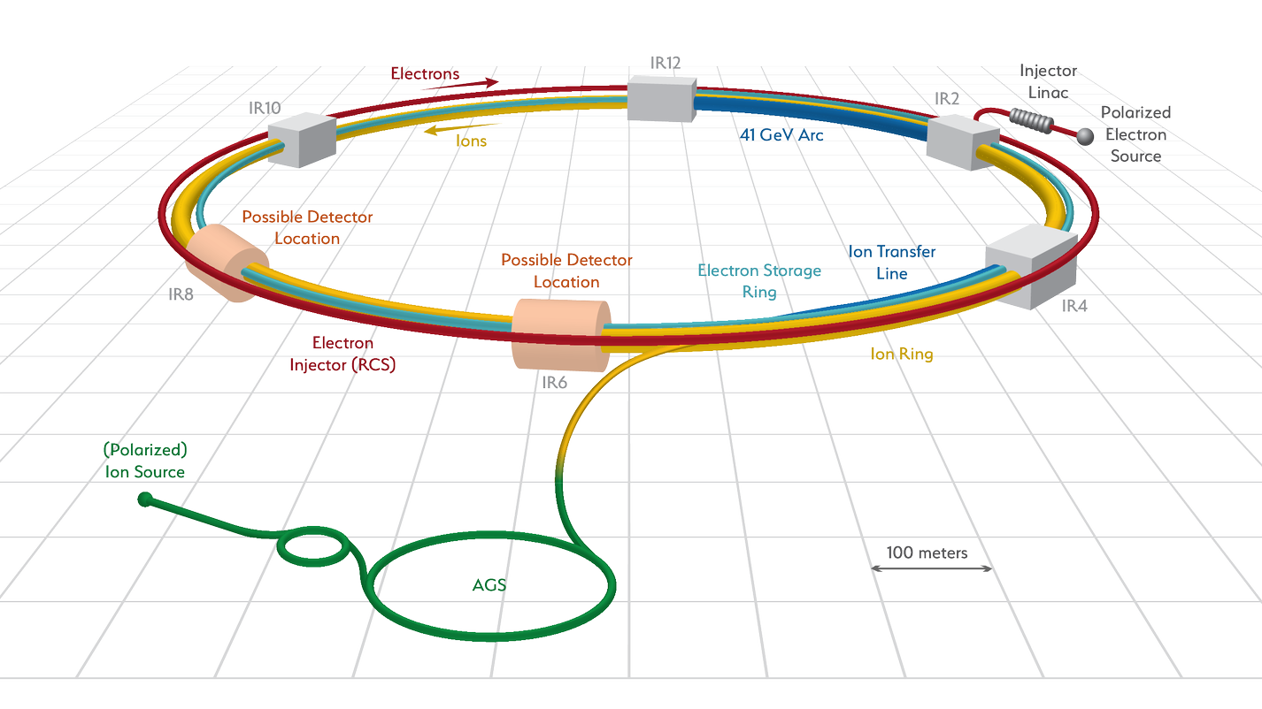
Facility layout
Electron complex to be installed in existing RHIC tunnel – cost effective

Slide 5
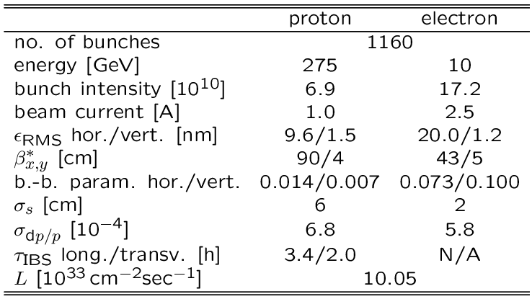
Parameters for Highest Luminosity
Hadron beam parameters similar to present RHIC, but smaller vertical emittance and many more bunches
2 hour IBS growth time requires strong hadron cooling, OR frequent beam replacement
Electron beam parameters resemble a B-Factory
Parameters optimized for high luminosity at high energy
Alternative optimizations are possible, for example for high luminosity at low energy

Slide 6
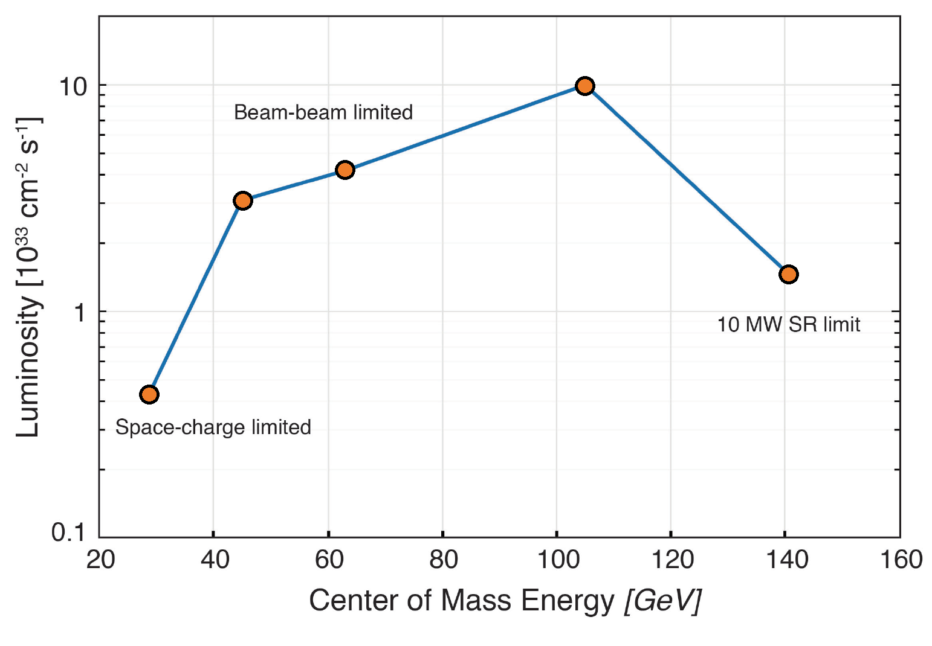
Luminosity vs. CM Energy
Parameter and IR optimization at 105 GeV center-of-mass energy
Optimization yields ${10}^{34}{cm}^{−2}\sec^{−1}$luminosity at 105 GeV

Slide 7
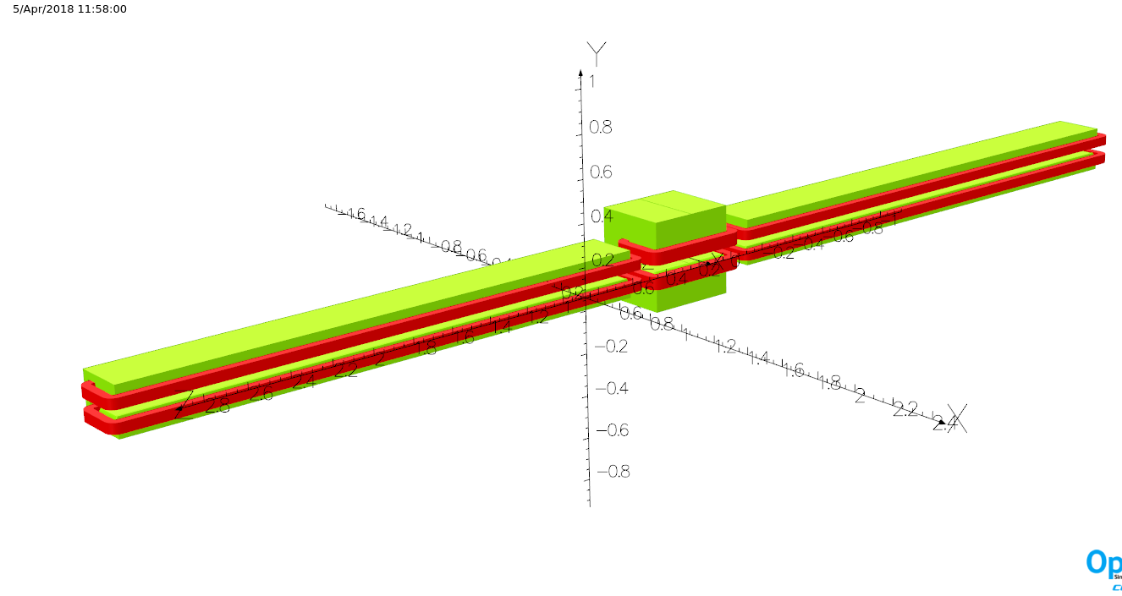
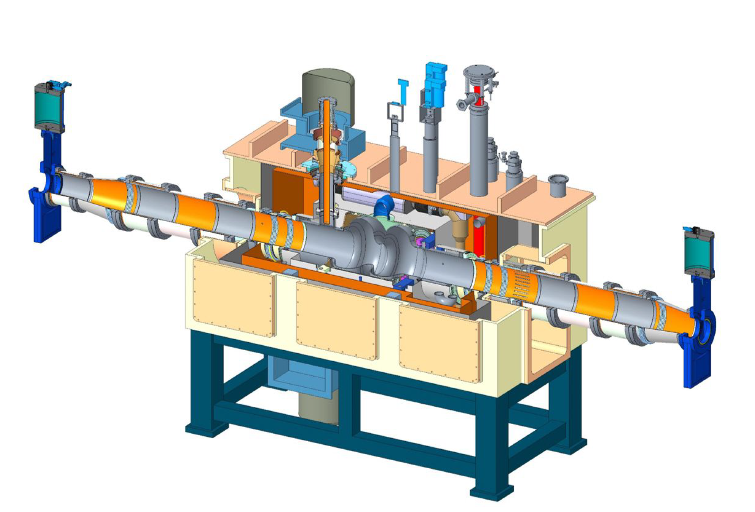
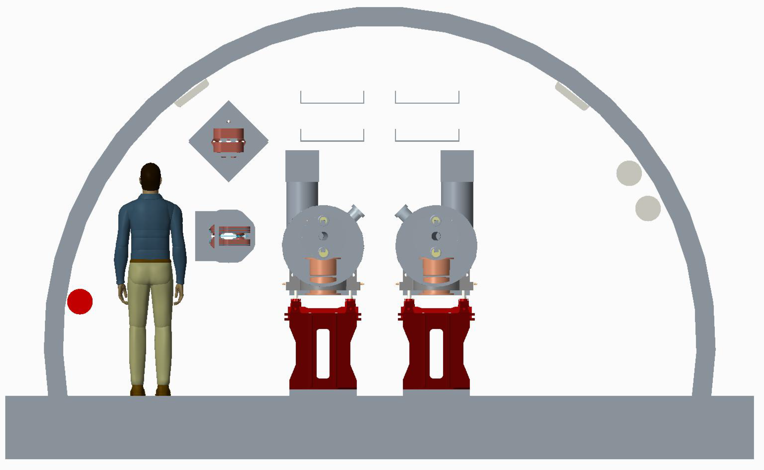
Electron Storage Ring
Composed of six FODO arcs, 60º /cell for 5 to 10 GeV
90º /cell for 18 GeV
Super-bends for 5 to 10 GeV for emittance control
Radiate approx. 10 MW for maximum luminosity parameters at 10GeV
➔ 14 superconducting 2-cell 591 MHz RF cavities
Storage
Ring

Slide 8
EIC Electron Polarization
Physics program requires bunches with spin “up” and spin “down” (in the arcs) to be stored simultaneously
Sokolov-Ternov self-polarization would produce only polarization anti-parallel to the main dipole field
Only way to achieve required spin patterns is by injecting bunches with desired spin orientation at full collision energy
Sokolov-Ternov will over time re-orient all spins to be anti-parallel to main dipole field
Spin diffusion reduces equilibrium polarization
Need frequent bunch replacement to overcome Sokolov-Ternov and spin diffusion

Slide 9
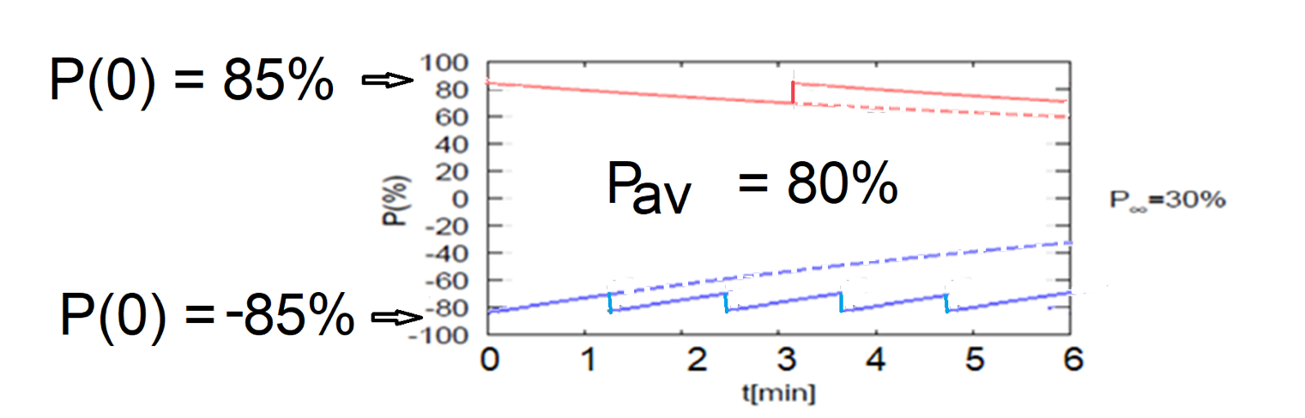
High Average Electron Polarization
Frequent injection of bunches with high initial polarization of 85%
Initial polarization decays towards P∞ < ~50%
At 18 GeV, every bunch is replaced (on average) after 2.2 min with RCS cycling rate of 2Hz
B P
B P
Refilled every 1.2 minutes
Refilled every 3.2 minutes
Re-injection
P_{av}=80%
P∞= 30%
(conservative)
P_{av}=80%
Re-injections

Slide 10
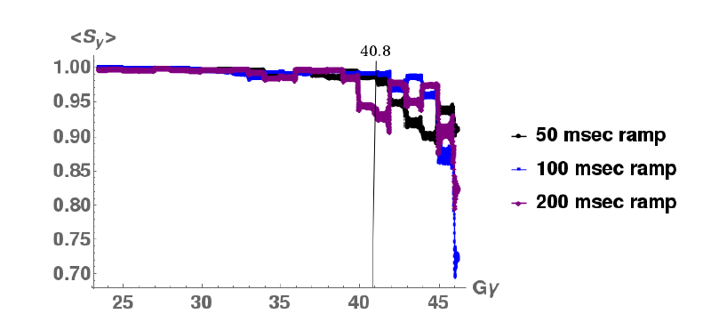
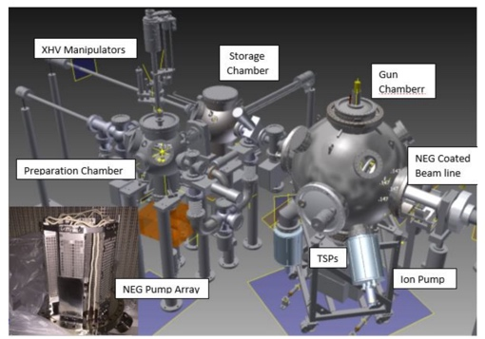
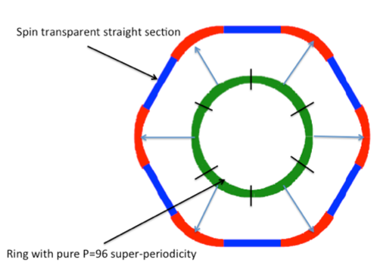
18 GeV Rapid Cycling Synchrotron as Full Energy Polarized Injector
Dedicated optical design: High periodicity arcs and unity transformation in the straights together with proper choice of the integer tune suppresses all systematic depolarizing resonances Gϒ = nP +/- Qy up to 18 GeV; intrinsic resonances outside energy range
No loss of polarization on the entire ramp up to 18 GeV (100 ms ramp time, 2 Hz)
Polarized Electron Source
(R&D Prototype)
RCS Design
RCS Polarization Performance
Requires well aligned quadrupoles @ rms orbit ≤ 0.5 mm @ good reproducibility
Well within the present state of the art of orbit control and
Orbit stability routinely achieved by NSLS-II Booster synchrotron.

Slide 11
Hadron Storage Ring
Existing RHIC ring as EIC Hadron Storage Ring
Add strong hadron cooling
Insertion of sleeves with copper and amorphous carbon coating to improve conductivity and reduce SEY,
Rebuild injection area with faster kickers to accommodate shorter bunch spacing
Remove energy-limiting DX separator dipoles
Inner arc between IRs 2 and 4 for circumference matching during 41 GeV low-energy operation
(Energy range from 100 to 275 GeV can be covered by radial shift)

Slide 12
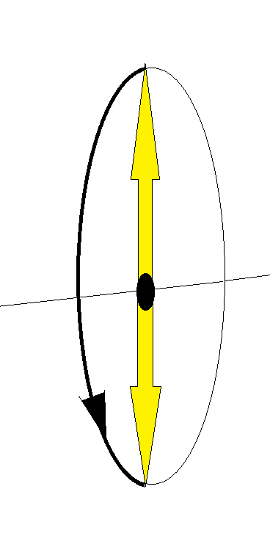
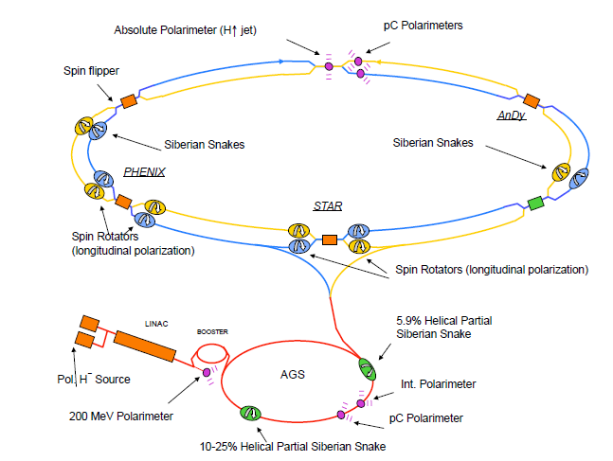
EIC Hadron Polarization
EIC will fully benefit from present RHIC polarization and near future upgrades
Measured RHIC Results with Siberian Snakes:
Proton Source Polarization 83 %
Polarization at extraction from AGS 70%
Polarization at RHIC collision energy 60%
Planned near term improvements:
AGS: Stronger snake, skew quadrupoles,
increased injection energy
➔expect 80% at extraction of AGS
RHIC: Add 4 snakes to 2 existing, no polarization loss
expect 80% polarization in EIC
Expected results obtained from simulations which are benchmarked by RHIC operations
Polarized ³He in EIC with six snakes
Achieved ~85% polarization in 3He ion source
Benchmarked simulations:
Polarization preserved with 6 snakes, at twice the design emittance
Polarized Deuterons in eRHIC:
Requires tune jumps in RHIC to overcome few intrinsic resonances
Benchmarked simulation shows 100% spin transparency
No polarization loss expected in the eRHIC hadron ring
Siberian Snakes

Slide 13
Spin Rotators
Longitudinal polarization is provided by pairs of spin rotators around the IR:
Helical dipole rotators for hadrons (same as in present RHIC)
Solenoid-based rotators for electrons (dipole based Steffen-rotator as in HERA would lead to meter-size vertical orbit excursions at low energy)
Rotators have to be included in spin matching to avoid polarization loss

Slide 14
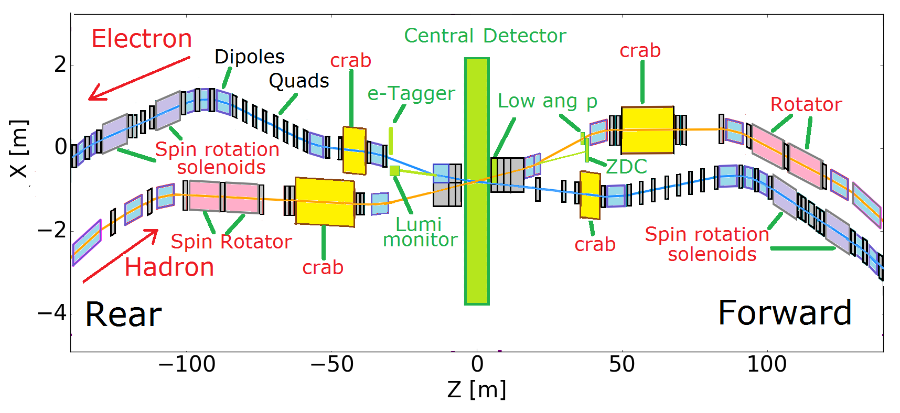
Interaction Region
+/- 4.5 m machine-element free space for central detector
25 mrad total crossing angle
Transverse momentum acceptance down to 200 MeV/c
Peak magnetic fields below 6T (NbTi sufficient)
Most magnets direct-wind; few collared magnets

Slide 15
Summary
The EIC is designed to collide highly polarized electron and light ion (p, d, h) beams, as well as unpolarized heavy ions
Arbitrary spin patterns (“up” and “down”) in both beams are provided by injectors
Dedicated design of the rapid cycling electron synchrotron (RCS) allows polarization preservation all the way up to 18 GeV
Additional Siberian snakes in the hadron ring will provide 100 percent polarization preservation during the ramp
eRHIC design reaches a peak electron-proton luminosity of
L= 1.05·10³⁴cm⁻²s⁻¹
at 105 GeV center-of-mass energy

