Slide 1
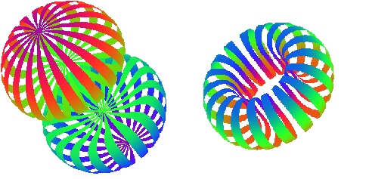
Physics with Polarized Deuterons
*PowerPoint has live captioning available under ‘Slide Show/Subtitles’ menu
Elena Long
Beam Polarization & Polarimetry @ EIC
June 25th, 2020

Slide 2
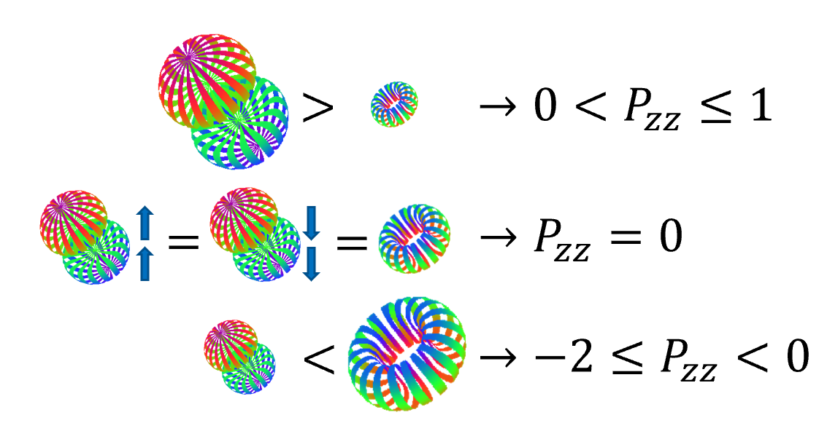
Types of Polarized Deuterons
Vector Polarization
Tensor Polarization
Vector $P_{z}=p_{↑}−p_{↓}$
Tensor $P_{zz}=\left(p_{↑}−p_{↓}\right)−2p_{0}$
-
Spin-1
System
( + )-2
m = +1
m = 0
>
$$→ 0<P_{z}≤1$$
m = -1
<
$$→ −1≤P_{z}<0$$

Slide 3
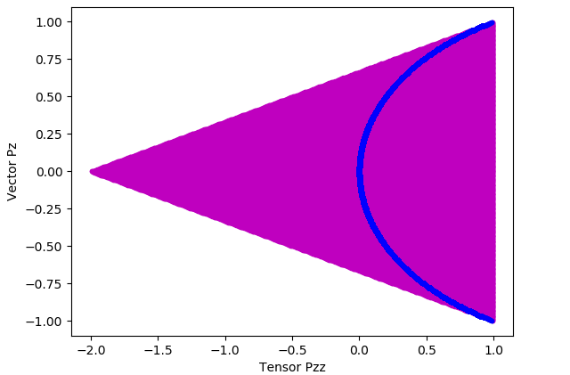
Types of Polarized Deuterons
Many combinations of vector & tensor polarization are possible
$$P_{zz}=2−\sqrt{4−3P_{z}^{2}}$$
All Possible
Polarizations

Slide 4
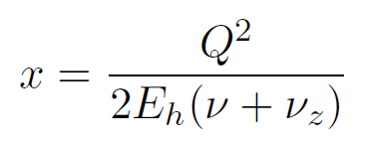
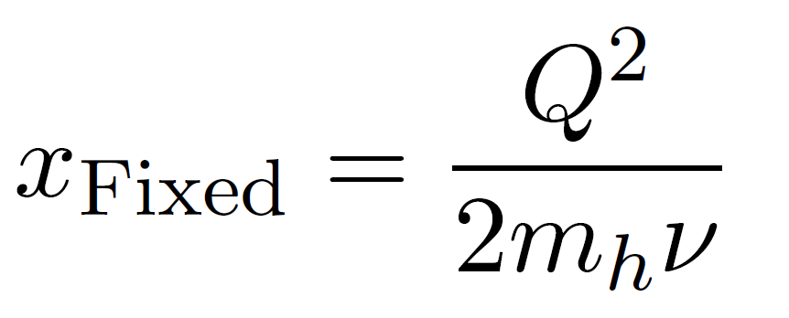
Clarification on $x_{Bj}$
E. Long, EIC Kinematics for Fixed Target Experimentalists, DocDB-doc-350-v1 on JLEIC Document Database (jleic-docdb.jlab.org)
Colliders
Fixed Target
$$0≤x_{Fixed}≤1$$
$$\sim$$
$$0≤x≤1$$
$$0≤x_{JLab}≲N$$

Slide 5
Clarification on $x_{Bj}$
Elastic Scattering
$$σ$$
Deep Inelastic
Scattering (DIS)
Quasi-Elastic (QE) Scattering
Nuclear
Resonances
$$1$$
$$x_{JLab}$$
$$0.7$$
$$i\sim 1,2,3,…N$$
($\sim$ # protons + # neutrons)
Probes Sub-Nucleon Effects
e
Probes Nucleon Effects
e
Probes Nuclear Effects
e
< 10⁻¹⁸ m
e
e
10⁻¹⁵ m
e
10⁻¹⁴ m

Slide 6
EIC Major Impact Regions
DIS → Very Low $x$, High $Q^{2}$
QE → High $Q^{2}$
Elastic → Low & High $Q^{2}$

Slide 7
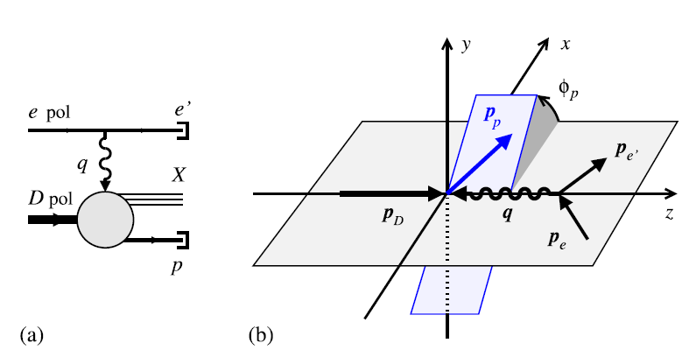
Vector Polarized $\vec{d}\left(\vec{e},e^{′}p\right)X$ DIS w/ Spectator Tagging
W. Cosyn, C. Weiss, arXiv:2006.03033 (2020)
W. Cosyn, C. Weiss, Phys. Lett. B 799, 135035 (2019)

Slide 8
Vector Polarized $\vec{d}\left(\vec{e},e^{′}p\right)X$ DIS w/ Spectator Tagging
Tagging eliminates dilution by IDing events w/ scattering from the neutron
Tagging controls neutron polarization
Tagged longitudinal spin asymmetries
D-wave drops as $p_{pT}→0$
Pure S-wave → 100% Neutron Polarization
Mostly D-wave @ $p_{pT}≈400 MeV$
W. Cosyn, C. Weiss, arXiv:2006.03033 (2020)
W. Cosyn, C. Weiss, Phys. Lett. B 799, 135035 (2019)

Slide 9
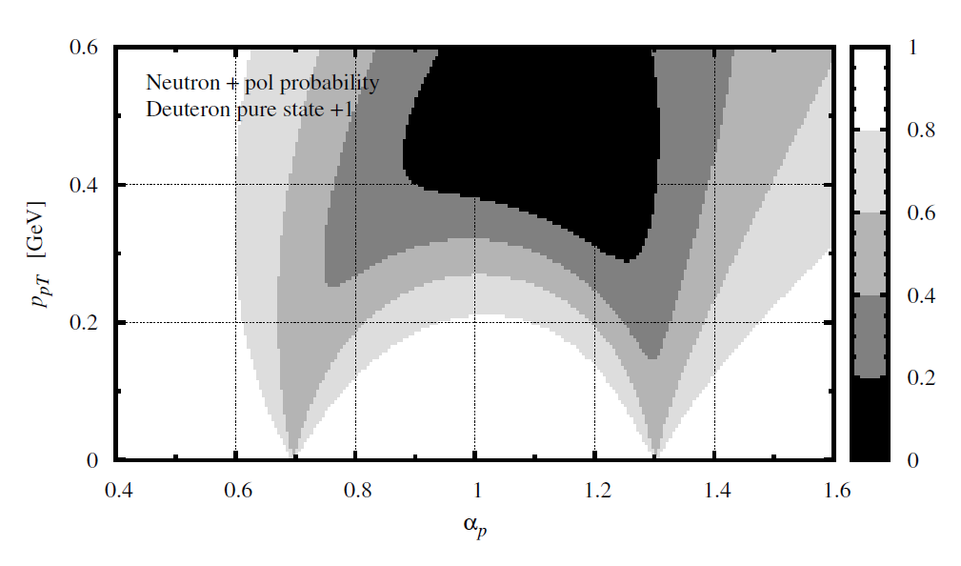
Vector Polarized $\vec{d}\left(\vec{e},e^{′}p\right)X$ DIS w/ Spectator Tagging
Neutron spin structure
Free neutron spin asymmetry can be extracted by pole extrapolation of tagged spin asymmetries
Nuclear light-front spectral function
3D mapping of nucleon momentum & helicity distributions in deuteron
Methods & results can be applied to study nuclear modifications of partonic spin structure
Polarized EMC effect, Antishadowing, Shadowing
W. Cosyn, C. Weiss, arXiv:2006.03033 (2020)
W. Cosyn, C. Weiss, Phys. Lett. B 799, 135035 (2019)

Slide 10
Tensor Polarized Deuteron w/ Spectator Tagging
Tagged tensor-polarized scattering
Maximize tensor polarization: $P_{zz}=1$ for $\left|p_{pT}\right|≈300 MeV$ & $α_{p}=1$
$P_{zz}=−2$ possible for $α_{p}≠1$
Tagged tensor asymmetries can be much larger than in untagged scattering
$$P_{zz}$$
W. Cosyn, C. Weiss, in progress
JLab EIC Meeting, 6/19/20

Slide 11
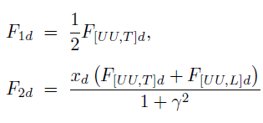
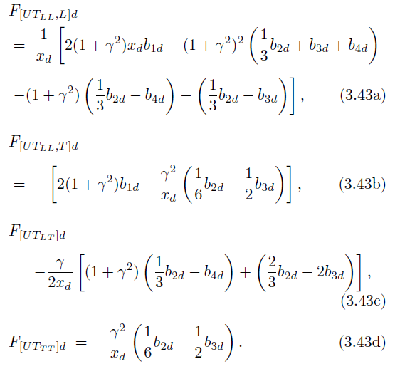
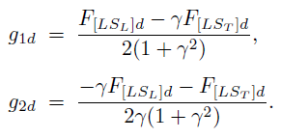
DIS – Structure Functions
$$W_{μν}=−αF_{1}+βF_{2}$$
Scattering on Unpolarized Targets
$$+iγg_{1}+iδg_{2}$$
Scattering on Vector Polarized Targets
$$−εb_{1}+ζb_{2}+ηb_{3}+κb_{4}$$
Scattering on Tensor-Polarized Targets
Very nice overview paper on these observables for EIC:
W. Cosyn & C. Weiss, arXiv:2006.03033 (2020)

Slide 12
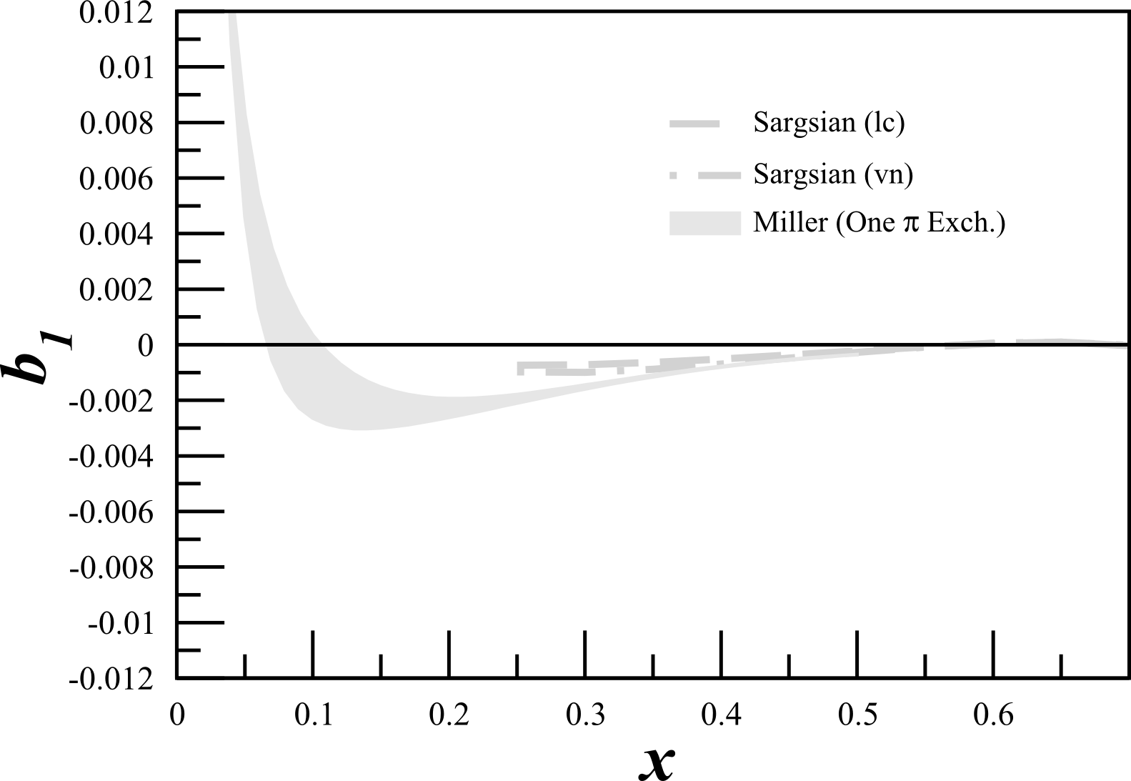
Tensor Structure Function, $b_{1}$
$b_{1}$ probes nuclear effects at quark resolution!
$$b_{1}\left(x\right)=\frac{q^{0}\left(x\right)−q^{±1}(x)}{2}$$
All conventional models predict small or vanishing values of $b_{1}$
A Airapetian, et al, PRL 95 242001 (2005)
K Slifer, et al, JLab C12-13-011

Slide 13
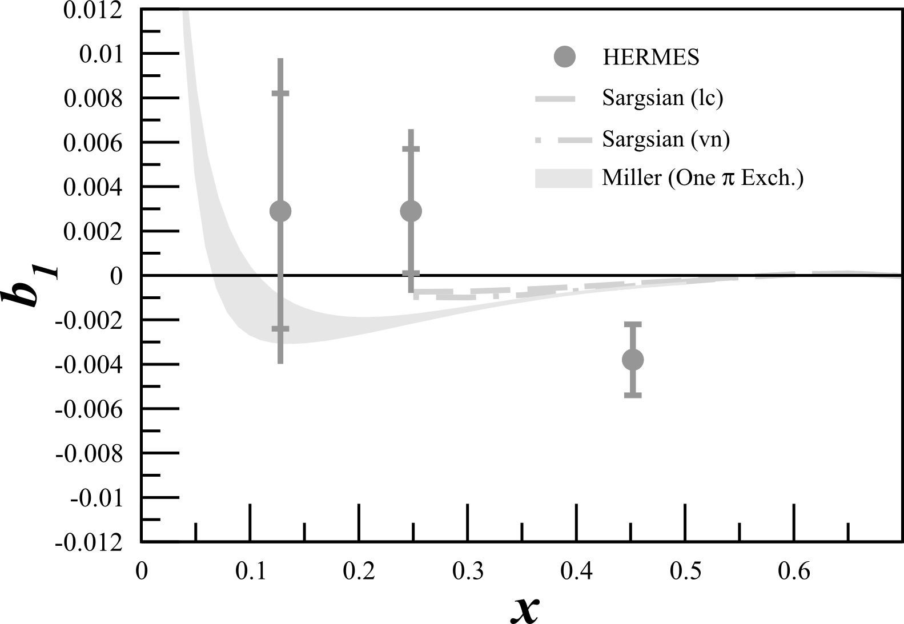
Tensor Structure Function, $b_{1}$
$b_{1}$ probes nuclear effects at quark resolution!
$$b_{1}\left(x\right)=\frac{q^{0}\left(x\right)−q^{±1}(x)}{2}$$
All conventional models predict small or vanishing values of $b_{1}$
HERMES found something very different!
Only $\sim 2σ$
A Airapetian, et al, PRL 95 242001 (2005)
K Slifer, et al, JLab C12-13-011

Slide 14
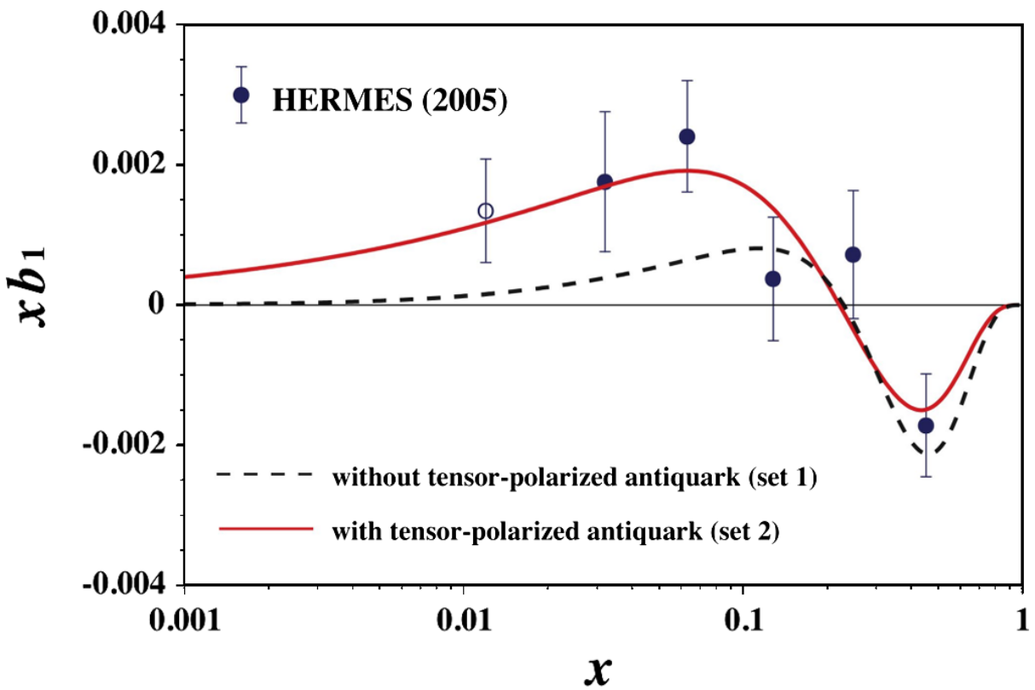
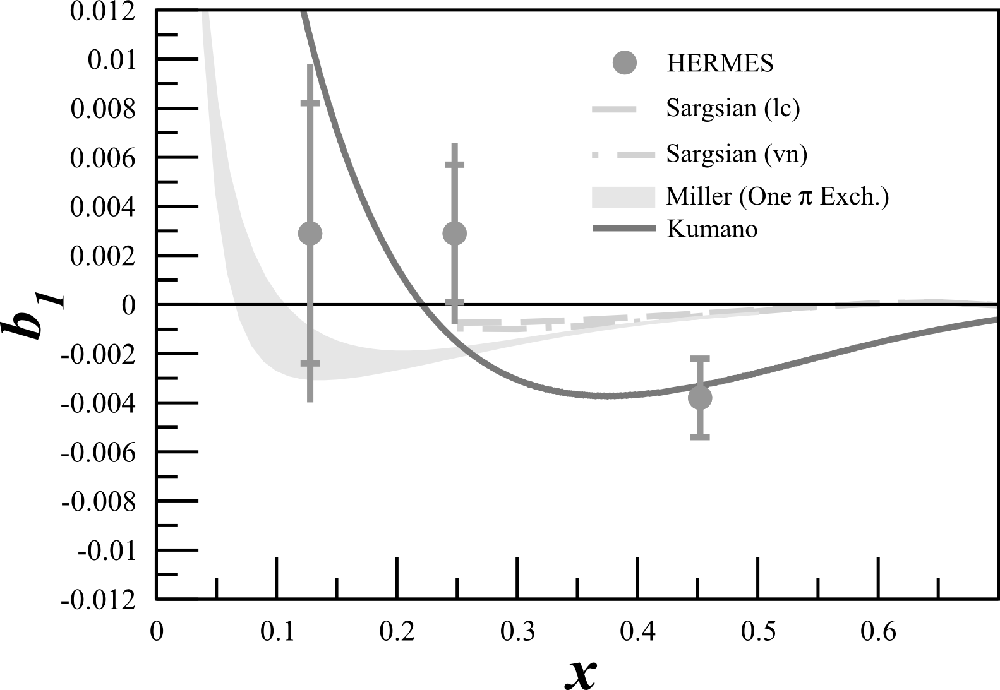
Tensor Structure Function, $b_{1}$
$b_{1}$ probes nuclear effects at quark resolution!
$$b_{1}\left(x\right)=\frac{q^{0}\left(x\right)−q^{±1}(x)}{2}$$
All conventional models predict small or vanishing values of $b_{1}$
HERMES found something very different!
Any measurement of $b_{1}<0$ indicates exotic physics
Indicates significant tensor polarization in antiquark distributions
A Airapetian, et al, PRL 95 242001 (2005)
K Slifer, et al, JLab C12-13-011
S Kumano, PRD 82 017501 (2010)

Slide 15
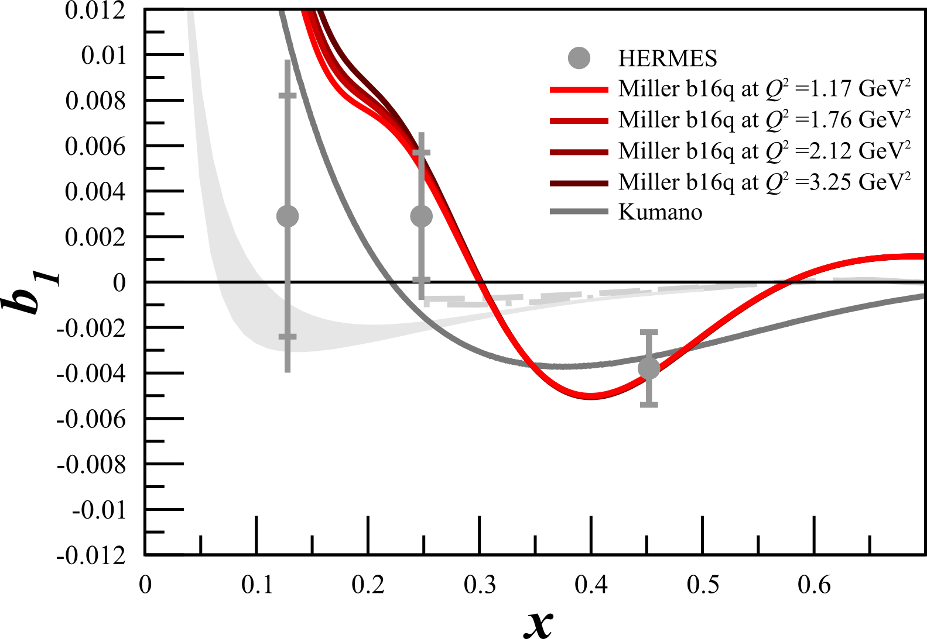
Tensor Structure Function, $b_{1}$
$b_{1}$ probes nuclear effects at quark resolution!
$$b_{1}\left(x\right)=\frac{q^{0}\left(x\right)−q^{±1}(x)}{2}$$
Pionic Effects
All conventional models predict small or vanishing values of $b_{1}$
HERMES found something very different!
Any measurement of $b_{1}<0$ indicates exotic physics
Predictions using 6q Hidden Color
A Airapetian, et al, PRL 95 242001 (2005)
K Slifer, et al, JLab C12-13-011
S Kumano, PRD 82 017501 (2010)
G Miller, PRC 89 045203 (2014)

Slide 16
Tensor Structure Functions
$b_{2},{ b}_{3}, \&{ b}_{4}$ remain unexplored
→ Potential probes for gluonic effects

Slide 17
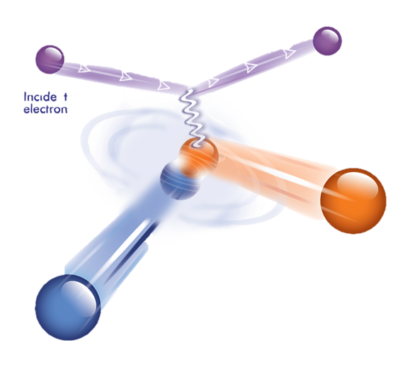
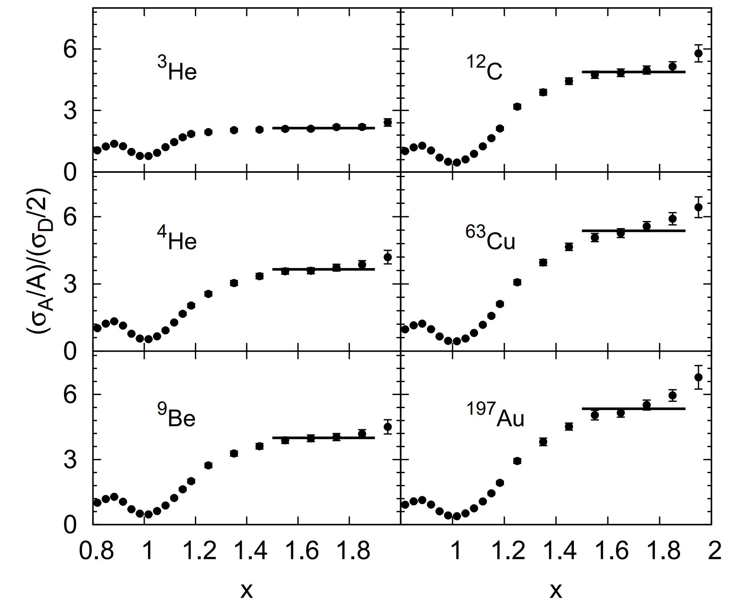
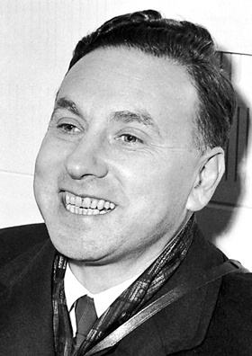
Quasi-Elastic Tensor Asymmetry
Short-Range Correlations: Everything looks like deuterons!
Look @ Deuteron: Simplest composite nuclear system
Short-range, high p structure probed with:
$x>1$ kinematics
Enhancing tensor polarization
N Foman, et al, PRL 108 092502 (2012)
Looks like deuterons!
Looks like deuterons!
Probe the tensor force with tensor polarization!
Everything
Looks like deuterons!
Deuteron
Looks like deuterons!
Looks like deuterons!
Looks like deuterons!
Combine both techniques!

Slide 18
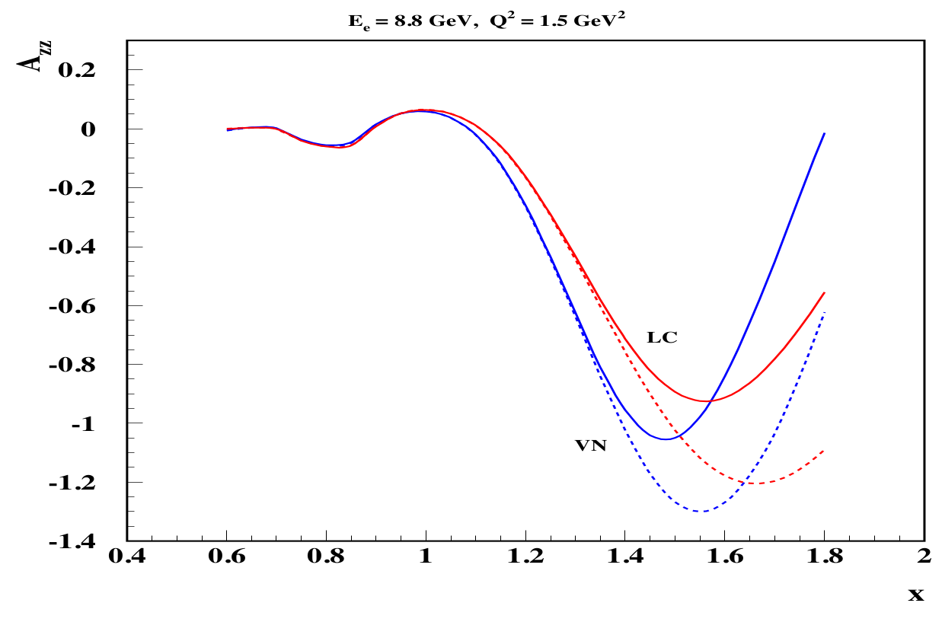
Quasi-Elastic Tensor Asymmetry $A_{zz}$
$A_{zz}$ extremely useful in the quasi-elastic region
Can give insight to short range deuteron structure → Hard v. Soft WFs; VN v. LC
→ Calculations improve @ high $Q^{2}$
making $A_{zz}$@EIC interesting!
EIC
$$A_{zz}∝\frac{\frac{1}{2}D^{2}−SD}{S^{2}+D^{2}}$$
AV18
AV18
cdBonn
Upcoming @ JLab
cdBonn
Sargsian, Strikman, J. Phys.: Conf. Ser. 543, 012099 (2014)
L. Frankfurt, M. Strikman, Phys. Rept 160, 235 (1988)

Slide 19
$A_{zz}$ Connects Tensor Physics
DIS: $b_{1}∝F_{1}A_{zz}$
QE/SRC Region: $A_{zz}$
Elastic: $T_{20}∝A_{zz}$
In fixed target experiments:
$$A_{zz}=\frac{2}{fP_{zz}}\left(\frac{σ^{+}−σ^{u}}{σ^{u}}\right)$$
In collider experiments:
$$A_{zz}=2\frac{σ^{+}−σ^{−}}{\left|P_{zz}^{+}\right|σ^{−}+\left|P_{zz}^{−}\right|σ^{+}}$$
$σ^{+}=$Cross-section w/ positive tensor pol.
$σ^{−}=$Cross-section w/ negative tensor pol.
$σ^{u}=$Unpolarized cross-section

Slide 20
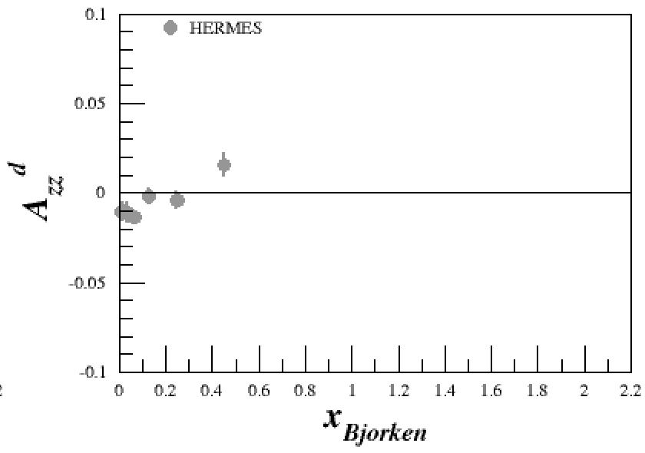
JLab12 Tensor Program

Slide 21
JLab12 Tensor Program

Slide 22
JLab12 Tensor Program

Slide 23
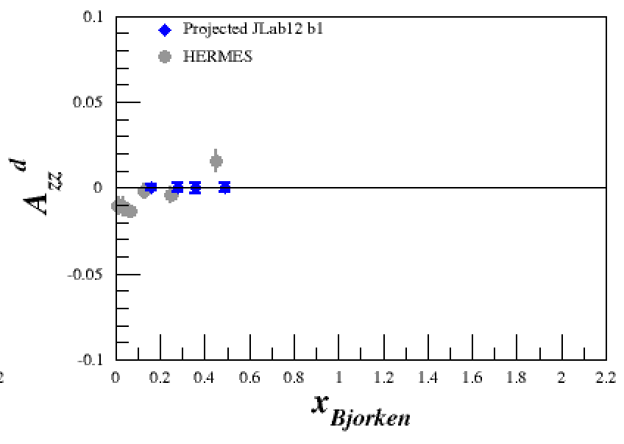
JLab12 Tensor Program

Slide 24
JLab12 Tensor Program

Slide 25
JLab12 Tensor Program

Slide 26
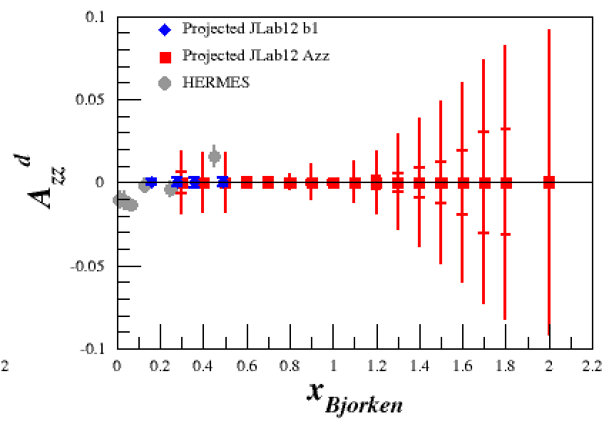
JLab12 Tensor Program

Slide 27
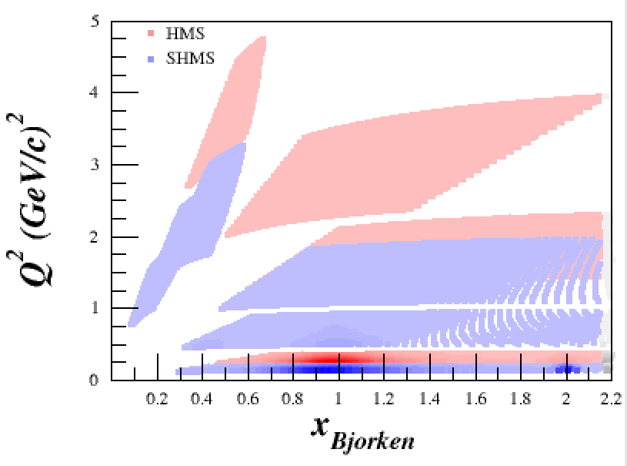
JLab12 Tensor Program

Slide 28
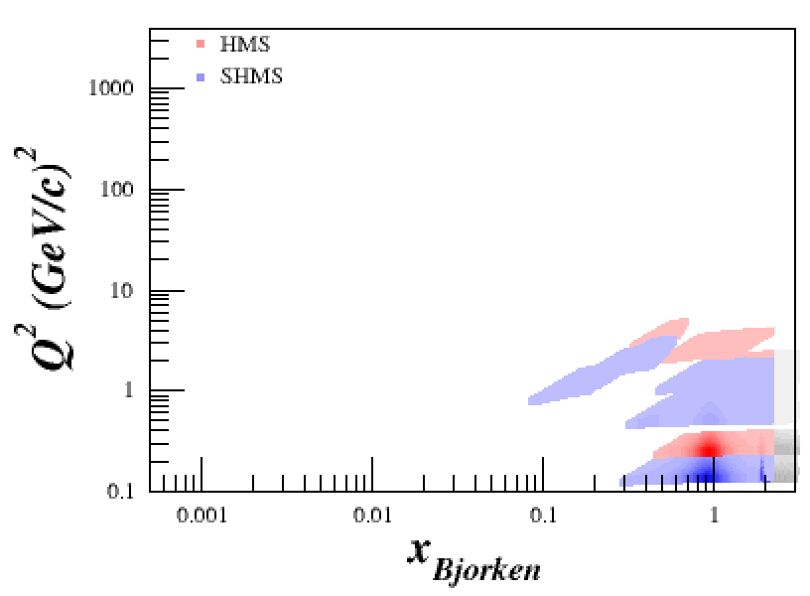
JLab12 Tensor Program

Slide 29
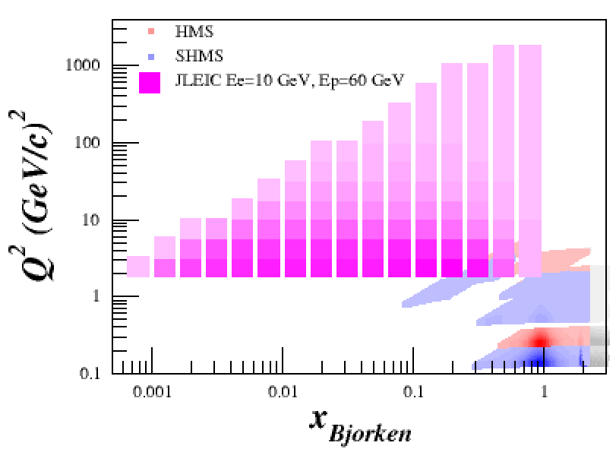
Tensor EIC Kinematics
Disclaimer: EIC studies shown are preliminary & are in process of being re-run
→ QE & Elastic simulations in progress
High Beam Energies
Lowest Beam Energies
Huge Thank You to Yulia for JLEIC estimates

Slide 30
EIC Unpolarized → EIC Tensor Polarized
$P_{zz}=$ Tensor Polarization $(−2≤P_{zz}≤1)$
Assumed max $P_{zz}^{+}=0.85$, max $P_{zz}^{−}=−1.70$, and $δP_{zz}=0.05$
$N^{+}=+P_{zz}$ events = Deuteron in $m=±1$ spin states
$N^{−}=−P_{zz}$ events = Deuteron in $m=0$ spin states
$N^{+}=N^{−}={N_{tot}}/2$
$A_{zz}=2\frac{N^{+}−N^{−}}{\left|P_{zz}^{+}\right|N^{−}+\left|P_{zz}^{−}\right|N^{+}}$
Good estimate for x<1 region

Slide 31
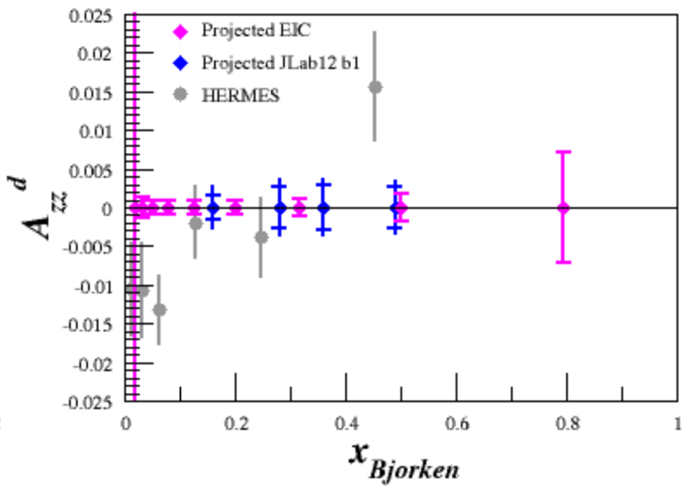
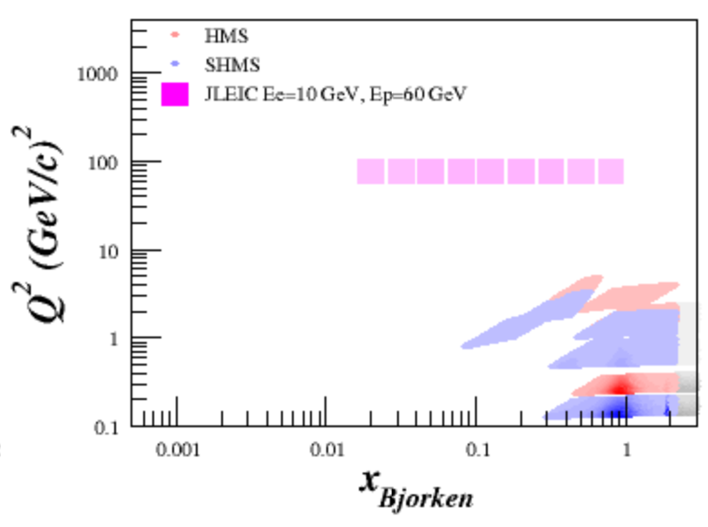
2 Weeks EIC Running (10 fb⁻¹ @ high beams)
1 $Q^{2}$ bin out of ~6
w/ reasonable statistics
$$Q^{2}\sim 72\frac{{GeV}^{2}}{c}$$

Slide 32
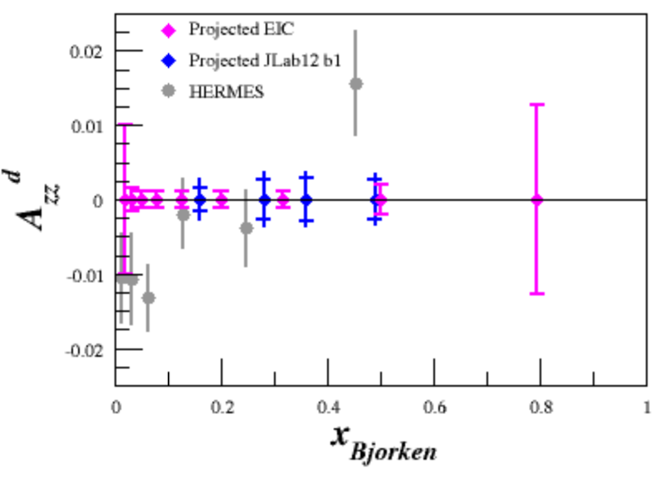
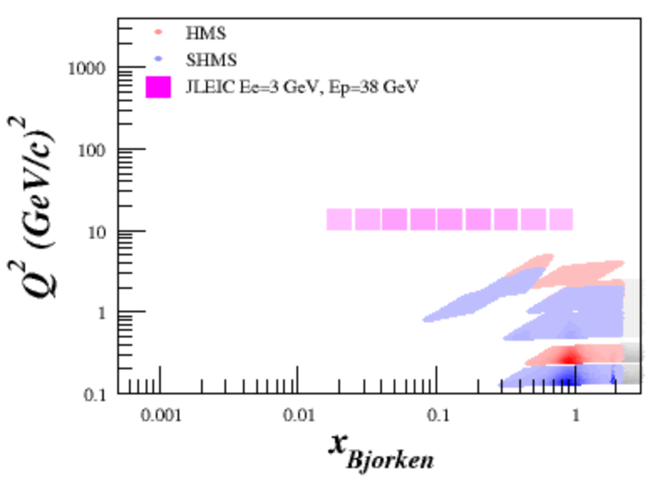
2 Weeks EIC Running (1 fb⁻¹ @ low beams)
1 $Q^{2}$ bin out of ~6
w/ reasonable statistics
$$Q^{2}\sim 13\frac{{GeV}^{2}}{c}$$

Slide 33
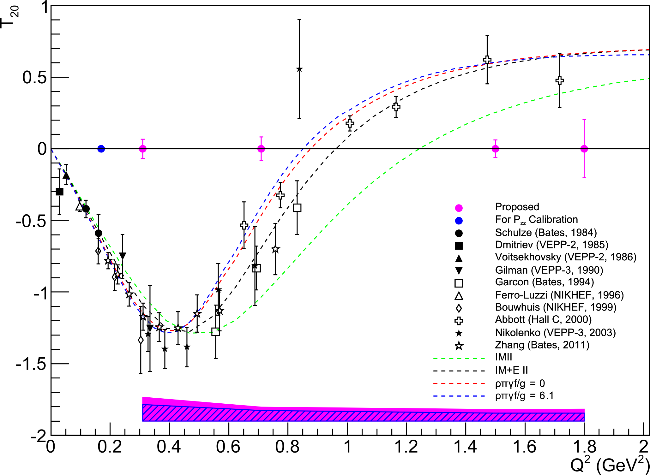
Elastic $T_{20}$
$T_{20}$, along with unpol. $A$ & $B$ form factors, gave rise to current deuteron understanding
$T_{20}=$ $\frac{A_{zz}}{d_{20}\sqrt{2}}$on elastic peak
$$d_{20}=\frac{3\cos^{2}θ^{∗}−1}{2}$$
At low $Q^{2}$,
$T_{20}$ well known
$P_{zz}$ can be extracted from $T_{20}$
EIC can potentially double the $Q^{2}$ coverage of $T_{20}$
Simulations in progress
Proposed from E Long, et al, JLab C12-15-005
World Data from R Holt, R Gilman, Rept.Prog.Phys. 75 086301 (2012)
J Forest, et al, PRC 54 646 (1996)

Slide 34
Elastic & Quasi-elastic: Forward/Backward Angles Critical
‘Visibility Bar’ added to highlight thin momentum bins of elastic scattering
‘Log-like’ plotting developed to highlight very forward/background angles
Upper half: Linear $θ$, $r=log\left(E′\right)$
Lower half: Log-like toward $θ=90°$ from both $0°$ & $180°$
Kinematic plots in progress
https://github.com/ellie-long/EIC/tree/master/CirclePlots

Slide 35
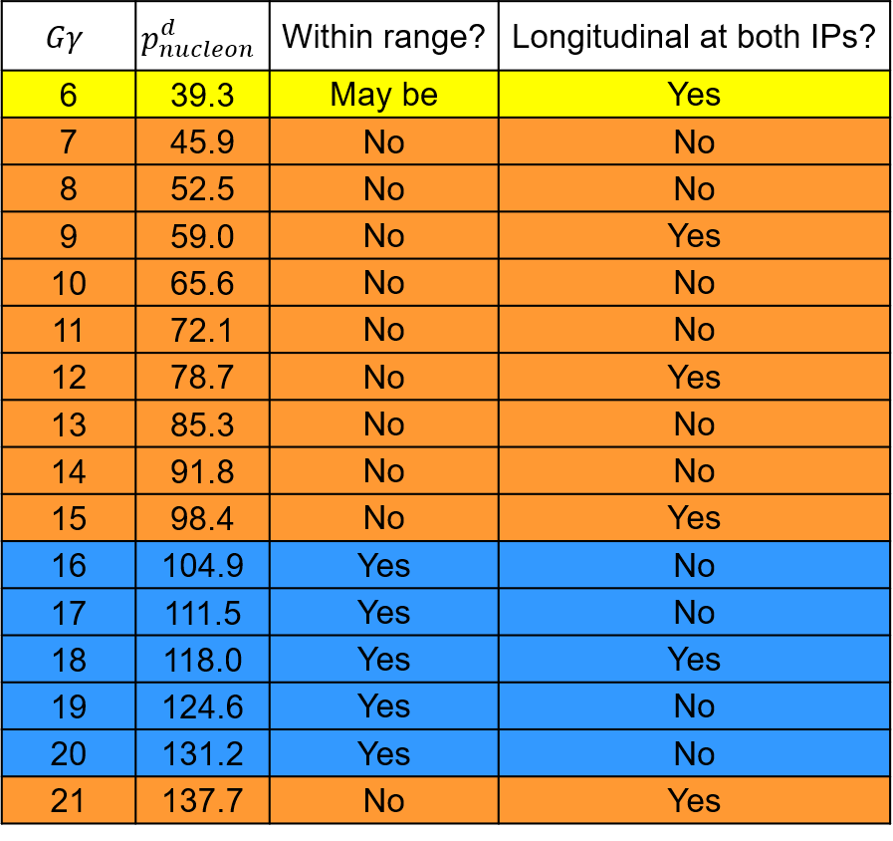
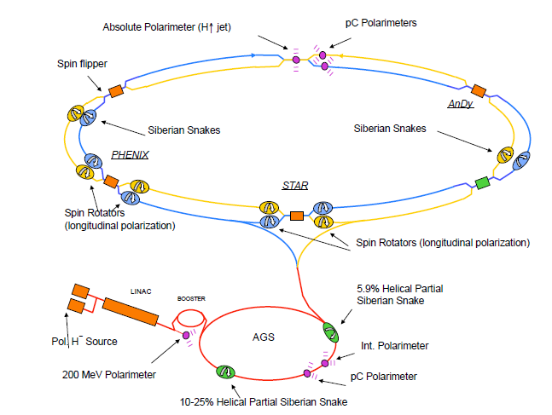
Getting EIC Tensor Polarization: ‘Magic Energies’
V. Morozov, J. Guo, Y. Zhang, JLab EIC Meeting, 6/19/20
Which magic momenta fall into the EIC deuteron momentum range?
The two IPs are separated by 1/6th of the ring. If spin is longitudinal at one IP, it will be longitudinal at the second IP if the spin precession between the two IPs in an integer number of $π$
$$\frac{2πGγ}{6}=kπ ⇒ Gγ=3k$$

Slide 36
Getting EIC Tensor Polarization: Using Vector Polarization
→ See Barak Schmookler’s talk on Monday @ 9am!
Potentially get both positive & negative $P_{zz}$ w/ vector beam!

Slide 37
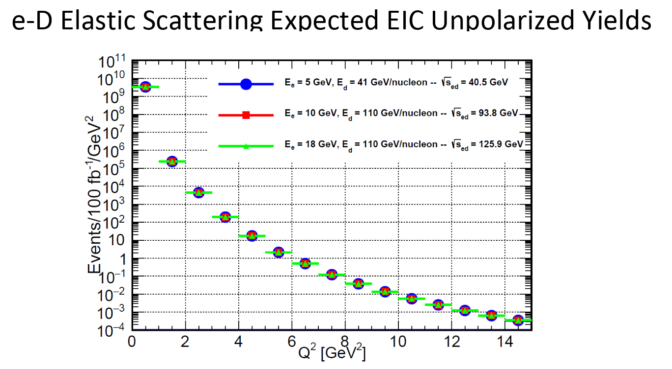
Getting EIC Tensor Polarization: Measuring $P_{zz}$
→ See Barak Schmookler’s talk on Monday @ 9am!
Measuring $P_{zz}$ from low-$Q^{2}$ $T_{20}$
where $T_{20}$ is well known

Slide 38
EIC Major Impact Regions
DIS → Very Low $x$, High $Q^{2}$
Vector & Tensor Structure Functions, neutron structure, pionic effects, sea polarization, Polarized EMC effect, Antishadowing, Shadowing, etc.
QE → High $Q^{2}$
SRCs, NN structure, Virtual Nucleon/Light Cone, nucleon form factors, etc.
Elastic → Low & High $Q^{2}$
Measure $P_{zz}$, high-momentum form factors ($A, B, T_{20}$)

