Slide 1
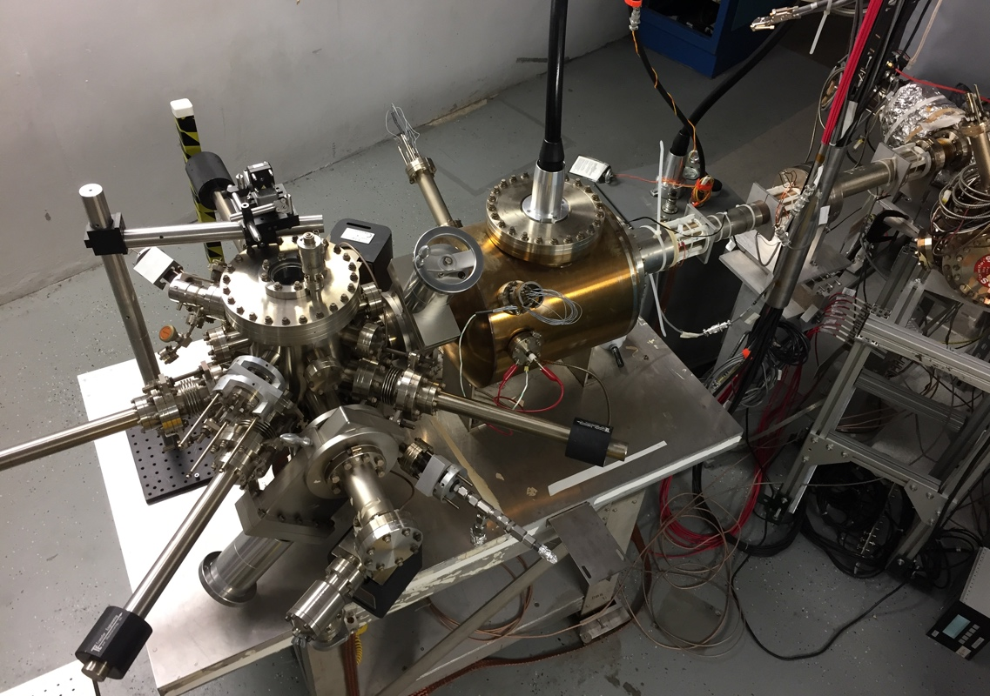
Possibilities for Polarized Positrons at the EIC
Joe Grames
Jefferson Laboratory
This work is supported by the U.S. Department of Energy contract DE-AC05-06OR23177 and the U.S.-Japan Science and Technology Cooperation Program in High Energy Physics.
I would like to acknowledge the following for their long time encouragement for this work: Larry Cardman, Arne Freyberger, Hugh Montgomery, Matt Poelker and Eric Voutier.
CFNS Workshop on Beam Polarization and Polarimetry at EIC
(https://indico.bnl.gov/event/7583/)
June 26, 2020

Slide 2
Outline
As a means of motivating future discussions for producing polarized positrons at the EIC, I will describe progress at Jefferson Lab in developing a polarized positron beam for 12 GeV CEBAF.
  Broad strokes : producing + capturing the e⁺
  Polarized positrons : 4 options
  PEPPo at Jlab : polarized e⁻ and e⁺ source R&D topics

Slide 3

CEBAF User Requirements (see E. Voutier’s talk)
Electrons
Simultaneous Users : 4
Beam Energy: 12 GeV
Duty Factor: 100% (cw)
Polarized Beams: >150 uA (P>85%)
Unpolarized Beams: >150 uA
Helicity Reversal: 30 Hz + Wien flips
Positrons
Simultaneous Users : Same
Beam Energy: Same
Duty Factor: Same
Polarized Beams: > 100 nA (P>50%)
Unpolarized Beams: > 5 uA
Fast/Slow Helicity Reversal: Same

Slide 4
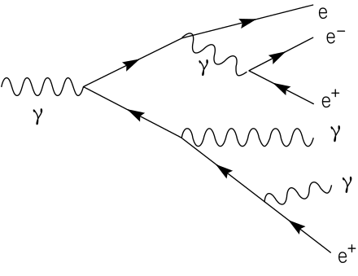
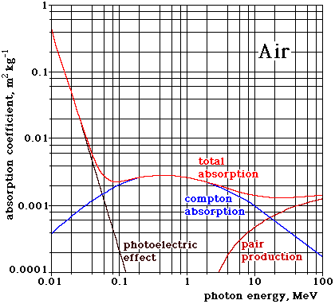
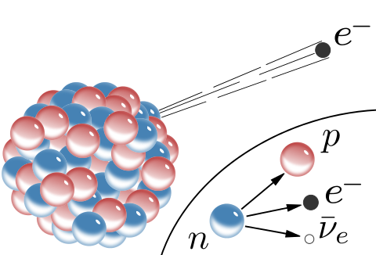
Two ways to produce positrons
Positron Generation by Pair Creation (typically EM shower)
Photons > 10 MeV dominate pair production
Positron Generation by β Decay
e⁺
n
e⁺
p
ν_{e}

Slide 5
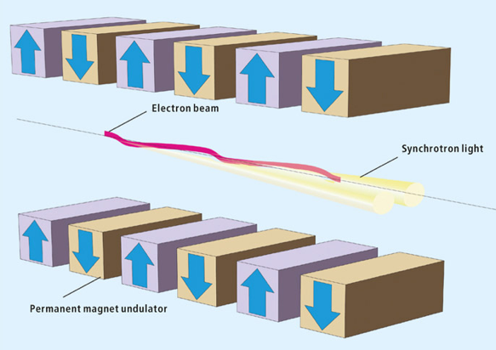
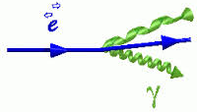
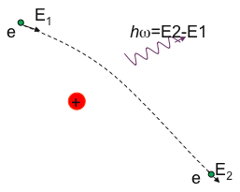
Generating MeV energy photons
Inverse Compton Scattering
Undulator (SR)
E_{γ} < E²_{beam} ν
Bremsstrahlung
Coherent Bremsstrahlung
E_{γ} < E_{beam}
(Yield ~ 20-40 greater)

Slide 6
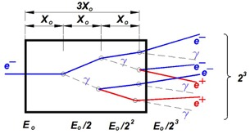
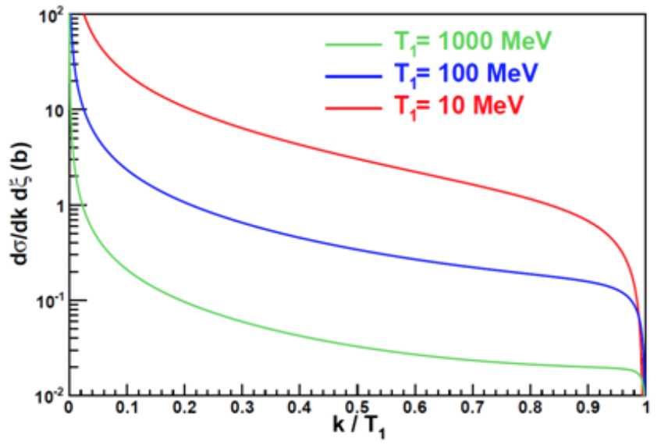
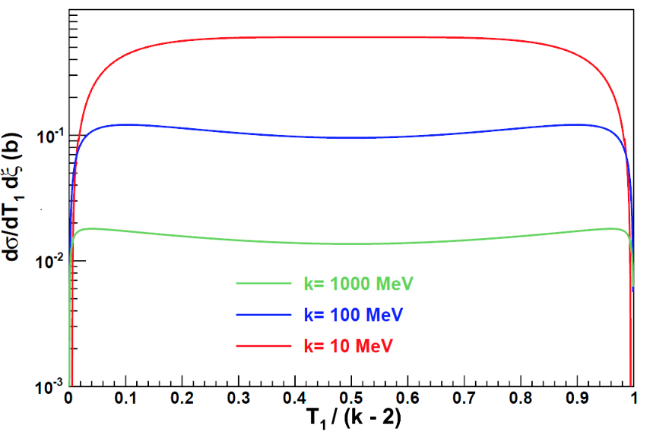
Electromagnetic shower drives the yield
Bremsstrahlung
Z=74 (W), θ_{γ}=0.41 mrad
Yield
Energy
Target
Intensity
Pair Creation
Z=74 (W), θ_{γ}=0.41 mrad

Slide 7
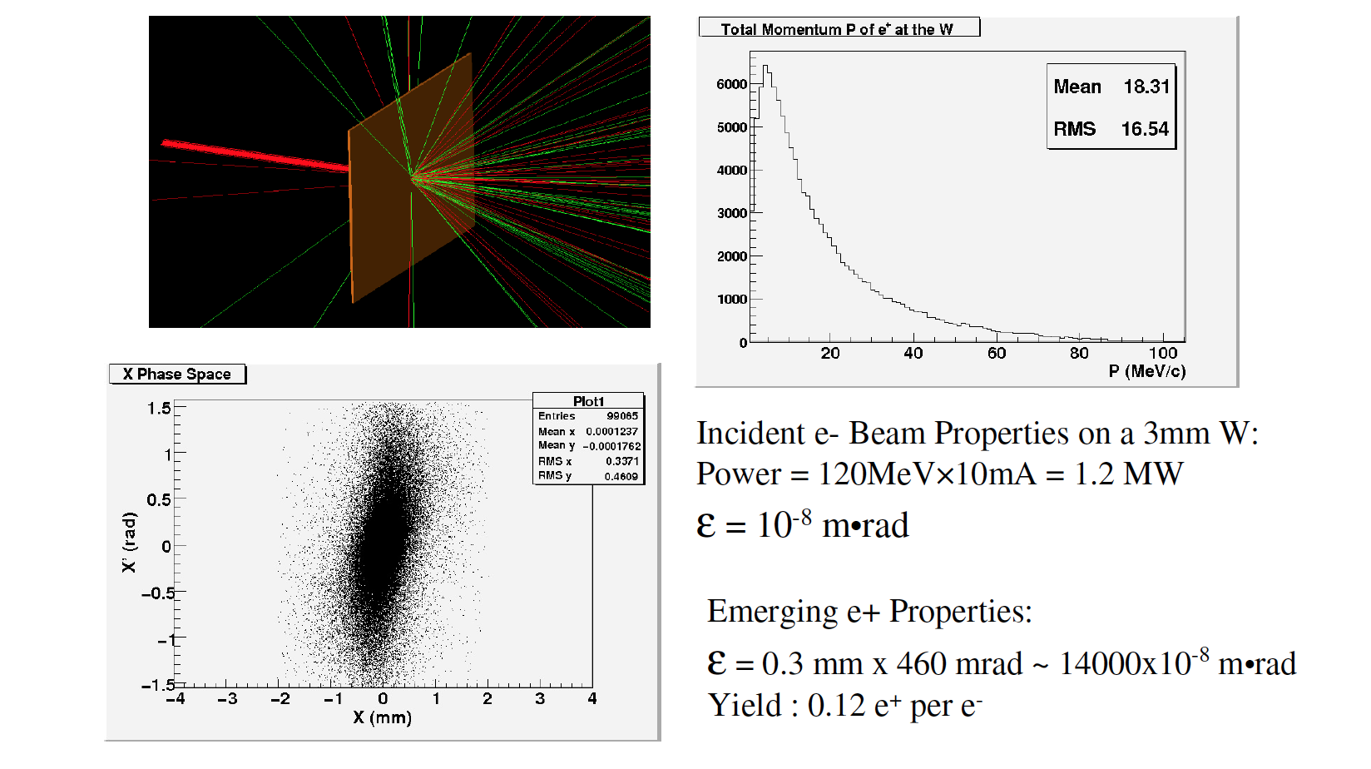
Beehive (it’s a mess!)
e-
e+
2π

Slide 8
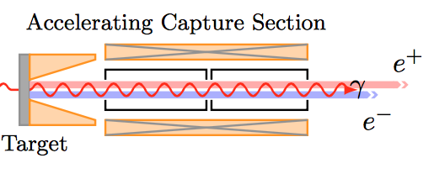
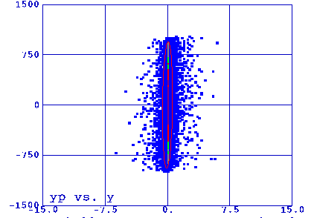
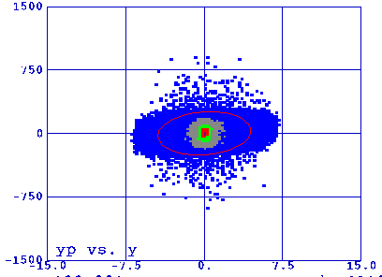
Taming the Positrons
High field solenoid transforms large divergence small radius at radiator to smaller divergence and larger radius
Low field solenoid maintains beam envelope through nearby acceleration sections
Narrower momentum acceptance
Broader momentum acceptance

Slide 9
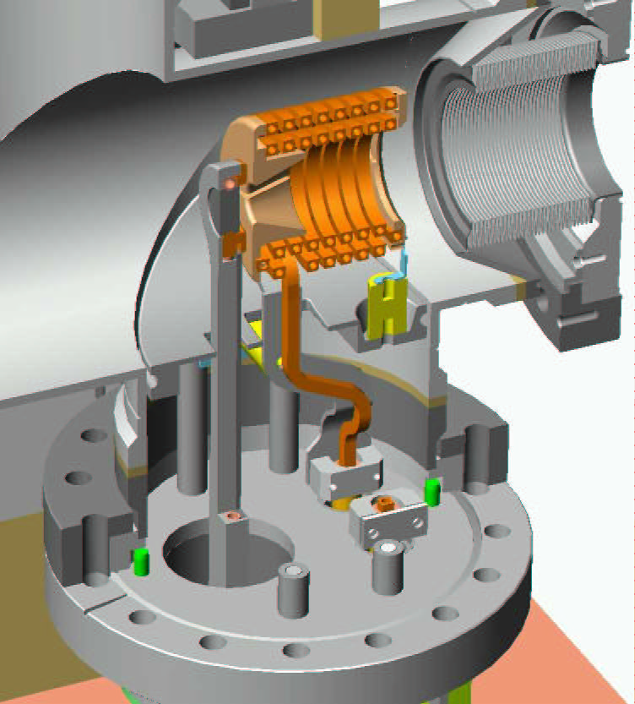
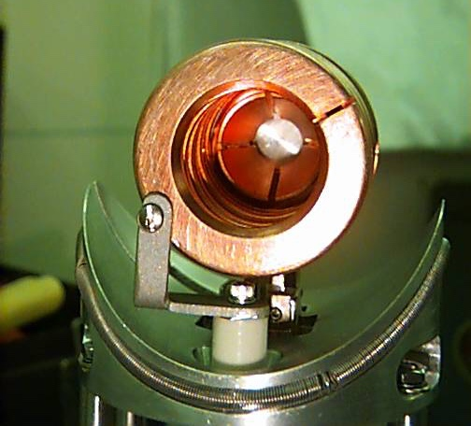
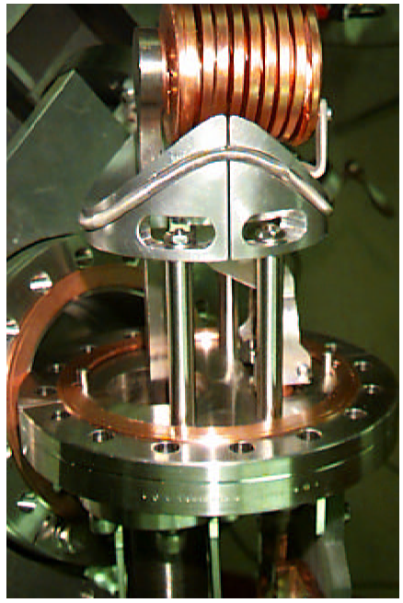
Example: Cornell Positron Source (QWT)
J. Barley, V. Medjidzade, A. Mikhailichenko, “New Positron Source for CESR”, CBN-01-19, Oct 2001. 16pp.
This short-focusing lens followed by RF structure immersed in solenoid
W Target
Focusing coil with flux concentrator
Positron rate ~10¹¹ /sec at 50 Hz operation at ~200 MeV
Conversion efficiency~2.5%, DC power consumption ~2.5 kW

Slide 10
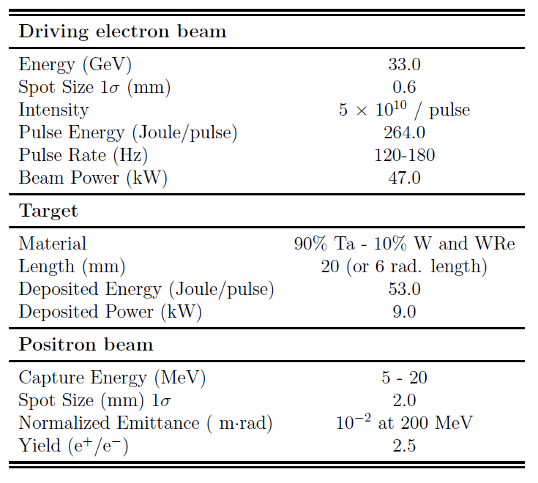
Example: Stanford Linear Collider (AMD)
Maximize e+ momentum acceptance

Slide 11




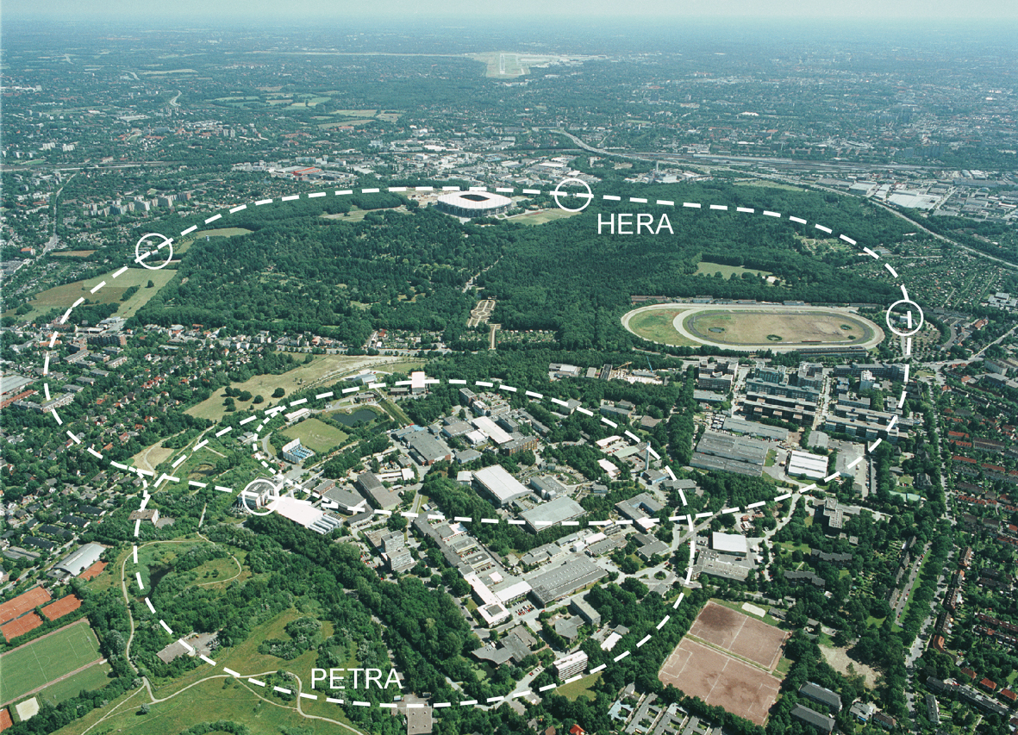
Polarizing the Unpolarized Positron beam
A small fraction of synchrotron radiated power (<10⁻⁸) results in a spin flip. The difference in energy levels (e- in a B field) results in an asymmetry in the spin state (parallel or anti-parallel to the magnetic field)
e⁺
γ
Sokolov-Ternov Effect
D. Barber , AIP Conf. Proc. 588, 338 (2001)
HERA 27.5 GeV e+/e-
Theoretical limit 92.38%, however, radiative depolarization and non-ideal orbit may lessen achieved value
Best suited for high energy (10’s GeV) electron storage rings and where build-up time of minutes to hours is acceptable
P(e⁺) ~ 70 %

Slide 12


Polarized Positron Electromagnetic Shower
Bremsstrahlung and Pair Creation can be efficient for transferring polarization.
Bremsstrahlung
Pair Creation
P_{circ}(γ) / P_{z} (e⁻)
P_{z} (e⁺) / P_{circ} (γ)
E_{γ} / T_{e-}
T_{e+} / (E_{γ} – 2m_{e+})
E.A. Kuraev, Y.M. Bystritskiy, M. Shatnev, E.Tomasi-Gustafsson, PRC 81 (2010) 055208

Slide 13
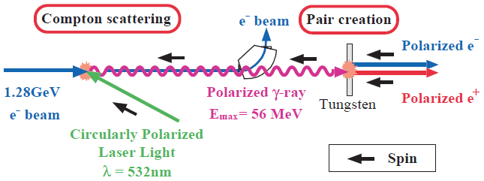
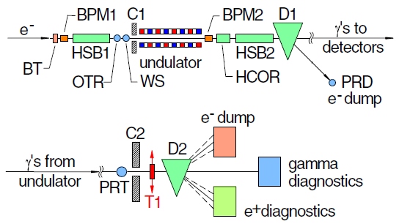
Generating Polarized Positrons at the ILC
Two methods have been experimentally tested, first generating polarized MeV photons, and then illuminating a target to produce polarized positrons (next talk by Jenny List).
Inverse Compton Backscattering (KEK)
T. Omori et al, PRL 96 (2006) 114801
Helical Undulator (SLAC E166)
G. Alexander et al, PRL 100 (2008) 210801
47.7GeV
P(e⁺) = 73 ± 15_{(stat)} ± 19_{(syst)} %
P(e⁺) = 80 ± 7_{(stat)} ± 9_{(syst)} %
~ GeV e- beam + challenging (>MW) laser power
>10’s GeV e- beam + >100 m helical undulator

Slide 14
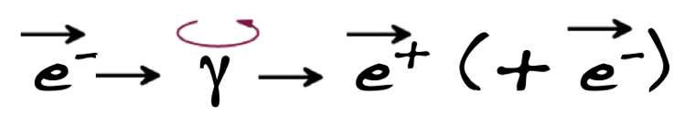

Polarized Electrons for Polarized Positrons (PEPPo)
At Jefferson Lab, the polarized electron beam forms the basis for producing polarized positrons beams
Initial electron polarization is high (about 90%)

Slide 15

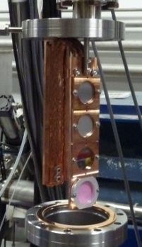
PEPPo Experiment : Feasibility Demonstration at the CEBAF Injector
PEPPo (Polarized Electrons for Polarized Positrons) => demonstrate feasibility of using bremsstrahlung radiation of MeV energy Polarized Electrons for production of Polarized Positrons.
J. Grames, E. Voutier et al., JLab Experiment E12-11-105 (2011)
8 MeV, 1μA, 85% polarization
Tungsten (1mm)
PEPPo possible due to support from SLAC E166, DESY, Princeton, Cornell, International Linear Collider Project and the Jefferson Science Associates

Slide 16
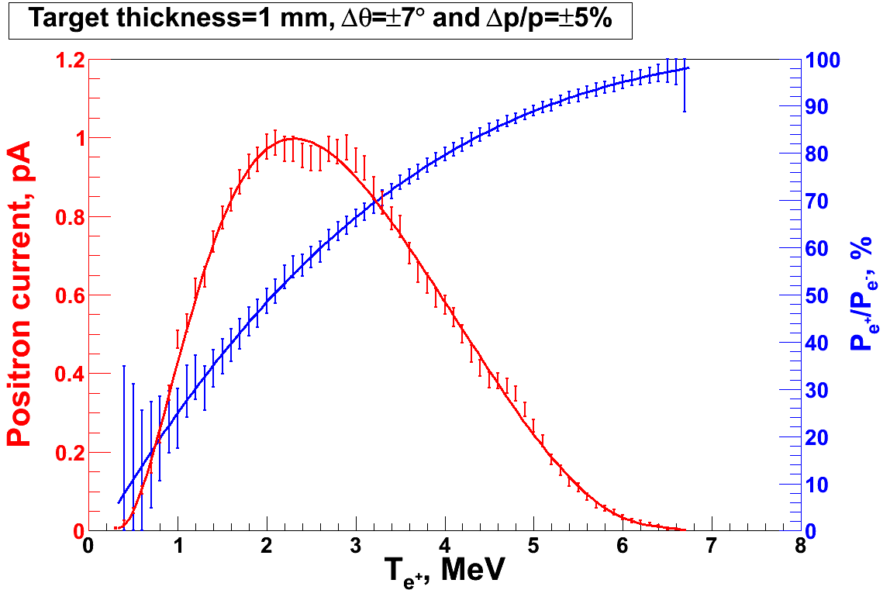

PEPPo Principle of Operation
Polarized Electrons
(< 10 MeV/c) strike production target
Geant4
Positron Transverse and Longitudinal Phase Space Selection
J. Dumas, PhD Thesis (2011)
E_{e} = 6.3 MeV
I_{e} = 1 µA
T₁ = 1 mm W
S₁
e⁺
D
e⁻
e⁻
PEPPo
T₁
S₂
P_{T}
D
Calorimeter
e⁺
T₂
Compton Transmission Polarimeter
PEPPo measured the longitudinal polarization transfer from 8.25 MeV/c e⁻ to e⁺ in the 3.07-6.25 MeV/c momentum range.

Slide 17
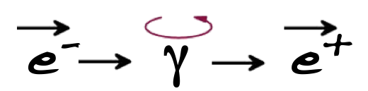

PEPPo : Polarized Positron Production
(PEPPo Collaboration) D. Abbott et al. , Phys. Rev. Lett. 116 (2016) 214801
PEPPo demonstrated efficient polarization transfer of 8.2 MeV/c polarized electrons to positrons, expanding polarized positron production using MeV electron beam energies.
electron beam polarization
85.2 ± 0.6 ± 0.7 %
Whenever producing e⁺ from e⁻, polarization is coming for free, if initial electrons are polarized.

Slide 18
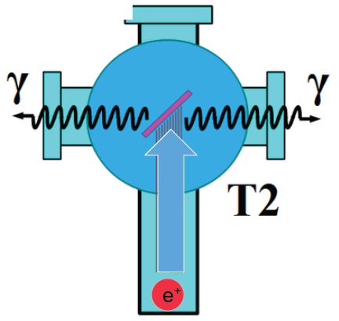
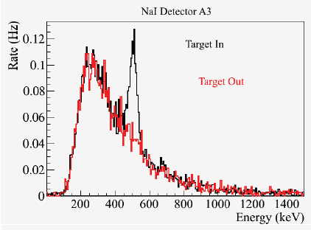
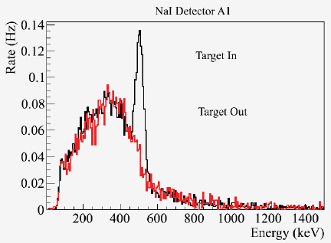
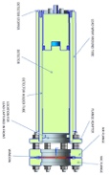
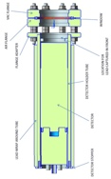
PEPPo : e+/e- yield
Two NaI detectors measured coincidence of back-to-back photons emitted by annihilation of positrons in a viewscreen.
S₁
e⁻
e⁺
D
T₁
p_{e-}= 8.2 MeV/c
A3
A3
A1
D
e⁺
S₂
T₂
A1
For these data we had a yield of ~10⁻⁵ e⁺/e^{-.}

Slide 19
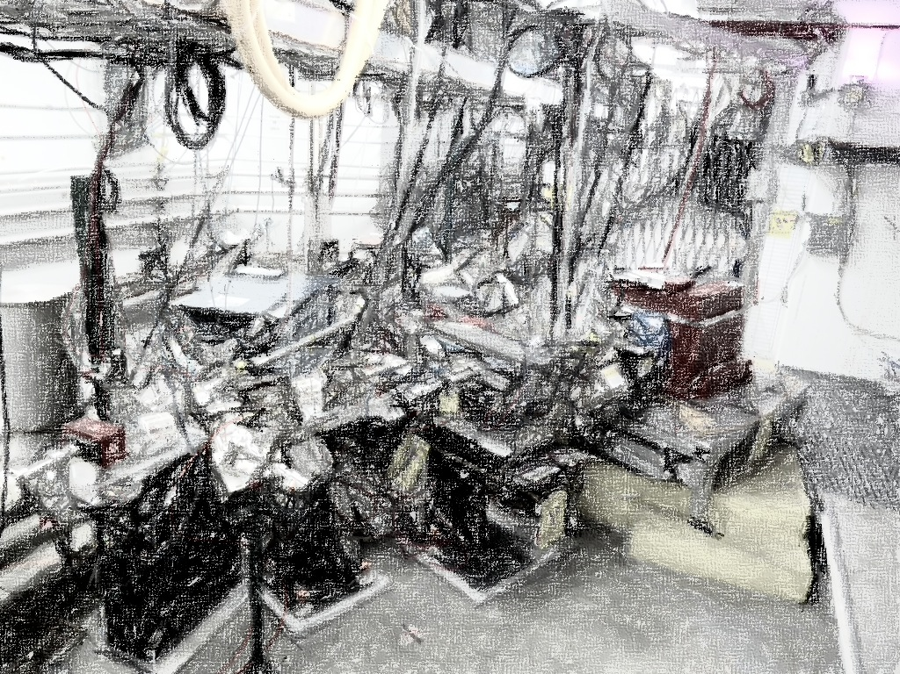
PEPPo Collaboration
P. Adderley¹, A. Adeyemi⁴, P. Aguilera¹, M. Ali¹, H. Areti¹, M. Baylac², J. Benesch¹, G. Bosson², B. Cade¹, A. Camsonne¹, L. Cardman¹, J. Clark¹, P. Cole⁵, S. Covert¹, C. Cuevas¹, O. Dadoun³, D. Dale⁵, J. Dumas^{1,2}, E. Fanchini², T. Forest⁵, E. Forman¹, A. Freyberger¹, E. Froidefond², S. Golge⁶, J. Grames¹, P. Guèye⁴, J. Hansknecht¹, P. Harrell¹, J. Hoskins⁸, C. Hyde⁷, R. Kazimi¹, Y. Kim^{1,5}, D. Machie¹, K. Mahoney¹, R. Mammei¹, M. Marton², J. McCarter⁹, M. McCaughan¹, M. McHugh¹⁰, D. McNulty⁵, T. Michaelides¹, R. Michaels¹, C. Muñoz Camacho¹¹, J.-F. Muraz², K. Myers¹², A. Opper¹⁰, M. Poelker¹, J.-S. Réal², L. Richardson¹, S. Setiniyazi⁵, M. Stutzman¹, R. Suleiman¹, C. Tennant¹, C.-Y. Tsai¹³, D. Turner¹, A. Variola³, E. Voutier^{2,11}, Y. Wang¹, Y. Zhang¹²
¹ Jefferson Lab, Newport News, VA, US ² LPSC, Grenoble, France ³ LAL, Orsay, France
⁴ Hampton University, Hampton, VA, USA ⁵ Idaho State University & IAC, Pocatello, ID, USA
⁶ North Carolina University, Durham, NC, USA ⁷ Old Dominion University, Norfolk, VA, US
⁸ The College of William & Mary, Williamsburg, VA, USA ⁹ University of Virginia, Charlottesville, VA, USA ¹⁰ George Washington University, Washington, DC, USA ¹¹ IPN, Orsay, France
¹² Rutgers University, Piscataway, NJ, USA ¹³ Virginia Tech, Blacksburg, VA, USA
Many thanks for support from SLAC E166, DESY, Princeton, Cornell, International Linear Collider Project and Jefferson Science Associates

Slide 20
How might we apply PEPPo to provide high-energy polarized positron beams to the CEBAF 12 GeV program?

Slide 21
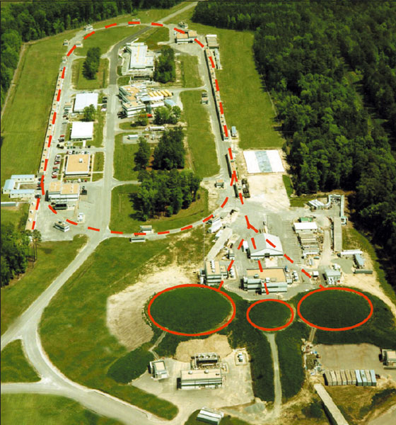
Electron Driver for Positrons at CEBAF
1000 MeV
100 MeV
10 MeV
10 MeV
100 MeV
1000 MeV

Slide 22
Using the CEBAF Polarized Electron Injector
J. Dumas, Doctorate Thesis (2011)
Simulating 5-100 MeV electron beam (with dp/p < 10% and angle<10°), at the maximum value in the Figure of Merit (IS_{z}²) we find
  conversion efficiency (ε ∼ e⁺/e⁻) varies from about 10⁻⁵ - 10⁻³
  electron polarization transfer is “flat” ~75%
Using a 100 MeV electron beam and a more realistic momentum spread dp/p <1% (ΔE ~ 1 MeV) the conversion efficiency is ~5 x 10⁻⁴.

Slide 23
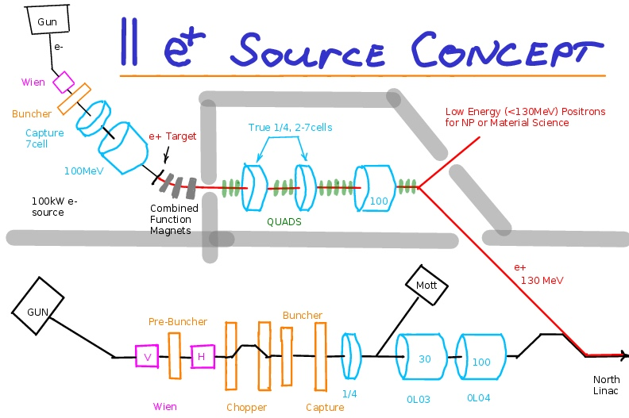
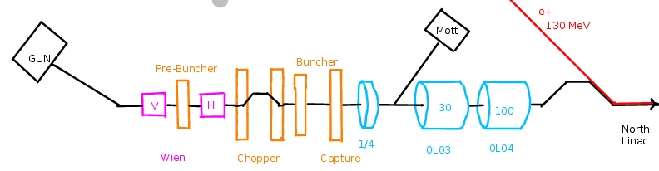
One Concept for a Dedicated e⁺ Source
Build a Second Injector Dedicated to Positrons
Start with the existing CEBAF Injector
Concept S. Golge Thesis
Drawing A. Freyberger
Existing
CEBAF
Electron
Injector
What are some requirements for a 100 MeV electron beam to generate a positron beam with intensity I_{e+} > 100 nA and polarization P_{e+} > 65% (at max FoM) ?
  Collecting e+ at 60 MeV with ~10⁻⁴ e⁺/e⁻ efficiency suggests ~1 mA polarized electron beam and a high power conversion target (typ. >10% in target).

Slide 24
CEBAF Injector Modified for Polarized Positrons
5 MeV Dump
Synchrotron Light Monitor
Chopper
Cryounit
Bunchlength
Cavity
Cryomodules
Buncher
Capture
~6 MV
~120 MV
Injection Chicane
Gun#2
~123 MeV e-
~123 MeV e+
PCup
FC#1
Prebuncher
Apertures
Wien Filter
E Select
Filter
Δφ Select
e⁺ production
target
Set for E = 61.5 MeV
for maximum e⁺ FOM
Set φ = -30º relative to e⁻
Beam Energies:
Gun: 130 keV
After Capture Secton: 500 keV
After Cryounit: 6.3 MeV
After Cryomodules: 123 MeV

Slide 25
If we only want (unpolarized) positrons
e⁻ → γ → e⁻ + e⁺
Take advantage of the fact that the positron yield increases dramatically as the positron energy is a smaller and smaller fraction of the electron beam energy (color code in this figure)

Slide 26
CEBAF Injector Modified for Unpolarized Positrons
5 MeV Dump
Synchrotron Light Monitor
Wien Filter
Chopper
Cryounit
Bunchlength
Cavity
Cryomodules
Buncher
Capture
Injection Chicane
~123 MeV e+
Gun#2
PCup
FC#1
Prebuncher
Apertures
Wien Filter
E Select
Filter
Δφ Select
e⁺ production
target
Beam Energies:
Gun: 130 keV
After Capture Secton: 500 keV
After Cryounit: 6.3 MeV
After Cryomodules: 123 MeV
Set for E = 6.3 MeV* for maximum e⁺/e⁻ ratio
Set φ = -180º relative to e⁻
*Optimization may lead to a
Somewhat higher energy

Slide 27
PEPPo at GeV energies : ILC e-driven source
J. Grames, presented 2018 Linear Collider Workshop, Dallas Texas
If the ILC e-driven source were polarized, then some degree of spin polarization would be transferred to the collected positrons.
E(e+)=150 MeV, W=16mm
E (e-) | N(e+)/N(e-) | <Sz> | P (%)
3 GeV | 0.436 | 0.23 | 21
1 GeV | 0.091 | 0.44 | 40

Slide 28
Supporting PES R&D
PEPPo converts “polarized” beam power (Gun Current x LINAC gradient) into e+
  Accessible today, with high energy accelerators (e.g. 100 uA x 1 GeV)
  Electron injector methods are attractive though…
    Small footprint (gradient, space, cost)
    <10 MeV very little radioactivity
    Heat/stress load challenging at all energies
Are polarized electron sources up to the challenge (e.g. >1 mA)?
  Higher quantum efficiency GaAs-photocathodes
  Spin polarization
  Lifetime
  DC high voltage photo-guns

Slide 29
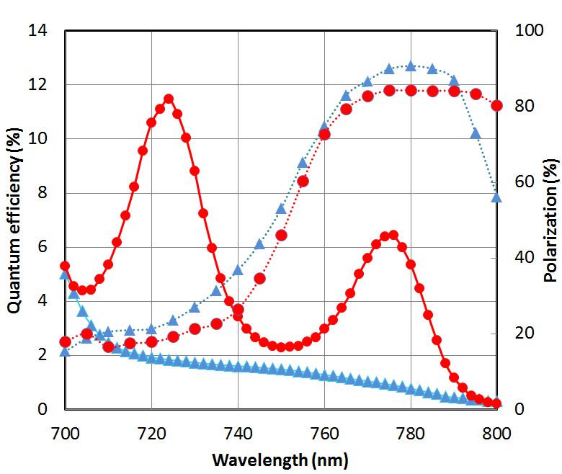
World record QE for high-polarization SSL GaAs photocathode
W. Liu, S. Zhang, M. Stutzman, M. Poelker, Y. Chen, W. Lu, and A. Moy, Appl. Phys. Lett. 109, 252104 (2016)
DBR strained-superlattice
  QE = 6.4%
  Polarization = 84%
Standard strained-superlattice
  QE ~1 %
  Polarization ~90 %
The highest reported QE of any high polarization photocathode
Candidate for EIC, polarized positrons
U.S. DOE SBIR partnership

Slide 30
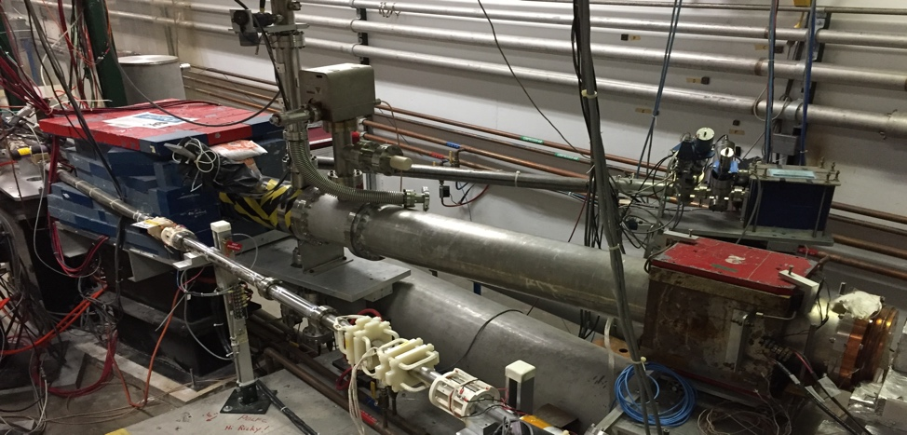
First measurement of polarized beam at milliamp current from SSL
First measurement of beam polarization at JLab from strained superlattice GaAs/GaAsP photocathode at milli-Ampere current
No sign of spin depolarization when QE ~ 1%, with strong band-bending region. More measurements planned at lower QE.
CEBAF 5 MeV Mott Polarimeter
J. Grames and R. Suleiman, to be submitted to Phys. Rev. Accel. Beams
PEPPo (1uA)
JLab e- (200uA)
JLab e+ (1-10 mA)
?
30

Slide 31
Increasing charge photo-gun lifetime at milliamp current using SSL
  Initial testing shows increasing laser size extend milliamp operations into the “Week” regime
  Active R&D simulation efforts to “straighten the curve”
J. Grames and D. Moser, in Proc. 2017 Polarized Sources, Targets and Polarimeters Workshop, Dajeon South Korea

Slide 32
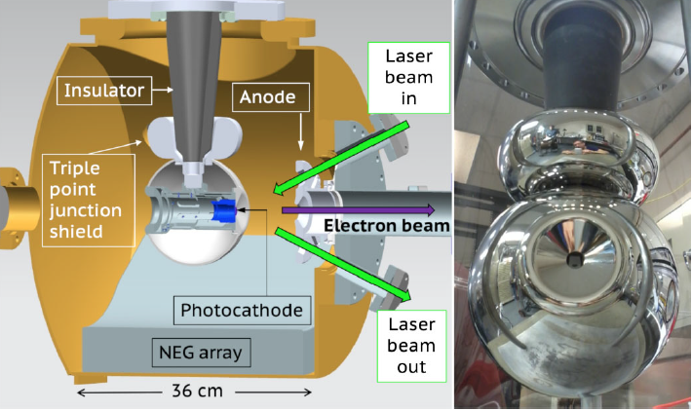
Building up a 300 kV UHV Polarized Electron Gun
  Applying the experience and lessons learned from the CEBAF PES and the magnetized beam photogun to build a 300 kV UHV polarized electron source for SSL operation
CEBAF 130 kV Polarized Electron Source (SSL)
300 kV Magnetized Beam Electron Source (CsKSb)
P. Adderley et al., Phys. Rev. Accel. Beams 13, 010101 (2010)
C. Hernandez-Garcia et al., Phys. Rev. Accel. Beams 22, 113401 (2019)

Slide 33
Summary
Polarized MeV photons are essential for prompt generation of polarized positron beams; three methods after been demonstrated (ICS, HU, PEPPo), each with their respective pros and cons.
The PEPPo experiment demonstrated an excellent approach to providing highly spin-polarized positrons from moderate energy polarized electrons, and is being pursued as the relevant technology to enable a high-energy polarized positron beam program at 12 GeV CEBAF.
This workshop provides an opportunity to begin discussing what a polarized positron beam source for the EIC may look like, and to motivate further investigations.

