Slide 1
Proton Polarization Improvements for EIC
Vincent Schoefer, BNL
CFNS Workshop on Beam Polarization and Polarimetry at EIC
Stony Brook, June 29, 2020

Slide 2
Overview
Requirements for protons for EIC
Present proton polarization at RHIC
Improvements for the collider
Improvements for the ion injectors
This talk entirely about protons.
  For helium-3, see F. Meot’s talk
  For electrons, see V. Ranjbar’s talk
  For deuterons, see H. Huang’s talk

Slide 3
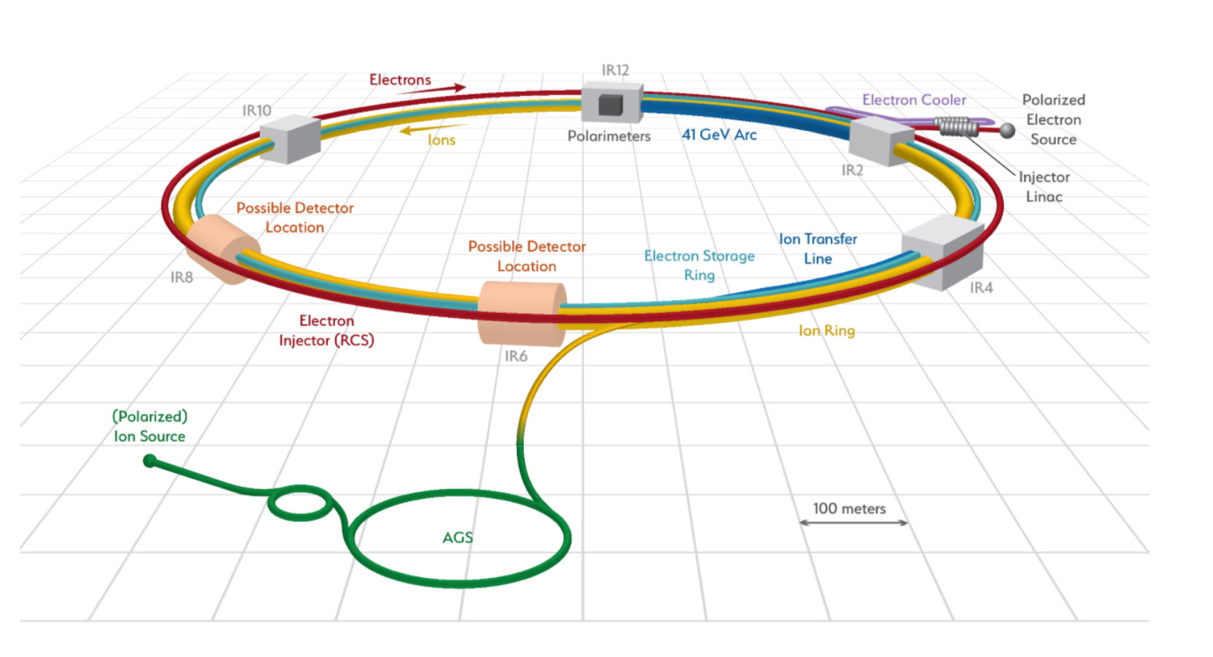
EIC Polarized Beam Complex
Proton beam requirements
  70%+ store average polarization
  2.7 x 10¹¹ /bunch in 290 bunches for injection and ramp
    (Split longitudinally in various ways at top energy)
  ~3.0 x 10¹¹ / bunch from injectors
Efforts to improve proton polarization largely the same in both EIC scenarios (with different emphasis)

Slide 4
RHIC Polarized Beam Complex
 | Max Energy [GeV] | Pol. At Max Energy [%] | Method
Source+Linac | 0.2 | 82-84 | Lamb shift
Booster | 2.5 | ~80-84
AGS | 25.5 | 67 | p-Carbon
RHIC | 255 | 55-60 | Jet, full store avg*
2 Siberian Snakes/ring
Spin flipper
Absolute Polarimeter (H jet)
RHIC pC Polarimeters
PHENIX
STAR
* Includes both ramp and store decay
Spin Rotators
(longitudinal polarization)
Spin Rotators
(longitudinal polarization)
 | Relative Ramp Polarization Loss (Run 17)
AGS | 17 %
RHIC | 8 %
LINAC
BOOSTER
Pol. H⁻ Source
Helical Partial
Siberian Snake
200 MeV Polarimeter
AGS
AGS Polarimeter
Strong AGS Snake

Slide 5
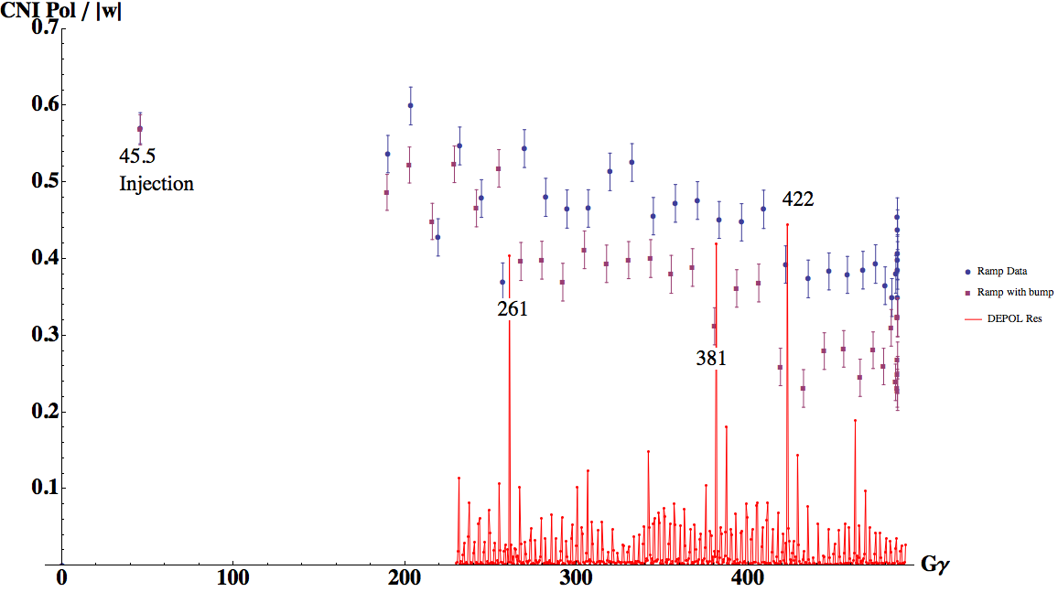
Helical Dipole Snakes in RHIC
The RHIC lattice has two full-flip helical dipole snakes
RHIC Design Expectation: The two full RHIC snakes would be enough to give near full polarization transmission to 255 GeV.
So why do we have polarization loss?
RHIC Polarization transmission lessons:
Run12: not very sensitive to snake parameter errors
  Robust vs. tune shift and spread
Run17: stronger sensitivity to orbit distortions
RHIC proton polarization loss driven by
Peak intrinsic resonances amplitudes
Coupled with underlying (unknown) orbit-driven imperfection resonances
Run 17: p-Carbon Measurements During RHIC Ramp
No orbit change
With orbit change
(slow ramp, larger than normal polarization loss)

Slide 6
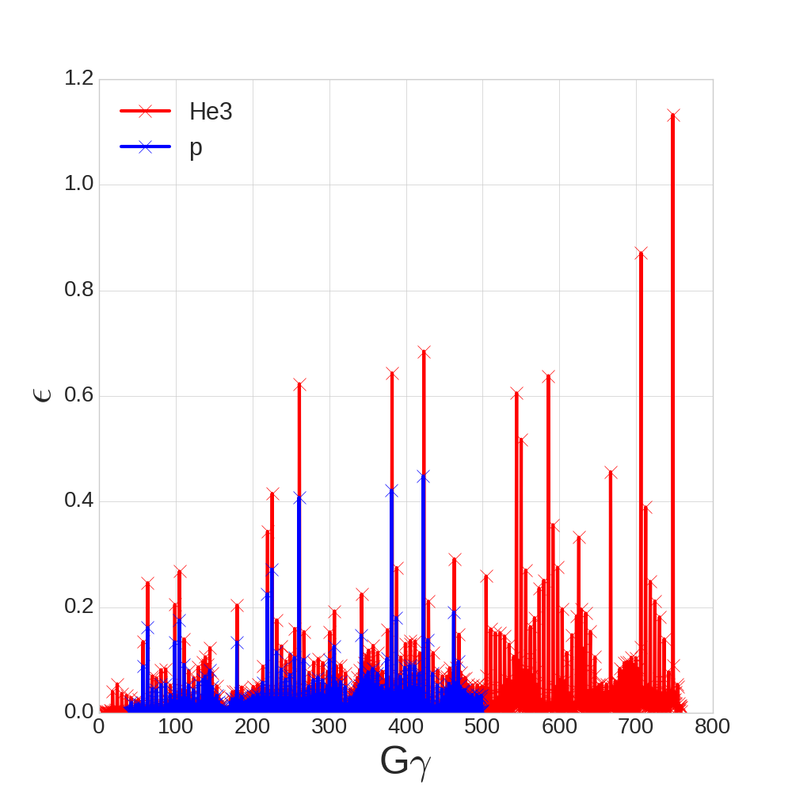
Helical Dipole Snakes in RHIC
RHIC Intrinsic Resonance Strength (DEPOL, RHIC lattice)
Protons have larger than expected depolarization with 2 snakes
Orbit-based compensation have met with some success
(but no silver bullets)
Helium3 resonances are 2-3 times stronger than for protons
Motivates introduction of additional snakes

Slide 7
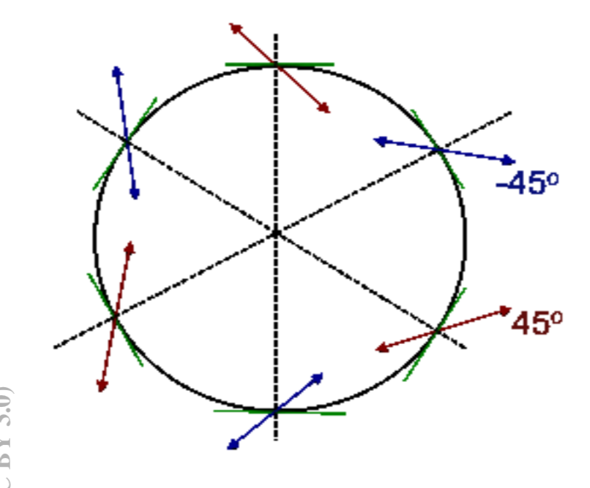
Helical Dipole Snakes in RHIC
Protons have larger than expected depolarization with 2 snakes
Helium3 resonances are 2-3 times stronger than for protons
Motivates introduction of additional snakes
If only one EIC ion ring need 6 snakes, then all magnets are available (by reconfiguring magnets from Blue to Yellow)
Constrains optics: spin tune shift and spread requires matching of orbit angles and dispersion functions at snakes. Now has six points of constraint rather than two
Snake rotation axis for 6-snake configuration

Slide 8
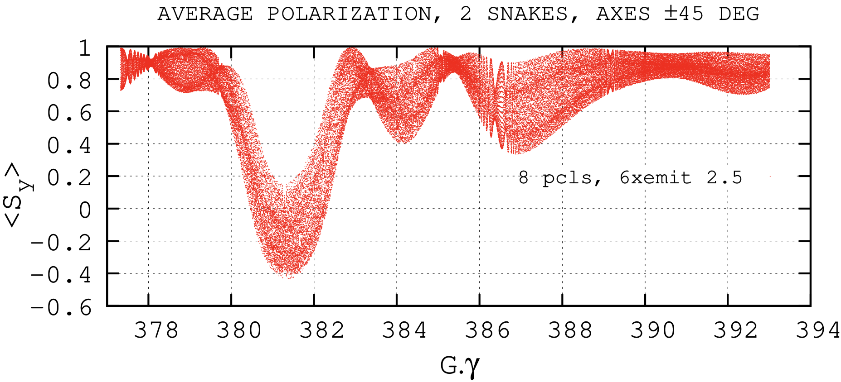
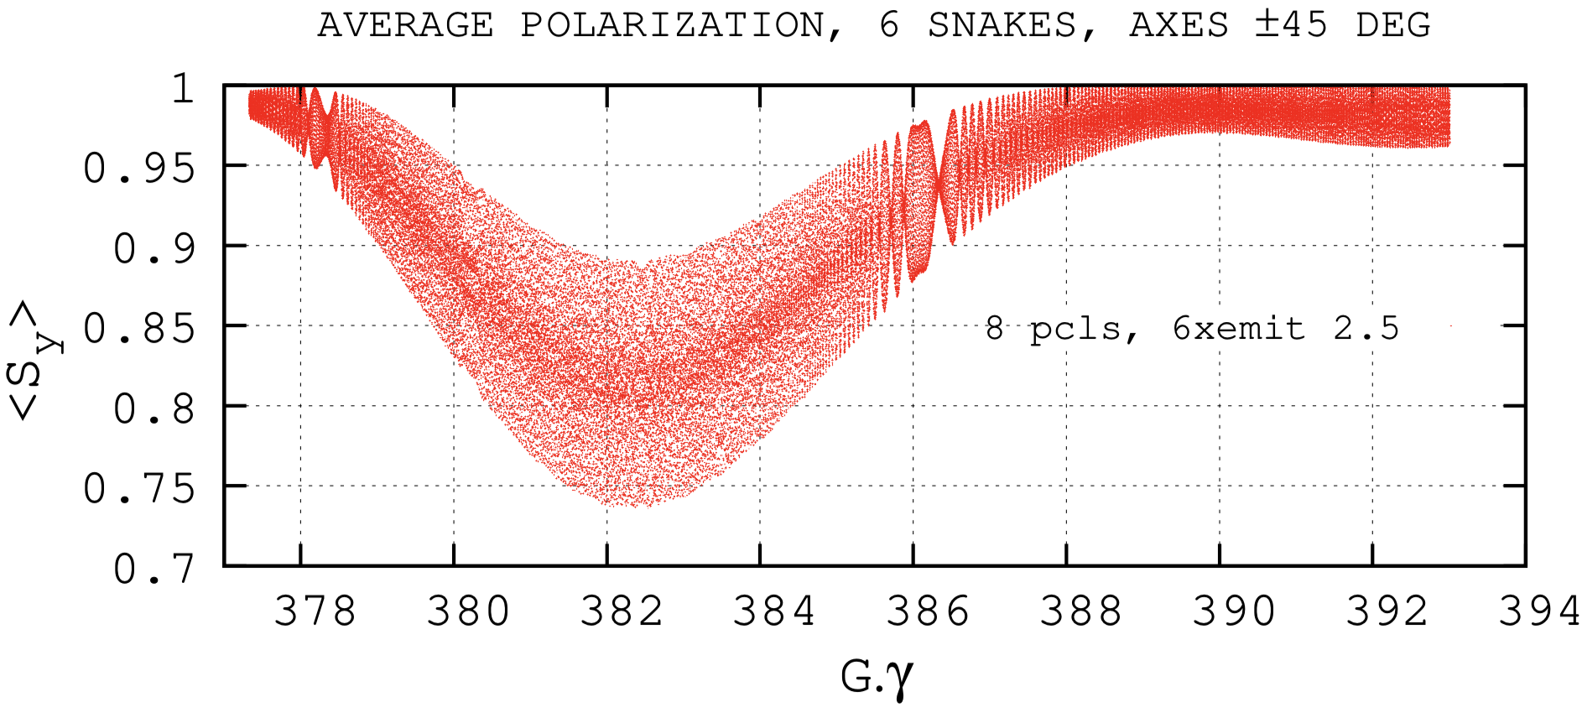
Helical Dipole Snakes in RHIC
Spin tracking, few large amplitude particles
Gɣ = 382
2-snakes
6-snakes
Gɣ = 420
Substantial improvement in tracking with 6 snakes
through strong intrinsic resonances
[Note differences in vertical scales]
6-snakes

Slide 9
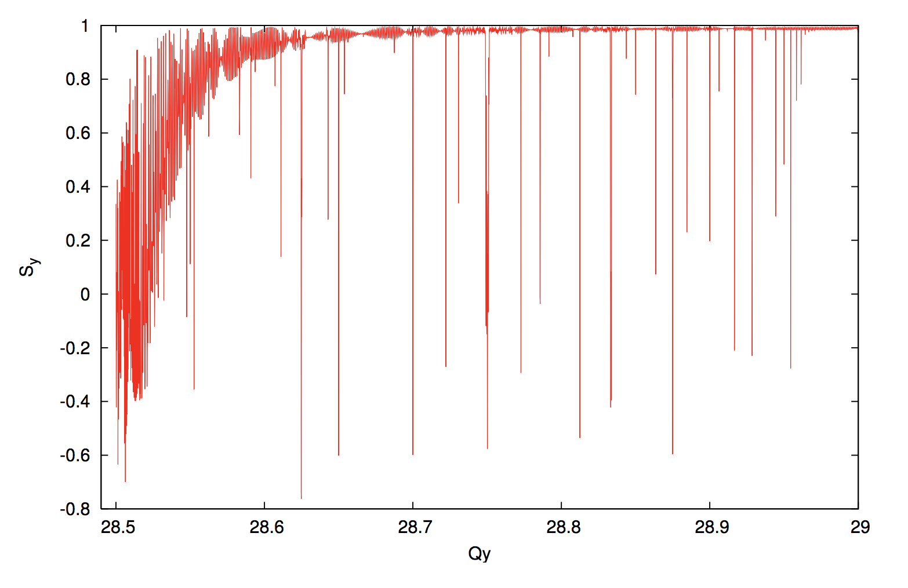
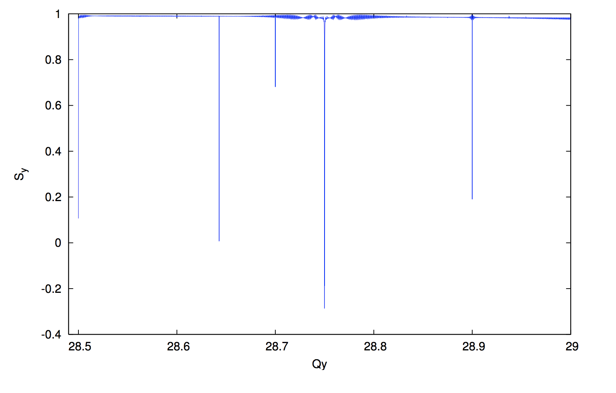
Snake Resonances
Snake resonance spectrum
Snake resonances constrain the working point
  Depolarization at certain vertical betatron tunes
Far more tune space available in six snake configuration
  Important for flexibility in the face of complicated beam dynamics (high peak currents, interaction with coolers, etc)
S_{y}
RHIC tune space
2-snakes
S_{y}
6-snakes
Q_{y}

Slide 10
Injector improvements
Directly to polarization
  Focused on eliminating loss from horizontal “partial snake” resonances
Emittance improvements
  Reduces depolarization from intrinsic (amplitude dependent) resonance

Slide 11
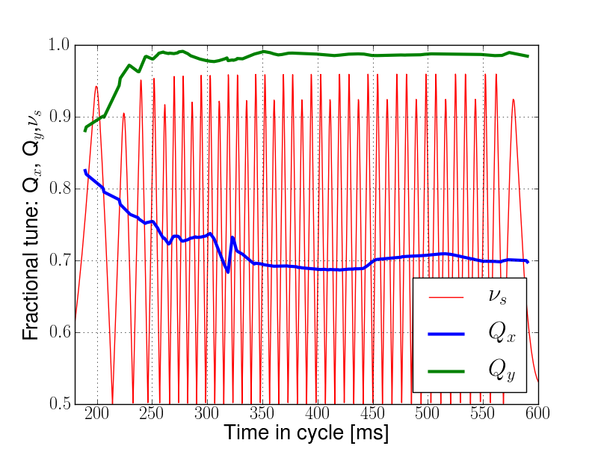
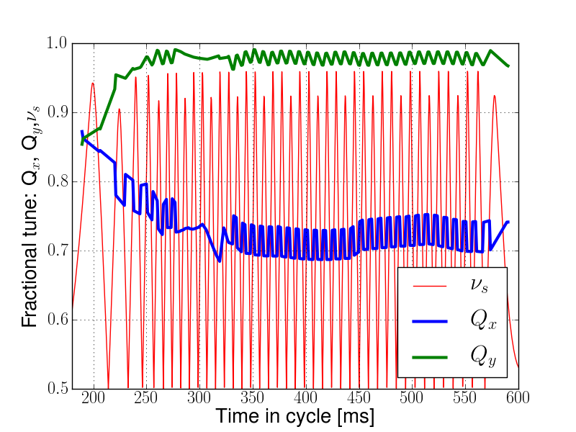
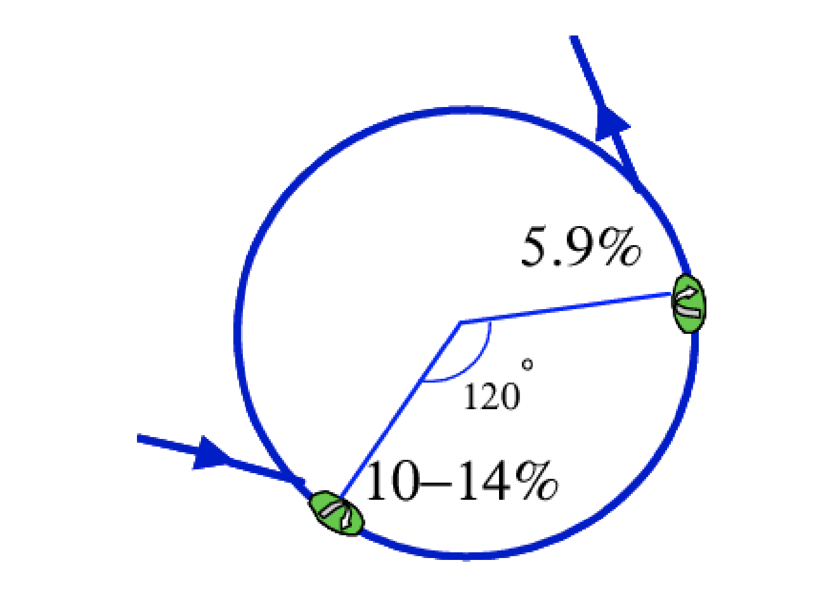
AGS Partial snakes
AGS has two partial snakes (10% and 6%)
Provides spin tune ‘gap’ where imperfection and vertical intrinsic resonance condition are never met
  ν_{s} != N
  ν_{s} != N +/- Q_{y}
Horizontal resonance condition still met
  ν_{s} != N +/- Q_{x}
  Horizontal resonance are weak, but many (82 crossings)
  Currently handled with tune jump
Spin tune
gap
Hor resonance crossings
Tune
jump
Extraction
Injection

Slide 12
Partial snakes drive horizontal resonances
The drive term kick for horizontal resonance is the partial snake itself
*Horizontal betatron motion modulates the spin tune at Qx
Horizontal partial snake resonances cause ~15% relative polarization loss in AGS, only half of that is countered by the tune jump system
Two proposed solutions:
1 )Additional partial snakes
2) Skew quad compensation
With jump
NO dp/p spread
With jump
+ dp/p spread
No jump

Slide 13
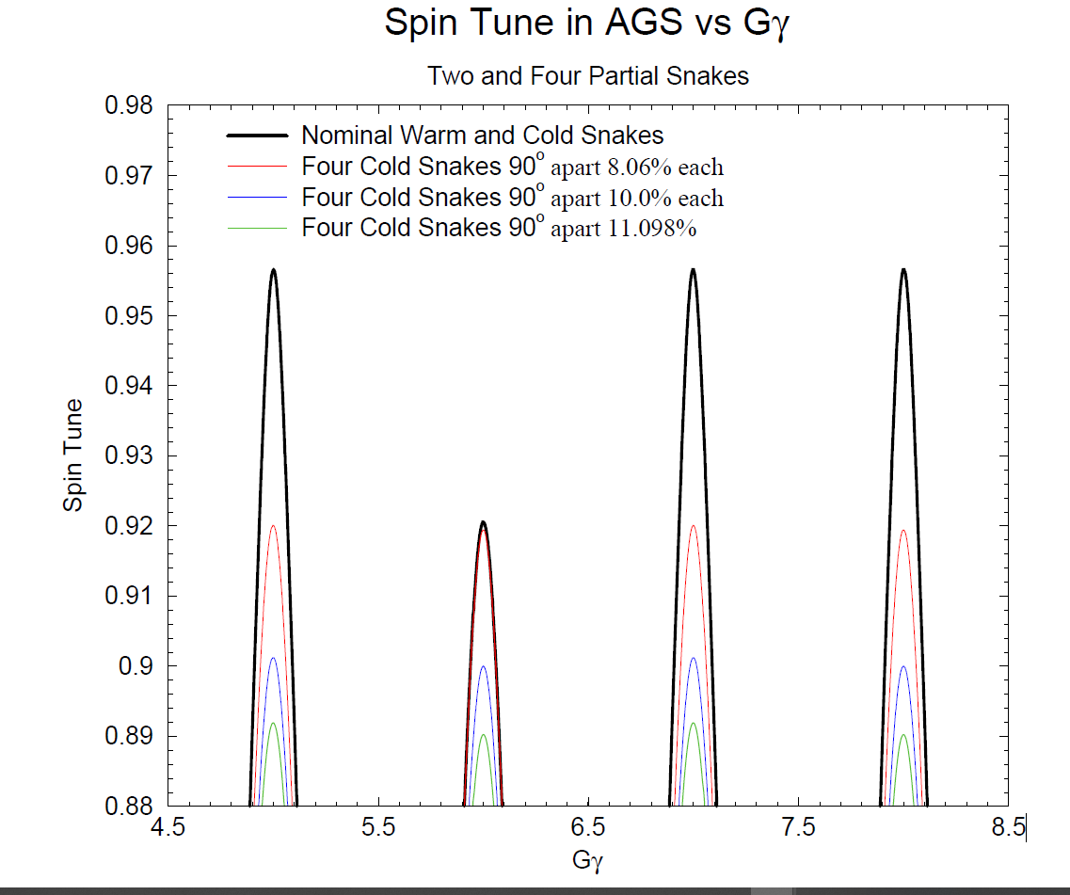
Still more (partial) snakes….
Replicate the current superconducting 2.1 Tesla, 10% snake at three other locations
Increases the spin tune gap
  Possibility of fitting Qx in the spin tune gap
  Optical distortion is actually reduced, relative
  to two snake optics (β-max ~40-50 m)
Extraction
φ_{spin}=δ=19º
φ_{spin}=δ
θ=90º
φ_{spin}=-δ
φ_{spin}=δ
Injection

Slide 14
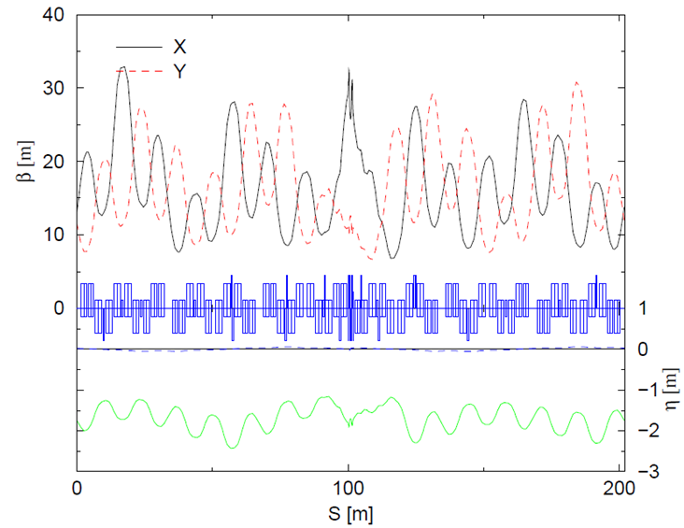
Still more (partial) snakes….
Replicate the current superconducting 2.7 Tesla, 10% snake at three other locations
Increases the spin tune gap
  Possibility of fitting Qx in the spin tune gap
  Optical distortion is actually reduced, relative
  to two snake optics (β-max ~40-50 m)
AGS Optics with Four Snakes (1/4 ring)
β range,
No snakes
Extraction
φ_{spin}=δ=19º
φ_{spin}=δ
θ=90º
φ_{spin}=-δ
φ_{spin}=δ
Injection

Slide 15
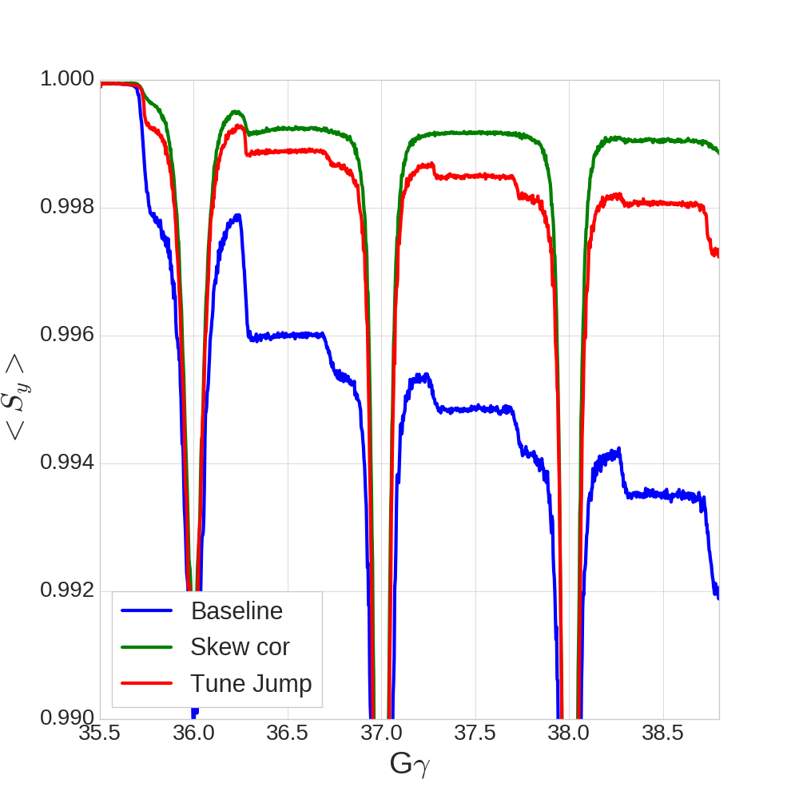
Partial snake resonance suppression with betatron coupling
Both partial snake spin resonance and resonance from betatron coupling both occur at
  ν_{s} = N +/- Q_{x}
Introduce skew quads to excite coupling spin resonance to cancel snake drive term
Benefits:
  Possibility of full resonance correction (better than tune jump)
  Tune jump is sensitive to timing at the 100 us level. Correction is on for a full millisecond around the resonance.
Design challenges:
  Phasing changes a lot from resonance to resonance, requires fast ramping skew quads
  Qy is near integer, additional constraints to limit optics distortion
Partial correction
(compromise with stability)
Total correction
Correction with 15 skew quadrupoles

Slide 16
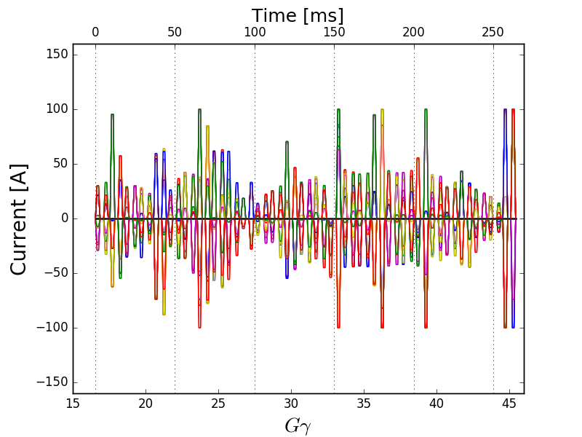
Partial snake resonance suppression with betatron coupling
Both partial snake spin resonance and resonance from betatron coupling both occur at
  ν_{s} = N +/- Q_{x}
Introduce skew quads to excite coupling spin resonance to cancel snake drive term
Design challenges:
  Phasing changes a lot from resonance to resonance, requires fast ramping skew quads
  Qy is near integer, additional constraints to limit optics distortion
Skew quads currents for resonance suppression

Slide 17
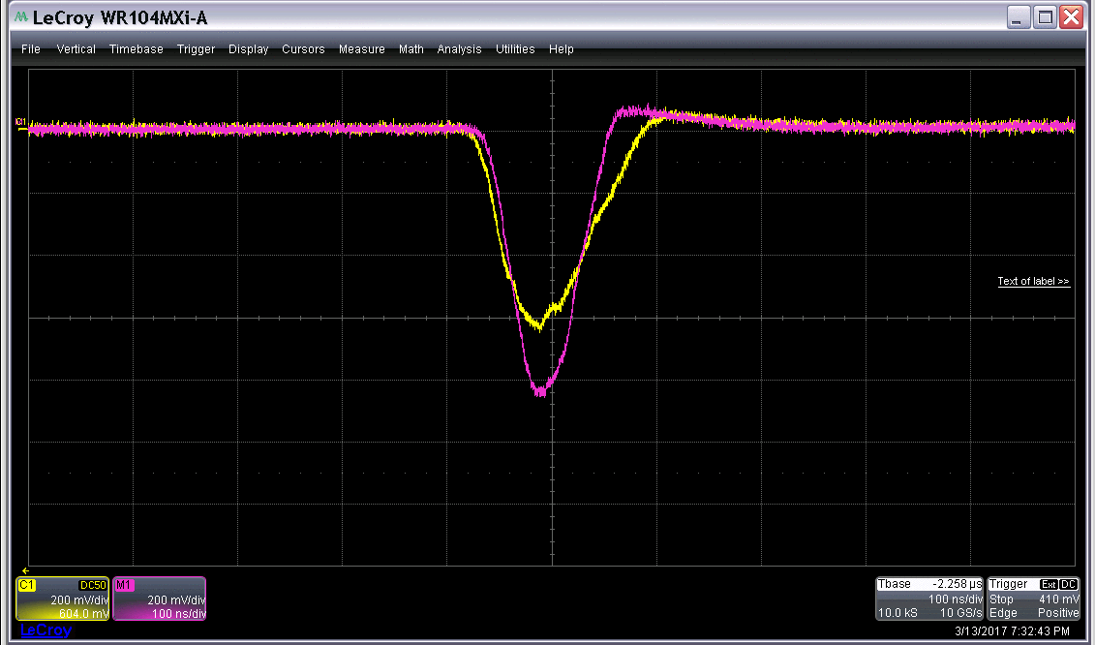
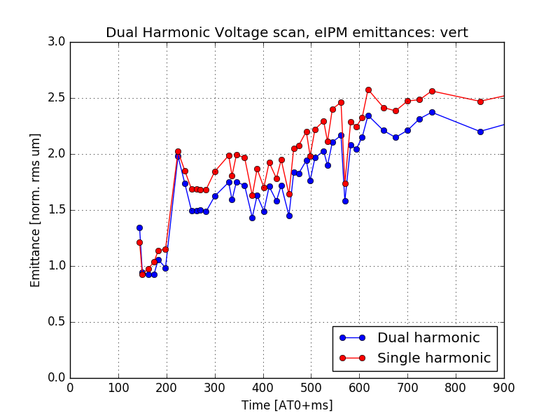
Emittance Preservation in AGS
AGS Longitudinal distribution
Run 17 Lessons: Peak current-drive emittance growth at AGS injection
Addition of defocusing RF voltage:
  20% reduction in peak current
  15% reduction in vertical emittance
AGS has large injection space charge tune shifts
  ΔQ_{sc}(x,y) = -0.17, -0.25
AGS Vertical Emittance
Two mitigation strategies
  Raise the Booster to AGS transfer energy
  Bunch splitting/merging

Slide 18
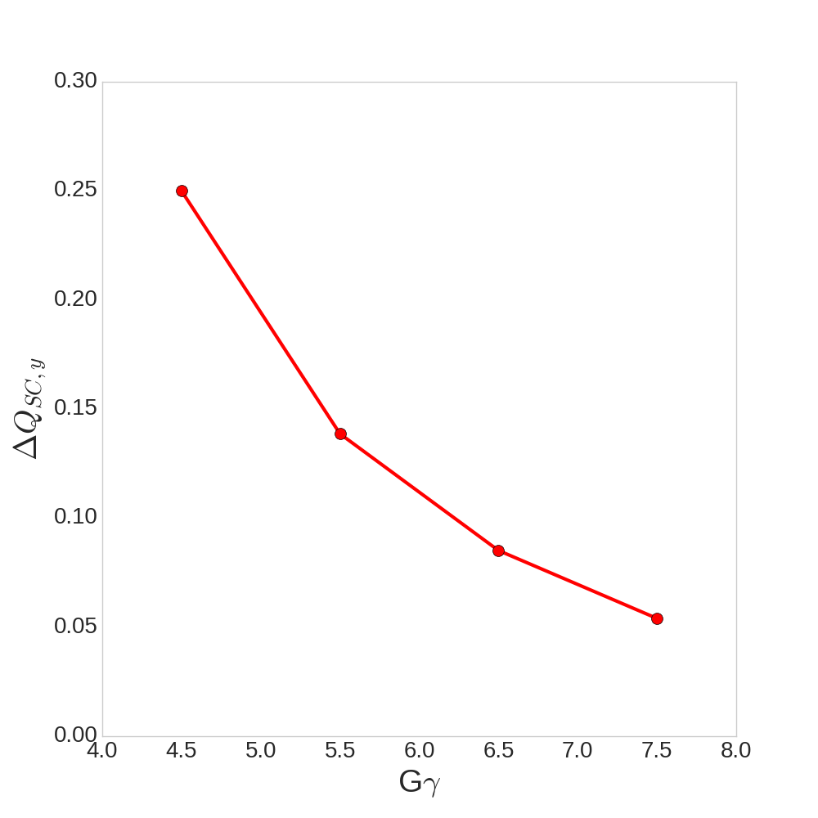
Raising AGS Injection Energy
Actually driven by helium-3 spin considerations
Raising injection of He3 from |G_{He}ɣ| = 7.5 → 10.5 avoids a major AGS resonance crossing
This would also allow higher energy transfer of protons.
|G_{proton}ɣ| = 4.5 → 6.5
Protons injected at the higher rigidity would have space charge tune shift reduced by 70%
Challenges:
Additional spin resonance crossing in the Booster and AGS need to be considered (and avoided)
Spin transparency of the transfer line is energy dependent (-3% pol for G_{proton}ɣ = 6.5)
Expensive: Boooster main dipoles and quads, Booster RF, transfer line dipoles and pulsed power need upgrades
Present
Transfer
Transfer at
Upgraded rigidity

Slide 19
Splitting and merging polarized protons
Present scheme: Single bunch from source to RHIC, dual harmonic RF at Booster and AGS injection
Booster
AGS
Extract to RHIC
Extract to AGS
Dual harmonic RF
Dual harmonic RF
Proposed scheme: Add a longitudinal split in Booster and merge in AGS at 25.5 GeV
Booster
AGS
Extract to RHIC
Extract to AGS
Bunch Merge
Dual harmonic RF
Bunch Split
Dual harmonic RF

Slide 20
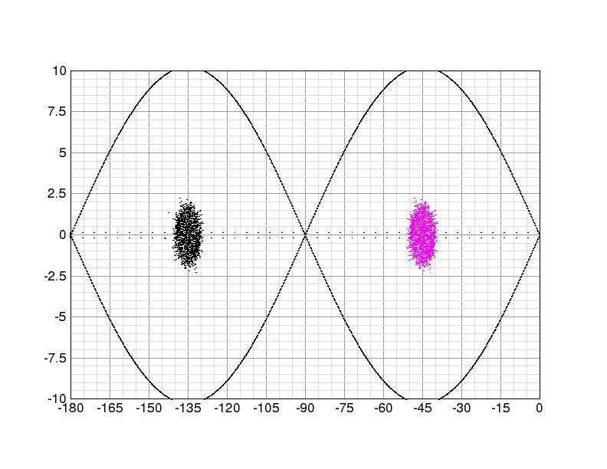
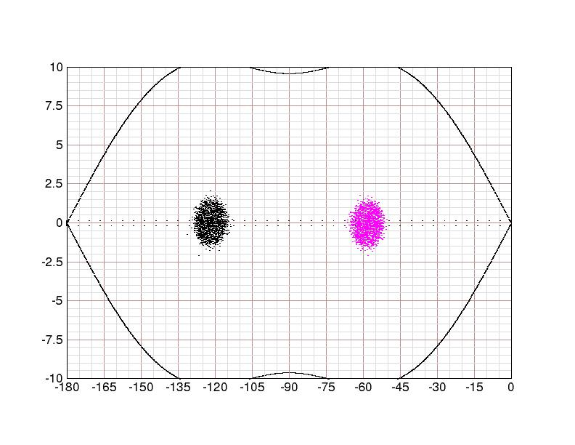
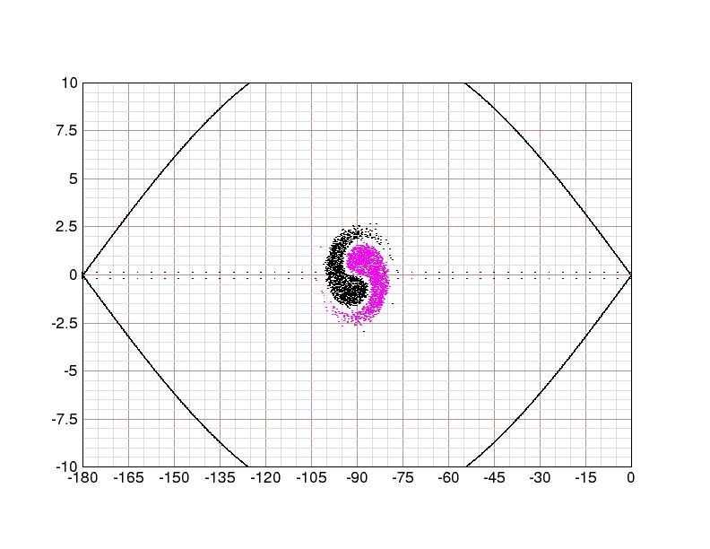
Splitting and merging polarized protons
AGS Merge: 25.5 GeV
Split bunches at AGS injection have
  ½ intensity
  ½ longitudinal emittance
  30% reduced peak current (and peak space charge)
Longitudinal bunch merges are common in Booster and AGS for heavy ions BUT
Possible challenges:
  What are the spin and beam dynamics constraints to the energy of the ‘split porch’ in the Booster?
  Synchrotron period at AGS extraction energy is
  ~12 ms, a reasonable merge takes ~500 ms in simulation
    Longitudinal emittance growth, dipole noise over a long period etc.
Time
Phase [deg]

Slide 21
The Road to 80%
With plausible expectations about the combined effects of the above (non-exhaustive) list of efforts, high proton polarization is achievable in the EIC
 | Polarization | Gain factor | Method
RHIC | 60%
+ fix AGS horizontal resonances | 69% | 1.15 | tune jump/correction/snakes
+ RHIC transmission efficiency | 76% | 1.1 | Six snakes
+ emittance reduction | 80% | 1.05* | Peak current reduction
* Hard to predict, impact of emittance on polarization depends on how well the resonance corrections work!

Slide 22
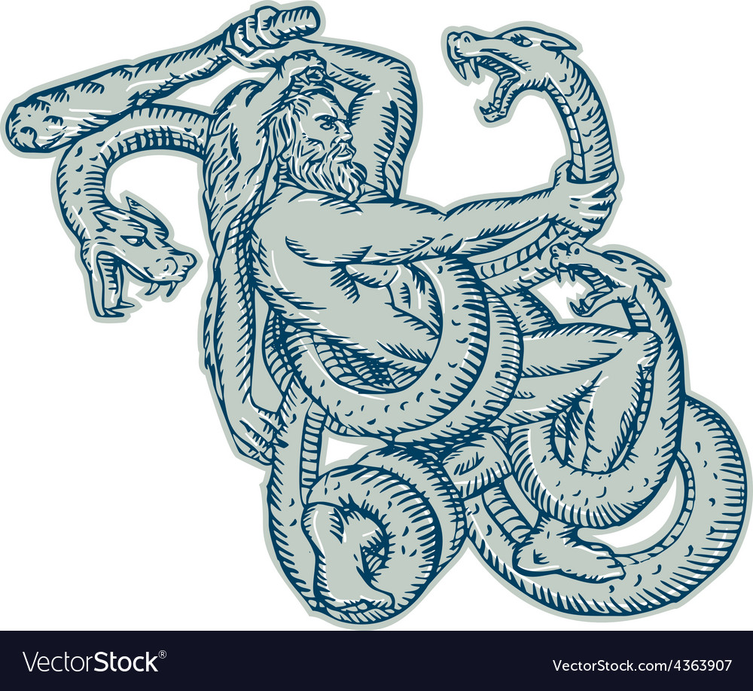
Summary
The main sources of polarization loss are identifiable from the RHIC experience
Six snakes in EIC is sufficient for proton polarization preservation to full energy
A combination of horizontal resonance suppression strategies and emittance preservation in the AGS should yield high polarization input for EIC
Big job?
Many snakes?
You might need a
Thanks!
Hadron
Electron
Relativistic
Collider

Slide 23
Backups

Slide 24
Polarization lifetime
Proton polarization decay in RHIC is currently ~ 0.5-1%/hour
EIC polarization lifetimes studies are a work in progress since polarization lifetime “rides on” the beam dynamics, which are also being worked out.
To lowest order, the polarization lifetime is proportional to emittance
In both EIC scenarios, the vertical emittance is ~5 times smaller than the RHIC emittance: back of the envelope: 0.2%/hr
Scenario 1: Strong cooling, long (20 hr) stores
  Small emittance, six snakes and careful control of neighboring resonances
Scenario 2: No cooling, frequent (1-2 hour) proton stores
  Short stores and small emittance

Slide 25
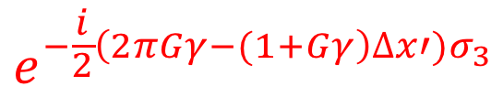
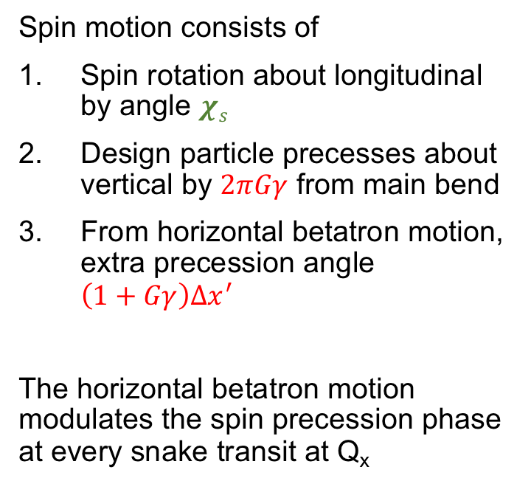
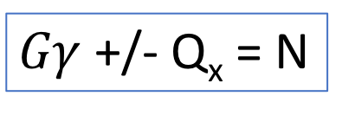
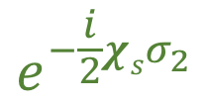
Partial snakes drive horizontal resonances
Simple case (one partial snake)
Spin motion consists of
Spin rotation about longitudinal by angle $χs$
Design particle precesses about vertical by $2πGγ$ from main bend
From horizontal betatron motion, extra precession angle $\left(1+Gγ\right)∆x^{′}$
The horizontal betatron motion modulates the spin precession phase at every snake transit at Q_{x}
$$e^{−\frac{i}{2}χsσ_{2}}$$
$$e^{−\frac{i}{2}\left(2πGγ−(1+Gγ\right)∆x′)σ_{3}}$$
$Gγ$+/- Q_{x} = N

