Slide 1



High-Accuracy 5-MeV Mott Polarimetry at the CEBAF Injector
J. M. Grames¹, C. K. Sinclair², R. Suleiman¹, M. Poelker¹, X. Roca-Maza³, M.L. Stutzman¹, Md.A. Mamun^{1,4}, M. McHugh^{1,5}, D. Moser¹, J. Hansknecht¹, B. Moffit¹, K. Foreman⁶, and T.J.Gay⁶
¹JLab; ²TIAA-CREF; ³Università degli Studi di Milano; ⁴Old Dominion U.;⁵George Washington U.; ⁶U. of Nebraska-Lincoln

Slide 2
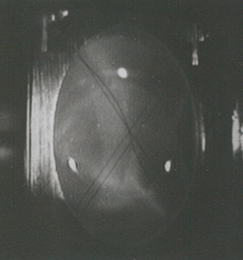
CEBAF Polarized Electron Injector
synchronous photo-injection
SRF acceleration
(123 MeV)
polarized electron source
(130 keV)
5-MeV Mott polarimeter
Mott
Polarimeter
Synchrotron
Light Monitor
Cryounit
Cryomodules
Apertures
Buncher
Capture
Gun#2
Bunchlength
Injection Chicane
V-Wien Filter
H-Wien Filter
Cavity
Spin Solenoids
Chopper
PreBuncher
Gun#3
Spectrometer Dump
bunching & acceleration
(500 keV)
SRF acceleration
(3-8 MeV)
4π spin manipulation

Slide 3
High-Energy Polarimetry in the Jlab Experimental Halls (2020)
Hall A
Compton: ~ 1%
Møller: ~1.8%
Hall B
Møller: ~2.5%
Hall C
Compton:~0.6
Møller: ~0.8%
¡Møller, PVDIS need polarimetry with an accuracy better than 0.5%! This will lab-wide polarimeter upgrades and a 2nd SPIN DANCE

Slide 4
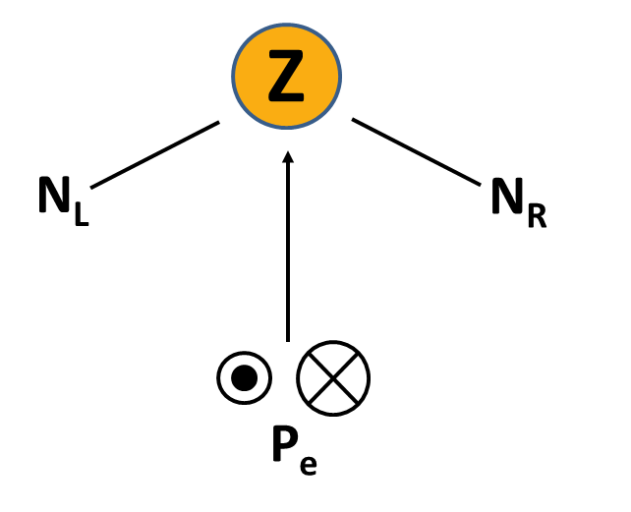
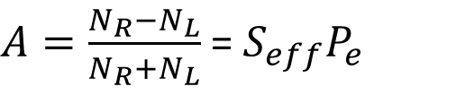
The Ascent to A _{TRUE}
S = the “Sherman Function”
Calculate for elastic scattering from single atoms
The Sherman function is calculated assuming elastic scattering from single atoms.
As the incident energy increases, the surface of the “effective Sherman function”, S_{eff}, flattens out
$A=\frac{N_{R}−N_{L}}{N_{R}+N_{L}}$ = ${S_{eff}P}_{e}$

Slide 5
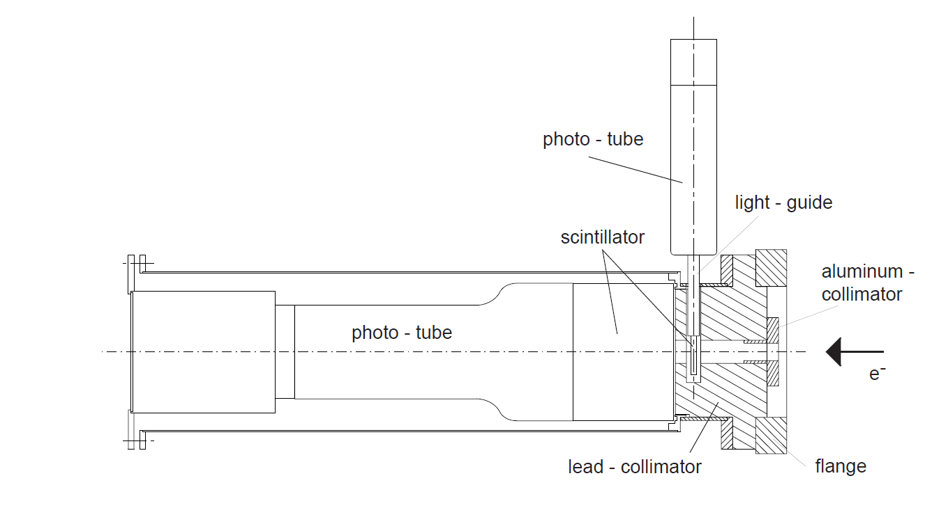
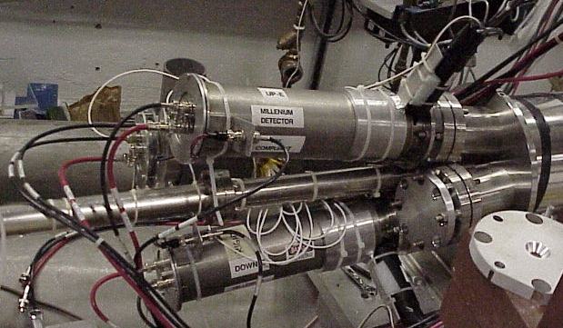
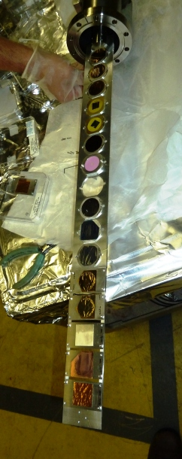
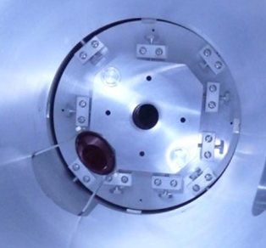
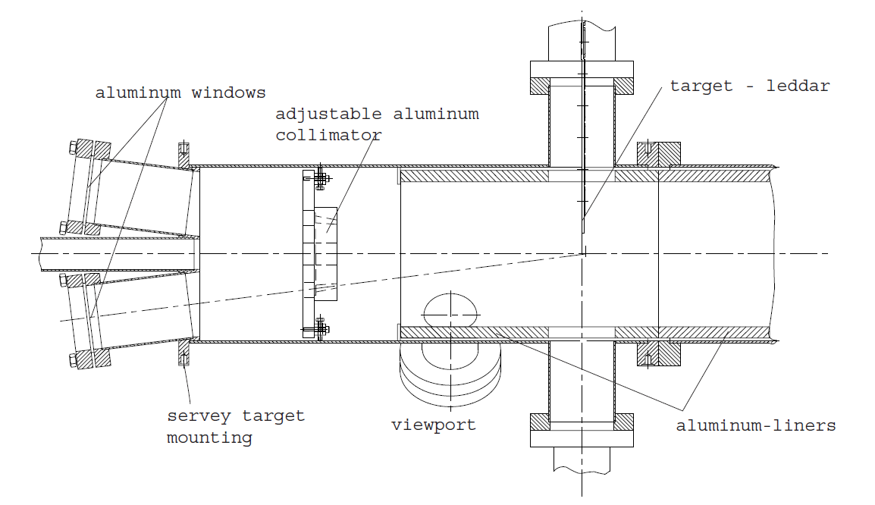
The CEBAF 5-MeV Mott Polarimeter
θ = 172.6°
Ω= 0.18 msr

Slide 6
Pulse-Height Analysis & Energy Resolution
After time-of-flight cuts, the Gaussian fit (green) is made after the exponential quasi-inelastic tail is temporarily subtracted.
2σ
Pulse-height cuts made between
- 0.5σ and +2.0 σ

Slide 7
Extrapolation to Single-Atom Scattering
In parallel with GEANT modeling, we explored multiple fitting functions (see Fletcher et al. PRA 34, 911 (1986)
Try both A(t) and A(R)
Use the method of Pade approximates (suggested by D. Higinbotham):
or (n,m),
Previous Mott scattering zero-thickness extrapolations have considered forms (1,0), (0,1), (1,1), (0,2), (2,0), and (∞,0)
Reject fits based on poor reduced chi-squared values and the outcomes of F-tests
Expand statistical uncertainty to include all reasonable fits
Run 1 Run 2

Slide 8
J. M. Grames, C. K. Sinclair, M. Poelker, X. Roca-Maza, M. L. Stutzman, R. Suleiman, ­ Md. A. Mamun, M. McHugh, D. Moser, J. Hansknecht, B. Moffit, and T. J. Gay, “A High Precision 5- MeV Mott Polarimeter,” Phys. Rev. C, in press.

Slide 9
Error Budget and Result

Slide 10
Q:How good is the theory for S?
A: “Probably about 0.5%...”
QED effects (vacuum polarization, self-energy) and bremsstrahlung, which are just starting to become important at 5 MeV, lead to some uncertainty in S, although the cognoscenti are “pretty sure” that the effects of vacuum polarization offset those of self energy. (There is some circumstantial experimental evidence to support this.) The effect of bremsstrahlung has not yet been quantified.
With Mott precision of < 0.5%, we can test theory indirectly by comparing experimental results with the predictions of theory for the Z- and E-dependence of S.
New regime for tests of QED
Z
E

Slide 11
Acurate Electron Spin Optical Polarimetry (AESOP)
y
e⁻
135º
P₁ ; P₂ ; P₃
90º
P_{e}
45º
0º
γ
See also MAMI POLO: B.Collin et al., NIM A 534, 361 (2004)
z
x

Slide 12
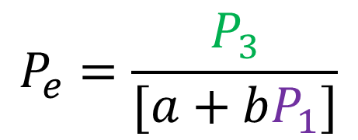
The General Electron Optical Polarimeter Equation
$$P_{e}=\frac{P_{3}}{[a+bP_{1}]}$$
NB – a,b, exactly computable
P₃ → Electron polarization in the direction of the emission direction
P₂ → Validity of the kinematic assumptions
P₁ → Analyzing Power

Slide 13
Mott Calibration
Goal: A 0.4% calibration with the 0.3% precision - now demonstrated - would give give an accuracy of 0.5%
This would also allow direct checks of the theoretical Sherman function calculations; tests of QED in a new energy regime

Slide 14
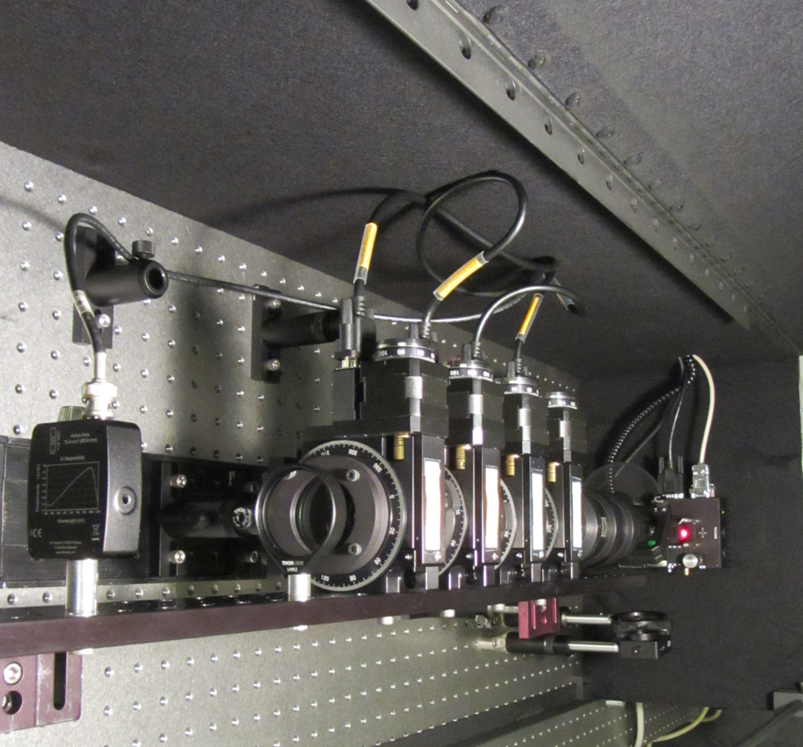
AESOP Optical Polarimeter Tests
K.W. Trantham, K.D. Foreman, and T.J. Gay, “Demonstration of vacuum strain effects on a light collection lens used in optical polarimetry” Appl. Opt. 59, 2715 (2020).

Slide 15
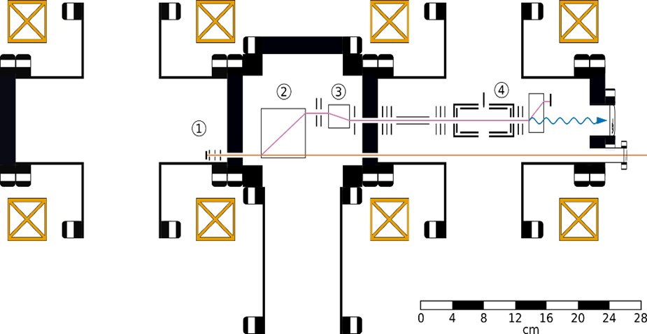
Scale drawing of the combined GaAs/trochoidal monochromator AESOP prototype showing: (1) GaAs photocathode (source of polarized electrons); (2) trochoidal deflector and (3) trochoidal monochromator; (4) target cell with optical 2-axis access.

Slide 16
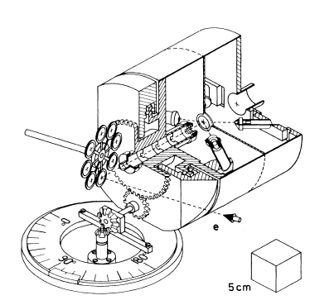
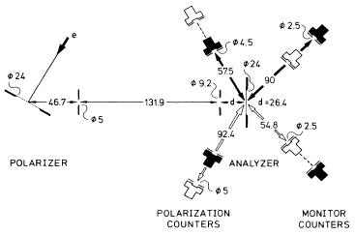
Double Scattering Calibrations – see the next talk!
A. Gellrich u J.Keβler, Phys. Rev. A 43, 204 (1991)

Slide 17
¿e?
Supported by the USDOE under contract No. DE-AC05-84ER40150, the NSF (KF, TJG.) under Grants PHY-1505794, PHY-1632778, and PHY-1806771. XR-M acknowledges funding from the European Union’s Horizon 2020 Research and Innovation Program under Grant No 654002.

