Slide 1
Spin rotator design and spin matching
V. Ptitsyn, S.Tepikian
BNL

Slide 2
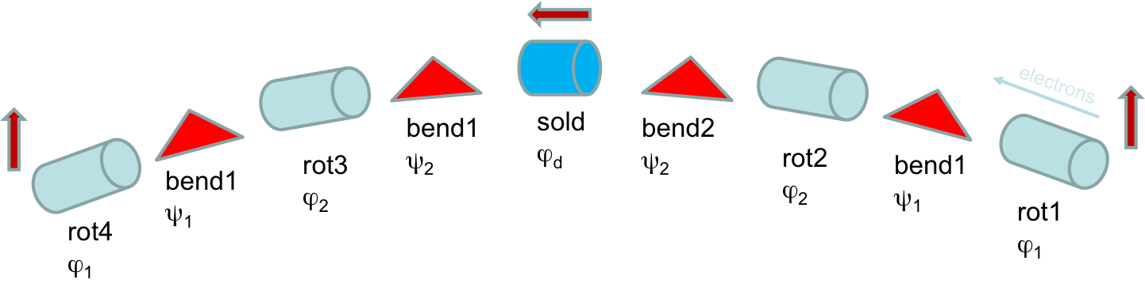
EIC electron spin rotators
Electron energy range: 5-18 GeV
A HERA-type rotator (based on sequence of vertical and horizontal bend) creates meter scale orbit excursion at lower energies.
The rotator design capable to operate in all energy range is based on the combination of solenoidal and horizontal bending magnets.
eRHIC spin rotator
C-type bending configuration
ϕ_{j} – spin rotation angle in solenoids
ψ_{i} – spin rotation angle in bends

Slide 3
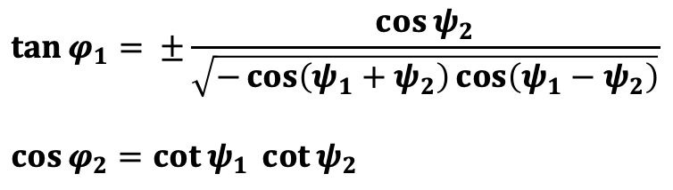
Spin rotator: spin rotation angle definitions
electrons
detector
bend2
ψ₂= ν₀θ₂
ν₀= γa
θ_{1,2}− bending angles
rot2
ϕ₂
bend1
ψ₁= ν₀θ₁
rot1
ϕ₁
Relations between solenoidal rotation angles (ϕ) and horizontal bend spin rotation angles (ψ) to convert vertical spin to longitudinal:
$$\tan{φ_{1}= ±\frac{\cos{ψ_{2}}}{\sqrt{−\cos\left(ψ_{1}+ψ_{2}\right)cos\left(ψ_{1}−ψ_{2}\right)}}}$$
$$\cos{φ_{2}=\cot{ψ_{1}} }\cot{ψ_{2}}$$

Slide 4
Selecting rotator parameters
In gray areas of (ψ₁, ψ₂) plane the spin transformation from vertical
to longitudinal can not be realized
ψ₂
Spin rotation angles (ψ₁, ψ₂) are related with bend angle values:
ψ₁= γa θ₁ , ψ₂= γa θ₂
Thus, any straight line passing through the origin point corresponds to varying electron energy at fixed dipole bending angles.
For instance, the red line on the plot corresponds to varying energy at fixed and equal θ₁ and θ₂
3π/2
π/2
π/2
3π/2
5π/2
ψ₁
15 GeV point
5 GeV point
(required $θ_{2}+θ_{1}$ = 138.4 mrad)
With this rotator design example the longitudinal polarization at 18 GeV energy can not be realized, since energy range is limited (5-15 GeV)

Slide 5
Achieving largest continuous energy range
Red lines θ₁=2θ₂ and θ₂=2θ₁ span over longest continuous good parameter intervals
Thus, these lines (and bend angle relations) provides largest possible continuous energy range:
Maximum-to-minimum energy ratio = 5
θ₁=2θ₂ line leads to smaller values of required solenoid fields, than θ₂=2θ₁
Thus this is a preferable choice for EIC rotator
ψ₂
3π/2
π/2
π/2
3π/2
5π/2
ψ₁
Two examples of continuous ranges covering all EIC energies (using θ₁=2θ₂ line )
5-25 GeV:
3.6-18 GeV:
25 GeV point
(18 GeV)
5 GeV point
(3.6 GeV)
θ₁= 92.27 mrad
θ₂= 46.14 mrad
θ₁= 128.15 mrad
θ₂= 64.08 mrad

Slide 6
Spin rotator: required solenoid fields
Provides longitudinal polarization in IP throughout the whole energy range.
Calls for SC solenoids
with up to 7T field
 | 18 GeV | 5 GeV | Magnet length
1st rotator solenoid field integral , T*m | 33.2 | 26.1 | 5.4 m
2nd rotator solenoid field integral , T*m | 121.9 | 0 | 18 m
1st bend angle, mrad | 46.1
2nd bend angle, mrad | 92.3

Slide 7

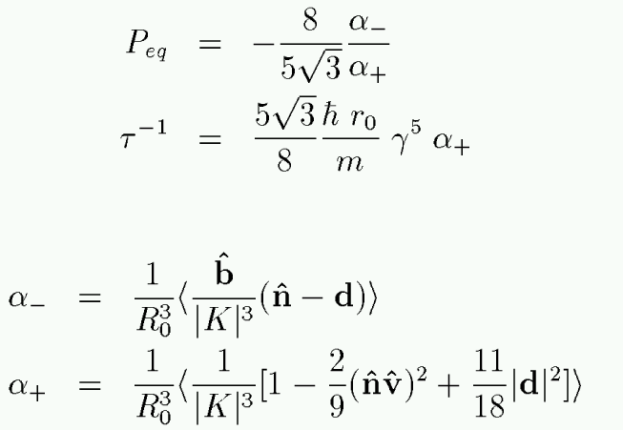
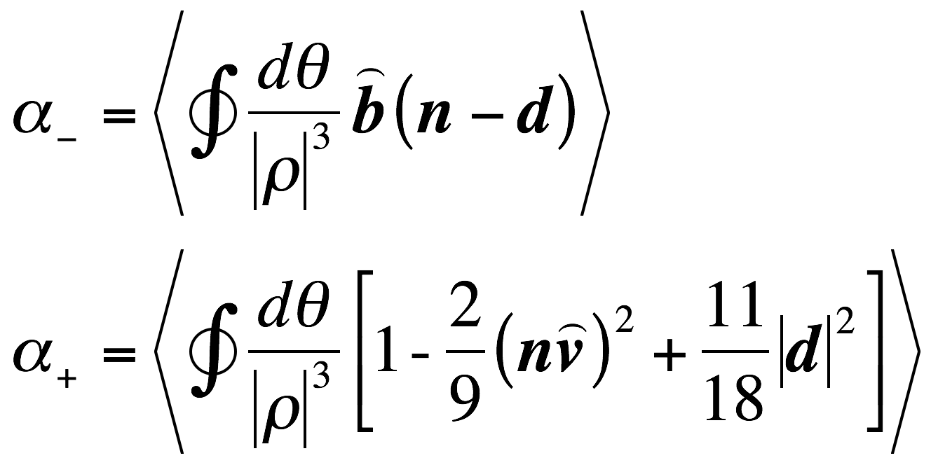
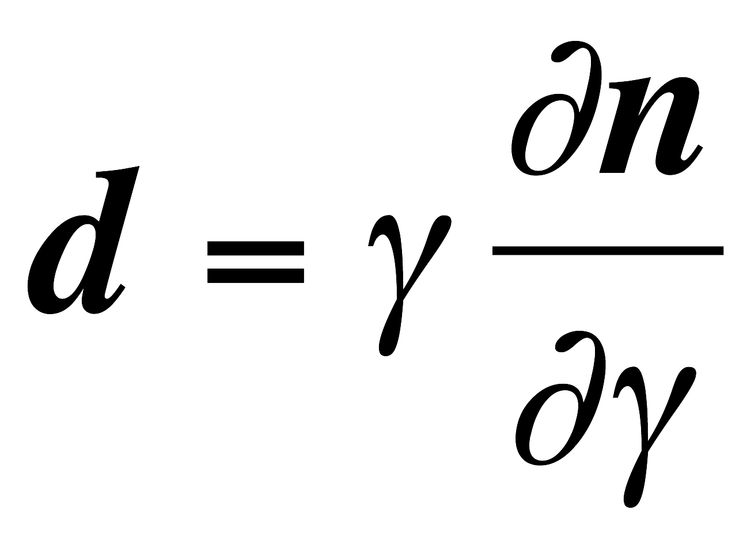
Polarization evolution in electron ring
Synchrotron radiation determines the polarization evolution through Sokolov-Ternov spin-flip emission and spin diffusion caused by quantum emission of S photons. Both processes combined define the equilibrium polarization P_{eq} and polarization relaxation time t.
Derbenev-Kondratenko:
(1973)
Depolarization caused by spin diffusion is
defined by a derivative of invariant spin
field over :
(taken at const x, x’, y, y’)

Slide 8
First-order spin perturbation consideration
The magnetic fields on design orbit define the periodical spin solution n₀ and two others
spin eigenvectors k₀ = l₀+im₀, k₀*.
l₀,m₀,n₀ form normalized triad convenient for considering spin motion perturbations.
In the first order spin perturbation α₀ by momentum deviation or betatron motion is described by the following equation:
where components perturbation precession vector w (neglecting terms of order of anomalous magnetic moment a ) are:
With proper periodical conditions the solution of this equation gives the invariant spin field
in first order.

Slide 9
Exploring spin matching conditions
The goal: eliminate (minimize) dependence of the spin invariant field (α₀) on horizontal betatron amplitude A_{x} and energy deviation δ outside the rotator system.
Thus avoiding any spin dynamics distortion by synchrotron radiation in the arc bends.
The following integral over the whole spin rotator system must be made 0 for terms
proportional to A_{x} and δ:
The orbital motion is considered in a standard form through components of betatron motion
eigen-vectors f_{I} and f_{II} and dispersion functions D_{x}, D_{y}:

Slide 10
Spin matching conditions for solenoidal rotators
We assumed following reasonable optics conditions:
-betatron coupling is fully compensated individually for each of four solenoidal insertions by
dividing each solenoid in two halves and using set of quadrupoles/skew quadrupoles between
and around them
-the vertical dispersion function D_{y} does not leak into the horizontal bends
Then, using integration by parts one gets following set of spin matching conditions
(neglecting terms of order a):
Betatron motion conditions
Direct energy effect condition
where:
F is either f_{I} or D
entrance of first part
of solenoid
exit of second half
of solenoid

Slide 11
Direct energy effect spin matching
Contribution
from solenoids
Contribution from
IR an rotator dipoles
This term can be nullified either
by not allowing dispersion function
inside solenoids or by proper optics
This combination is completely defined by the choice of bending angles of the dipoles and solenoidal fields.
For S-type bending configuration around IP and spin-up to spin-up transformation through the whole rotator system: automatically zero .
For C-type bending configuration around IR, used in EIC, can be nullified at a particular energy with following choice of rotator parameters:
ϕ₁ = ϕ₄ = 0.524 rad, ϕ₂ = ϕ₃ = 2.094 rad
ψ₁ = ψ₄ = π rad, ψ₂ = ψ₃ = π/2 rad
It makes sense to consider fully longitudinal matching the rotators at EIC highest energy, 18 GeV

Slide 12
The rotator solution corresponding to full direct energy spin match at 18 GeV
ψ₂
Solenoid strength:
ϕ₁ = 0.524 rad, ϕ₂ = 2.094 rad
3π/2
Dipole bend angles:
θ₁= 76.89 mrad, θ₂= 38.45 mrad
π/2
But with this rotator design the longitudinal
polarization only realized down to 6 GeV energy.
π/2
3π/2
5π/2
ψ₁
30 GeV point
6 GeV point
(required $θ_{2}+θ_{1}$ = 115.34 mrad)

Slide 13
Solenoidal insertion with betatron spin matching
Spin matching conditions related with betatron motion can be satisfied for each individual solenoidal insertion, using two solenoid halves and (at least 6) quadrupoles between them.
That is for each j :
T_{x,y}
For a betatron spin-matched and fully decoupled solenoidal insertion the horizontal and vertical transport matrices must have following forms:
L

Slide 14
Realization of short solenoid insertion
V.5.3 lattice

Slide 15
Realization of long solenoid insertion
However, present solution requires superconducting quadrupoles.
Thus, we are continuing to work on optics trying to find solution without SC quads.
V5.3 lattice

Slide 16
Example of d-function around the ring for two lattices
pCDR’18 lattice
v5.2 lattice
Optimization of rotator layout for 18 GeV
resulted in good spin match into the arc
in v5.2.
However, sufficiently large d-function is
still present throughout IR.
Spin matching was not very good

Slide 17
Three rotator design options for comparison
Option 1: Minimized depolarization at 18 GeV. But limited energy range (to 6 GeV)
Option 2: covers 5-18 GeV energy range, but stronger depolarization is expected
Option 3: covers 5-18 GeV energy range, but stronger depolarization is expected
θ₁= 76.89 mrad
θ₂= 38.45 mrad
θ₁= 92.27 mrad
θ₂= 46.14 mrad
θ₁= 128.15 mrad
θ₂= 64.08 mrad

Slide 18
Polarization Relaxation Time Comparison
(first-order calculation)
Calculations are done at energies corresponding to 0.5 fractional spin tune
(17.84-17.89 GeV and 10.25-10.34 GeV depending on rotator option)
Option 1
Option 2
Option 3
Option 1
Option 2
Option 3
Conclusion:
Although the Option 1 demonstrates longer polarization relaxation times,
the times in the Option 2 is not much lower.
Both option 1 and 2 remains on the table as a possible implementation of rotator design.

Slide 19
Polarization formulas
Sokolov-Ternov (ST)
Baier-Katkov-Strakhovenko (BKS)
BKS + kinetic polarization mechanism
Derbenev-Kondratenko (Full DK)
(with stochastic depolarization)

Slide 20
18 GeV lattices: disentangling different contributions in the polarization
Energy used for calculation: 17.84 GeV (corresponding to ~.5 fractional spin tune)
pCDR’18
v5.0
v5.2
v5.3
v5.3
no IR dipoles
pCDR’18
v5.0
v5.2
v5.3
v5.3
no IR dipoles
pCDR’18: eSR not yet fitted in the tunnel; Option 2 rotator
v5.0: eSR partially fitted in the tunnel; lattice with longer bends; Option 1 rotator
v5.2: eSR fully fitted in the tunnel, Option 1 rotator
v5.3: IR design layout adjustments, Option 1 rotator
v5.3 no IR dipoles: excluded (only for the analysis purposes) 0.44-0.46 T dipoles in IR6 and IR8

Slide 21
10 GeV lattices: disentangling different contributions in the polarization
Kinetic polarization effect is notable for
both 10 GeV and 18 GeV lattices
Energy used for calculation: 10.25 GeV
v5.2
v5.3
v5.2
v5.3
Spin matching at 10 GeV is worse than at 18 GeV resulting in less asymptotic polarization.
But, it is not so important since the polarization relaxation time is very long at 10 GeV.

Slide 22
Summary
EIC spin rotator design has been developed based on combination of solenoidal and dipole magnets covering wide energy range required by EIC
The design optimization continues:
  reducing compensation quad strength
  optimal selection of rotator configuration (two options)
The conditions for spin matching have been derived from spin-orbital integrals and implemented in the rotator optics
Betatron related spin-matching can be done by using a special transport matrix of solenoidal insertions
There is a rotator configuration that can provide full spin matching at 18 GeV, but its minimum energy is limited to 6 GeV
Alternative version of spin rotator is presently being evaluated, with potential of reducing space taking by rotator system (and saving cost). Please, see next talk by Fanglei.

