Slide 1
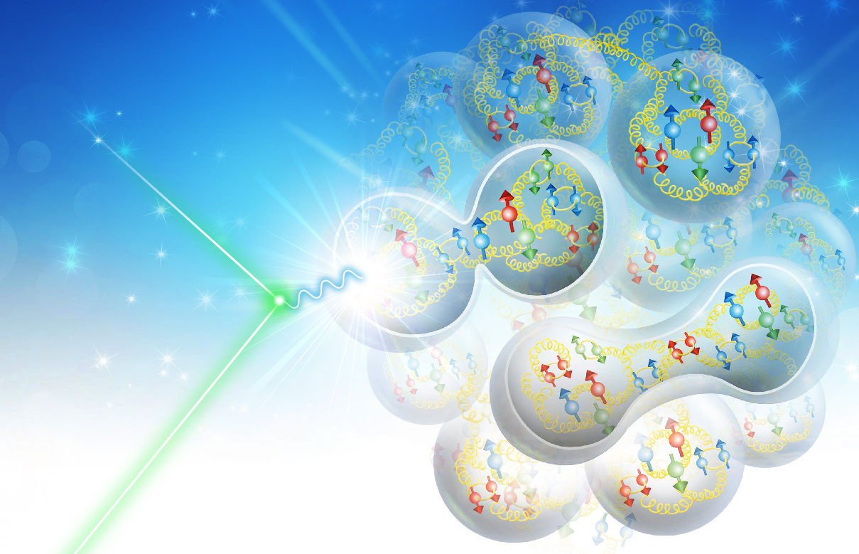
IR Related Effects
V.S. Morozov, F. Lin, Ya.S. Derbenev Jefferson Lab, Newport News, VA
A.M. Kondratenko, M.A. Kondratenko Novosibirsk, Russia
Yu.N. Filatov, MIPT, Moscow, Russia
Beam Polarization and Polarimetry at EIC, July 1, 2020

Slide 2
Outline
Detector solenoid effect
Crabbing effect
Beam-beam effect

Slide 3
Detector Solenoid Effect on Orbit I
The beam trajectory inside a solenoid is a spiral
Evolution of the unit vectors of the accelerator frame is described using the angular velocity vector $\vec{K}$ $\frac{d{\vec{e}}_{i}}{dz}=\vec{K}×{\vec{e}}_{i}$
The angular velocity components are constant inside a solenoid. Therefore, the equation of motion in the matrix form becomes
$$\frac{d\vec{e}}{dz}=K\hat{n}\vec{e}$$
where
$$\hat{n}=\left(\begin{matrix}0 & n_{z} & {−n}_{y} \\ −n_{z} & 0 & n_{x} \\ n_{y} & {−n}_{x} & 0\end{matrix}\right)$$
The solution in the general form can be written in terms of a 3D rotation matrix $Λ\left(\vec{K},z\right)$ as
$$\vec{e}\left(z\right)=Λ\left(\vec{K},z\right)\vec{e}\left(0\right)$$
where
$$Λ\left(\vec{K},z\right)=I+\left(1−\cos\left(Kz\right)\right){\hat{n}}^{2}+\sin\left(Kz\right)\hat{n}$$

Slide 4
Detector Solenoid Effect on Orbit II
The trajectory inside the solenoid
$${\vec{r}}_{0}\left(z\right)=\int_{0}^{z}{{\vec{e}}_{z}\left(z\right)dz}=\int_{0}^{z}{Λ_{31}\left(z\right)dz}{\vec{e}}_{x}\left(0\right)+\int_{0}^{z}{Λ_{32}\left(z\right)dz}{\vec{e}}_{y}\left(0\right)+\int_{0}^{z}{Λ_{33}\left(z\right)dz}{\vec{e}}_{z}\left(0\right)$$
When the solenoid is pitched in the horizontal plane ($n_{y}=0$), the design orbit curves mainly in the vertical direction
$$X\left(z\right)=\left(z−\frac{\sin\left(Kz\right)}{K}\right)n_{x}n_{z} ,$$
$$Y\left(z\right)=−\frac{\left(1−\cos\left(Kz\right)\right)}{K}n_{x} ,$$
$$Z\left(z\right)=z−\left(z−\frac{\sin\left(Kz\right)}{K}\right)\left(1−n_{z}^{2}\right)$$

Slide 5
Detector Solenoid Effect on Spin
Spin rotation when moving along the design orbit is described by similar expressions with the following replacement
$$\vec{K}→{\vec{K}}^{s}≡\left({γGK}_{x}\text{ , } γGK_{y}\text{ , }{\left(1+G\right)K}_{z}\right)$$
i.e.
$$Λ^{s}\left({\vec{K}}^{s},z\right)=I+\left(1−\cos\left(K^{s}z\right)\right){{\hat{n}}^{s}}^{2}+\sin\left(K^{s}z\right){\hat{n}}^{s}$$
The spin rotation angle $θ$ and rotation axis $\hat{S}$ can be extracted using
$$\cos{θ}=\frac{1}{2}\left(\text{Tr} Λ^{s}−1\right)$$
$$\hat{S}=\frac{1}{\sqrt{\left(3−\text{Tr} Λ^{s}\right)\left(1+\text{Tr} Λ^{s}\right)}}\left(Λ_{32}^{s}−Λ_{23}^{s},Λ_{13}^{s}−Λ_{31}^{s},Λ_{21}^{s}−Λ_{12}^{s}\right)$$

Slide 6
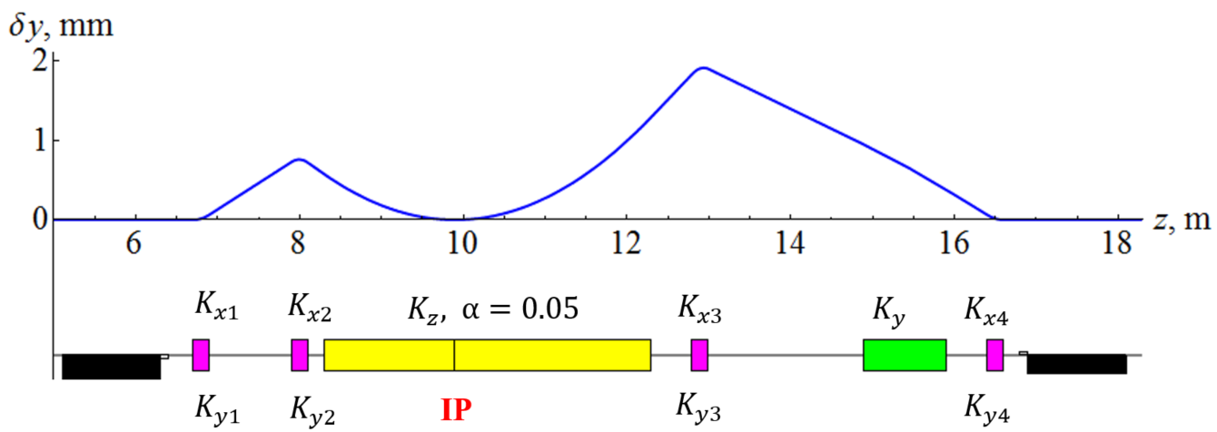
Accounting for Correction System
The orbital kick of the detector solenoid is compensated by dipole correctors, which also have effect on the spin. Therefore, the spin effect of the detector solenoid must be considered in combination with the dipole spin rotations.
Consider an example correction scheme
Vertical closed orbit excursion of a 3 T 4 m long solenoid at 100 GeV

Slide 7
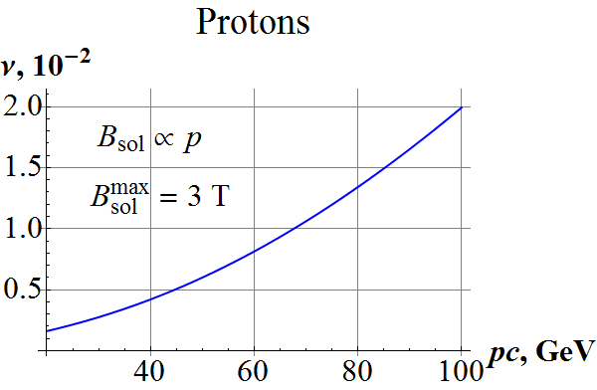
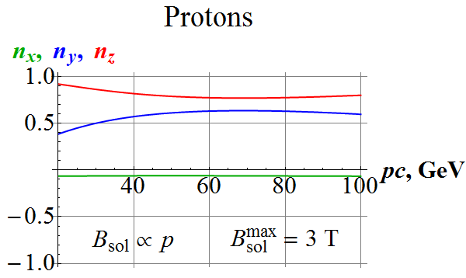
Combined Solenoid and Corrector Spin Effect as Function of Energy
For simplicity assume that solenoid field is proportional to beam energy up to 3 T at 100 GeV.
Dipole corrector strength
$$K_{x1}=−0.0033 m^{−1}, K_{y1}≈2.9⋅{10}^{−5}{ m}^{−1}, K_{x2}≈0.0069 { m}^{−1}, K_{y2}≈−5.5 ⋅{10}^{−5}{ m}^{−1},$$
$$K_{x3}= 0.0079 m^{−1}, K_{y3}≈9.2⋅{10}^{−5}{ m}^{−1}, K_{x4}≈−0.0031 { m}^{−1}, K_{y4}≈−4. ⋅{10}^{−5}{ m}^{−1}.$$
Spin tune and rotation axis components

Slide 8
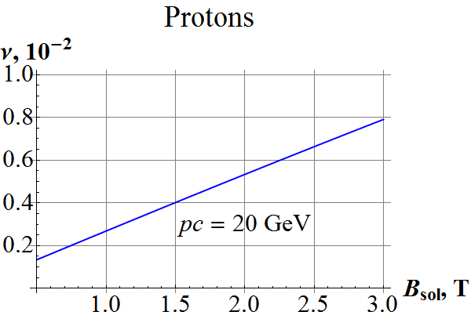
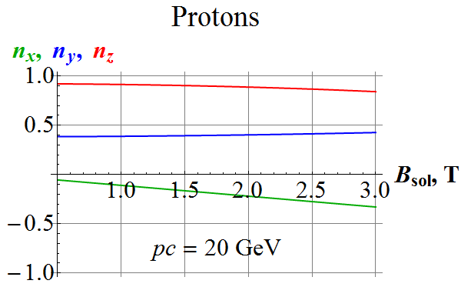
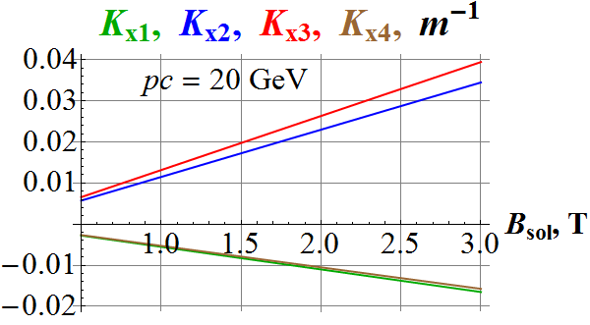
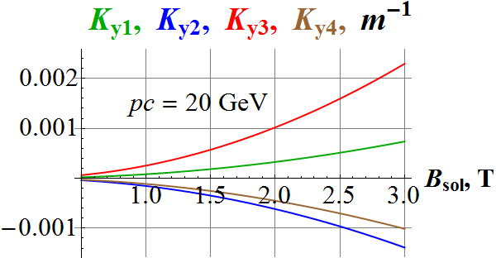
Spin Effect as Function of Solenoid Field at 20 GeV

Slide 9
Horizontal Crabbing in Figure-8 Ring
It is convenient to consider spin dynamics in the “natural” reference frame connected to the particle velocity $\vec{v}$ ($c=1)$
Consider crabbing in the horizontal plane
The spin response of the ring to the horizontal crabbing kick is zero
Crab resonators only contribute directly to the second component (vertical when $τ_{y}=0$) of the spin precession rate
$$\left\{\begin{matrix}W_{1}=0 \\ W_{2}=γG\left(K_{y}+τ_{x}^{′}\right)+\frac{1+G}{γv}{\hat{E}}_{x} \\ W_{3}=0 \end{matrix}\right., \left\{\begin{matrix}τ_{x}^{′}={\hat{B}}_{y}−K_{y}−\frac{{\hat{E}}_{x}}{\text{v}} \\ τ_{y}^{′}=0 \end{matrix}\right.$$
where $\vec{τ}=\vec{v}/v$ the normalized spin components are
$$\left({\hat{B}}_{x},{\hat{B}}_{y},{\hat{B}}_{z}\right)=\left(1+K_{x}y−K_{y}x\right)\frac{\vec{B}}{Bρ} , \left({\hat{E}}_{x},{\hat{E}}_{y},0\right)=\left(1+K_{x}y−K_{y}x\right)\frac{\vec{E}}{Bρ}$$

Slide 10
Horizontal Crabbing in Figure-8 Ring
Net vertical spin rotation per turn
$$2πν_{crab}=\int_{C}{W_{2}dz}=\int_{C}{\left(γG\left(K_{y}+τ_{x}^{′}\right)+\frac{1+G}{γv}{\hat{E}}_{x}\right)dz}=\frac{1+G}{γv}\int_{C}{{\hat{E}}_{x}dz}=\frac{(1+G)}{γv }\frac{z}{\sqrt{β_{crab}β_{IP} }} \tan{φ_{crab} }$$
In case, when betatron phase advance between the crab cavities ${Δμ}_{crab}=2πk$
$$2πν_{crab}=0$$
For ${Δμ}_{crab}=π(2k+1)$
$$ν_{crab}=\frac{(1+G)}{2π γv }\frac{z}{\sqrt{β_{crab}β_{IP} }} \tan{φ_{crab} }$$
This is a tune spread along the bunch but it is suppressed by $1/γ$ down to $∼{10}^{−7}$ and averages out over multiple turns due to synchrotron oscillations.
Variation in the spin rotation along the bunch causes a spin spread in the spin directions at the IP
$$Ψ_{crab}=γG \frac{ σ_{z}}{\sqrt{β_{crab}β_{IP} }} \tan{φ_{crab}}$$
Effective depolarization $D_{crab }={〈Ψ_{crab}^{2}〉}/2$ is a small effect of the order of ${10}^{−5}.$

Slide 11
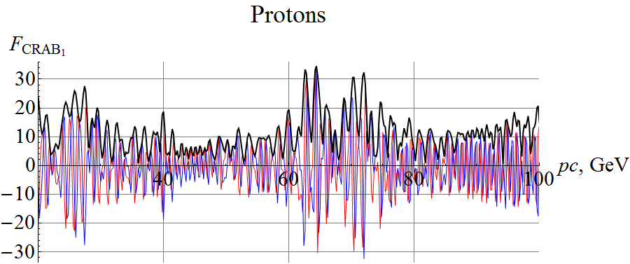
Vertical Crabbing in Figure-8 Ring
Consider vertical beam crossing
Spin precession rate in the natural frame
$$\left\{\begin{matrix}W_{1}=−γGτ_{y}^{′}−\frac{1+G}{γv}{\hat{E}}_{y} \\ W_{2}=γG\left(K_{y}+τ_{x}^{′}\right) \\ W_{3}=K_{y}^{′}y+G{\left(K_{y}y\right)}^{′} \end{matrix}\right., \left\{\begin{matrix}τ_{x}^{′}={\hat{B}}_{y}−K_{y} \\ τ_{y}^{′}={−\hat{B}}_{x}−\frac{{\hat{E}}_{y}}{\text{v}} \end{matrix}\right.$$
Crab resonators excite vertical motion, which results in contribution to the spin rotation from the ring
This effect can be described using a response function $F$. The resonance strength is given by
$$ω=γG 〈\frac{{\hat{E}}_{y}}{\text{v}} F〉$$
Contribution of each crab resonator is
$$ω­_{crab}­=\frac{γG}{2π} \frac{ σ_{z}}{\sqrt{β_{crab}β_{IP} }} F_{crab}\tan{φ_{crab}}$$
With typical values of $L_{b}=1$ cm, $\sqrt{β_{crab}β_{IP} }=6$ m, $φ_{crab}=25$ mrad, $pc=100$GeV, $\left|F\right|=30$, this effect reaches a value of $0.07.$

Slide 12
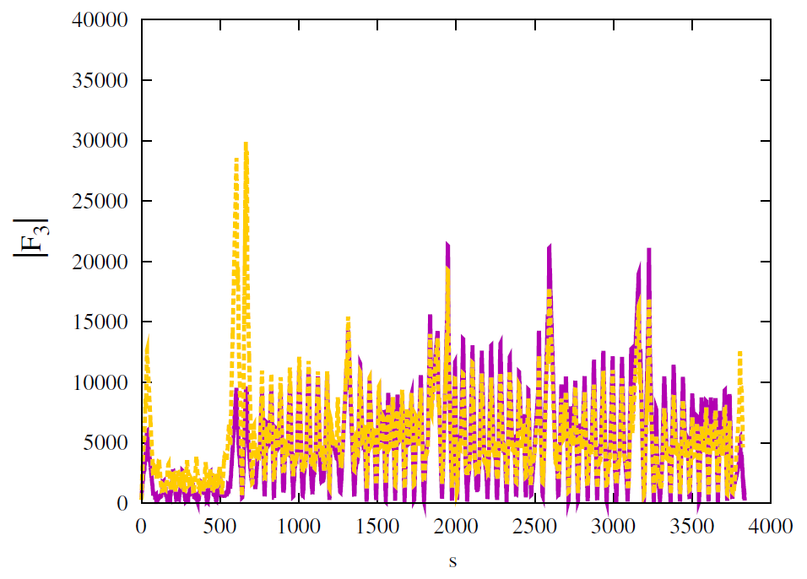
Crabbing in EIC
Crabbing at the EIC is done in the horizontal plane potentially with a small contribution to the crabbing kick in the vertical plane
Response function formalism can be used to evaluate the crabbing effect on the spin in the EIC
The ring response may not necessarily be suppressed even for horizontal crossing due to a different configuration
The response function formalism and numerical tools applicable to the EIC case exist and response function calculations have been done and published earlier. It is a matter of a careful analysis using linear optics of both electron and hadron collider rings.
$$ε=\frac{1}{2π}\left|\oint{{\left[{ΔK_{y}F}_{1}−ΔK_{x}F_{3}+\left(1+G\right)ΔK_{z}η_{z}\right]}_{ν=k}dθ}\right|$$
Note that there is a difference in definitions of parameters compared to earlier equations, e.g. $Gγ$ is folded into $F_{1}$ and $F_{3}$ definitions.

Slide 13
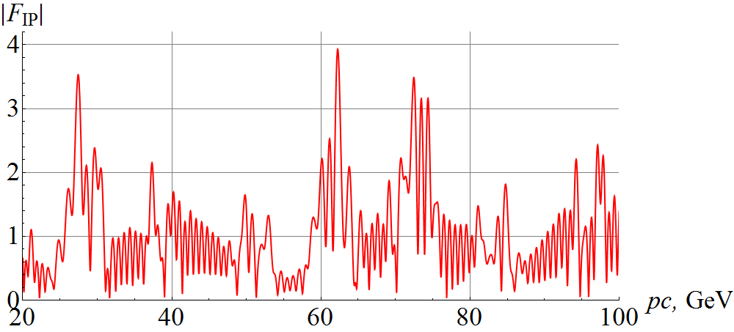
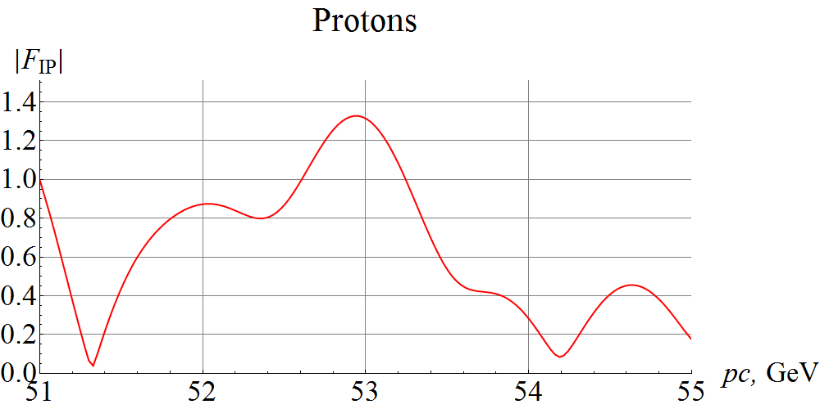
Analysis of Beam-Beam Effect
Similarly to how colliding bunches impact each other’s orbital dynamics, the magnetic fields the two bunches impose on each other can impact their polarization dynamics
Response function can be used to estimate the beam-beam effect on the spin at the linear level
$$φ_{spin}= \frac{γG}{Bρ}{|F}_{IP}|\int_{collision}{B\left(\vec{x}\right)dz}≈\frac{γG}{Bρ} {|F}_{IP}|B_{bunch}L_{bunch}$$
Response function depends only on the linear optics and can be made small at the IP but adjusting the optics therefore reducing the beam-beam effect in the leading order
An example response function and its zoomed in graph around 53 GeV

Slide 14
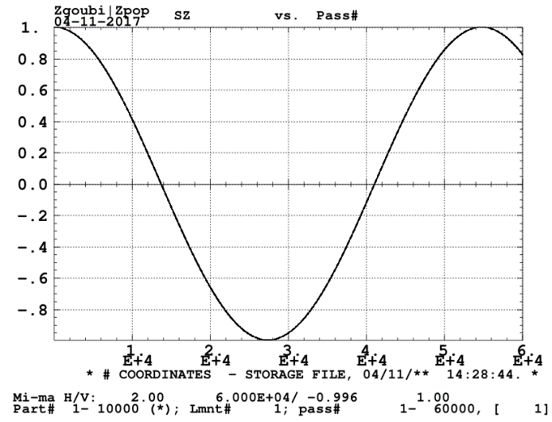
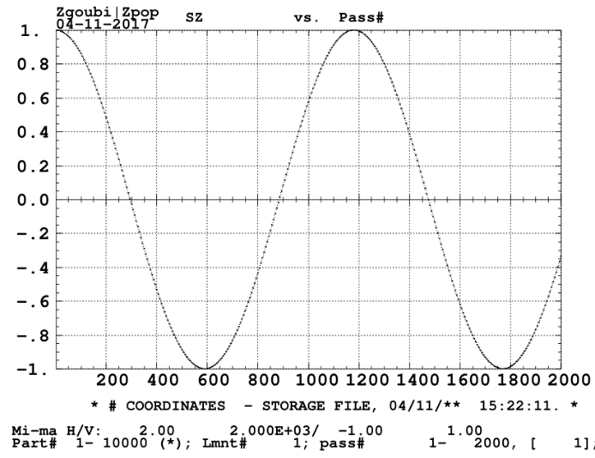
Simulation of Beam-Beam Effect
2 cm long radial dipole with a field strength of $2⋅{10}^{−3} m^{−1}$ at the IP
Two energy points:
51.32 GeV/c with $\left|F\right|=$ 0.0322
52.94 GeV/c with $\left|F\right|=$ 1.329
Analytic prediction:
$φ_{spin}^{E1}≈2π⋅2.01⋅{10}^{−5}$
$φ_{spin}^{E2}≈2π⋅8.56⋅{10}^{−4}$
Zigoubi simulation
$$φ_{spin}=\frac{2π}{N_{turns}^{spin period}}$$
$φ_{spin}^{E1}≈2π⋅1.85⋅{10}^{−5}$
$φ_{spin}^{E2}≈2π⋅8.54⋅{10}^{−4}$
Illustrated impact of energy and potential for response function optimization

Slide 15
Conclusions
An analytic approach to estimate the spin effect of a pitched detector solenoid has been developed
The solenoid effect must be considered together with the orbit correctors
The crabbing effect can be considered using the response function
Crabbing can potentially cause spin spread, which can be amplified by the ring optics
With proper betatron and spin phase advance, crabbing effect can be compensated
Beam-beam effect can be estimated using response function
Beam-beam effect depends on energy and optics
Beam-beam effect can be suppressed by minimizing the response function at the IP

