Slide 1
Acceleration of Electrons in the RCS
Vahid Ranjbar, BNL
Beam Polarization and Polarimetry at EIC
July 1st 2020
Electron Ion Collider

Slide 2
Outline
Requirements
Spin Resonance Review
Concept Overview and Design
Geometry
Detector bypass
Spin resonance strengths
Polarization Performance
Tolerances for vertical misalignments
vertical orbit
Spin imperfection correction scheme
Summary

Slide 3
eRHIC Injector Requirements
A cost effective design to accelerate polarized electrons from 400 MeV → 18 GeV
For injection of 10-28 nC bunches into storage ring
Injection rate two bunches per sec. (1Hz)
Maintain polarization transmission losses < 5%
Has to fit inside existing RHIC tunnel with bypass for detectors
Use existing cost effective technologies.
The Rapid Cycling Synchrotron (RCS) design meets these design requirements.

Slide 4
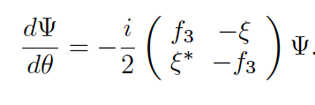
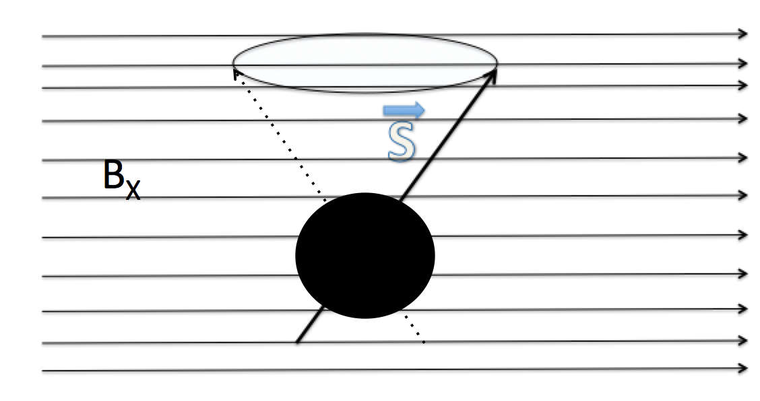
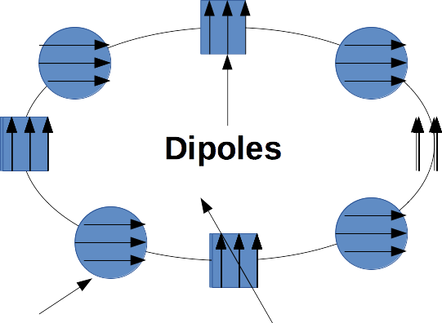
Spin Resonance Review
Spinor Form

Slide 5
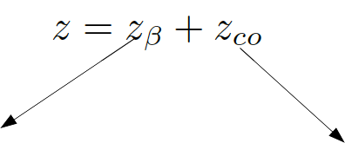
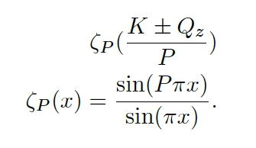
Spin Resonance Driving terms

Slide 6
Concept Overview: Spin Resonance Free Lattice
Both the strong intrinsic and imperfection resonances occur at:
K = nP +/- Qy
K = nP +/- [Qy] (integer part of tune)
To accelerate from 400 MeV to 18 GeV requires the spin tune ramping from
0.907 < Gϒ < 41.
If we use a periodicity of P=96 and a tune with an integer value of 50 then our first two intrinsic resonances will occur outside of the range of our spin tunes
K1 = 50+ν_{y} (ν_{y} is the fractional part of the tune)
K2 = 96 – (50+ν_{y} ) =46-ν_{y}
Also our imperfection will follow suit with the first major one occurring at K2 = 96 – 50 = 46

Slide 7
How to make this work in the RHIC tunnel?
It is easy to accomplish this with a perfectly circular ring. Just construct a series of FODO cells with bending magnets so that we have total periodicity of 96.
The problem is that the RHIC tunnel is not circular and has an inherent six fold symmetry.
The solution make the spin resonances integrals over the straight sections equal to zero.

Slide 8
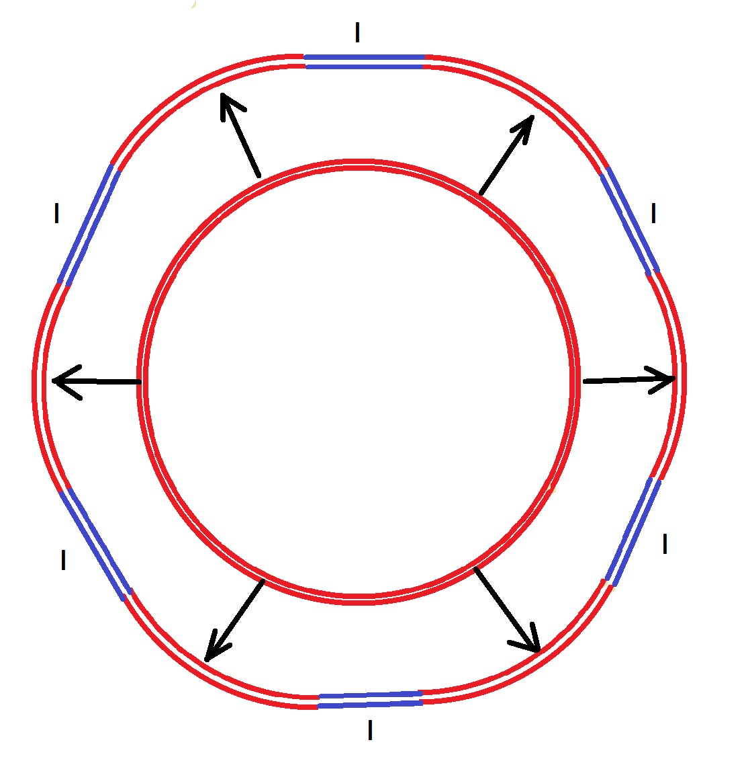
Project onto the RHIC tunnel
RHIC Tunnel

Slide 9
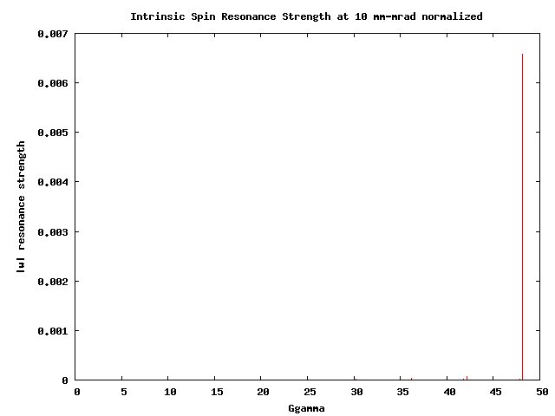
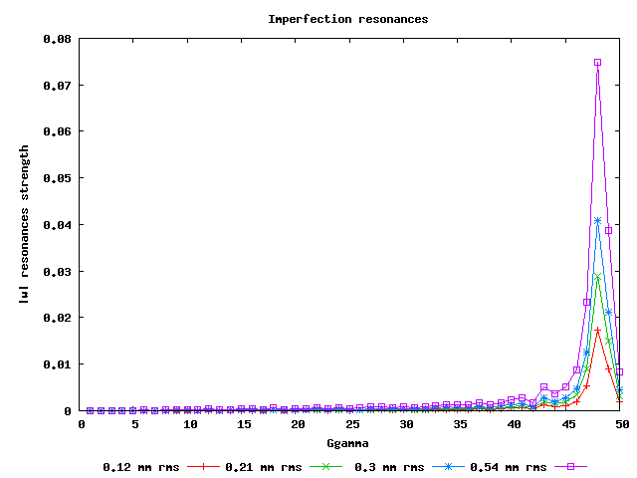
Calculating Spin Resonances
Extraction
Extraction
No polarization loss from cumulative effective of intrinsic spin resonances for distributions with rms normalized emittance > 1000 mm-rad (100 msec ramp rate).
At 200 mm-mrad rms normalized emittance, we can tolerate beyond 2% field errors and still maintain above 95% polarization transmission.
Issue to control: Imperfection spin resonances ~ vertical rms orbit 0.5 mm to keep losses < 5%.

Slide 10
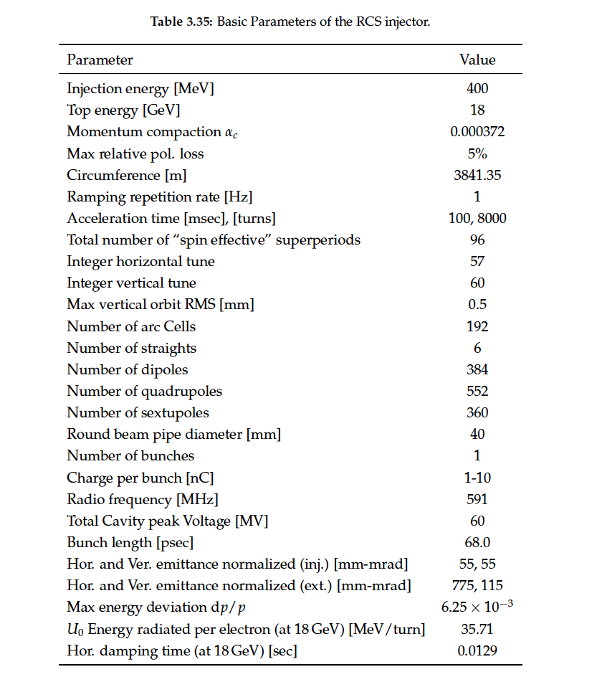
RCS Design Parameters
Current Design accommodates detector bypasses and RF physical needs
Two connecting arc designs
Detector→ IP6, IP8
RF, Extraction, Injection
IP10→ RF
IP12→ Extraction
IP2 → Injection
IP4
Achieved 3-4 meter bypass at the IP.
Impacts symmetry of lattice.
However by optimizing the quad strengths in the bypass region we can recover low intrinsic losses.
Spin resonance free electron ring injector Phys. Rev. Accel. Beams 21, 111003 – Published 27 November 2018

Slide 11
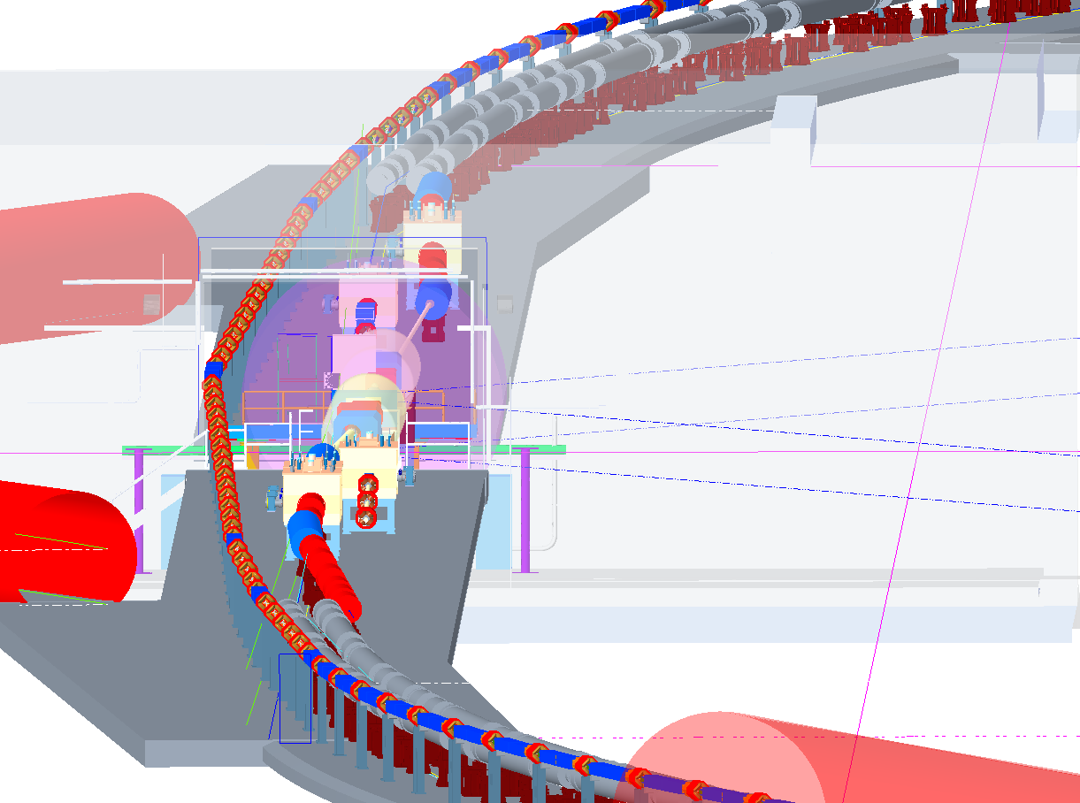
Detector Bypass design (Doug Holmes) IP6, IP8

Slide 12
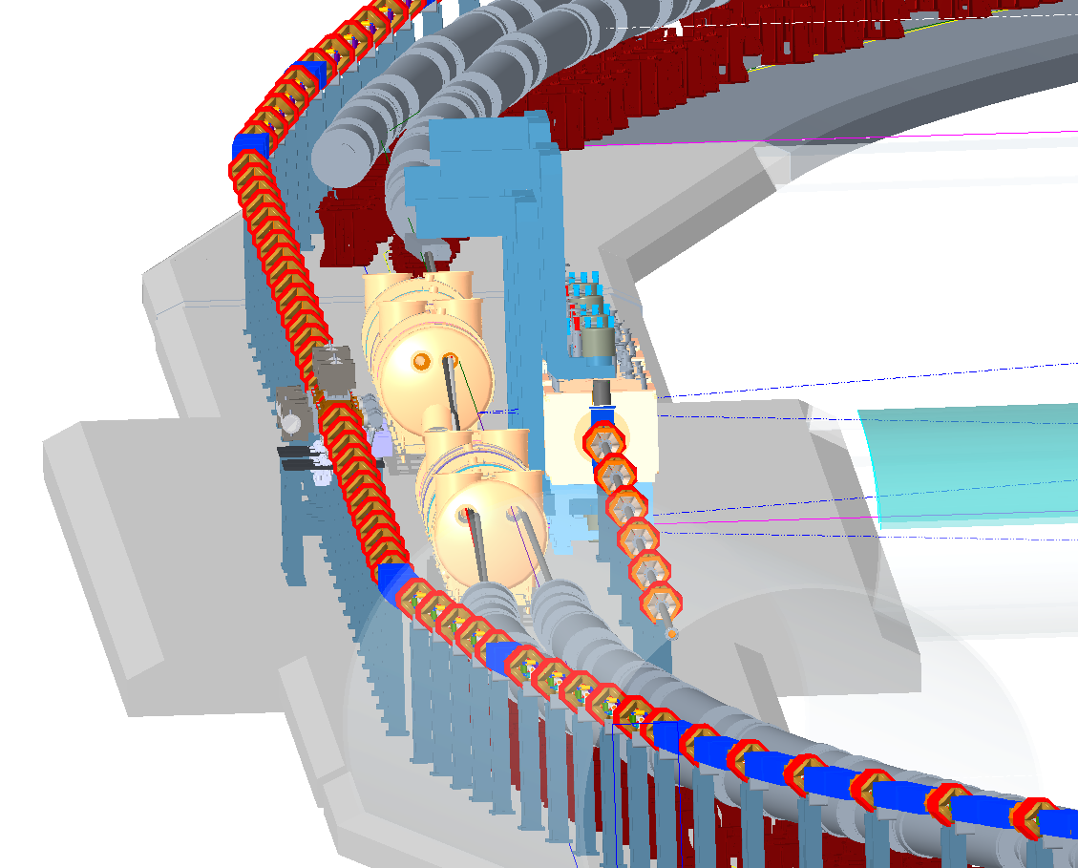
Design IP10,12,2 and 4 (Doug Holmes) RF, Extraction, Injection

Slide 13
Polarization Performance
Intrinsic resonance as calculated by DEPOL yield no cumulative depolarization loss for a beam with below 1,000 mm-mrad rms normalized emittance.
Imperfections could however potentially cause greater than 5% losses during ramp.
Due primarily to quadrupole misalignment and dipole rolls.
But these effects can be controlled to bring our losses below 5% on ramp.→ Orbit Smoothing and Imperfection bumps.

Slide 14
Analysis of Imperfections:
Survey estimates are 0.2 mm rms with a 2 sigma cut off and +/- 1 mrad rolls. This yields an estimated rms orbit distortion of between 3-6 mm rms.
Extracting at 10 GeV RCS can handle > 3 mm RMS orbit with < 5% pol. Loss and 2 mrad uncorrected rolls.
With appropriate BPM and corrector pairs this can be corrected down to below 0.5 mm rms and push our polarization losses below 5% extracting at 18 GeV.
Once corrected, dynamical changes of the relative field strength in the quads and dipoles of greater than 0.5% can be tolerated with little effect on polarization transmission.
Orthogonal imperfection bump scheme to fix any remaining losses beyond SVD orbit smoothing.

Slide 15
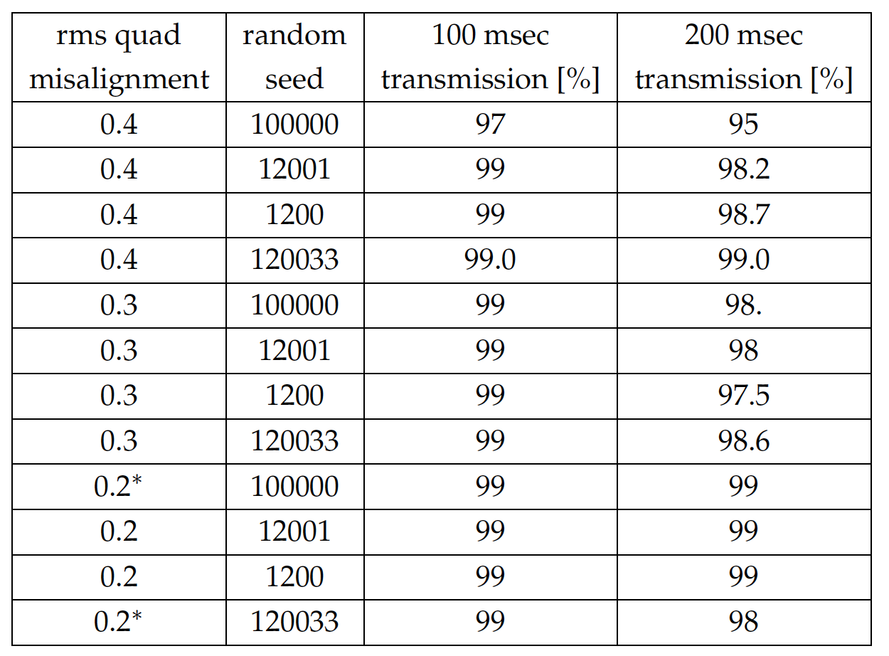
Studies with SVD orbit correction: Quadrupole Misalignments
Polarization Transmission to 18 GeV for random gaussian quadrupole misalignments with SVD orbit correction for 4 different random seeds. * indicates tests with bpm misalignments of 0.2 mm rms

Slide 16
Studies with SVD orbit correction: Dipole Rolls
Polarization Transmission to 18 GeV for random gaussian dipole rolls with SVD orbit correction for 2 different random seeds. (calculated using spin tracking in Zgoubi)

Slide 17
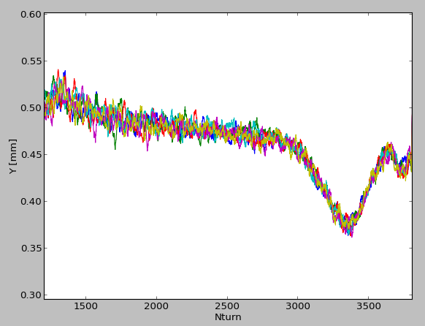
Dynamical Orbit Effects Example: NSLS-II Booster
Thanks :Wang, Guimei
400 msec Ramp, 8M Turns to 3 GeV
Randomly collected 50 shots over 1 hr.
Shot to shot variation ~ 70 microns.
Transient dynamics die after 1st 50 msec :
Equivalent to below 10 GeV in RCS
In RCS tolerate > 3 mm RMS orbit below 10 GeV
After 50 msec variation on ramp peak swing 0.1 mm over 50 msec.
→ 0.02 mrad kick at quads. This is well within the existing bandwidth of our corrector system (swing +/- 1 Amp 20Hz) Possible to achieve 200 Hz ~ 5 msec

Slide 18
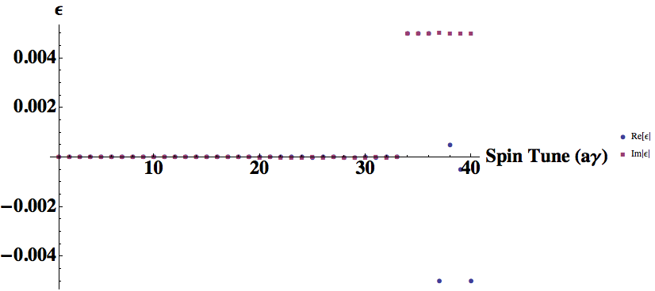
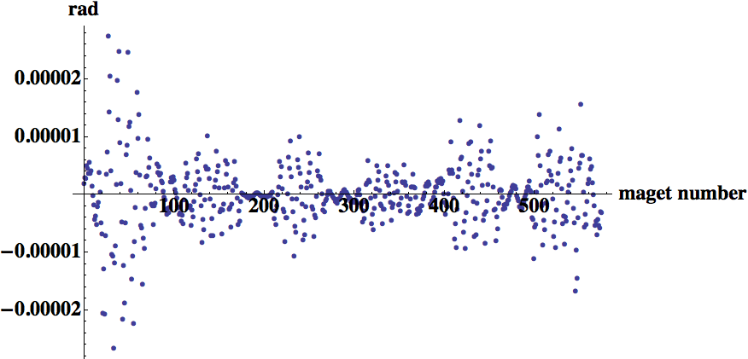
Orthogonal Imperfection Bump
Static imperfection bumps at any imperfection resonance location on the ramp.
Bumps are orthogonal to each other and localized in energy space → no required bandwidth beyond what is needed to ramp the dipoles with the energy.
Example Shown on Right: 10 to 15% (0.005 res.) Depolarization Kick Imaginary and Real no kicks anywhere else.

Slide 19
Summary
Resonances in this lattice are driven by imperfections
Intrinsic resonances are so weak that even large field distortions don’t hurt.
Resilient to misalignments, dipole rolls and orbit distortions:
- Up to 0.4 mm quadrupole misalignments and 2.5 mrad dipole
rolls are tolerable provided the orbit is corrected to 0.5 mm RMS level.
- Assume orbit correction using SVD algorithm with a corrector and a BPM next to each quadrupole.
- within state-of-the art orbit control hard-and software
This will result in > 95% polarization transmission.
To provide additional margin we show that fixed orthogonal imperfection bumps are capable of removing any residual polarization losses.

