Slide 1
Introduction to Tracking Working Group
Kick-off Meeting, February 13, 2020
Kondo Gnanvo

Slide 2
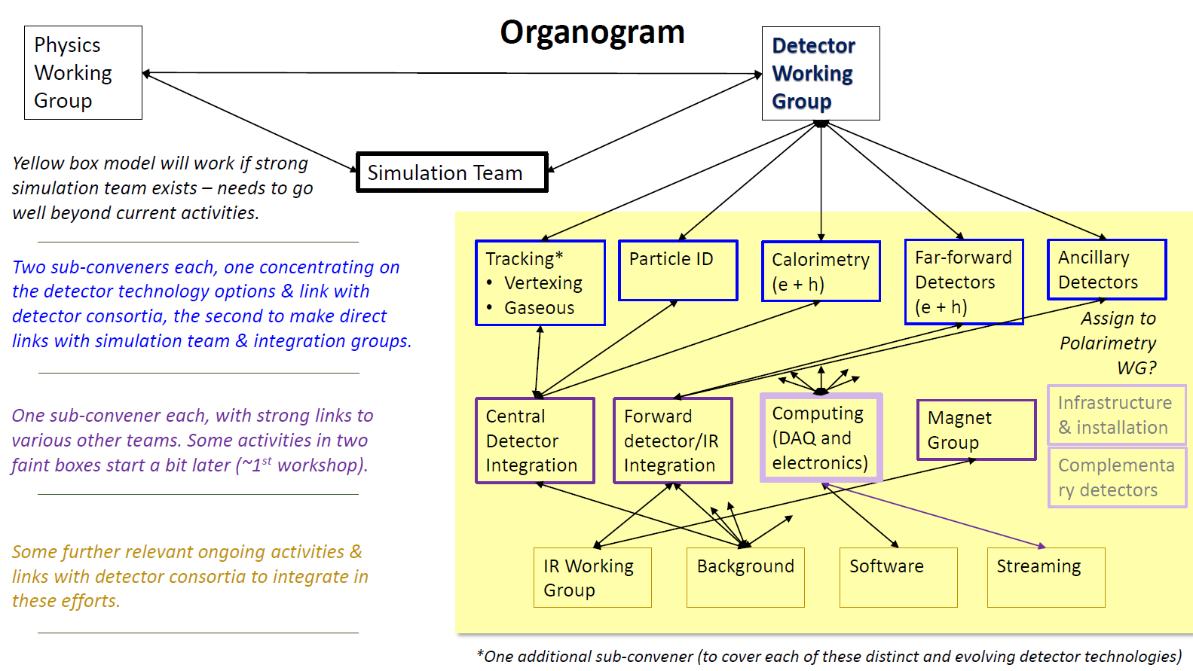
Introduction to Tracking Working Group
Yellow Report:
Kick-off Meeting @ MIT Dec 2019
3 Main Working Groups
Physics Working Group
Detector Working Group
Accelerator Working Group
Tracking Working Group: Peter Jones
Include the tracking in both Barrel and the End Caps regions but not far forward (backward) trackers
sub conveners:
Annalisa Mastroserio ⇨ Simulation and Integration Coordination
Kondo Gnanvo ⇨ Gaseous Detectors
Leo Greiner ⇨ Silicon Detectors

Slide 3
Useful links of Tracking Working Group
Mailing list: Currently 46 members
eicug-yr-detector-tracking@eicug.org
Google groups: Currently 46 members
https://groups.google.com/a/eicug.org/forum/?hl=en#!forum/eicug-yr-detector-tracking
Indico page
https://indico.bnl.gov/category/276/
Bluejeans link: could also be found from the Indico page
https://bluejeans.com/623490569
We will up later today a doodle poll to chose a meeting time that work for the majority. Will probably settle for a weekly meeting
Next meeting will be next week after the doodle poll results: ⇨ Will discuss in more details task assignment to participating groups

Slide 4
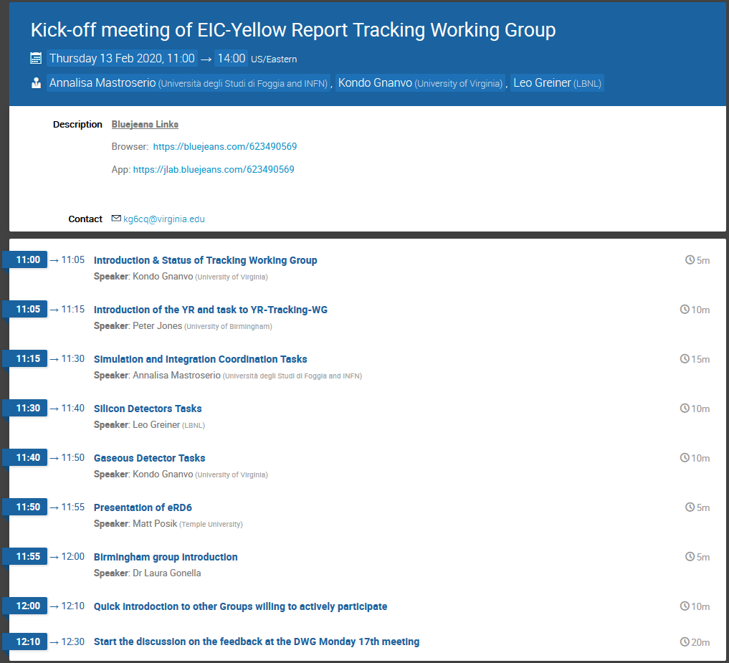
Today’s agenda

