Slide 1


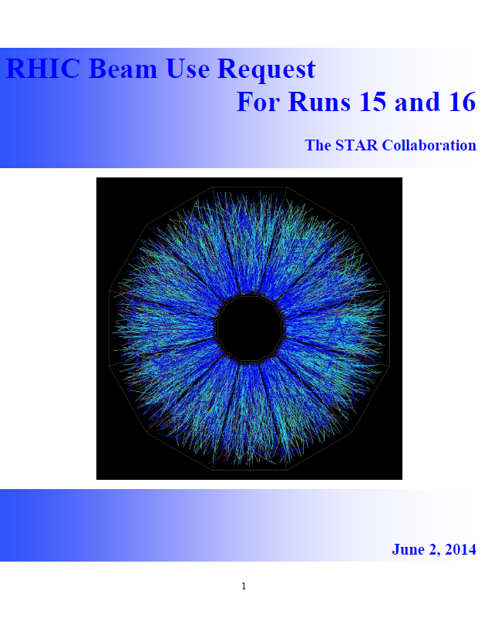
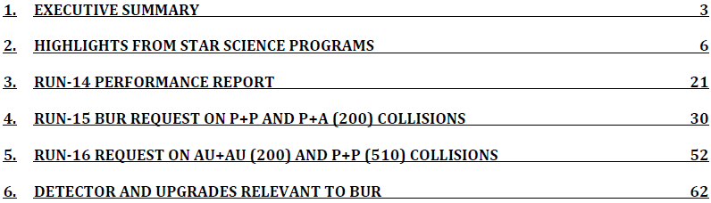
Zhangbu Xu
(Brookhaven National Lab)
https://drupal.star.bnl.gov/STAR/starnotes/public/sn0606
https://drupal.star.bnl.gov/STAR/star-run-15-16-bur

Slide 2
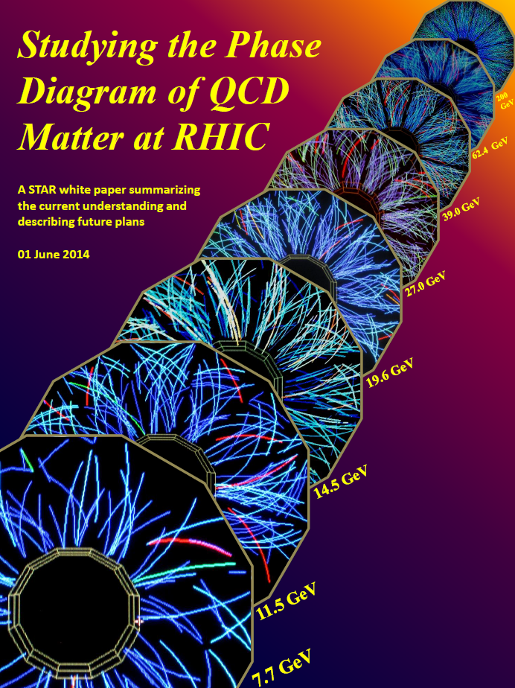
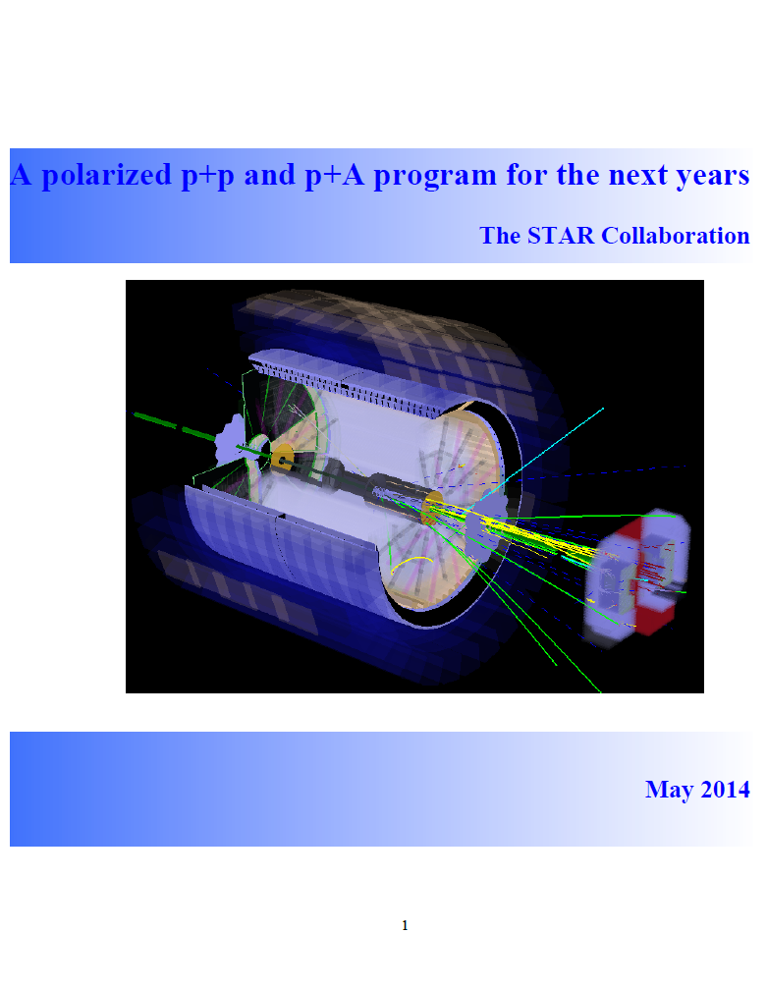
STAR Plan on BES II and pp/pA LoI
Talk by Dan Cebra (UC Davis)
Committee co-chairs: Bedanga Mohanty
Talk by Elke Aschenauer (BNL)
Committee co-chairs: Ernst Sichtermann
Huan Huang
https://drupal.star.bnl.gov/STAR/starnotes/public/sn0598
https://drupal.star.bnl.gov/STAR/starnotes/public/sn05605

Slide 3

Executive Summary
Run | Energy | Duration | System | Goals | priority | sequence
15 | √s_{NN}=200GeV √s=200GeV | 5-week 12-week | Transverse p+Au 1) p+p 2) transverse 6 weeks 3) longitudinal 6 weeks | saturation physics, ridge and reference, L=300 nb⁻¹ 1) HI reference L=90 pb⁻¹, 500M MB 2) Study transversity, Sivers effects L=40 pb⁻¹, 60% pol. 3) Study Δg(x) L=50 pb⁻¹, 60% pol. | 1 2 2 | 3 2 1
16 | √s_{NN}=200GeV √s=510GeV | 10-week 7-week | Au+Au Transverse p+p | Λ_{c}, D v₂, R_{AA}, ϒ 10nb⁻¹, 2billion MB A_{N} of W±, γ, Drell-Yan, L=400 pb⁻¹ | 1 2 | 1 2

Slide 4
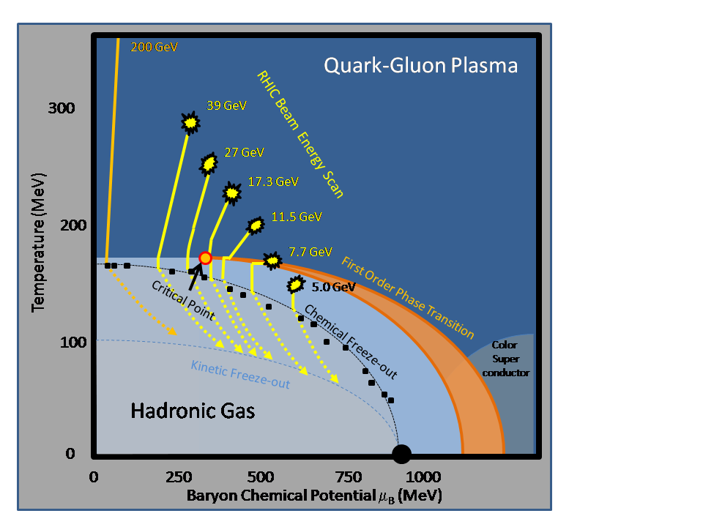
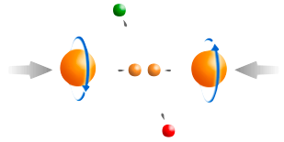
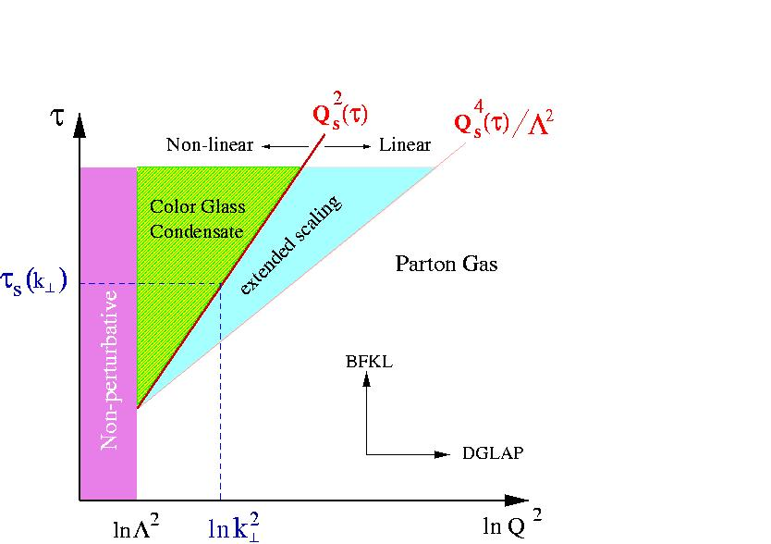
RHIC: eight key unanswered questions
Hot QCD Matter
Partonic structure
6: Spin structure of the nucleon
7: How to go beyond leading twist
and collinear factorization?
1: Properties of the sQGP
2: Mechanism of energy loss:
weak or strong coupling?
3: Is there a critical point, and if so, where?
4: Novel symmetry properties
5: Exotic particles
8: What are the properties of
cold nuclear matter?
STAR Decadal Plan
http://www.bnl.gov/npp/docs/STAR_Decadal_Plan_Final%5b1%5d.pdf

Slide 5


STAR Detector System
EEMC
Magnet
MTD
BEMC
TPC
TOF
BBC
HFT

Slide 6
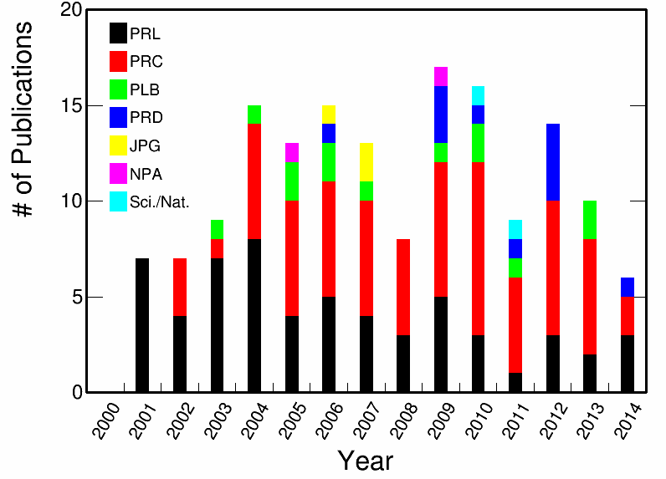
Publication & Citation Summary
Citations:
17,544 (as of June 3)
159 peer-reviewed scientific papers
2005 Whitepaper: 1836 citations
49 papers >100 citations
average citations/paper: 110
June 15, 2013 - 2014
12 published papers
12 papers submitted and in review process
15 papers in the collaboration
(GPC) review process
12 PhD student graduations

Slide 7
Heavy Ion Program Highlights

Slide 8

QGP properties and QCD Phase Diagram
Initial Geometry
  U+U shape and density➔v₂ and strangeness
Free Quarks
  Flow of heavy quarks
  Color Screening of Heavy Quarkonia
Excited Vacuum
  Dileptons as tool to systematically study Chiral Symmetry Restoration
  What are the procedures to achieve that?
Properties of QGP
  Jet
  Long-Range Correlations
Projections from STAR Upgrades
  Heavy-Flavor Tracker (HFT)
  Muon Telescope Detector (dimuon and e-μ)
space coordinators
mass scale
penetrating thermal scale
high momentum scale
causality time scale

Slide 9
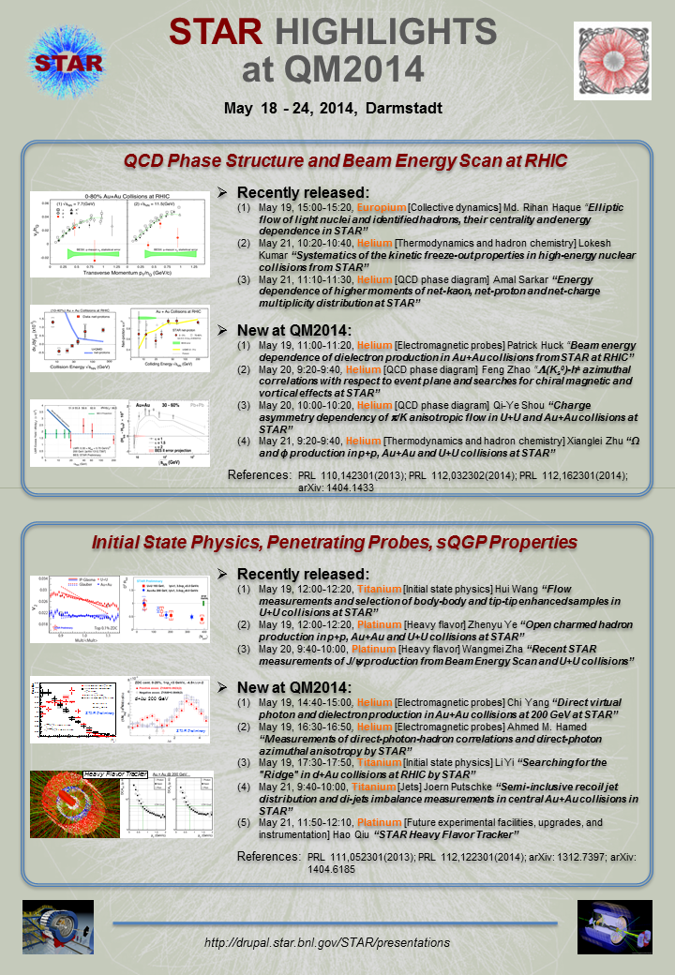
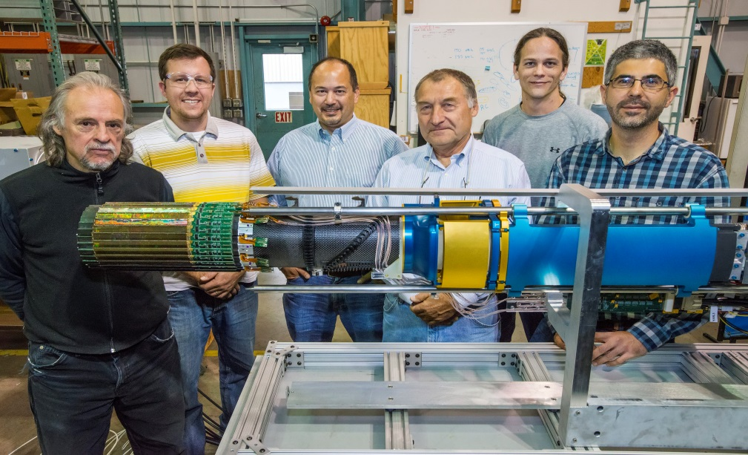
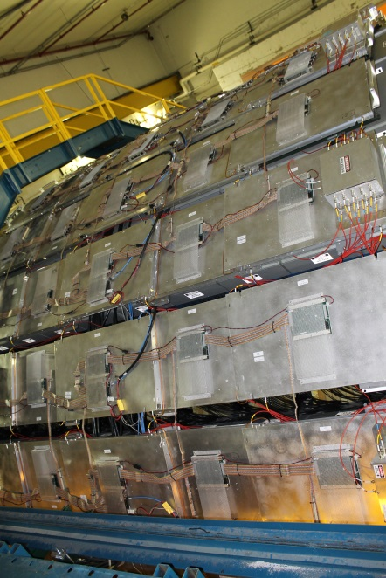
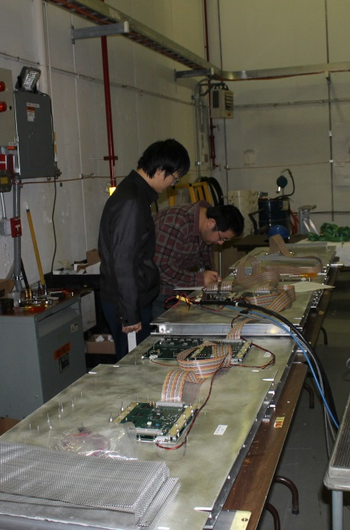
Results, technologies and
people who made it happen
https://drupal.star.bnl.gov/STAR/presentations

Slide 10
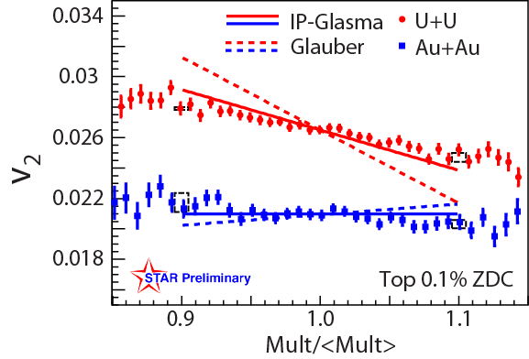
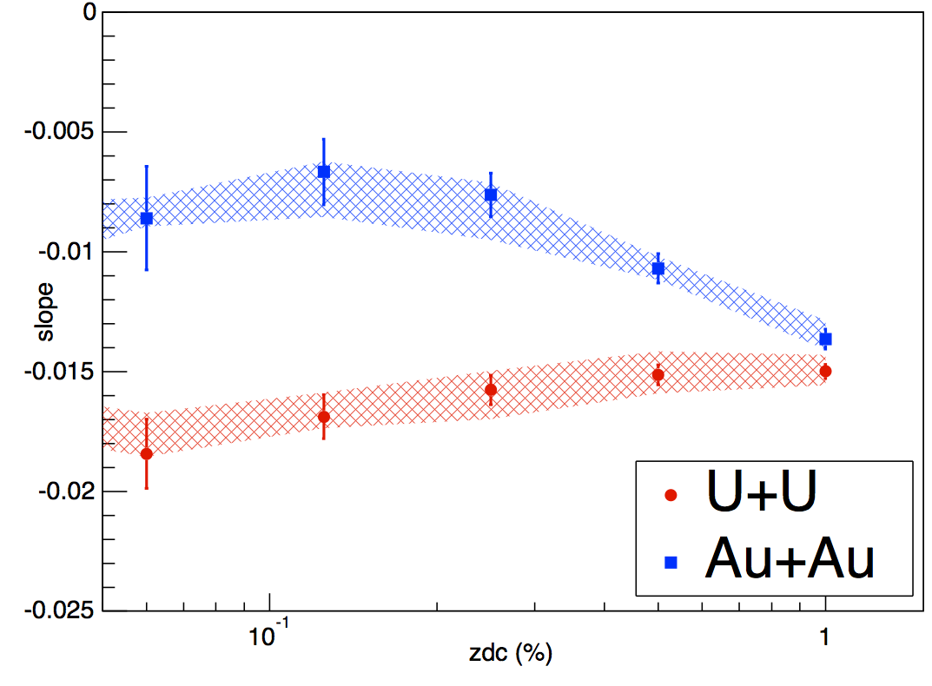


Shape Matters: U+U Collisions
STAR Preliminary
v₂ Slope
Collision centrality (ZDC)
RHIC delivered the U+U collisions in order to study geometry effects. Model expectation: 20% increase in energy density in very central collisions
Tip-tip and body-body enhanced samples selected via ZDC-mult cut
IP-Glasma model consistent with the observation: implying CGC type of initial condition at RHIC
- Bjoern Schenke, et al. arXiv:1403.2232
- Maciej Rybczyński, et. al. PRC87,044908(13)

Slide 11
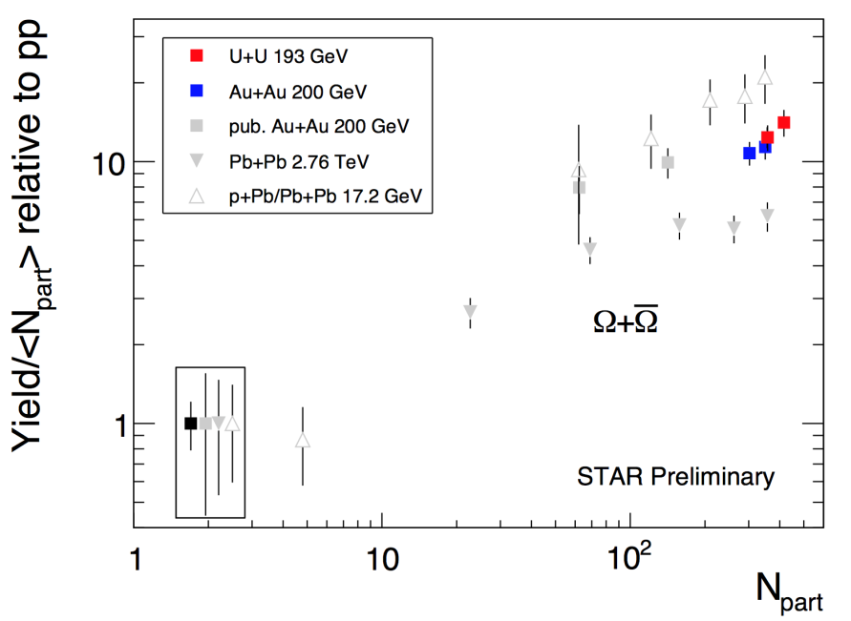
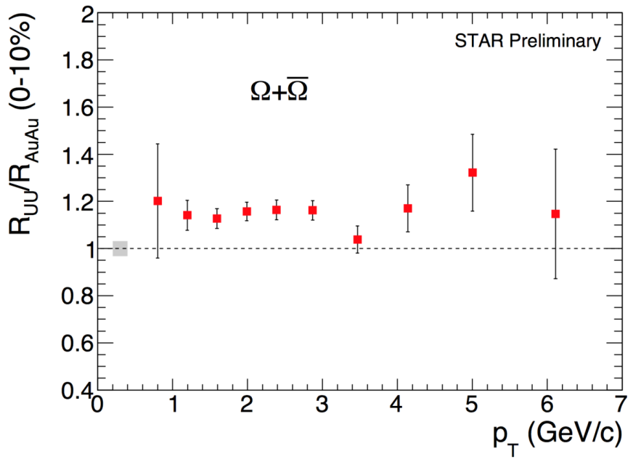
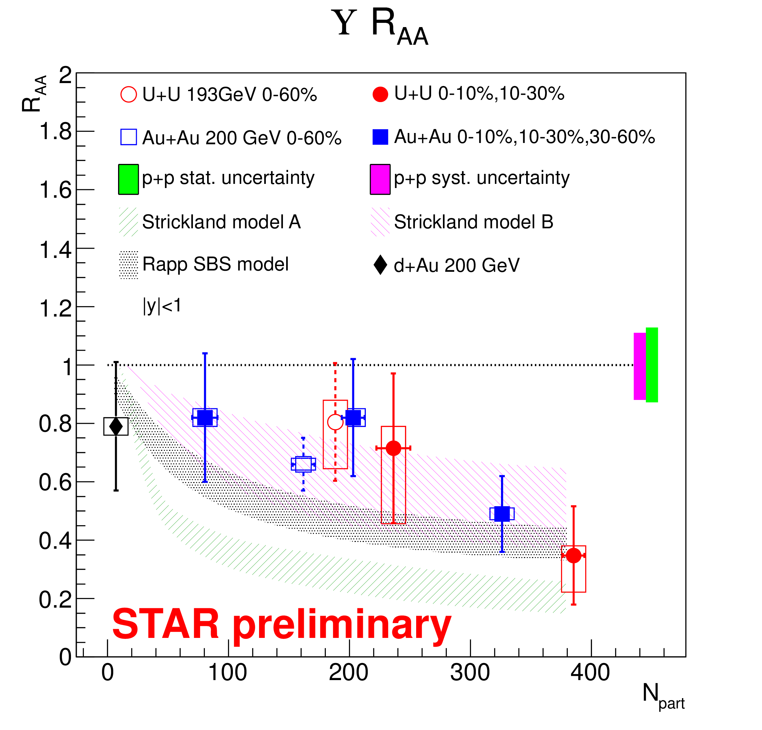
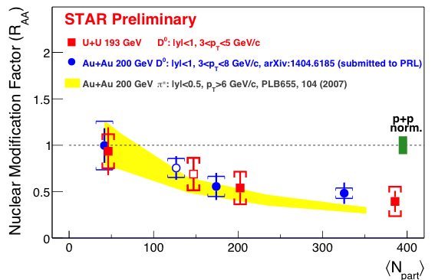
Volume and Density Matter: U+U
What condition makes strangeness saturate?
Which p_{T} coalescence/jet Quenching transit?
Statistical error only
Heavy Flavor Energy Loss and Quarkonium Melting
D⁰
ϒ

Slide 12
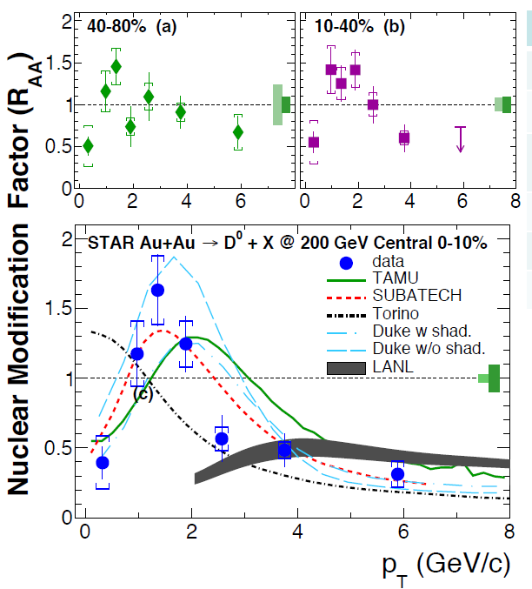
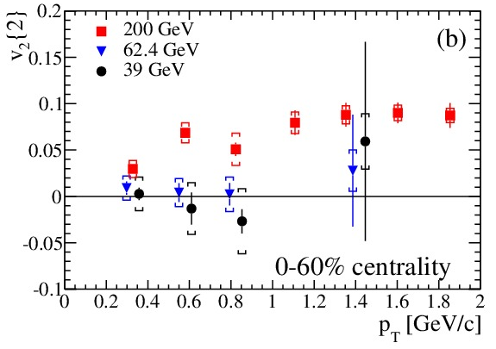
Flow and Quenching of Heavy Quarks
Elliptic flow of
Electrons from heavy-flavor hadrons
Finite v₂ at low p_{T}
Jet contribution at high p_{T}
Difference at lower energy
arXiv: 1405.6348
First measurement of directly reconstructed
Charmed hadron radial flow at RHIC
arXiv: 1404.6185
HFT Crucial to moving forward the Program

Slide 13
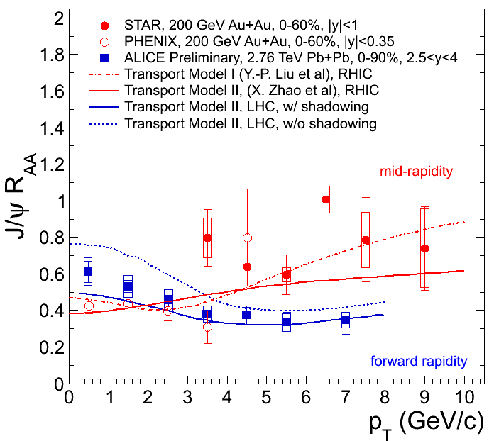
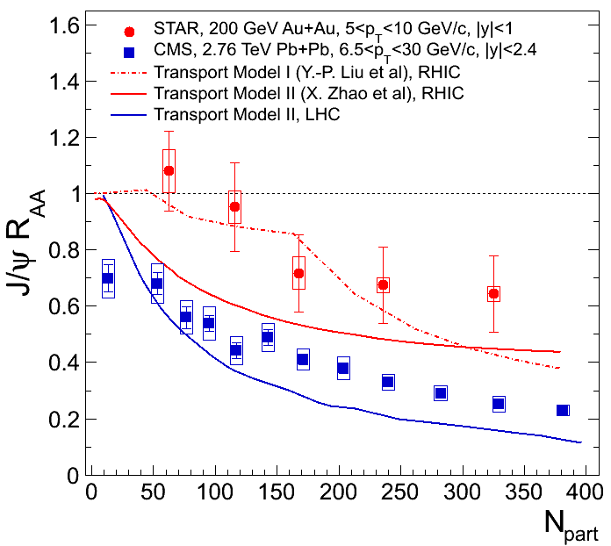
J/ψ p_{T} dependence in A+A
PHENIX: PRL98(2007)232301;
STAR: arXiv: 1208.2736, PLB (2013)
J/ψ R_{AA} decreases from low to high p_{T} at LHC.
J/ψ R_{AA} increases from low to high p_{T} at RHIC.
J/ψ R_{dA} reach unit at p_{T}>4GeV/c (PHENIX).
At high p_{T}, J/ψ more suppressed at LHC.
Substantial interaction (not just cold nuclear effect)
Notes:
13

Slide 14
J/ψ Suppression without flow
RHIC:
large suppression, zero flow
LHC:
less suppression, hints of flow
Phys. Rev. Lett. 111 (2013) 52301
Color Screening and quark coalescence
STAR low-p_{T} arXiv:1310.3563 high-p_{T} : Phys.Lett. B722 (2013)

Slide 15
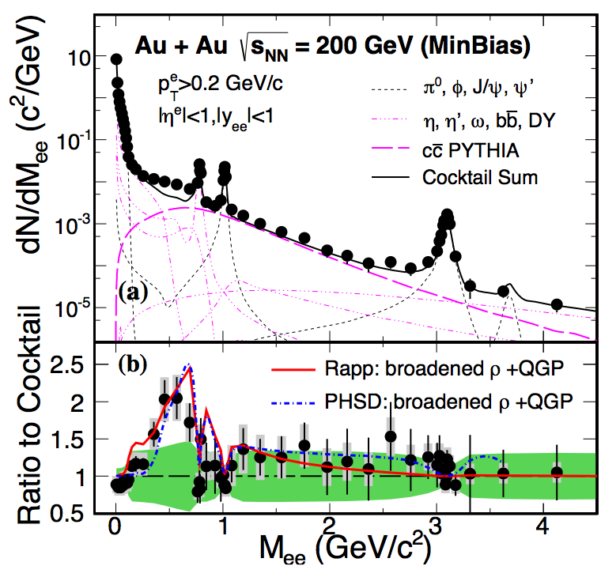
Dilepton In-medium Effect
Practical way of observing chiral symmetry restoration from dileptons:
disappearance of hadronic structure (vector meson peaks)
dissolve into continuous thermal distribution from LMR to IMR
Subtract charm contributions at IMR
Submitted to PRL, arXiv:1312.7397, Accepted for publication 06/10/2014
LMR
ρ→e⁺e⁻
πηφω
IMR
q‾q→l⁺l⁻
c→l
HMR
J/Ψ, DY, ϒ(1,2,3)

Slide 16
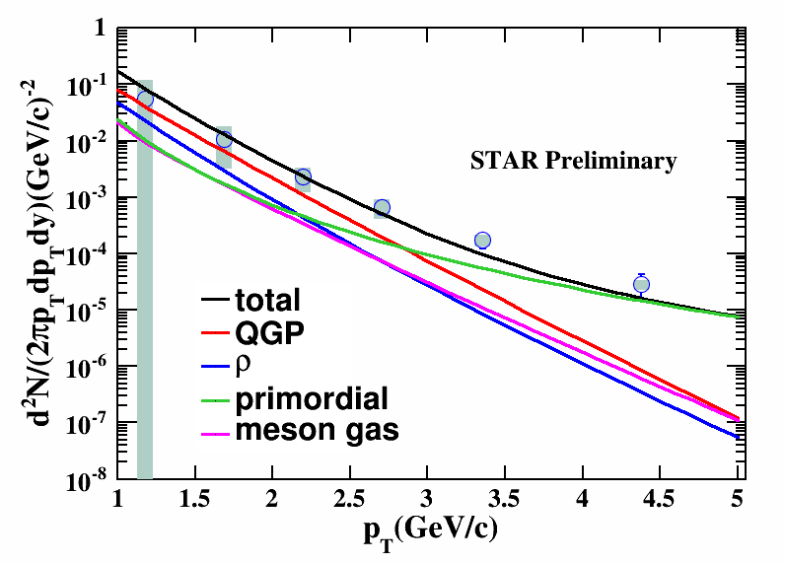
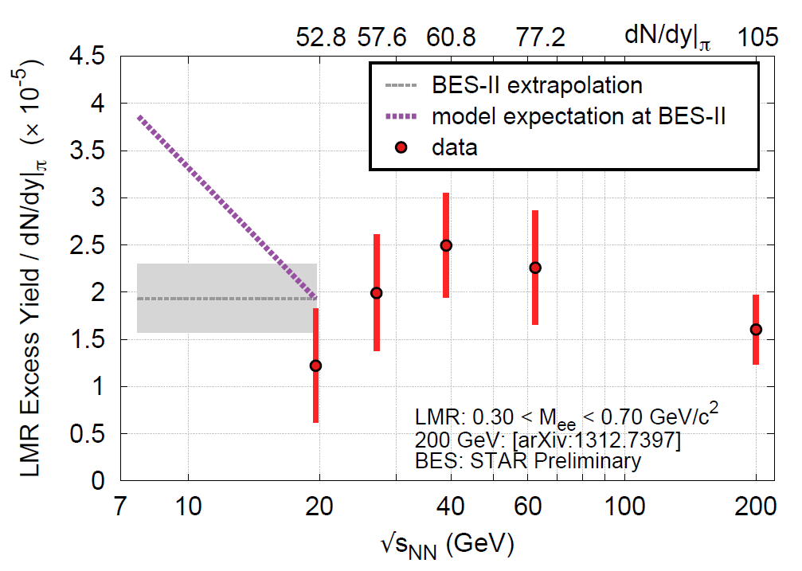
Quantify the spectral function
Temperature dependence of rho spectral function
Beam energy range where final state is similar
Initial state and temperature evolution different
Density dependence by Azimuthal dependence (v₂)
Use centrality dependence as another knob
Direct photon results should match with extrapolation
Baryon dependence of rho spectral function
1. LMR excess consistent with baryon density increase
Direct virtual photons
QM14: Chi Yang, Patrick Huck

Slide 17
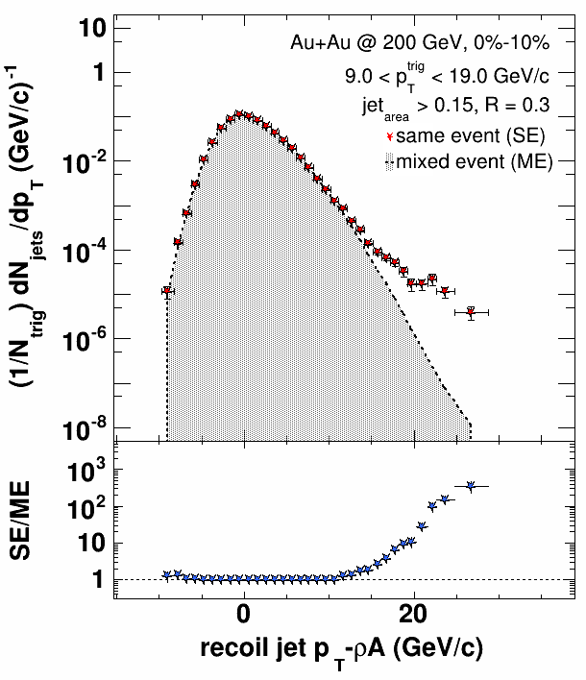
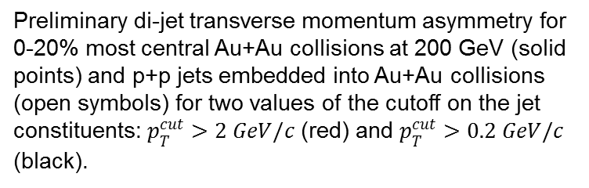
Recoil-jet/di-jet reconstruction
Preliminary di-jet transverse momentum asymmetry for 0-20% most central Au+Au collisions at 200 GeV (solid points) and p+p jets embedded into Au+Au collisions (open symbols) for two values of the cutoff on the jet constituents: $p_{T}^{cut}>2 GeV/c$ (red) and $p_{T}^{cut}>0.2 GeV/c$ (black).
QM2014: Joern Putschke

Slide 18
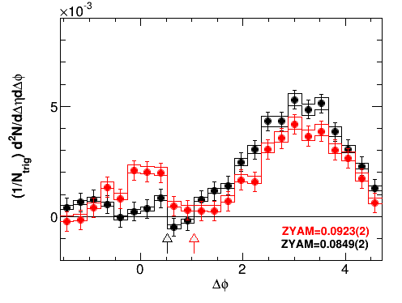
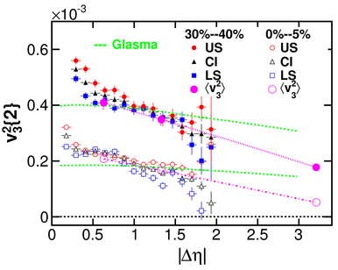
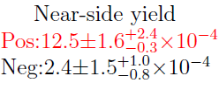
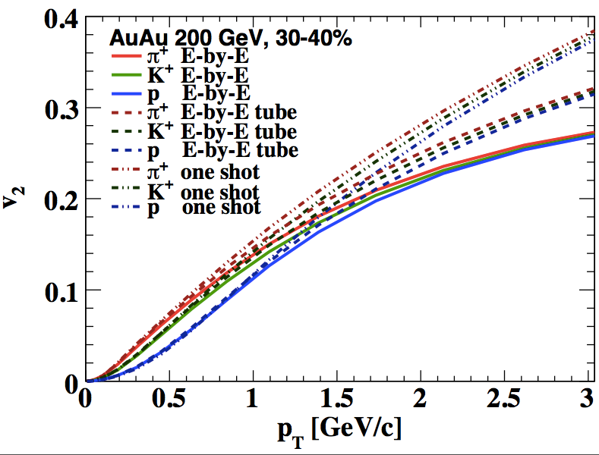
Longitudinal (η) Correlations
STAR Preliminary
ZDC 0-20%
d+Au
Saturation Effect
Flow in small collision systems
Effect of longitudinal fluctuation on constraining η/s
Effort in building a robust forward calorimeter
and tracking system (run16+)
Pang, Wang, XN Wang PRC (2012)
STAR, PRC (2013)

Slide 19
Run 14 Status and Highlights

Slide 20
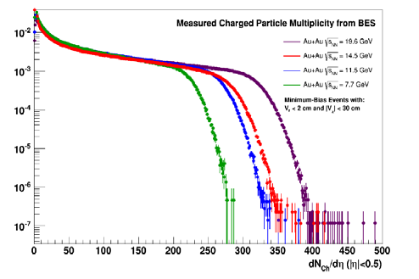
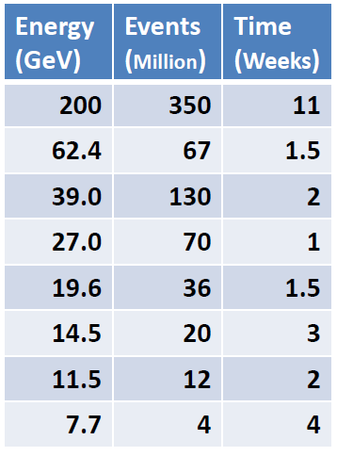
Status of run14: Au+Au@14.5GeV
Feb 13th: First Collisions
Feb 17th: Start Taking Data
Mar 11th: reach MB Goals
Mar 11th: 14.5 GeV run over
Acquired: 21 M mb VPD
See Dan Cebra’s talk and
backup slides for more details

Slide 21
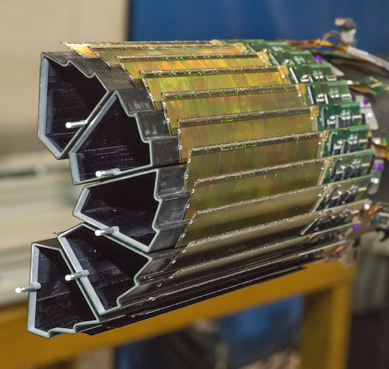
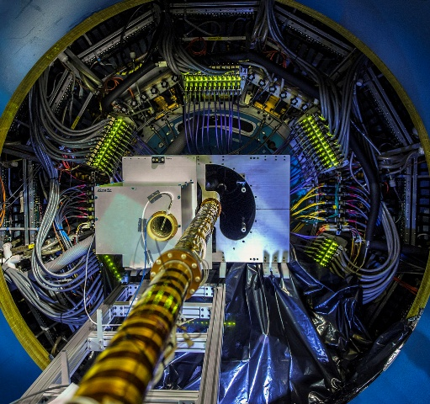
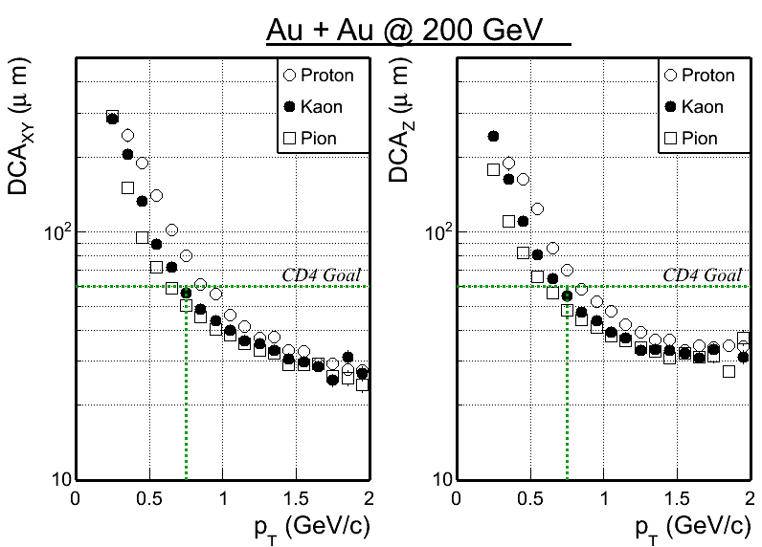
Status: Heavy Flavor Tracker
Heavy Flavor Tracker (HFT) Fully reconstruction of charm
hadron with displaced vertex
Physics goal: Precision measurement of heavy quark hadron production in heavy ion collisions
All 3 sub-detectors (PXL, IST, SSD) were completed, installed prior to Run14
PXL – heart of the HFT: state-of-art detector, MAPS technology, first time used at a collider experiment.
Taking data with STAR detector system, on track towards the physics goal
Reach Performance Requirement Goal:
With survey and preliminary alignment, Kaons at 750 MeV/c: DCA < 60μm
√s_{NN} = 200GeV Au+Au Collisions

Slide 22
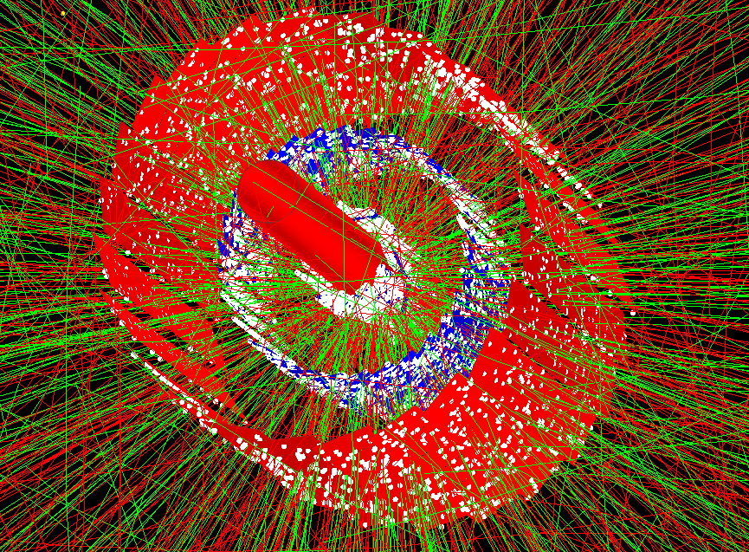
16cm

Slide 23

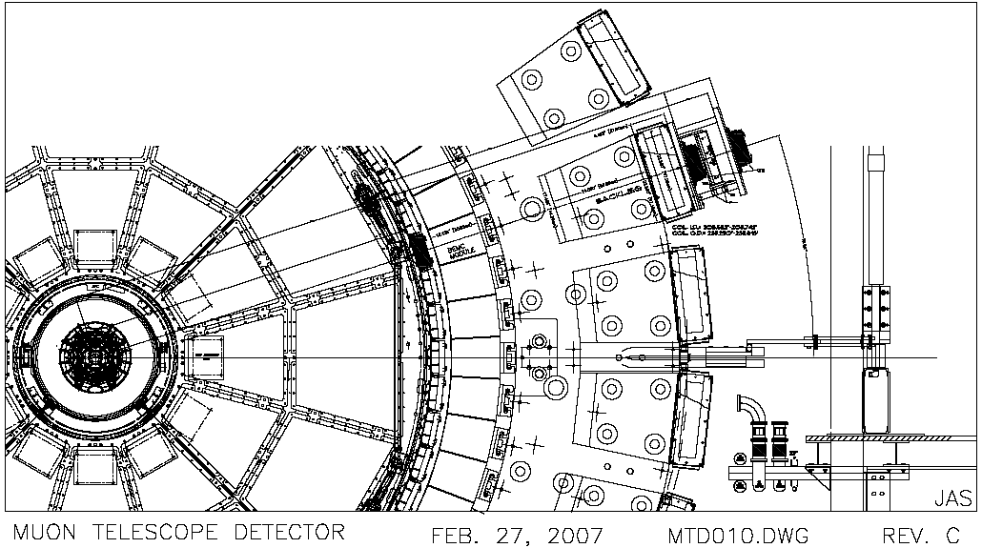
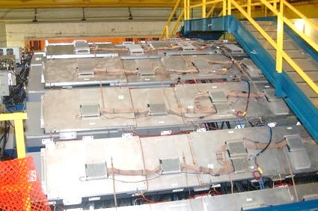
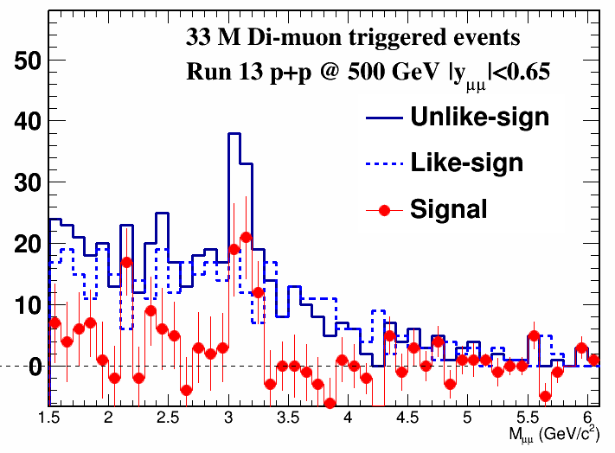
Status: Muon Telescope Detector
Beam pipe
HFT
TPC
TOF
EMC
Magnet
MTD
Muon Telescope Detector (MTD):
Physics goal: Heavy Quarkonia
MRPC technology; covers ~45%
azimuthally and |y| < 0.5
3) Fully installed in Run14: on track for
sampling 10nb⁻¹ in 200GeV Au+Au
for quarkonium physics

Slide 24
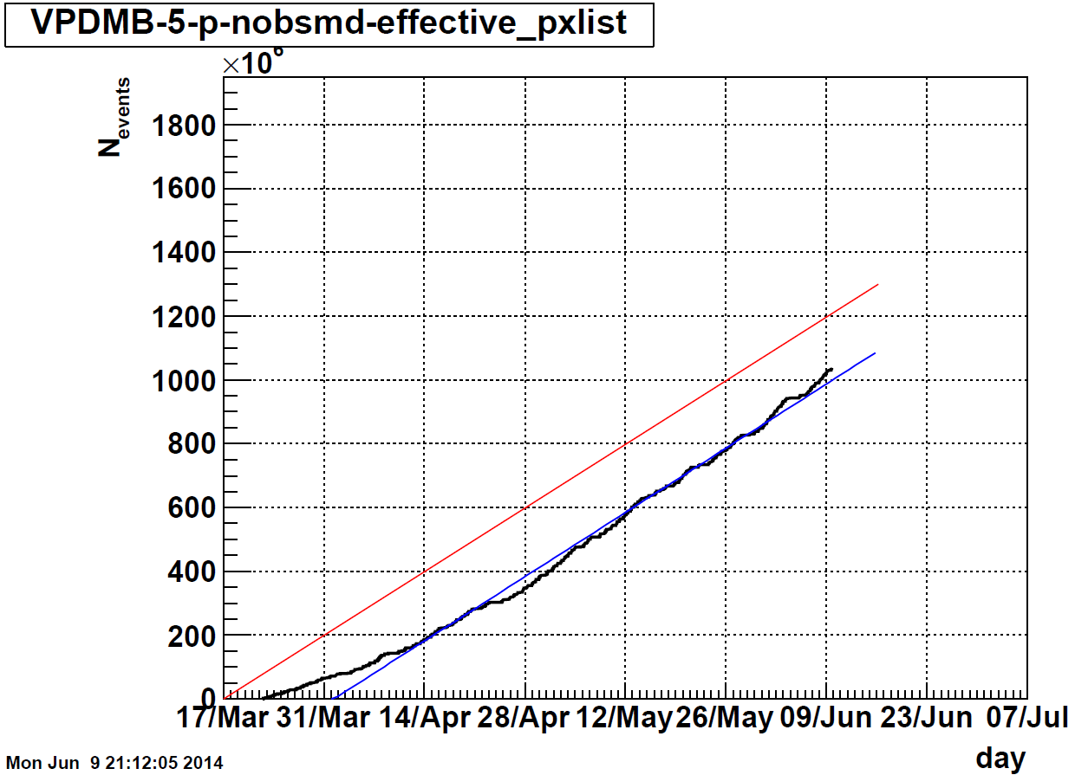
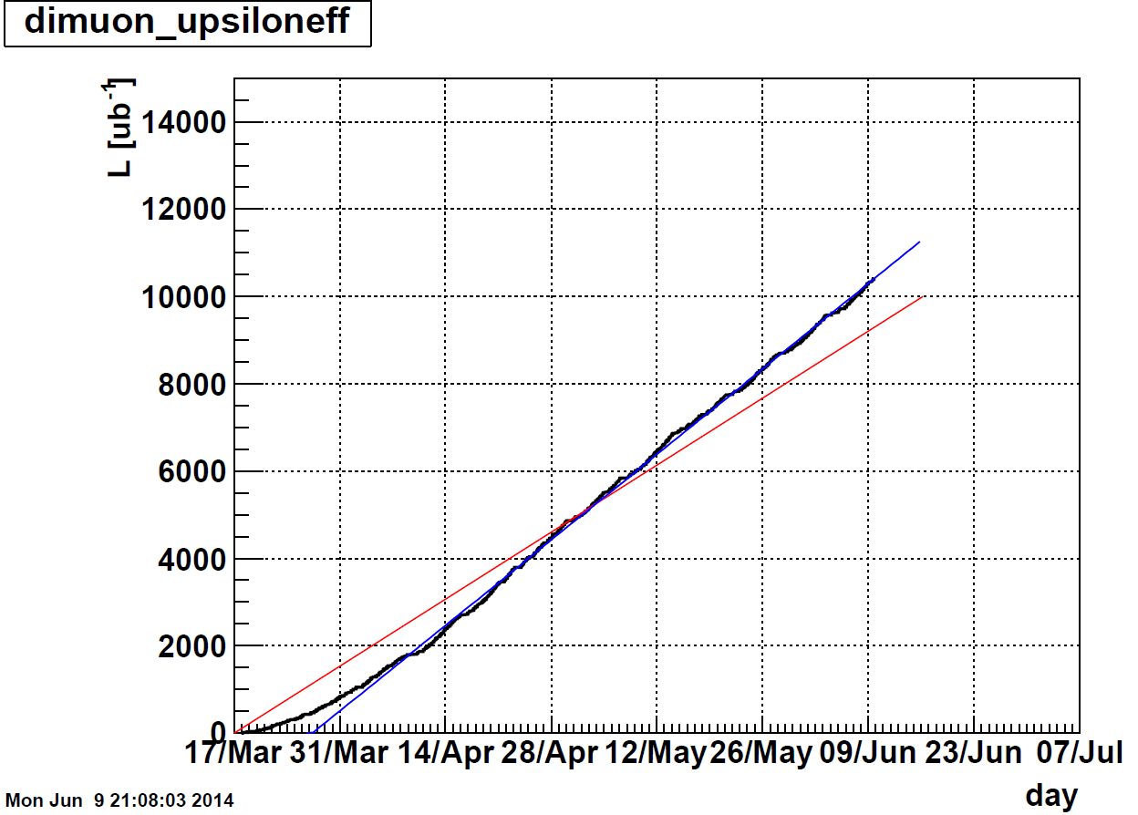
Dataset status and projections
HFT minbias goal
MTD dimuon goal
Excellent RHIC Machine Performance
Reach our integrated Luminosity goal for run14
  10nb⁻¹ from run14
  20nb⁻¹ two-year MTD goal for Upsilon
Toward our Minbias Dataset goal
  1 billion minbias from run14
  2 billion minbias from run16

Slide 25
Run 15-16 Heavy-Ion Program BUR and Projections

Slide 26
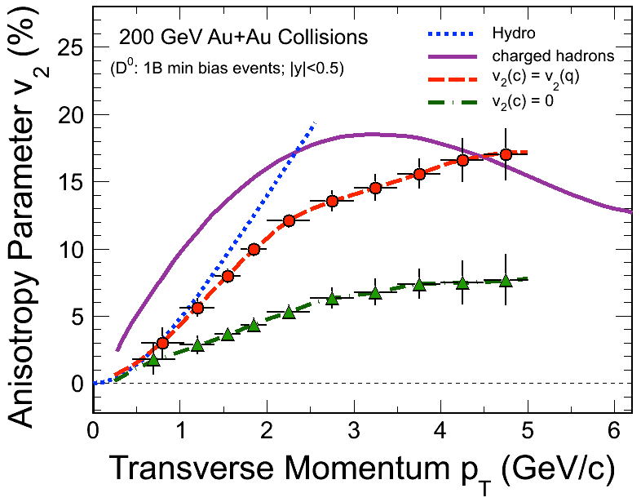
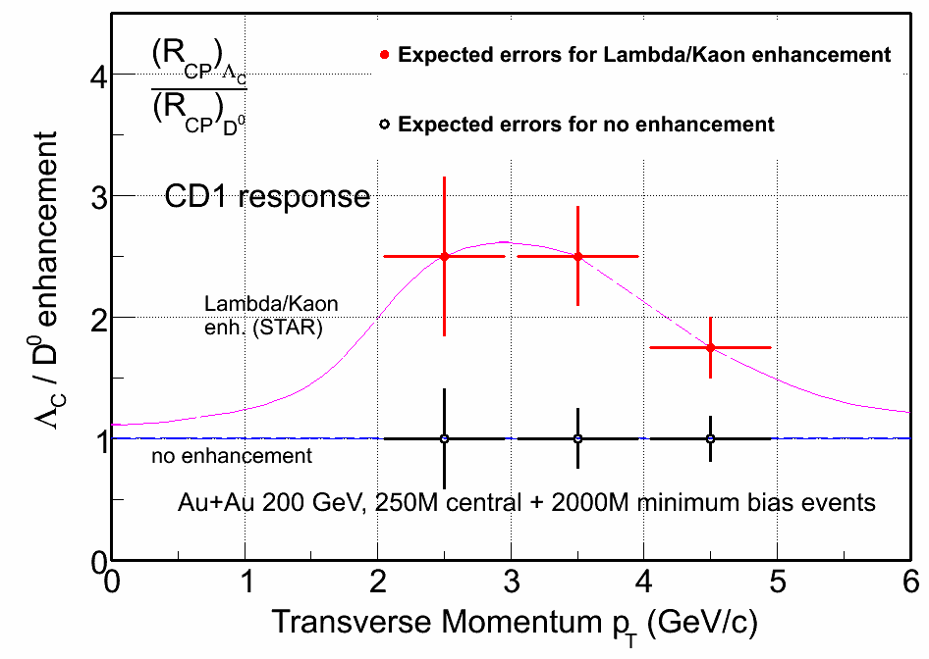
Open charm flow and coalescence
HFT Projection for Au+Au run14 + run16
Quantify charm quark flow and coalescence

Slide 27
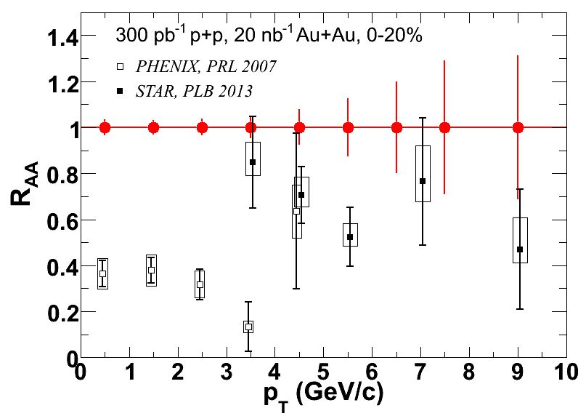
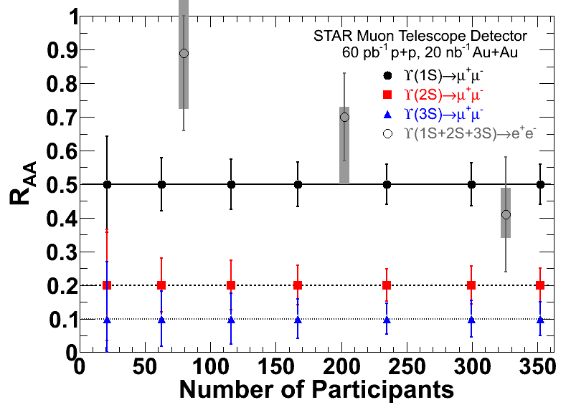
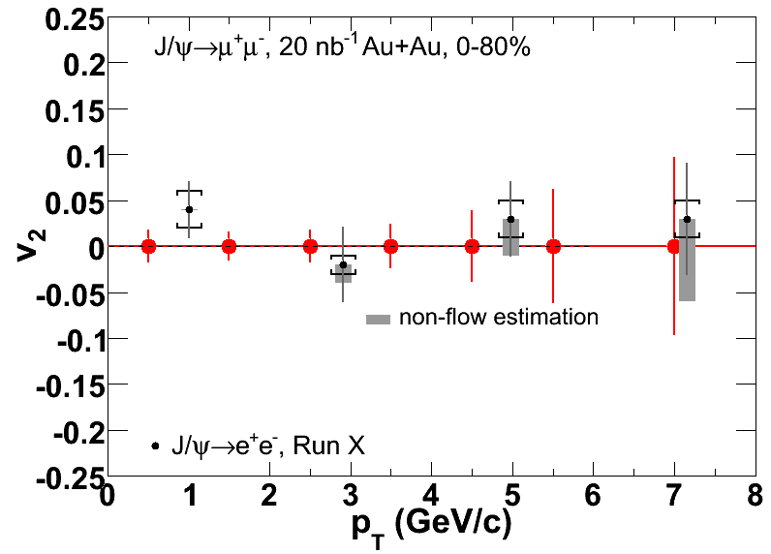
Run14+16 Quarkonium Measurements
MTD: Improves statistical uncertainty
As well as systematic uncertainty
Separate Upsilon states
MTD+HFT: B→J/ψ, J/ψ-D …

Slide 28
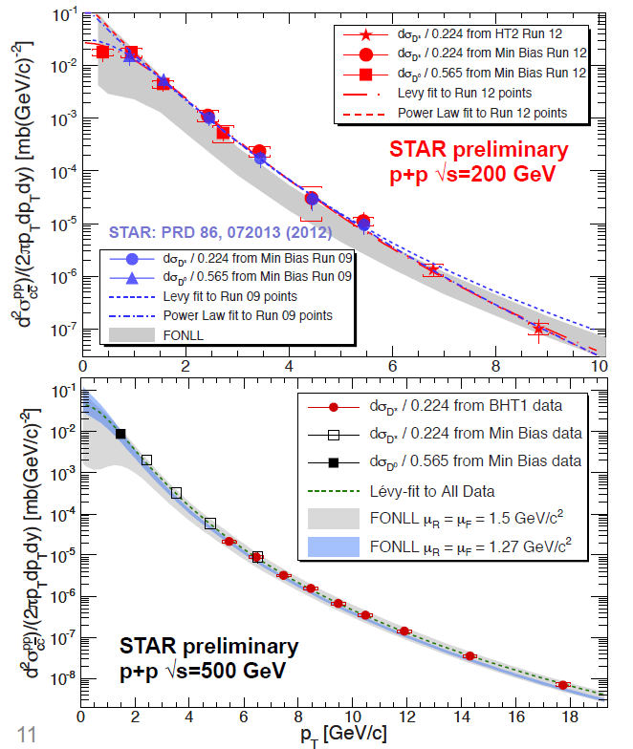
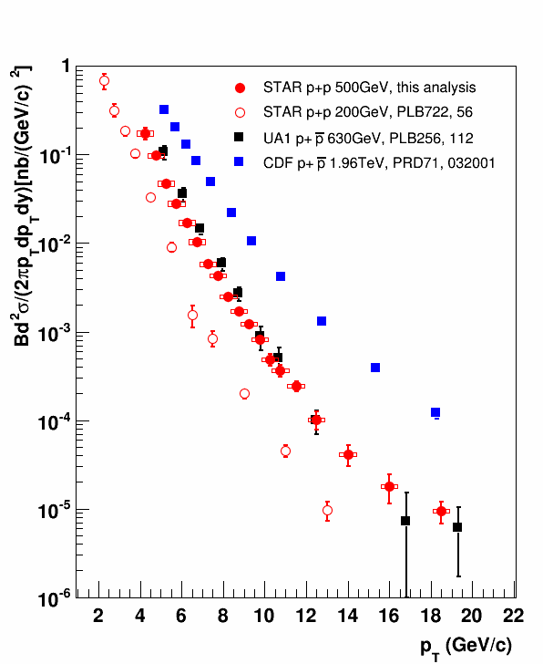
Establishing good reference in p+p
STAR Preliminary
Amazing reach with current detector;
Cannot wait to see what we can do with HFT+MTD

Slide 29

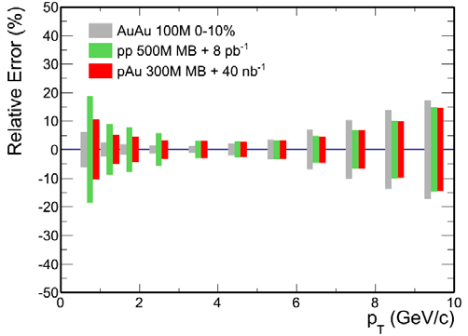


Baseline p+p Measurements for HI
D⁰ from HFT
Quarkonia from MTD
arXiv:1308.4720, PRC2013
12 weeks of p+p 200
5 weeks of p+Au 200
Full HFT

Slide 30
Spin Program Highlights

Slide 31



Spin Program Highlights and Upgrades
Roman Pot
FMS+preshower

Slide 32


Longitudinal A_{L} of W± and A_{LL} of jets
Provide best constraints on Sea-quark and Gluon Polarizations
Submitted to PRL
arXiv: 1404.6880
arXiv:1405.5134

Slide 33

Transverse Polarization Measurements
kinematic and dynamical effects that are directly sensitive to
quark transversity and partonic motion within the proton.
A_{N} decreases with increased jettiness of the event; Possible diffractive nature.
run15 Roman Pot Upgrade critical to the program
The only non-zero A_{N} measurements at mid-rapidity
Interference fragmentation Function

Slide 34
Run 15 Spin Program BUR and Projections

Slide 35

Longitudinal Spin run15 Projections
The improvement of the χ² profile for the integrated gluon contribution in the x region currently probed at RHIC for √s = 200 GeV (DSSV fit).
And projections with existing and proposed datasets
6 weeks of longitudinally
polarized Study Δg(x)
L=50 pb⁻¹, 60% pol.

Slide 36


Run15 Transverse Spin Goals
6 weeks of transversely polarized:
Study transversity, Sivers effects
L=40 pb⁻¹, 60% pol.
Track matching FMS/PS1,2
$n_{cluster}=1$ (above 1 GeV)
$$E_{cl}>15.0 \text{GeV}$$
$$p_{T} > 2.0 \text{GeV}$$
For systematic uncertainty:
$$A_{N}\left(π^{0},η\right)≈{max⁡(A}_{N}(π^{0}))$$
Preshower for FMS:
photon_survival ≥ 0.98
hadron_survival ≤ 0.02

Slide 37


Heavy-Ion meets Spin (run15)
5 weeks
Polarized p+Au
L=300nb⁻¹
Saturation physics,
pA-ridge
Cold Nuclear Effect
GPD gluon (pre-EIC)
π⁰
Au
Au’
Upgrades for run15:
Roman-Pot Phase II
(move RP closer)
Refurbish FMS
FMS pre-shower
Forward Instrumentation (proton in BLUE)
p
p’

Slide 38
Run 16 Spin Program BUR and Projections

Slide 39


LRP Spin Goals (run16)
A_{N} of W±,γ, DY in pp 510
All three measurements are sensitive to the famous sign-change!
STAR can access to all three world-class measurements
Discovery Potential before 2020

Slide 40

Transversely polarized p+p 510 (run16)
DIS2014
Proof of Principle
2011 pp510 transverse data,
L=25pb⁻¹
Uncharted Territory

Slide 41


Direct Photon A_{N} (run16)

Slide 42
Run 15-16 Detector Upgrades and Improvements

Slide 43

FMS with pre-shower for run15
FMS pre-shower:
scintillators with Pb convertor and SiPM readout
Run16 for direct photon and DY: + post-shower for hadron rejections
Issues need to look into: radiation hardness, Heavy-Ion Program

Slide 44



Roman Pot Phase II* (run15)
Will allow taking data without special accelerator conditions,
as recommended by the PAC.
Requires new vacuum chamber in DX-D0 region.
Uses Roman Pot system and detectors of pp2pp.
We are utilizing shops
at Yale and Creighton to reduce
cost and to help the schedule.
Polish collab. are contributing
part of the electronics.

Slide 45

Run16 Detector Improvements
HFT = PXL+IST+SSD
The detector installed currently is built with
Cu-Cable expect for two inner ladders with thin
Al cable
Online Vertex Resolution improvement with new
QT electronics
Figure of Merit x6 over run14

Slide 46





Option 2 (run16) with pixelized E864 HCAL
HI: Centrality, Reaction Plane, eta-correlation
pp/pA: Lambda, Di-jet, photon, DY
Each (10 cm)² cell has (47x47) scintillating fibers embeded in lead
As a SPACAL, it has an excellent electromagnetic response ( δE/E < 10% / √E )
A test is in progress to pixelize cells
⇒ better resolution for π⁰→γγ
Propose to pixelize a forward HCal for 2016
10 cm

Slide 47



STAR Long-Term Plan
https://drupal.star.bnl.gov/STAR/starnotes/public/sn0592

Slide 48

Conclusions
STAR/RHIC high-impact science with state-of-the-art detectors and ever-increasing luminosity and machine versatility.
Run 15:
  crucial references in p+p and p+Au for HI
  Transversity and Gluon Spin Contribution
  Novel probe of saturation using Uniquely polarized p+Au
Run 16:
  Quantify heavy-flavor flow, thermalization, energy loss and color screening.
  Explore potential discovery of QCD predicted A_{N} relation between p+p and DIS.
Incremental Detector Upgrades:
Run15:
Refurbishing FMS
FMS Pre-shower
Roman Pot Phase II*
Run16:
HFT PXL with Al Cable
VPD with new Online QT
Forward Calorimeter Options

Slide 49


Executive Summary

