Slide 1
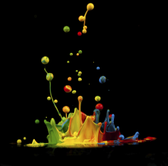
PHENIX Beam Use Proposal
Run-15 and Run-16
Jamie Nagle
for the PHENIX Collaboration
Taking maximal advantage of RHIC
uniqueness and versatility
Utilizing new detector capabilities
Following up on surprising
new observations

Slide 2
Outline
Brief highlights of a few recent accomplishments
Run-14 Au+Au data taking status
Run-15 Beam Use Request
Run-16 Beam Use Request

Slide 3
Brief highlights of a few recent accomplishments

Slide 4
Scientific Paradigm (Shift)
A+A
Enough particles to equilibrate, QGP, collective motion
p+A
Not enough particles to equilibrate, control experiment (?)

Slide 5
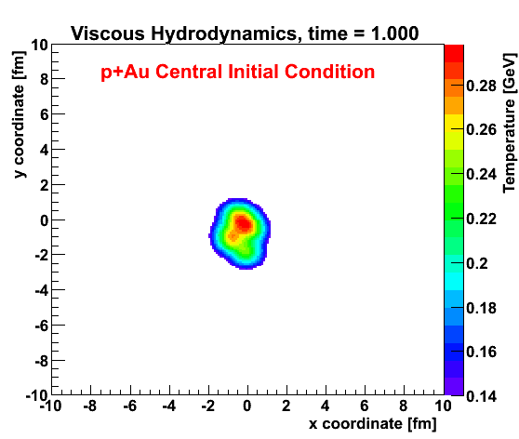
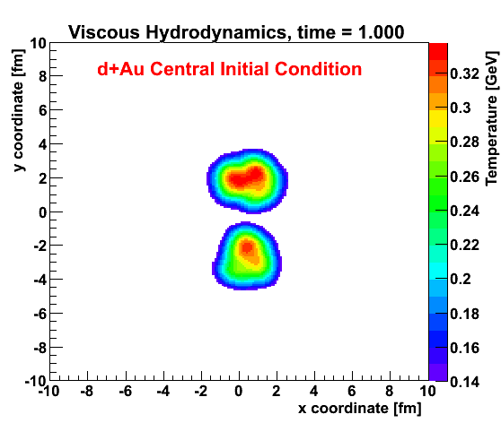
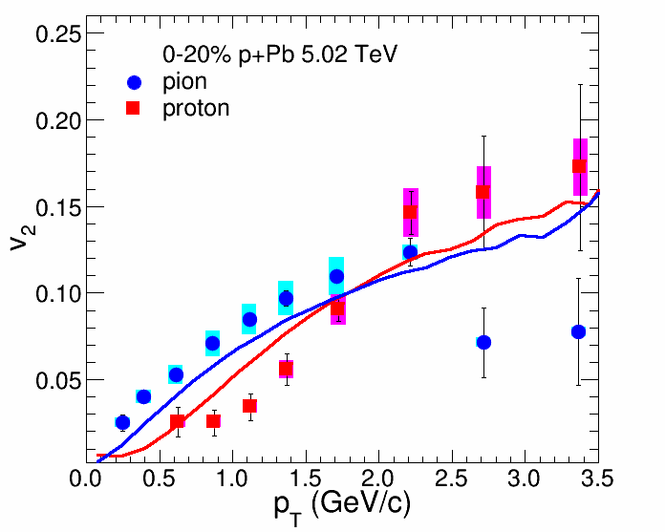
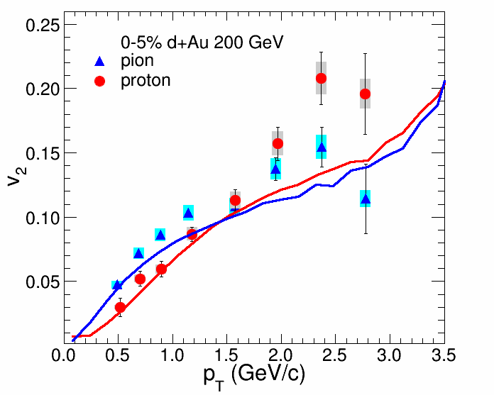
Viscous Hydrodynamics + Cascade
Similar Flow Fingerprint?
Small QGP?
ALICE Experiment
p+Pb @ LHC
PHENIX
d+Au @ RHIC
arXiv:1404.7461

Slide 6
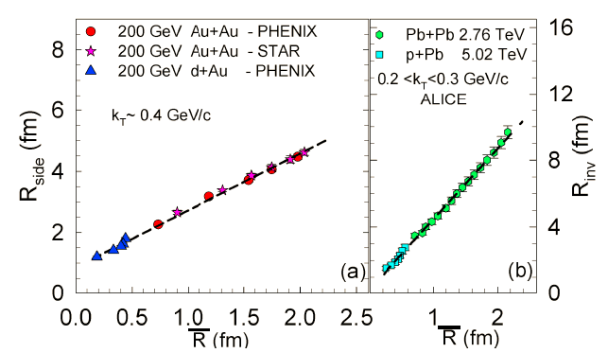
HBT Source Size in d+Au
arXiv:1404.5291
Smooth trend of final size with initial geometry
p(d)+A central has smaller initial size than A+A peripheral

Slide 7
Charm electrons in d+Au

Slide 8
Charm Flow in d+Au (?)

Slide 9
J/ψ in Cu+Au

Slide 10
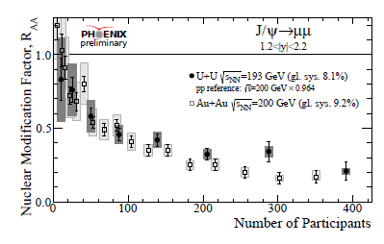
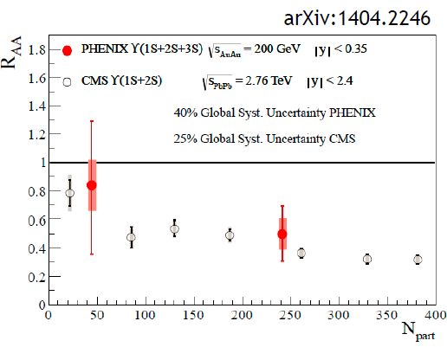
J/ψ in U+U and Upsilon in Au+Au
J/ψ in U+U
Similar trend to Au+Au results
Υ(1s,2s,3s) in Au+Au
Within uncertainties
same pattern as CMS at LHC
and melting of 2s and 3s

Slide 11
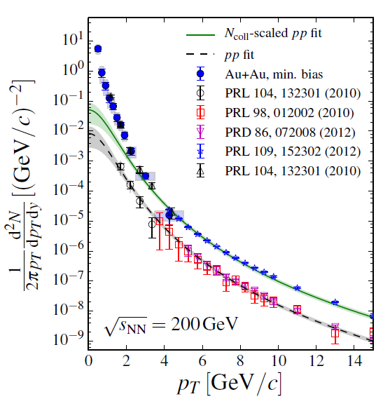
Precision Direct Photons in Au+Au
arXiv:1405.3940
Method using conversion of real photons
Confirms published result with virtual photons
Extends low p_{T} reach, centrality, and precision

Slide 12
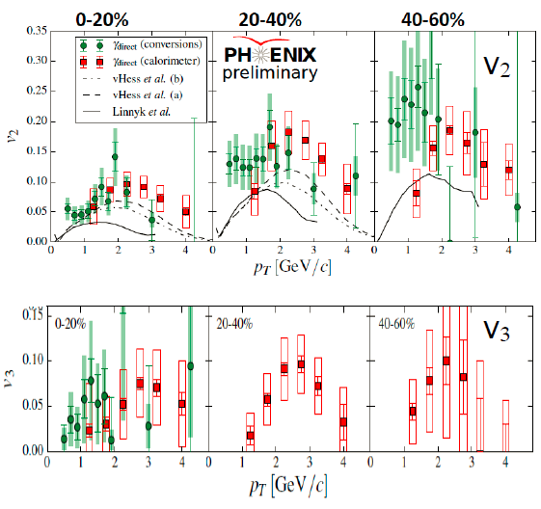
v₂ and v₃ of Direct Photons
Two new analysis methods indicate large v₂ for direct photons and also first measure of v₃
Attempts to reconcile with theory assume much stronger coupled QGP near T_{c} (e.g. Rapp et al.)
Exotic mechanisms too (B field)

Slide 13
Real Photons, Virtual Photons, Dark Photons (?)
Muon g-2 experiment (E821) has 3.6σ
result beyond the Standard Model
One explanation is the dark photon –
Low mass, weak coupling
PHENIX has excellent dark photon search capabilities
No dark photon signal seen
Our upper limit, plus others
Nearly rules out dark
Photons as g-2 explanation

Slide 14
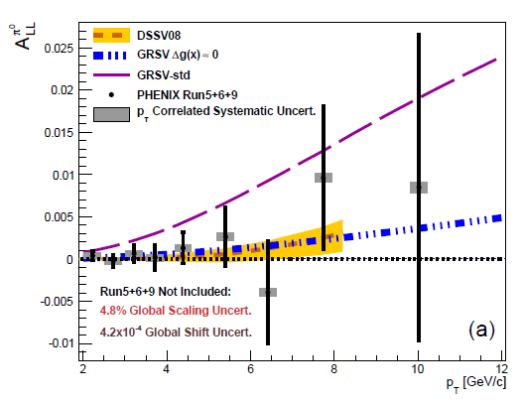
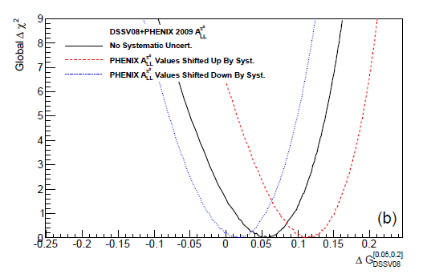
Spin Results
arXiv:1402.6296
Final neutral meson double spin asymmetry results submitted
Constraint on lower-x gluon spin contribution
Highlights that global theory fits need to include systematics

Slide 15
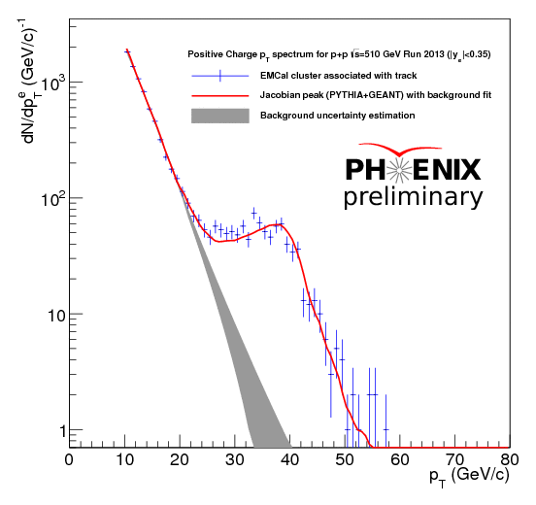
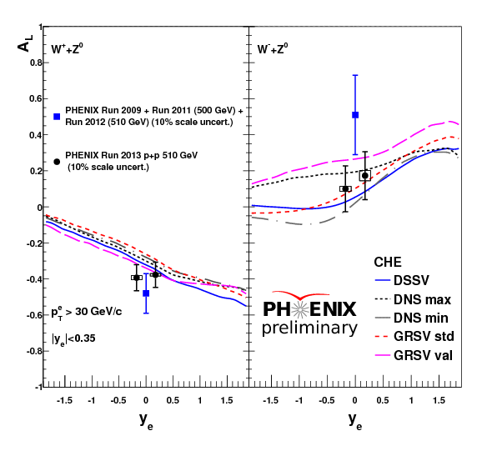
W Analysis Update
Full Run-13 p+p @ 500 GeV data set production complete
Preliminary W→e result show with full statistics, paper soon
Focused effort of forward W→μ results for final result

Slide 16
21 PHENIX Papers Submitted in Last 12 Months
1.Cross section for bb¯ production via dielectrons in d+Au collisions at sNN−−−√=200 GeV
2.Low-mass vector-meson production at forward rapidity in p+p collisions at s√=200 GeV
3.Centrality dependence of low-momentum direct-photon production in Au+Au collisions at sNN−−−√=200 GeV
4.Measurement of K0S and K∗0 in p+p, d+Au, and Cu+Cu collisions at sNN−−−√=200 GeV
5.Heavy-quark production and elliptic flow in Au+Au collisions at sNN−−−√=62.4 GeV
6.Measurement of long-range angular correlation and quadrupole anisotropy of pions and (anti)protons in central d+Au collisions at sNN−−−√=200 GeV
7.Comparison of the space-time extent of the emission source in d+Au and Au+Au collisions at sNN−−−−√=200 GeV
9.Measurement of Υ(1S+2S+3S) production in p+p and Au+Au collisions at sNN−−−√=200 GeV
10.Nuclear matter effects on J/ψ production in asymmetric Cu+Au collisions at sNN−−−√ = 200 GeV
11.Inclusive double-helicity asymmetries in neutral pion and eta meson production in p⃗ +p⃗ collisions at s√=200 GeV
12.Concept for an Electron Ion Collider (EIC) detector built around the BaBar solenoid
13.Azimuthal-angle dependence of charged-pion-interferometry measurements with respect to 2nd- and 3rd-order event planes in Au+Au collisions at sNN−−−√=200 GeV
14.Transverse-energy distributions at midrapidity in p+p, d+Au, and Au+Au collisions at sNN−−−√=62.4--200~GeV and implications for particle-production models
15.Measurement of transverse-single-spin asymmetries for midrapidity and forward-rapidity production of hadrons in polarized p+p collisions at s√=200 and 62.4 GeV
16.Heavy-flavor electron-muon correlations in p+p and d+Au collisions at sNN−−−√ = 200 GeV
17.System-size dependence of open-heavy-flavor production in nucleus-nucleus collisions at sNN−−−√=200 GeV
18.Centrality categorization for R_{p(d)+A} in high-energy collisions
19.Cold-nuclear-matter effects on heavy-quark production at forward and backward rapidity in d+Au collisions at sNN−−−−√=200 GeV
20.Azimuthal anisotropy of pi^0 and eta mesons in Au+Au collisions at sqrt(s_NN)=200 GeV
21. Cross Section and Transverse Single Spin Asymmetry of $\eta$ Mesons in $p^{\uparrow}+p$ collisions at $\sqrt{s}$\,=\,200~GeV at Forward Rapidity

Slide 17
Run-14 Au+Au
data taking status

Slide 18
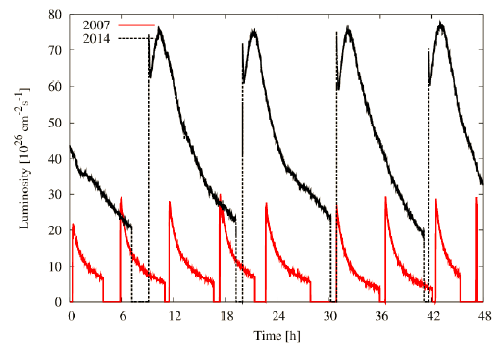
Run-14 Fantastic RHIC Performance!

Slide 19
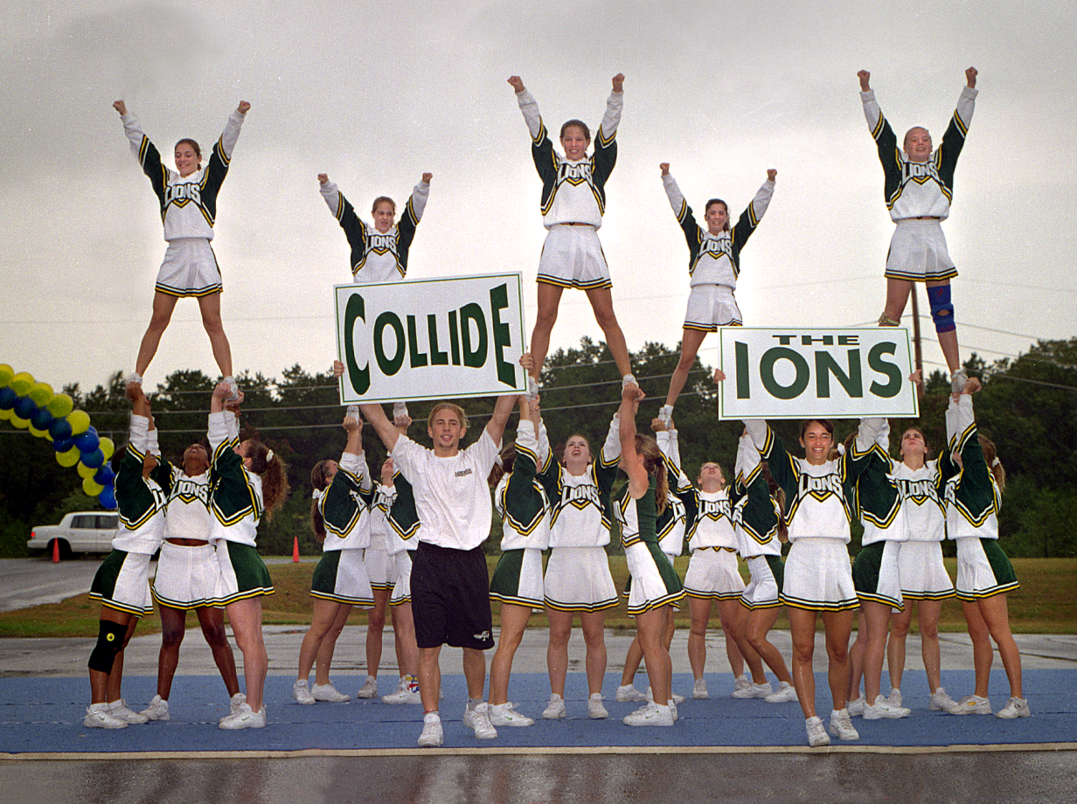
End of Run-0 Celebration (1999)
Stochastic
Cooling
Imagined Run-14 Celebration (2014)

Slide 20
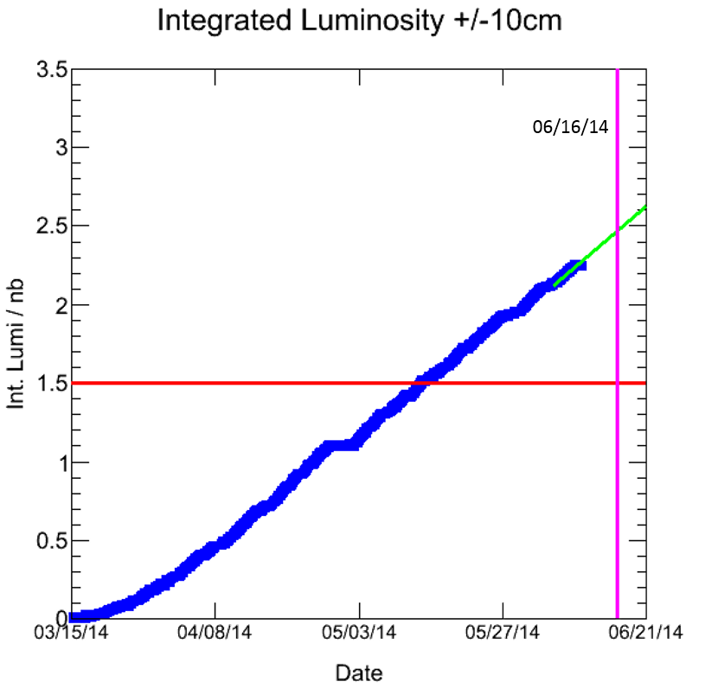
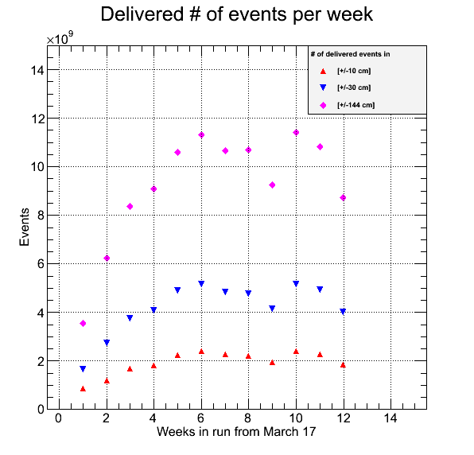
Steady Beam Week-after-Week!
Our goal was 1.5 nb⁻¹ within |z|< 10 cm.
Achieved earlier and now exceeded by 55%
Very quick ramp up, PHENIX uptime > 80%

Slide 21
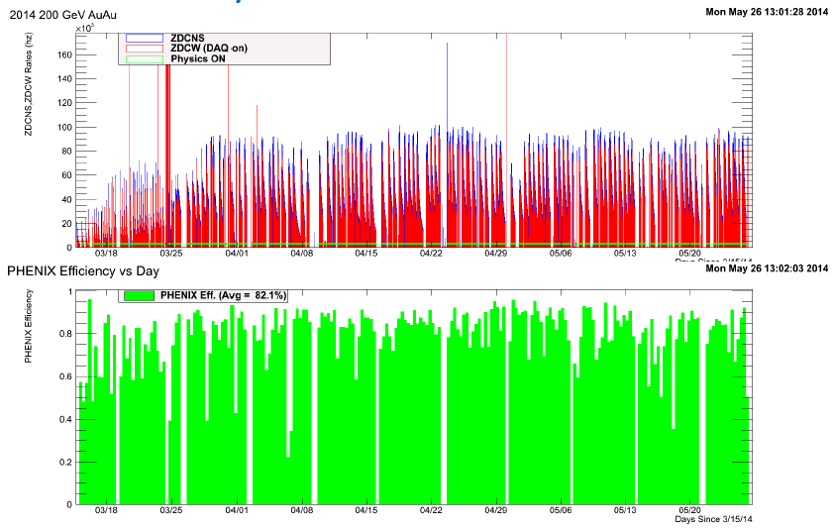
PHENIX Performance in Run-14
Overall very stable PHENIX detector and running
Stable long stores are a major contributing factor
Special Thanks to our Run Coordinator Klaus Dehmelt!

Slide 22
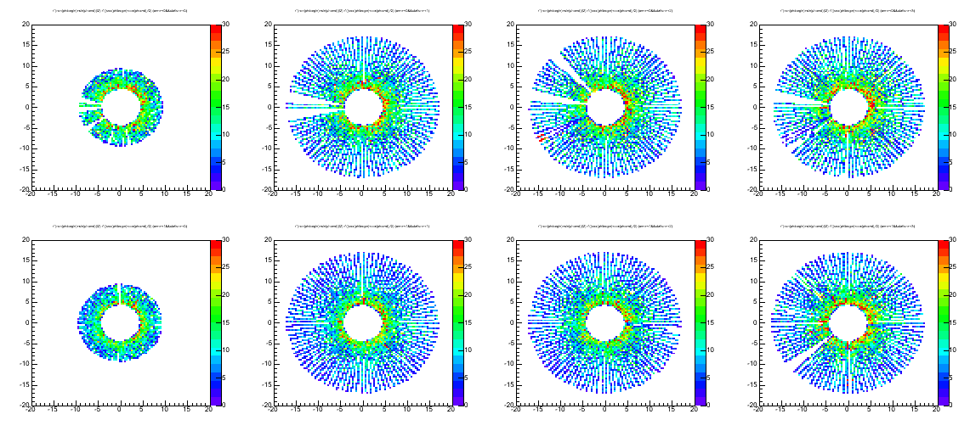
PHENIX Forward Silicon (FVTX)
DCA Analysis from
Run-12 data
Detector meeting resolution specifications
arXiv:1311.3594 (accepted NIM)
South Reconstructed Coords Per Station
FVTX Run-14
Live > 95%
Internal alignment
within 4 μm
North Reconstructed Coords Per Station

Slide 23
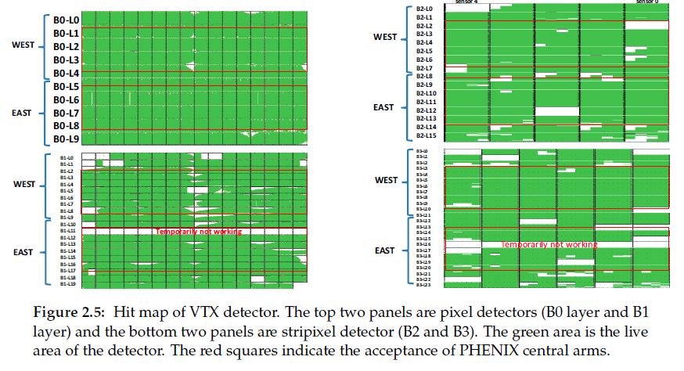
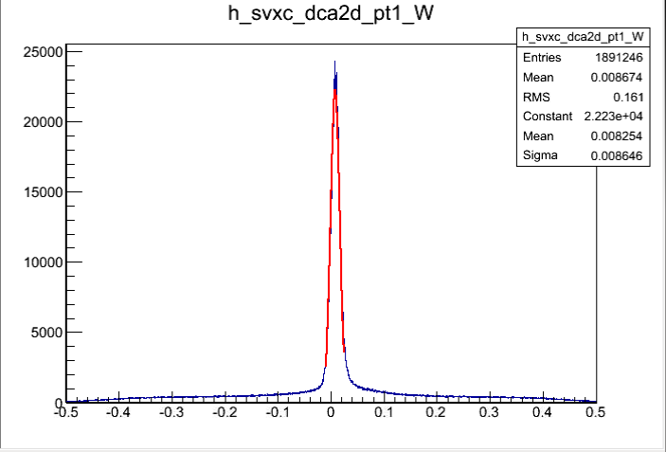
PHENIX Barrel Silicon (VTX)
Run-14
Repairs successful
Pixel Live > 80%, Very Stable
Strip-pixel > 85%
DCA Resolution from Run-14 alignment already exceeds
100 μm specification
Full VTX / FVTX alignment with MILLIPED underway
Run-14 Au+Au
Distance Closest Approach 2D
σ=86μm

Slide 24
Run-15 and Run-16
Beam Use Requests

Slide 25
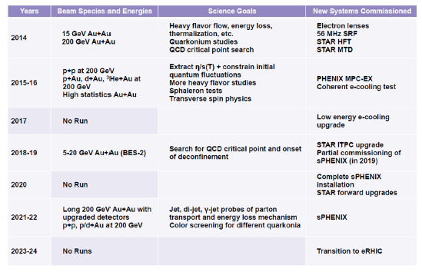
Brookhaven Lab Timeline
Plan to remove PHENIX after
Run-16 for installation of sPHENIX
Run-14/15/16: Thinking in terms of definitive measurements
(not hints to return to later)

Slide 26
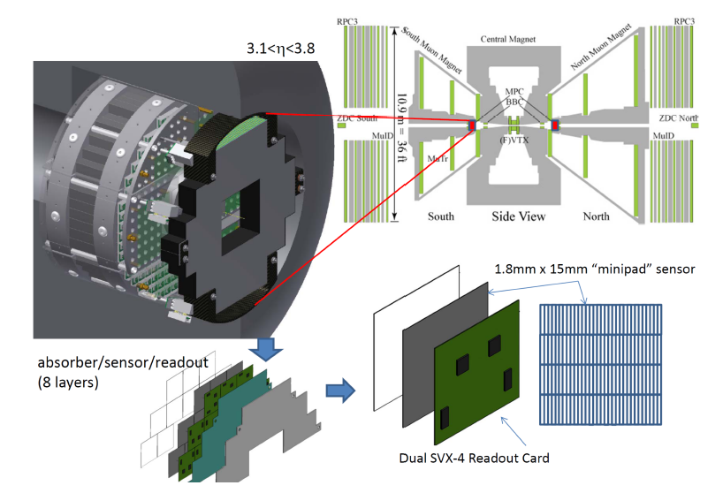
MPC-EX Upgrade
The PHENIX MPC Crystal Calorimeter (|η|=3.1-3.8) has played a critical role in our forward (low-x) and transverse spin physics program
MPC-EX upgrade adds novel silicon tracking / preshower detector to enable direct photon identification and π⁰→γγ to higher momentum
Beam test in fall, and section installed for integration tests in Run-14
Full detector available for physics in Run-15

Slide 27
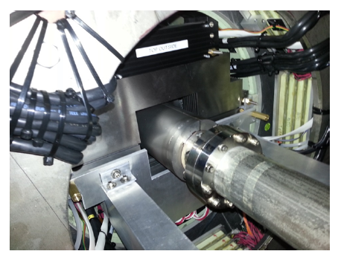
MPC-EX Section in Situ

Slide 28
The “Wiggler”
Coherent electron Cooling (CeC) test is key for EIC
The Coherent electron Cooling Proof-of-Principle project was planning to install the electron beam line including the undulator in IP2 this summer for first beam tests during RHIC Run-15. We are also planning to run pA during Run-15 and this asymmetric configuration limits the available aperture in the undulator.
We are now proposing to set up the electron beam line parallel to the RHIC IR but separate from RHIC to avoid this potential interference. All the tests on the electron beam can still be completed. During the summer of 2015 the undulator section would then be moved parallel to itself into the RHIC beam for the full cooling tests during Run-16. For this to work we would need your agreement to schedule only symmetric RHIC beam configurations during Run-16.
Thus we have not proposed any p+A running in Run-16.
That said, the MPC-EX physics program provides crucial new measurements and we should not prematurely decide that all p+A physics must come from only Run-15.

Slide 29
What did the PAC (you) say last year?
http://www.bnl.gov/npp/docs/Pac0613/recommendations_0613_final.pdf

Slide 30
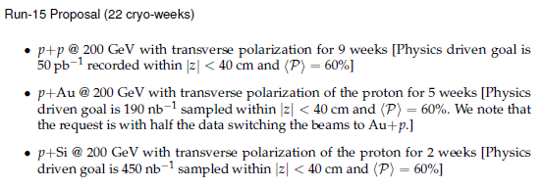
PHENIX Run-15 Request
Note that not utilizing additional collision combinations diminishes total knowledge gain and does not fully exploit the uniqueness of RHIC

Slide 31
Transverse Spin Physics
Single spin asymmetries A_{N} in transversely polarized p+p collisions may contain key information on the parton’s transverse motion in the transversely polarized proton
(i.e. language already hinting at orbital angular motion)
Different theoretical approaches
(TMD factorization and Collinear twist-three factorization)
TMDs include Sivers and Collins functions
Direct photon A_{N} is an excellent clean test
almost exclusively sensitive to Sivers
Also, good measure of twist-three quark-gluon correlator T_{q,F}

Slide 32
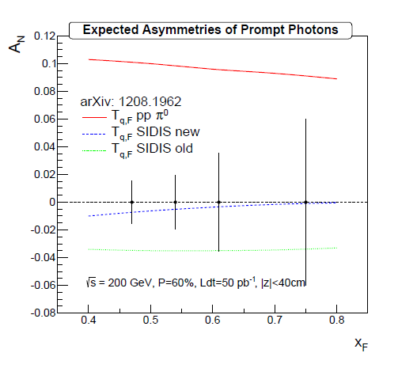
p+p (transverse pol.) @ 200 GeV for 9 weeks
(50 pb⁻¹ |z|<40cm)
Utilize unique capabilities of MPC-EX upgrade
Direct photon with no final state interactions
Uncertainties clearly resolve sign disagreement for T_{q,F}

Slide 33
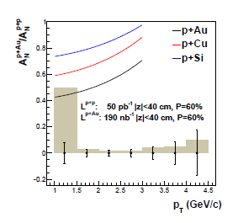
p+Au with transversely polarized proton
New theory developments… Transverse polarization A_{N} in p+A scales with the saturation scale for p_{T} < Q_{s}
Completely unique RHIC access to saturation physics
p+Au measurement with projected uncertainties in
190 nb⁻¹ |z|<40cm
Testing geometric scaling with Si target nuclei
Comparable uncertainties with 2 week runs

Slide 34
Constraining Gluon nPDFs
Strong indications of low-x shadowing/saturation physics with d+Au J/ψ, e-μ correlations, h-h correlations, single muons, electrons, …
And yet, all have final state interactions.
Golden channel direct photon
MPC-EX Direct Photon
Gluon nPDF
Au Nucleus
Using full statistical / systematic constraint method on EPS09 nPDFs, blue bands indicate projected measurement (1, 2 σ level)

Slide 35
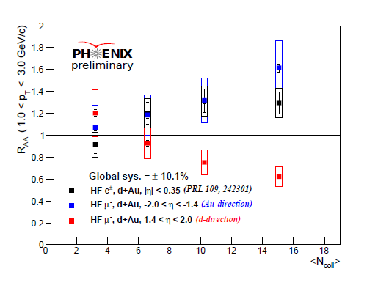
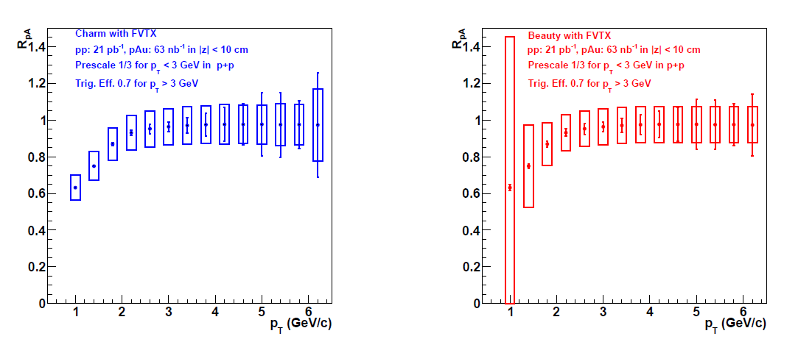
Open Heavy Flavor Probes of nPDFs and More
Another handle on gluon nPDF
and critical baseline for quarkonia
Measure open charm and beauty at forward/backward rapidity with FVTX
We request p+Au and Au+p for systematic checks (a la LHC p+Pb)?
Anti-shadowing?
Gluon
Saturation?
Charm
Beauty

Slide 36
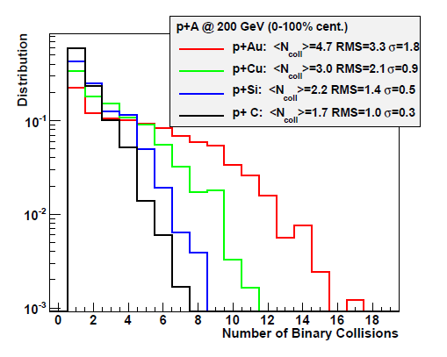
Geometry Test
DIS measures give geometry averaged nPDF
Utilized d+Au centrality measures to date…
Excellent opportunity to validate with direct photons nPDF of different nuclei

Slide 37
Quarkonia in Medium (Cold or Hot)
J/ψ and ψ’ are hard to explain w/ nPDF & σ_{breakup}
Instead of d+Au centrality selection, another method to change nuclear density is with different targets
Also combined with improved S/B and for the first time ψ’ at forward and backward rapidity (FVTX)

Slide 38
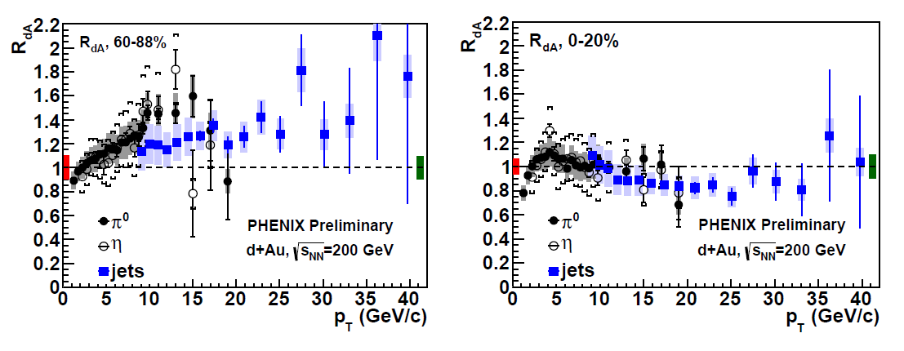
Cracking the Geometry Code
Are there competing partonic effects at play at high p_{T}?
Are there auto-correlations beyond those accounted for between centrality measure and particle of interest?
2 weeks of p+Si gives <N_{coll}> ~ (d+Au 60-88% central), better statistical precision, and no centrality categorization required

Slide 39
RHIC / LHC Physics Connection
ATLAS in p+Pb also observes enhancement in peripheral and suppression central
Scaling trend with jet Energy
Fluctuating proton size/shape and auto-correlations (?)
RHIC is uniquely position to test peripheral enhancement with p+Si

Slide 40
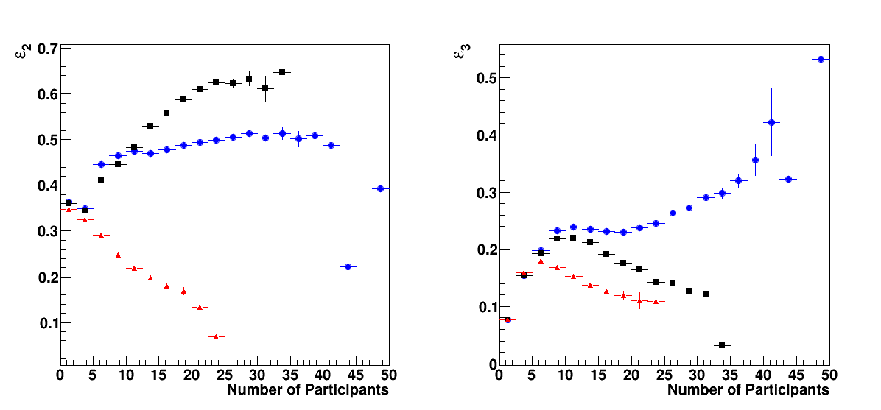
Geometry Control
p+Au
d+Au
He3+Au
Comparison of different geometries provides key tests of underlying physics (initial conditions, equilibration time, medium properties, etc.)

Slide 41
PHENIX Run-16 Request

Slide 42
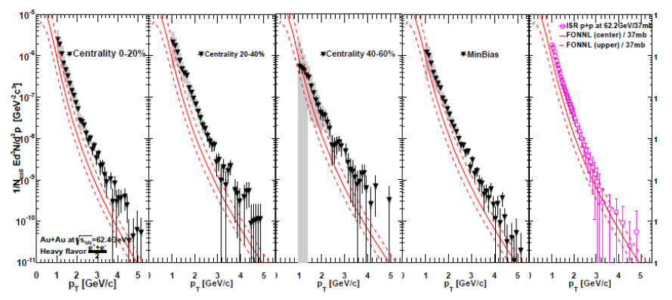
Why 62 GeV?
arXiv:1405.3301
Heavy Flavor electrons enhanced (not suppressed) in Au+Au collisions at 62 GeV !
STAR has similar preliminary result

Slide 43
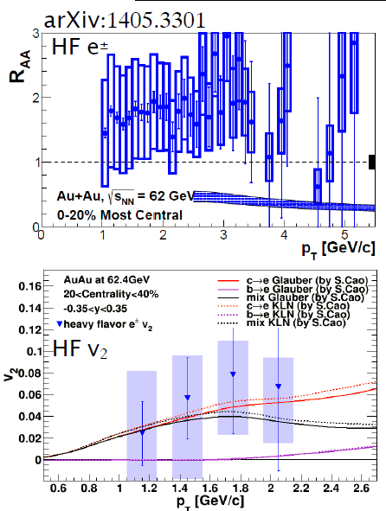
Strange Heavy Quark Trends
Nuclear modification factor uncertainties dominated by lack of p+p RHIC reference
Quenching theory predicts suppression
What about charm flow?
Elliptic flow
Uncertainties are too large

Slide 44
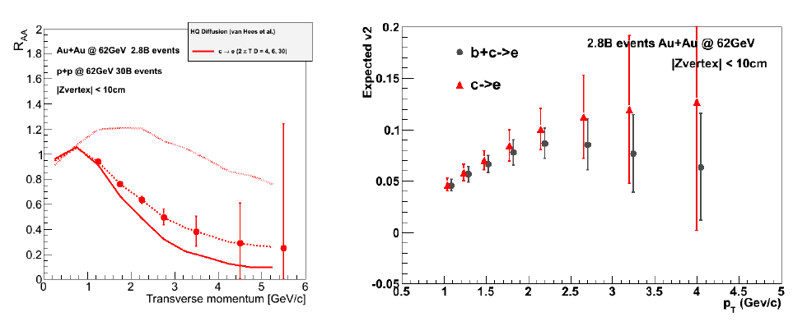
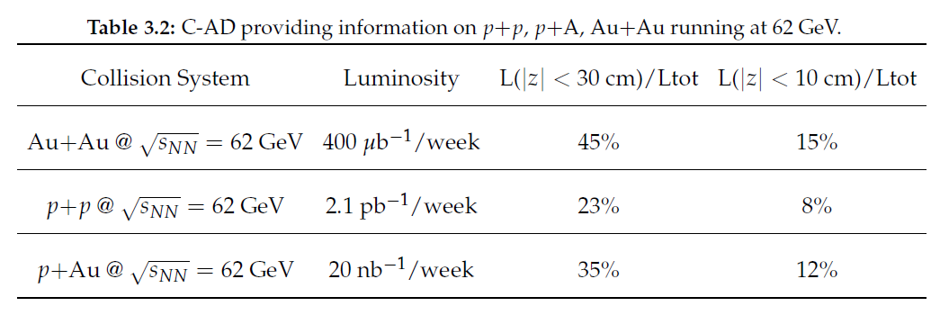
Projections with PHENIX Silicon Detectors
Definitive Measurements

Slide 45
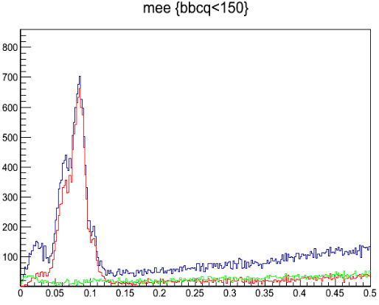
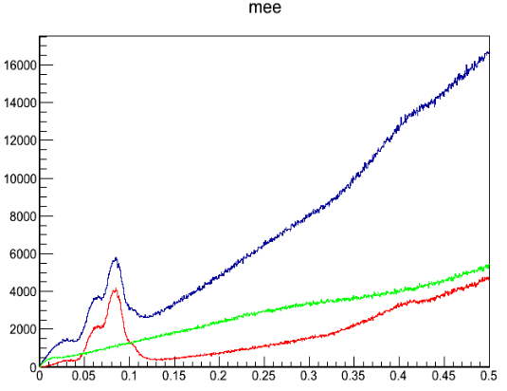
Photons via Conversion Electron Pairs
As in our Au+Au @ 200 GeV analysis, we can measure direct photons via conversion electron pairs in the VTX
Measurement of direct photon yield and possible v₂ and v₃ with early time closer to T_{c} is
very exciting
Applying proven techniques and utilizing energy flexibility of RHIC machine (with stochastic cooling benefits too)
Au+Au @200 GeV data
Peripheral
Total
PhiV<0.1
PhiV>0.6
Mee(GeV/c2)
Minimum Bias
Mee(GeV/c2)

Slide 46
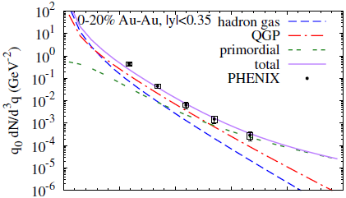
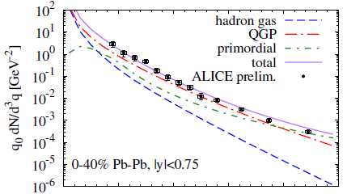
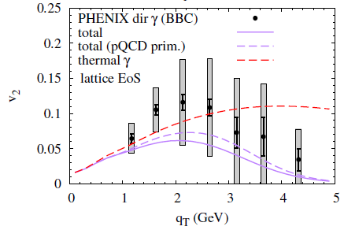
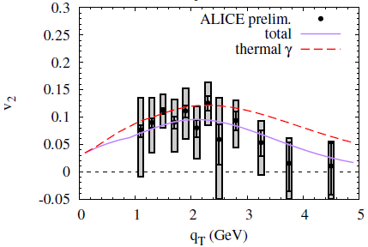
QGP Strongest coupling near T_{c}
Slide from Ralf Rapp at QM14
Enhanced Photon Rates in Hydro
upscale photon rates by factor of 2, up to 3 for T_{pc} ± 30MeV
RHIC LHC
getting close(r) to the data (more so with fireball)

Slide 47
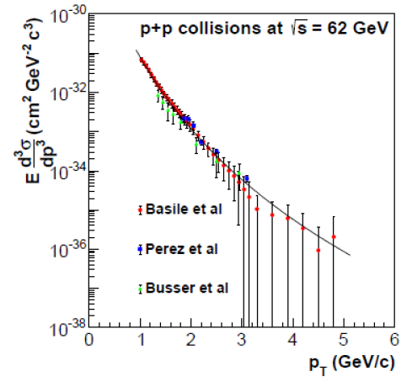
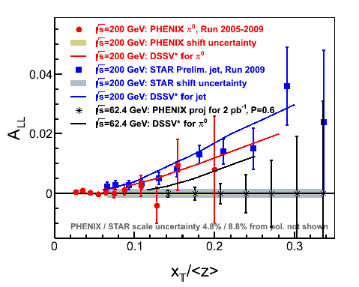
p+p @ 62 GeV
Provides critical baseline for heavy flavor and photon measurements
Also p+A @ 62 GeV would be very useful
At the same time, longitudinal polarized measurement of π⁰ A_{LL} would provide check
in same kinematics of STAR positive jet A_{LL}

Slide 48
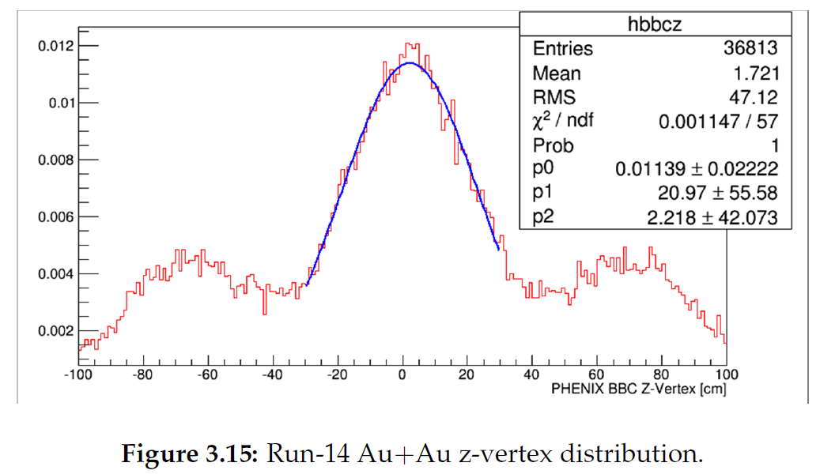
Run-16 Alternative Considerations (I)
PHENIX considered more Au+Au @ 200 GeV running
No new detector capabilities
Run-14 has been so successful, hard to beat
In optimistic scenario with 10 weeks, one might increase our statistics by 150%

Slide 49
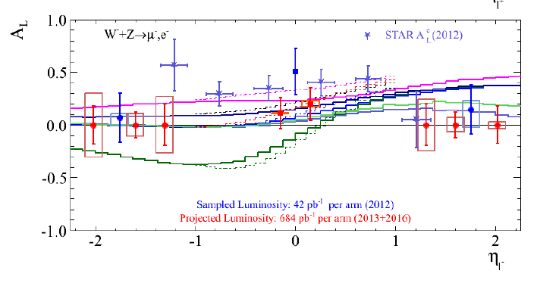
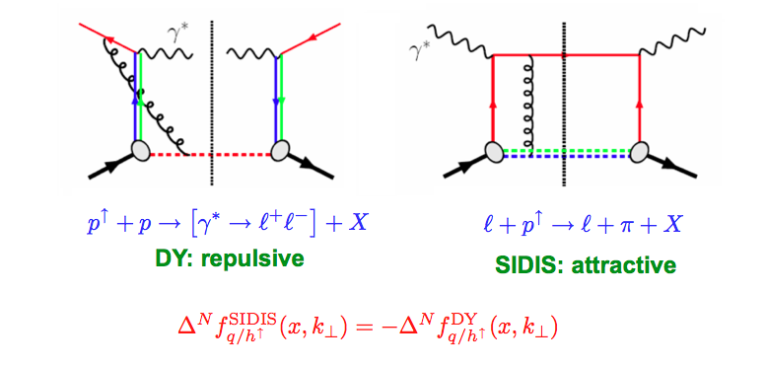
Run-16 Alternative Considerations (II)
p+p @ 500 GeV Longitudinal
p+p @ 500 GeV Transverse
Not clear non-dedicated run would significantly add to the measurement
MUID Efficiency dropping at highest luminosities
Possible Low-mass DY measurement with sufficient significance
Lots of debate about meaning of low-mass DY at higher p_{T} (where better S/B)

Slide 51
PHENIX BUP Summary
Outstanding C-AD delivered performance in Run-14
Exciting physics program for Run-15 and Run-16
Running periods need to be sufficient to make definitive measurements and to take full advantage of the unique capabilities at RHIC
Request emphasizes the truly unique RHIC capabilities to provide definitive new insights
Bright future with sPHENIX and EIC on the horizon

Slide 52
EXTRAS

Slide 53
Run-15 PHENIX Proposal - Details
1 week cool-down
1 week setup p+p
1 week ramp up p+p
9 weeks data
1 week setup p+Au
1 week ramp up p+Au
5 weeks data p+Au [also switch to Au+p]
0.5 week switch/setup p+Si
2 week data (p+Si)
0.5 week warm-up → 22 cryo weeks
C-AD possible constraint on only p+A in Run-15
BUP draft expresses concern and need to maintain flexibility to ensure MPC-EX results and to follow the physics
BUP assumes we run He3+Au at the end of this run

Slide 54
How did we calculate 12 weeks Au+Au for 1.5 nb⁻¹ recorded by PHENIX within |z| < 10 cm.
(VTX/FVTX optimal acceptance)
Physics driven goal (set by desire to decompose charm and beauty contributions over a wide p_{T} range).
Low to moderate p_{T} electrons/muons come from minimum bias data sample (no Level-1 trigger selection).
Excellent DAQ bandwidth 5 kHz even with silicon detectors.
Thus, the key is running time and luminosity exceeding 5 kHz for
|z|< 10 cm (mostly true with current projections)
Evts / week = 5000 x 60x60x24x7 x 0.7 x 0.55 = 1.16 B = 0.17 nb⁻¹/wk
Note 0.7 (PHENIX Uptime), 0.55 (RHIC Uptime)
Thus, it might only take 9 weeks to achieve this goal.
However, there is some ramp-up time for luminosity to exceed the 5 kHz DAQ bandwidth. There is also some vertex trigger resolution.
Based on past experience, scale luminosity/wk x 0.75
and that gives the 12 week request.

Slide 55
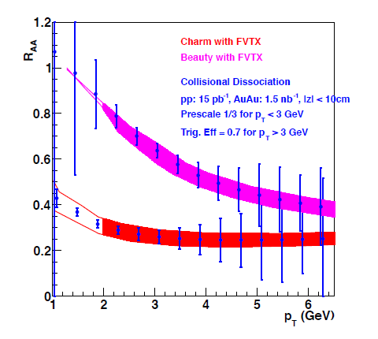
Run-14 Au+Au @ 200 GeV Request
1.5 nb⁻¹ request is driven by charm / beauty physics
FVTX first Au+Au data set
Example projected uncertainties in collisional dissociation model
Bands include unfolding systematic uncertainties
Beauty
Charm
12 weeks is our estimate to obtain the physics driven goal

Slide 56
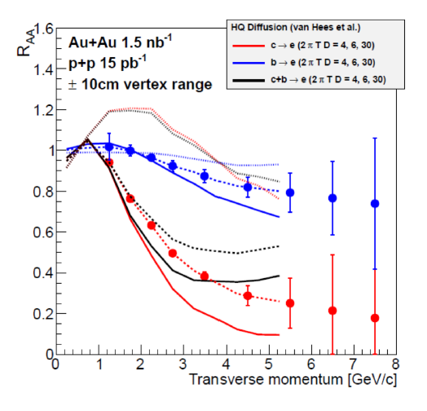
VTX projected uncertainties and sensitivity relative to heavy quark
diffusion parameter
Beauty
Charm
Charm
Beauty
In extreme scenario of beauty quarks following flow field, very different prediction

Slide 59
Can a nearly inviscid fluid be created in p(d) + A too?
IP Glasma versus Other
Hydrodynamic flow? Glasma diagrams? Something else?
LHC has highest parton densities…
RHIC has unique access to geometry controls…

