Slide 1

Who I am
Martin L. Purschke
Sr. Physicist at BNL
Former DAQ guy of PHENIX
Now in the same role in sPHENIX
30% of my time is spent on EIC-themed things
eRD{1,6,23}
2 BNL LDRDs

Slide 2
RCDAQ - sPHENIX / ePHENIX DAQ system
Right now we are in a R&D phase for both sPHENIX and EIC
RCDAQ is the workhorse DAQ system used in virtually all sPHENIX R&D efforts
Used for a lot of EIC-themed R&D efforts eRD1, eRD6, eRD23, …
Readout of GEMs and derivatives (microRwell, LAPPD, ..) using the SRS or DREAM (almost all EIC-centric)
The sPHENIX TPC/MVTX/etc using the ATLAS FELIX card
Lots of commercial systems, DRS4, CAEN V1742, Struck Flash ADCs, etc
Where does RCDAQ fit into the picture?

Slide 3
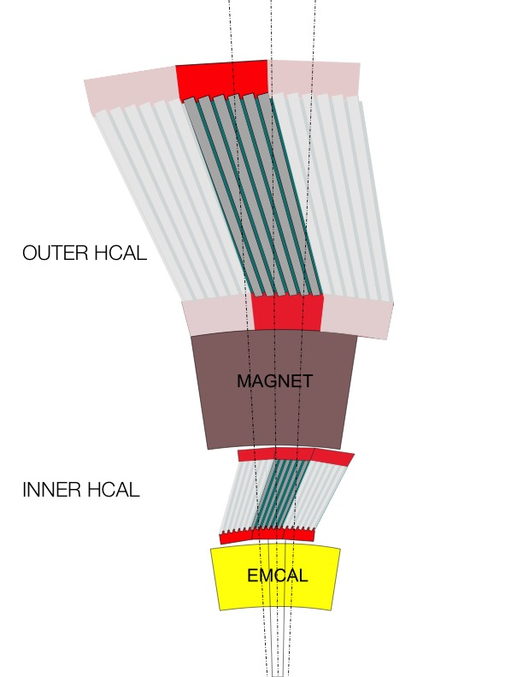
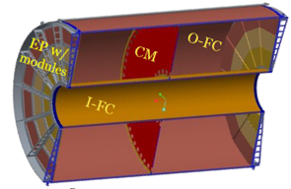
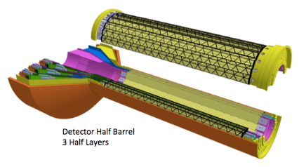
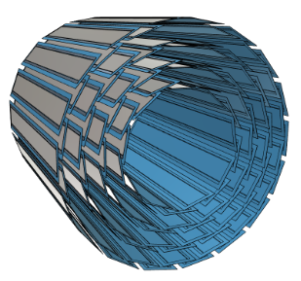
The eventual sPHENIX DAQ system
FEM
DCM
DCM2
DCM
DCM
Triggered readout
DCM
DCM
Network
Switch
Buffer Box
FEM
DCM
SEB
DCM
DCM
DCM2
DCM
DCM
DCM
Buffer Box
FEM
DCM
SEB
DCM
DCM
DCM
DCM2
Buffer Box
DCM
SEB
Calorimeters, MBD
DCM
To the
RACF/HPSS
DCM
Buffer Box
FEE
DCM
DCM
FELIX
EBDC
Streaming readout
DCM
Buffer Box
TPC, MVTX, INTT
FEE
DCM
DCM
FELIX
EBDC
Buffer Box
DCM
FEE
DCM
FELIX
EBDC
DCM
Buffer Box
DCM
Before you ask: I would have loved to readout everything in streaming mode, but the funding ain’t there – we need to re-use the PHENIX DAQ components for the calorimeters

Slide 4
What is RCDAQ, then?
RCDAQ looks conceptually like one of the readout components shown here. We log data at the Subevent buffer level
FEM
DCM
DCM2
DCM
DCM
SEB
DCM
DCM
Network
Switch
Buffer Box
FEM
DCM
DCM
DCM
DCM2
DCM
DCM
DCM
Buffer Box
FEM
DCM
SEB
DCM
DCM
DCM
DCM2
Buffer Box
DCM
SEB
DCM
To the
RACF/HPSS
DCM
Buffer Box
FEE
DCM
DCM
FELIX
EBDC
DCM
Buffer Box
FEE
Buffer Box
DCM
DCM
FELIX
EBDC
DCM
FEE
Buffer Box
DCM
FELIX
EBDC
DCM
DCM
RCDAQ is geared towards a R&D setting with lots of amenities that allow you to automate things, etc
But the RCDAQ components can then trivially be converted into the above front-end parts (“less of the same”, I call it).
No new readout/driver/firmware/data format developments, all can be used as-is

Slide 5
RCDAQ Applications and Users
Many groups in sPHENIX & friends (LANL, Oak Ridge, UIUC, VU, also ATLAS)
Many groups doing EIC R&D – BNL, SBU, Yale, Temple, ...
Regular Fermilab test beam campaigns each year (some years multiple test beams) since 2013 (sort of the Superbowl of data taking for us each year)
CERN RD51
A collection of people/groups coming to RCDAQ through a particular device readout, often the SRS – U Texas @ Arlington, MPI Munich, etc etc

Slide 6
RCDAQ - geared towards R&D setups
Ok, it reads your detectors as you would expect from a DAQ system
It fully supports streaming readout paradigms
It is inherently scriptable and supports measurements on “full autopilot”
Has support for including any kind of meta data in the data files (anything that can be had by a computer)
Online monitoring support through root / pmonitor
Fully tied in with our analysis framework Fun4All
Electronic logbook support
Network-transparent control interfaces (rpc, http, web sockets)
Lots of devices supported, generally, the slow controls are part of the package

Slide 7
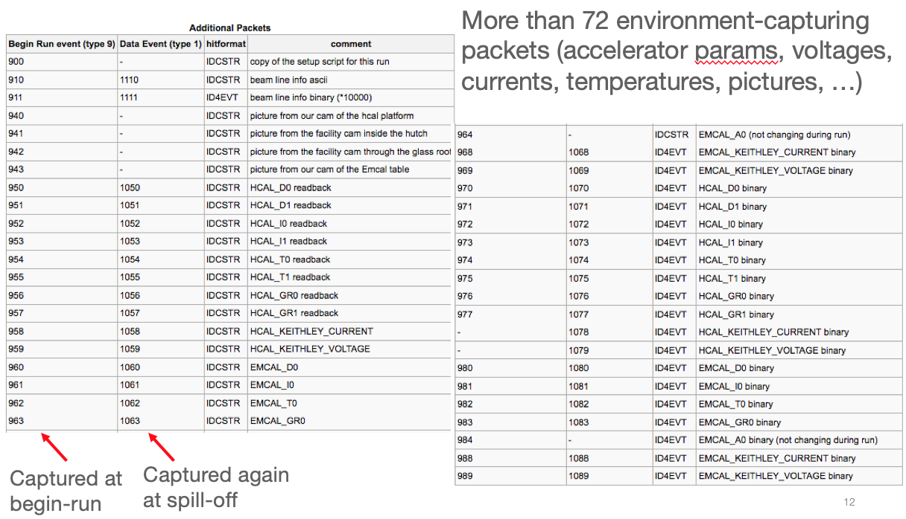
More about capturing meta data
Many times you capture things only “just in case”
You don’t routinely look at them in your analysis (such as cam pictures shown before)
But if you have some inexplicable feature, you can use the data to do “forensics”
Find out what, if anything, went wrong
The more data you capture, the better this gets
Think of it as “black box” on a plane…

Slide 8
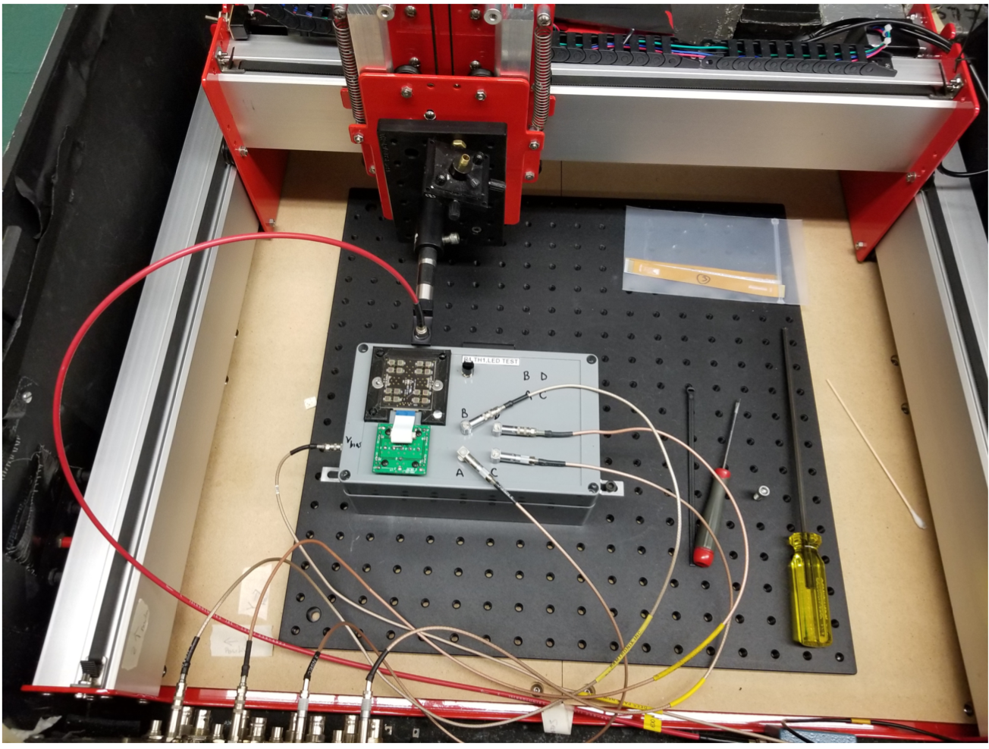
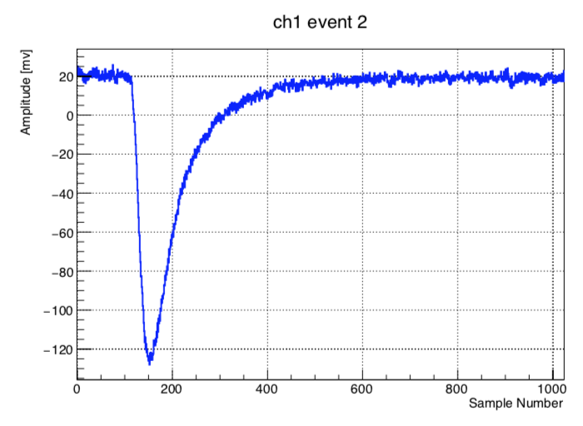
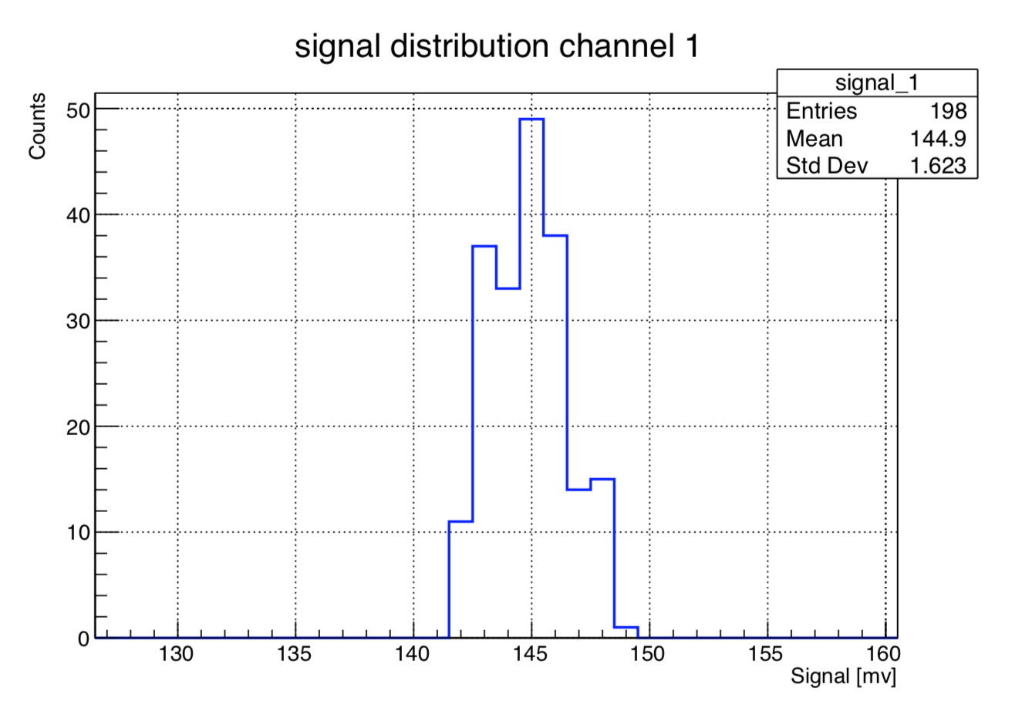
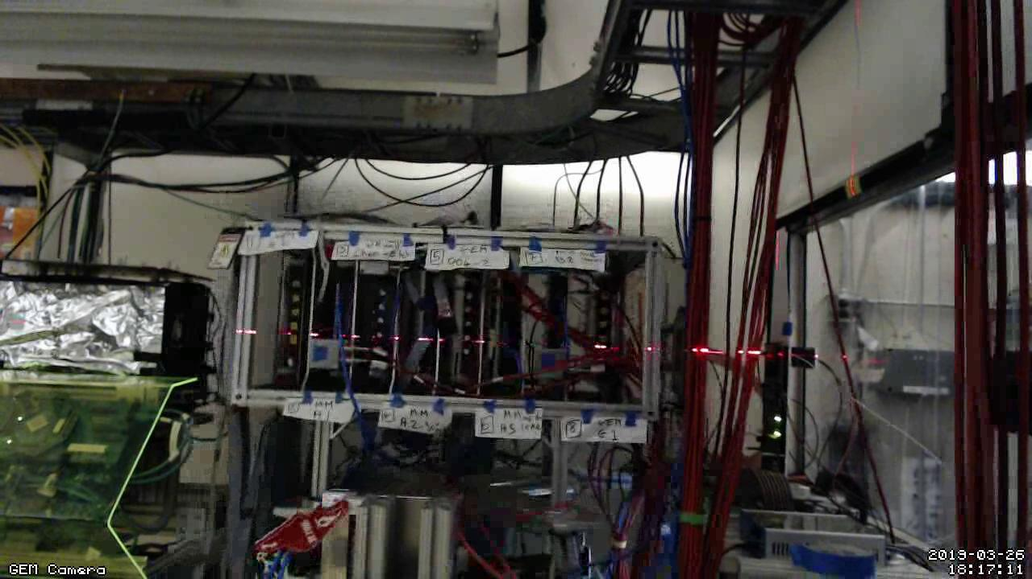
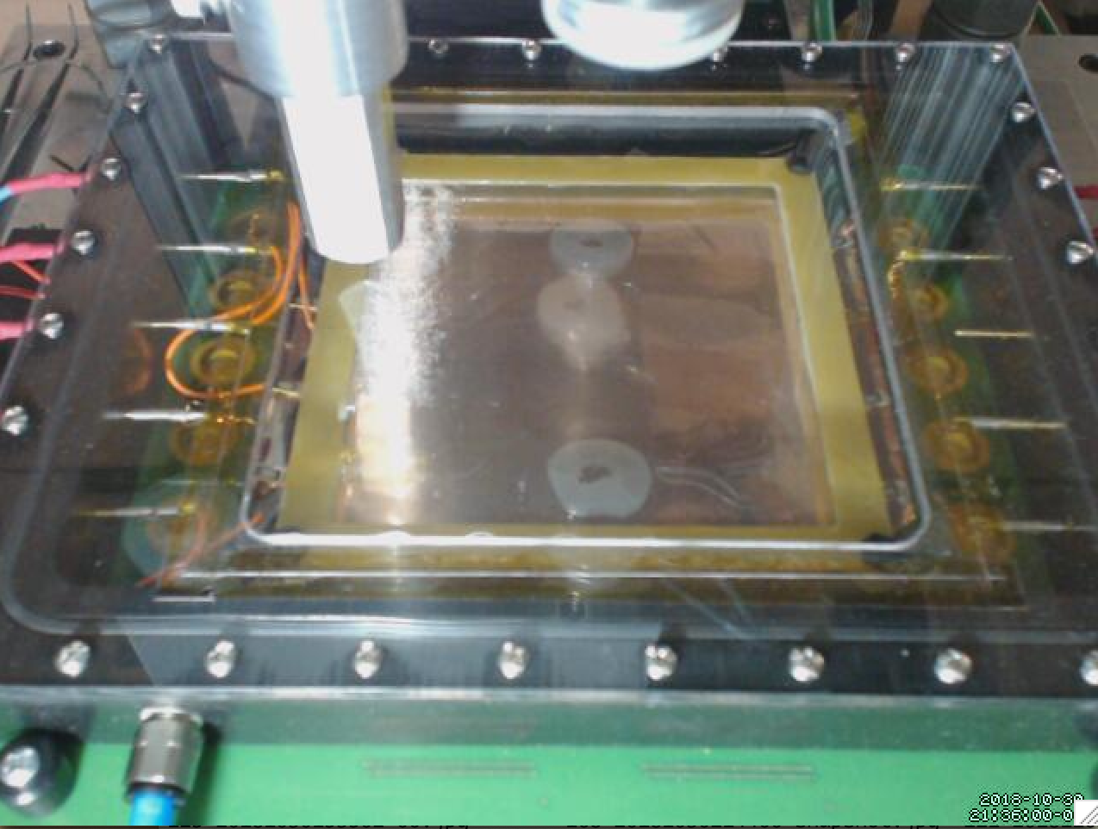
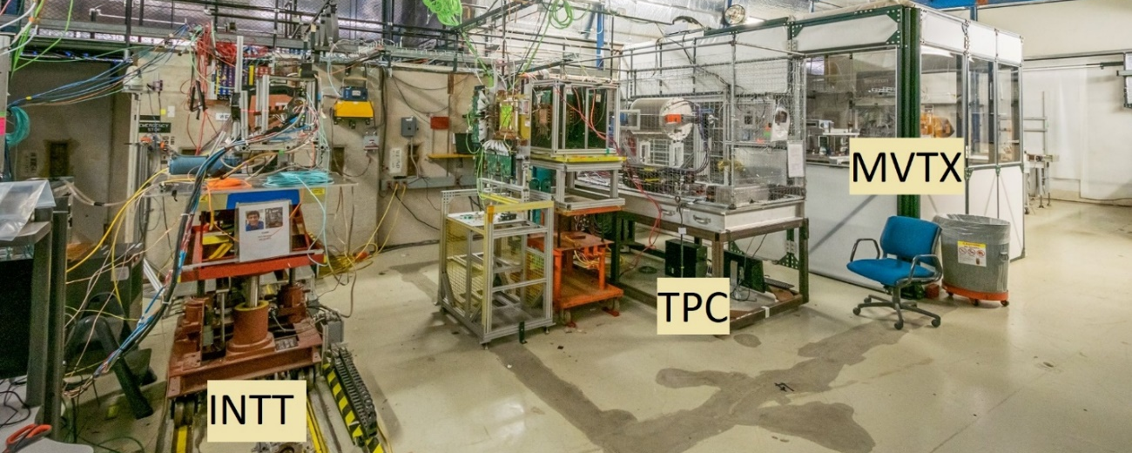
Some RCDAQ setups

Slide 9
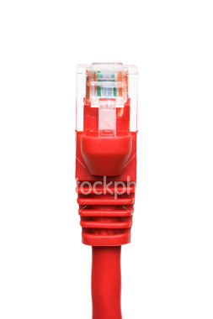
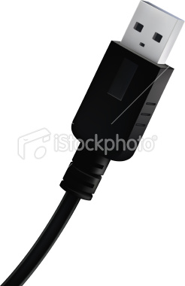
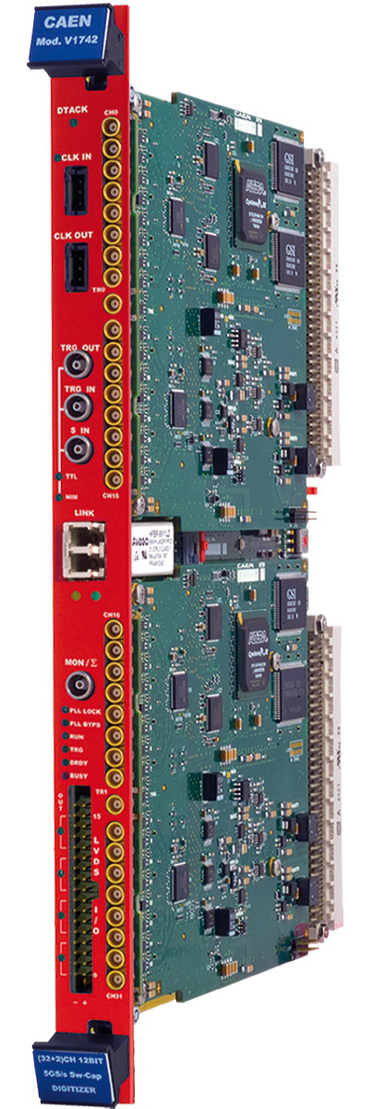
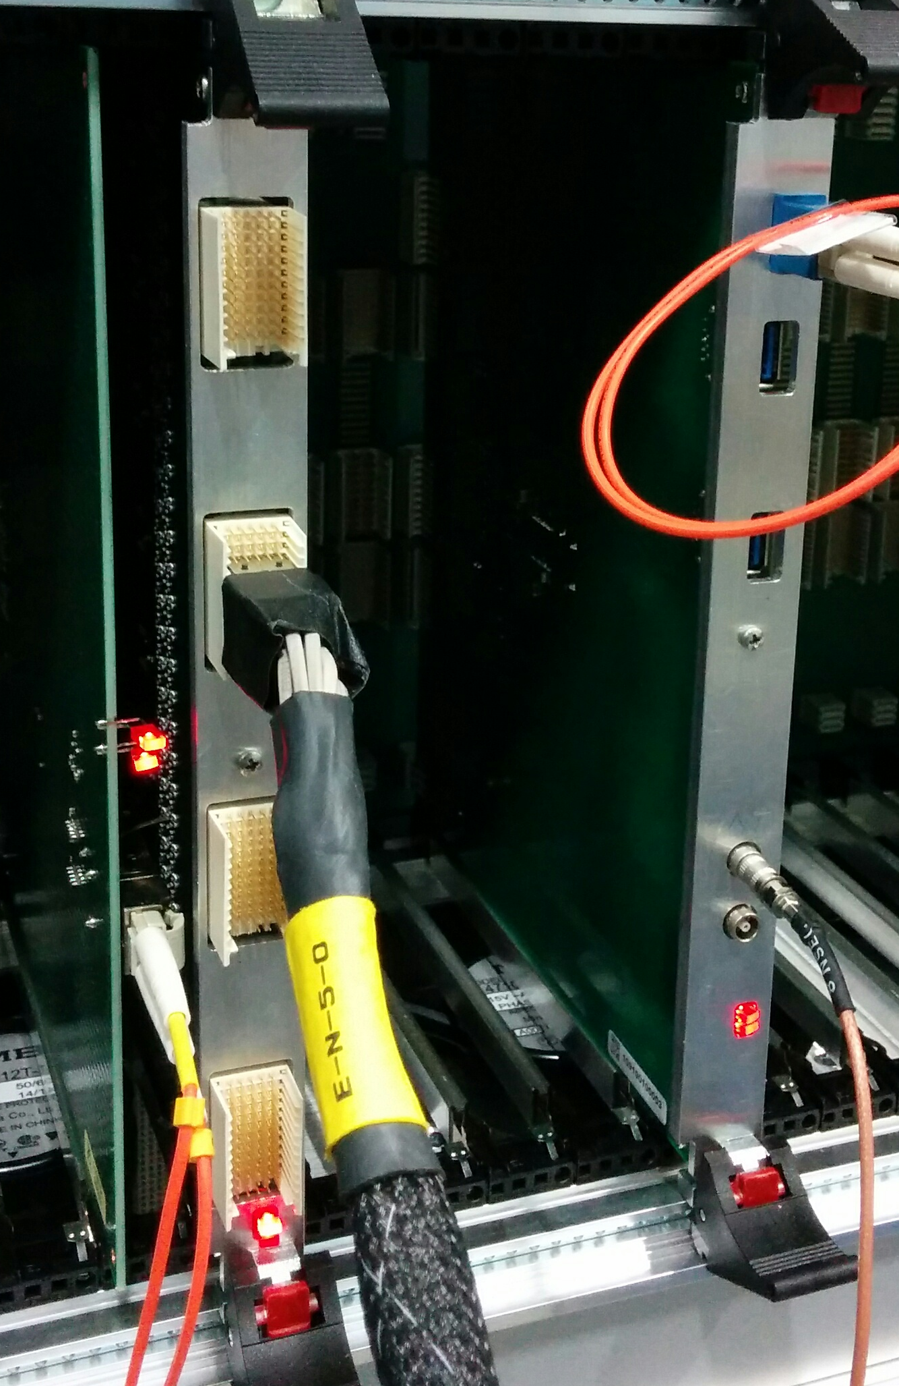
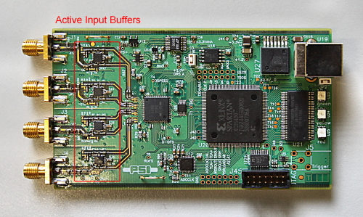
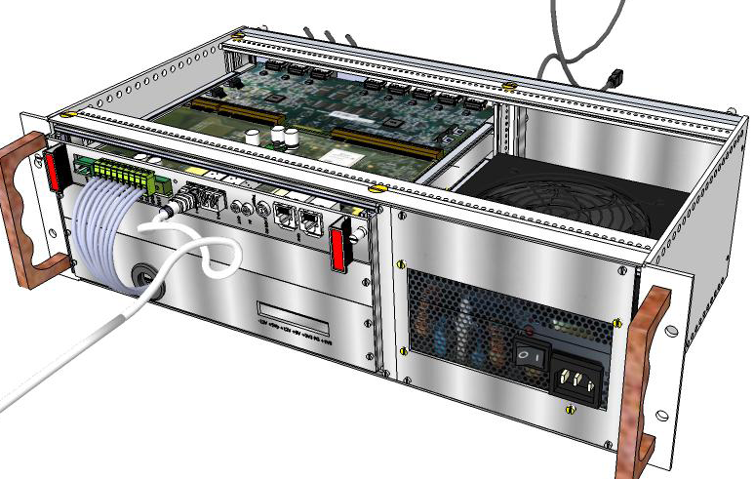
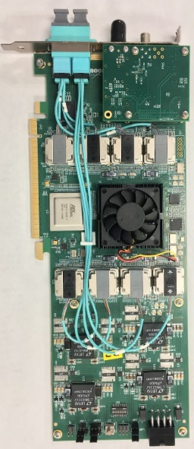
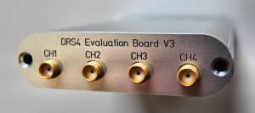
Some standard devices implemented in RCDAQ
RCDAQ
PCIe
PCIe
PCIe
The CERN RD51 SRS System
FELIX card
new sPHENIX digitizer prototype
DRS4 Eval board
“USB Oscilloscope”
The CAEN V1742 waveform digitizer
There are many more not shown some 30 devices maintained by me
Some more “in the wild”

Slide 10
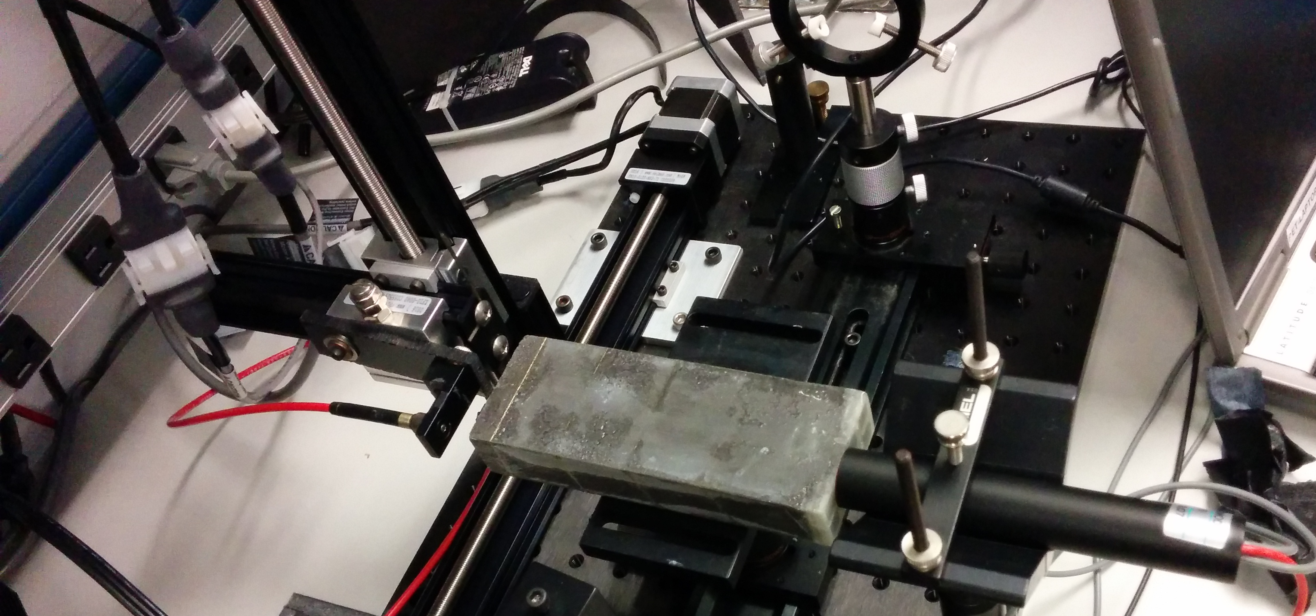
Measurements on autopilot through scripting
Figure out how uniform the light response of one of our emcal modules is:
Move a light fiber injecting light with 2 step motors, take a run for each position w/ 4000 events
50 x 25 = 1250 positions (you really want to automate that)
Let it run overnight, come back in the morning, look at the data
X-Y step motor
Calorimeter
Module
Light Fiber
PMT

Slide 11
The Script
#! /bin/sh
STARTPOSX=0
STARTPOSY=9900
INCREMENTX=200
INCREMENTY=-200
CURRENTPOSY=$STARTPOSY
for posy in $(seq 25) ; do
quickmove.sh $CURRENTPOSY 2
sleep 5
CURRENTPOSY=$( expr $CURRENTPOSY + $INCREMENTY)
CURRENTPOSX=$STARTPOSX
for posx in $(seq 50) ; do
echo "moving to $CURRENTPOSX"
quickmove.sh $CURRENTPOSX 1
sleep 5
CURRENTPOSX=$( expr $CURRENTPOSX + $INCREMENTX)
done
done
The DAQ operation becomes an integral part of your shell environment
25 positions in y
move the Y motor
50 positions in x
move the x motor
next x
next y
Automatic end after 4000 events
start the DAQ
rcdaq_client daq_set_maxevents 4000
rcdaq_client daq_begin
wait_for_run_end.sh

Slide 12
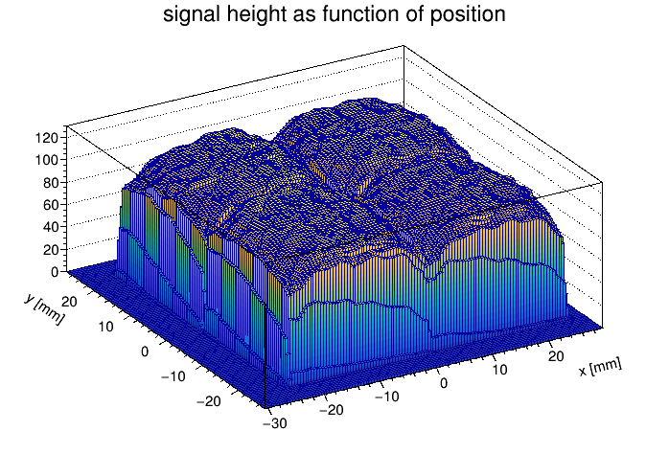
Remember our 1250 data data files?
We figure out the mean of a pulse height distribution for each position
Fill that into the right “spot”
The position info from the stepper motors gets embedded in the data files
“throw” all 1250 data files at the analysis, and get the above plot, no tedious position lists or so
A real time-saver for many lab setups that do scans (vary bias/HV, positions, pressure (cherenkovs) etc etc)

Slide 13
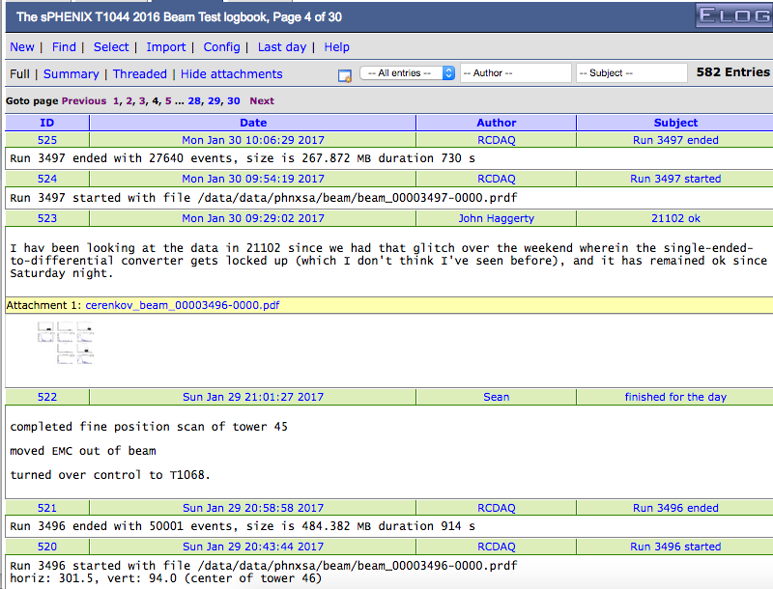
Automated Elog Entries
RCDAQ can make automated entries in your Elog
Of course you can make your own entries, document stuff, edit entries
Gives a nice timeline
and log
Notes:
----- Meeting Notes (1/27/16 16:27) -----

Slide 14
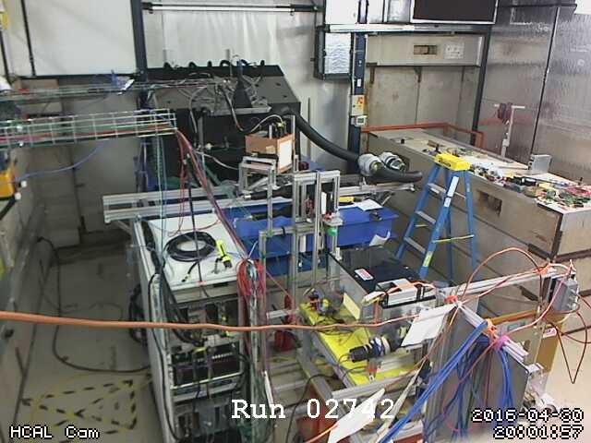
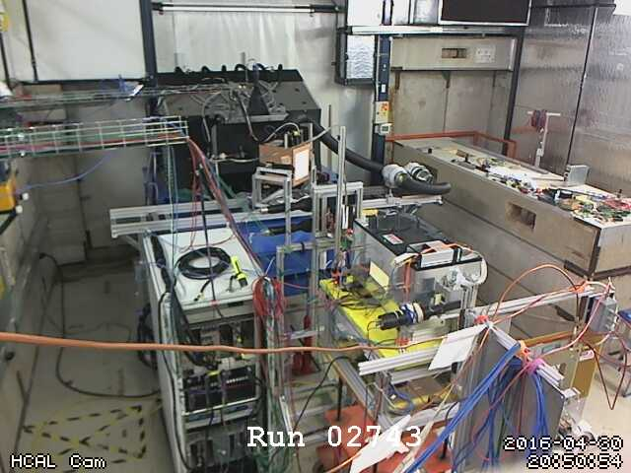
Meta Data forensics example
I usually capture a webcam picture of the setup at each begin-run
Very useful if you “scan” the detector in a beam – does it move right when it should?
Here we had an issue of “more showering in the HCal starting with run 2743”
Nothing in the log , everyone was scratching their heads…
$ ddump -t 9 -p 940 beam_00002742-0000.prdf > 2742.jpg
$ ddump -t 9 -p 940 beam_00002743-0000.prdf > 2743.jpg

Slide 15
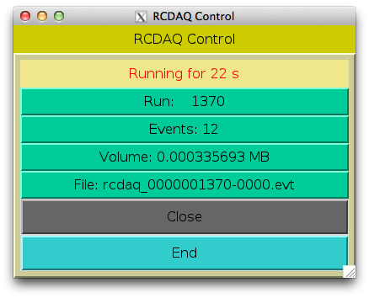

Slide 16
This page is intentionally left blank

