Slide 1
ASIC Group at BNL for EIC
Grzegorz W. Deptuch
February 19, 2020

Slide 2
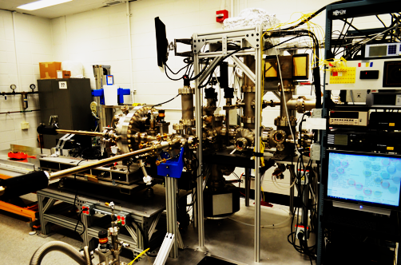
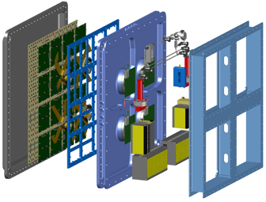
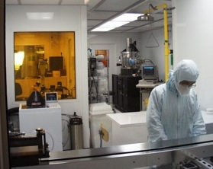
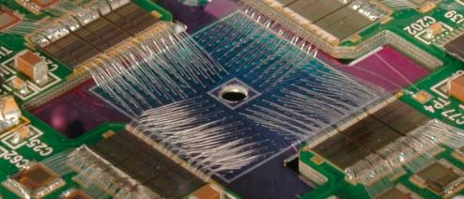
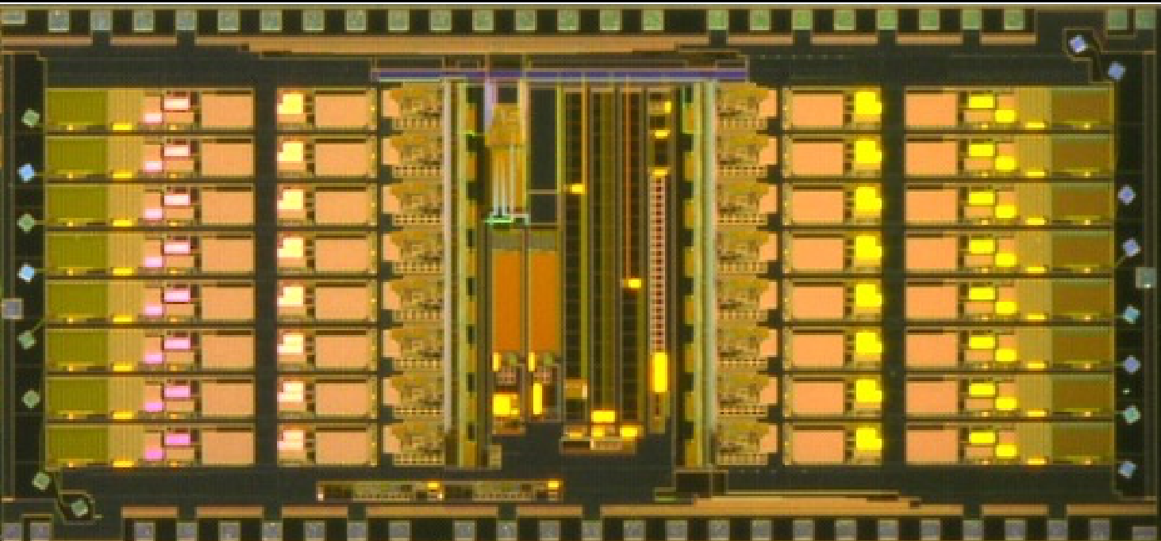
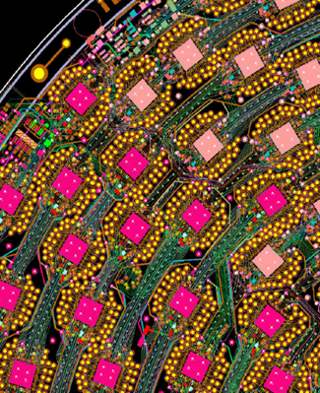
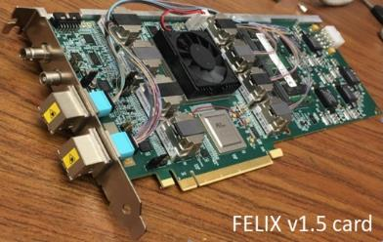
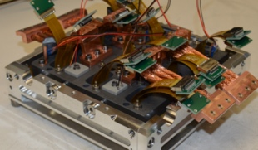
Instrumentation Division Radiation Detector Platform
key capabilities enabling BNL Science Programs:
Si (CdTe/CdZnTe) Sensors
Gas & Noble Liquid Detectors
Application Specific Integrated Circuits (ASICs)
CAD for Device & Board Level Circuit Design
Microelectronics Assembly and HDI
High throughput TDAQ
Photocathode Development & Production (for detector and accelerator applications)
Photocathode Facility
Gas & Noble Liquid Detectors
Microelectronics
Assembly
ASIC
Development Facility
Si Sensor Development
Device & Board Level Circuit
High Throughput
Trigger & Data Acquisition
LSST
Assembly & Testing

Slide 3
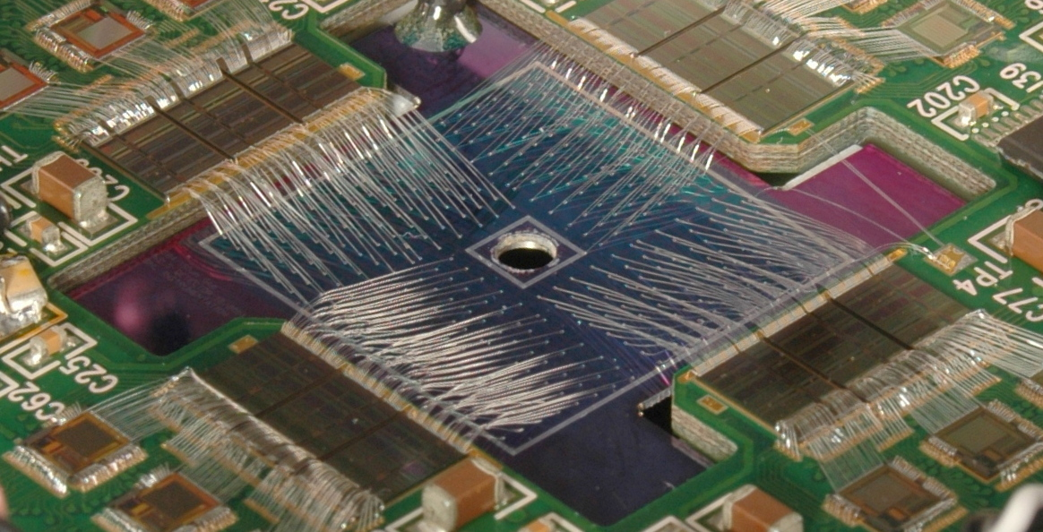
Application Specific Integrated Circuit (ASIC)
Expertise in low-noise, low power, large mixed-signal designs
7 full time ASIC designers (6 PhDs + 1 in PhD program, some w/ industrial background)
plan for further expansion (ASIC designers , CAD/OS manager)
open for hosting guest/visitors and grad/post-grad students
hand-in-hand work with in-house TDAQ, PCB, Sensors groups
Design tools and methodologies
industry-standard tools from Cadence, Mentor, etc. for interoperability between analog and digital designs for final tape out (analog on top or digital on top) analog: full custom flow digital RTL2GDS: functional simulation, logic synthesis, automated P&R, parasitics extraction, static timing analysis library characterization: customs standard cell libraries for handling designs for extreme environments, i.e. cryogenics and radiation verification: IR drop, functional (SV), physical device modeling: TCAD, FEM solvers, transistor model parameter extraction foundry PDK’s:
TSMC CMOS 350nm, 250nm, 180nm, 130nm, 65nm, 28nm, GF CMOS and BiCMOS SiGe 130nm, 90nm, + specialized processes: monolithic CIS on HR, sensors co-design, etc.
access to foundries via: MOSIS, IMEC, CERN-IMEC Foundry Services, FhG-IIS, and directly

Slide 4
Approach towards ASICs
Support for the fast-developing scales and functionalities of modern microelectronics
satisfy customer’s need using established processes (130nm, 65nm)
reaching for emerging technologies for R&D
development and maintenance of model (spice-type model parameters) and characterization (.lib) of standard cell libraries - post total ionizing dose of radiation (100-500Mrad), - for cryogenic (LNT, 4K, and subK) conditions
Integration HDI, 3D-IC
Collaborations:
Universities: SMU, UMich, UPenn, MIT, Georgia Tech, Columbia, UIUC
National Laboratories: FNAL, LBNL, ORNL, NRL
Industry: several ind. partners + more collaborators
International: CERN, OMEGA, KIT Karlsruhe, AGH Krakow, UBonn, CPPM, KULeuven
Pixel detectors for X-rays: tier-stacking, integration with passive and active sensors, mixing technologies

Slide 5
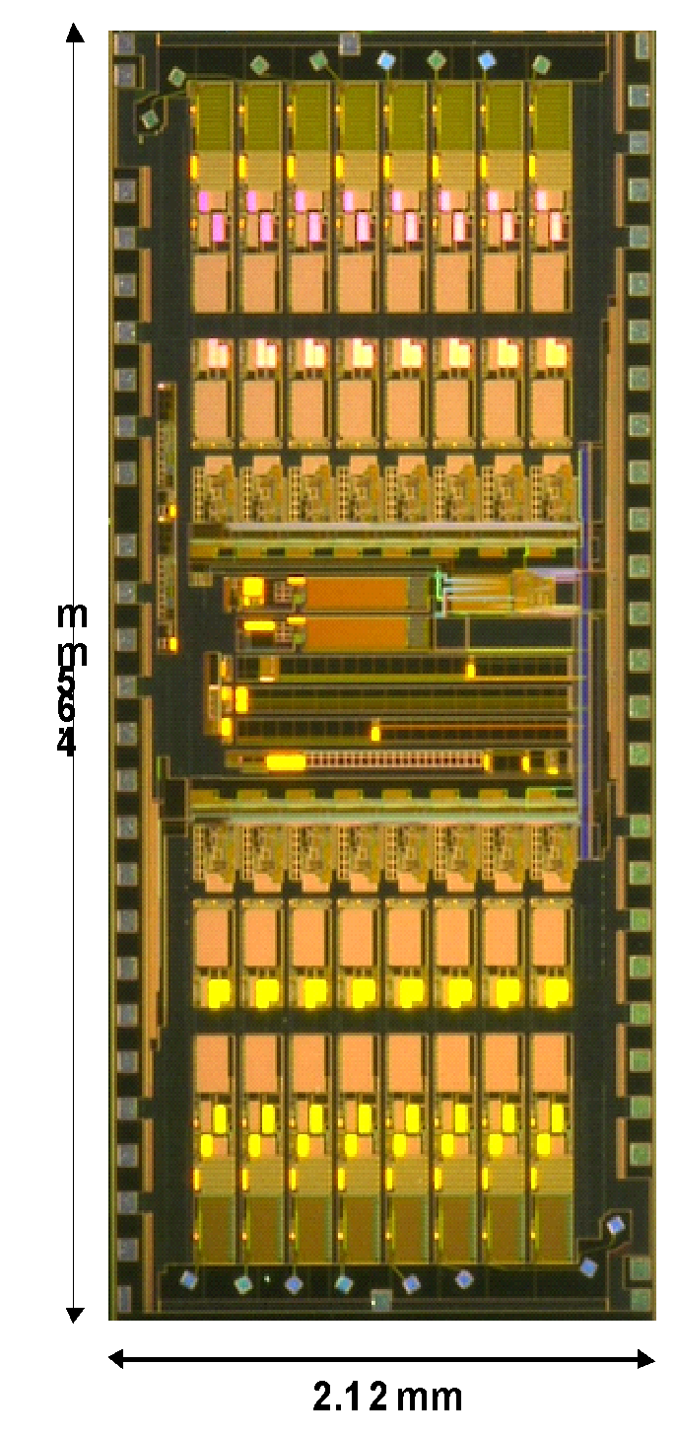
Areas of Activities / Interests (1)
Low-noise and low-power
custom analog front-end matched to a specific sensor
front-end circuits optimized for amplitude & time-resolution
data, event driven or zero-suppressed readouts
Cryogenic operation
liquid Noble gasses TPCs readouts
long lifetime reliability
Radiation-Hard
immunity to TID, NIEL and SEE effects
Hybrid-pixel detectors
counting and spectroscopic detectors for BES photon science, NNSA applications
3D-IC and High-Density Interconnect
edgeless and gapless, highly granular pixel detectors with extended functionalities
Monolithic Active Pixel Sensors
on HR, thick substrate with full CMOS capability and built-in charge-signal processing

Slide 6
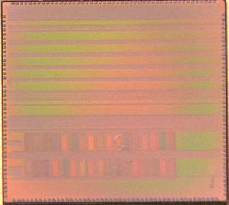
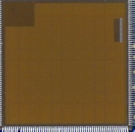
Evolution lAr (~80K) electronics chain
DIGITAL LINKS
DAQ
MicroBooNE
LArASIC
COTS ADC
FPGA
DIGITAL LINKS
DAQ
proto-DUNE
LArASIC
COLD_ADC
FPGA
DIGITAL LINKS
SBND
DAQ
LArASIC
COTS ADC
FPGA
DIGITAL LINKS
DUNE
DAQ
LArASIC
COLD_ADC
COLD DATA
ASIC
88K
300K

Slide 7
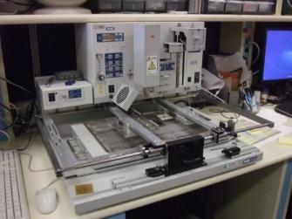
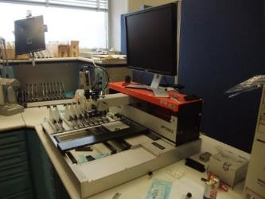
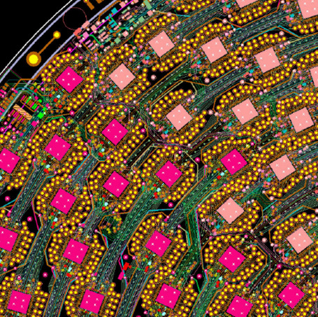
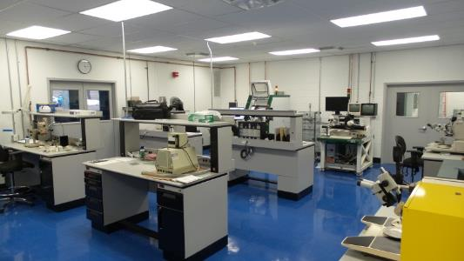
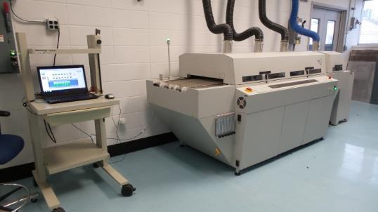
Microelectronics Fabrication & Assembly and High-Density Interconnects
Printed Circuit assembly:
Semi automatic pick and place assembly station
Manual and automatic machine dispensers for solder pastes
Ball Grid Array (BGA) placement and rework
Automatic conveyor multi-stage reflow oven
Thermal flow BGA/SMD rework station
X-ray and microscope inspection stations
High-Density Interconnect
Interconnecting Advanced Detectors to ASICs
Gold bump and Al- wedge bonding of ASICs to high density detectors & circuit boards
Rework and testing of Interconnects – die shear, wire bond pull tests
Flip-Chip Interconnection gold bumping
Semi-automatic flip chip bonding, X-Ray aligner
Epoxy dispensing for die attachment and placement, conformal coating and under fill
Surface mount rework
Semi-automatic pick and place
PCB for TPC detector
HDI Interconnect Laboratory
Automatic 6 stage reflow oven

Slide 8
Areas of Activities / Interests in EIC
Where would the involvement of the ASIC Group of IO at BNL be most effective, ensuring a productive and long-time role in the EIC?
Involvement in Roman Pot could grow naturally from the LGAD’s dependence on technology development ongoing in-house. The studies of DC vs. AC coupled LGADs, where the AC pads involve RC parameters, signal interpolation and noise is where the IO staff could contribute to optimize the design. And then comes the timing resolution at moderate LGAD gain, which is a critical question, and the ASIC design with the best timing scheme for this detector. We intend strengthen partnership links with the Fermilab (ETROC) and Omega ALTIROC development groups.
Involvement in vertex tracking is also very attractive. IO would be a new player in addition to several major players. What role could we have in the “truly cylindrical vertex detector”? It is a very attractive and transforming idea. IO could join the proposed effort (ITS3/EIC) to benefit from the contacts with technology developments (LBL, U.of Birmingham) also at CERN with technology provider TJ and others, and reevaluate that effort later.

