Slide 1
Tracking with Fun4All
Based on the questions in https://docs.google.com/document/d/1EgEMZV3PpHcaGKL1IrzoSAv4o8btBGDUefVDxvlt8JI/edit#heading=h.cdtqoutchphb

Slide 2
Distribution
SL7 OS runs in singularity (and docker container)
  Very rarely updated (basically never)
Software and 3rd party packages in cvmfs (/cvmfs/eic.opensciencegrid.org)
  Works with JLab, RACF and CERN accounts
  Should run on the OSG (truth in advertising: not tested yet)
  Production campaigns have been run in RACF and LLNL
  Non Linux Laptop/desktop installation via Ubuntu VM under virtualbox
    https://github.com/sPHENIX-Collaboration/Singularity
  Environment setup via sourcing a script
    source /opt/eic.opensciencegrid.org/x8664_sl7/opt/sphenix/core/bin/eic_setup.sh
  You can keep your own code base in your own repo and just link against this
  Help
    Mattermost chat: https://chat.sdcc.bnl.gov/eic/channels/fun4all-software-support
      Non racf accounts need invite
    Email: pinkenburg at bnl.gov, jinhuang at bnl.gov

Slide 3
G4 program flow within Fun4All
Modular: Each detector is its own entity providing the flexibility needed for complex setups
Fun4AllServer
Geant4
Event generator (input file, single particle, pythia8)
PHG4Reco
Initializes Geant4 before detectors are added
The processing is done by chaining up modules. At every step the state of the Node Tree can be saved and the analysis can pick up where it left
Node tree
Interface Detector 1
Construct() → Geometry
Stepping Action (Hit extraction)
Generic detectors like boxes, cylinders, cones exist and can be configured on a macro level
Interface Detector 2
Construct() → Geometry
Stepping Action (Hit extraction)
Digitisation
Raw Data
RCdaq
Common reco for raw and simulated data
Setup
Tracking,Clustering
calls
Jet Finding, Upsilons, Photons,…
dataflow
Output Files

Slide 4
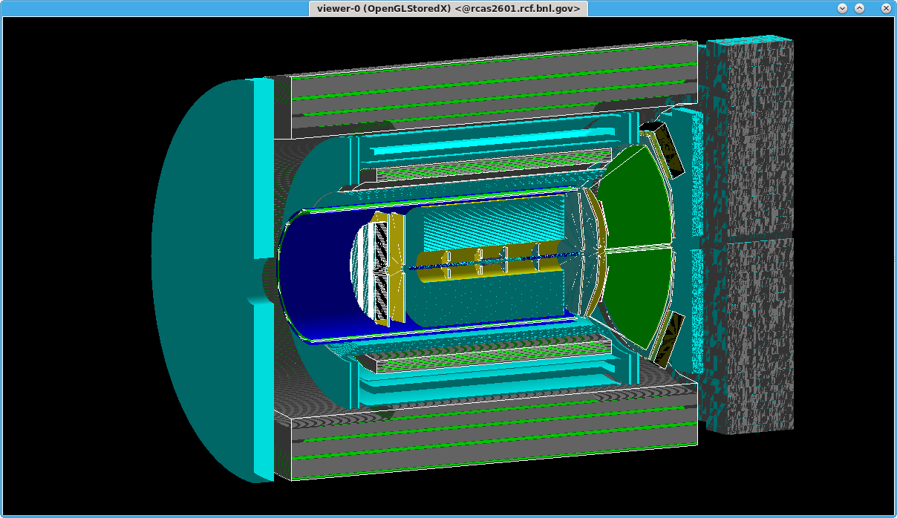
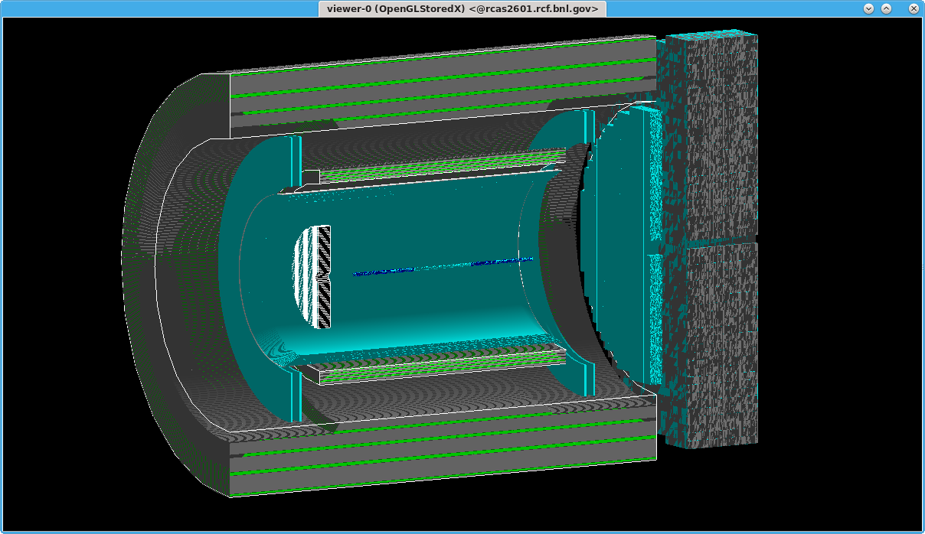
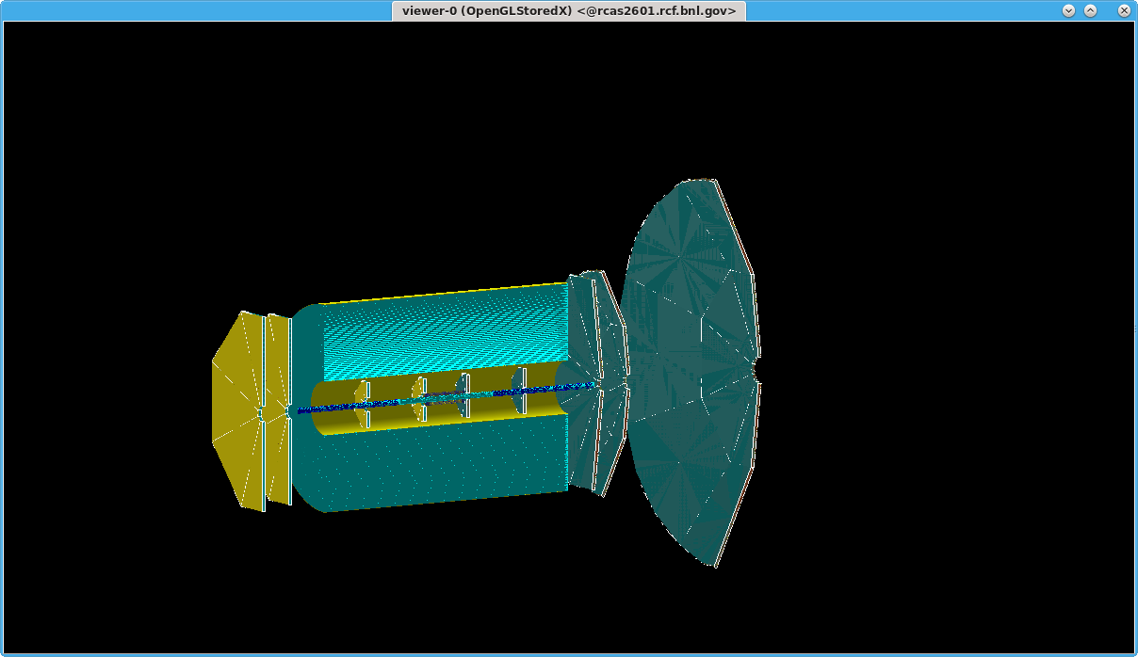
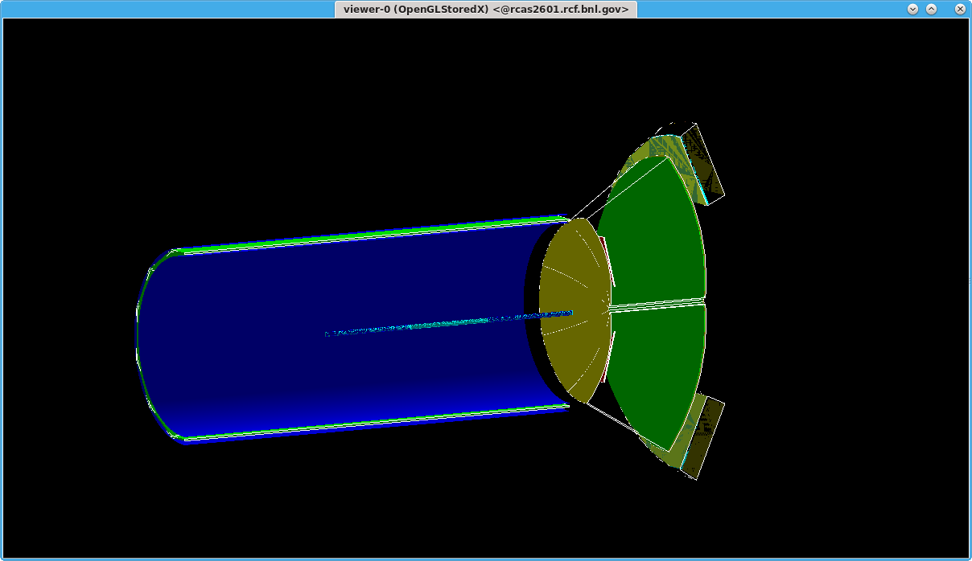
Modularity of the frameworks ( fun4all should be modular, but it is not clear at least to me what happens with g4e): how easy is to replace one tracking detector with another one with a different technology ( sensitive volumes + digitization ). Is the experimental setup (= included detectors) configurable via a .C macro where the user can add each single detector one by one? For instance can only one tracking detector, the beam pipe and the magnet be included?
EIC detector based on the sPHENIX magnet:
Complete detector
EIC detector based on the sPHENIX magnet: Calorimeters
EIC detector based on sPHENIX magnet:
tracking system
EIC detector based on the sPHENIX magnet:
pid detectors
No recompilation, just true/false settings in ROOT macro

Slide 5
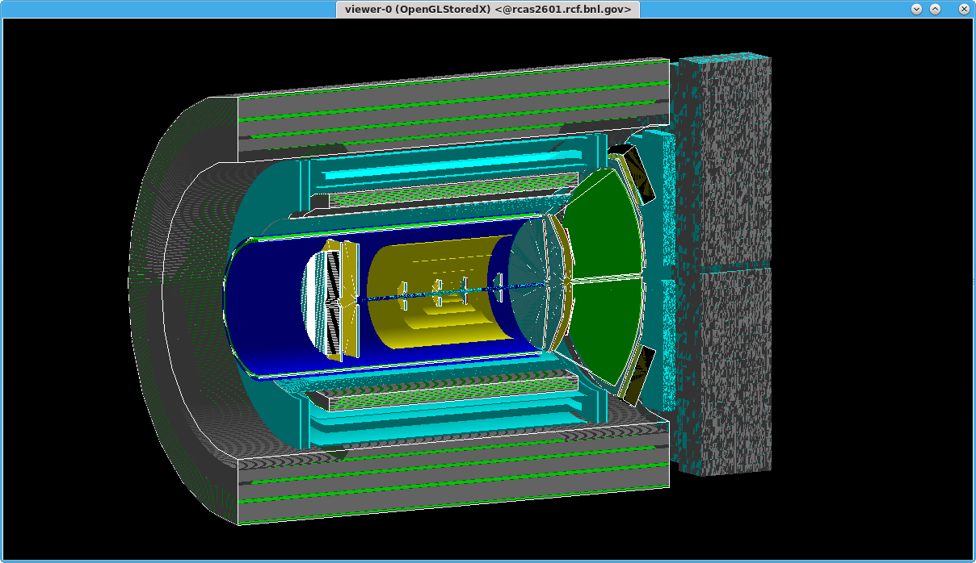
Modularity of the frameworks ( fun4all should be modular, but it is not clear at least to me what happens with g4e): how easy is to replace one tracking detector with another one with a different technology ( sensitive volumes + digitization ). Is the experimental setup (= included detectors) configurable via a .C macro where the user can add each single detector one by one? For instance can only one tracking detector, the beam pipe and the magnet be included?
Inner tracker replaced by old 6 layer silicon mockup → replaced sub-macro which implements TPC+inner tracking by sub-macro implementing 6 layer silicon. No recompilation, no code change
Sensitive volumes are activated in macro, absorber/support structures can be sensitive allowing to “measure” energy dumped in absorber or doing geantino scans to verify geometry
Digitization done during reconstruction

Slide 6
Access to the geometry / segmentation and the kinematics : can the user access to the geometry and kinematic quantities in parallel with the reconstructed quantities? Can one user load the event i-th in reconstruction and access the event i-th in the kinematics? -> This doubts overlap with the "Simulation Needs" of the gaseous detector.
All objects are accessible to any module (and can be written out and read back)
We have the capability to write multiple output files in parallel containing different objects and synchronize them during readback
Full Truth information is preserved
Evaluators for tracking, calorimeters and jets exist
Possible to track everything back to the input particle
Geometry is kept in TGeo, relevant geometry and parameters (for tracking and clustering) are passed on and accessible
  Dirty little secret – using the full GEANT4 geometry for tracking is a dumb idea

Slide 7
Tracking algorithms : is there already one working algorithm in both softwares? Can one switch from a general common tracking algorithm to a gaseous standalone one or to a Silicon standalone one? Can several track finding algorithms be considered? ( Kalman filter, Cellular automaton, etc.). Clearly this point can also be discussed at a later stage, nevertheless it may be interesting to start talking on what is currently implemented and start thinking together on how to proceed.
Genfit based tracking with Rave vertex fitting is available in the central region
Fast momentum reconstruction (fitting just the truth hits) is available (central and forward)
Silicon layer only tracking should be available (worked at some point, need to confirm if still functional)
cellular automatons (based on Alice, another based on STARs) are under development as fast track seeders (for e-p/eA multiplicities probably good for tracking)
ACTS actively being worked on, silicon is partially implemented – TPC is expected to work by summer

Slide 8
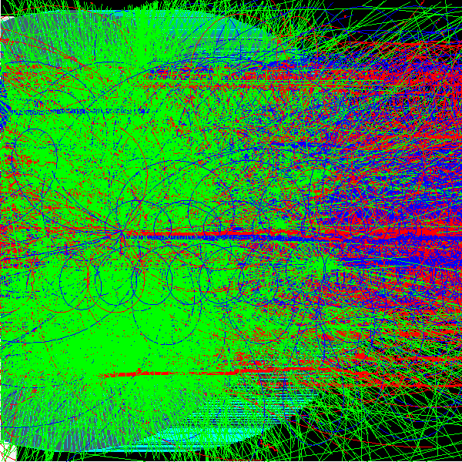
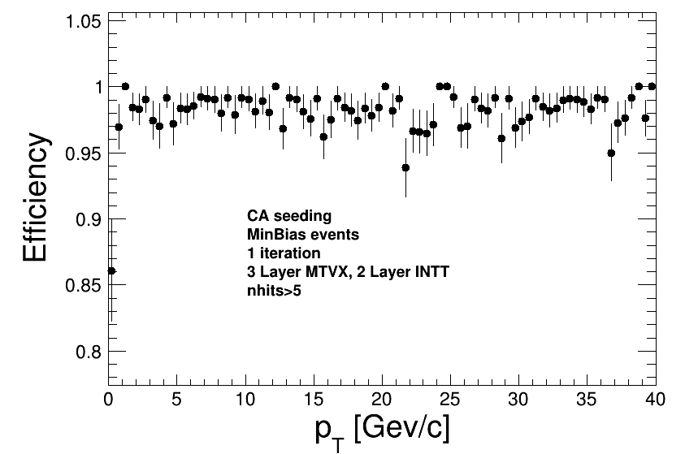
CA from Alice for Seeding
Just to show what kind of tracking problems we are dealing with
Very peripheral heavy ion collision from hijing
MinBias+PU still processing
MinBias efficiency almost indistinguishable from 100% (95% minimum except for pt=0 bin)

Slide 9
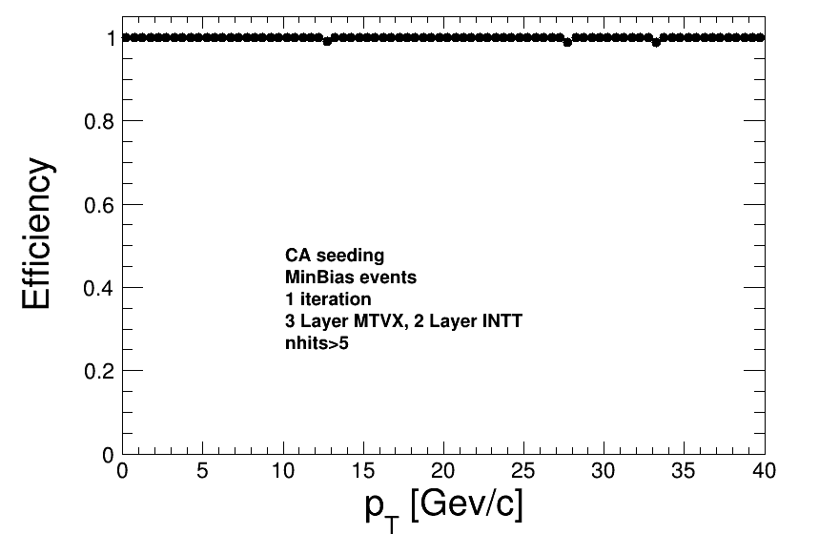
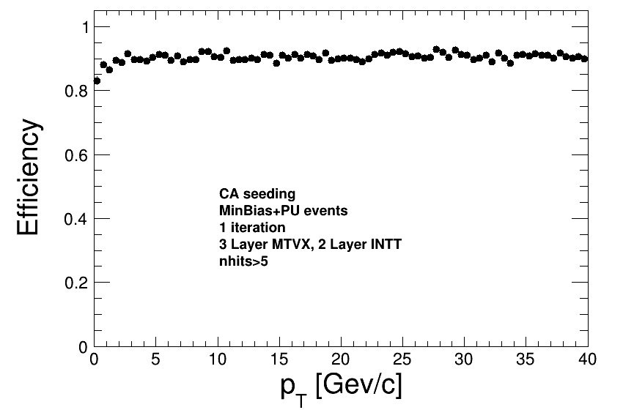
Initial High-Occupancy Tests: Efficiency
MinBias sample: seeding efficiency basically indistinguishable from 100%
MinBias+PU sample: seeding efficiency at roughly 90%

Slide 10
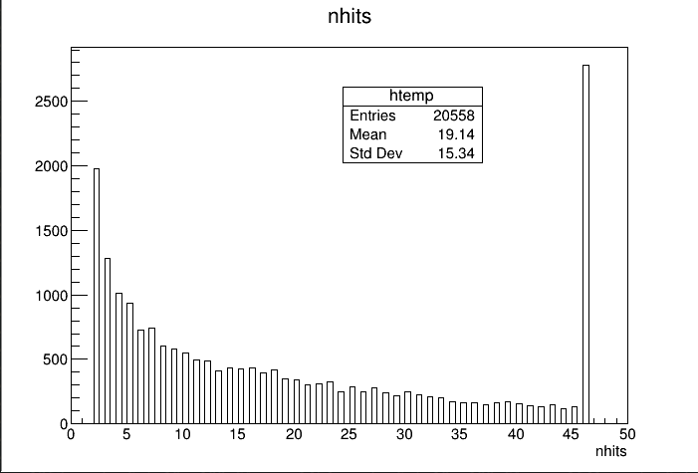
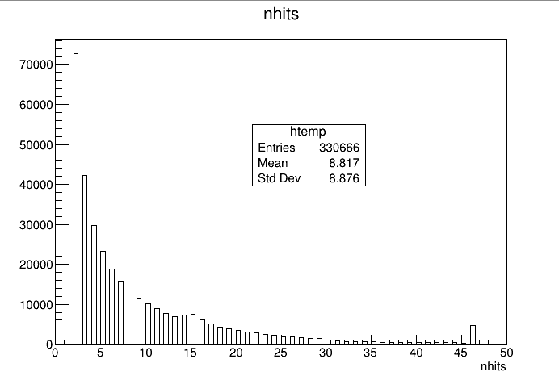
Initial High-Occupancy Tests: nHits
MinBias sample: combinatorics not dominant (46-cluster seeds dominate)
MinBias+PU sample: distribution dominated by short seeds

Slide 11
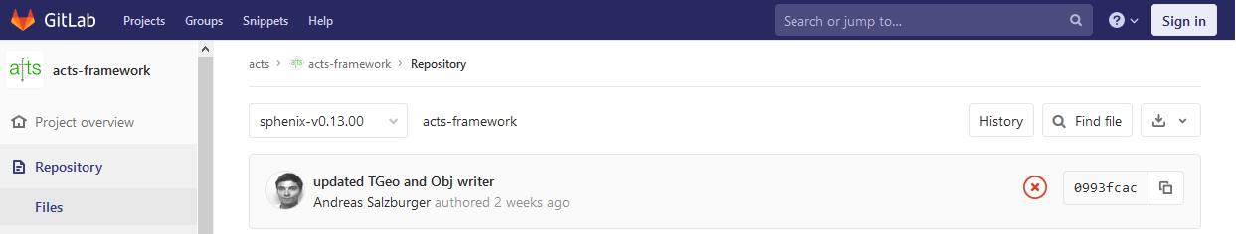
ACTS in Fun4All
sPHENIX has its own development branch in acts-framework, it is part of our nightly build
sPHENIX geometry was implemented by Andy (Many Thanks)
  https://github.com/sPHENIX-Collaboration/calibrations/blob/master/ACTS/sPhenix.root

Slide 12
Status of ACTS in Fun4All
Complete Code base and all 3rd party packages ported to gcc 8.3
gcc 8.3 environment fully functional, setup via
source /cvmfs/eic.opensciencegrid.org/gcc8.3/opt/sphenix/core/bin/eic_setup.sh

Slide 13
Flexibility of the digitization+clusterization of the code : how easy is to implement different read-out options ( e.g.: pixel pitch, pads, etc.) and clustering algorithms. Are there common base classes? How easy is for the detector developers to implement more read out options (e.g.: different inherited classes)? -> This doubts overlap with the "Simulation Needs" of the gaseous detector.
We had bad experiences with strip/pixel implementations in GEANT4 (bugs in the parametrized volume implementation)
All granularity and digitization is done in reconstruction modules
  We do have some generic granularity modules for cylinders and blocks available
All reconstruction modules inherit from the same base class
  We do have a padplane base class to play with different geometries for the TPC
  Otherwise it is up to the user how to organize their code
We do define the interfaces and base classes for our data objects so reconstruction modules can be exchanged (or run simultaneously for comparisons)
And yes – we have the full chain from particle generator to jet reconstruction implemented

Slide 14
Your Reconstruction Module
You need to inherit from the SubsysReco Baseclass
(offline/framework/fun4all/SubsysReco.h) which gives the methods
which are called by Fun4All. If you don’t implement all of them it’s
perfectly fine (the beauty of base classes)
Init(PHCompositeNode *topNode): called once when you register the module with the Fun4AllServer
InitRun(PHCompositeNode *topNode): called whenever data from a new run is encountered
Process_event (PHCompositeNode *topNode): called for every event
ResetEvent(PHCompositeNode *topNode): called after each event is processed so you can clean up leftovers of this event in your code
EndRun(const int runnumber): called before the InitRun is called (caveat the Node tree already contains the data from the first event of the new run)
End(PHCompositeNode *topNode): Last call before we quit
If you create another node tree you can tell Fun4All to call your module
with the respective topNode when you register your modue

Slide 15
1. Various types of digitization schemes supported by the track fitting code
§ TPC
§ X-Y (planar trackers, i.e. GEMs)
§ Z-𝜙 (cylindrical trackers, e.g. cylindrical 𝑀𝑃𝐺𝐷 )
2. Track fitting code should available and usable
§ No hard coded detector lists or sensitive volumes
§ Automatic geometry match along the simulation -> digitization -> reconstruction chain
3. Symmetric access to simulated (truth) and reconstructed quantities
§ e.g. track parameterizations at various locations
1: simulated hits in the detectors are translated into measurements with associated errors
  TPC generates electrons from deposited energy and drifts electrons onto pad plane
  planar/cylindrical trackers provide 3d space points with error based on granularity/resolution
2: Tracking code based on Genfit and Rave is available for central region, forward tracking in form of truth tracking
  Detectors are configured on the macro level as is the tracking
  Geometry is propagated from the simulation to the reconstruction
  Full Truth tracking implemented up to jets
  Track projections using genfit are possible(?)
The approach of EICRoot and Fun4All is very similar, switching should be a fast learning curve for users

Slide 16
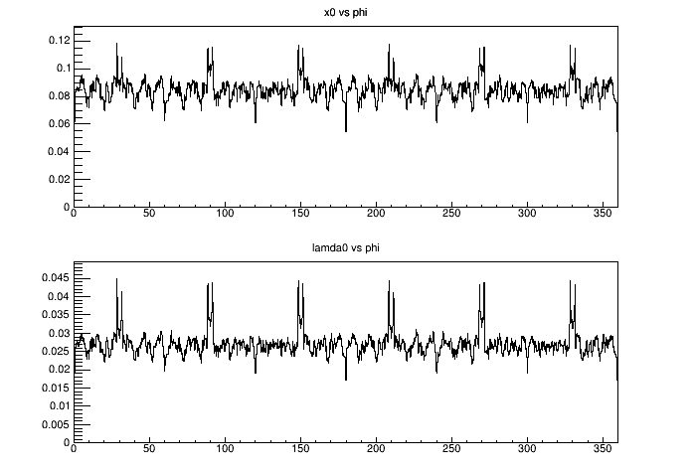
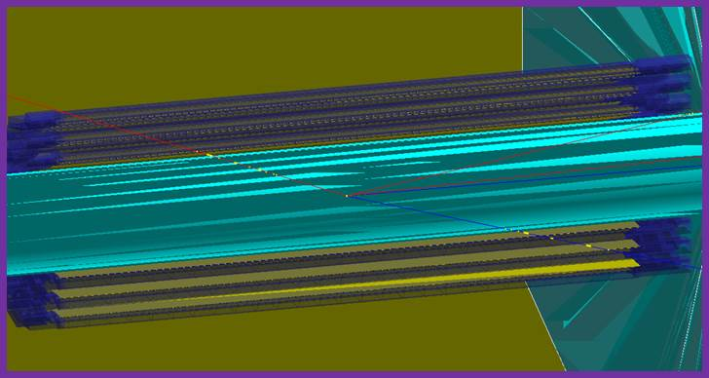
4. Material scans
4: Implemented on a macro level:
  https://github.com/sPHENIX-Collaboration/tutorials/tree/master/materialscan
Material budget of sPHENIX inner tracker
Example Detector from gdml (TGeo) file:
https://github.com/sPHENIX-Collaboration/coresoftware/blob/master/simulation/g4simulation/g4detectors/PHG4GDMLDetector.cc

Slide 17
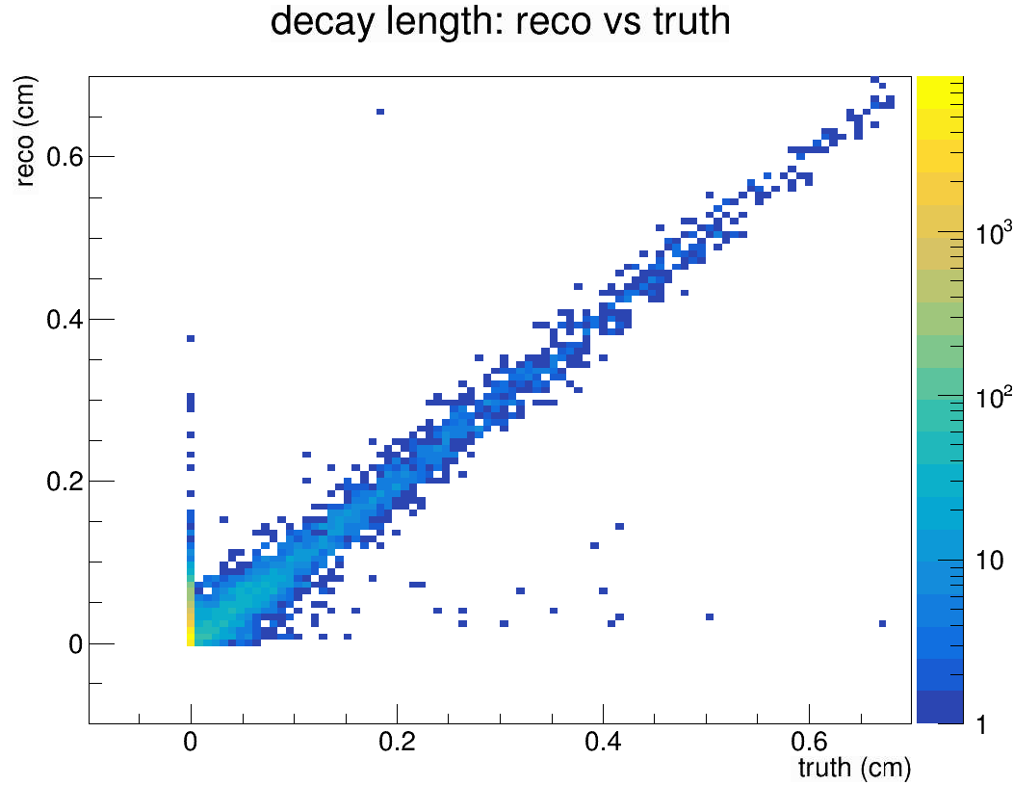
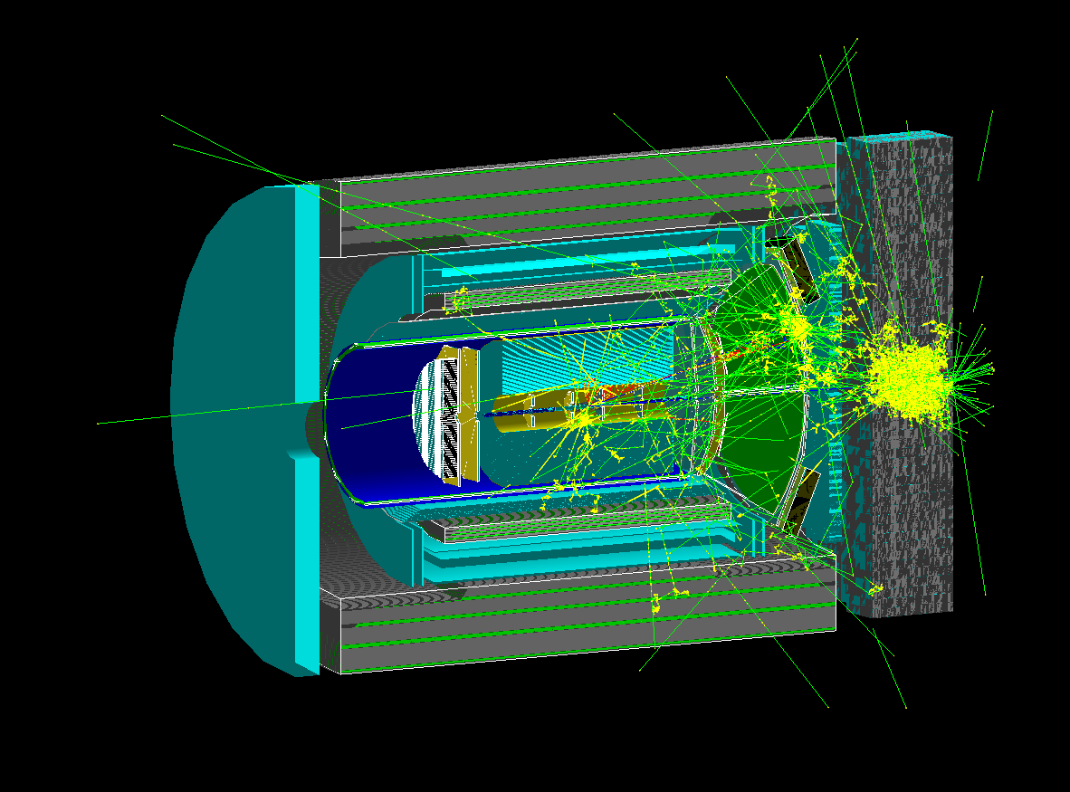
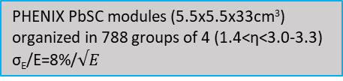
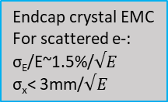
Leptoquark Study for an EIC Detector Based on Babar Magnet
5. Easy to use vertexing
Full detector simulation, tracking, vertex and secondary vertex finding using Fun4All infrastructure
LQGENEP for signal
DJANGOH/PYTHIA for SM bkgd
Outer HCAL
GEM/sTGC Tracking Stations(z=120,165, 50-100μm in φ, 1cm in r)
EMCAL
Central DIRC for PID
Inner HCAL
Pb/Sc sandwich hadronic calorimeter (NEW) 10x10x100cm³ towers (1.2<η<4.0)
Reconstructed tau decay vertex
Forward RICH for hadron PID
20x20 array of 2.2x2.2x18cm³ PbWO₄ crystals (PHENIX MPC) with 10x10cm square hole (300 crystals total) 3.0-3.3<η<4.0
Truth tau decay vertex
Courtesy of Jinlong Zhang, Stonybrook
Endcap crystal EMC
For scattered e-:
σ_{E}/E~1.5%/$√E$
σ_{x}< 3mm/$√E$
PHENIX PbSC modules (5.5x5.5x33cm³) organized in 788 groups of 4 (1.4<η<3.0-3.3) σ_{E}/E=8%/$√E$
See Parallel talk https://indico.in2p3.fr/event/18281/contributions/71617/

Slide 18
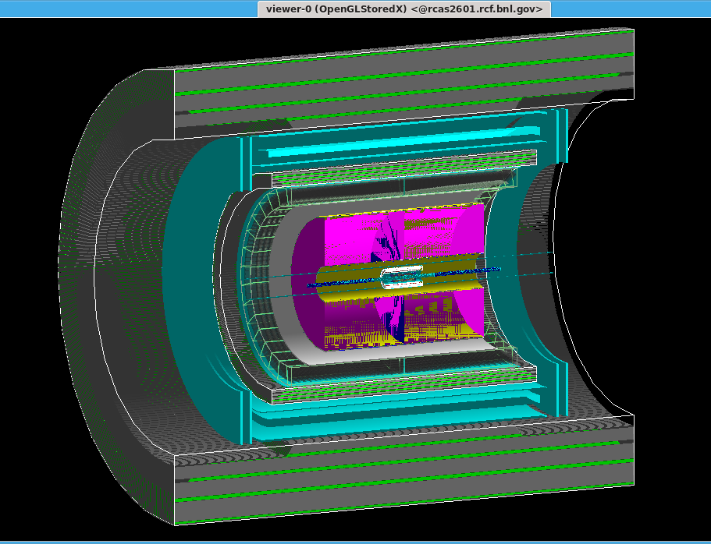
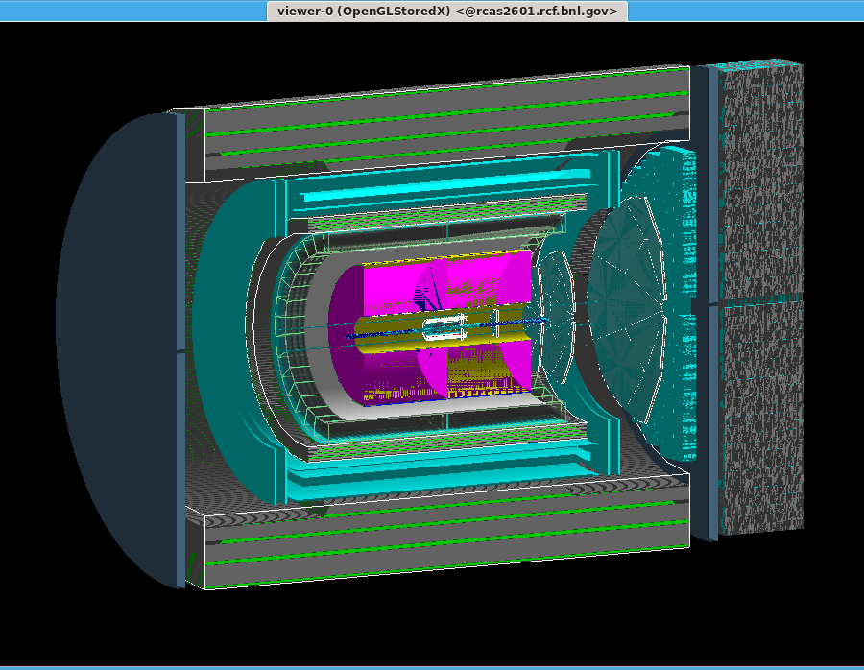
6. Suite should be modular so swapping detectors in and out does not require a lot of effort such as making changes in multiple places and needing to constantly recompile.
  Detectors are configured in ROOT macros, no recompilation needed. Easy maintenance of multiple configurations
sPHENIX
sPHENIX with forward instrumentation

Slide 19
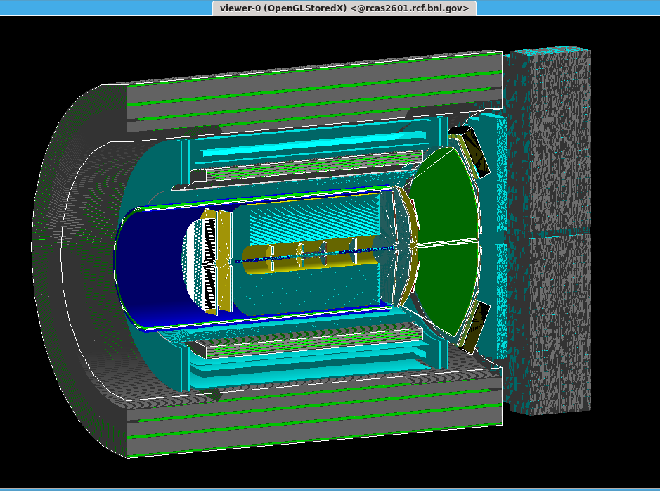
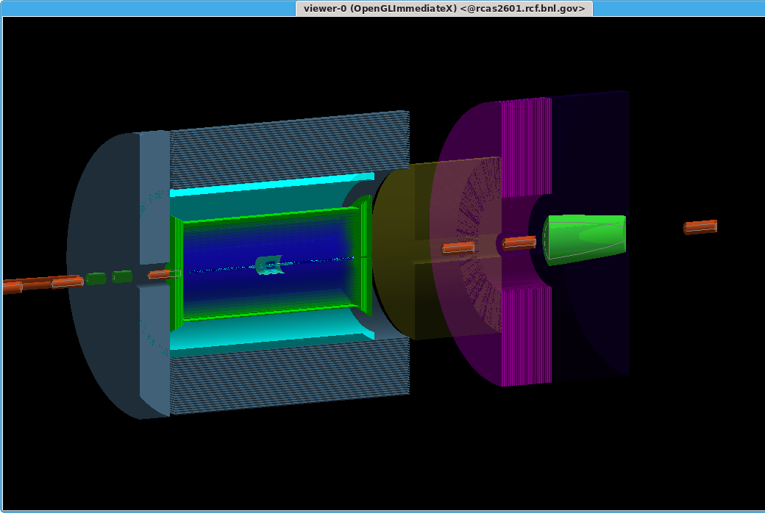
6. Suite should be modular so swapping detectors in and out does not require a lot of effort such as making changes in multiple places and needing to constantly recompile.
  Detectors are configured in ROOT macros, no recompilation needed. Easy maintenance of multiple configurations
EID detector based on sPHENIX
(different inner tracking + emcal)
Partial JLeic Detector
(reverse engineered in 2 days)
https://github.com/EIC-Detector/g4jleic

Slide 20
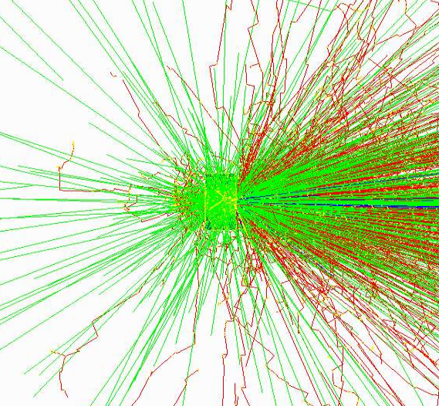
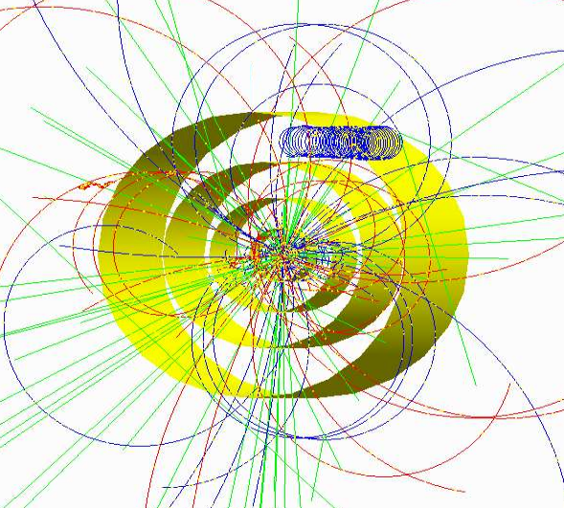

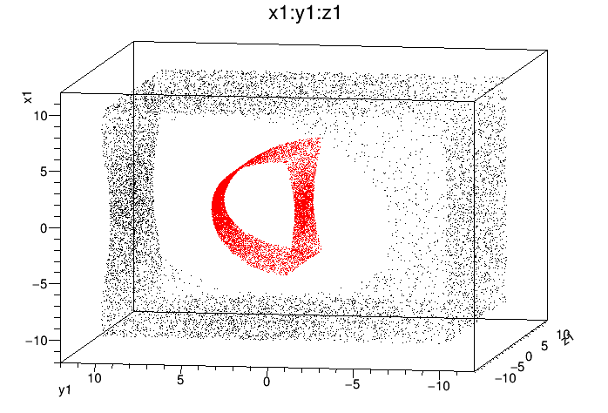
6. Suite should be modular so swapping detectors in and out does not require a lot of effort such as making changes in multiple places and needing to constantly recompile.
  Detectors are configured in ROOT macros, no recompilation needed. Easy maintenance of multiple configurations
10 GeV Au on
water phantom
(NSRL)
Pythia8 in a 6 layer silicon detector mockup and 2T field
Geantino scan of an example detector
Entry hits (inner side)
Exit hits (outer side)
Absolute Coordinates (cm)
https://github.com/EIC-Detector/g4exampledetector/tree/master/simple

Slide 21
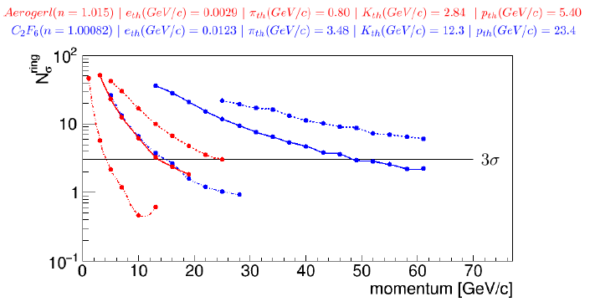
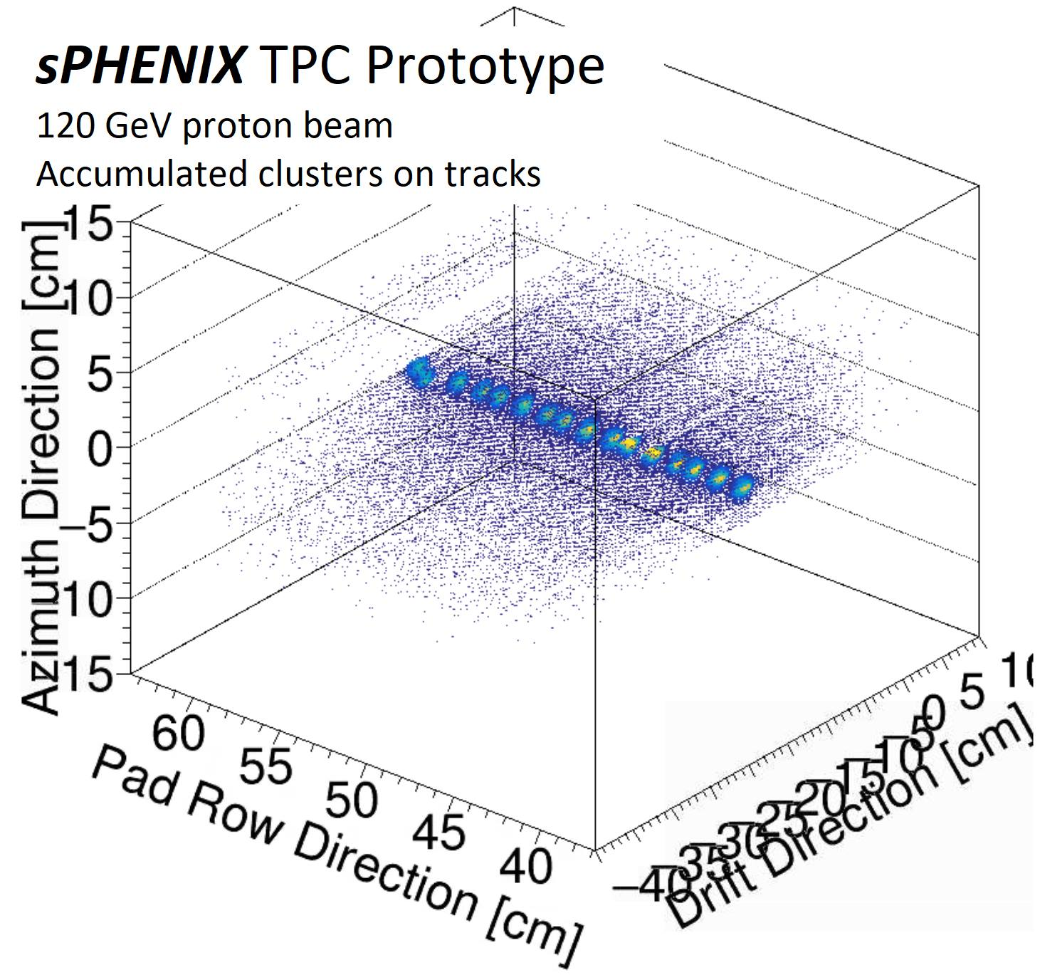
Rich PID
Forward Quarkonia
Forward Momentum Resolution
Material budget of sPHENIX inner tracker
Central Barrel Jet Energy Resolution
Fun4All Framework is ready for use NOW
  Major collider detector successfully brought through cd-process
Modularity allows easy re-use of existing components
Chain from event generator/raw data to final user output
Snapshots of chain can be saved, chain can pick up from there
Runs in Singularity Container and uses cvmfs for libraries
  Use on a farm or on a laptop
  Running on the OSG and HPC should be possible
30+ detectors implemented so far
No geometry model enforced
  low bar to add existing GEANT4 based projects
Large and active user base already
  support via Mattermost channel
Tracking Efficiency
Forward Jet Energy Resolution
Physcis List Calorimeter Test
TPC with streaming readout

