Slide 1
OLiMPS – OpenFlow Link-layer MultiPath Switching
Dr. Michael Bredel (Caltech)
Prof. Harvey Newman (Caltech; PI)
Dr. Artur Barczyk (Caltech)

Slide 2
Challenges and Objectives
Research context: Efficient interconnection between nodes in a network
Practical context: LHC Open Network Environment (LHCone)
OLiMPS – OpenFlow Link-layer MultiPath Switching
Addresses the problem of topology limitations in large-scale layer-2 networks
Removes the necessity of a tree structure in the topology achieved through the use of the Spanning Tree Protocol
Allows for per-flow multipath switching and increases the robustness and efficiency of layer-2 network resources
Integrates dynamic circuit provisioning systems, like OSCARS, and OpenFlow

Slide 3
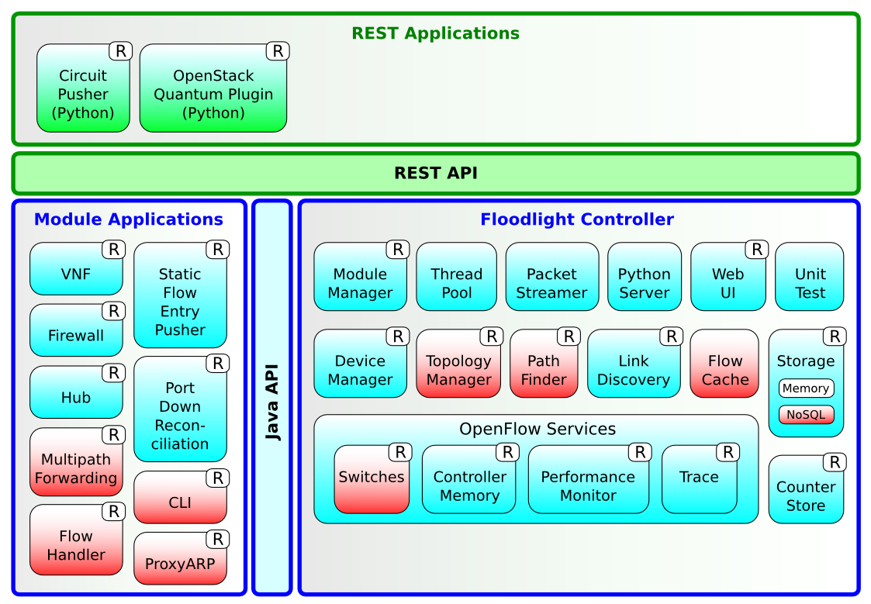
Technical Solution: OLiMPS Controller
An SDN/OpenFlow approach
A centralized out-of-band control to construct a robust multipath system without modifications of to the layer-2 frame structure
The OLiMPS OpenFlow controller (based on Floodlight)
Download at http://www.uslhcnet.org/projects/olimps/

Slide 4
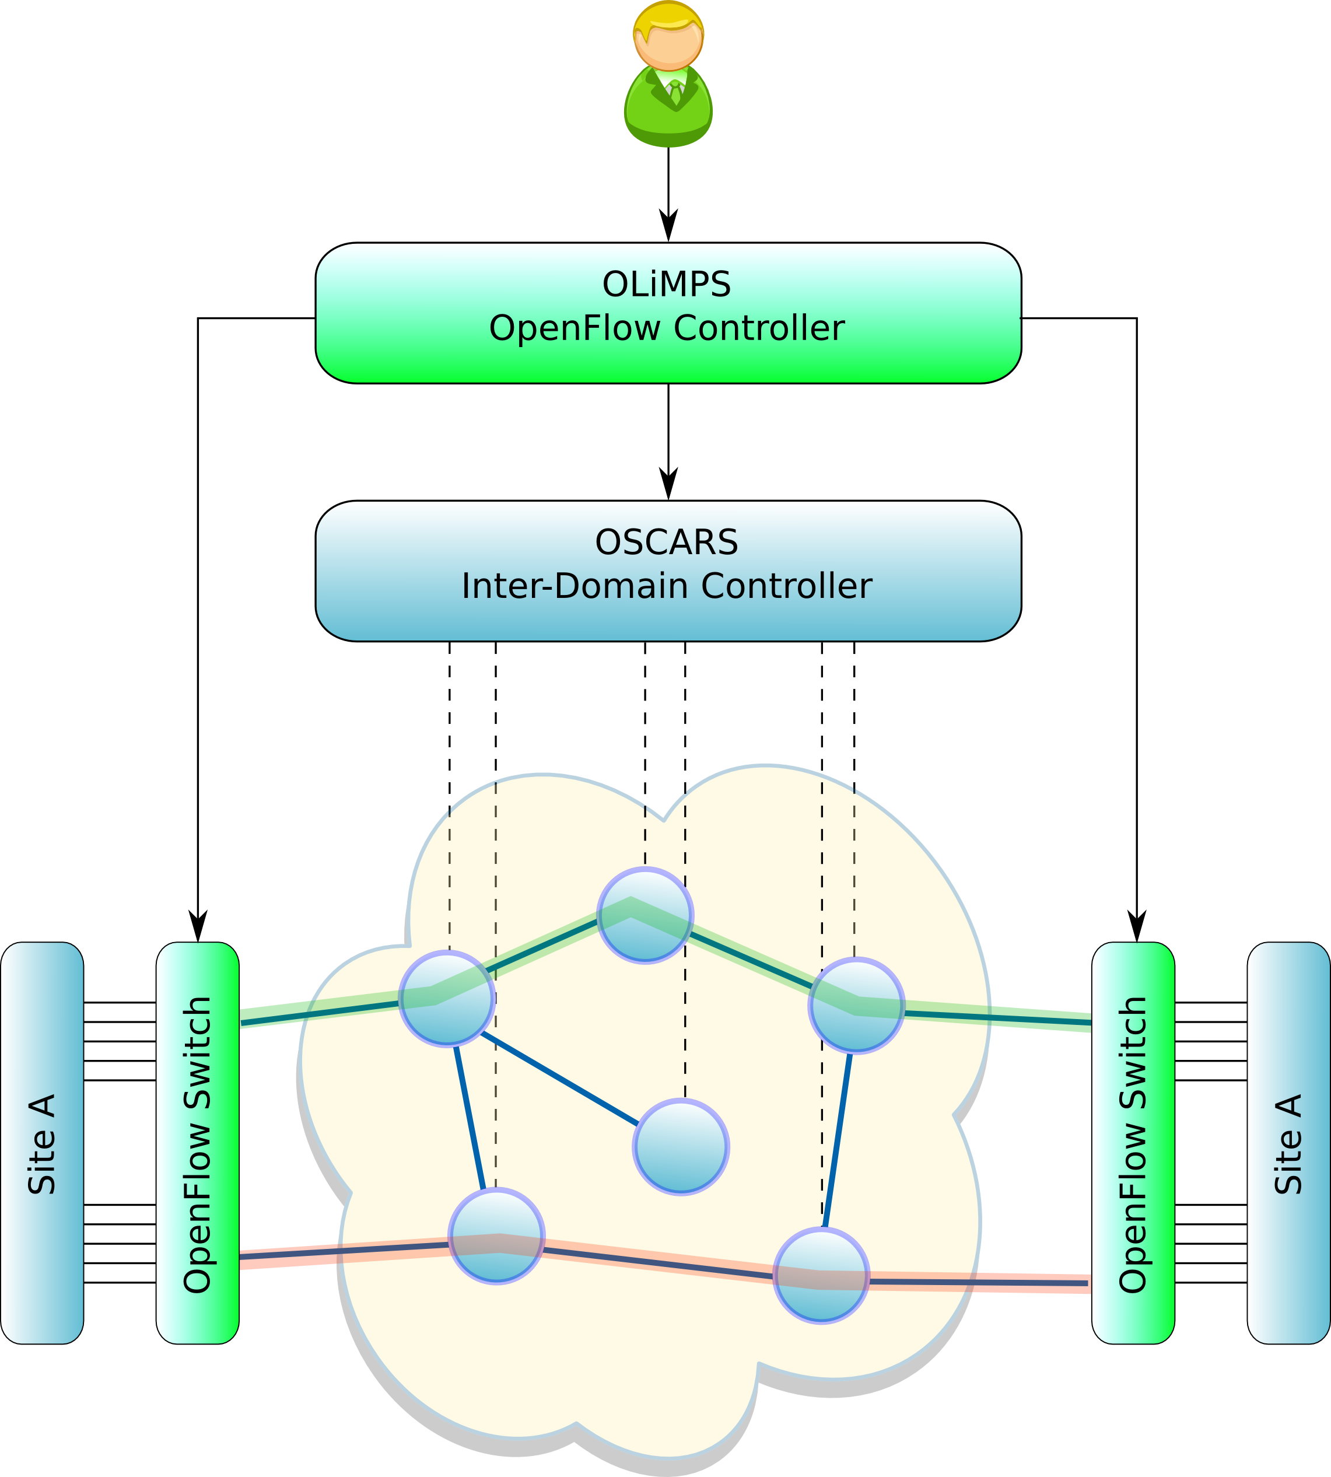
Technical Solution: OSCARS Integration
OLiMPS/OSCARS interface
User (or application) requests network setup from OLiMPS controller
OLiMPS requests setup of multiple paths from OSCARS-IDC
OLIMPS connects OpenFlow switches to OSCARS termination points, i.e. VLANs
OLiMPS transparently maps the site traffic to the VLANs
Status: Under testing

Slide 5
Achievements
Successful SC’12 demo of a first prototype in collaboration with SurfNet, iCAIR, and SARA.
Basic setup with one controller and a limited number of links and flows
Successful SC’13 demo in collaboration with University of Victoria, University of Michigan, Vanderbilt, and University of Sao Paulo
Extended setup with multiple links and a large number of flows
Invited presentation at Open Networking Summit 2013
Floodlight success stories
Accepted paper at HotSDN 2014
Compares various load balancing algorithms

Slide 6
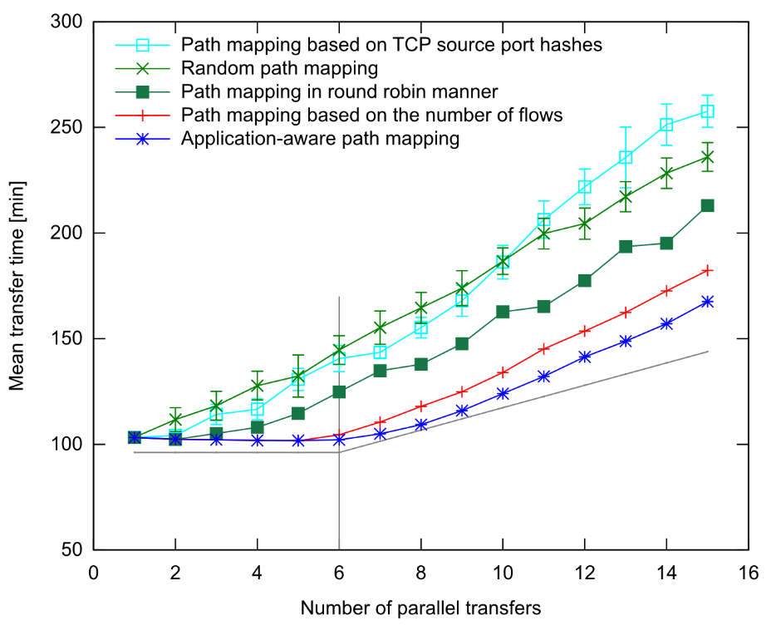
OLiMPS Results: In-Network Load-Balancing
Testbed with 6 link disjoint paths
Multiple data flows, approx. 500 GByte each
Comparison of different in-network load balancing algorithms
Accepted at HotSDN 2014, August 2014, Chicago, USA

Slide 7
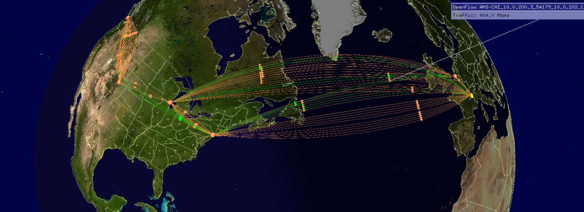
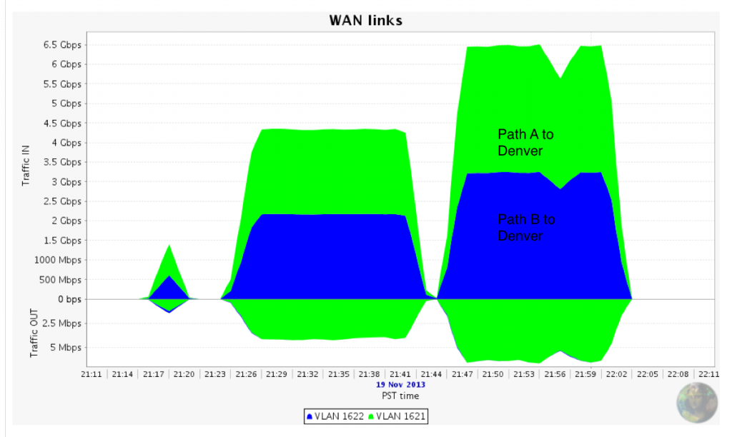
OLiMPS Results: Wide Area Deployment
Intercontinental OpenFlow demo at SC13
Testbed with equipment in AMS, GVA, NYC, CHI, DEN, and VIC
Controlled by the OLiMPS controller

Slide 8
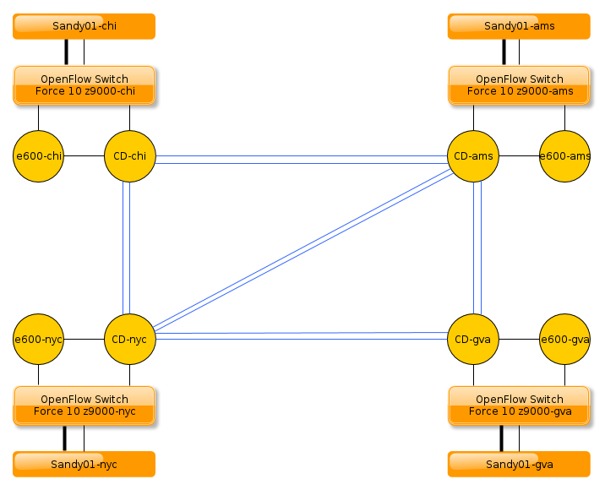
OLiMPS Results: Deployment in US LHCNet
Permanent OpenFlow testbed within US LHCNet
Equipment in GVA, AMS, CHI, and NYC
Controlled by the OLiMPS controller
Used for tests and experiments, e.g. OSCARS integration
Used for an upcoming SDX demonstration

Slide 9
Thank you for your attention
Contact: Michael.Bredel@cern.ch
Project web page: http://www.uslhcnet.org/projects/olimps

