Slide 1
SDN Enhancements for TeraPaths
Dantong Yu
Dimitrios Katramatos
BNL CSC
May 2014

Slide 2
Looking back in history…
2004: Lab 04-03 High Performance Network Research: Ultra High-Speed transport protocols and Dynamic Provisioning technologies
OSCARS/TeraPaths/Lambda Station projects aim to provide dynamic networks for applications instead of requiring static configuration by network engineers
All these systems use software to configure networks, effectively separating the control from the data plane, a.k.a. Software Defined/Managed/Controlled Networks (SDN, SMN, SCN).
Could SDN origins be actually traced back to the 2004 DOE research program?!

Slide 3
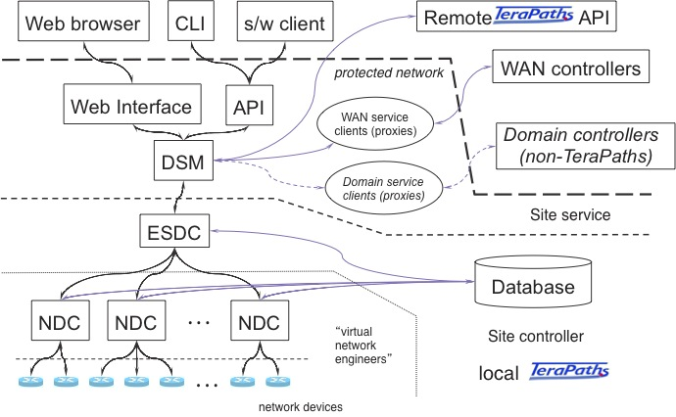
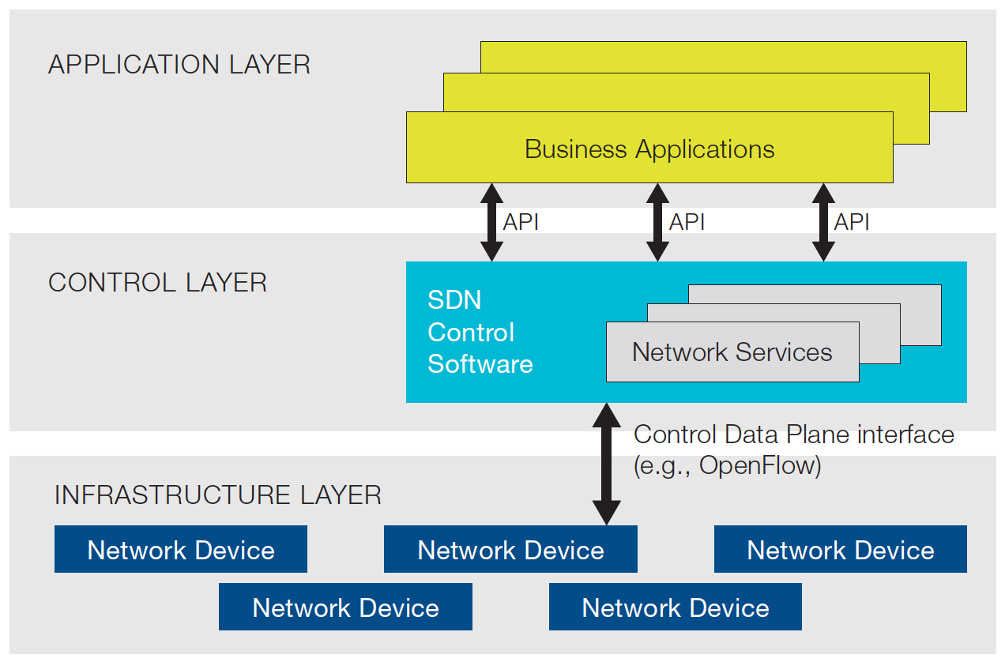
TeraPaths and SDN
TeraPaths functionality:
Enables users and applications to reserve virtual end-to-end (i.e., host-to-host) paths with guaranteed QoS for specific data flows
Interfaces with OSCARS to acquire dynamic virtual circuits over WAN domains and interconnect end-sites
Clearly an SDN architecture:
TeraPaths architecture*
SDN architecture**
vs.
* Early version of figure appeared in 2006 BROADNETS TeraPaths paper
** Figure from 2012 ONF white paper

Slide 4
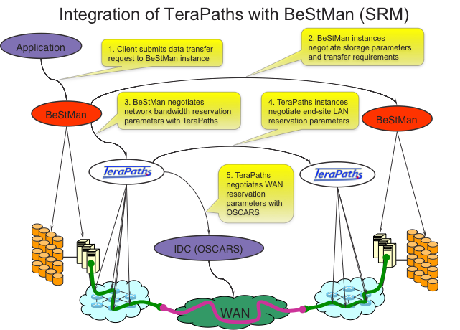
TeraPaths spinoffs
StorNet (2009): co-scheduling of storage and network bandwidth through integration of TeraPaths with BeStMan
VNoD (2010): scheduling of virtual network instances comprising multiple virtual paths to interconnect multiple end-sites

Slide 5
So, what can we enhance?
Leverage OpenFlow for controlling network devices
TeraPaths uses hardware-specific drivers
Need a different driver for each vendor and/or hardware model
Need OpenFlow-based driver functionality
Interface with SDN controllers, e.g., Floodlight
Could potentially control any kind of device supporting the OpenFlow protocol, making life a lot easier
Combination of vendor-specific and OpenFlow-based drivers can control a wide range of devices both in-service and future-installed

Slide 6
TeraPaths and OpenFlow
TeraPaths uses DiffServ for LAN QoS and PBR to forward traffic into circuits
OpenFlow can provide alternative provisioning methods
“Quality of Service is at its infancy when it comes to OpenFlow”
http://www.openflowhub.org/display/floodlightcontroller/How+to+implement+Quality+Of+Service+using+Floodlight
Version 1.3 added support for “per-flow meters” to measure and control packet rates
Simple DiffServ policers should now be possible
More R&D is needed – Floodlight enhancements?

Slide 7
Looking into the Future
Enhance TeraPaths and sister projects (OSCARS, Lambda Station) with OpenFlow functionality for inter- and intra-domain network virtualization: Intelligent Network Operating System (iNOS?)
Enhance OpenFlow/OpenStack Cloud stack with StorNet/VNOD-style co-scheduling algorithms to provision/schedule network resources along with CPUs and storage: Software Defined Data Center (SDDC)

