Slide 1
sTGC Integration
- Rahul Sharma

Slide 2
sTGC Pentagonal module and STAR West Poletip
Please note that EEMC PMT Boxes are missing from the poletip snapshot.
Snapshot shows the new sTGC Pentagonal Modules.
All dimensions are in mm in this snapshot

Slide 3
Front and Cross-sectional Views
All dimensions in inches in this snapshot

Slide 4
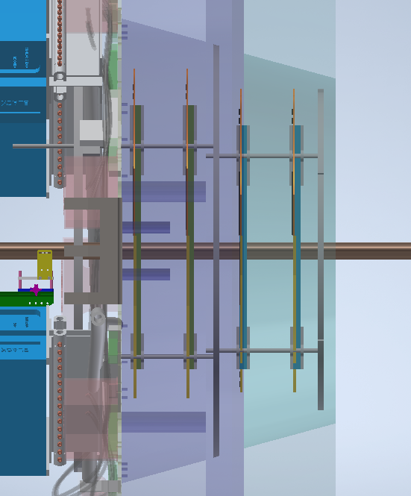
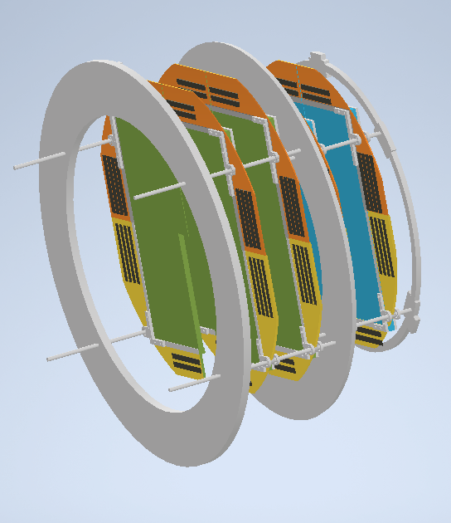
Previous Design

