Slide 1
FST Support Structure and Novec Cooling System
Rahul Sharma

Slide 2
Status
Support Structure for Integration
Conceptual Design exists since September last year. Some modification and details have been added since then.
Hiring a new designer to start work on detail design and integration
Novec Cooling System:
Problems identified: Leakage points, filtration problems etc
Parts ordered for replacement (pumps, controllers, filters, leak lock special grade): Waiting for delivery
Working on Test Plan
Plan to assemble and test it sometime in May/June
Novec in Stock

Slide 3
Structure inside Cone (Hollow Stationary Rails and Supports)
The inner support structure is designed in a way that it can counteract deflections due to weight of the detectors and other factors.
As Cone is not perfectly concentric around beampipe, design includes feature that allow the FST structure to be supported by cone and still be centered on the beampipe. This is done using adjustment screws and pads arrangement.
To protect the inner surface of cone from scratching/being damaged by the FST support structure, EPTFE will be used as a material at contact regions between support structure and carbon fiber cone.

Slide 4
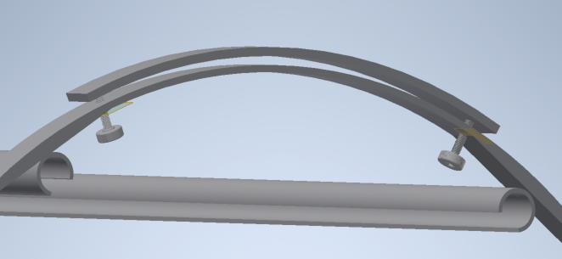
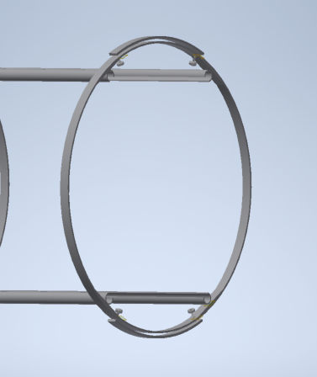
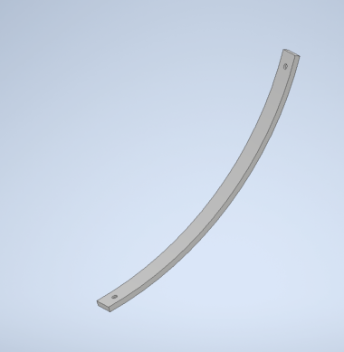
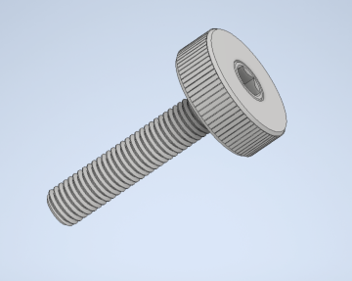
Rings and Collars
Pad
McMaster-Carr
Part #: 98704A730

Slide 5
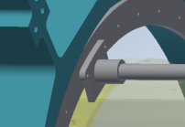
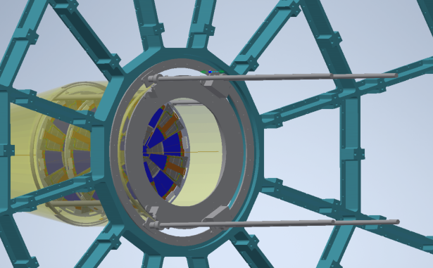
Outer Support Structure (Ring and Brackets)
Brackets as shown in the figure can be directly attached using screws to existing ring on TPC wheel with threaded holes.
These support brackets will be used to mount 4 Aluminum rails
These rails will be used to build and guide the sliding installation and support mechanism.
Please note that these rails and Support brackets and other components will be removed after detector installation.

Slide 6
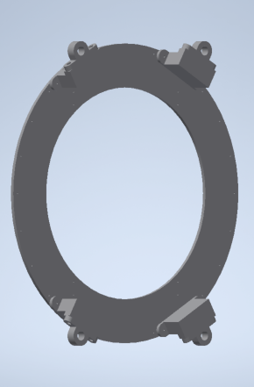
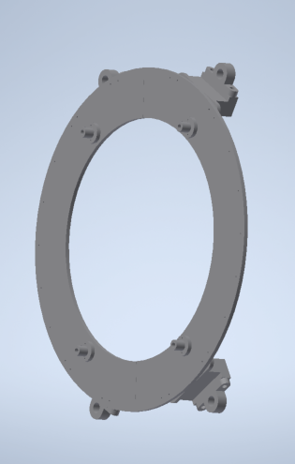
Outer Structure for Support during Installation
Outer Busings
Inner Busings
Sliding Support Ring Assembly with Outer and Inner Bushings

Slide 7
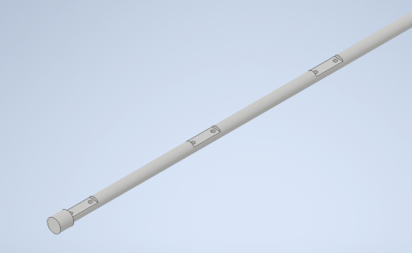
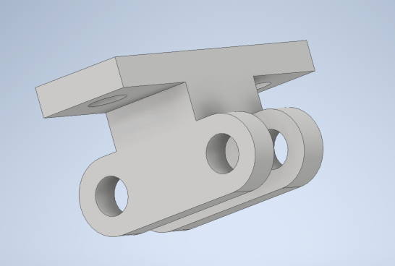
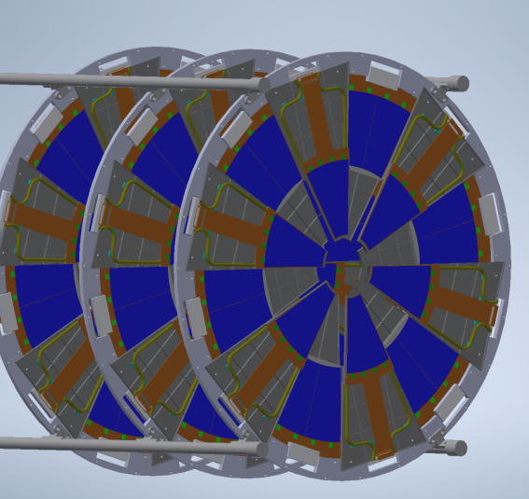
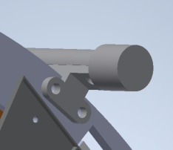
FST Disk Installation Rail and Bracket
Holes have to be added to the detector strongback at 4 places as shown in the snapshot.
These holes will serve as a way for holding the detectors using a holding bracket (Aluminum) and a rail (Aluminum).
+
+
+
=
Bracket gets attached to both the Sliding Rail and the detector Stongback
Eight ¼” holes for structural support

Slide 8
Full Assembly

Slide 9
Schedule
Detailed design: August 31st.
Procurement and Fabrication: December 31st
Installation : by April 2021?

