Slide 1
Application of WireCell toolkit on ICARUS minicrate dataset
Wenqiang Gu, Andrea Scarpelli
Brookhaven National Laboratory

Slide 2
Motivation
Wire-Cell toolkit provides the “2D” deconvolution with a long-range induction effects considered in the field response
https://sbn-docdb.fnal.gov/cgi-bin/private/ShowDocument?docid=16386
The first step is to integrate the toolkit into the ICARUS environment
Connection with larsoft in both simulation and data

Slide 3
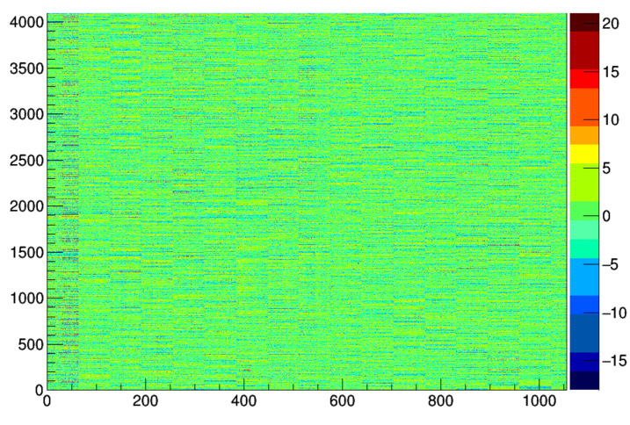
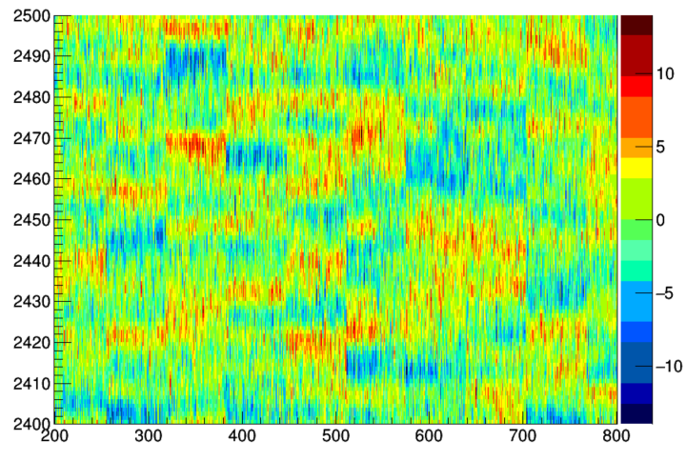
Porting minicrate dataset to WireCell toolkit
64 channels
Raw Waveform (de-baseline)
Reading larsoft data format: successful!
First 1000 channels in one event
Baseline ~ 2000, should be induction
Coherent noise across each readout board (x64 channels)

Slide 4
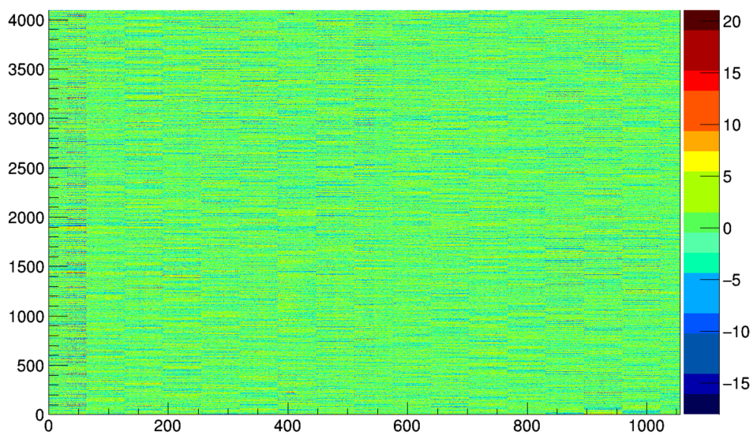
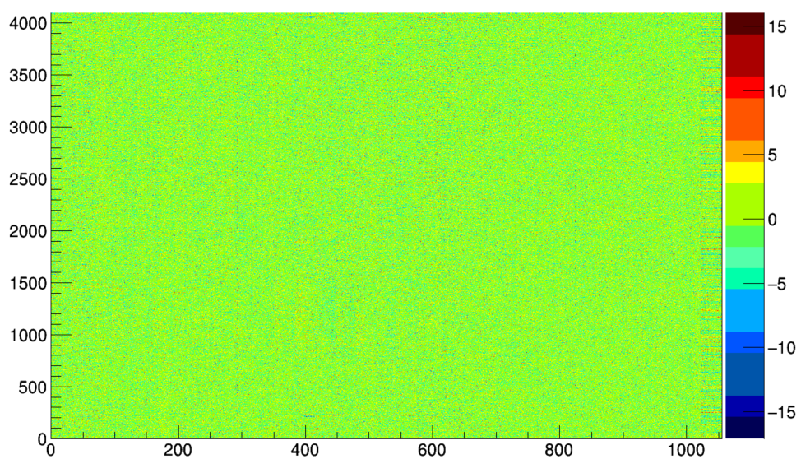
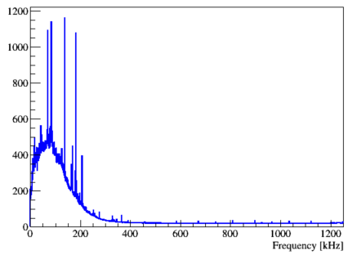
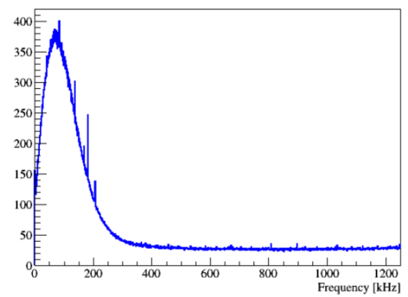
Coherent noise removal
Coherent Noise Removal
Power spectrum
The correlated noise component is reduced

Slide 5
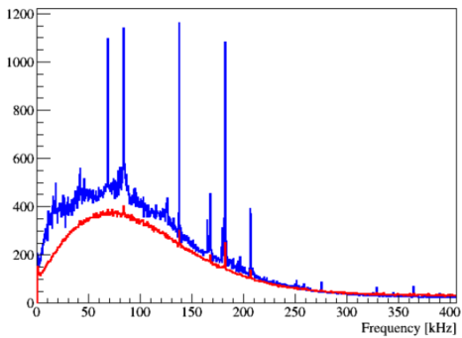
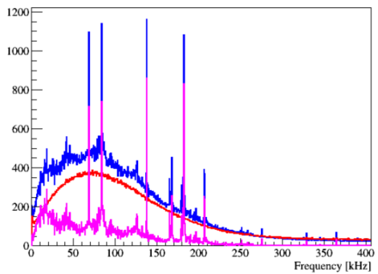
Comparison of the power spectrum
Raw
Denoised
Raw
Denoised
Difference between above two
Some spikes are also “coherent” and got filtered

Slide 6
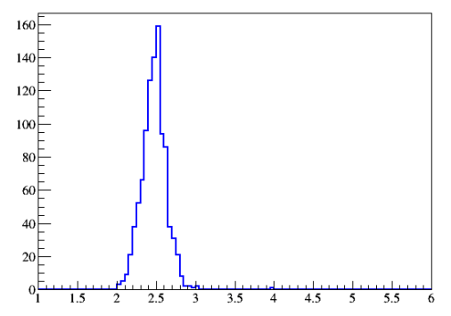
RMS of ADC from each channel
Coherent Noise Removal
RMS ~ 3.2 ADC
RMS ~ 2.5 ADC

Slide 7
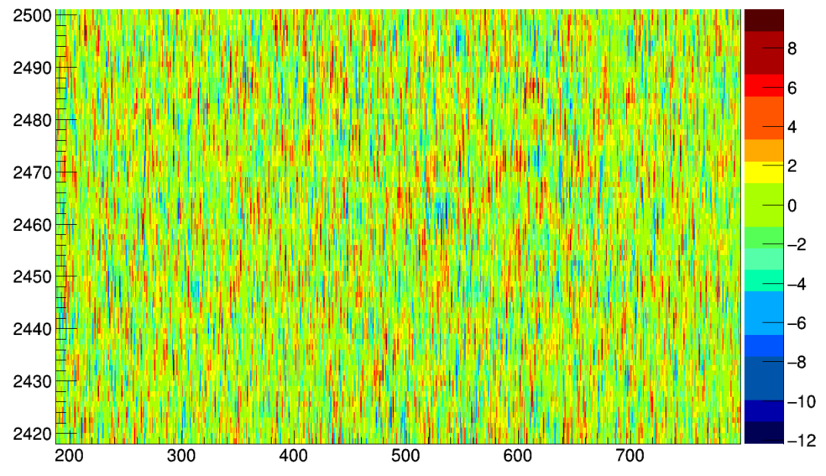
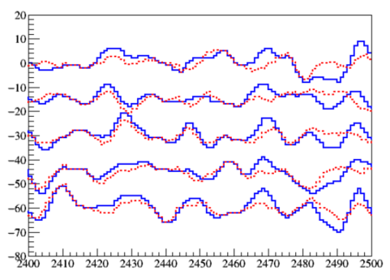
Coherent Noise Removal
Ch: 320
321
322
323
$−$Raw waveform
--- Denoised
324

Slide 8
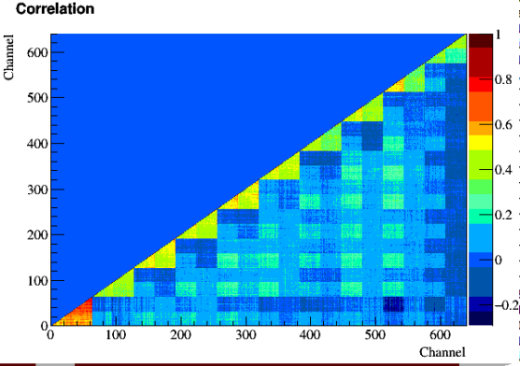
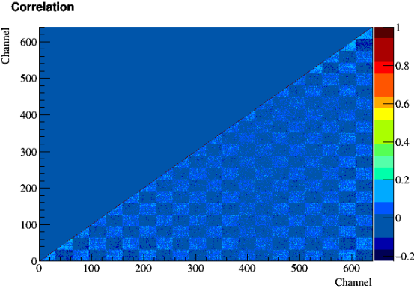
Coherent Removal according to 64 channels / group
Coherent Noise Removal

Slide 9
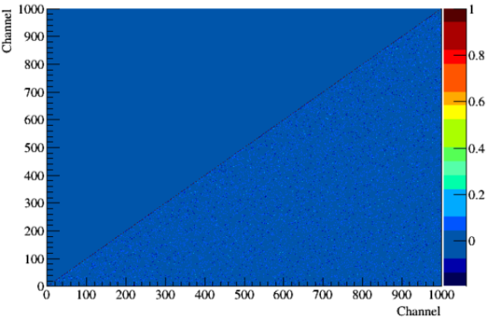
Coherent Removal according to 32 channels / group
Coherent Noise Removal

Slide 10
On-going works
Understanding of the noise from the minicrate data
Performance tuning of the 2D signal processing
Based on both simulation and data
Validation of the field response
As well as the transparency
The plan is to catch up with the commissioning

