Slide 1


Tungsten Scintillator Calorimeter Technologies for EIC
Craig Woody
Brookhaven National Lab
EIC Users Group Yellow Report
Working Group on Calorimetry
February 25, 2020

Slide 2
eRD1 Collaborators
sPHENIX W/SciFi
W/Shashlik

Slide 3
Calorimetry for an EIC Detector (Conceptual)
B
EMCAL resolution ~ (5-7)%/√E ⊕ 1%
EMCAL resolution
~ (10-12)%/√E ⊕ (2-3)%
Energy resolution ~ (1.0-2.0)%/√E ⊕ 0.5%
Requires high resolution crystal calorimetry
Candidates for W-Scintillator Calorimeters

Slide 4
Kinematics of Scattered and Produced Particles

Slide 5
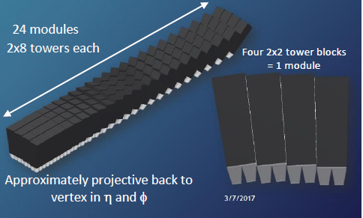
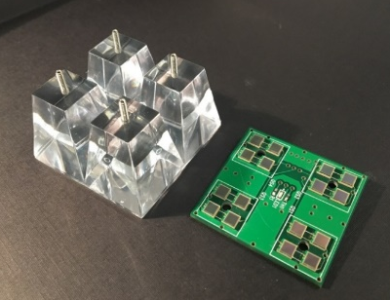
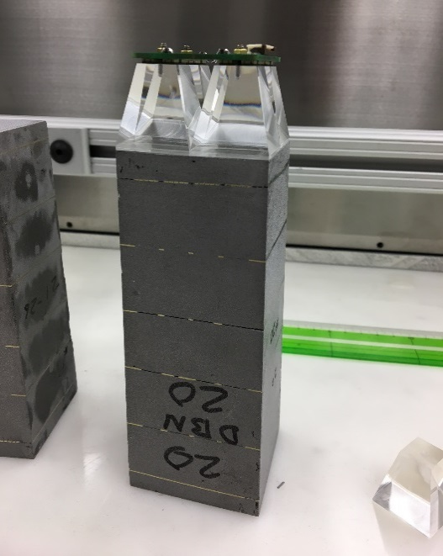
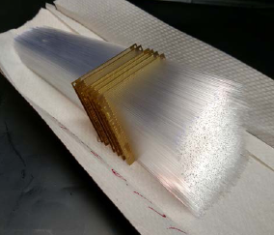
sPHENIX W/SciFi EMCAL
Barrel electromagnetic calorimeter covering ± 1.1 in η and 2π in φ
2(±η) x 32 (φ) = 64 Sectors
  6144 Blocks (24,576 towers)
Matrix of tungsten powder and epoxy with embedded scintillating fibers
(0.47 mm, spacing 1 mm, SF ~ 2%)
Density ~ 9 g/cm3
X₀ ~ 7 mm (18 X₀ total), R_{M} ~ 2.3 cm
2D Projective
Blocks
Readout with light guides and SiPMs
W Powder ~ 50 μm
Fiber Assembly
Mold with W powder, fibers + epoxy

Slide 6
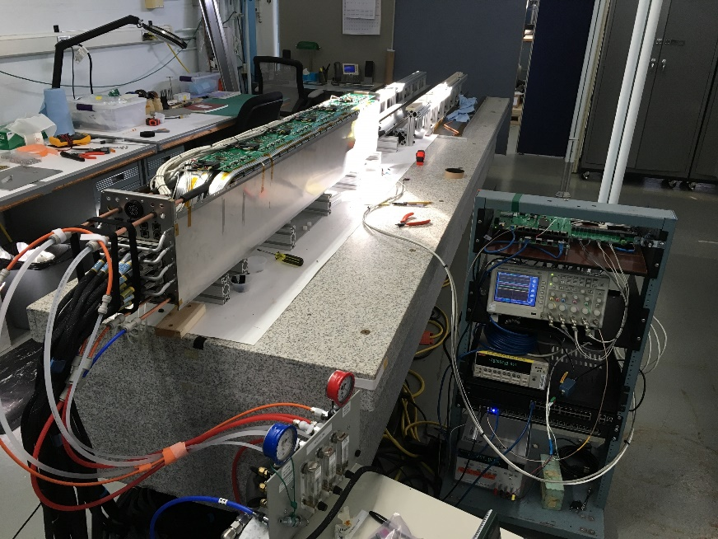
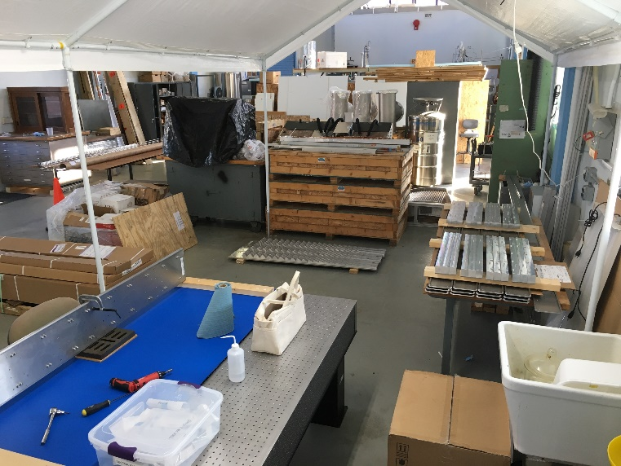
sPHENIX EMCAL under construction
Sector 0 undergoing testing at BNL
Sector storage and testing area in the Physics High Bay
11 Tons of W powder now at UIUC
Blocks for Sector 2 at UIUC

Slide 7
W/SciFi Performance
Non-uniformities are inherent in the design and contribute to the energy resolution
Uniformity of response over 8x8 towers with 8 GeV electrons (test beam data)
Uniformity after position dependent correction
Resolution ~ (13-14)%/√E ⊕ 3%

Slide 8
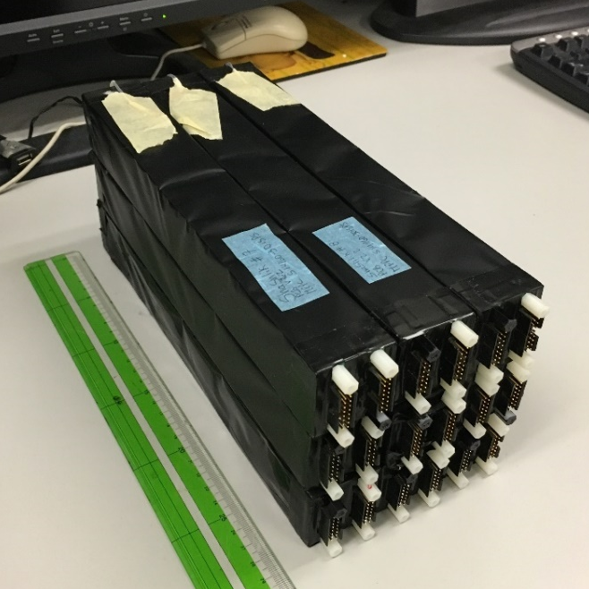
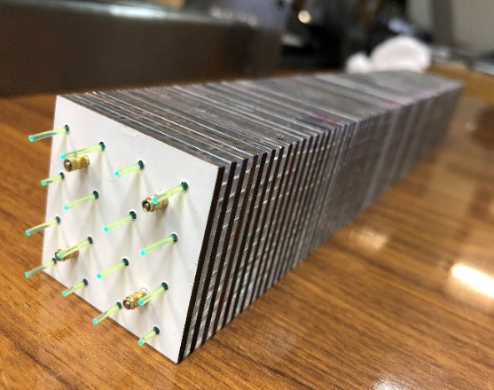
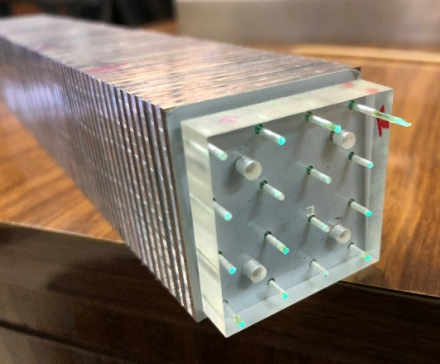
W/Shashlik Calorimetry
  A compact shashlik offers the possibility of improving the light collection uniformity due to the short light path to the WLS fibers.
  Availability of low cost SiPMs allows reading out each fiber individually. This allows determining the position of a shower even within a tower.
80% W/20 % Cu absorber plates
1.5 mm scintillating tiles read out with WLS fibers
Each fiber read out by its own SiPM
3x3 array of W/Shashlik modules built at UTSFM (Chile)

