Slide 1
Yellow Report PID
TK Hemmick & P Rossi

Slide 2
Overview of PID Task for Yellow Report
The fundamental process of the Yellow Report is to match needs and performance:
Needs = physics measurements that require PID
Minimum bias cannot be sufficient, a broad consideration is needed.
The breadth of the consideration present challenges.
How to address and present the variety of needs in a simple, yet effective manner.
How to approach detector complementarity.
How to allow simple inclusion and/or exclusion of processes to drive PID requirements.
It may be best to start-the-task then grow-the-task rather than in the other order.
Requires (at least one) standardized capture of the physics-driven-requirements.
Performance = technology choices for PID and their reach and/or range.
The physics of PID is varied and complex.
Nonetheless, we must at least begin with simple presentations of competing choices.
Requires (at least one) standardized capture of the technology-driven-performance.
Choosing explicitly a (any) first approximation for these facilitates:
Explicit & immediate requests to the software group.
Then explicit requests to the physics group.
Then explicit requests to the detector proponents.
Need to capture the physics processes in a standard manner that makes PID requirements blatantly clear.
Need to capture the detector performance in a standard manner that makes PID performance blatantly clear.
Present Discussion:
A first standard set to get things moving…

Slide 3
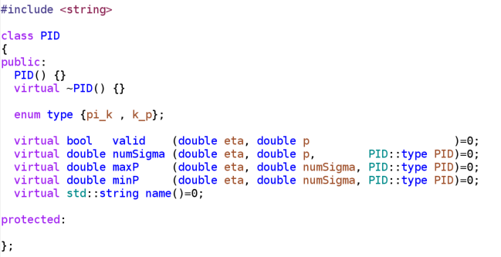
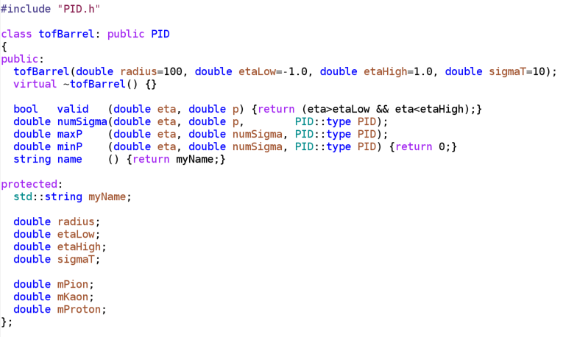
Performance Evaluation
A reasonable start for quantifying PID performance has two questions:
numSigma vs. p and p vs. numSigma
Sometimes easy to calculate … sometimes hard to calculate.
Propose this as required homework for any/all technologies in the YR
Code thoughts (up to software group…but these are a starting point):
Should have common interface. (e.g. imposed by base class)
Derived classes are the responsibility of technology proponents.
Comparative evaluations publicly available.
Guidance pending from software group.

Slide 4
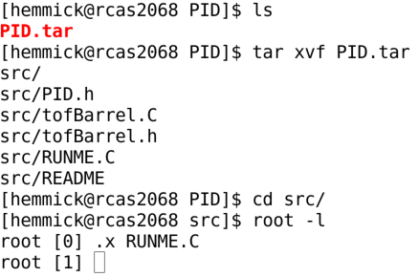
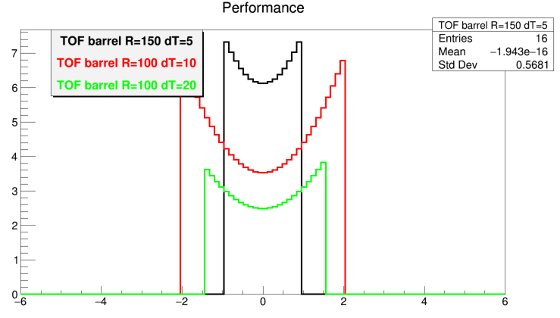
Unsanctioned Code Example
Do this:
I put a tiny tiny tiny code on the Indico Page.
In the end of the day, we must accomplish all the following:
Choice of detector concept(s).
Realistic Implementation in Geant
Realistic Simulation
Final Performance Plots.
The PID co-convenors will require
We are able to ACCESS performance results from any/all technology via code.
We currently do not care how these results were obtained…but we need them badly.
We ask you to immediately begin coding something with the expectation that it will change/improve.
No matter how the framework changes, the questions remain:
numSigma(p, PID)
maxP(numSigma, PID)
minP(numSigma, PID)
Get this:

Slide 5
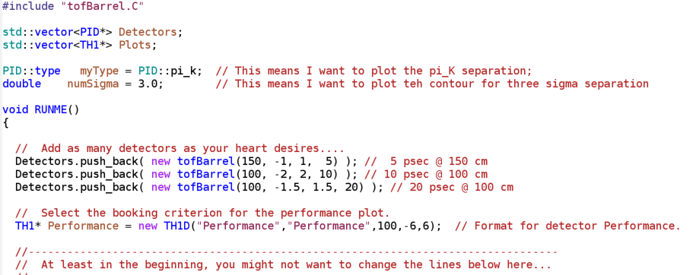
Simple Macro to Generate the Plot(s)
Add as many detectors here as you desire…
We would like all proponents of any detector technology to write their own class(es) in time for the Temple meeting.
This is easiest for groups with long experience in PID (perhaps that is only fair).
We intent to combine these contributions in a working session.
We will present to the community by the end of the meeting plots like this that contain the contributions from our colleagues.
New upgrades (base class, what to plot, how to evaluate, etc…) will be discussed as part of the working session.

Slide 6
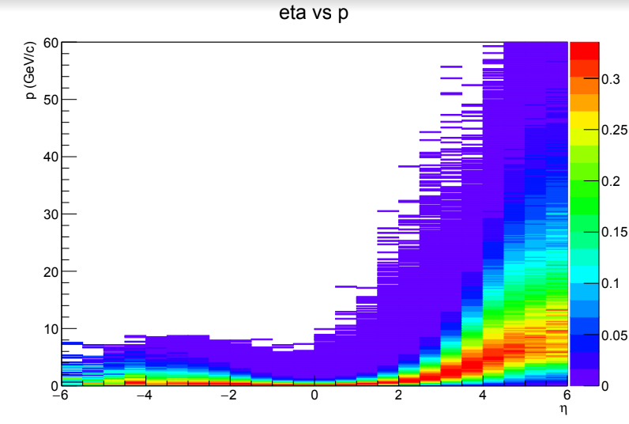
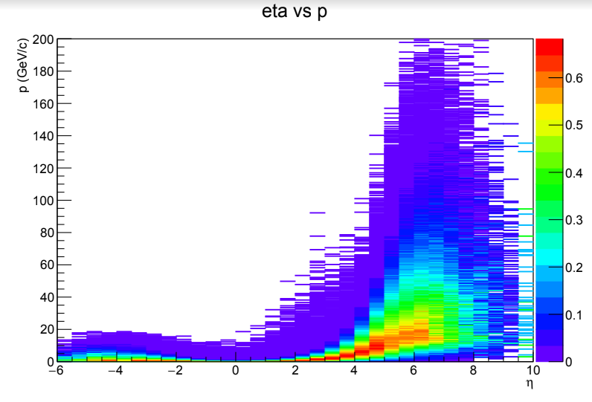
Capturing Physics Needs – Slide 1 of 3
10 GeV x 100 GeV
20 GeV x 250 GeV
Color Scale = Yield
Color Scale = Yield
No red here, but very high momentum
Good:
Detector technologies are arrayed in eta (or THETA).
PID performance is typically presented as a function of p.
Bad:
Yield is not the same as range (therefore colors do not directly represent needs).
Distribution differs from one physics process to the next.
Keep the x,y axes
Improve the z-scale.
Accommodate varied physics

Slide 7
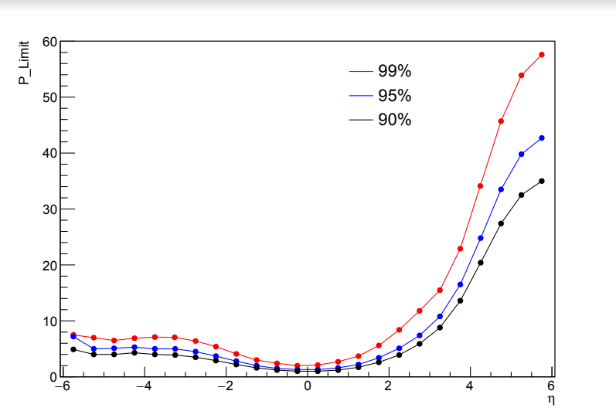
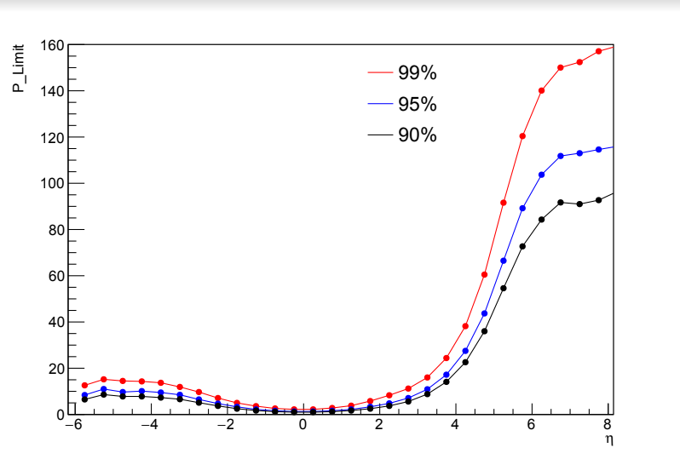
Capturing Physics Needs – Slide 2 of 3
10 GeV x 100 GeV
20 GeV x 250 GeV
Line = Fractional Coverage
Line = Fractional Coverage
99% of yield below 34 GeV
90% of yield below 20 GeV
Each line represents the momentum at which xx% of the yield falls below the line.
Better presentation of the needs.
Required:
Yield plots in standard binning for all relevant physics processes.
Range plots are calculated from these “on the fly” and “after the fact”.
Systematic way to combine specific needs into overall needs.

Slide 8
Capturing Physics Needs – Slide 3 of 3
Check-boxes for processes
Sliders for kinematics
Summary: Most Demanding
Driven by ZZ
“Physics Collection”
Driven by XX
Driven by YY
When collection of physics inputs exists (imagine check-boxes).
Any subset of these processes can be combined into a summary that defines the “Most Demanding Contour”.
Anyone can live-generate a “Most Demanding Contour” plot for their chosen subset of physics processes.
Allows for a straightforward and flexible “what if” analysis of needs.

Slide 9
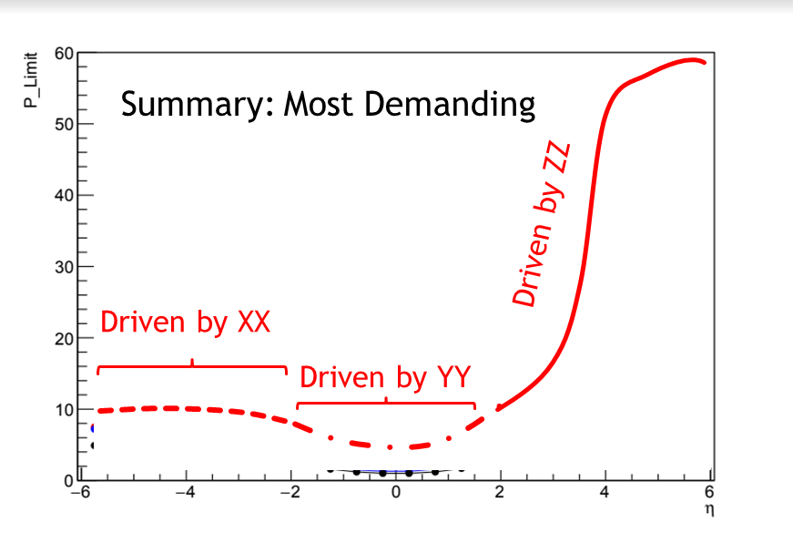
Imagined Workflow
“Physics Collection”
User selects any subset of processes
Outputs “Most Demanding” & Limiting Process.
User Overlays each and any detector performance lines.
This provides COMMON means of reaching consensus.

Slide 10
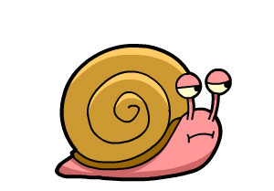
Implementation Scheme
Request from software group:
Rapidly generate a common plan that can be distributed.
Request from physics groups:
Process by process p-vs-eta plots.
Request from Detector Folks:
Code to implement the PID inheritance.
Make a site (Jupyter?) that allows:
Users make a “check box” of physics to generate a “Most Demanding”
Users make overlays of any/all detector performance technologies.
Our community should push on this process

