Slide 1
sPHENIX PMG Meeting

Slide 2
Agenda
Brief Status
Cost & Schedule performance
Status of EMCal electronics boards procurement and cradle/carriage bids
Contingency monitoring
Plans for I&F Upgrade PMP signature

Slide 3
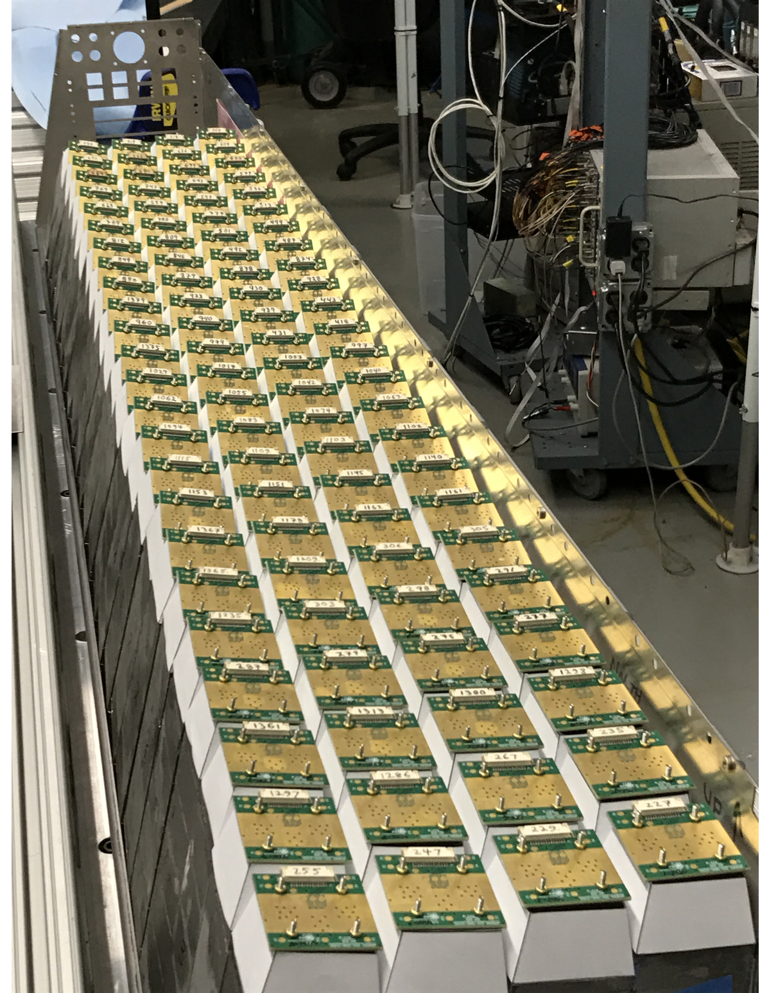
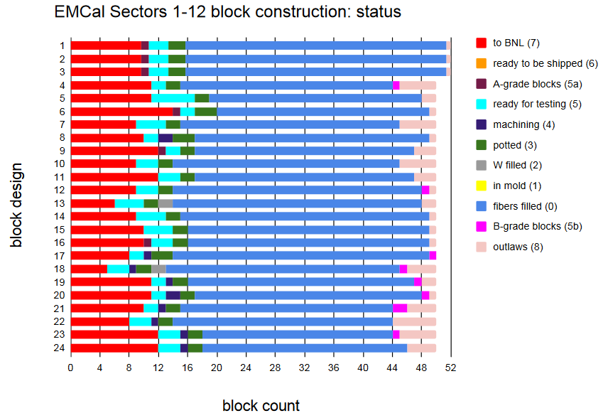
Assembly of EMCal Sector 1
Assembly of EMCal Sector 1 advanced
UIUC ordered W powder for sectors 38-64 this week
Expect powder to arrive at UIUC in 2-3 months
Block fabrication at various stages between 3 and 5 sectors
Expected factory rate 60 blocks/week by this summer. Recent week the rate was 35-40 blocks

Slide 4
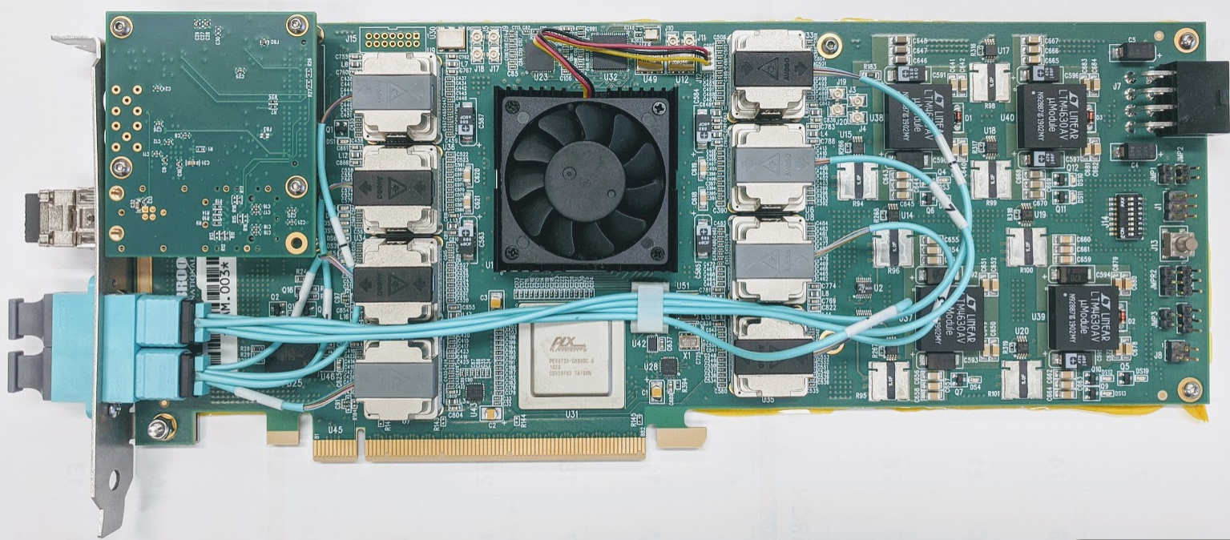
TPC DAM Card (FELIX 2.0)
sPHENIX (Jin Huang) produced 27 FELIX 2.0 cards.
The first 3 test good. The other 24 will be tested over the next 4 weeks.
This is a preproduction order. 10 produced for the TPC, 2 produced for the MVTX. 15 fabbed for CBM.
The TPC needs 24 FELIX ( 14 additional + spares) cards for operations
The MVTX need 10 FELIX cards ( 8 additional + spares)

Slide 5
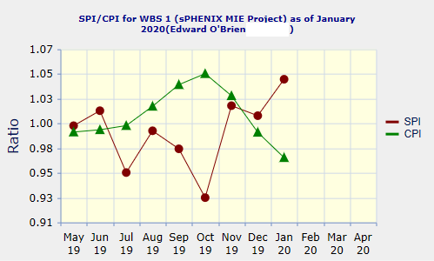
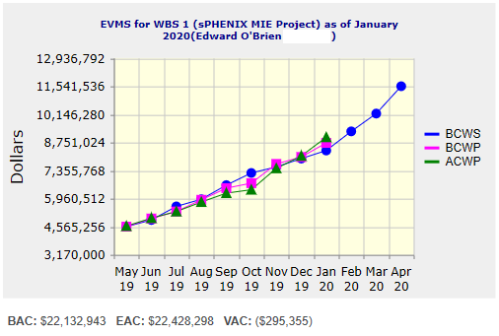
Performance Indices – sPHENIX MIE
Cumulative SPI | Cumulative CPI
1.05 | 0.97
Cumulative BCWS (Scheduled) | $8,354,801
Cumulative BCWP (Performed) | $8,733,074
Cumulative ACWP (Actual) | $9,013,485
DOE SPI or CPI Value Thresholds
0.90 to 1.15
0.85 to 0.89 or 1.16 to 1.25
<0.85 or >1.25
Note- $194K accrual is being reversed in 1.03 EMCal Control Account.
Will be reflected in next months CPR. So the cum CPI should be 0.99 instead of 0.97

Slide 6
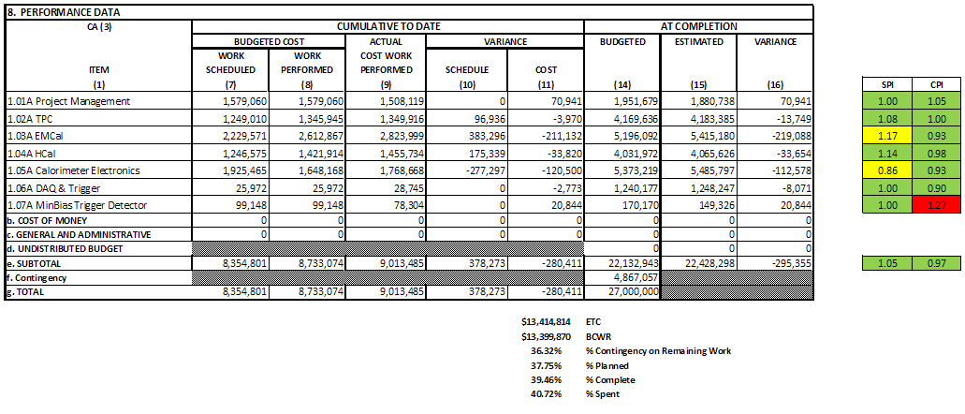
Cost Performance Report (CPR) – sPHENIX MIE
DOE SPI or CPI Value Thresholds
0.90 to 1.15
0.85 to 0.89 or 1.16 to 1.25
<0.85 or >1.25
Note- $194K accrual is being reversed in 1.03 EMCal Control Account.
Will be reflected in next months CPR. So the CV will only -$18K instead of -$211K

Slide 7
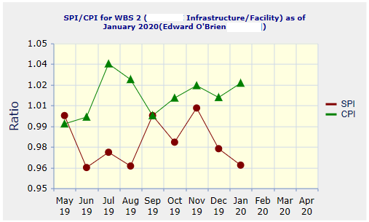
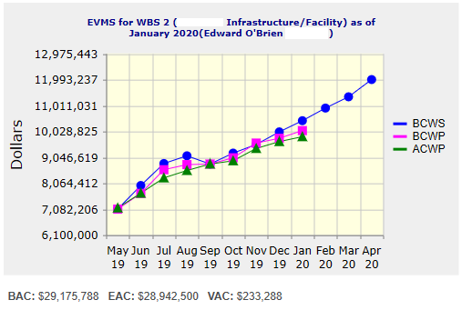
Performance Indices – 1008 Infra and Facility Upgrade
Cumulative SPI | Cumulative CPI
0.96 | 1.02
Cumulative BCWS (Scheduled) | $10,439,215
Cumulative BCWP (Performed) | $10,063,748
Cumulative ACWP (Actual) | $9,832,882
DOE SPI or CPI Value Thresholds
0.90 to 1.15
0.85 to 0.89 or 1.16 to 1.25
<0.85 or >1.25

Slide 8
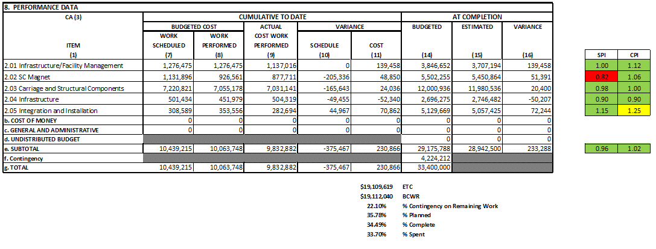
Cost Performance Report (CPR) – 1008 Infra and Facility Upgrade
DOE SPI or CPI Value Thresholds
0.90 to 1.15
0.85 to 0.89 or 1.16 to 1.25
<0.85 or >1.25

Slide 9
Milestones Status – sPHENIX MIE
# | WBS | Milestone Name | Target Milestone Date | Forecast | Actual Finish | Variance (in work days) | Comments
1 | 1.01.01 | Approve Project Baseline and Construction PD2/3 | 30-Sep-19 | 20-Sep-19 A | 20-Sep-19 | 6
2 | 1.02.02.02 | Production Readiness Review - TPC Module Factories | 31-Dec-19 | 17-Dec-19 A | 17-Dec-19 | 8
3 | 1.03.02.03.02 | EMCal Preproduction Sector 0 Assembled | 31-Dec-19 | 25-Nov-19 A | 25-Nov-19 | 23
4 | 1.02.06.02 | Production Readiness Review - TPC DAM | 28-Feb-20 | 4-Feb-20 |  | 16
5 | 1.05.02.03 | HCal Preproduction FEE Complete | 30-Apr-20 | 22-Jan-20 A | 22-Jan-20 | 70
6 | 1.05.02.01 | EMCal Electronics Preproduction Complete | 29-May-20 | 4-May-20 |  | 17
7 | 1.03.01.03.01 | EMCal W Powder Acquisition Complete | 30-Jun-20 | 13-Apr-20 |  | 54
8 | 1.03.02.03.03 | EMCal Prodctn Readiness Review Blocks/Modules/Sectors Complete | 31-Jul-20 | 11-May-20 |  | 56
9 | 1.02.05.03 | SAMPA ASIC Performance Accepted | 30-Sep-20 | 22-Jul-20 |  | 48
10 | 1.05.01 | EMCal/HCal SiPM Sensor Procurement Complete | 30-Oct-20 | 22-Jul-20 |  | 69
11 | 1.05.02.04 | HCal SiPM Boards Assembly Complete | 30-Nov-20 | 16-Jun-20 |  | 112
12 | 1.02.06.03 | TPC DAM Felix 2.0 Production Complete | 29-Jan-21 | 9-Feb-21 |  | -8
13 | 1.06.02.03 | Trigger LL1 Preproduction complete | 26-Feb-21 | 11-Dec-20 |  | 50
14 | 1.05.02.02 | EMCal SiPM Boards Production Complete | 31-Mar-21 | 11-Dec-20 |  | 73
15 | 1.04.04.02 | First Outer HCAL Sector and Splice Plates Ready to Install | 30-Apr-21 | 19-Aug-20 |  | 172
16 | 1.04.01 | Inner HCAL Support Structure Ready for Installation | 30-Apr-21 | 12-Feb-21 |  | 53
17 | 1.02.01.06 | GEM Production Complete | 31-May-21 | 12-Apr-21 |  | 34
18 | 1.03.01.03.01 | EMCal Scintillating Fiber Acquisition Complete | 31-May-21 | 3-Mar-21 |  | 62
19 | 1.06.01.03 | DAQ Production: DAQ Ready for Operation | 31-May-21 | 8-Jul-21 |  | -27
20 | 1.05.02.04 | HCal Electronics Complete: Production | 30-Jun-21 | 8-Jan-21 |  | 119
21 | 1.02.05.04 | TPC FEE Production Complete | 30-Jul-21 | 18-May-21 |  | 50
22 | 1.05.03.02 | Calorimeter Electronics Complete | 30-Jul-21 | 3-May-21 |  | 61
23 | 1.05.02.02 | EMCal Electronics Complete | 30-Jul-21 | 3-May-21 |  | 61
24 | 1.07 | MinBias Detector Ready to Install | 30-Sep-21 | 2-Sep-21 |  | 18
25 | 1.06.03.03 | GL1 Ready to Operate | 30-Sep-21 | 16-Sep-21 |  | 9
26 | 1.01.01 | Early Project Completion | 29-Oct-21 | 25-Oct-21* |  | 4
27 | 1.02.01.08 | TPC Ready to Install (Assembly Complete) | 29-Oct-21 | 14-Sep-21 |  | 31
28 | 1.02.06.03 | TPC DAM Production Complete | 29-Oct-21 | 15-Sep-21 |  | 30
29 | 1.03.02.03.03 | EMCal Ready to Install | 29-Oct-21 | 12-Oct-21 |  | 12
30 | 1.04.04.02 | Last Outer HCAL Sector Ready to Install | 29-Oct-21 | 16-Jun-21 |  | 93
31 | 1.06.02.04 | LL1 Trigger Production Complete | 29-Oct-21 | 16-Sep-21 |  | 29
32 | 1.06.02.04 | LL1 Ready to Operate | 29-Oct-21 | 16-Sep-21 |  | 29
33 | 1.01.01 | Approve Project Closeout PD-4 | 30-Dec-22 | 29-Dec-22* |  | 0

Slide 10
Milestones Status – 1008 Infra and Facility Upgrade
# | WBS | Milestone Name | Target Milestone Date | Forecast | Actual Finish | Variance (in work days) | Comments
1 | 2.03.03 | Completion of Outer HCAL Sector Mechanical Structure Procurement | 30-Sep-19 | 03-Sep-19 A | 3-Sep-19 | 19
2 | 2.03.02 | Magnet Supports Released for Production (Milestone) | 31-Jul-20 | 2-Jul-20 |  | 19
3 | 2.02.03.04.01 | Completed - (Controls Hardware) Power distribution drawings | 31-Oct-20 | 20-Jul-20 |  | 66
4 | 2.03.01 | Completed - Steel Track Modifications | 30-Nov-20 | 5-Nov-20 |  | 13
5 | 2.04.02.01 | Magnet cryo, electrical and control structural support components Ready for Installation | 31-Mar-21 | 30-Oct-20 |  | 100
6 | 2.03.02 | IHCal Structural Support Components Ready for Installation | 31-Mar-21 | 1-Mar-21 |  | 21
7 | 2.05.04 | Outer HCal Sectors Ready for Installation | 30-Apr-21 | 19-Aug-20 |  | 172
8 | 2.03.01 | Carriage Cradle - Components Ready for Installation | 31-May-21 | 24-Feb-21 |  | 67
9 | 2.03.05 | CC Bridge, Mid Platforms & Access - Ready for Installation | 31-Oct-21 | 20-Apr-21 |  | 134
10 | 2.02.03.02.04.02 | Completed - Procure LN2 supply transfer line system - Phase 5 - Shipping - Delivery Acceptance | 30-Nov-21 | 2-Sep-21 |  | 57
11 | 2.05.05 | Completed - Install SC Magnet on Cradle | 30-Nov-21 | 17-Sep-21 |  | 47
12 | 2.04.02.06 | Assembly Hall Components Ready for Installation | 30-Nov-21 | 16-Sep-21 |  | 48
13 | 2.04.01.03 | Detector Electronics Racks and Rack generic support systems Components Ready for Installation | 30-Nov-21 | 7-Sep-21 |  | 55
14 | 2.04.01.05 | Detector Safety Subsystems Components Ready for Installation | 31-Dec-21 | 20-Oct-21 |  | 47
15 | 2.02.02 | Completed - Magnet and Solenoid Valvebox - Reinstall | 31-Jan-22 | 8-Nov-21 |  | 53
16 | 2.05.04 | Completed - Install Remainder of Outer HCal Sectors | 31-Jan-22 | 16-Nov-21 |  | 48
17 | 2.05.03 | Completed - Install platforms & access | 28-Feb-22 | 16-Dec-21 |  | 47
18 | 2.05.07 | Completed - Install EMCal Sectors | 31-Mar-22 | 6-Jan-22 |  | 57
19 | 2.05.03 | Completed - Install Pole Tips | 31-May-22 | 30-Mar-22 |  | 42
20 | 2.02.03.04.03 | (Cryo Controls Hardware) Hardware Installed | 30-Jun-22 | 6-Apr-22 |  | 59
21 | 2.02.03.01.06 | RHIC Helium Interface - Installation complete | 30-Jun-22 | 4-May-22 |  | 39
22 | 2.02.01.02 | Magnet is operational | 31-Jul-22 | 15-Jun-22 |  | 31
23 | 2.02.05.03 | Completed - Magnet Field Measurements: Map Magnetic Field of SC Magnet | 31-Aug-22 | 7-Jul-22 |  | 38
24 | 2.05.08 | Completed - Install TPC | 30-Sep-22 | 26-Jul-22 |  | 46
25 | 2.05.11 | Completed - Install Min Bias | 31-Oct-22 | 26-Aug-22 |  | 43
26 | 2.05.10 | Completed - Install MVTX | 30-Nov-22 | 4-Oct-22 |  | 36
27 | 2.05.12 | sPHENIX Ready for Operations | 30-Nov-22 | 12-Oct-22 |  | 31

Slide 11
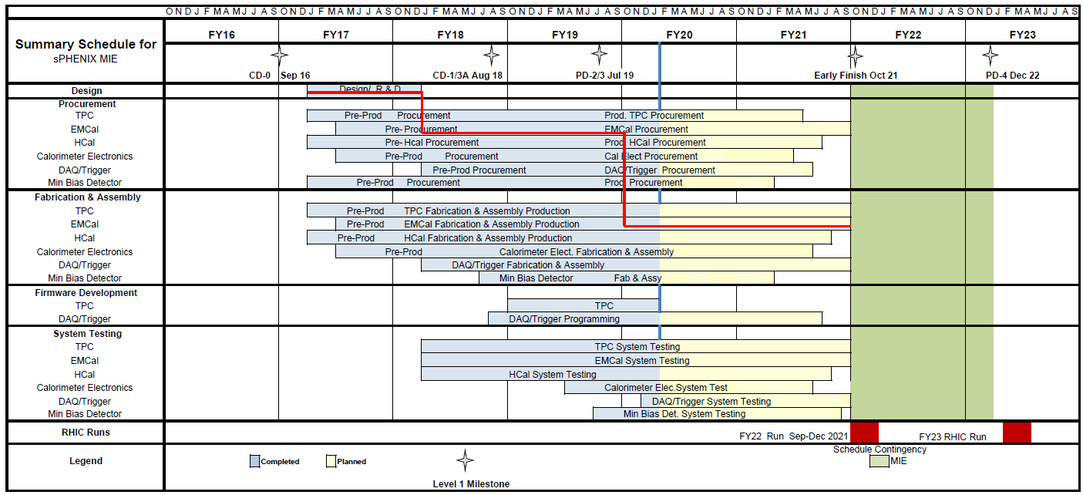
Summary Schedule – sPHENIX MIE

Slide 12
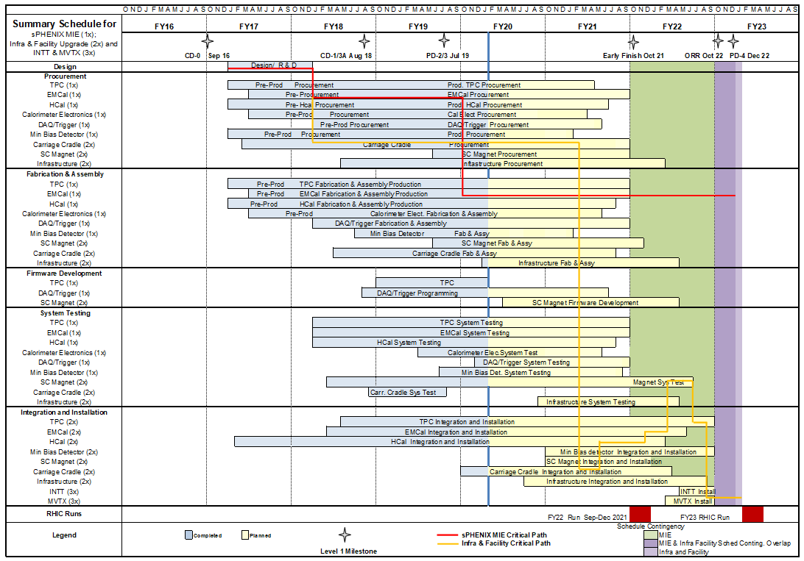
Summary Schedule – sPHENIX MIE and 1008 Infra and Facility Upgrade

Slide 13
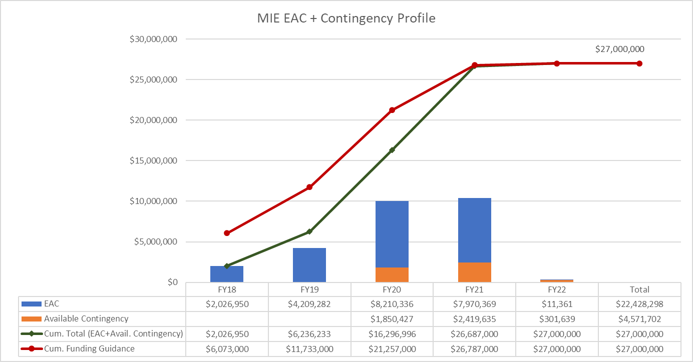
EAC and Contingency Profile – sPHENIX MIE

Slide 14
Baseline/Contingency Log - MIE

Slide 15
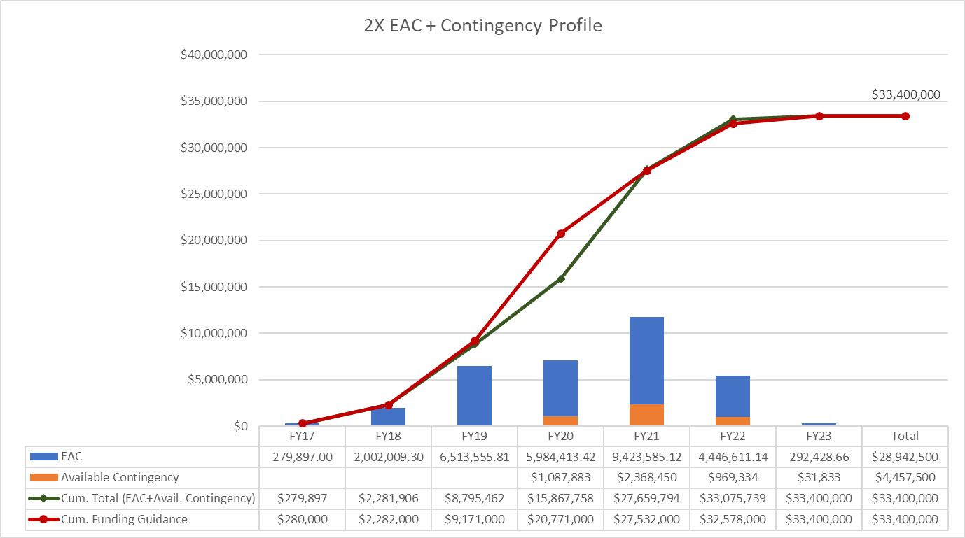
EAC and Contingency Profile – 1008 Infra and Facility Upgrade

Slide 16
Baseline/Contingency Log - 1008 Infra and Facility Upgrade

Slide 17
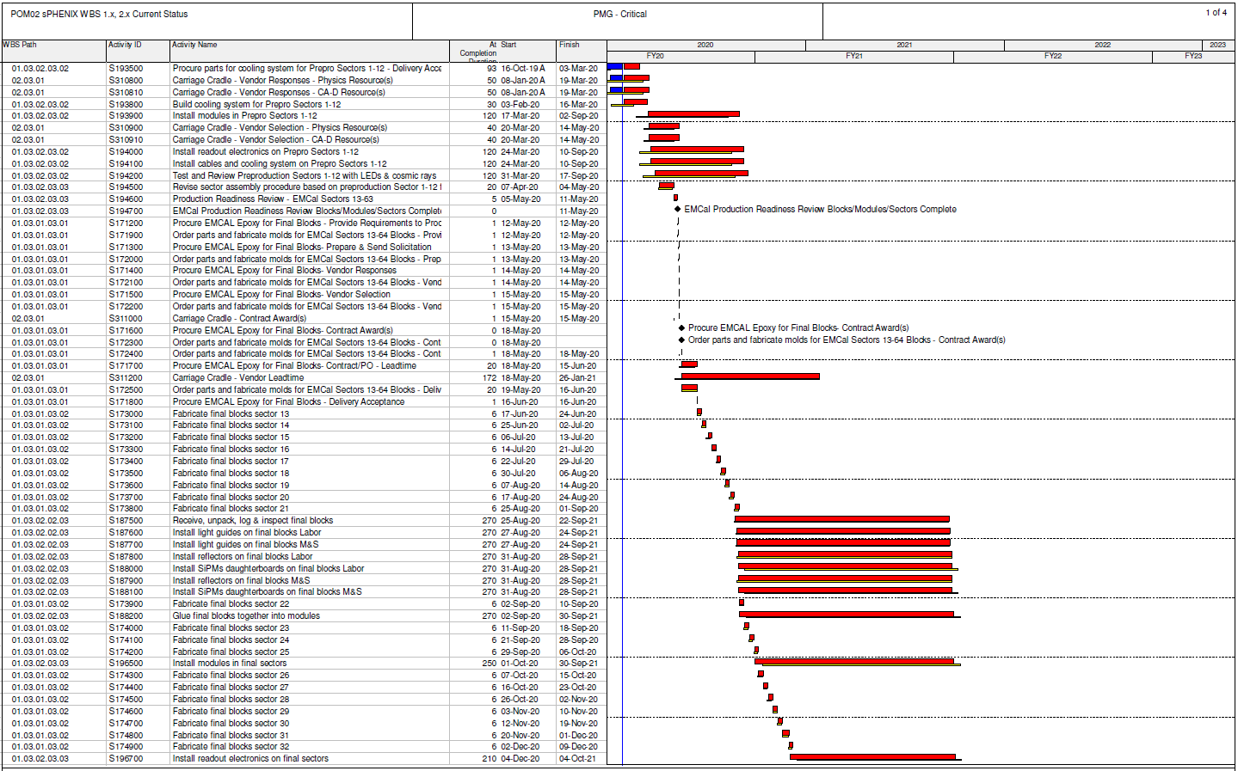
Critical Path (1x, 2x and 3x Combined)

Slide 18
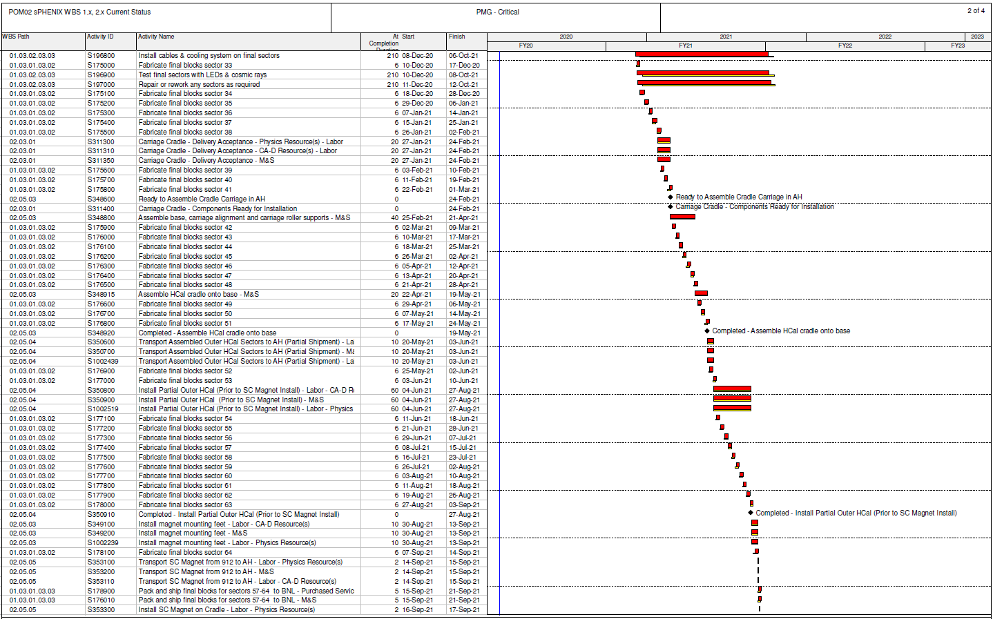
Critical Path (1x, 2x and 3x Combined)

Slide 19
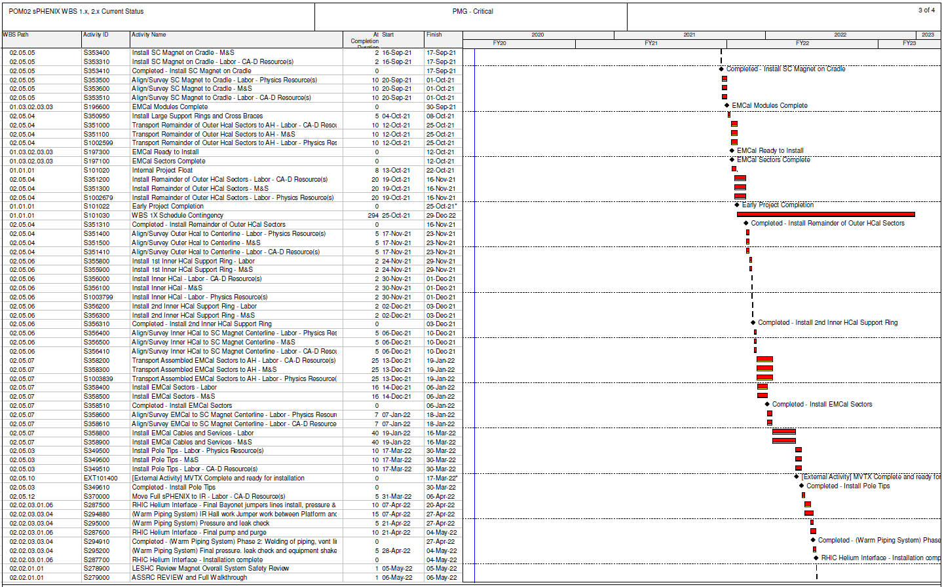
Critical Path (1x, 2x and 3x Combined)

Slide 20
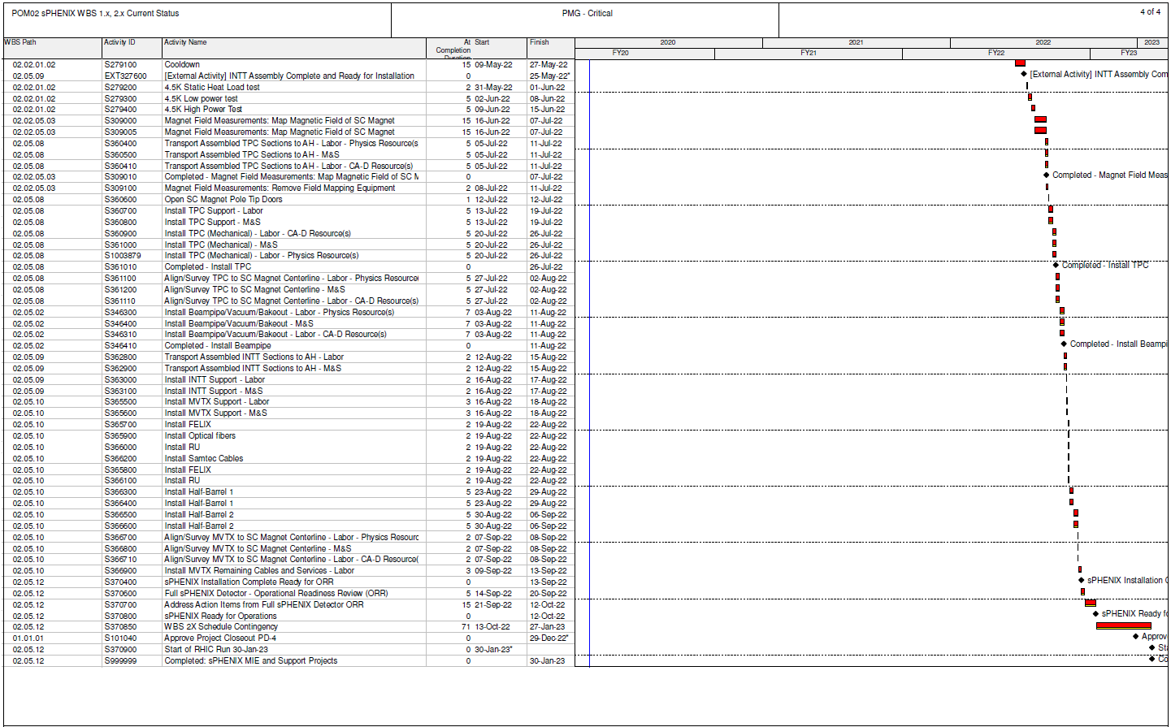
Critical Path (1x, 2x and 3x Combined)

Slide 21
Status of EMCal Electronics and Cradle/Carriage Bids
All EMCal on-detector electronics for Sectors 1-12 are at BNL which the exception of the SiPM daughter cards. We have enough SiPM daughter cards for Sector 1 but the next order, which is for ~40 additional sectors, will be at BNL in 6-8 weeks.
Carriage/cradle has not yet been awarded. The terms of the contract are still being negotiated with the prospective vendor. On the table
41 weeks delivery with a cost significantly over budget but not over the budget + 30% contingency(EU)
A 41 week delivery will be an improvement over the schedule in the P6 file
33 week delivery with a cost increase of $200,000 which is significantly over the budget + 30% contingency
Glenn and I strongly favor to 41 week quote for $200,000 less cost.

Slide 22
Plans for I&F PMP Completion and Signing
Based on my interaction with DOE-NP on the issue of whether the I&F should have been a BNL Capital project, I strongly recommend that we do not share the I&F PMP with DOE
An advanced draft of the I&F PMP exists.
It incorporates the schedule improvements recommended at the October I&F review.
The sPHENIX Project team last updated the PMP in February
We need to add the latest milestone table
We do not propose changing the TPC or budget profile
Once we make a few remaining changes we can submit the I&F PMP to Maria and the PMG for comment.

Slide 23
Summary
sPHENIX MIE and 1008 I&F continue to have good cost and schedule performance at summary level as measured by EV. Project End Date and Critical path remain unchanged
sPHENIX production components are starting to be built and tested (EMCal, HCal, TPC electronics, Calorimeter electronics)
CD-3A parts continue to arrive. PD-3 parts are being ordered.
Engineering design, R&D and preproduction prototyping continues for many subsystem.

