Slide 1
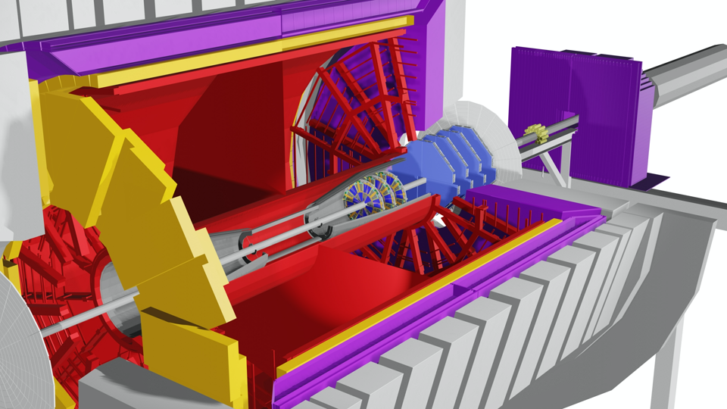

BNL NPP 2020 PAC Meeting
Overview of the STAR
forward Upgrade
Project
E.C. Aschenauer
September 10th, 2020

Slide 2
The 2022+ Physics program with fSTAR
Forward-rapidity 2.8<η<4.2
Observables:
inclusive and di-jets
hadrons in jets
Lambda’s
correlations mid-forward & forward-forward rapidity
Requirements from Physics:
good e/h separation
hadrons, photon, π⁰ identification
A+A
p↑+p↑ & p↑ +A
Beam:
Full Energy AuAu (2023/25)
Physics Topics:
Temperature
dependence of
viscosity through
flow harmonics up
to η~4
Longitudinal
decorrelation up to
η~4
Global Lambda
Polarization
→ strong rapidity
dependence
Beam:
500 GeV: p+p
200 GeV: p+p and p+A
Physics Topics:
pp:
TMD measurements at
high x
o transversity → tensor
charge
o Sivers through DY, direct
γ and tagged jets
pA:
Gluon PDFs for nuclei
R_{pA} for direct photons & DY, and hadrons
Test of Saturation
predictions through
di-hadrons, γ-Jets, di-jets
→ all measurement are critical to the scientific success of EIC to test universality and factorization
Detector | pp and pA | AA
ECal | ~10%/√E | ~20%/√E
HCal | ~50%/√E+10% | ---
Tracking | charge separation photon suppression | 0.2<p_{T}<2 GeV/c with 20-30% 1/p_{T}
FY2022: 500 GeV polarized pp run
All other data taking in parallel to sPHENIX data taking campaign: AA, pA, pp

Slide 3
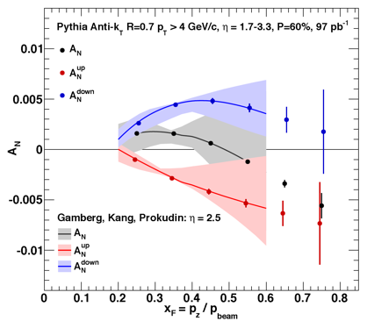
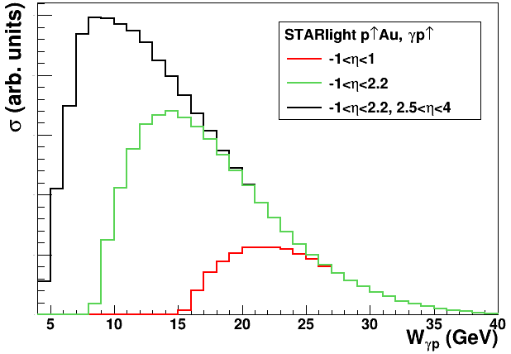
STAR forward upgrade and polarized p↑p ↑ /p ↑ A
Understanding the proton in 3d: spatial and momentum
critical to fully realize the scientific promise of the EIC
different complementary probes are critical to test universality
forward upgrade → access to low and high x
varying √s → Test Evolution
Sivers through tagged jets
A_{UT} for J/ψ in UPC → E_{g}
Transversity x Collins
through hadron in jet

Slide 4

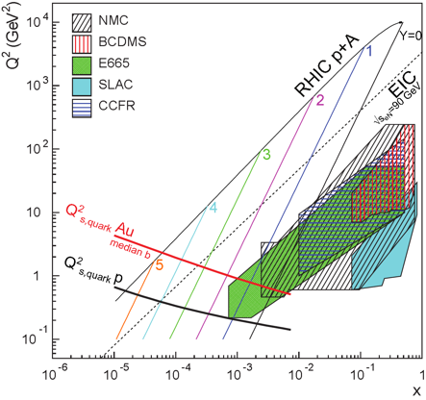
Probing Non-linear Effects in QCD
Forward rapidities at STAR provide an absolutely
unique opportunity to have very high gluon densities
→ proton – Au collisions
combined with an unambiguous observable
counting experiment of Di-jets in pp and pA
Saturation: Disappearance of backward jet in pA
p
p
p
A
STAR forward upgrade to characterize non-linear effects with charged di-hadrons,
γ-jet, di-jet
critical measurement to
test universality → EIC
rcBK: arXiv:1805.05711
GPW: arXiv:1109.1817

Slide 5
Scope: ECal & HCal
Location: 7 m from the IP on the “FMS platform”
Readout: SiPMs
Used in Trigger
Split in 2 movable halves inside and outside of ring
Slightly projective
ECal:
reuse PHENIX PbSC calorimeter with new readout on front face → 1496 channels
  Secured one Sector (2592 towers) PbSc towers: 5.52 x 5.52 x 33 cm³ (18 X₀)
66 sampling cells with 1.5 mm Pb,
4 mm SC & Wavelength shifting fibers
HCal:
Fe/Sc (20mm/3 mm) sandwich.
520 readout channels
Lateral tower size 10 x 10 cm², ~ 4.5 λ
  in close collaboration with EIC R&D
Preshower
Use EPD → need to built splitter for the signals
Installation of entire system (HCal + ECal + Electronics) finalized by Feb 2021
~9 month to commission systems before Run-22 500 GeV pp

Slide 6
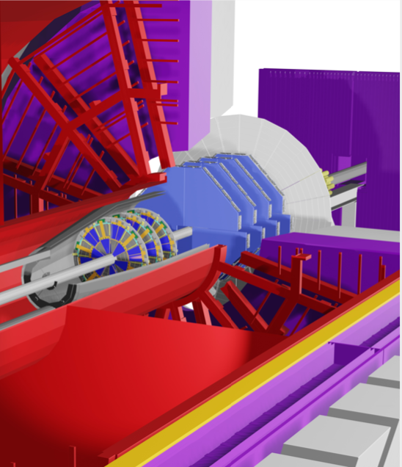
Scope: Silicon & sTGC
3 Silicon disks: at 146, 160, and 173 cm from IP
Built on successful experience with STAR IST
Single-sided double-metal mini-strip sensors
  Granularity: fine in φ and coarse in R
  Si from Hamamatsu
Frontend chips: APV25-S1 → IST all in hand
Material budget: ~1.5% per disk
Reuse
  IST DAQ system for FTS
  IST cooling system
Si
sTGC
4 sTGC disks: at 307, 325, 343 and 361 cm from IP
location inside Magnet pole tip opening
  inhomogeneous magnetic field
4 quadrants double sided sTGC → 1 layer
  diagonal strips to break ambiguities in the sTGC
Position resolution: ~200 μm
Material budget: ~0.5% per layer,
Readout: based on VMM-chips
→ following ATLAS design
Installation of entire Si and sTGC finalized by Mid of September 2021
~2-4 month to commission systems before Run-22 500 GeV pp

Slide 7
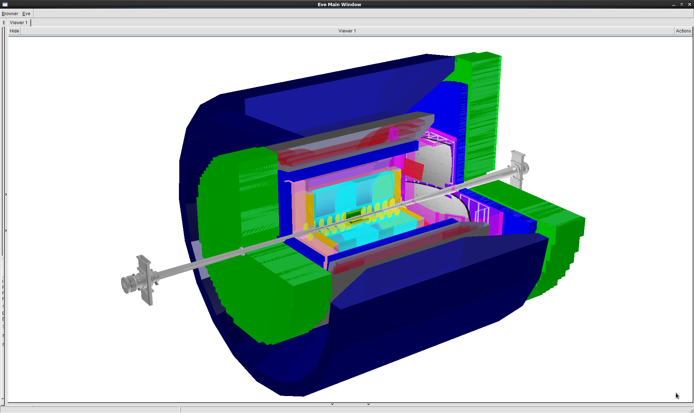
Importance of STAR forward upgrade for EIC
STAR forward upgrade: 2.5 < η < 4
rapidity coverage the same as
EIC hadron Arm
→ high-x EIC physics
HCal +SiPM readout same as
EIC-fHCAL
same rapidity as EIC
  background
small-strip Thin Gap Chambers (sTGC)
sTGC alternative technology to
EIC GEM Trackers
Si
sTGC
ECal
HCal
Barrel Hadronic calorimeter not shown
HCal
ECal
Analysis:
Learn how to reconstruct Jets close
to beam rapidity
Jet solid angle ~ R²/cosh²(η).
so for fixed jet multiplicity, dN/dΩ grows like cosh²(η)
15 times larger at η=2, 100 times larger at η=3
what are the effects of underlying event ep & eA
and √s
Si
sTGC or GEM
electrons
Training of young scientific generation:
20+ undergrads working > 2019/06
hadrons

Slide 8
Workforce
Several people plan sabbaticals, if COVID-19 situation allows:
Don Isenhower Oct 2020 – April 2021
Carl Gagliardi: 2021 and others
Installation supported
by CAD

Slide 9







Organizational Structure STAR Forward Upgrade
Dedicated manpower with large expertise for each subsystem
sTGC
Silicon
ECal
HCal
DAQ/Readout
Software
Integration
Calibration
Slow Controls
and the STAR collaboration, which stands enthusiastically behind the upgrade

Slide 10
Funding Sources and Remaining Procurements
Several different funding sources:
NSF MRI (Lead University IU) submitted to NSF January 2019
  Calorimetry, Readout & Trigger Electronics M&S and large fraction of labor
  received official notice of funding at 92% of request level ($1.920077 M)
All procurements finalized and basically in hand
Remaining budget: ~$200k
International Funding sources
  sTGC
    Modules through Shandong University
    Gas-System, Readout electronics, Infra- and Support structure by BNL
  Remaining Procurements:
    packaging of VMM chips ~$ 30k
    support structures $50k
  Silicon detector
    Mechanical Structure: NCKU in Taiwan
    Hybrid: Shandong University China
    Si, Infra- and Support structure by BNL
  Remaining Procurements:
    FNAL contract amendment for production module assembly: $89k
    support structures $50k
Remaining Budget at BNL: $340k

Slide 11
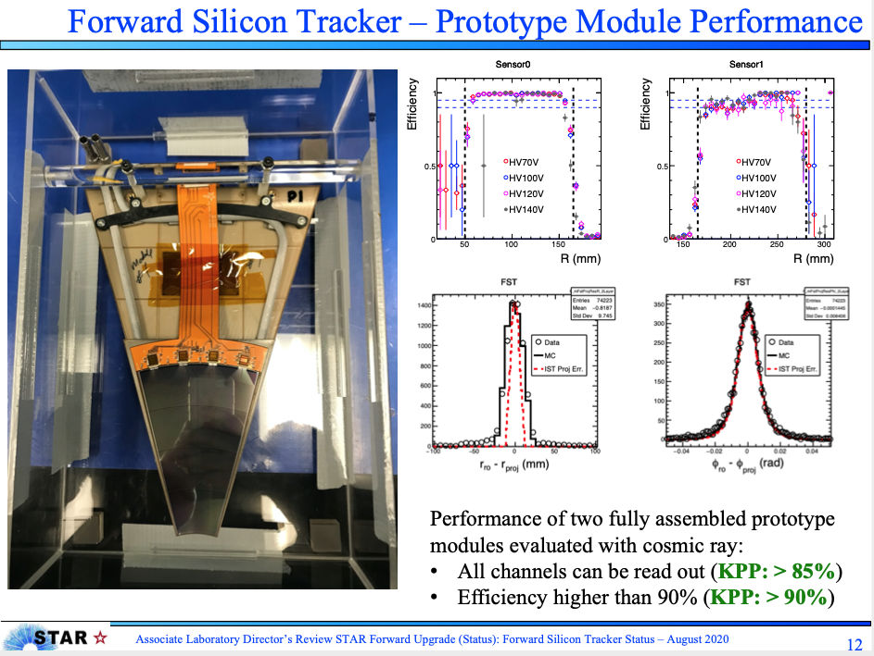
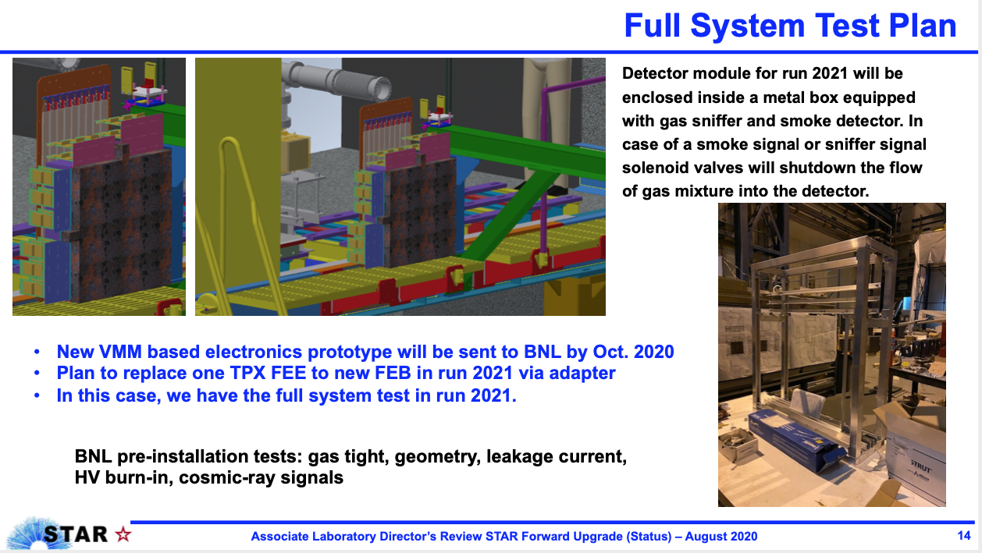
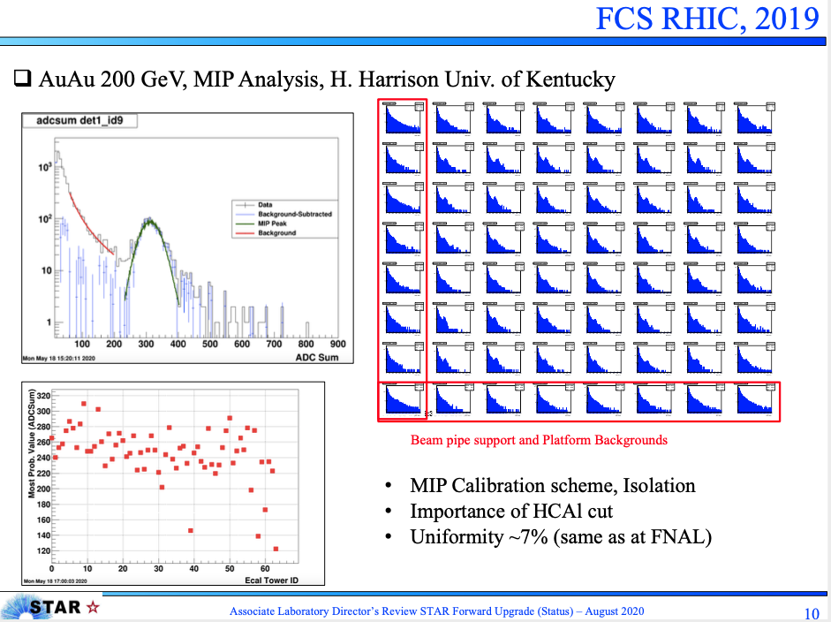
General Info
follow for all subsystems the successful STAR tradition of full system checks in situ including prototype module(s) + FEE + DAQ/Trigger
  ECAL and HCAL during Run-19
  sTGC Run-19 and Run 21
  Si November 2020

Slide 12
General Info and Requirements
Global Requirements:
Tight RHIC operations schedule requires
  Installation needs to be done without rolling STAR into assembly hall
  use currently installed inner TPC cone and the “non-HFT” beam pipe
  Si-tracker installation and maintenance need to be done without breaking the beam vacuum
sTGC: FEEs and ROCs need to be as much as possible outside the acceptance of the event plane detector and the forward calorimeters
  sTGC need to move with poletip → fast access to Si-detector
HCal and ECal need to be movable to allow access to the pump and the RHIC beam pipe
Installation needs to be split over several shutdowns
  → staggered request for readiness of different subdetectors
Meetings:
  Weekly fSTAR meeting Tuesday at 8:30 am
  Weekly Silicon Meeting Mondays at 9:00 am
  Weekly sTGC Meeting: Wednesday 9:00 am
  Quarterly Face-to-Face Meetings 2020: February 27th & 28th July 20th &21st
  Silicon Readiness Review: August 3rd 2020
  Associate Laboratory Director’s Review STAR Forward Upgrade (Status) August 27th 2020
  sTGC Readiness Review planed for October 2020

Slide 13
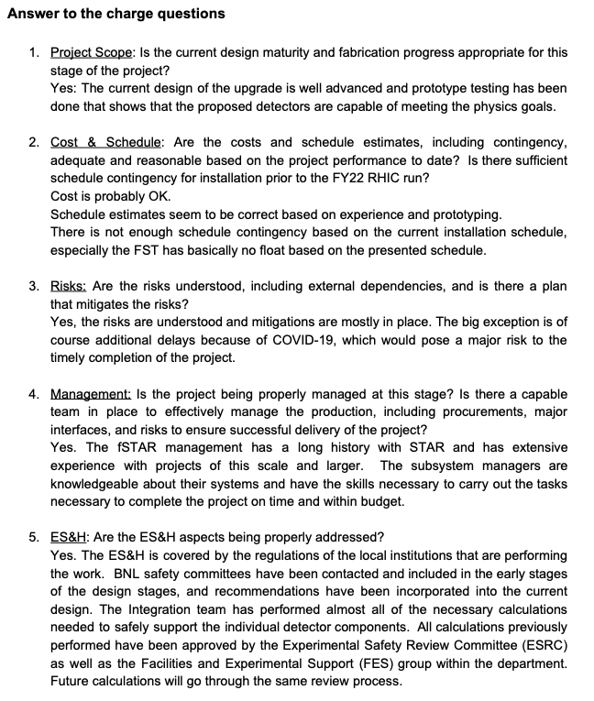
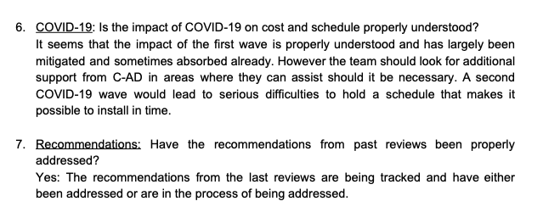
Summary on Recent Review
Associate Laboratory Director’s Review STAR Forward Upgrade (Status)
  Committee: E.Mannel (chair), J. Mills, G. van Nieuwenhuizen, M.-A.Pleier, C.Woody

Slide 14
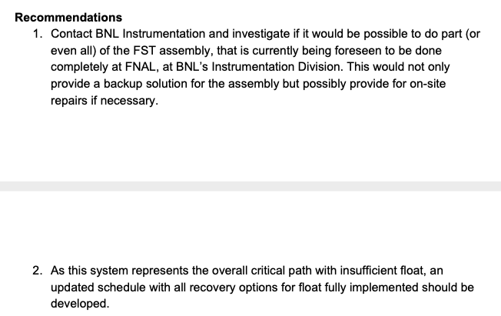
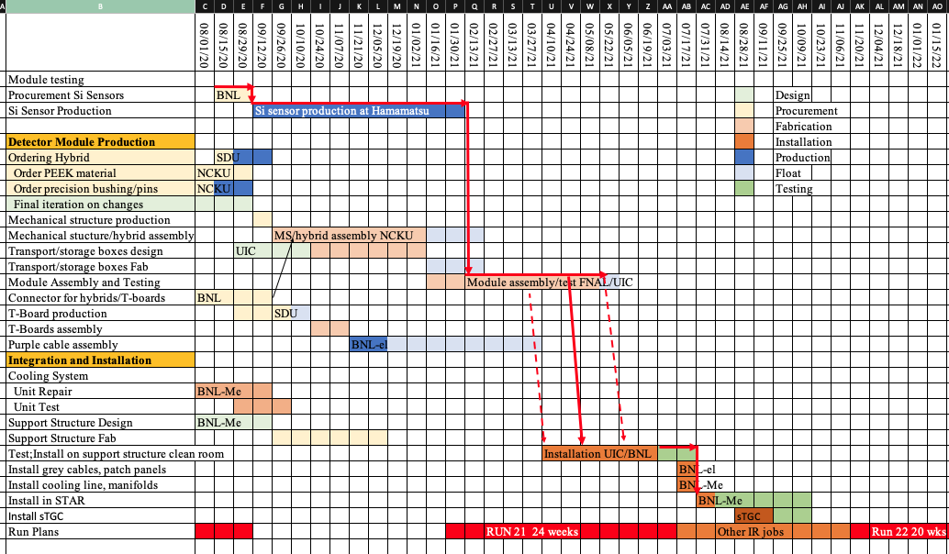
Recommendations for Si
Currently Investigating, but will need either double the test stands or move it to BNL
→ Impact on schedule still to be understood
Finish installation by August 2021
3 month to commission detector without beam

Slide 15
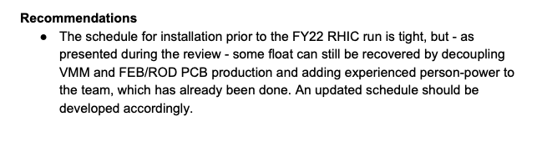
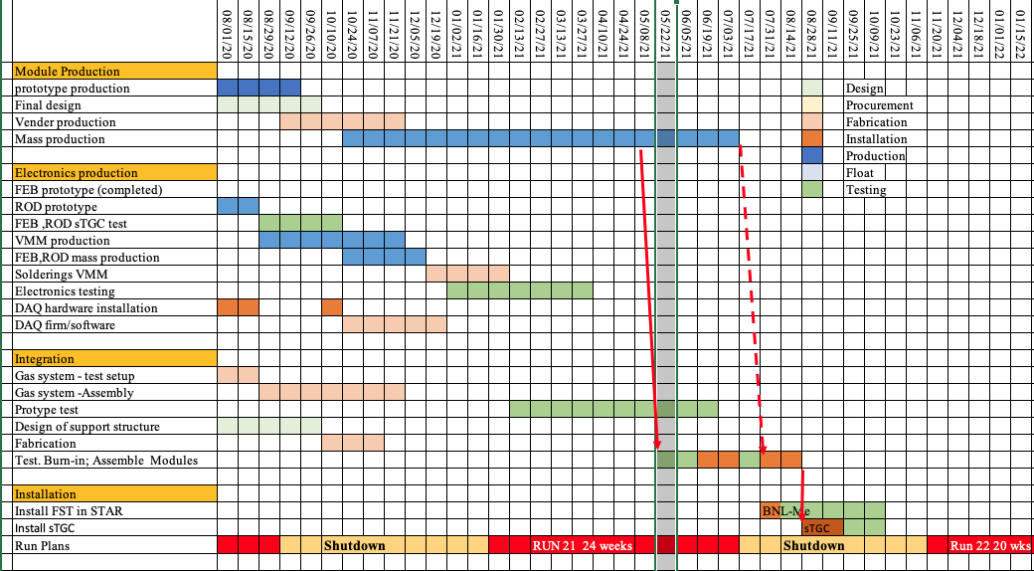
Recommendation for sTGC
Finish installation by end of September 2021
2 month to commission detector without beam

Slide 16

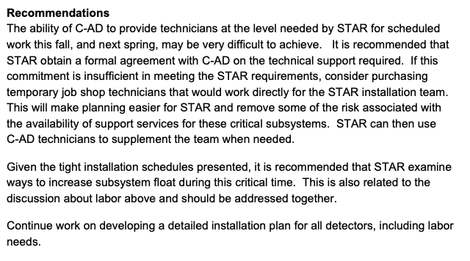
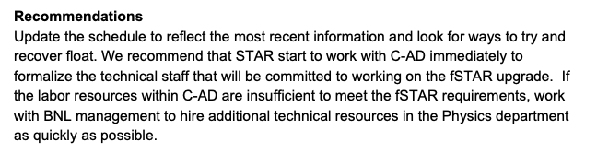
Recommendation for fSTAR Project
Trigger / DAQ:
have February 2021 to
November 2021 to test
with & without beam
Integration:
have the labor needed for 2020 shutdown, will work on the one for SD 2021
Will integrate the lessons learned from the Si and sTGC test installation in SD 2021 schedule
Cost, schedule, resources - All
Schedule updates done

Slide 17
Remaining Cost, Schedule and Workforce Risks
Cost:
  remaining costs well understood and based on quotes → small risk
Schedule:
  all schedules well understood, including installation in summer /autumn 2021
  Silicon detector on the critical path with little float
  → streamline production schedule to gain float
Workforce:
  needs are well understood, and the workforce is identified and available
    had to substitute student labor by CAD techs due to COVID-19
Further COVID-19 Impact
  Current: biggest risk BNL access rules for STAR users critical for installation → changes to COVID-19 in US and /or NY
  Future:
    Unpredictable COVID-19 situation in the US, NY and around the world → can lead to delays.
    Impossible to predict and mitigate in advance → will follow the FCS strategy approach of an agile management

Slide 18
High Level Schedule
September
14th , 2020
4.5 Month
Shutdown
January
25st , 2021
July
12th, 2021
(9th Aug)
18 weeks
Shutdown
November (Dec.)
15th , 2021
ECal already installed
Installation of:
ECal SiPMS & FEEs
HCal
HCal SiPMS & FEES
All DAQ & Trigger electronics
→ ECal and HCal ready for data taking
Full System check of Silicon
  Cooling system
  DAQ
  one Si prototype module
Si support structure test installation
sTGC gas system installation &
commissioning
24 (28)Weeks
BES-II
Installation of:
Si - tracker
sTGC-tracker & Readout (maybe
partially installed earlier during run)
Work during Run-21:
Commissioning of
Calorimeter system
Full System check of sTGC
with beam
  one sTGC prototype module
  VMM electronics prototype
  Gas system
  DAQ
Resource loaded shutdown schedules can be made available

Slide 19
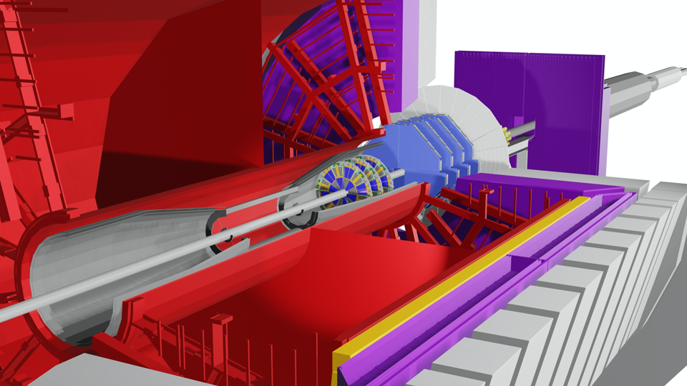
Conclusion
STAR forward upgrade will be fully ready for data taking in FY22
  COVID-19 impacts have been well managed and absorbed till now
  ECAL & HCAL their FEE, DAQ and Trigger electronics completely installed by 02/21
  Silicon and sTGC full system checks will be critical for a speedy commissioning in run-22
  Biggest challenge BNL access restrictions for users and Staff

Slide 20


Slide 21
