Slide 1
Tracking studies in Berkeley
Ernst Sichtermann, Miguel Arratia (through 2019) Winston DeGraw, Youqi Song, Jose Soria, Dhruv Dixit, Fernando Torales Acosta, Barbara Jacak

Slide 2
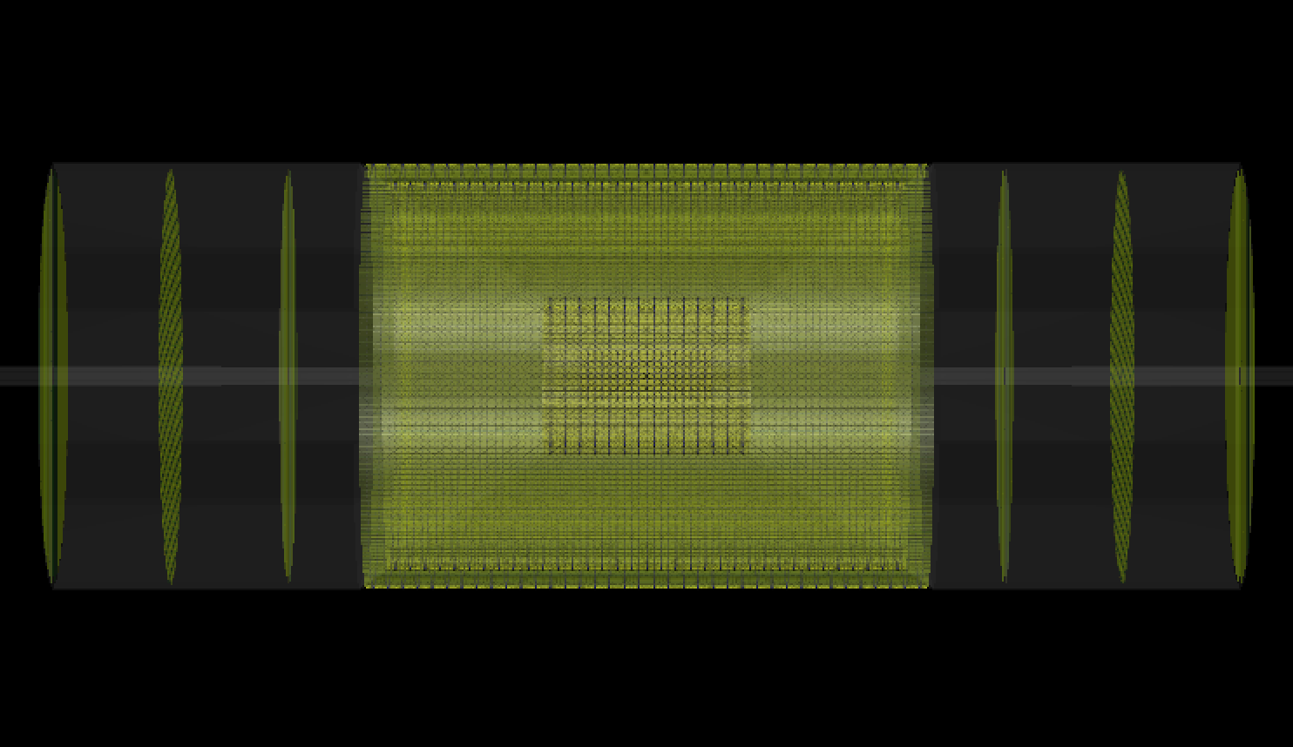
goals
Explore performance of all-Si tracker
Geometry defined by Yue Shi Lai and Ernst Sichtermann
All Si barrel layers, forward disk layers
Currently based on ALPIDE MAPS technology (next-gen sensor R&D underway)
Support structures, beam pipe, water cooling pipes now implemented in geometry

Slide 3
Questions we are addressing
Where do jets from DIS on small-x partons go?(make sure tracker can handle the relevant jets)
What is momentum resolution for all-Si tracker?
Compare all-Si with hybrid gas-Si tracker
  (use TPC-Si as the hybrid example)
What is the tracking efficiency for all-Si tracker?
What is the impact of the C-fiber cone?

Slide 4
Simulation tools used
Pythia for e-p collisions (generator level studies)
Fast MC (smearing level)
EICroot with Full Geant simulation
Fun4all

Slide 5
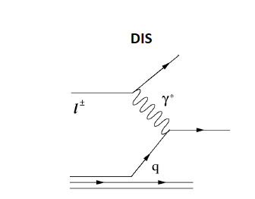
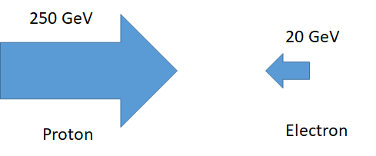
Probe matter with jets
Measure jets from small-x quarks
Low energy jets at -1<η<-2
Small number of particles
need efficiency at mid-backward interface
jets
100
J. Soria, M. Arratia – PYTHIA level simulation

Slide 6
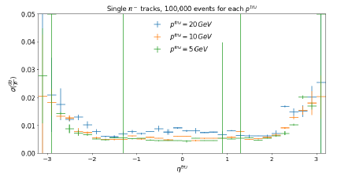
All-silicon tracker momentum resolution
Resolution looks good
Worse at 1<η<1.2
(C fiber support cone!)
Fewer hits in those tracks
EICroot full simulations
Detector response w/ GEANT
Winston DeGraw, Youqi Song

Slide 7
Resolution degraded by loss of hits
Youqi Song
Need 6 hits!

Slide 8
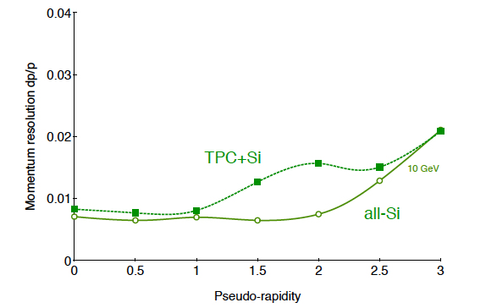
All-Si vs. hybrid tracker (BEAST magnet)
1 GeV
Ernst Sichtermann
Fast simulation
10 GeV

Slide 9
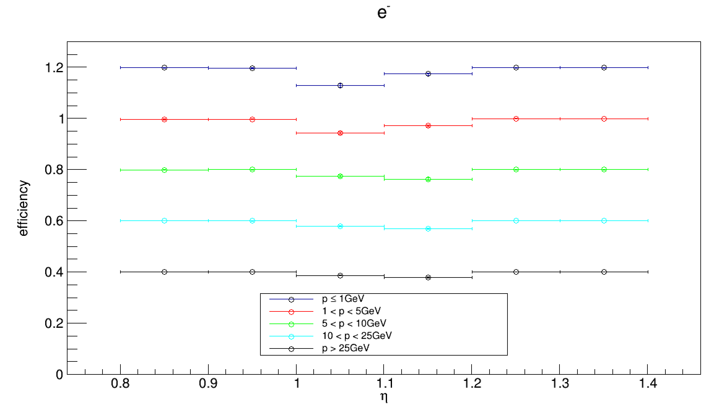
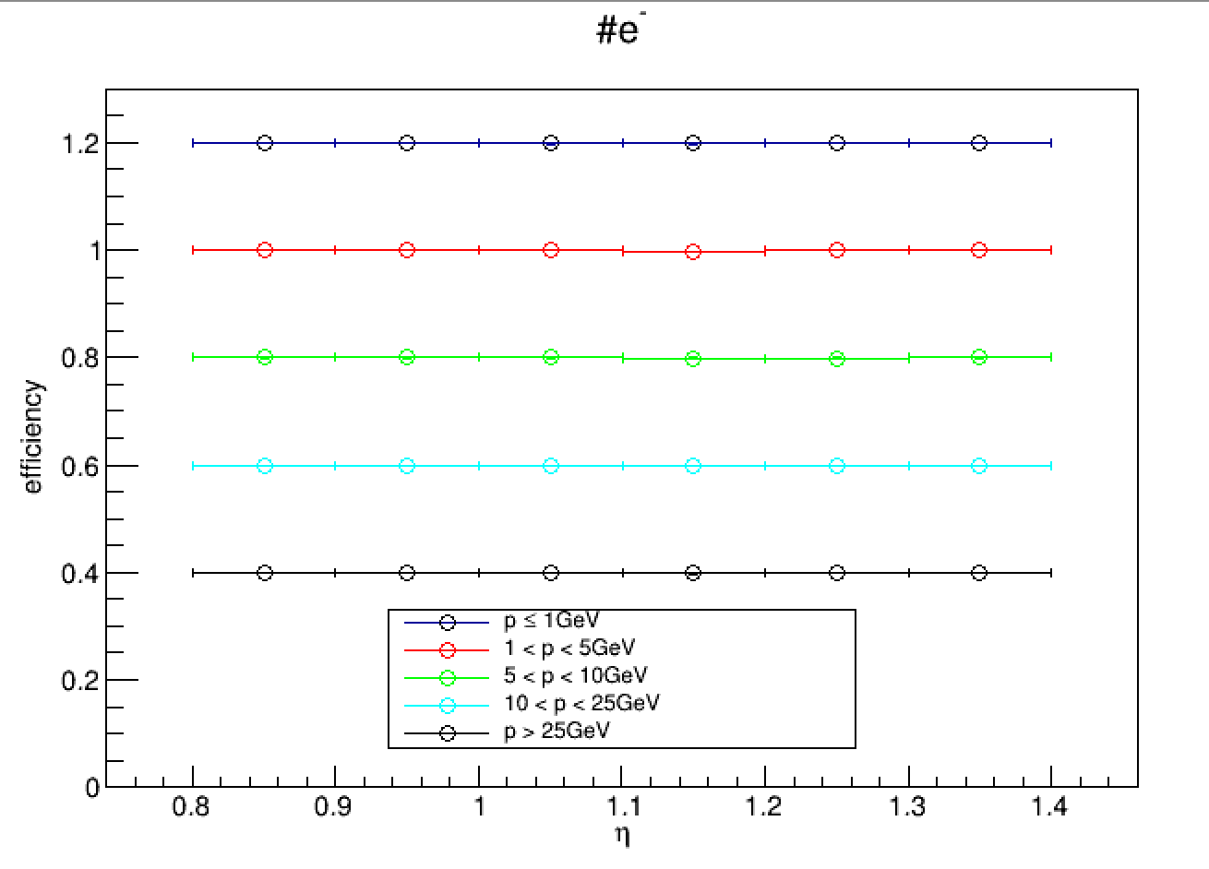
Tracking efficiency by particle type
μ
EICroot full simulations
Detector response w/ GEANT
Winston DeGraw

Slide 10
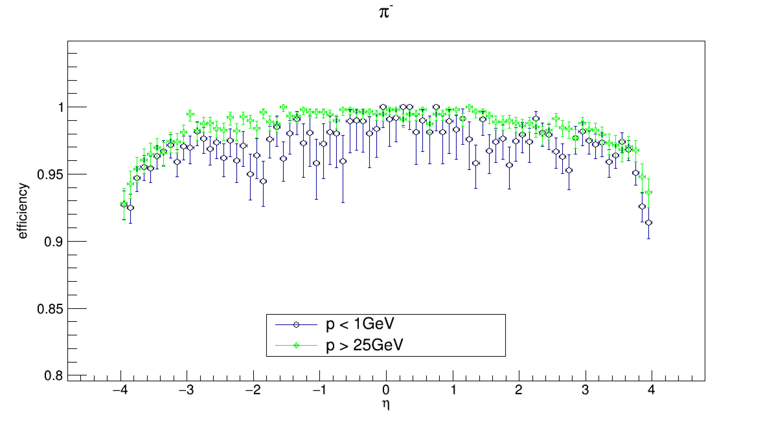
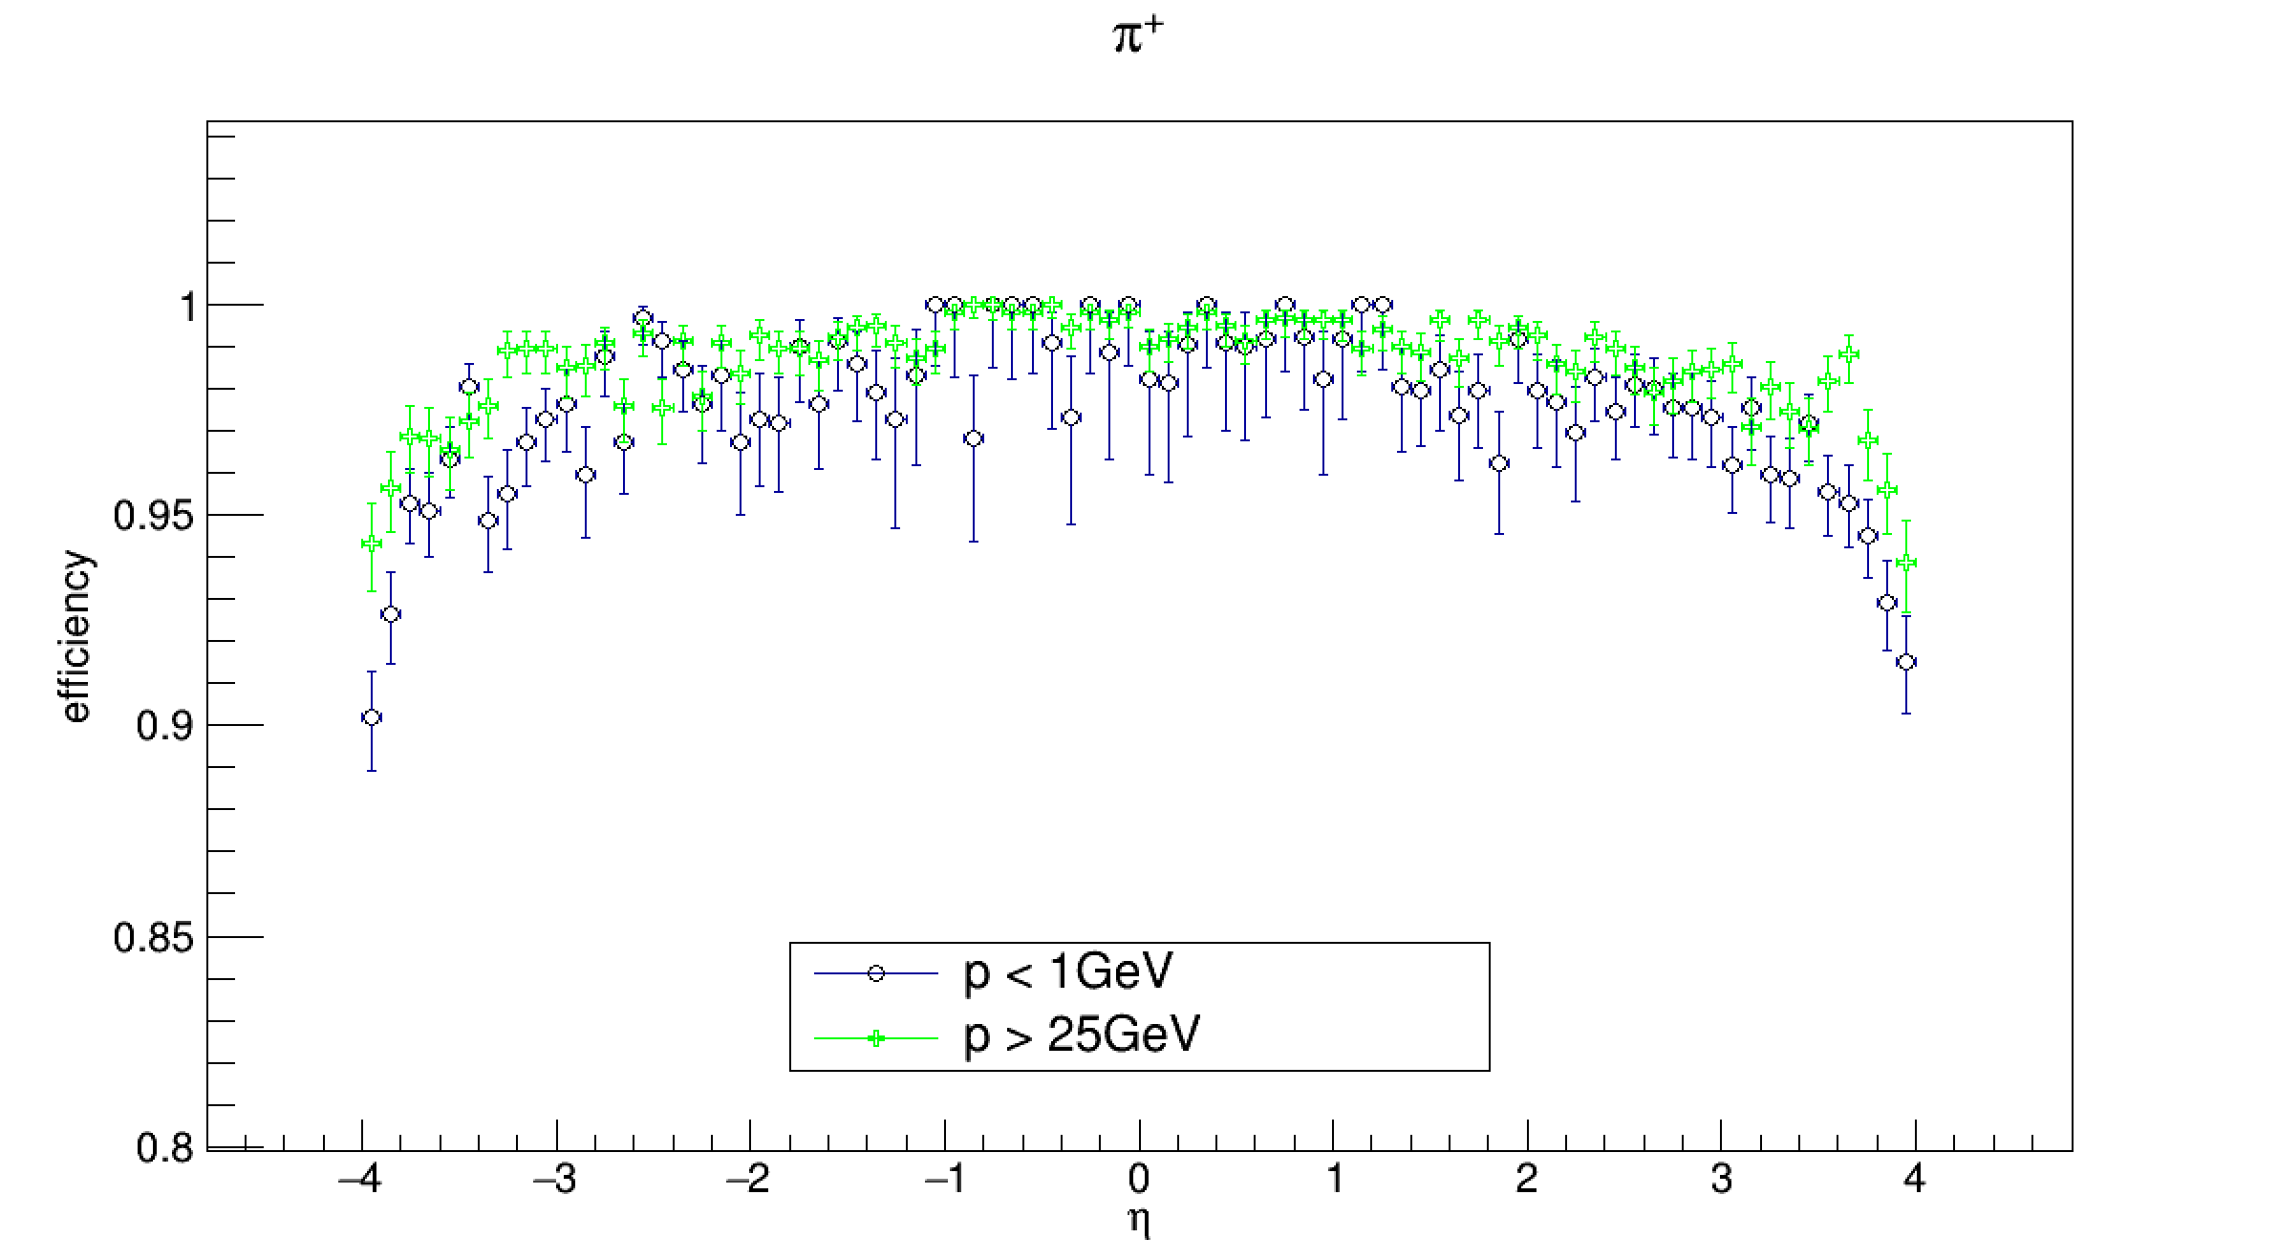
Tracking Efficiency

Slide 11
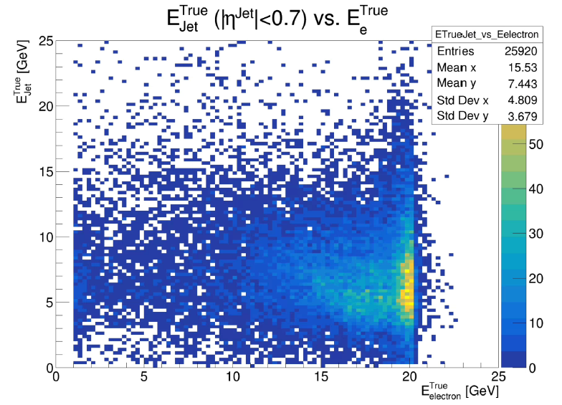
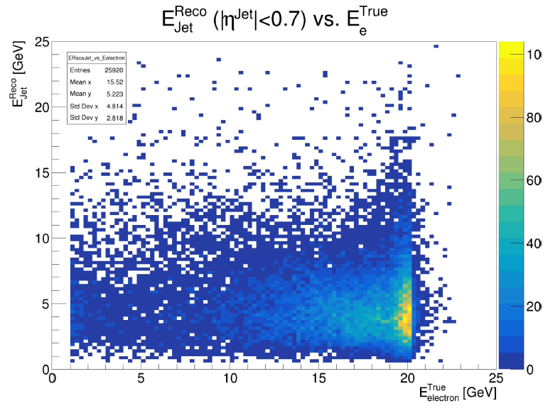
Jets with Fun4all (sPHENIX geometry)
Fernando Torales Acosta
Full simulations
Detector response w/ GEANT

Slide 12
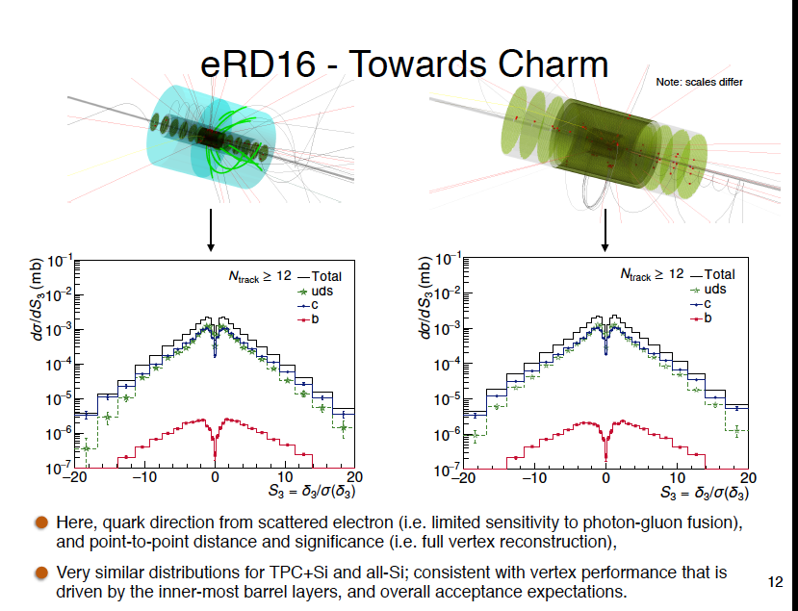
EICroot full simulations
Yue Shi Lai

Slide 13
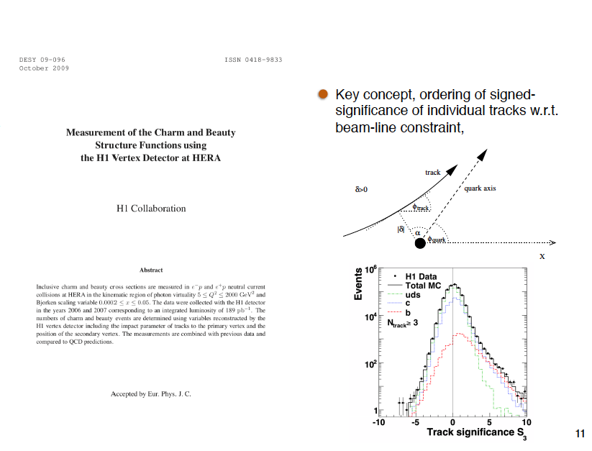

Slide 14
Next steps
Import all-Si tracker into Fun4all
Compare to Si+TPC with sPHENIX & BEAST magnets
Implement more detailed detector infrastructure
(using approach from Leo Greiner)
Collaborate on optimization

Slide 15







California Consortium
UC MRPI funding for ½ student per campus per year + workshops
Work is underway!
UCB: jet probes of gluon matter (arXiv:1912.05931)
UCR: calorimetry R&D/tests at STAR & jet fast simulations
UCLA: Hcal R&D/tests at STAR
UCD: Forward physics, collaborating on eSTARlight with Klein @ LBNL
LLNL & LANL collaborating on simulations

Slide 16
Backup

Slide 17
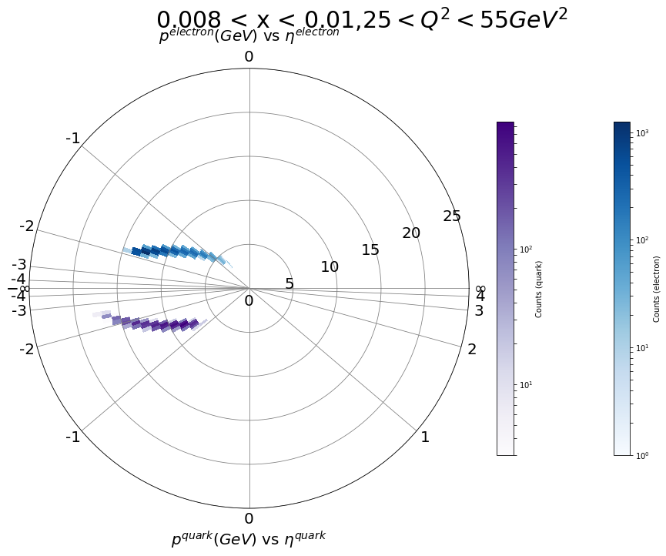
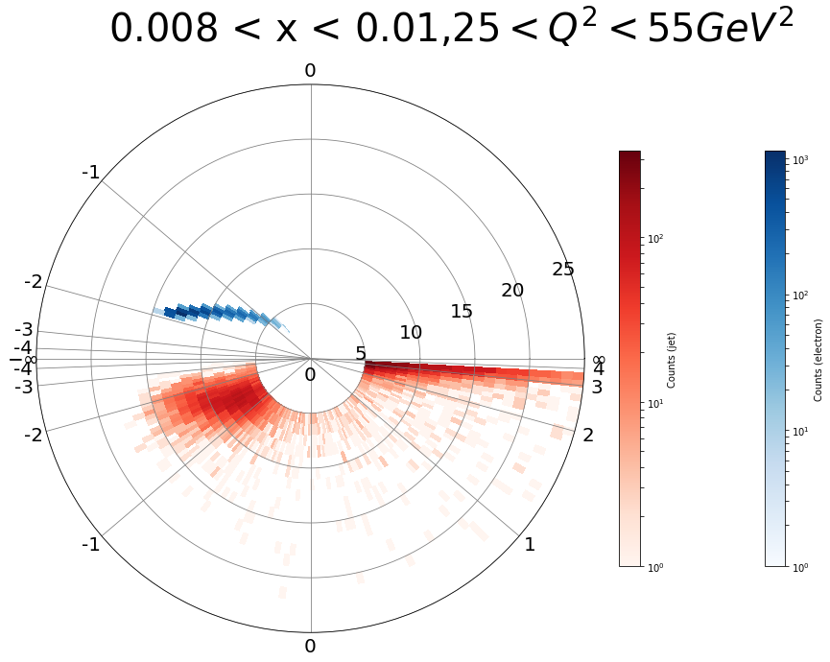
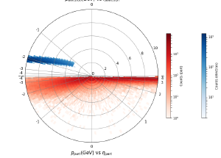
Probe CNM with tagged jet in e+A
e+p, DIS; Pythia 8. Require W² > 4 GeV²,
electron
p
η
struck parton
reconstructed jet
Youqi Song, M. Arratia
Smearing is larger for single hadrons; more so for low Q²

