Slide 1
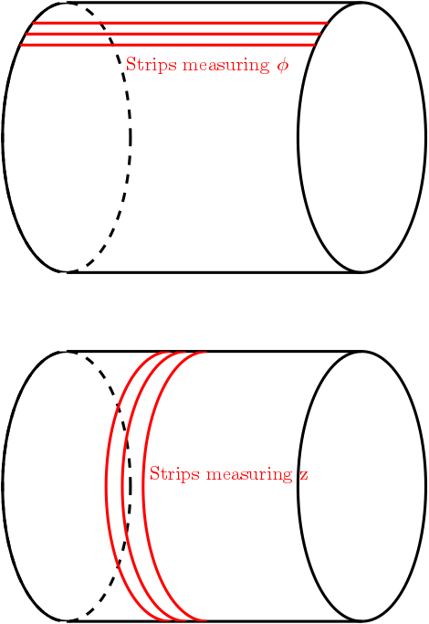
Questions Qinhua Huang (CEA Saclay)
Is there an out-of-the-box solution for reconstructing tracks detected by 1D cylindrical strip detectors?
One layer has only strips parallel to z-direction to measure φ
The other layer has only circular strips perpendicular to the z-direction to measure z
Is the patter recognition able to handle these kinds of detector information?

Slide 2
1D cylindrical strip detectors
For starters – our tracking can handle z strips (from playing with straw tubes) or uv strips from our si strip detector but not circular strips.
Multiple approaches possible here:
Use cylinders and bin them into strips (in z or in phi) – out of the box
Implement your own (simple to do but needs coding)
Truth tracking not really possible but you could create your own hits by matching phi and z from both layers and save this as a “hit”, you would need to deal with ambiguities

Slide 3
Example
Code: https://github.com/pinkenburg/qinhua
Generic binning of a cylinder into strips of adjustable sizes (resulting in “cells”)
→ Particles crossing from one strip to another contribute to multiple cells
Two Ntuples
one with hits which show the original location
one with “cells”, cell coordinates are the mean of their phi/z range
Cells have back pointers to hits and with this to MC info

Slide 4
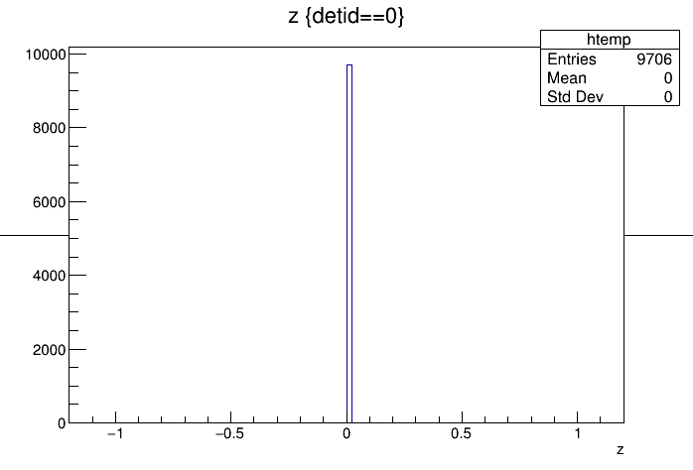
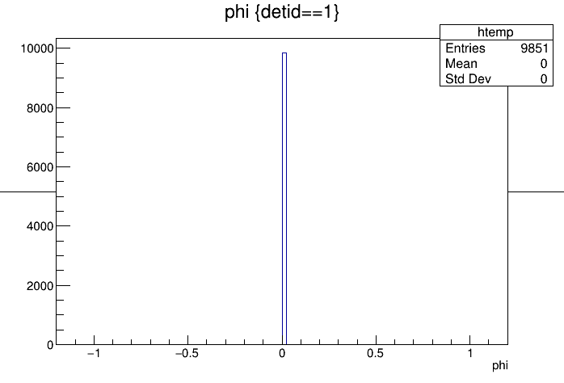
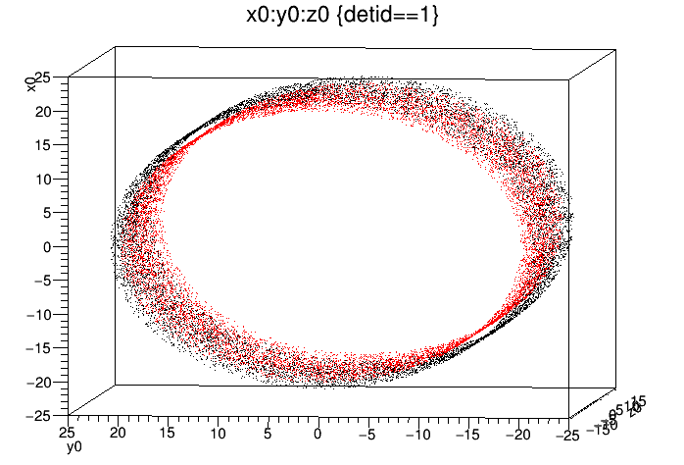
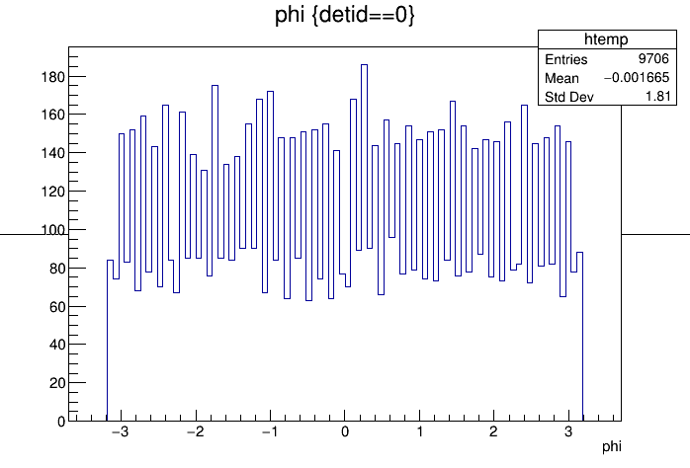
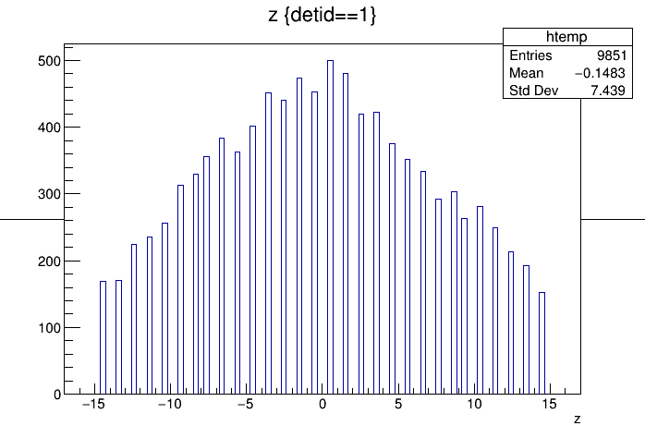
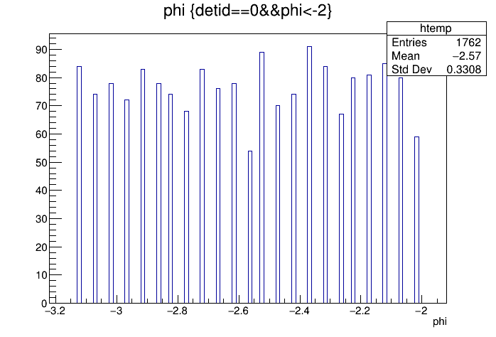
Hits + Cells
1D Strips in z (red)
1D Strips in phi (black)
Hit Coordinates
Just to show they are discrete phi bins

Slide 5
Can you provide examples showing how to write my own module, which does hit digitization or clustering based on G4 MC truth in Fun4All framework
G4Hits contain G4 info (next slide), ntuple code in example is a simple template how to get to those hits
But you can create your own as long as it inherits from PHObject (TObject+some methods) and is streamable (in fact you can create completely your own universe)

Slide 6
Our G4Hits (you’ll hear us talking about them a lot)
In our stepping method we add the energy loss in each volume and
store the entry and exit coordinates and time (and subdetector specific info like ionization energy, light output,…)
G4Hit
We also keep the ancestry for G4Hits so any hit can be traced back to a primary particle. To reduce size we do not store particles which do not leave G4Hits and are not in the ancestry of a particle which created a G4Hit

Slide 7
Can you provide example Fun4All macros, which display tracks reconstructed by GenFit?
.x Fun4All_G4_Momentum.C(2)
DisplayEvent();
Sadly somewhat instable (the ROOT display has issues)

Slide 8
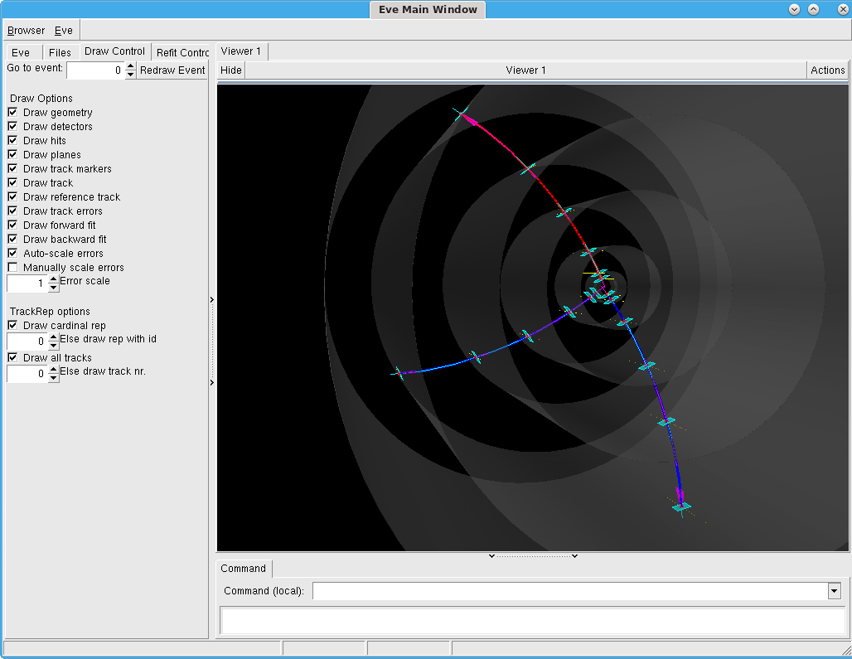
The outer layer is our black hole which terminates tracks to prevent loopers

Slide 9
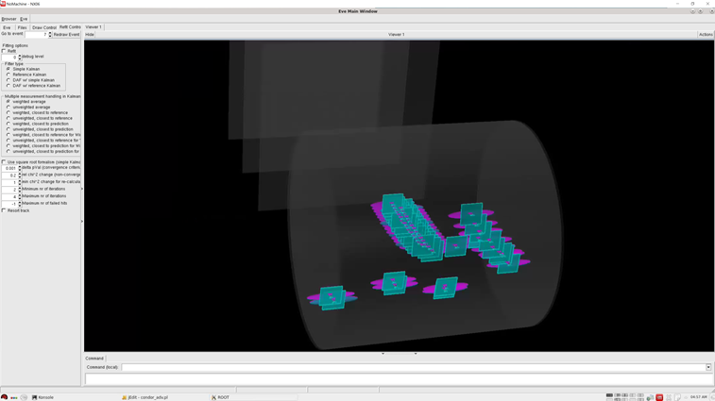
Kalman track fitting
Code reference: TpcPrototypeGenFitTrkFitter
1-removed residual: Remove the cluster in study, perform Kalman filter fit of rest clusters on track, extrapolate to cluster and calculate residual on both phi and z dimensions
Generate the GenFit ROOT file for further plotting, example macro: https://github.com/sPHENIX-Collaboration/prototype/blob/master/macros/tpc2019/DrawTpcPrototypeGenFitTrkFitter.C

Slide 10
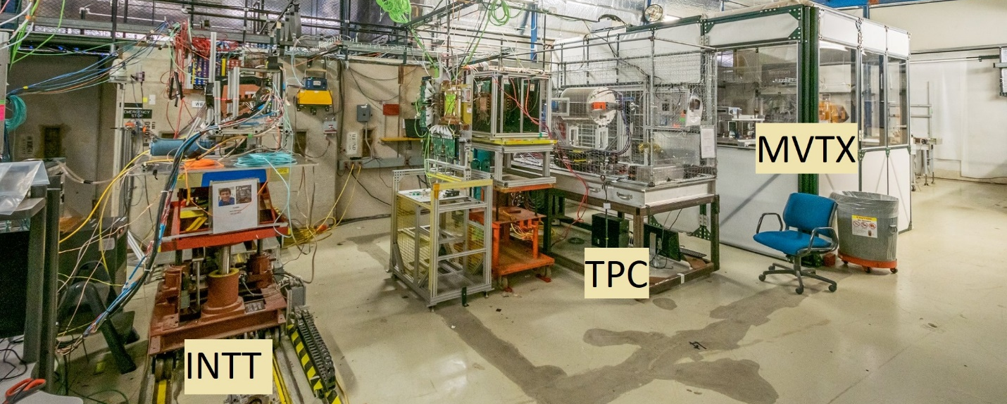
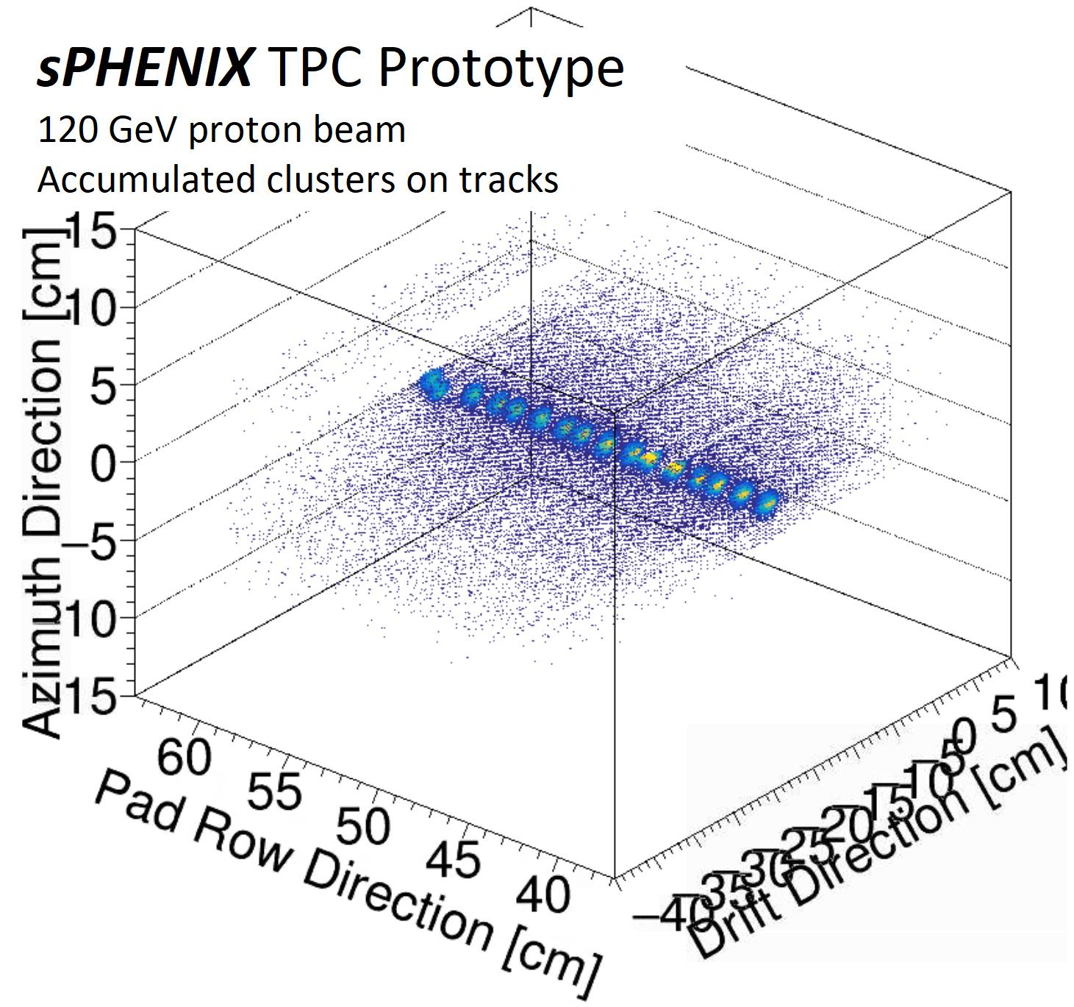
Simulation and analysis during test beam
Clustering
Track finding
Simulated response in Geant4
Kalman-filter fit
Resolution proj.

Slide 12
Questions
Could you provide the detailed parameters of the beam pipe?
If there are two IRs, could you provide any available geometries of the two IRs?
Any baseline components in the default EIC conceptual detector design?
How about the space limitation for a forward silicon tracking detector?
Could you provide the updated magnetic field map in both the central and forward (endcap) region?

Slide 13
Questions
Needs guidance from Accelerator or other YRG (beam pipe, space limitation for forward silicon tracking)
Often generic volumes (boxes, cylinders, cones) are sufficient to describe support structures (beampipe, magnets)
We can import step files (CAD drawings) as tessellated volumes which do not have a representation in TGeo (effects on tracking?)
If sPHENIX is baseline Magnet, Hcal (+ EMCal) may be reused, full implementation exists including fieldmap.
Field shaping forward discussed but not implemented
There might be an sPHENIX+forward fieldmap at LANL?
JLeic mostly implemented in terms of mother volumes (overlaps in beam elements last time I checked) , no fieldmap

Slide 14
Matt
Gems exist, configurable - parameters set in macro
No TRD (needs to be coded up – implement Yulias TRD?)
Single volume sPHENIX TPC actively being worked
Pad plane base class can be used to implement other pad planes
Truth tracking based on clusters tagged with G4 id
EIC TPC is gas layers (enables truth tracking based on hits)
Geometry can be set as parameters which have a default but can be overridden in macro (saved in output)
No central geometry – sources can be hardcoded, read from xml file, read from DB (or whatever you implement in your subsystem)

Slide 15
Summary (sales pitch)
You can just link against the libraries in cvmfs and implement the pieces you need – no recompilation of external code needed
Easy exchange of modules among users
Central repo possible (with daily builds and CI but details like responsibilities need to be discussed)
You are running in a chain – no issues how to propagate information from one step to the next or completely different way to run things. Easy batch job submission.
Lots of existing modules (tracking, calo clustering, jet reco)
Development is all about debugging and problem solving
Keep number of layers between us and what’s going on to a minimum – the strength of a framework is not how “easy” it is to use when everything works, it is how painful it is to find and fix the reasons when things don’t work
Tons of experience and tools to help with code issues
Staying with container enables us to reproduce problems and help out
You will have to provide us with the code and macro to reproduce the issue

