Slide 1
Tracking WG plans and next steps
30.7.2020
D. Elia, K. Gnanvo, L. Greiner
Outline:
  further needed/requested simulations
  requested parametrizations for the PWGs
  documentation: contribution to the wiki pages

Slide 2
Tracking requested/needed simulations
For each of the following configurations:
Updated beam pipe diameter , 1.5 T field, existing services/support approximation
Updated beam pipe diameter , 3 T field, existing services/support approximation
Updated beam pipe diameter , 1.5 T field, updated services/support approximation
Updated beam pipe diameter , 3 T field, updated services/support approximation
we would like to have:
 | 10 um pixels | 20 um pixels
All Si | Pointing/momentum resolution, low pT cut off | Pointing/momentum resolution, low pT cut off
Si + gas | Pointing/momentum resolution, low pT cut off | Pointing/momentum resolution, low pT cut off

Slide 3
Requested parametrizations for the PWGs
Need to extract the following from the existing studies (for both the 1.5 and 3 T field options):
fit the relative momentum resolutions vs momentum and provide the resulting parametrizations so that PWGs/SWG can include them in EIC-Smear
provide the expected minimum detectable p_{T} (or p vs eta) so that PWGs can remove spiraling tracks from their EIC-Smear simulation studies accordingly
To be done with the available performance figures, for a first feedback/input to the PWGs studies
To be updated at a later stage, once new studies/results will be available (previous slide)

Slide 4
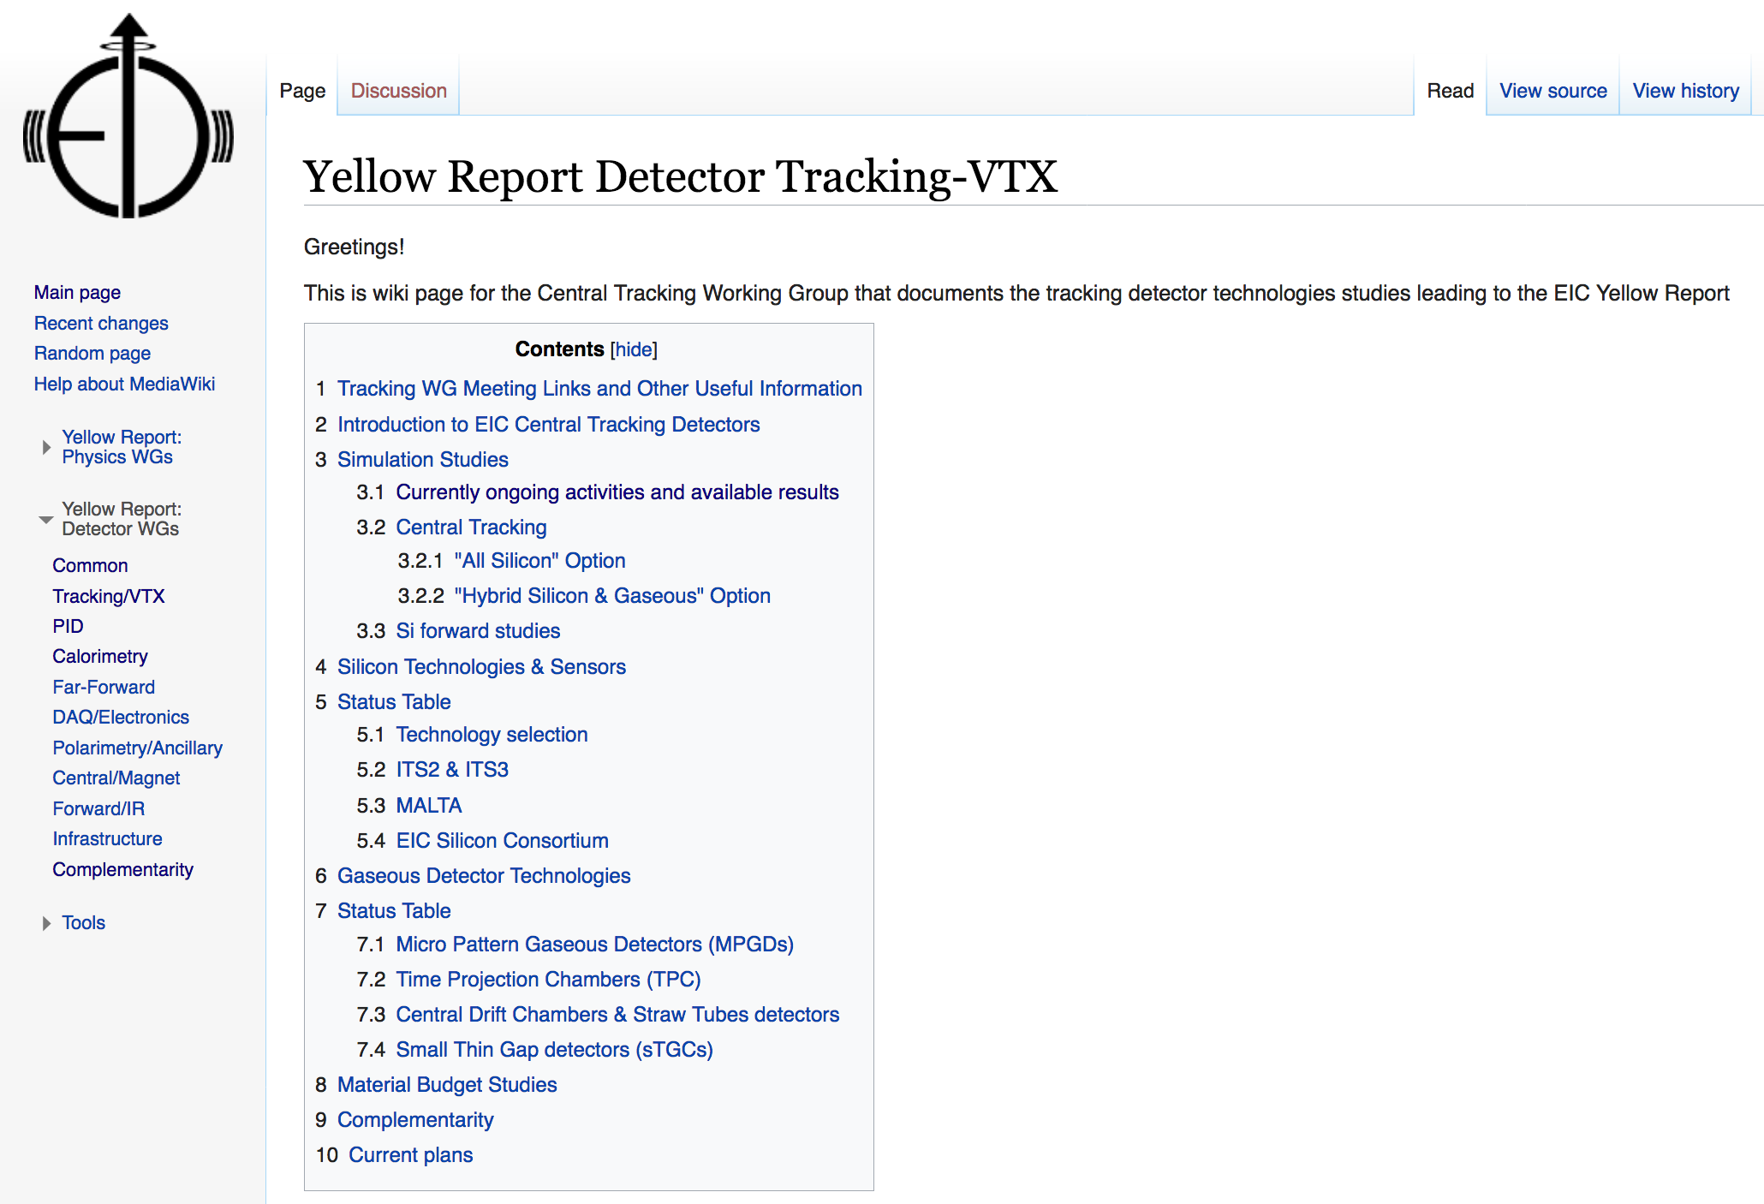
Further update of the YR wiki pages
We have started filling and organizing the info on the Tracking-WG part of the YR wiki pages:
https://wiki.bnl.gov/eicug/index.php/Yellow_Report_Detector_Tracking-VTX
We would ask all groups and colleagues involved in the WG activities (both simulations and technology solution investigations) to keep checking and increasing the available information with further details, eg:
including main performance figures
in the different studied configurations
mentioning ongoing studies and further plans

