Slide 1
Hybrid detector SVT baseline proposal
H. Wennlöf on behalf of eRD25, 27/8 -20

Slide 2
Previous simulations, and discussion within eRD25 on 25th of August concerning details yielded this proposal for the silicon part of a baseline hybrid tracker layout, taking beampipe and technology choice into account.
This layout has a gaseous tracker outside the silicon barrel, be it TPC or MPGD layers or a combination of them.
Silicon part consists of barrel and disks, inside the gaseous detector
  Whether or not to replace some silicon disks with gaseous detectors is up for discussion and investigation, but innermost disks should be high-granularity low-material detectors
All-silicon baseline nearly agreed on, just a few more simulations needed.

Slide 3
Hybrid baseline - silicon
3 inner layers
2 outer layers
7 disks in either direction
  Disk outer radii tapered, leaving space for supports and services
Material in accordance with Leo ITS3-like predictions;
  Inner layers: 0.05% X/X₀
  Outer layers: 0.55% X/X₀
  Disks: 0.24% X/X₀
Baseline pixel size: 10x10 µm²
Radial space used: 36.4 - 200.0 mm
Cross section sketch

Slide 4
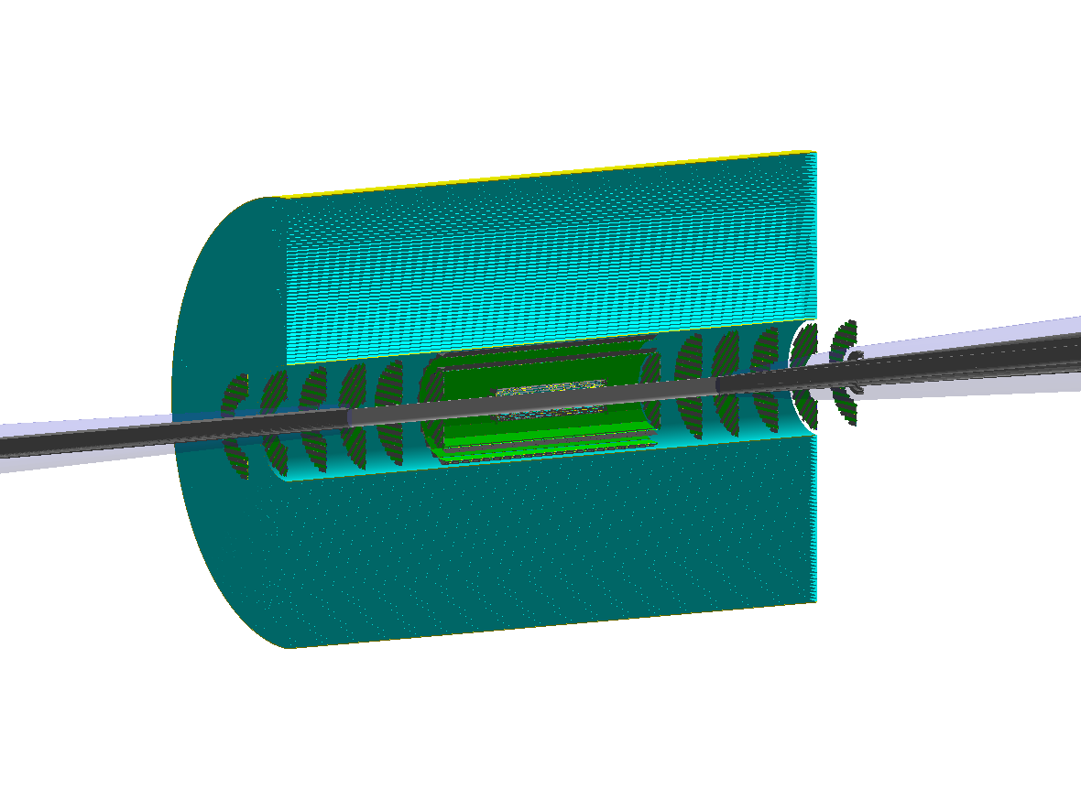
Created as GDML files using EICROOT and imported into Fun4All
GDML files and a way to import them into Fun4All can be found here
  Questions on how to do this can be sent to h.wennlof@cern.ch
Possible to integrate with different gas detectors.
  Image shows Fun4All TPC implementation

