Slide 1
University of Birmingham simulations update
P.P. Allport, L. Gonella, P. Ilten, P.G. Jones, P.R. Newman, S. Maple, H. Wennlöf (h.wennlof@cern.ch)
8th of October 2020

Slide 2
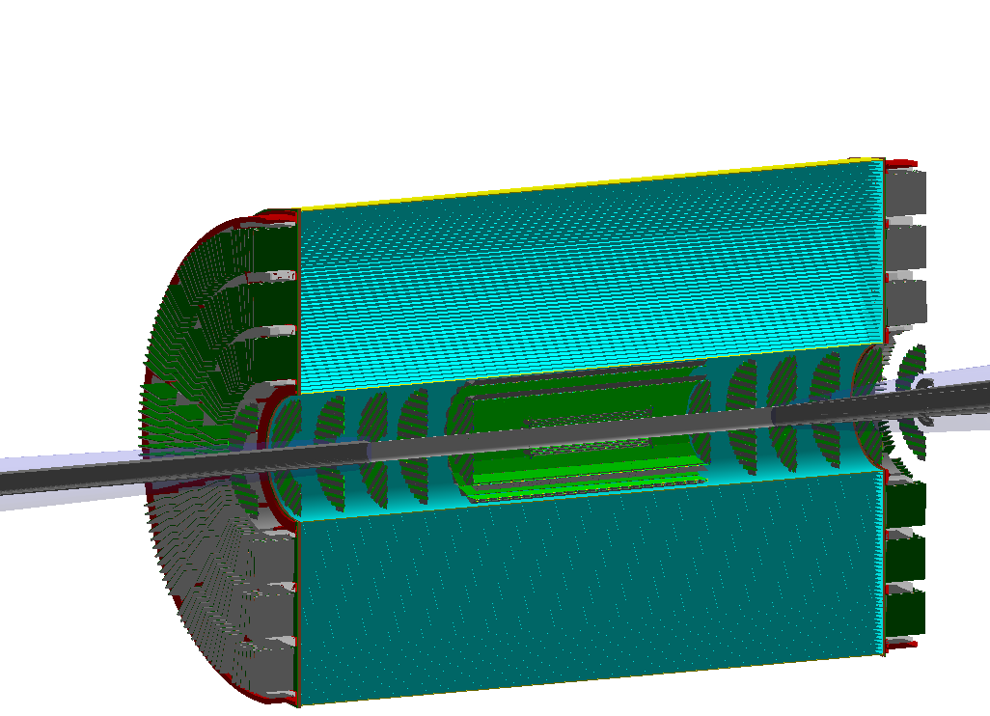
Study of low-momentum limit
Investigating pion and kaon low-momentum limit with the current baseline TPC hybrid tracker
Sending single pions and kaons in pseudorapidity interval -4 ≤η≤ -4, flat distribution in p_{T} 0 to 0.5 GeV/c
Checking for 1.5 T and 3.0 T
Goal: determine which fraction of events can be reconstructed
Using Kalman filter reconstruction
Important: this is just about the fraction of events that can be reconstructed. No inference should be made about resolutions from these results.
Note: “black hole” added outside (not shown), in lieu of other absorbing detectors

Slide 3
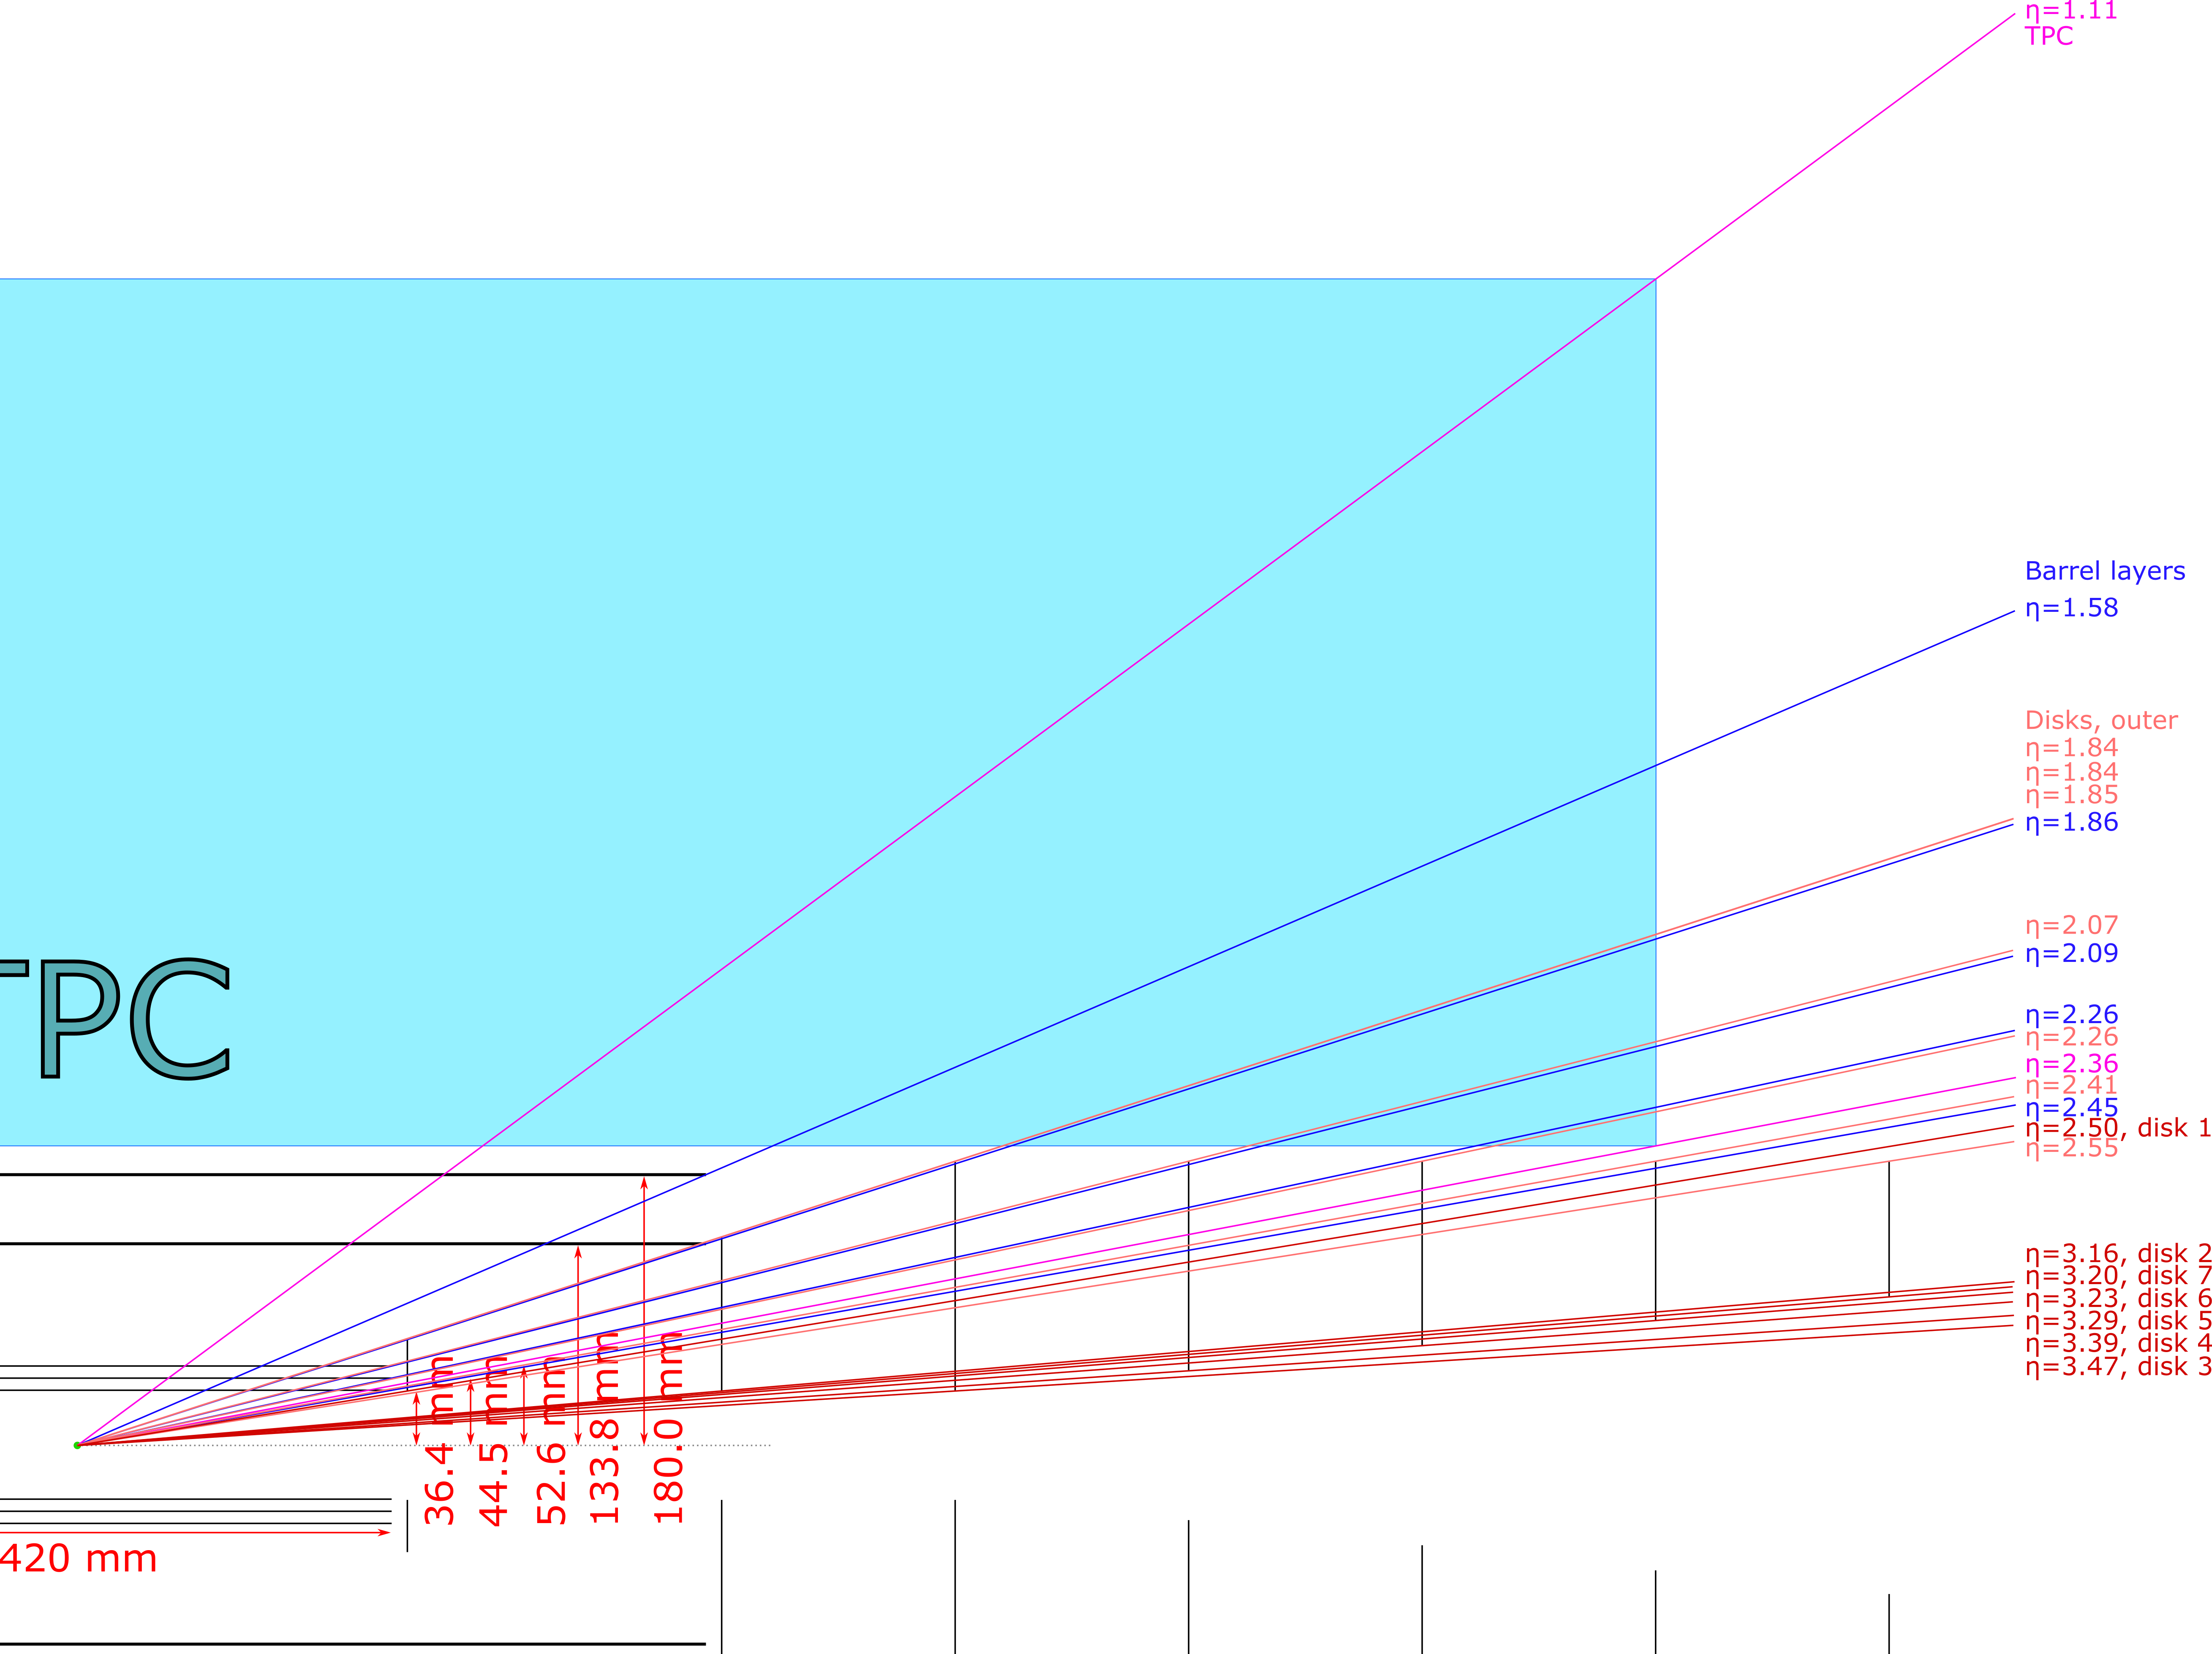
Layout sketch with pseudorapidities

Slide 4
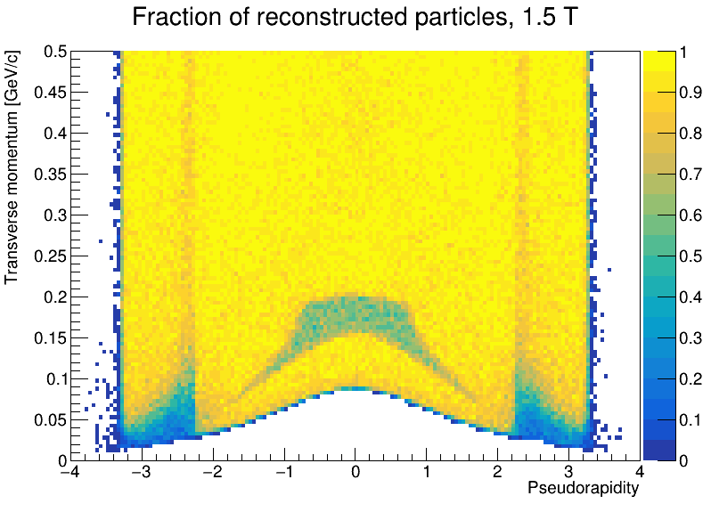
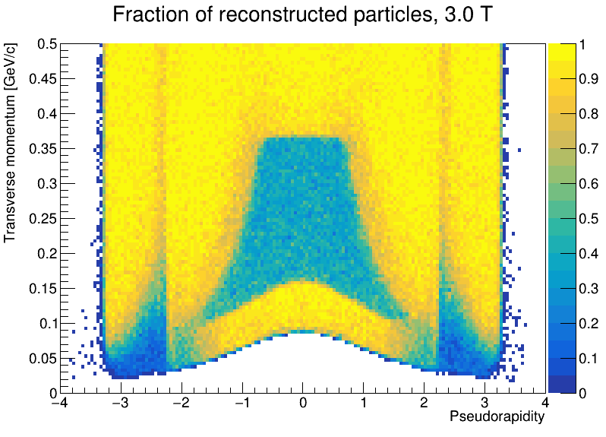
Kaon maps
Transverse momentum vs pseudorapidity, colour is fraction of reconstructed events
Yellow means 100% of events are reconstructed
Some clear features visible

Slide 5
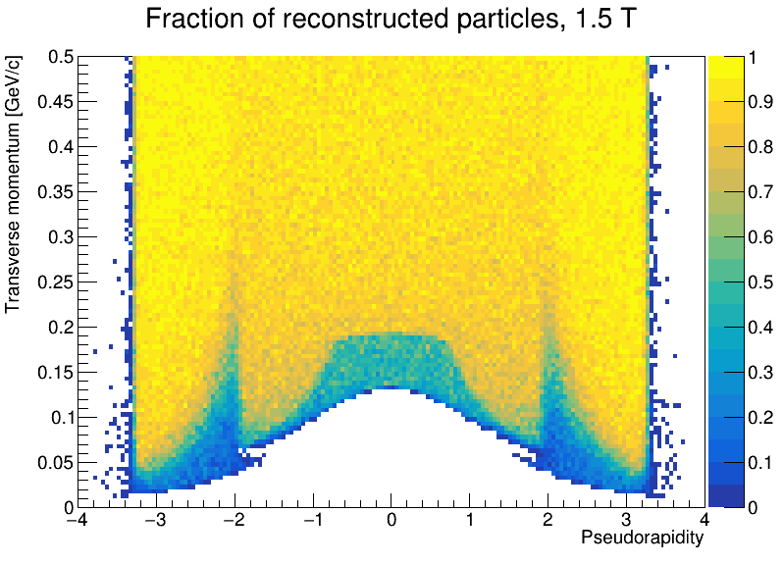
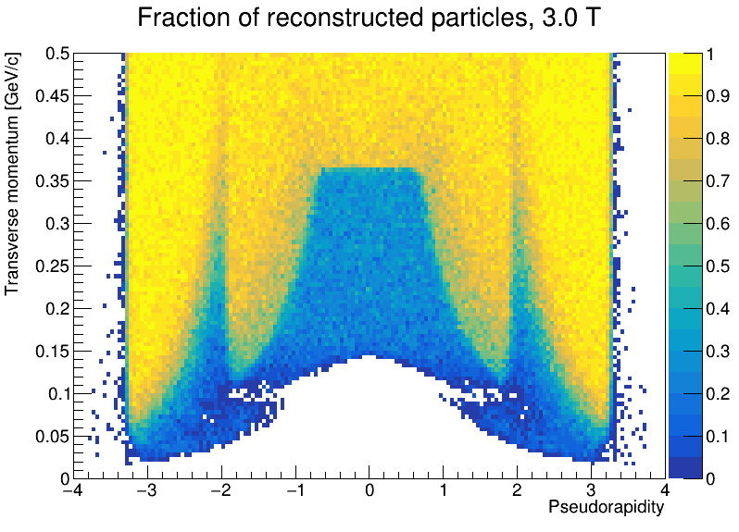
Kaon maps – no silicon barrel
Removed to investigate where inefficiencies come from
Mainly from spiralling in the TPC
Having the silicon barrel in place mitigates this
Removing silicon barrel removes the “good region” in the centre at low p_{T}, and moves “bad region” edges in in pseudorapidity
Flicking between this slide and the previous makes this clearer

Slide 6
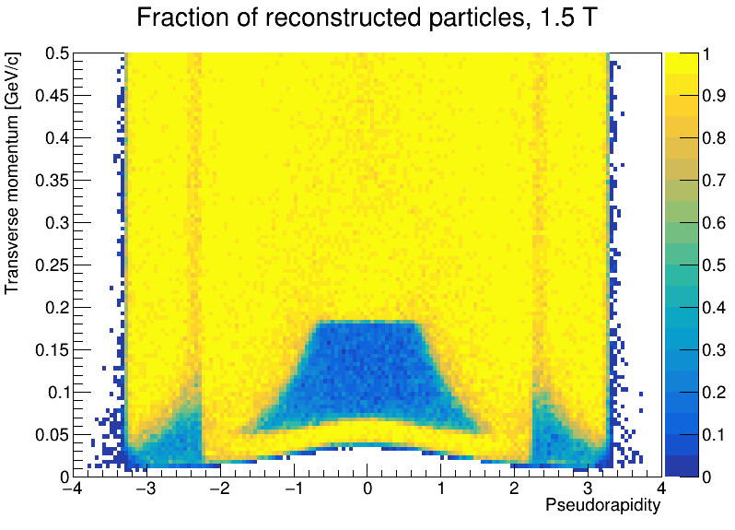
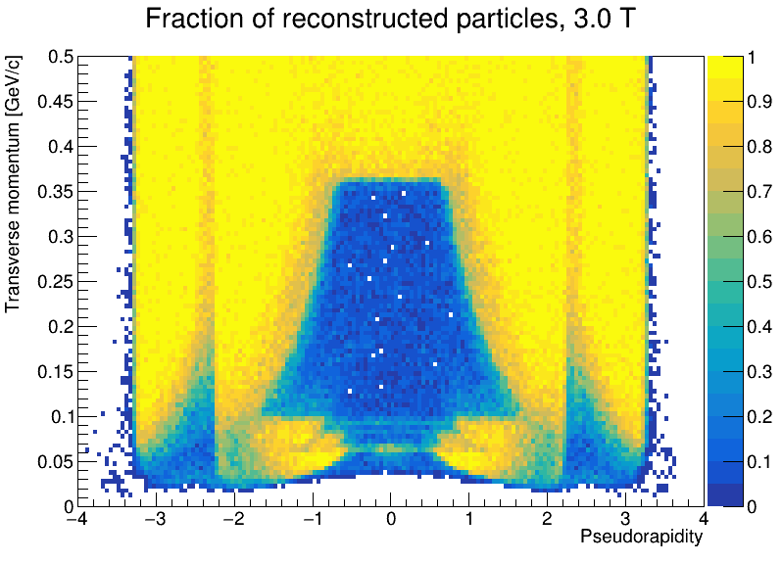
Pion maps
Similar to the kaon maps, but more extreme
Lower lowest momentum
Larger and deeper “central” efficiency loss region

Slide 7
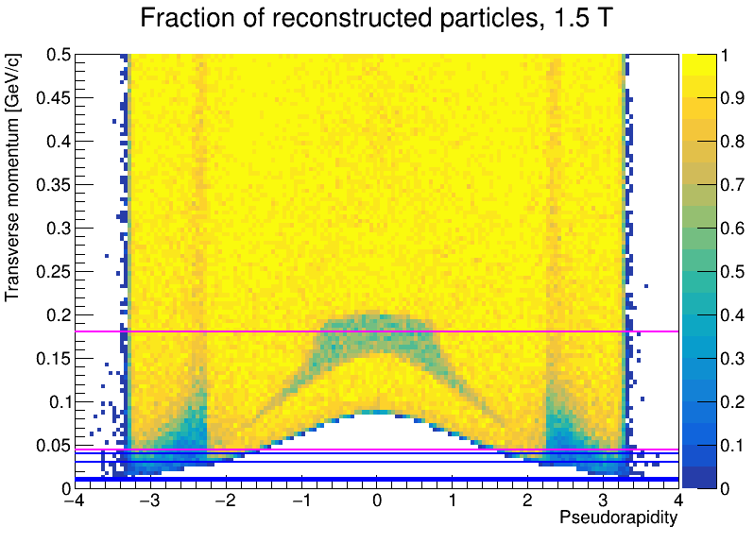
Lines of interest
Adding lines in plot, to show special areas in detector
Horizontal lines show spiralling momentum for certain radius
This, and all momenta below, will spiral inside the given detector edge
Important note: y-axis is initial momentum. Energy loss in the material will push the spiralling momentum edge up a bit.
Kaons, 1.5 T
TPC
Barrel layers
Central inefficiency comes from spiralling in TPC, but effect is mitigated by silicon barrel

Slide 8
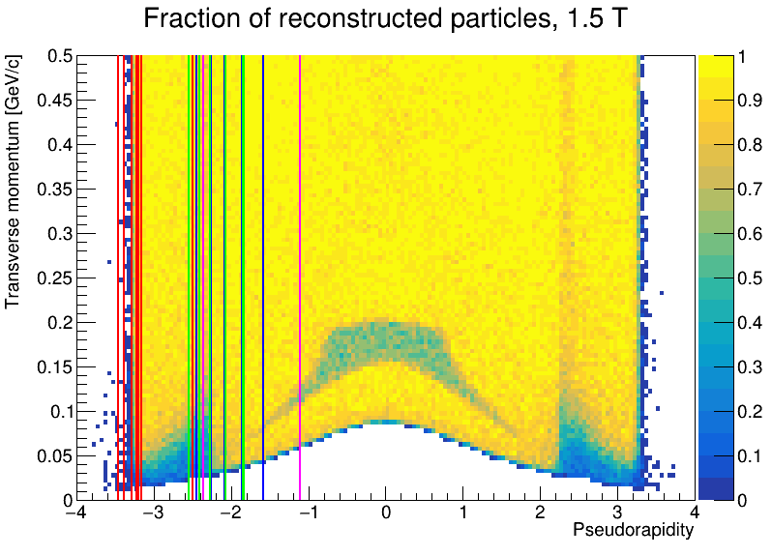
Lines of interest
Kaons, 1.5 T
Vertical lines give pseudorapidity
Magenta are TPC corners
Blue is where barrel layers end
Green is where disk outer edge is (i.e. where disks start to matter)
Red is disk inner edge (i.e. where disk is no longer hit)
Here: we lose reconstruction efficiency in η when all but one of the barrel layers are missed.

Slide 9
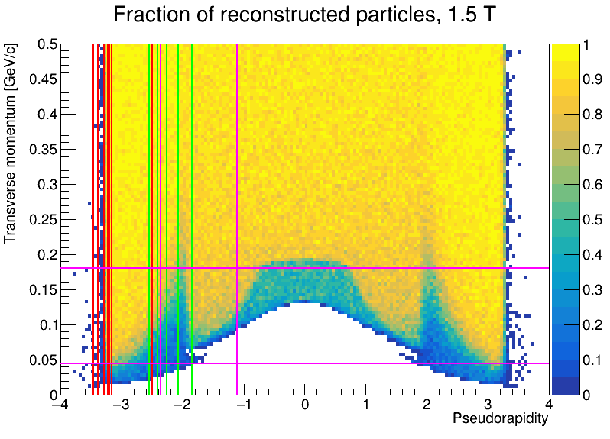
Lines of interest – no silicon barrel
Disk material causes drop in reconstructed fraction here (three disks are added at η = 1.86)
Remember: this is quite unrelated to resolutions. Adding disks will improve resolutions, but the added material might stop particles (and hence prevent reconstruction)
Kaons, 1.5 T

Slide 10
Projections
Projections of the fraction of reconstructed particles made in pseudorapidity bins. Shown on the following slides
Bins have size 0.5
These plots can be used to match detector matrix requirements, for discussions with Physics WG
This detector configuration is symmetric, so only plots between 0 and 4 in pseudorapidity are shown
These plots make it possible to infer the minimum reconstructable momentum. Given here as when the fraction of reconstructed tracks is consistent with 0.9 or higher
This is colour coded; blue is for 1.5 T, red is for 3.0 T
The first two plots (i.e. the more central regions) show lines for the “black hole” start radius, in terms of spiralling momentum

Slide 11
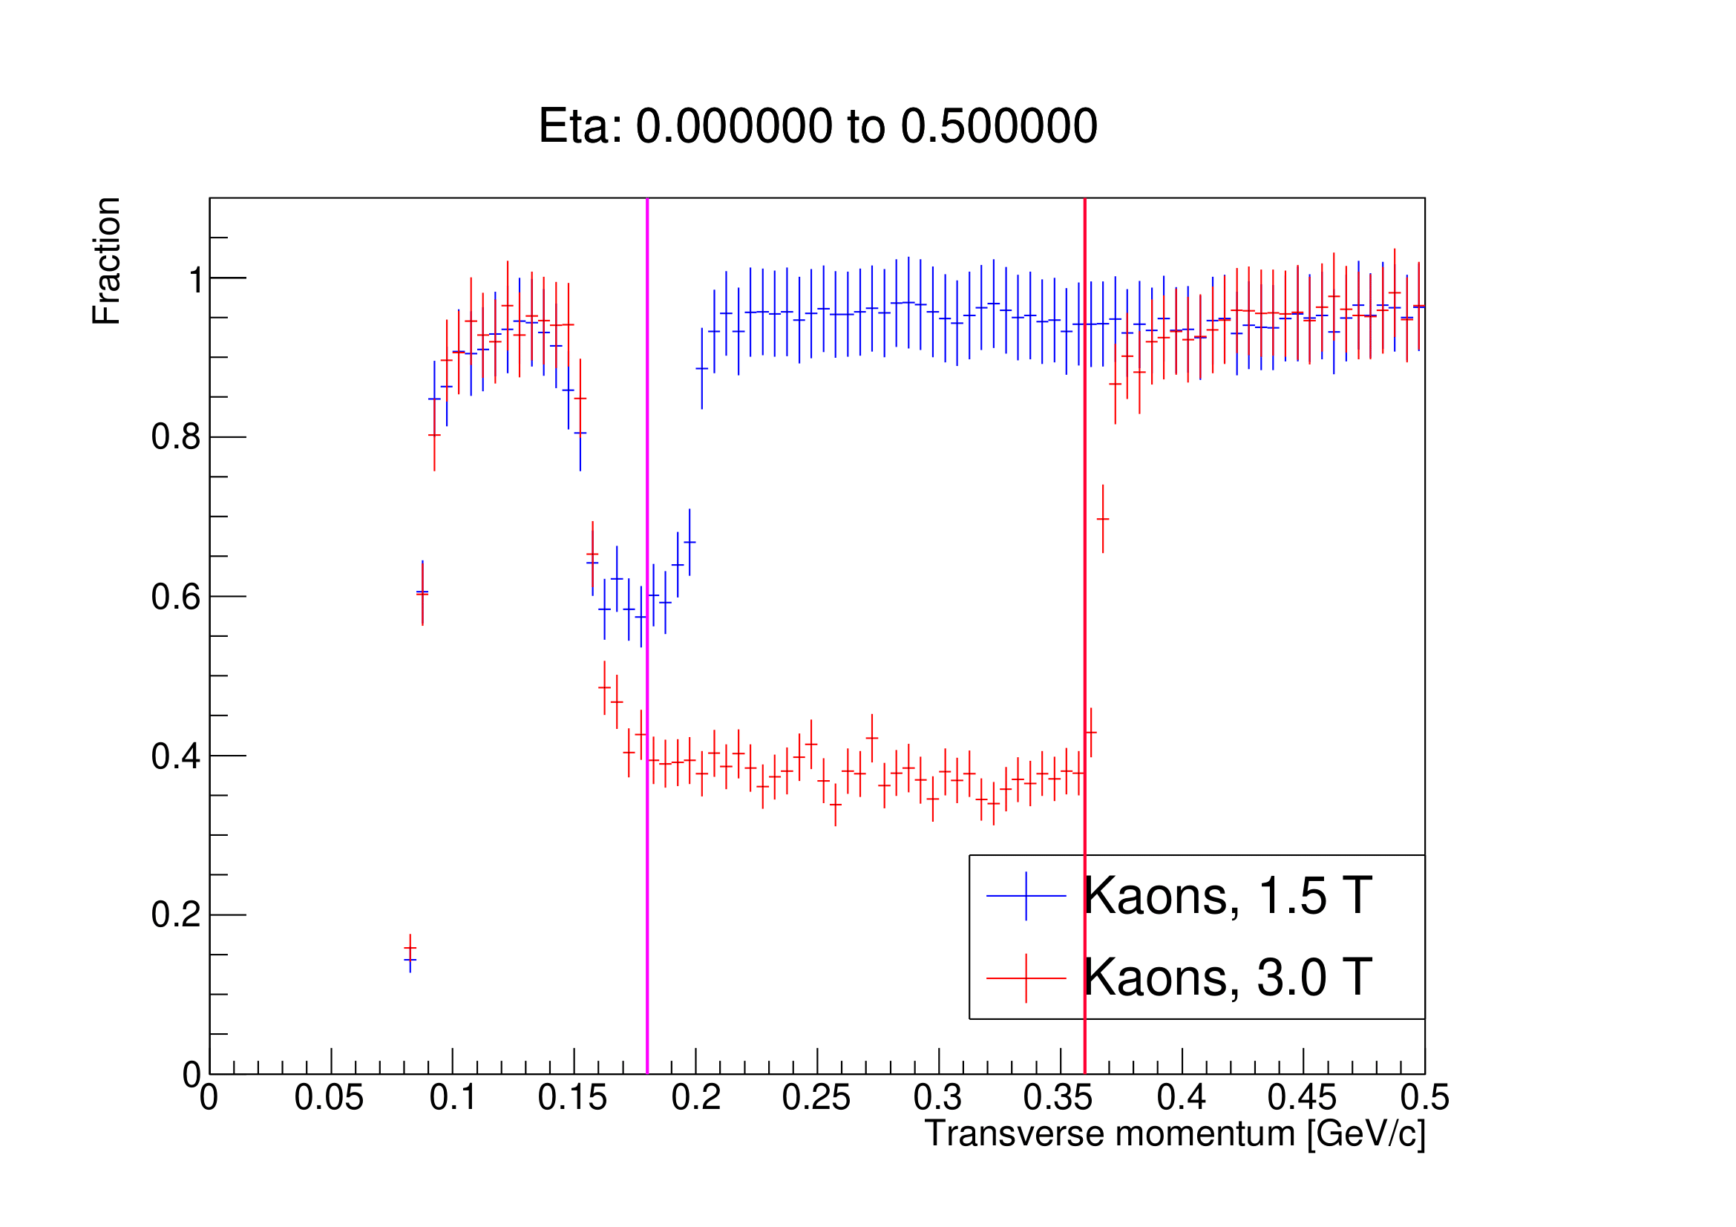
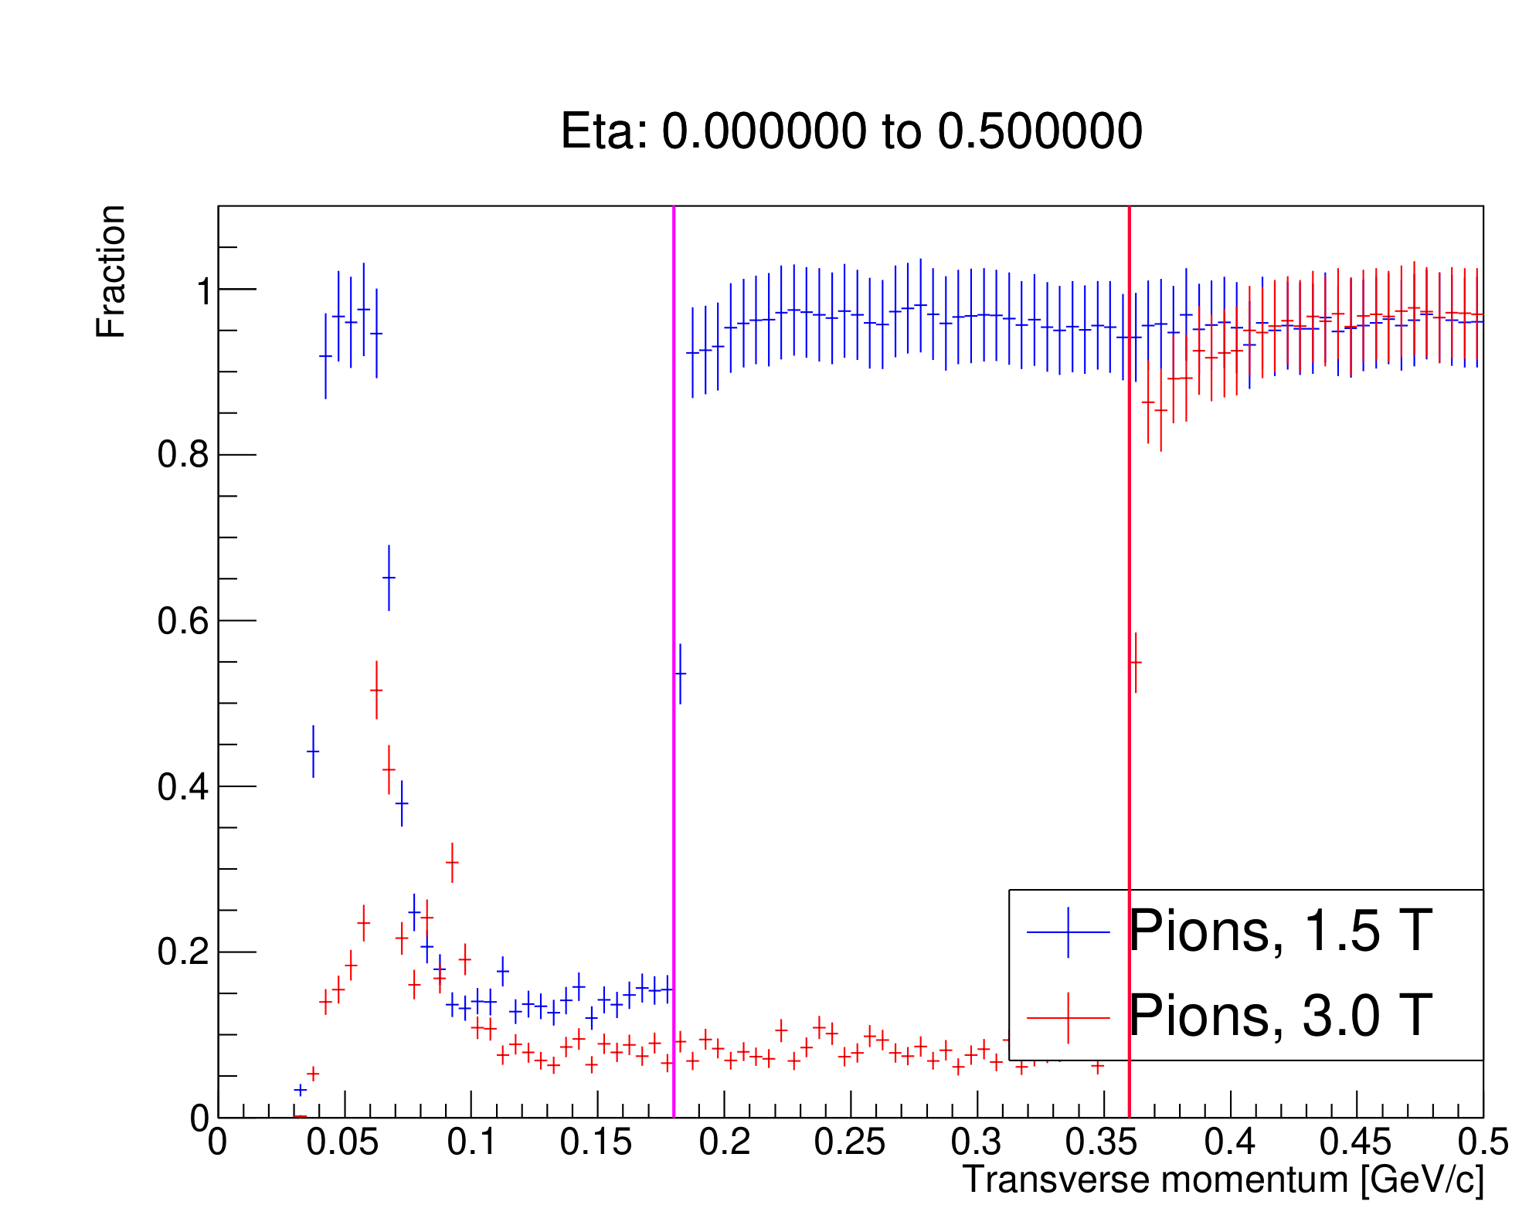
0.0 ≤ η ≤ 0.5
Kaons
Pions
BH spiralling, 1.5 T
BH spiralling, 3.0 T
BH spiralling, 1.5 T
BH spiralling, 3.0 T
Reconstructable momentum:
100 MeV/c ≤ p_{T} ≤ 150 MeV/c
p_{T} ≥ 210 MeV/c
p_{T} ≥ 380 MeV/c
Reconstructable momentum:
50 MeV/c ≤ p_{T} ≤ 65 MeV/c
p_{T} ≥ 190 MeV/c
p_{T} ≥ 370 MeV/c

Slide 12
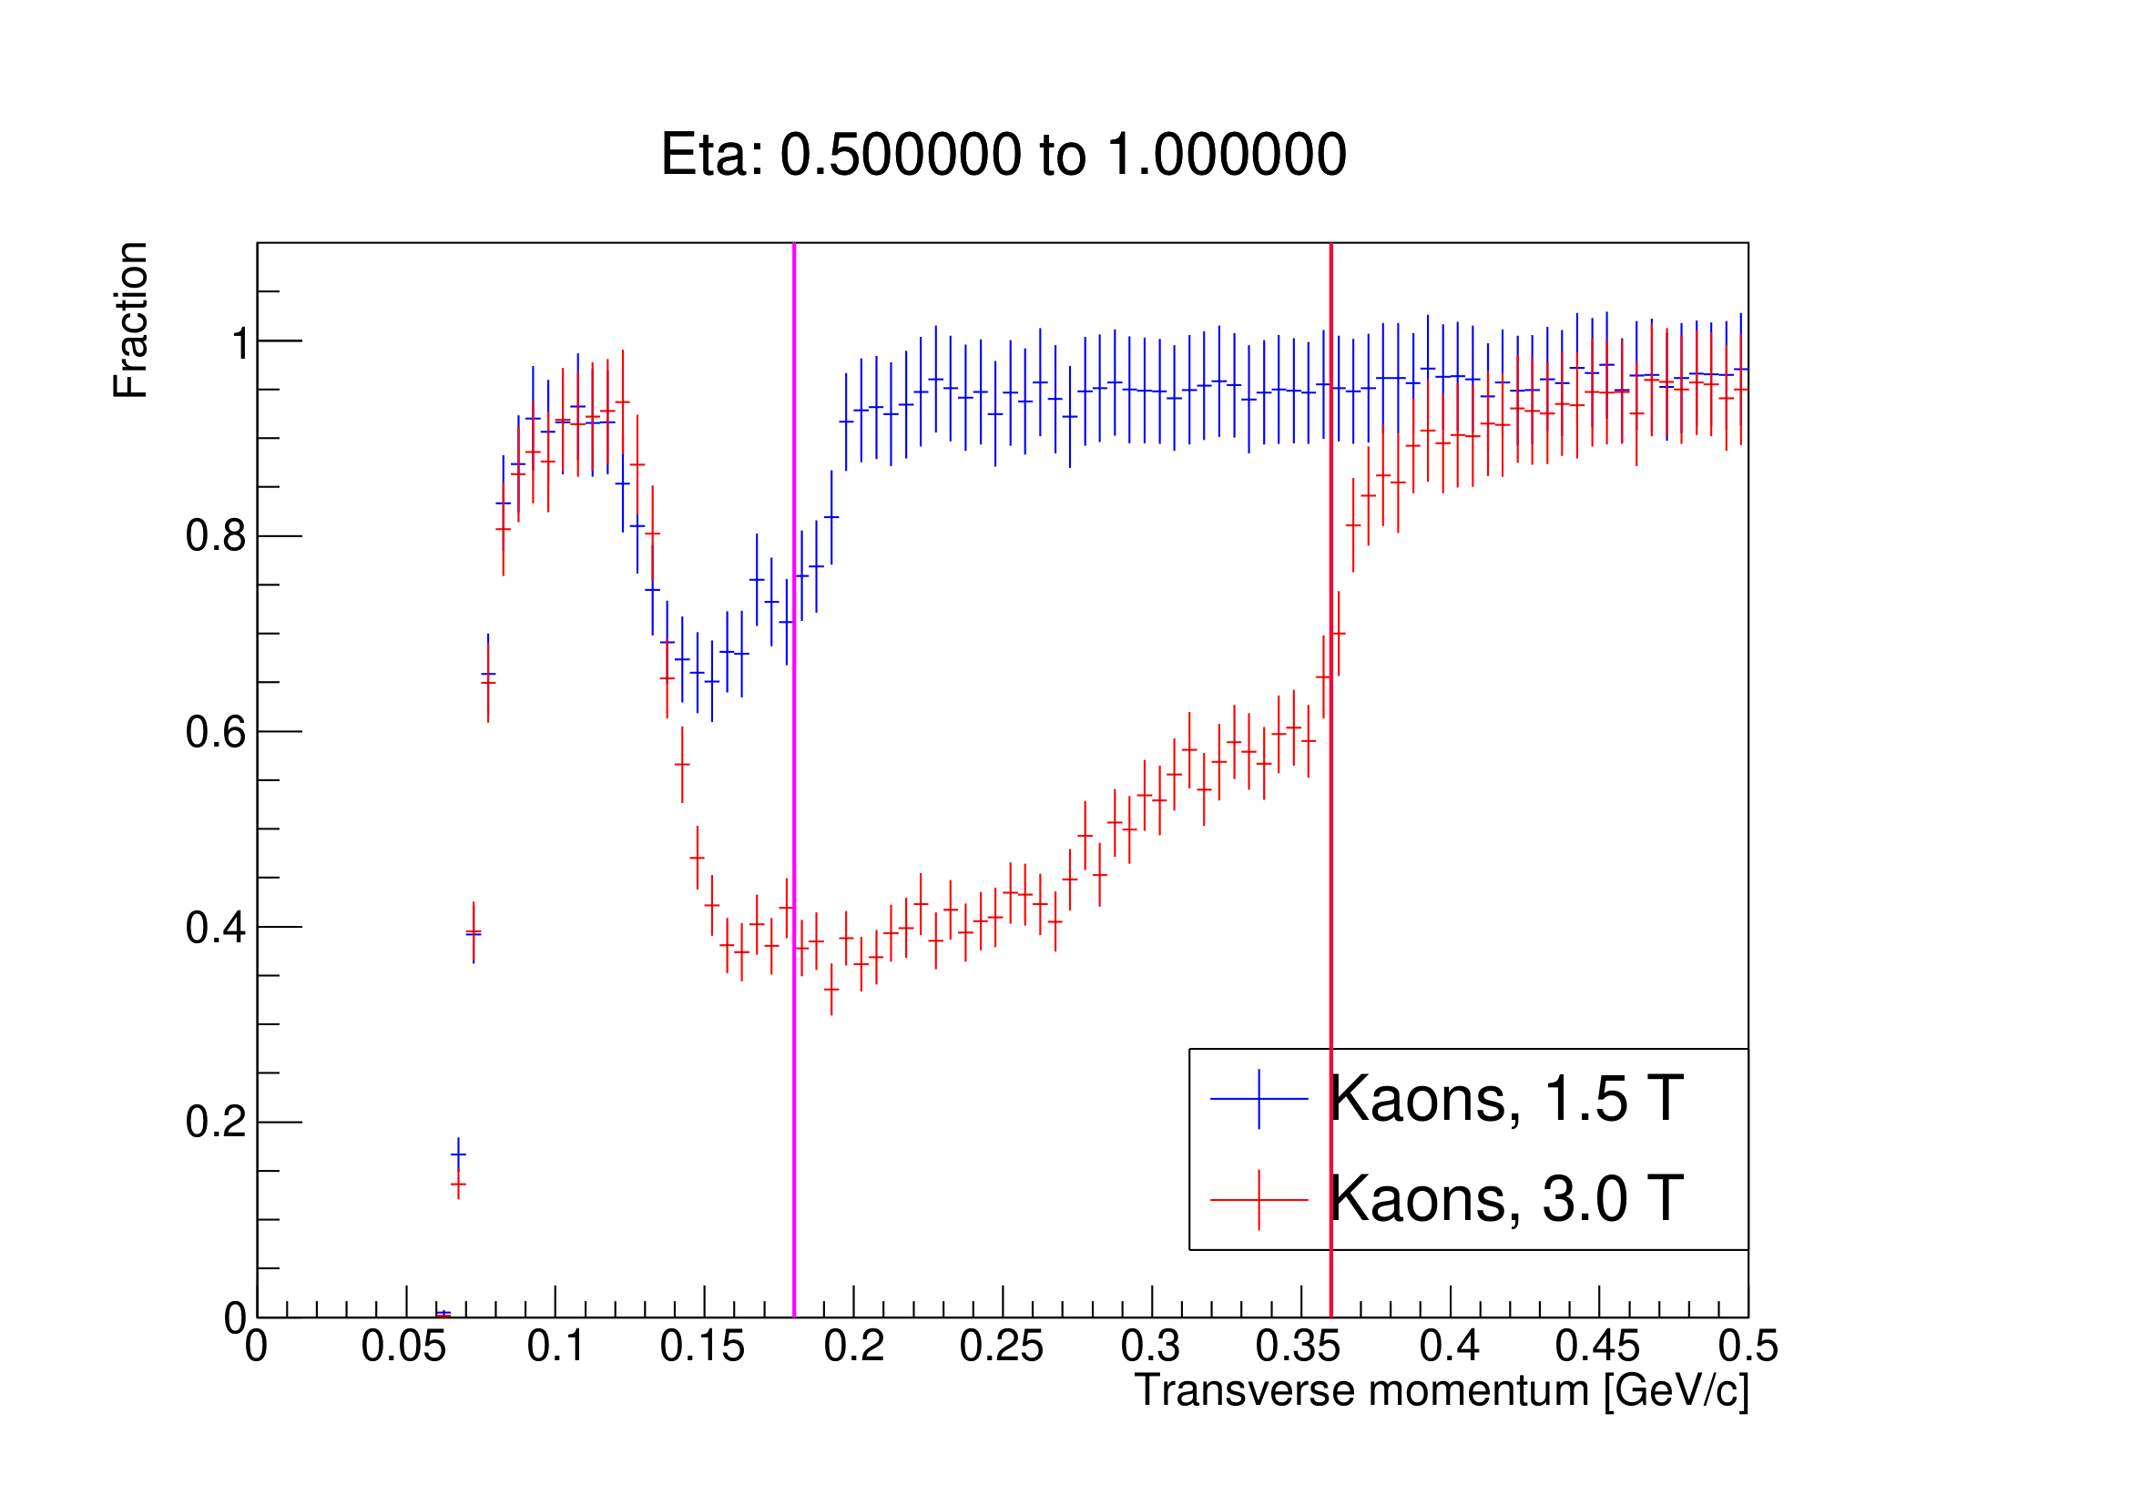
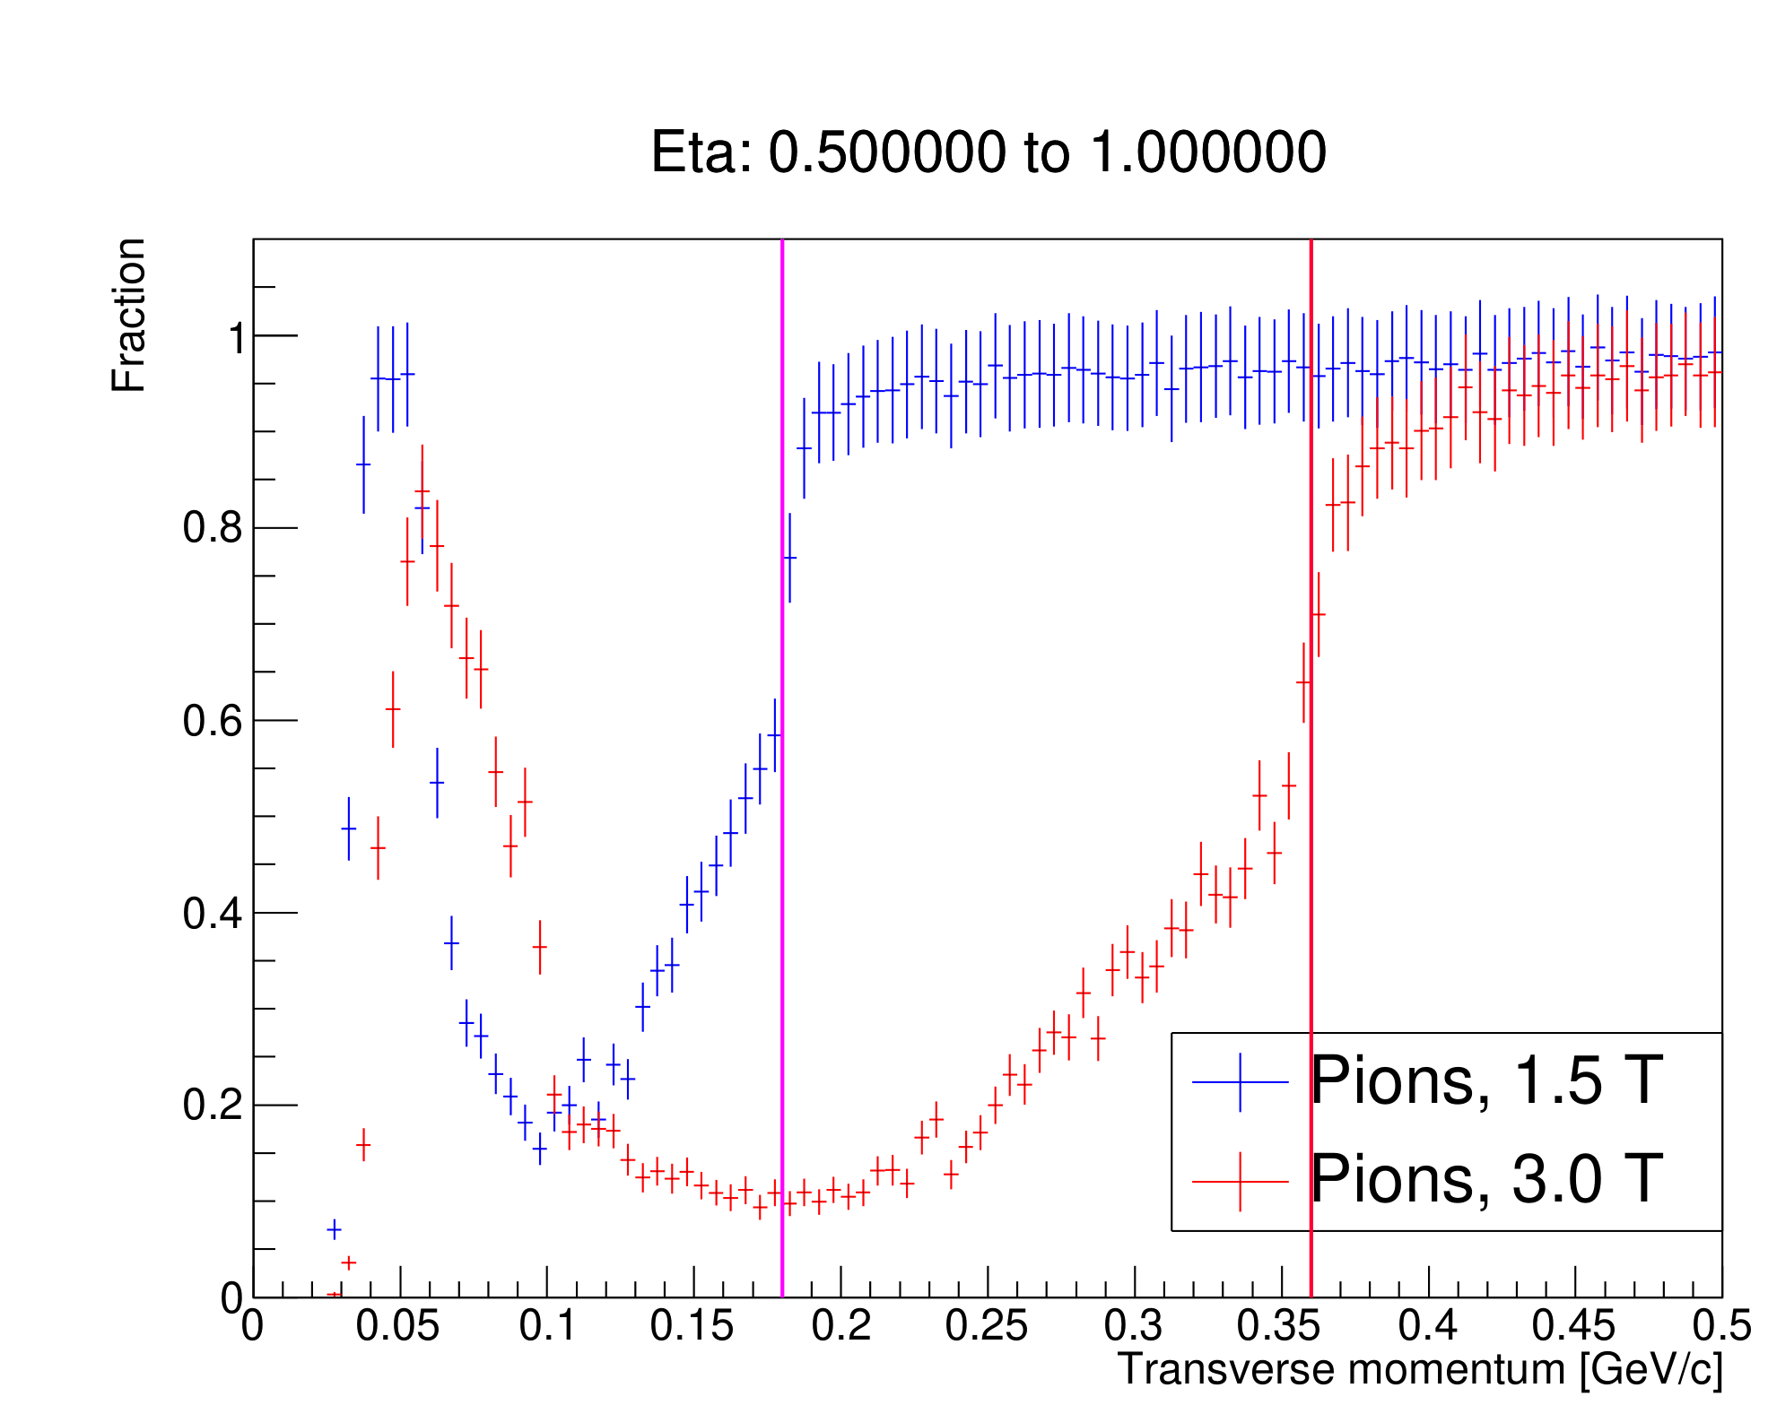
0.5 ≤ η ≤ 1.0
Kaons
Pions
BH spiralling, 1.5 T
BH spiralling, 3.0 T
BH spiralling, 1.5 T
BH spiralling, 3.0 T
Reconstructable momentum:
90 MeV/c ≤ p_{T} ≤ 120 MeV/c
p_{T} ≥ 200 MeV/c
p_{T} ≥ 380 MeV/c
Reconstructable momentum:
50 MeV/c ≤ p_{T} ≤ 60 MeV/c
p_{T} ≥ 190 MeV/c
p_{T} ≥ 380 MeV/c

Slide 13
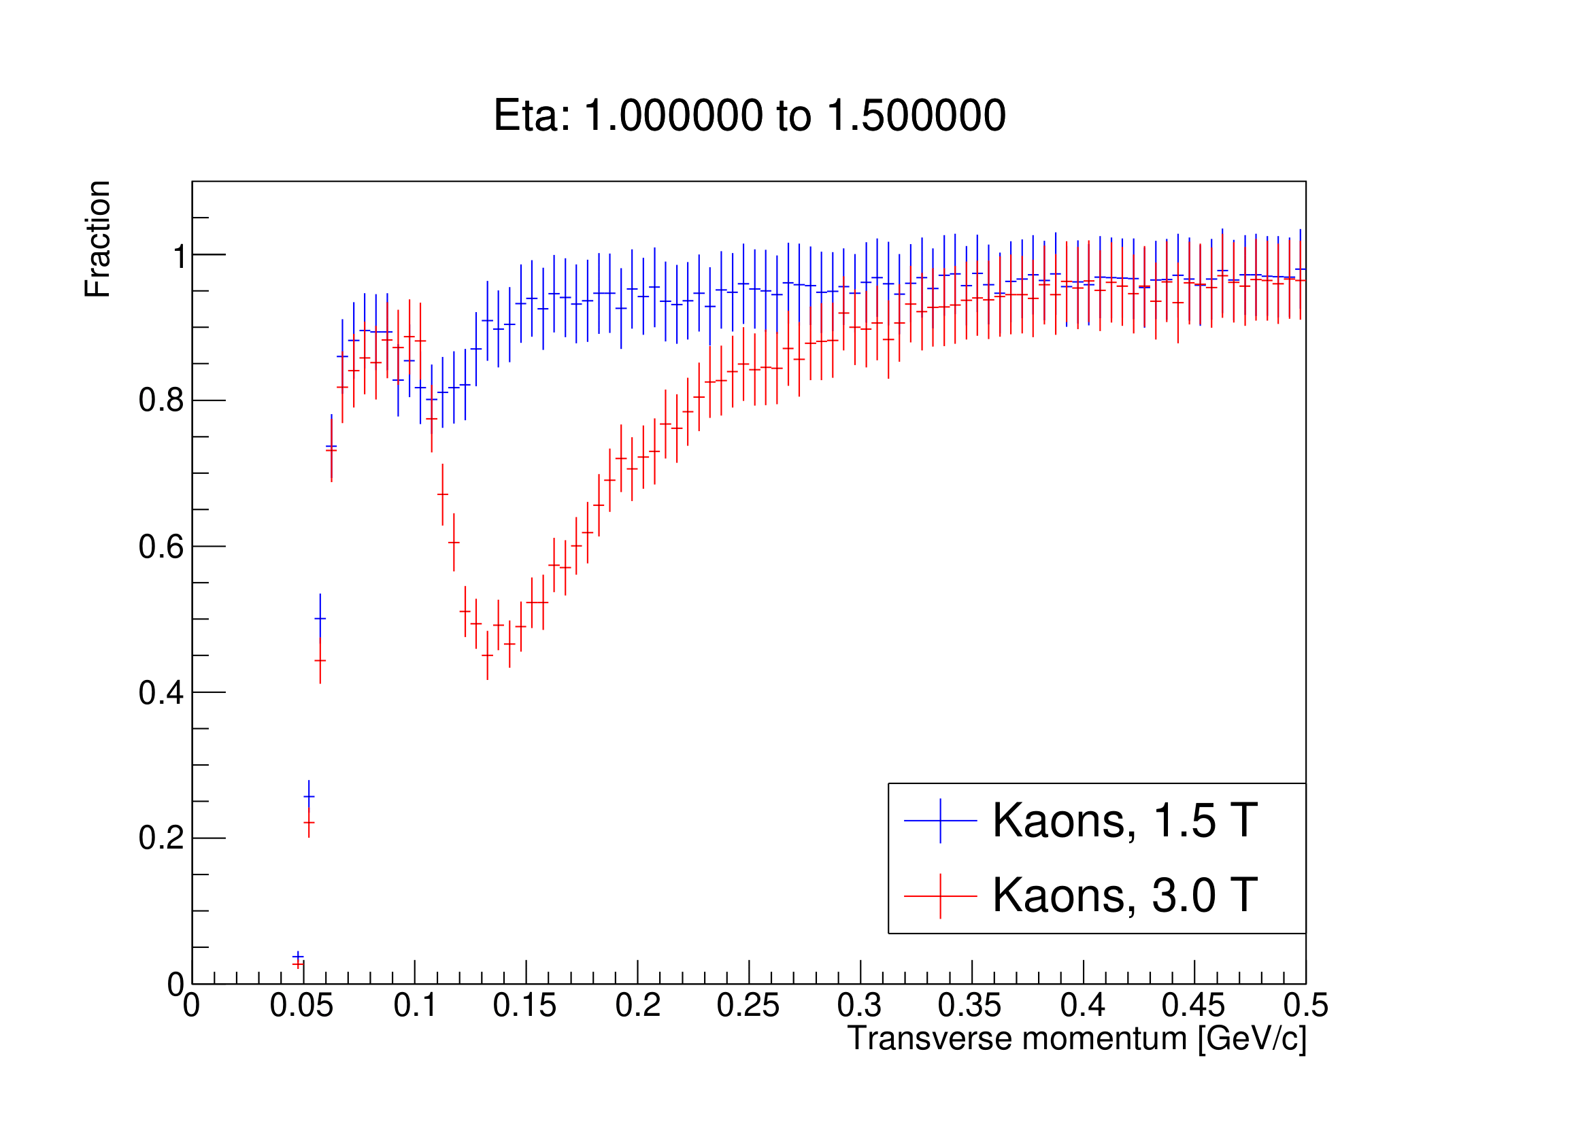
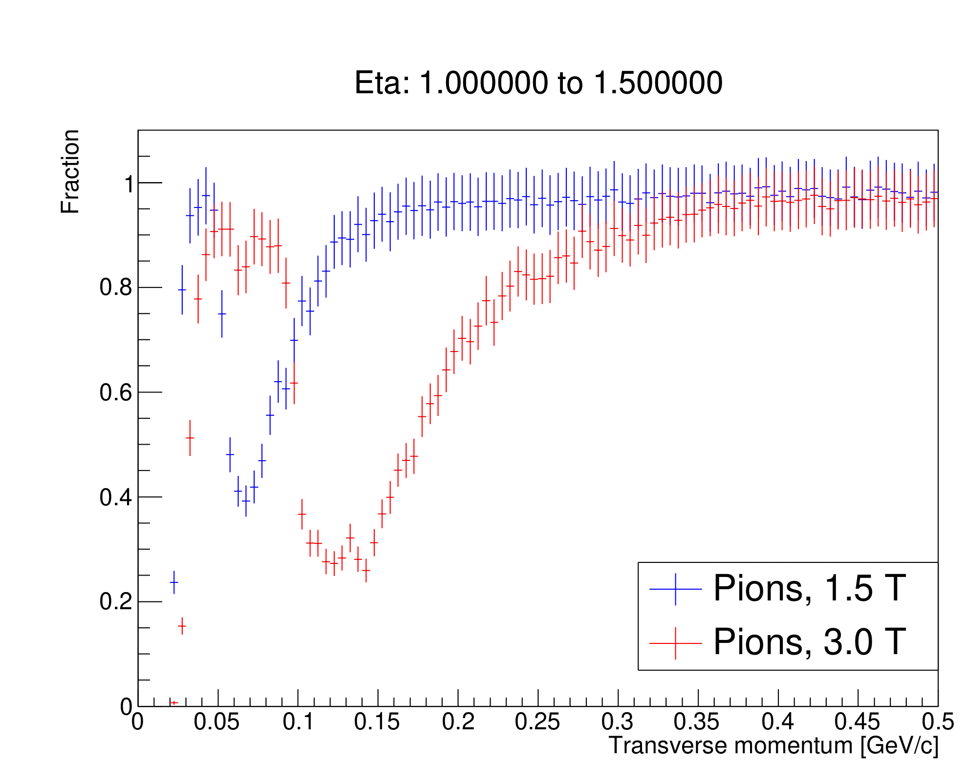
1.0 ≤ η ≤ 1.5
Kaons
Pions
Reconstructable momentum:
70 MeV/c ≤ p_{T} ≤ 80 MeV/c
70 MeV/c ≤ p_{T} ≤ 100 MeV/c
p_{T} ≥ 130 MeV/c
p_{T} ≥ 290 MeV/c
Reconstructable momentum:
40 MeV/c ≤ p_{T} ≤ 50 MeV/c
50 MeV/c ≤ p_{T} ≤ 60 MeV/c
p_{T} ≥ 120 MeV/c
p_{T} ≥ 280 MeV/c

Slide 14
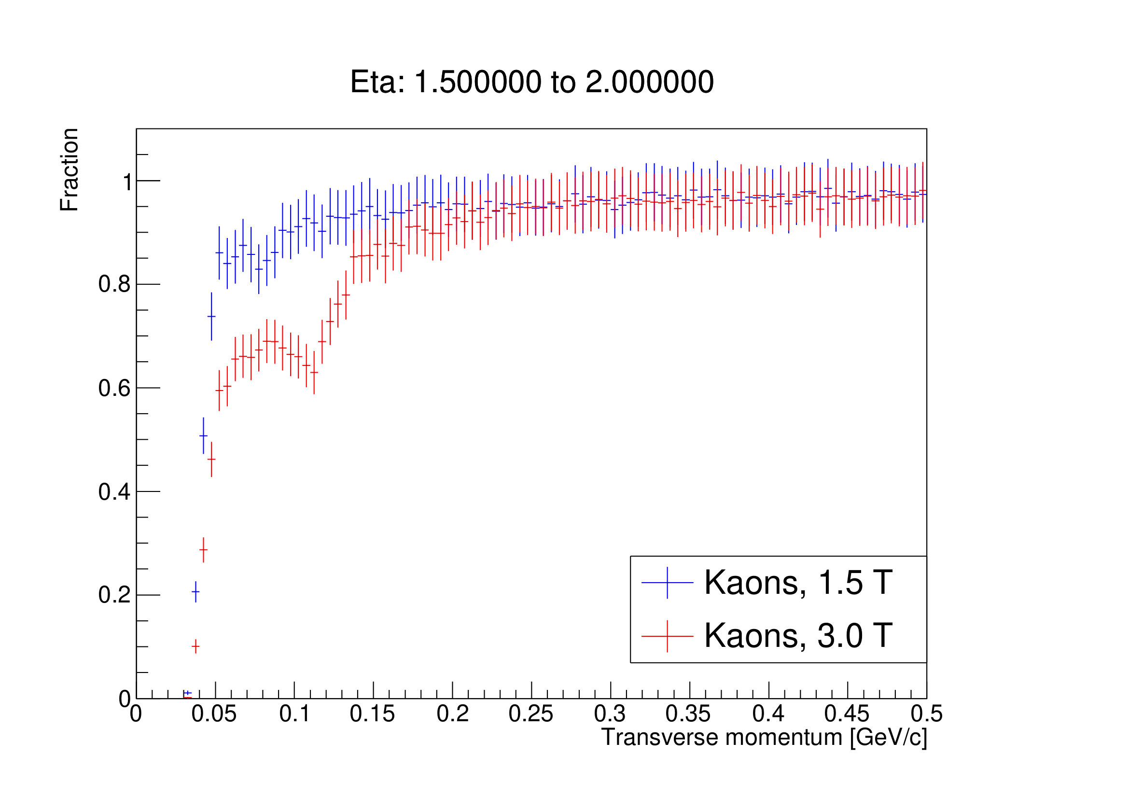
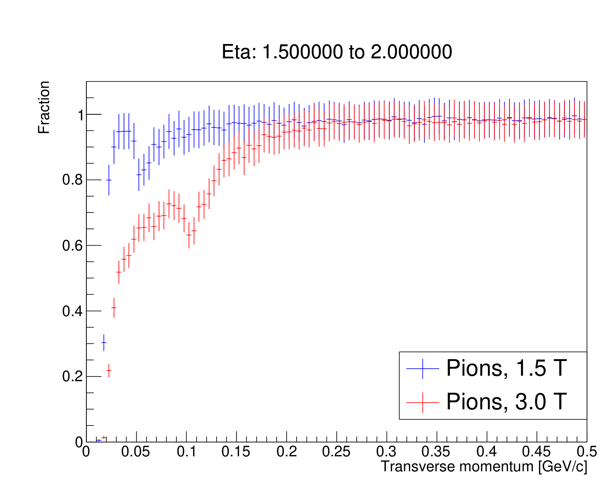
1.5 ≤ η ≤ 2.0
Kaons
Pions
Reconstructable momentum:
p_{T} ≥ 50 MeV/c
p_{T} ≥ 160 MeV/c
Reconstructable momentum:
30 MeV/c ≤ p_{T} ≤ 50 MeV/c
p_{T} ≥ 70 MeV/c
p_{T} ≥ 150 MeV/c

Slide 15
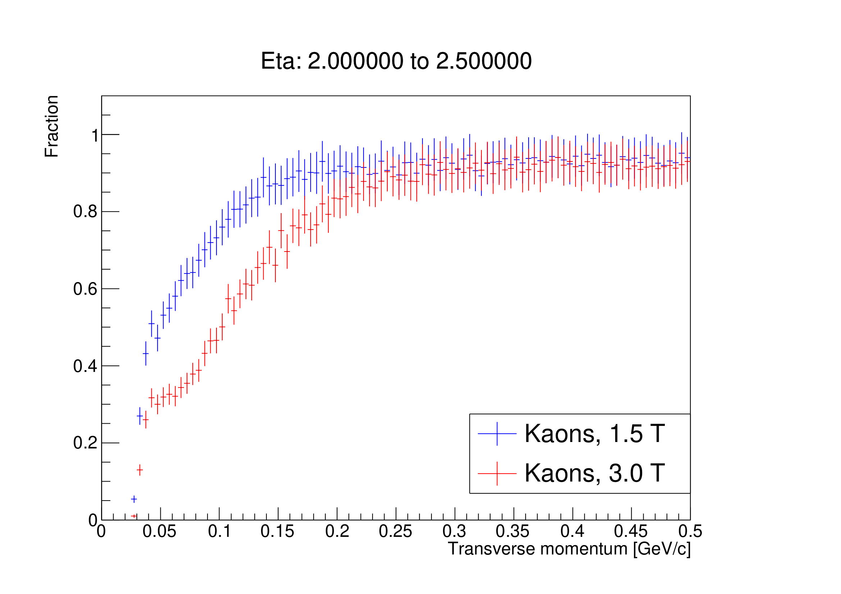
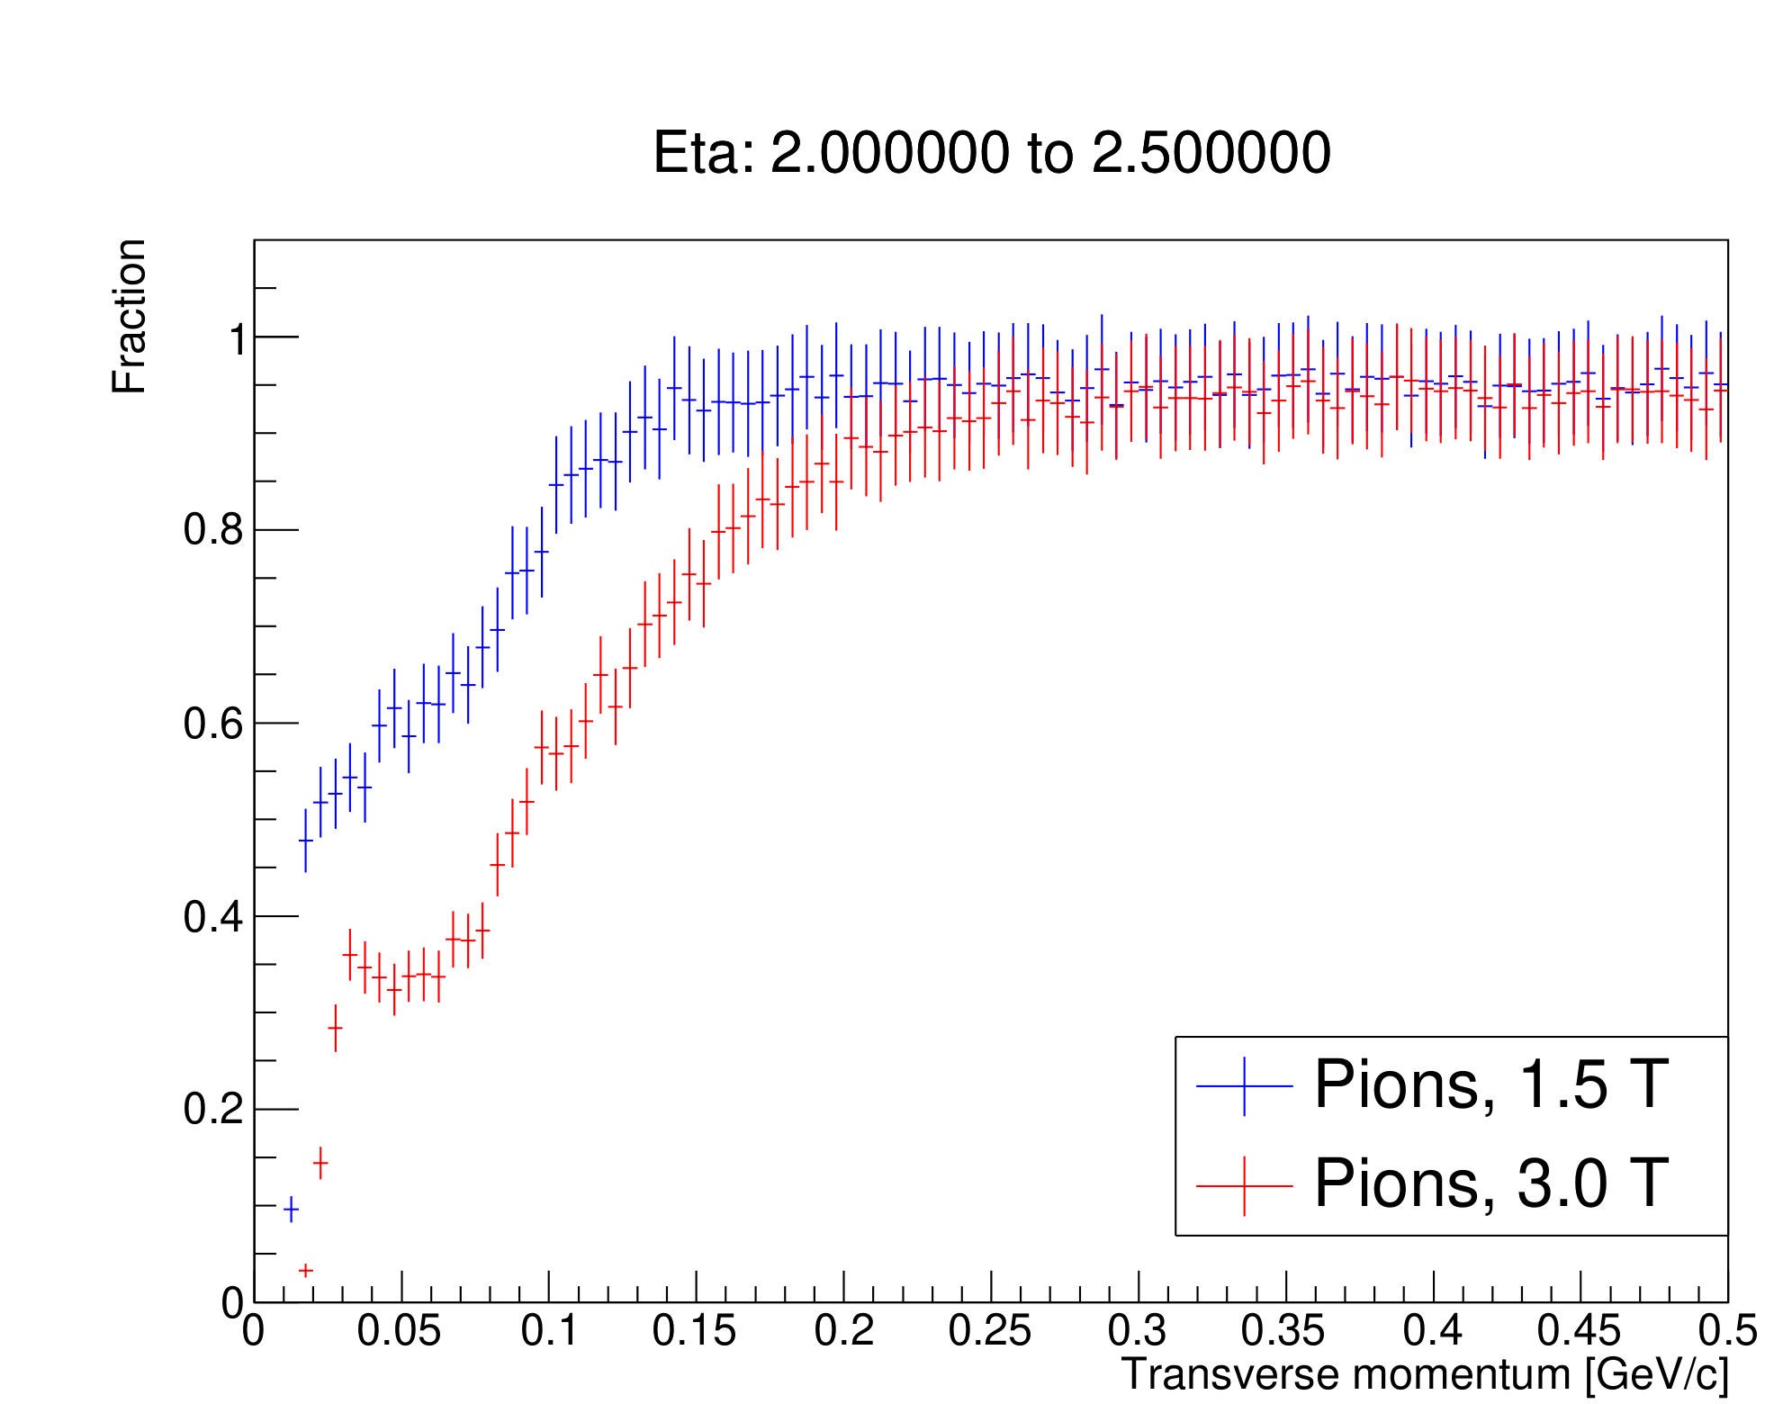
2.0 ≤ η ≤ 2.5
Kaons
Pions
Reconstructable momentum:
p_{T} ≥ 140 MeV/c
p_{T} ≥ 220 MeV/c
Reconstructable momentum:
p_{T} ≥ 130 MeV/c
p_{T} ≥ 200 MeV/c

Slide 16
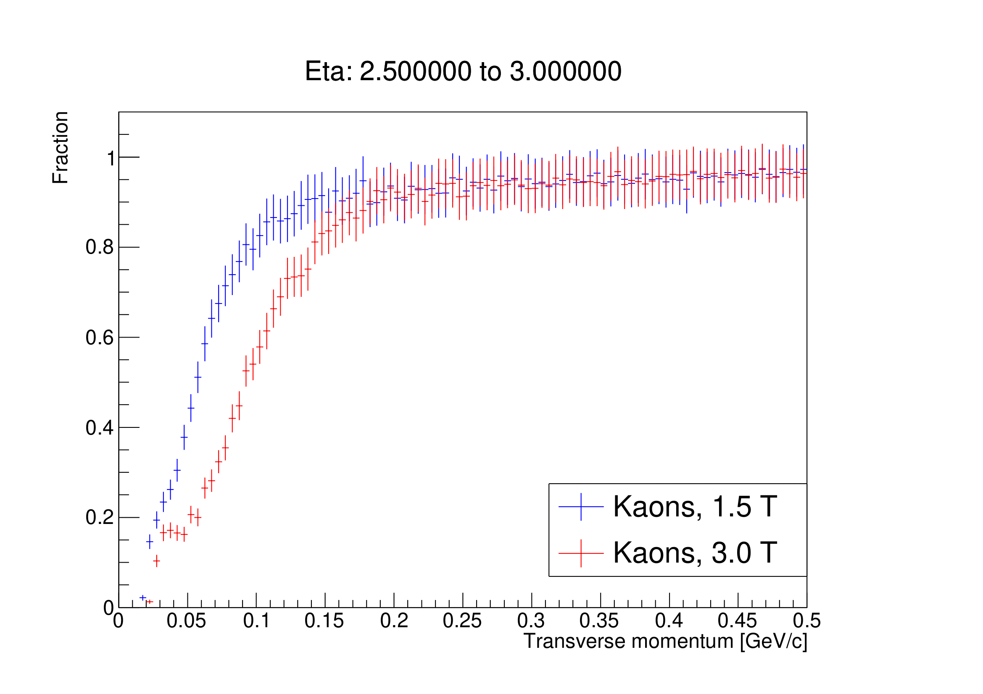
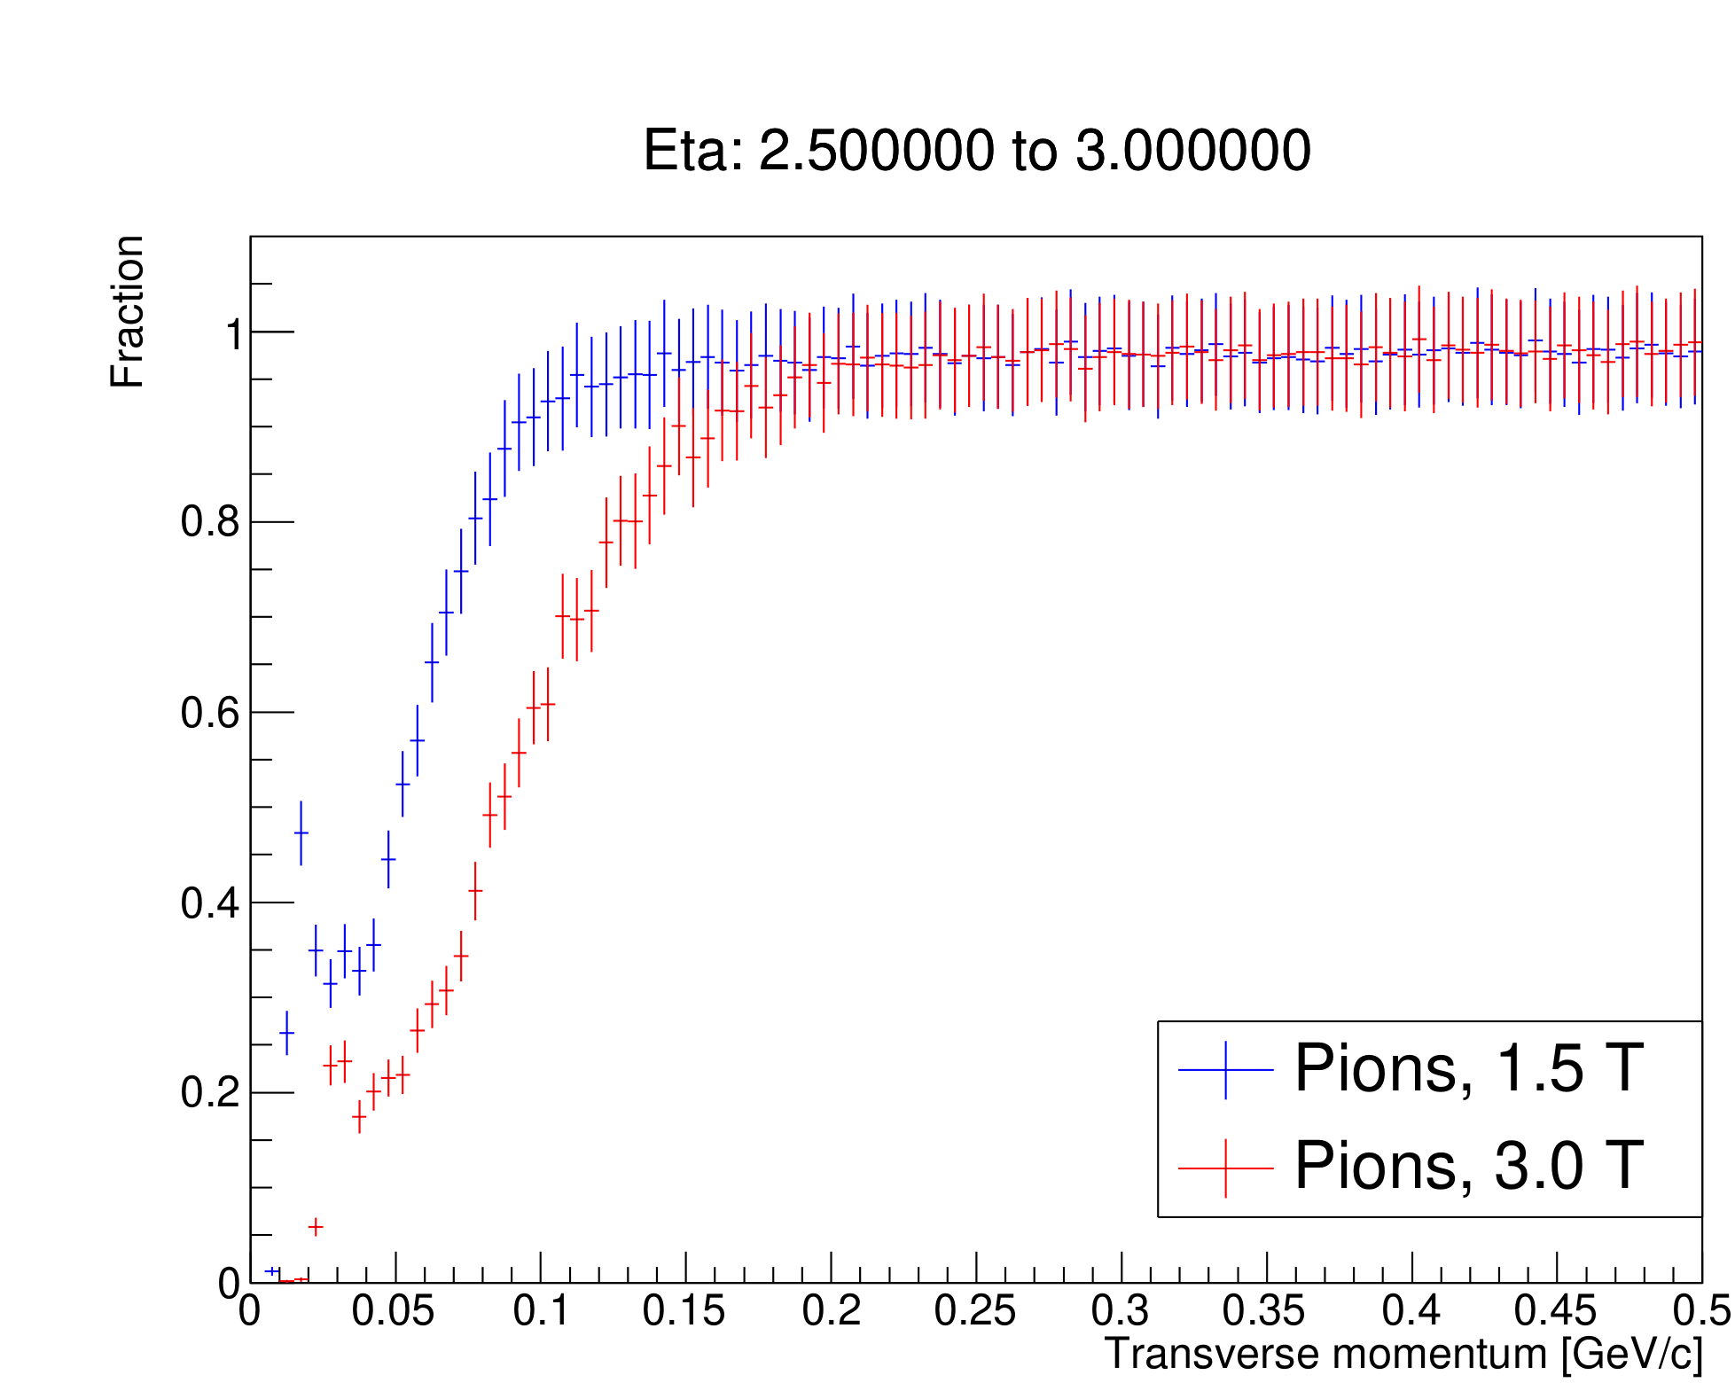
2.5 ≤ η ≤ 3.0
Kaons
Pions
Reconstructable momentum:
p_{T} ≥ 110 MeV/c
p_{T} ≥ 180 MeV/c
Reconstructable momentum:
p_{T} ≥ 100 MeV/c
p_{T} ≥ 150 MeV/c

Slide 17
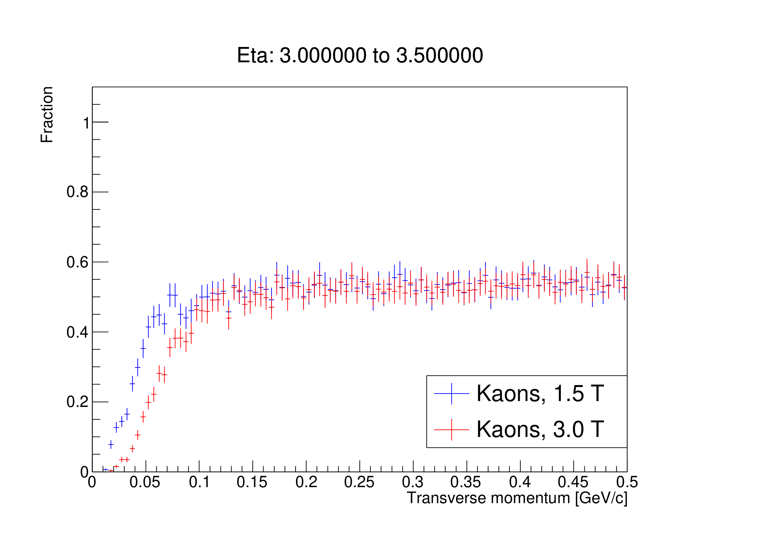
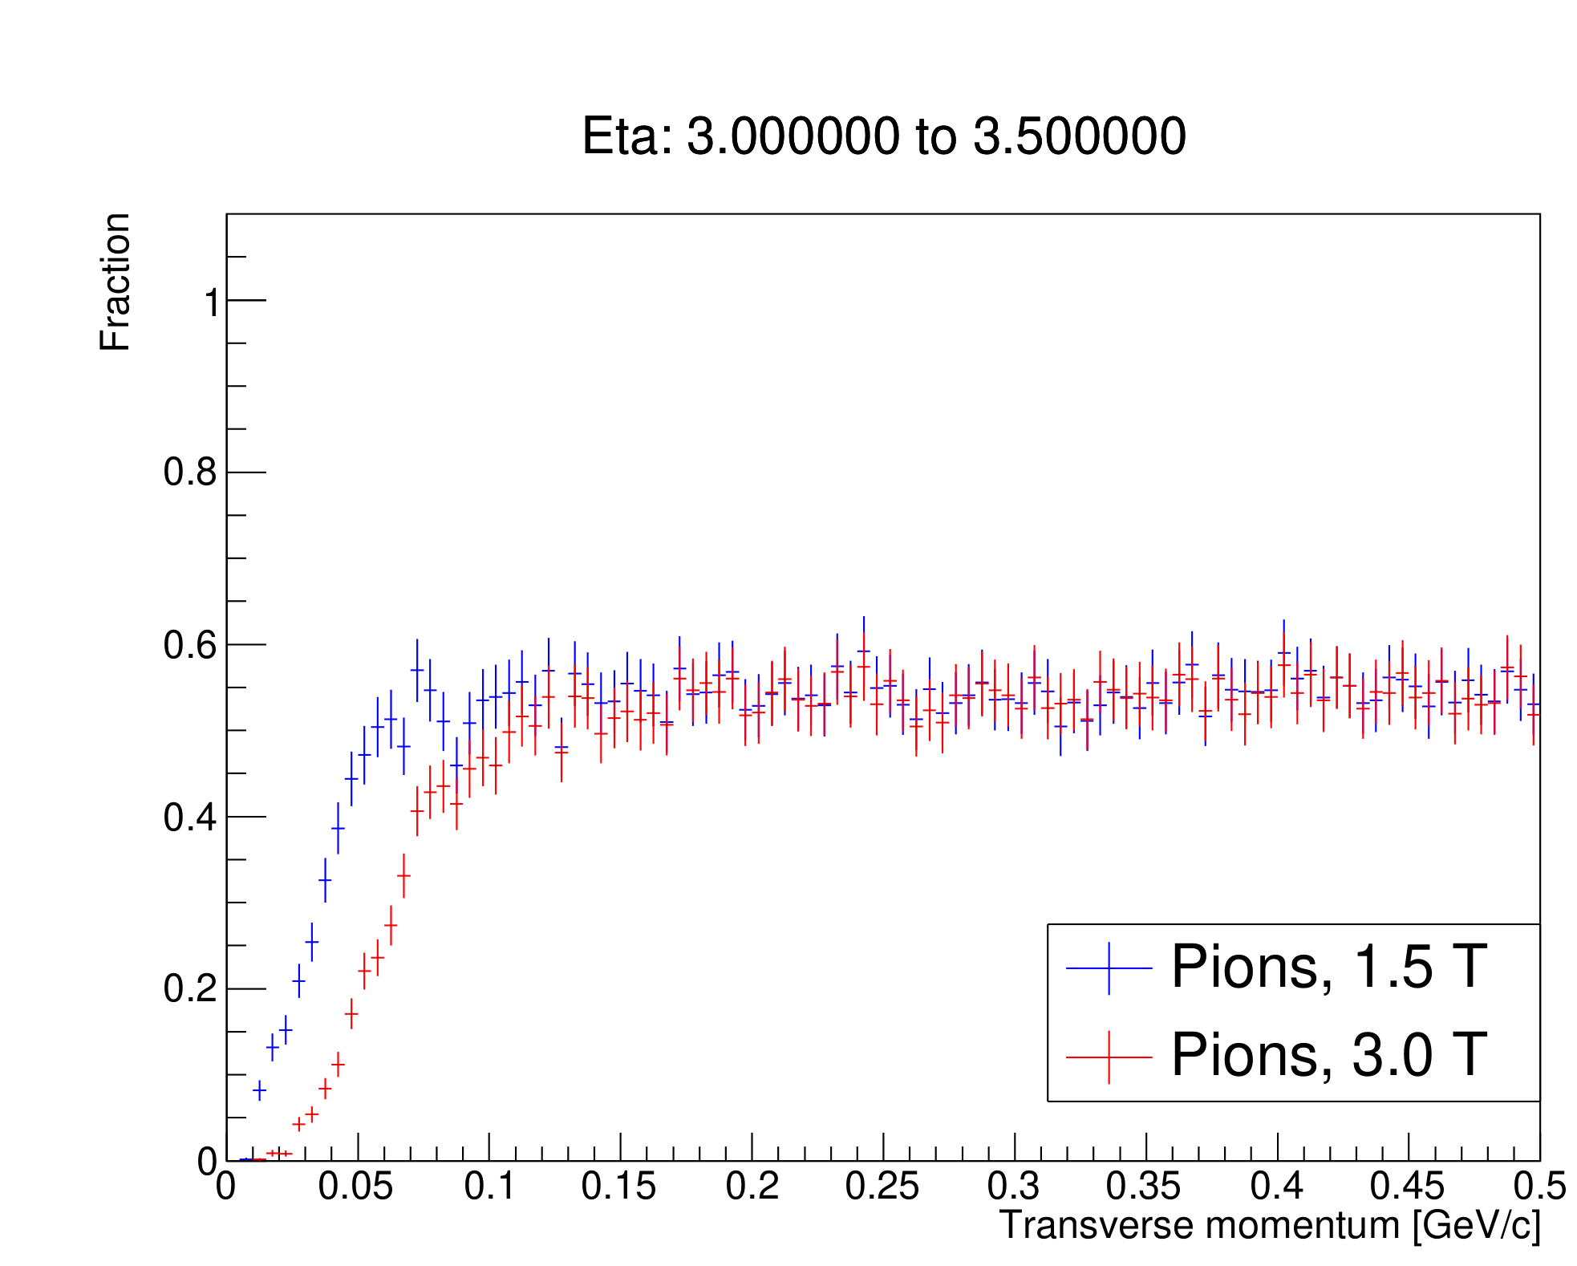
3.0 ≤ η ≤ 3.5
Kaons
Pions
Reconstructable momentum:
Detectors are missed in a large part of this interval, bringing the ”average” over the interval down
Reconstructable momentum:
Detectors are missed in a large part of this interval, bringing the ”average” over the interval down

Slide 18
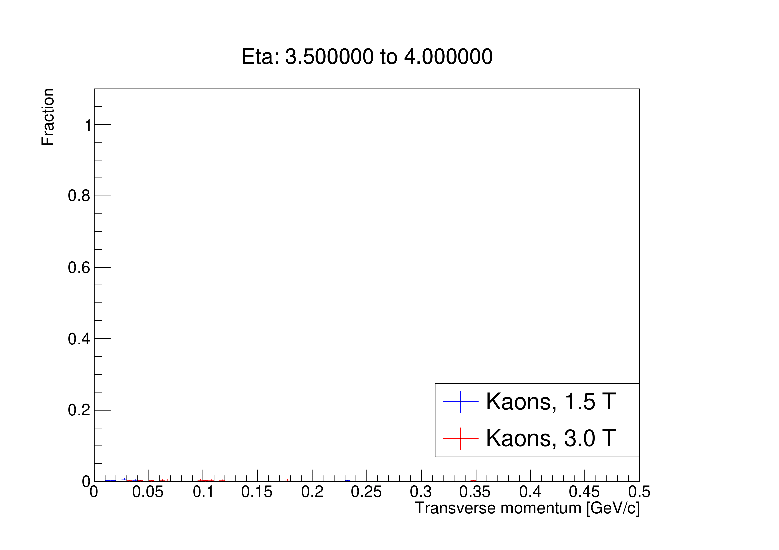
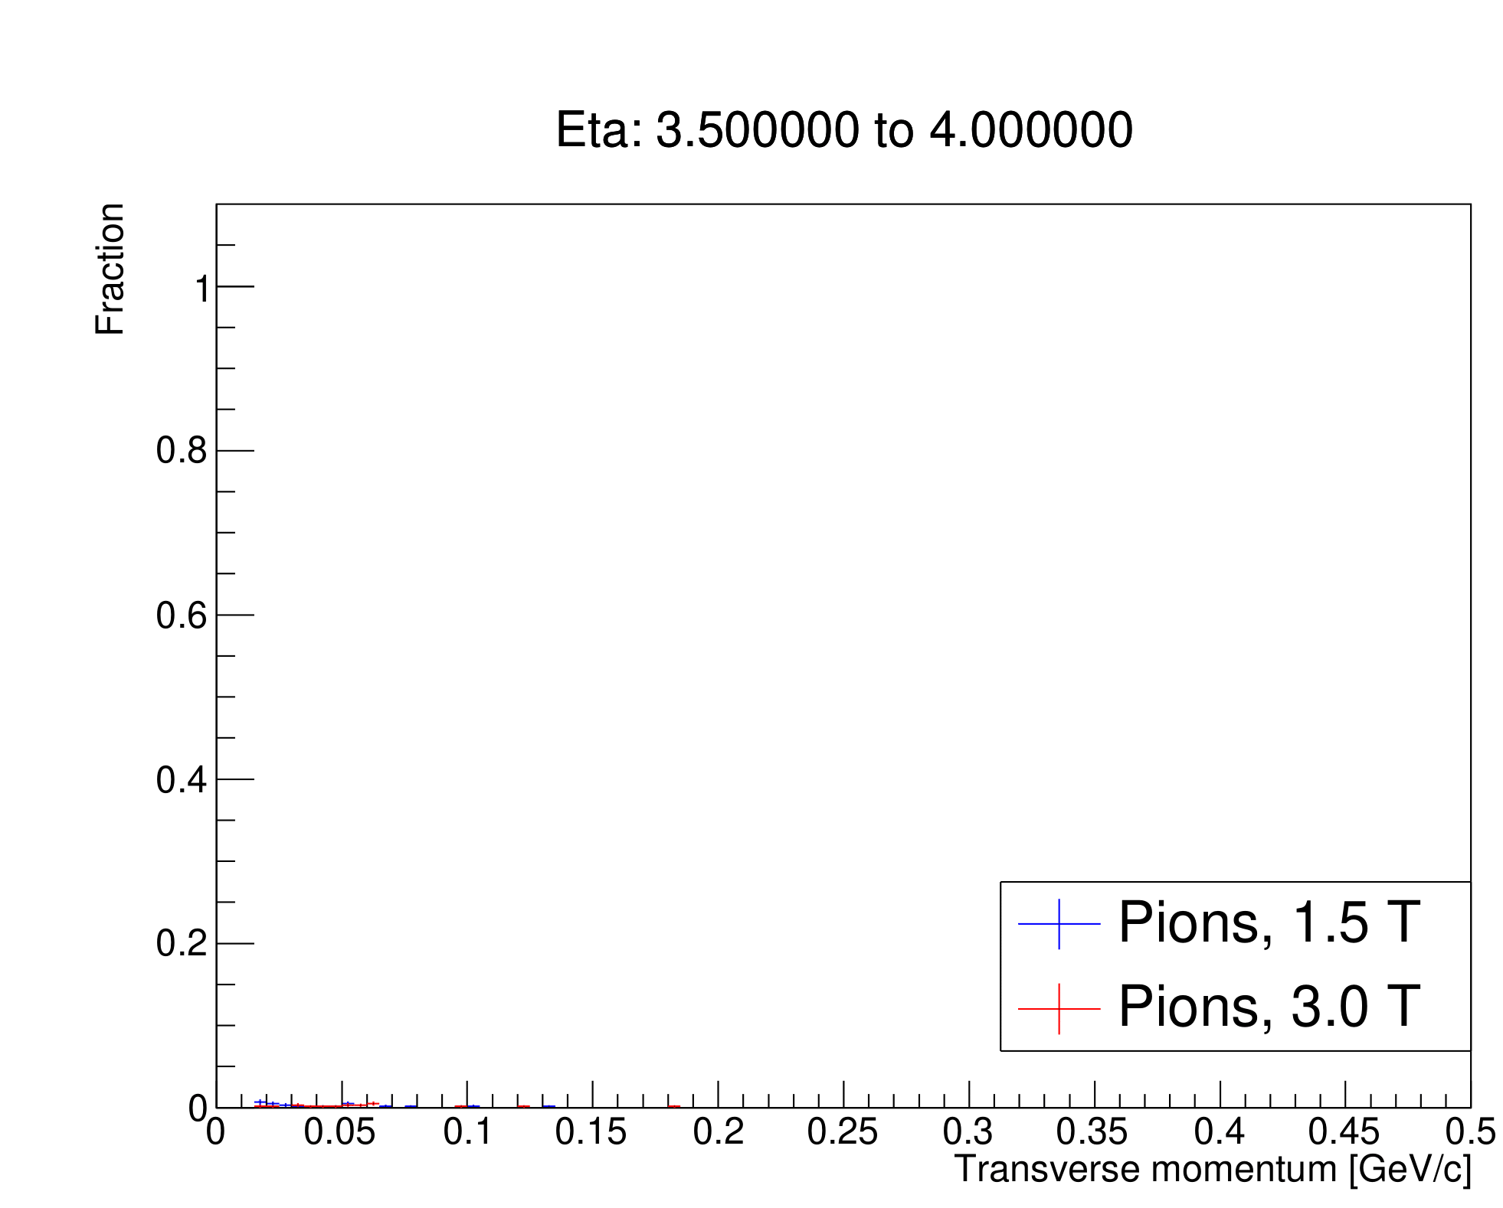
3.5 ≤ η ≤ 4.0
Kaons
Pions
Reconstructable momentum:
All detectors are missed. Only noise remains
Reconstructable momentum:
All detectors are missed. Only noise remains

Slide 19
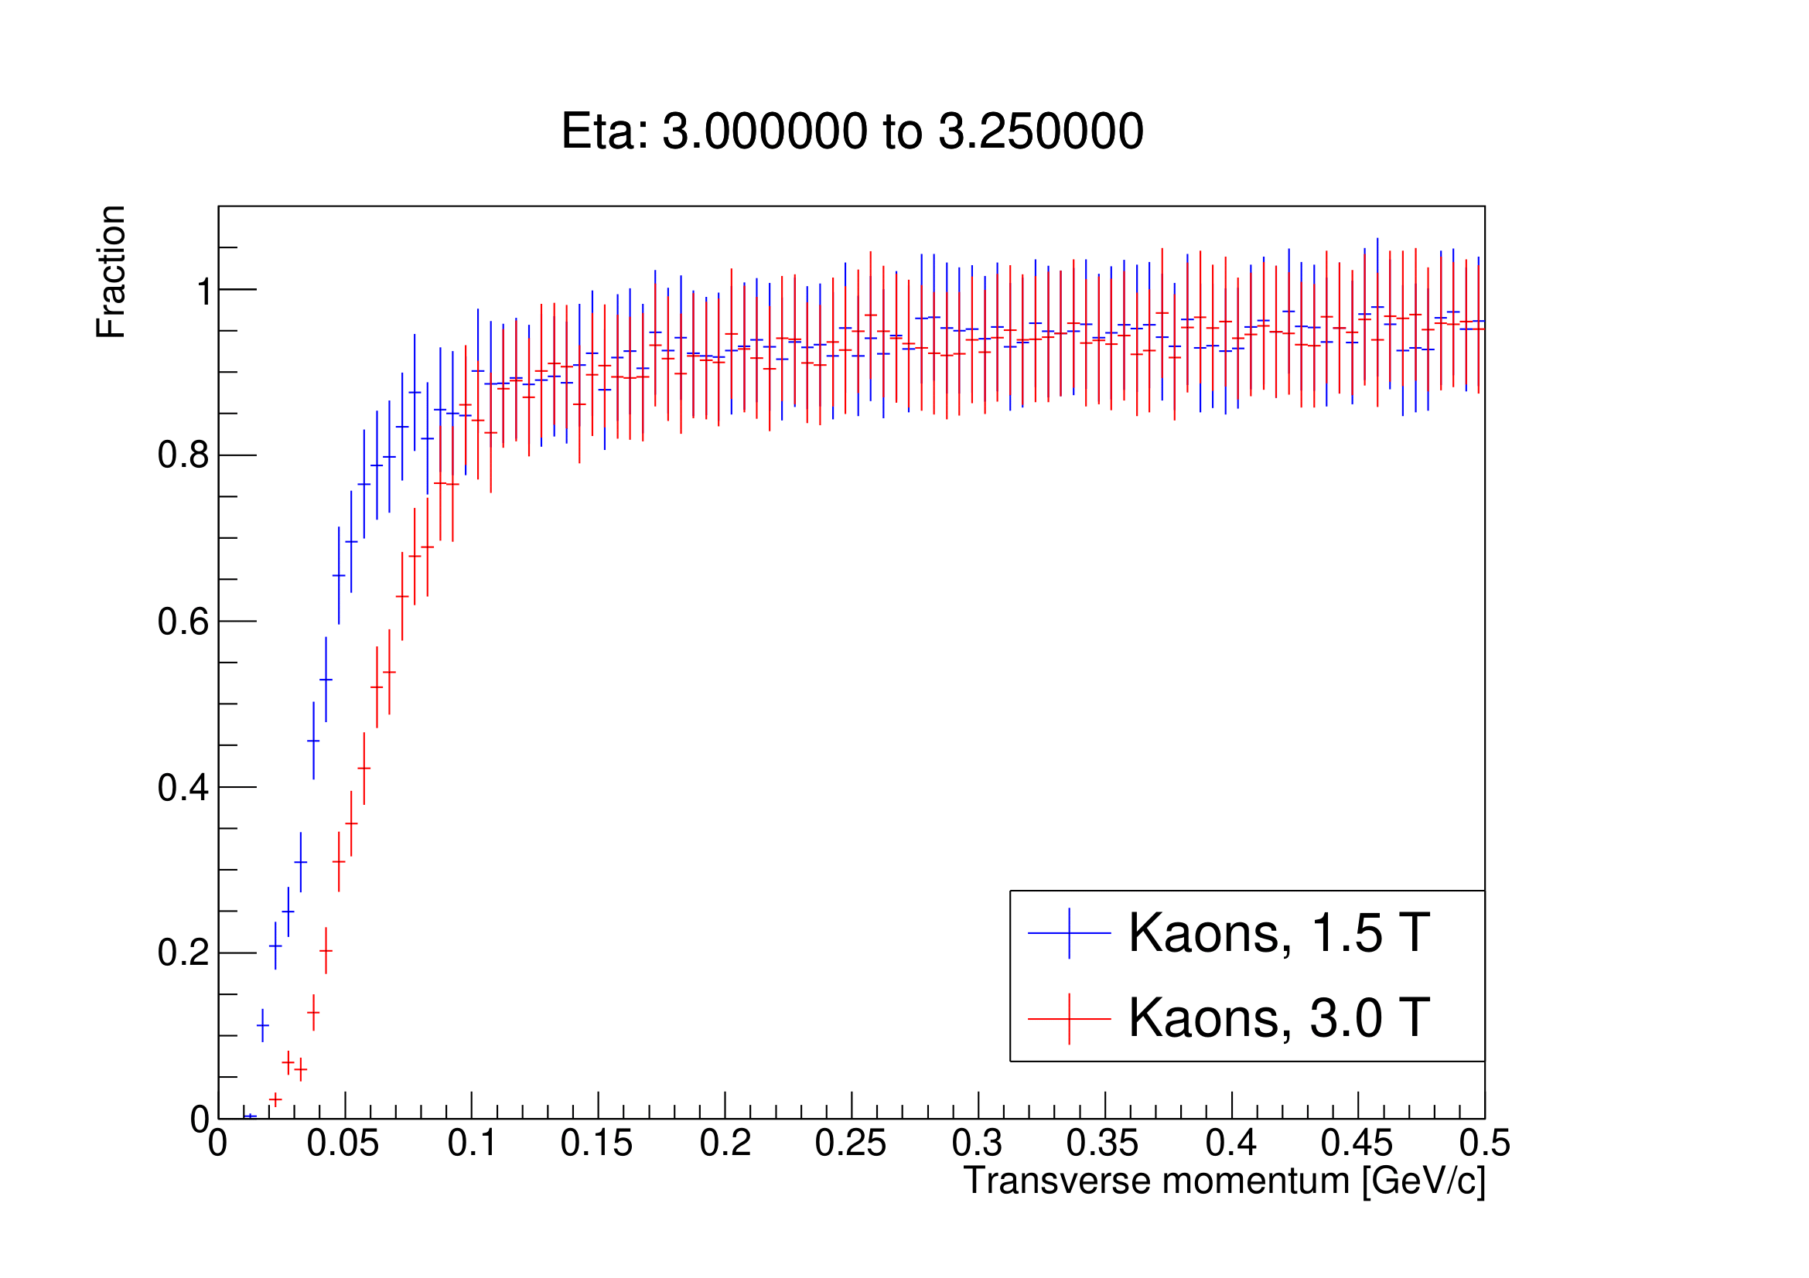
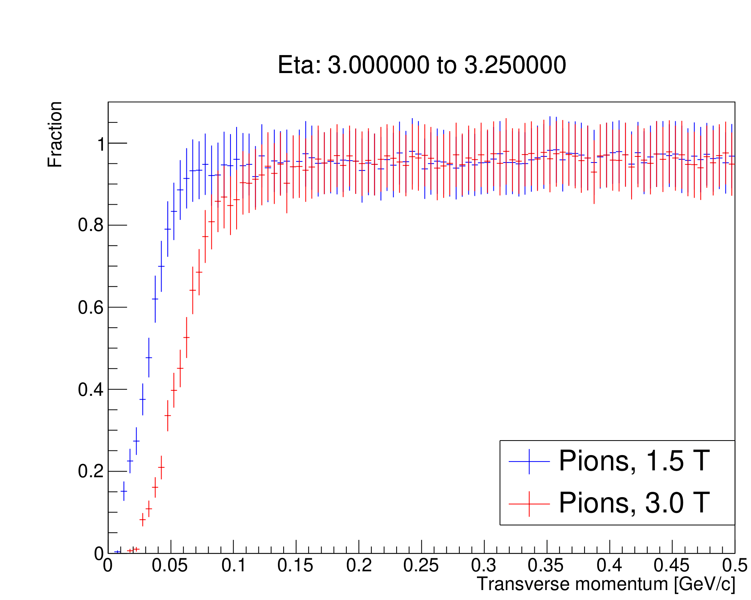
Splitting 3.0 ≤ η ≤ 3.5 into two; 3.0 ≤ η ≤ 3.25
Kaons
Pions
Reconstructable momentum (note that the error bars are larger):
p_{T} ≥ 100 MeV/c
p_{T} ≥ 110 MeV/c
Reconstructable momentum (note that the error bars are larger):
p_{T} ≥ 60 MeV/c
p_{T} ≥ 110 MeV/c

Slide 20
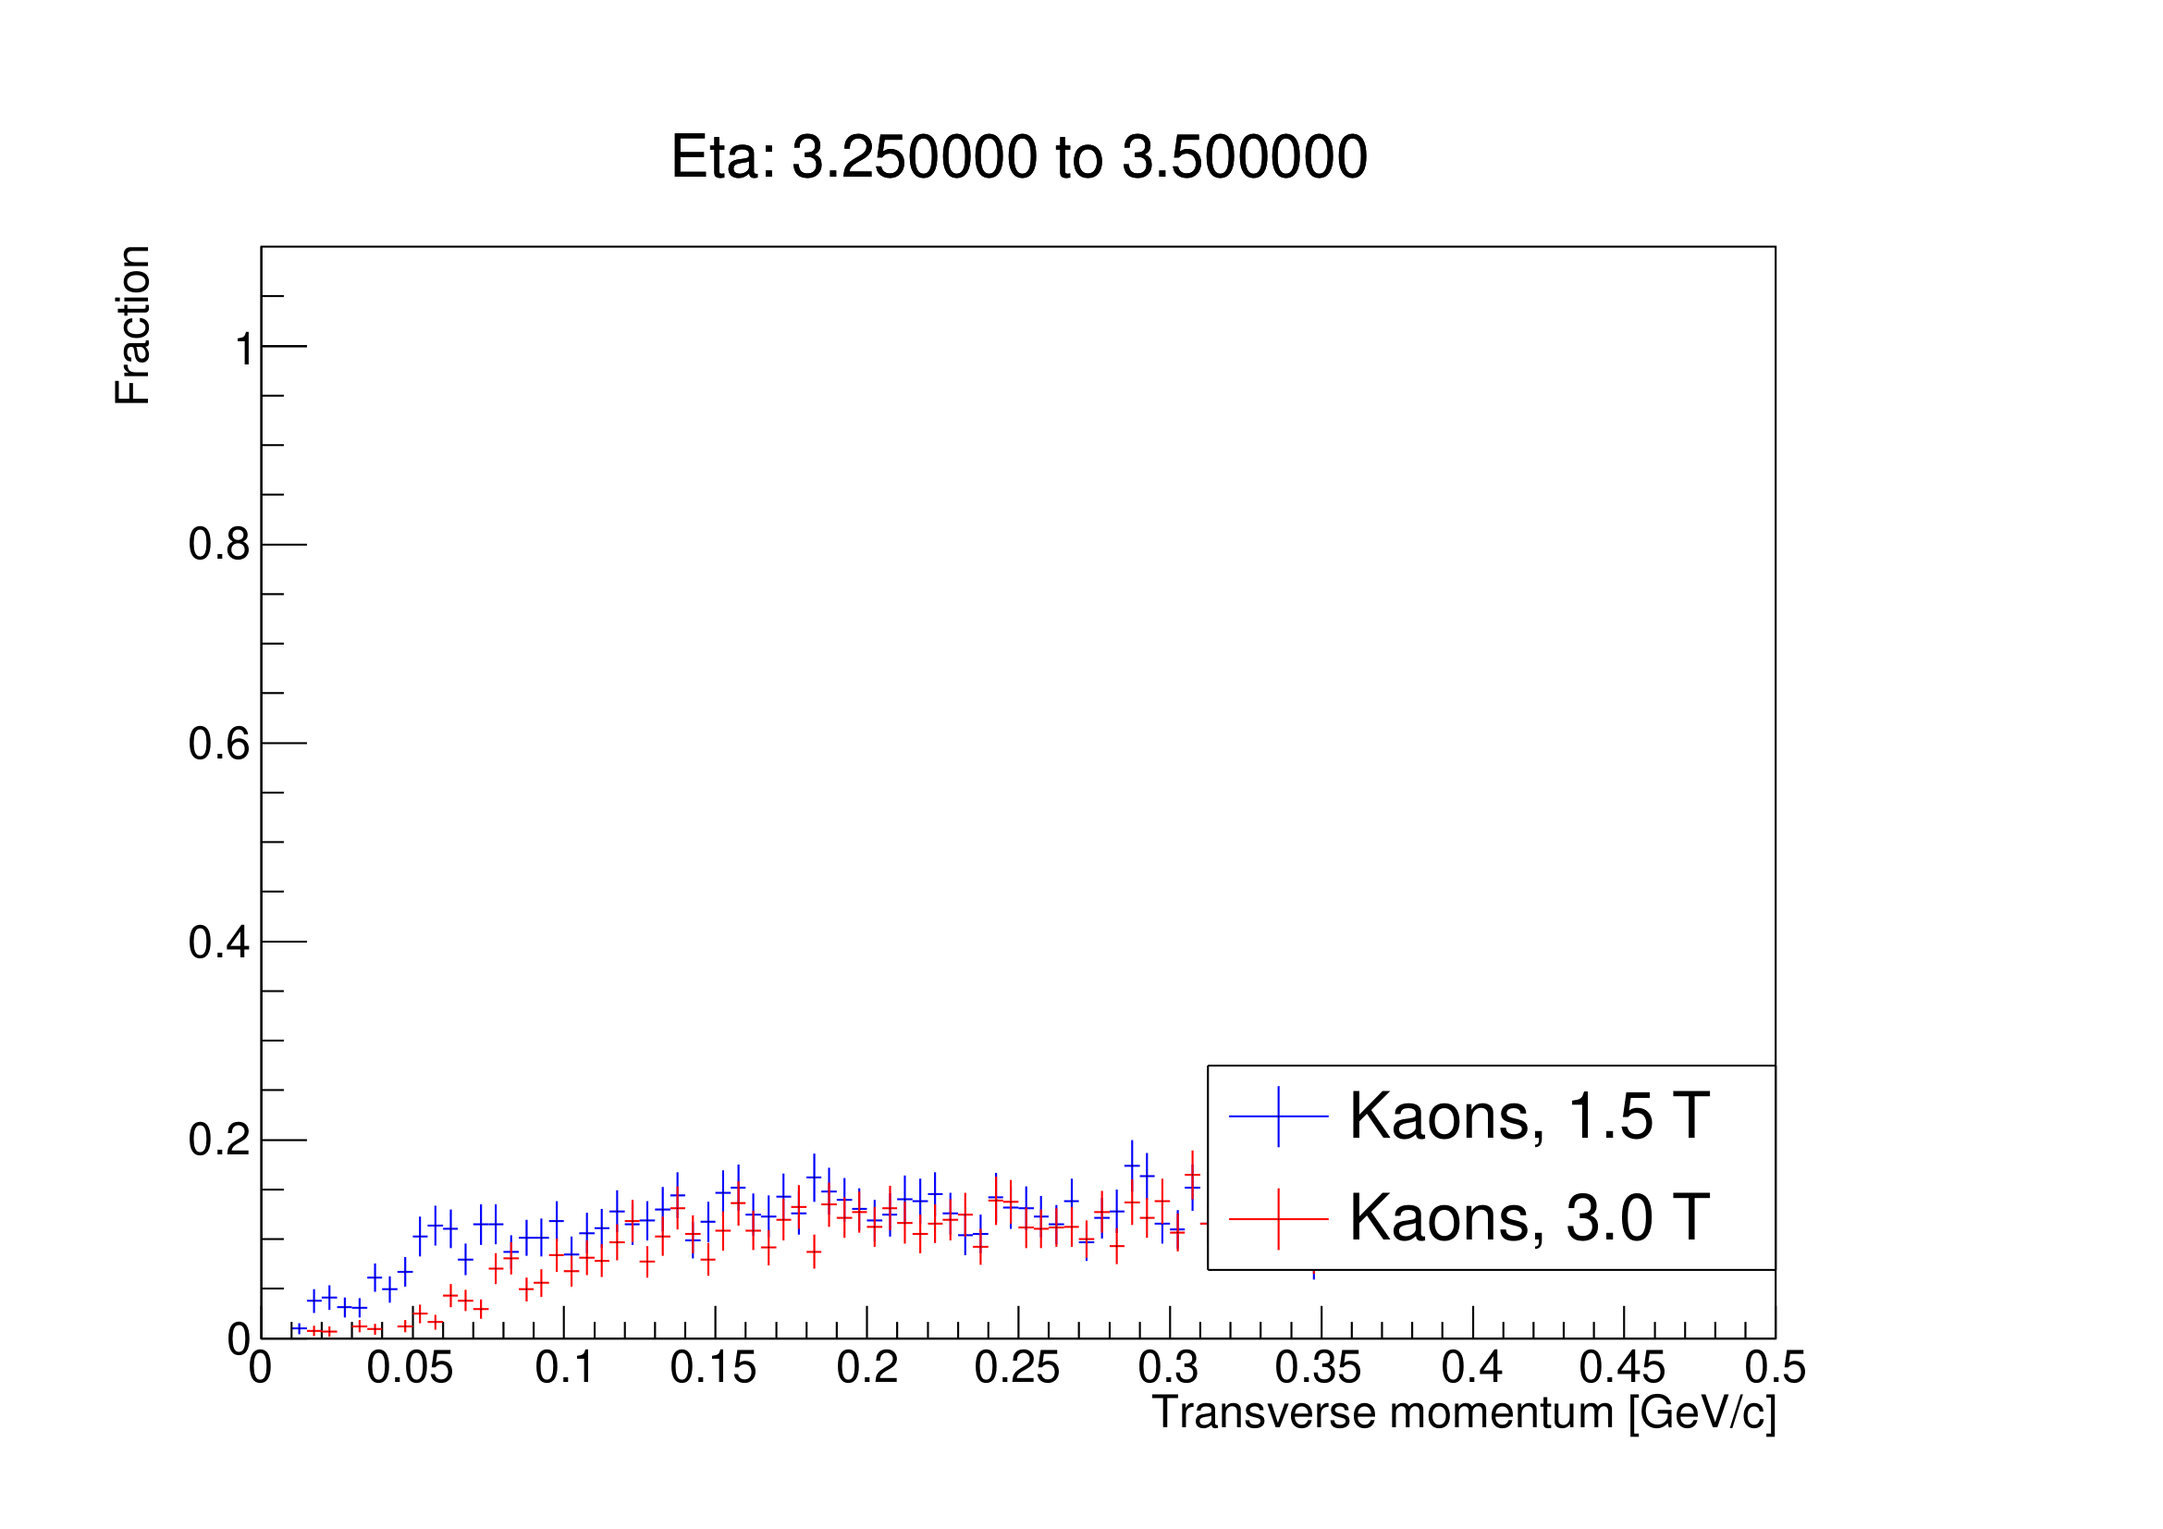

Splitting 3.0 ≤ η ≤ 3.5 into two; 3.25 ≤ η ≤ 3.50
Kaons
Pions

Slide 21
Backup slides

Slide 22
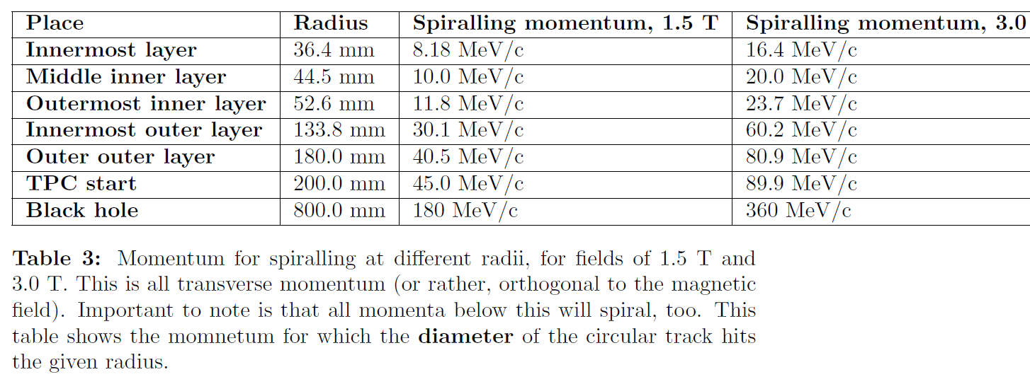
Table of spiralling momentum

Slide 23
Full layout sketch

