Slide 1
Tagging & Diffraction Working Group Update
9 March 2020
Conveners: Wim Cosyn (Florida), Or Hen (MIT), Douglas Higinbotham (JLab),
Spencer Klein (LBNL) and Anna Stasto (PSU)

Slide 2
Topics and Collaborators
Physics topics include
Pion/Kaon Tagged Deep Inelastic Scattering
Deuteron & ³He Tagging (e.g. F2n)
Nuclei & Short-Range Correlations ( A > 2 )
Target Fragmentation
Diffractive Processes
78 Collaborators Sign-up For This Working Group
People’s time to help currently limited (a global problem ?)
Activity / excitement is ramping up with many people committing to help in the near future especially this summer
Highlights today from the active groups.

Slide 3
Pion and kaon structure at the electron-ion collider
A.C. Aguilar et al., Eur. Phys. J. A 55, 190 (2019). https://doi.org/10.1140/epja/i2019-12885-0
Comparison of the electron-ion collider (EIC) with (HERA)
Paper shows how the EIC can answer questions about how the mass and structure arise in the pion and kaon
Done with geometric acceptance with standard Pythia
The group is now working on doing realistic simulations

Slide 4
Meson MC outputs lund files for use in GEANT4
Updated to the EIC crossing angle and beamline

Slide 5
Do To List From the Meson group
Currently only have Roman Pots in forward region, which is ok for DVCS, but will need more detectors for meson structure measurements
Determine where detectors should go by putting virtual detectors at different z-locations in-between the magnets
Based on these results determine what space is needed for these additional detectors.
More updates and details planned to ready by the TEMPLE meeting

Slide 6
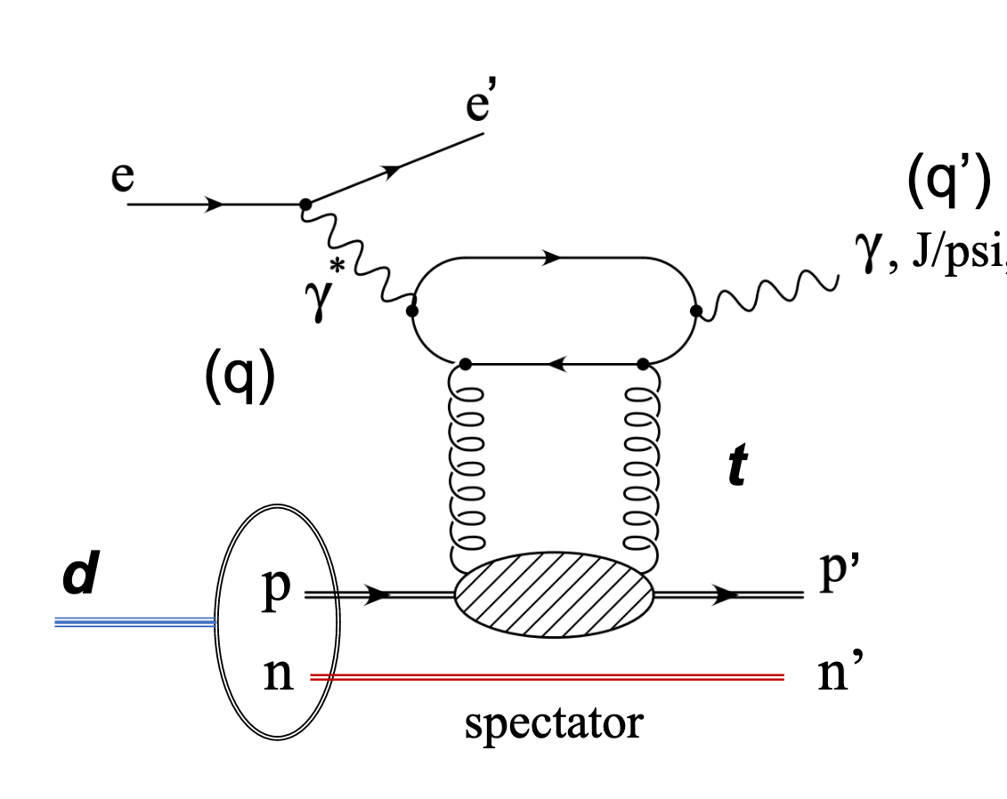
Deuteron Break-up In BeAGLE (J/Phi)
Kong Tu (BNL) with Mark Baker, Axel Jentsch, and others
e+D -> e’+J/psi+p’+n’
18 GeV electron scattering off 135 GeV deuteron
Realistic deuteron wavefunction from Phys. Rev. C 53, 1689
Light cone kinematics of nucleons in deuteron taken from Strikman & Weiss, Phys. Rev. C97, 035209
1M events with incoherent diffractive J/psi production
P_{m} is the momentum of the spectator
For more details: : https://indico.bnl.gov/event/7968/contributions/35578/attachments/26941/41029/Kong_03_05_2020.pdf

Slide 7
Low P_{m} limited by resolution effects while the high P_{m} limited by acceptance effects.
Simulations already done for other energies too and can be used in detailed simulations (e.g. EICROOT & GEANT4 )

Slide 8
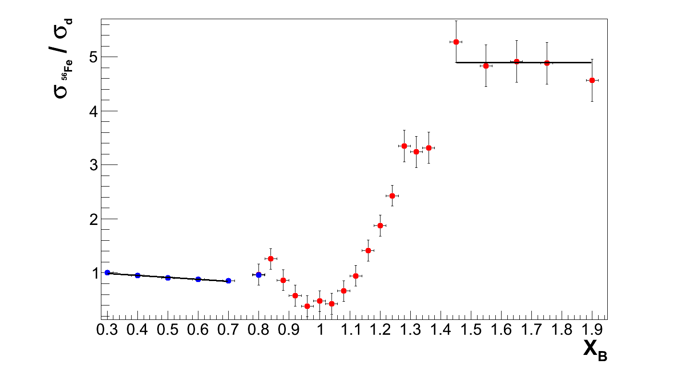
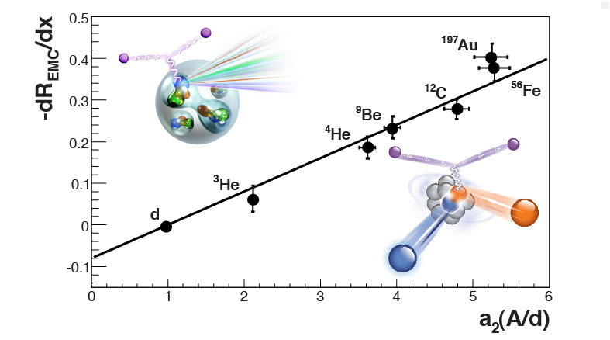
Short-Range Correlations & the EMC Effect
L. Weinstein et al., Phys. Rev. Lett. 106 (2011) 052301.
Q² = 2.5 [GeV/c]²
SRC Plateau
EMC Slope
Summary written for the CERN Courier: https://cerncourier.com/a/the-emc-effect-still-puzzles-after-30-years/

Slide 9
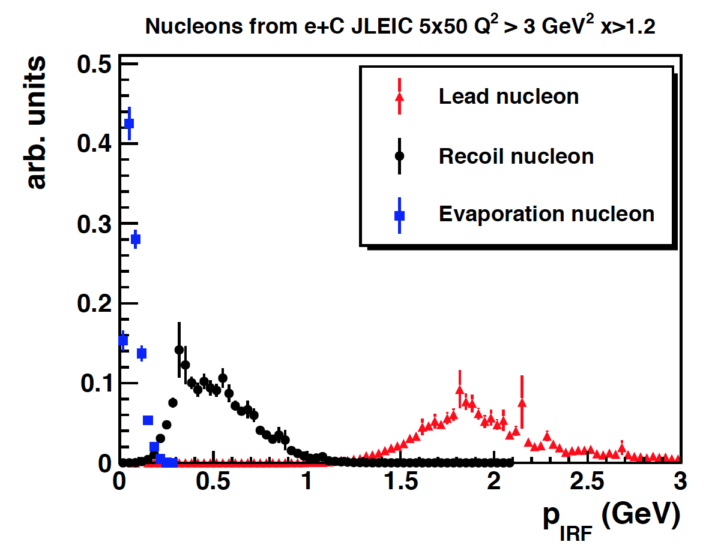
Detecting Quasi-Elastic SRC Events
BeALGE updated to have a realistic high momentum tail based on generalized contact formalism for A>2 (e.g. A. Schmidt et al., Nature 578, 540–544 (2020). https://doi.org/10.1038/s41586-020-2021-6
Figure shows example momentum distribution (from BeALGE) in the ion rest frame (p_{IRF}) for the leading and recoiling nucleon of an SRC pair (red and black) and evaporating nucleons from the A−2 remnant nucleus (blue).
The simulation was done with e+C reactions with beam energies of 5 GeV for electrons and 50GeV for carbon for x > 1.2 and Q² > 3 GeV².
Florian Hauenstein (ODU) is now redoing these simulations for the yellow report energies (with a report expected this Thursday).

Slide 10
Next Step will be to add DIS SRC Events!
Over the coming months (with support from MIT) plan to implement a DIS version of the generalized contact formalism into BeAGLE
This should create a rather realistic approximation of the EMC effect
This will let us test predictions of how the EMC effect should behave not just for inclusive but also for semi-inclusive events
Upcoming CLAS12 Experiments
EIC Yellow Report Detector Requirements
Hopefully will lead to the resolution of the EMC effort puzzle!

Slide 11
Summary & Outlook
Several sub-groups already have new result & new simulations
Pion/Kaon TDIS
Diffractive Deuteron
Short-Range Correlations
Polarized ³He group (Richard Milner et al.) is just getting going BUT they are planning on putting in a JLab/CLAS12 letter of intent and they are making sure to setup their simulations such that they can also do EIC simulations (Dien Nyugen (MIT) & Ivica Friscic (MIT/JLab).
Overall, the group is presently working on understanding how the current IR acceptances effect our golden measurements and what the detector requirements will need to be for these reactions.

