Slide 1

Kolja Kauder
Using Eic-Smear and Generators
A Walkthrough
Jets & HF Yellow Report Meeting
March 9, 2020

Slide 2
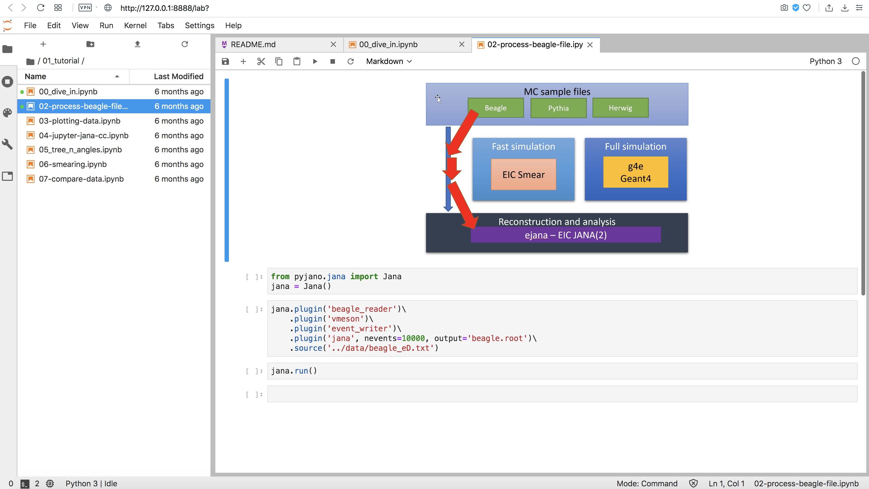
This Talk – What it is and isn’t
Quickstart guide for those comfortable with ROOT and the command line.
Help for those that want to run locally
NOT an introduction to the Jupyter/EPIC framework
https://eic.gitlab.io/documents/quickstart/
https://www.youtube.com/channel/UCXc9WfDKdlLXoZMGrotkf7w

Slide 3
Eic-smear – What it is and isn’t
Utility for unifying EIC MC output in ROOT
And for smearing said output
NOT a replacement for Geant!
But if you are asking...
“Given a known detector performance, how well can I measure some physics observable(s)?”
“If I need to measure X with to some precision, what detector performance do I need?”
or
… then it is an excellent tool

Slide 4
Work Flow
PYTHIA
DPMJet
Install packages
Run MC
PEPSI
gmc_trans
Djangoh
Milou
Rapgap
BeAGLE
Build ROOT tree
Build “Detector”
Perform Smearing
Standard Format: analyze different generators without change
Truth ⬌ Smeared: Friend Trees
Analyze Output

Slide 5
Shortcut
If you have an EIC RCF account at BNL, all packages are installed and available under $EICDIRECTORY
Make sure to include the following in your .cshrc
$ cat ~/.cshrc
setenv EIC_LEVEL pro
source /afs/rhic.bnl.gov/eic/restructured/etc/eic_cshrc.csh
$
$ # this should work now
$ cp $EICDIRECTORY/PACKAGES/PYTHIA-RAD-CORR/STEER-FILES-Other/ep_noradcor.20x250.quicktest .
$ $EICDIRECTORY/bin/pythiaeRHIC < ep_noradcor.20x250.quicktest
If you don’t, read on. Everything runs on my MacBook

Slide 6
Prerequisites
gcc 4.8.5 is just enough for most things
Necessary:
c++ and fortran compilers
cmake 3.1+
ROOT (6 is preferred)
Good to have:
LHAPDF
CERNLIB
Potentially FLUKA
Resources:
Your admin
Your favorite package manager (e.g. homebrew)
Google
My READMEs
EIC software support
5 is recommended, some PDFs are missing in 6
My installation notes on SL6 are world-visible on afs:
/afs/rhic/eic/restructured/env/pro/PACKAGES/READMES/

Slide 7
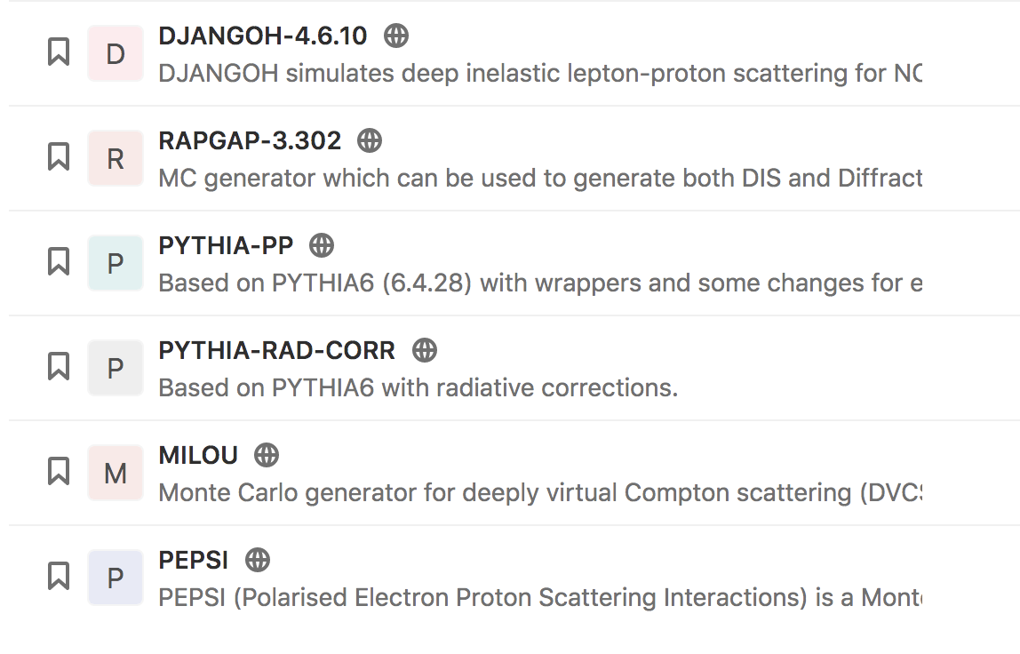
Pythia (et al) Installation
$ git clone https://gitlab.com/eic/mceg/PYTHIA-RAD-CORR
$
$ cd PYTHIA-RAD-CORR
$ mkdir build ; cd build
$
$ cmake ../ -DCMAKE_INSTALL_PREFIX=<path>
$ make -j 2 install
More generators are available at
https://gitlab.com/eic/mceg
All with README
Please report issues!
BeAGLE is hosted separately

Slide 8
Eic-smear Installation
$ git clone https://gitlab.com/eic/eic-smear
$
$ cd eic-smear
$ mkdir build ; cd build
$
$ cmake ../ -DCMAKE_INSTALL_PREFIX=<path>
$ make -j 2 install
auto_ptr warnings are being fixed
Development is on-going – check back often for new features and additional options
Please report issues!
Example detectors are in /scripts directory
“True” reference detectors are coming – needs time and collaboration with Detector groups

Slide 9
Generation
Generate 1M PYTHIA6 events, MinBias, Q² = 10 – 100 GeV²
  ~ 1 hour to generate
$ ${MYBINDIR}pythiaeRHIC < input.data.ep_noradcor.20x250.eic > log.txt
Large files (9 GB). Future:
Automatically use gz or bz2 streams
May require adapting your environment (e.g., include LHAPDF5 in (DY)LD_LIBRARY_PATH)
Many STEER files exist
  Tune, energy, radiative correction etc.
Which STEER cards to use is beyond the scope of this talk.
But needs to be agreed upon in this group or YR-wide!

Slide 10
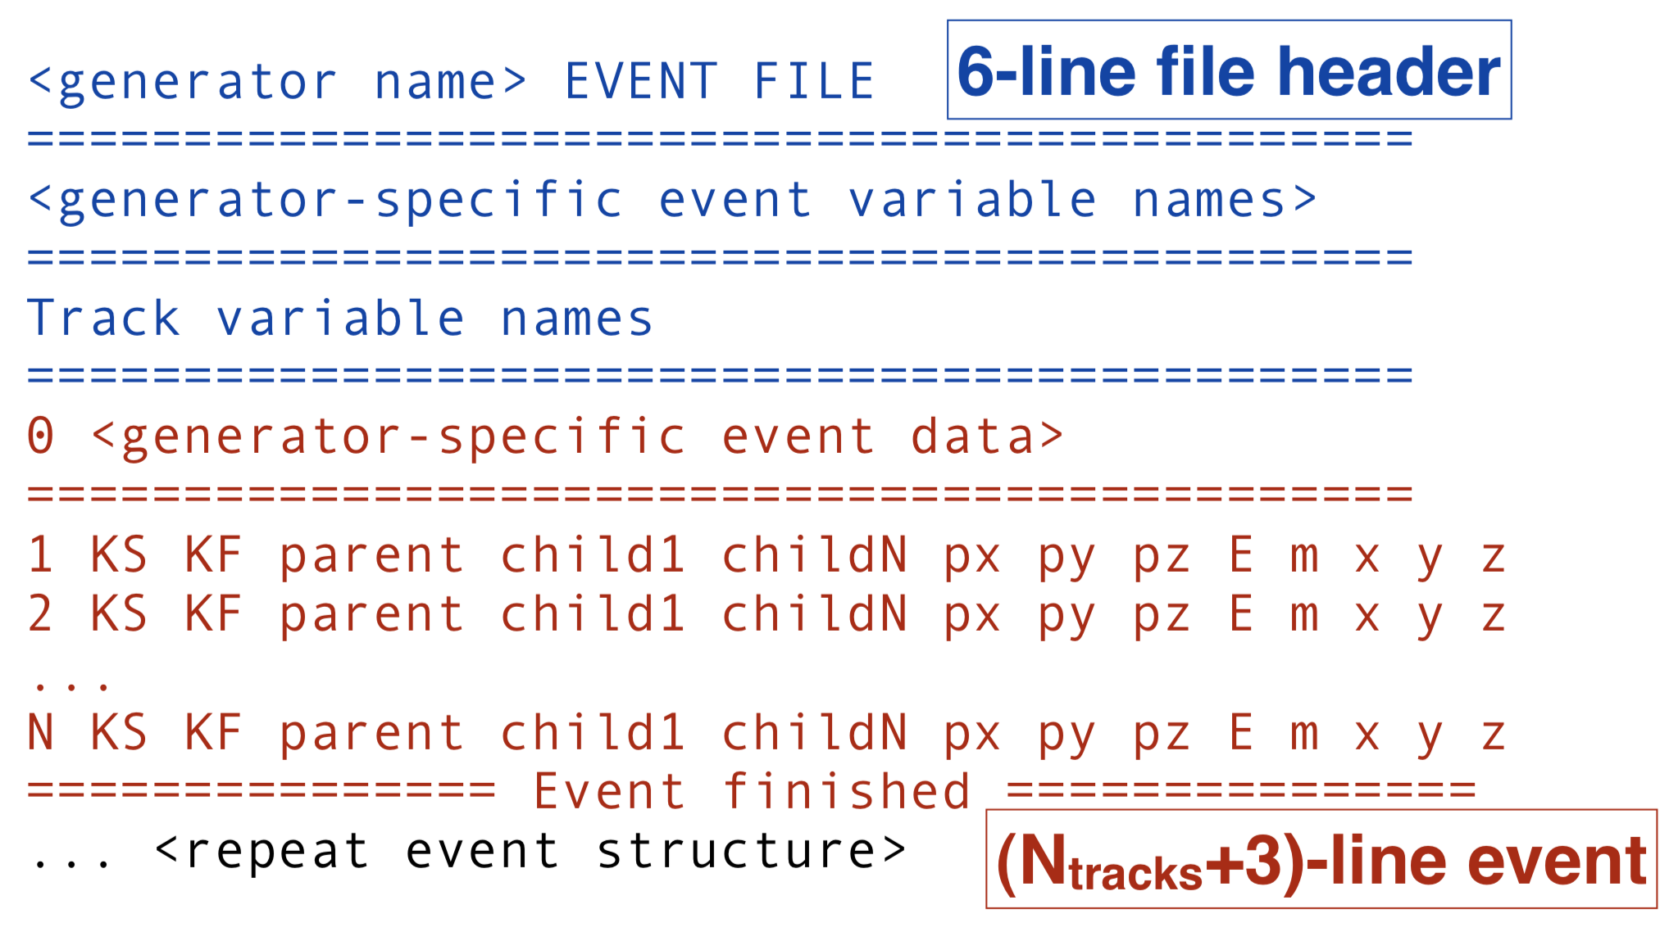
Common ASCII Format
Based on Lund format
wiki.bnl.gov/eic/index.php/PYTHIA

Slide 11
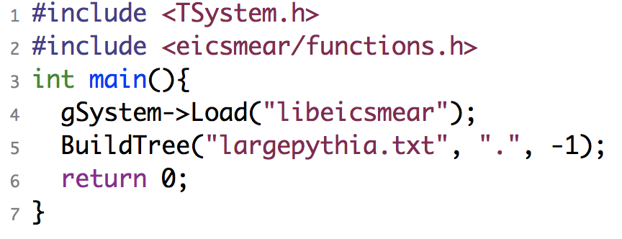
Transformation
Transform with BuildTree
  ~ 17 minutes to transform
$ root -l
root [0] gSystem->Load("libeicsmear")
root [1] BuildTree("pythia.txt",".", -1)
Note: BuildTree guesses generator
from the filename
Or compile:
$ g++ `root-config --cflags` \
`root-config --libs` \
-I<…>/include -L<…>/lib -leicsmear …
Note: Working on mechanism to bypass ASCII creation – this will form the basis for Pythia8 and other modern MCEGs

Slide 12
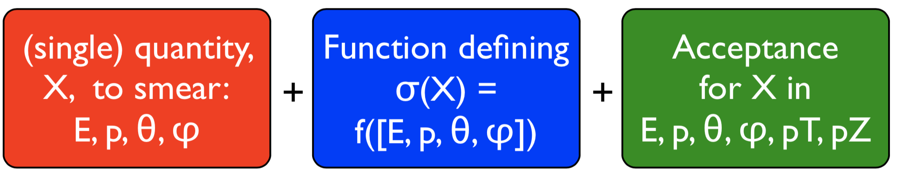
Smearing
“Smearer” defines some element of performance
+ acceptance
Standard Smearers are provided
Define your own via inheritance
NOT a “physical detector”
Represents the overall performance in measuring a quantity.
Smearer
“Detector”
Smearer
Smearers applied to
each final particle
Optionally, recalculate derived values e. g. x, Q²
Smearer
Smearer
Smearer

Slide 13
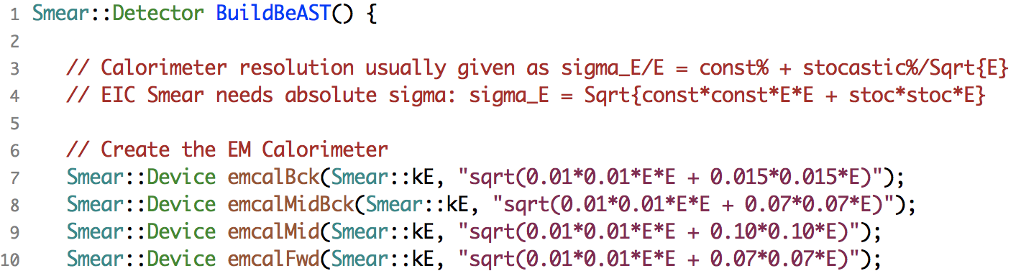
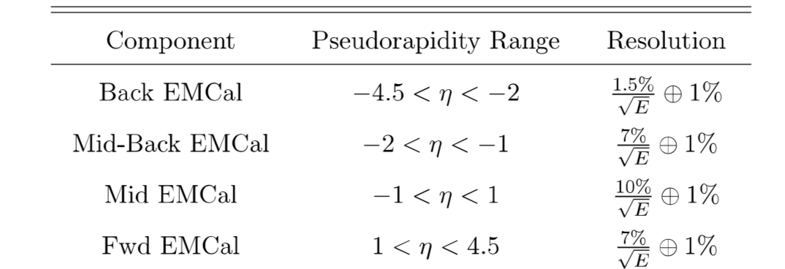
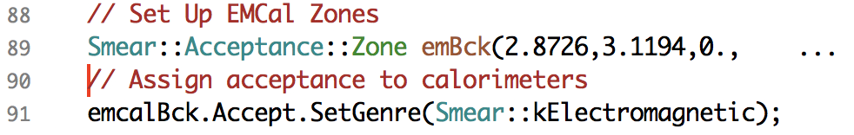
In Practice
BeAST Calo parameters
from eRHIC design study
Function returning a Smear::Detector
Acceptance (in θ)
Genre selects set of PIDs
→ can be customized
… same for HCal

Slide 14
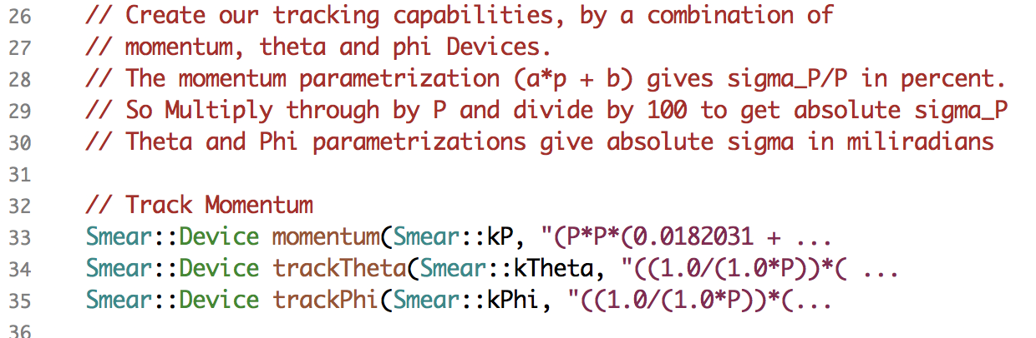
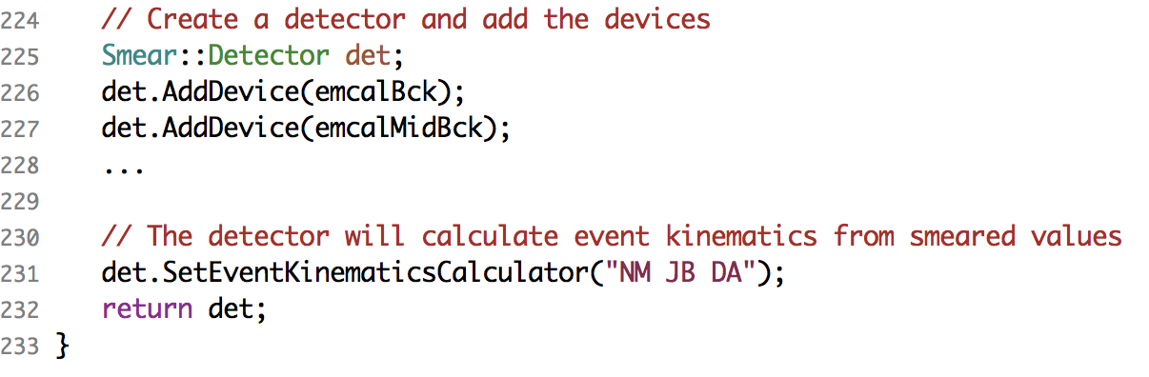
Example Continued
Tracking follows similar TFormula's.
Assemble devices
Kinematics options

Slide 15
Execution and Output
Investigating recent “Error in <ROOT::Math::BrentRootFinder>”
Smeared with SmearTree
  ~ 10 min to Smear (1.5k evts/sec)
root [0] gSystem->Load("libeicsmear")
root [1] .L smearBeAST.cxx
root [2] SmearTree(BuildBeAST(), "pythia.root", "smeared.root")
Load and befriend!
root [0] TFile mcf ("pythia.root")
root [1] TTree* mc=(TTree*)mcf.Get("EICTree")
root [2] mc->AddFriend("Smeared","smeared.root")
Smeared property is stored if final and in acceptance
Otherwise store NULL → 1-to-1 matching

Slide 16
Repeat for Emphasis
Only the smeared property of an accepted particle is stored
  Consequences:
  NULL can mean particle not accepted OR particle not smeared for some other reason
  E smeared → P set to 0 and vice versa, may need to recover from original or recalculate
  In principle, E and P can both be non-0, if smeared by different devices
Also note, if multiple devices smear the same quantity, only the last one in the list acts

Slide 17
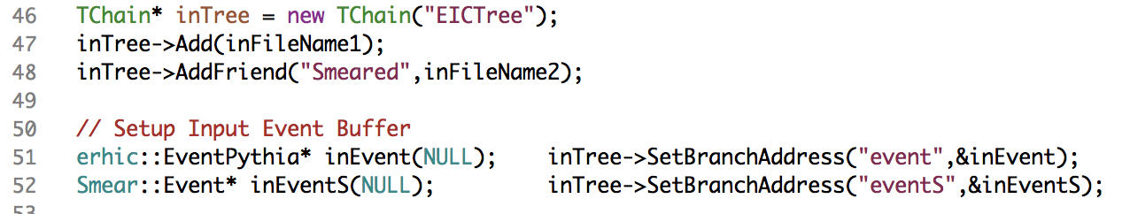
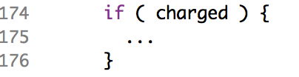
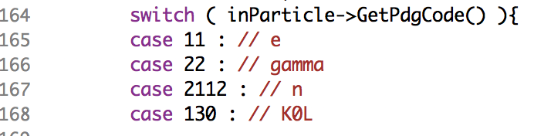
Analysis
Befriend and get matched branches
Particle Loop
Some additions at analysis level:
Tracking efficiency
Assign π mass to EMCal "hits"
Add convenience functions?

Slide 18
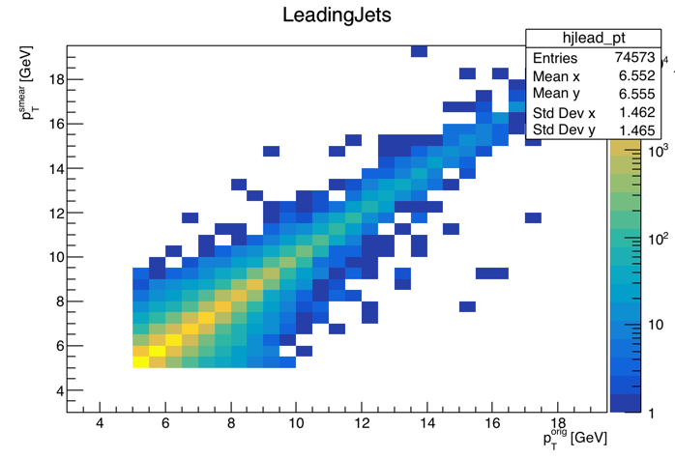
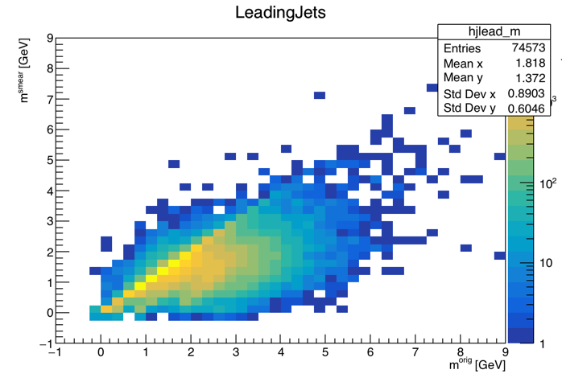
My Quick Result
Jet p_{T}
Jet Mass
No claims to correctness of these; main point of this slide:
This took ~two days to put together from scratch,
and I could now run many detector design variations in O(minutes)

Slide 19
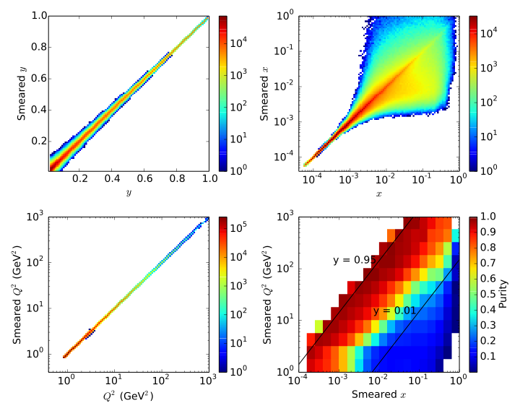
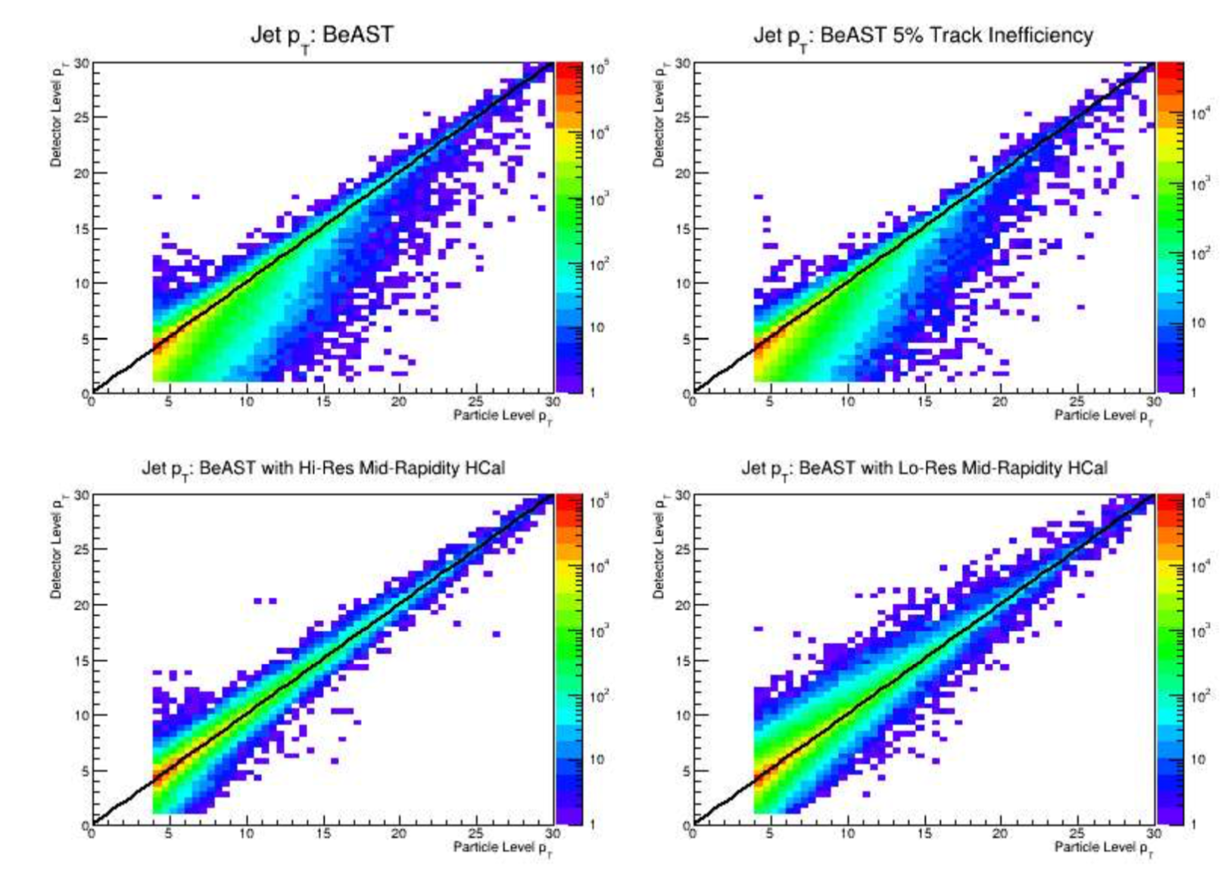
Some Physics Examples
y, x, Q² response and resulting purity
Jet p_{T} Performance study for various HCAL options
eRHIC Design Study
From B. Page

Slide 20
Limitations and Outlook
End of this week
Currently, no support for Pythia8, Herwig, …
No support for HepMC
Integration with eJANA is on-going
Not hard in principle.
Can profit from eJANA.
But: HepMC2 is limited, HepMC3 not widely supported
PID: Matrix-based functionality exists. But unclear origin of existing parameterization
Acceptance should reflect B-field
No 1→2 processes, decay vertices,
helixes, material budget, …
dE/dx, TOF, RICH smearing coming soon
Underway
Suggestions are welcome! But focus is on light-weight parameterization

Slide 21
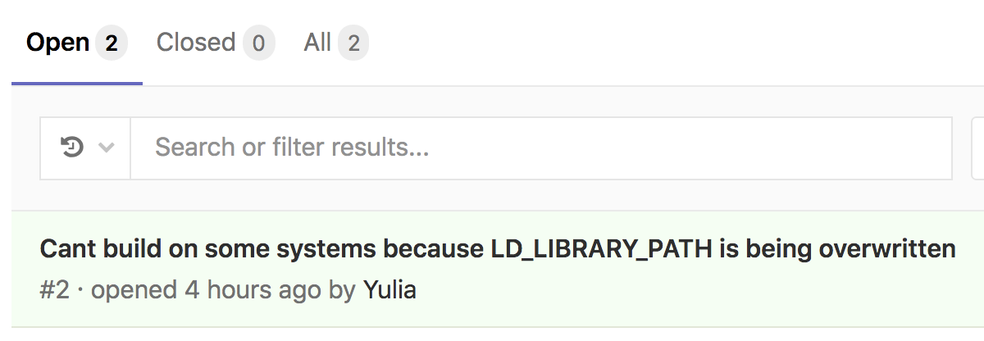
Resources
All hosted at gitlab.com/eic
Use issue tracker for bugs & requests!
Slack channel: eicug.slack.com/#software-support
Mailing list: eic-bnl-soft-l@lists.bnl.gov
Contact: kkauder@bnl.gov
Online users’ guide:
wiki.bnl.gov/eic/index.php/Eic-smear
Class documentation (temporary location):
www4.rcf.bnl.gov/~eickolja/

Slide 22
BACKUP

Slide 23
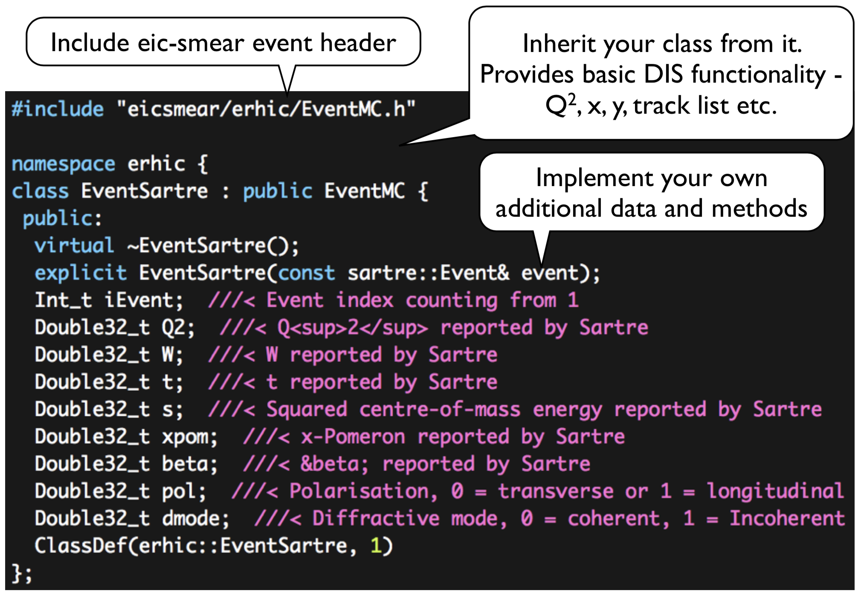
Extending (e.g., to Sartre)

Slide 24
A Brief History
Originally written by Michael Savastio (student)
Long-time main developer Thomas Burton
Current maintainers are Alex Kiselev … and as of late, me
With Annotations
Walk with me through a full analysis
And potential future development

Slide 25
Summary
eic-smear is fast, light-weight, extensible, well-written
No dependencies beyond ROOT
First stage unifies a host of EIC-relevant MC output
Cannot replace a full simulation
– but gives a good estimate of detector effects on observables in <10% of the time it takes to generate PYTHIA6.

