Slide 1
Practice on Signal Processing Tuning
Wenqiang Gu

Slide 2
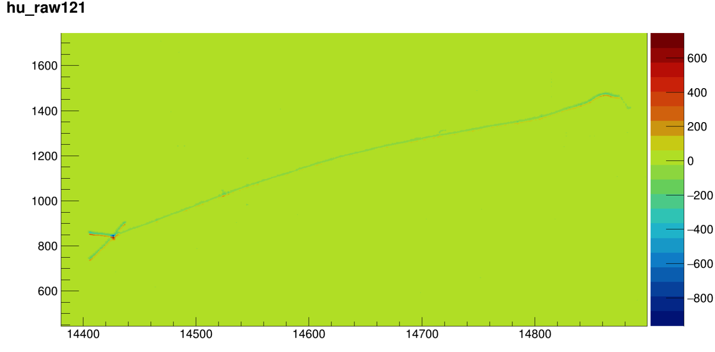
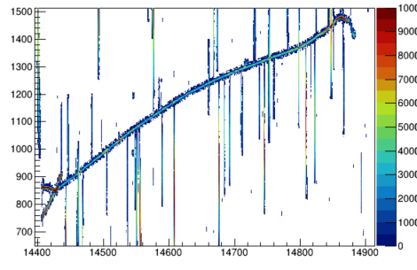
Simulation of a BNB event: out-of-box result without any tuning
First induction plane (Raw waveform)
First induction plane (deconvolved charge)
Some tuning work needs to be done for the signal processing to avoid the fake charges
Test 10 events of BNB simulation from Larsoft + WireCell toolkit
On average, 5000 depos / event
60 seconds for TPC simulation
35 seconds for naïve noise filtering
90 seconds for signal processing (2D deconvolution)

Slide 3
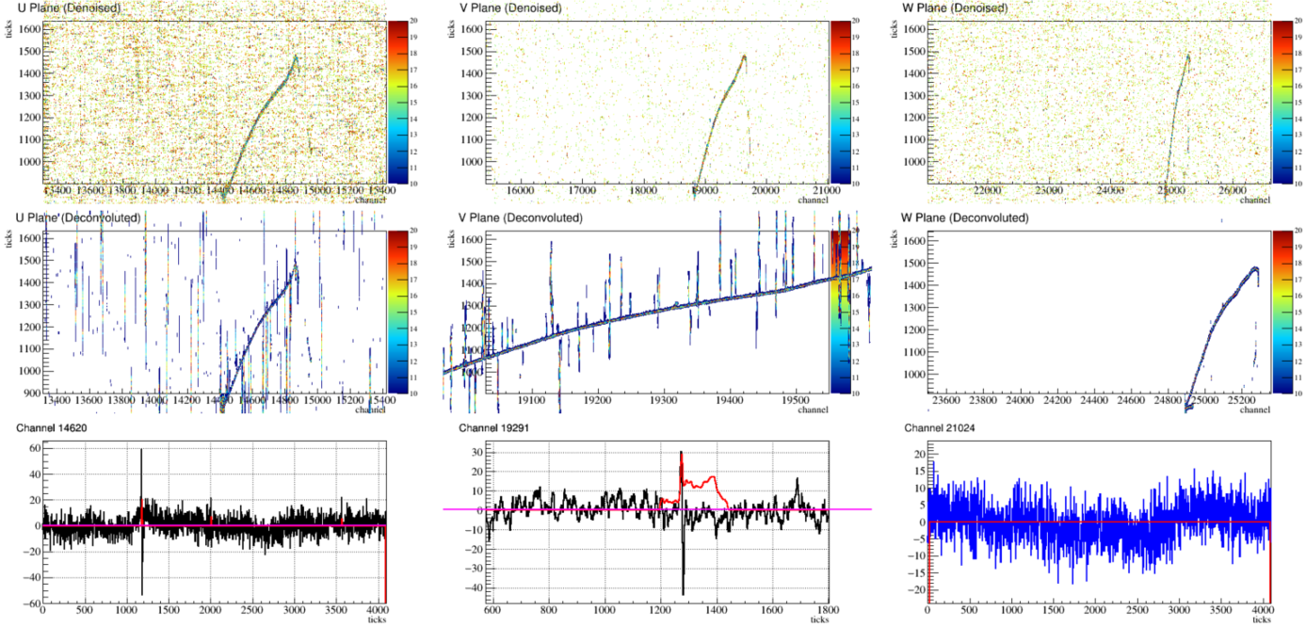
Simulation of a BNB event

Slide 4
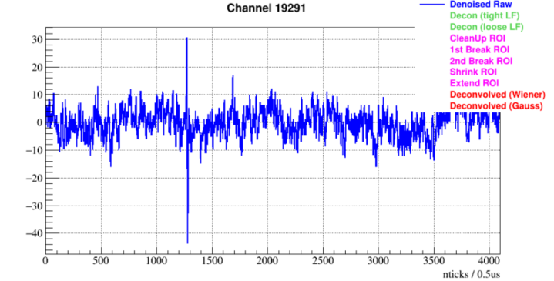
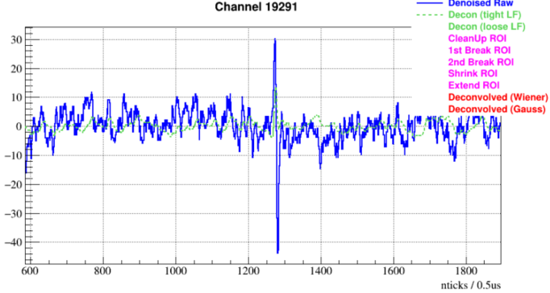
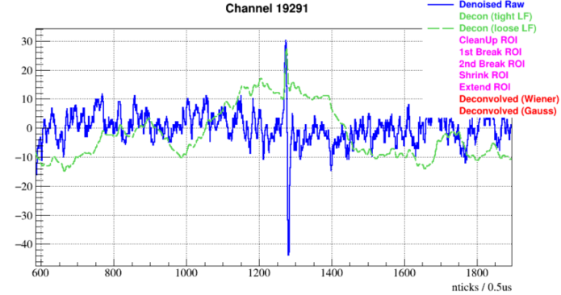
“Tight” low-frequency filter
“Loose” low-frequency filter
Strategy: ROI identified from loose filter needs to be confirmed by the tight filter

Slide 5
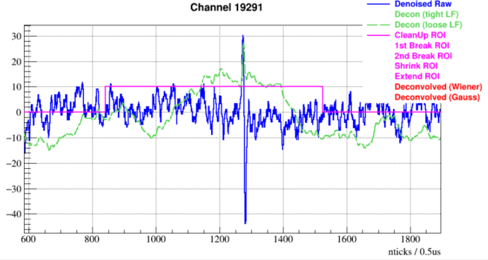
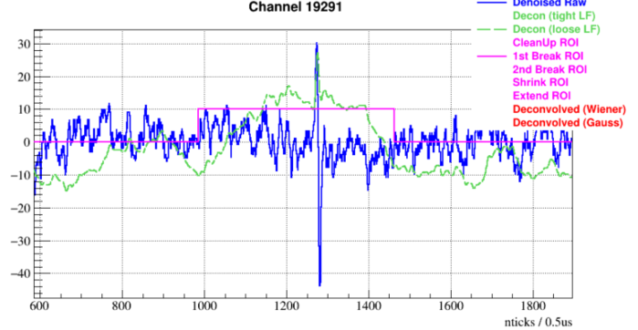
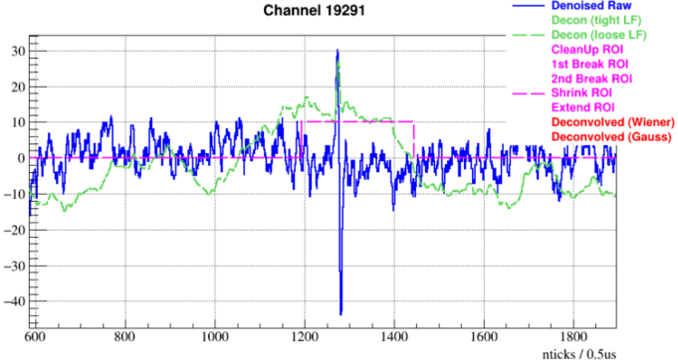
Initial ROI
“Break ROI”
“Shrink ROI”

Slide 6
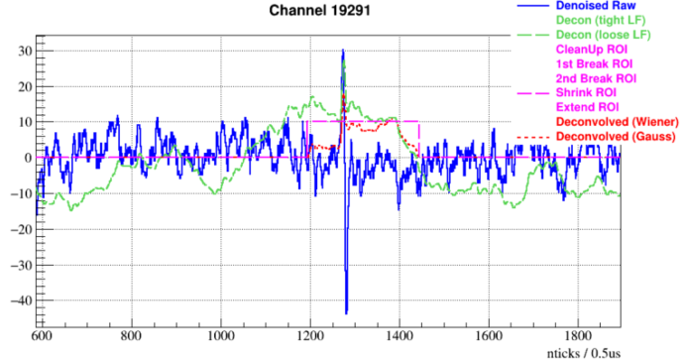
Final deconvolved charge with a baseline subtraction across the ROI window
The loose low-frequency filter & some essential thresholds for ROI finding needs to be tuned

Slide 7
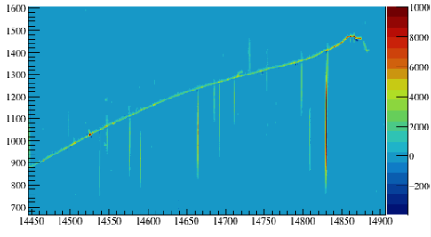
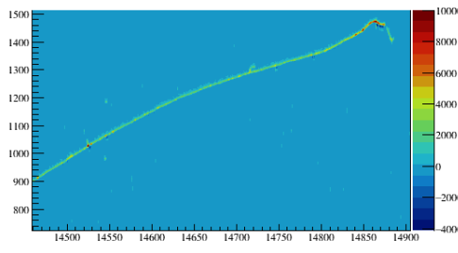
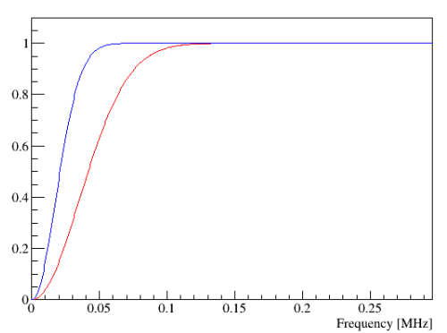
1st induction plane
1st induction plane
Low-frequency filter: $τ\sim 0.025$
Low-frequency filter: $τ\sim 0.05$
$$τ\sim 0.025$$
$$1−e^{−{\left(f/τ\right)}^{2}}$$
Change of the LF filter works better!
$$τ\sim 0.05$$

Slide 8
Summary
The signal processing parameters from protoDUNE does not work well for ICARUS
Try to tune the low-frequency filter, seems to be good
Need to understand more with the realistic simulation
Update the geometry
Update the electronic shaping

