Slide 1
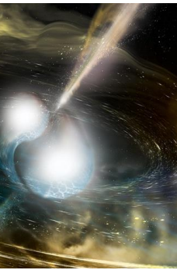
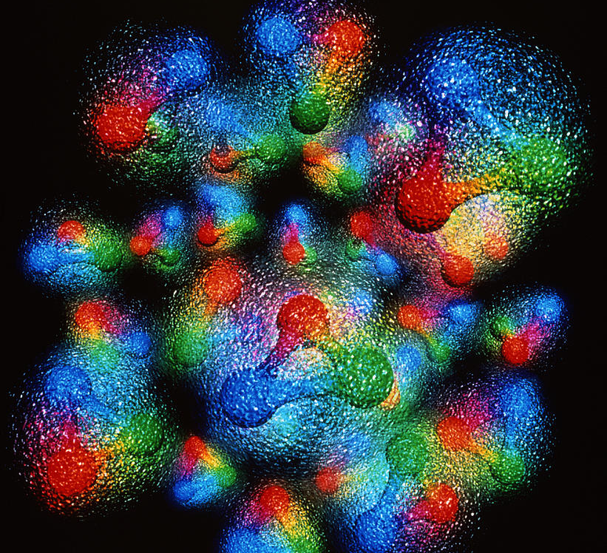
Theory of DVCS in Nuclei
Workshop
March 17, 2020
SIMONETTA LIUTI
UNIVERSITY OF VIRGINIA

Slide 2

A multi-step, multi-prong process
e⁺
Deeply Virtual Compton Scattering
Timelike Compton Scattering
e’
e⁻
e
q’= q+Δ
q
k+q
k
p
H,E
p’= p-Δ
t=Δ²

Slide 3
A multi-step, multi-prong process
Deeply Virtual Meson Production
Exclusive Drell Yan
e’
e
𝛑º,𝛑±
q’= q+Δ
q’= q+Δ
q
k+q
k
p
H,E
p’= p-Δ
t=Δ²

Slide 4
Observables: Coherent vs. Incoherent processes
(SL and S. Taneja, hep-ph/0505123, hep-ph/0504027 PRC, 2006)
q
DVCS
q-Δ
q
DVCS
q-Δ
p+Δ
p
p+Δ
p
P_{A}
P_{A} - Δ
P_{A}
P_{A-1}
Off-forward nucleon spectral function
“Standard” nucleon spectral function

Slide 5
Coherent/Incoherent contributions also in Bethe Heitler processes from
nuclei

Slide 6
Why is ⁴He interesting: it is ideal to study twist three contributions
A simper cross section structure
1 twist-two GPD, H
2 twist-three GPDs, H₃ and H₃||
H₃|| corresponds to a configuration with a longitudinally polarized quark in an unpolarized target associated with the quark’s spin-orbit contribution

Slide 7
Structure of cross section

Slide 8
DVCS in spin ½ compared to spin 0
twist two GPDs
twist three GPDs
H₃
λ_{e}
H₃||
S_{L}
λ_{e}
λ_{e}
S_{T}
λ_{e}
S_{L}

Slide 9
3/17/20
9
BH-DVCS interference
Unpolarized

Slide 10
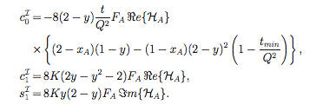
This formalism supersedes “harmonics”-based formalism
B. Kriesten, A.Meyer, SL, et al. arXiv:1903.05742

Slide 11
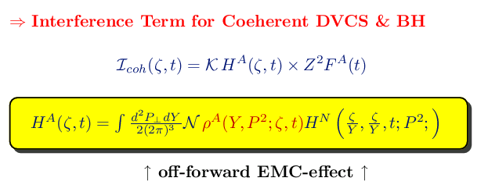
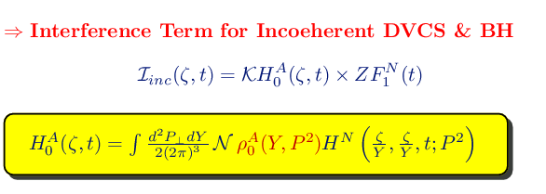
Non-forward spectral
function
Forward spectral function

Slide 12
Some predictions
No off-shell effects
Off-shell effects
Off shell effects grow with t because k_{T} becomes more important in this region

Slide 13
Conclusions and Outlook
Many future possibilities for exploring the nature of nuclear modifications of the proton structure thanks to the accessibility of deeply virtual exclusive reactions
Re-interactions/twist three is important: transverse d.o.f. connection between k_{T} and b
Future Jlab and EIC Exclusive experiments using nuclei will provide the much needed laboratory to study QCD in coordinate space: vast phenomenology scenario
…. BUT we need to start using the correct formalism

