Slide 1
PMG Agenda
Plans for I&F Upgrade PMP signature
sPHENIX Management agree with the final text changes proposed by Maria and are ready to sign the Upgrade Management Plan.
Min-safe status & plans
Potential impact of COVID-19
Brief Status Report
Cost & Schedule performance
Plans for I&F Upgrade PMP signature
Any other Business?

Slide 2
sPHENIX MIE Overview
TPC | Project Director | Last CD Achieved | % Complete | CPI | SPI
$27.0M | Edward O’Brien | PD-2/3 | 40.9% BCWP/BAC @ 2/29/2019 | 1.01 | 0.97
Scope
Detector systems produced, tested and ready for installation: Time Projection Chamber w/ electronics, Electromagnetic Calorimeter w/ electronics, Hadronic Calorimeter w/ electronics, DAQ/Trigger, Minimum Bias Detector, Project Management
Not in scope
SC-Magnet, Bldg/Det Infrastructure, Installation and System Commissioning
Schedule
CD-0 received Sept 2016
CD-1/3A received Aug 2018
PD-2/3 received Sept 2019
Early completion Oct 2021 (14 months float to PD-4)
PD-4 Dec 2022
Cost
$27.0M AY TPC 37.2% contingency on BCWR

Slide 3
1008 Infrastructure & Facility Upgrade
TPC | Project Director | % Complete | CPI | SPI
$33.4 M AY | Edward O’Brien | 35.1% BCWP/BAC @ 2/29/2019 | 1.02 | 0.94
Scope
SC-Magnet support including the Flux Return, Cryogenics into Bldg 1008, Detector Carriage/Cradle, other Bldg 1008 Infrastructure improvements
sPHENIX Installation, Integration and Commissioning of each Subsystem is part of the scope
Not in Scope
PreOps prior to RHIC collisions
Schedule
sPHENIX Ready for Operations Oct 2022
First RHIC run of sPHENIX Feb 1, 2023
3.5 months in schedule between sPHENIX ORR and nominal start of RHIC 2023 run.
Cost
$33.4 M AY Total Project Cost with 22.3% contingency on ETC

Slide 4
Impact of Worldwide Pandemic
All Universities and National Labs on work-pause due to COVID-19
UIUC (EMCal), GSU(HCal tiles), SBU(TPC), Columbia Univ (Cal Electronics, MBD, DAQ/Trigger) closed
Equipment and material deliveries continue at BNL. sPHENIX components are continuing to come in to Brookhaven.
Work is proceeding remotely at BNL. Remote work will continue for ?? months.
All but BNL essential personnel are working from home.
Work that can go on: Engineering design, reviews, documentation, procurement.
We have set up daily status meetings for BNL engineering and subsystems throughout the week.
Our standard weekly and biweekly meetings will go on.
Expect we will lose one week of schedule for each week that BNL is shut. If BNL is shut for > 8 weeks then I would expect there will be an additional ramp-up time to get back to full productivity
If the BNL shutdown is 4 weeks or less we will take the hit on schedule contingency and proceed. If the shutdown is greater than 4 weeks we will re-plan the work based on the duration of the interruption.

Slide 5
Project Status
February SPI and CPI are both close to 1.
All major milestones have been completed ahead of schedule.
EVMS processing complete, shows good cost and schedule performance.
Cobra and P6 monthly reports uploaded to the Interactive Project Database (IPD).
Estimate Uncertainty and Risks updated by removing them from completed activities.
Baseline Change Request approved for IHCal frame contract date, no cost impact.
Deliveries for all LLP orders continue to arrive
TPC DAM Production Readiness Review complete.
Pay close attention to Milestones on Critical Path.
PD-3 orders are being placed and procurements are monitored.
Hire replacements for retired personnel.

Slide 6
sPHENIX Technical Accomplishments
Carriage/Cradle order awarded to Streck’s March 13. Delivery 41 weeks from award date. The vendor’s facility is up and running.
The cryo vendor AET continues to work. The first spools of cryo line now due at BNL May 10. Previously the delivery date had been April 10. Plenty of float.
LLP-1 orders, 100% of SiPMs arrived at Univ. of Michigan. LLP-2 orders, 49% of scintillating fibers have arrived at UIUC. LLP-3 orders, 57% of scintillating tiles have arrived at GSU. LLP-4 order 50% of tungsten powder at UIUC. Balance of W powder due May 15.
1st OHCal sector fully instrumented and reading out cosmic-ray events. 6/32 OHCal sectors instrumented with scintillating tiles. Cabling has begun on Sectors 2-5.
SAMPA v5 (TPC ASIC). Four wafers diced and packaged. Testing had just begun at USP and Lund when work was paused due to COVID-19.Initial tests are positive.
10 TPC Data Aggregator Module at BNL. First 3 DAM cards passed test. Balance to be completed after work pause.
EMCal Sectors 1 & 2 being assembled at BNL. Sector 4-12 block fab continues at UIUC.
Production/ final R&D work progressing on all sPHENIX detector components.

Slide 7
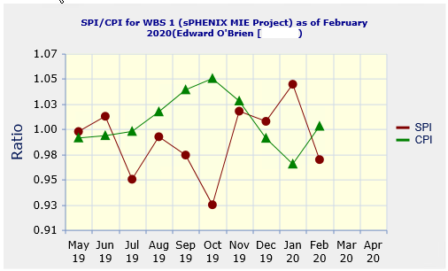
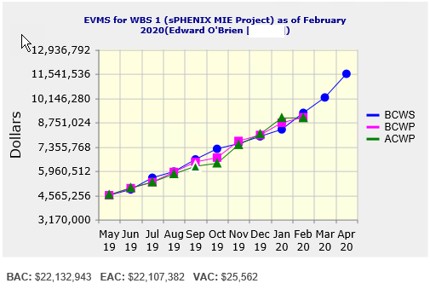
MIE: Performance Indices
Cumulative SPI | Cumulative CPI
0.97 | 1.01
Cumulative BCWS (Scheduled) | $9,305,511
Cumulative BCWP (Performed) | $9,055,520
Cumulative ACWP (Actual) | $9,009,379
DOE SPI or CPI Value Thresholds
0.90 to 1.15
0.85 to 0.89 or 1.16 to 1.25
<0.85 or >1.25

Slide 8
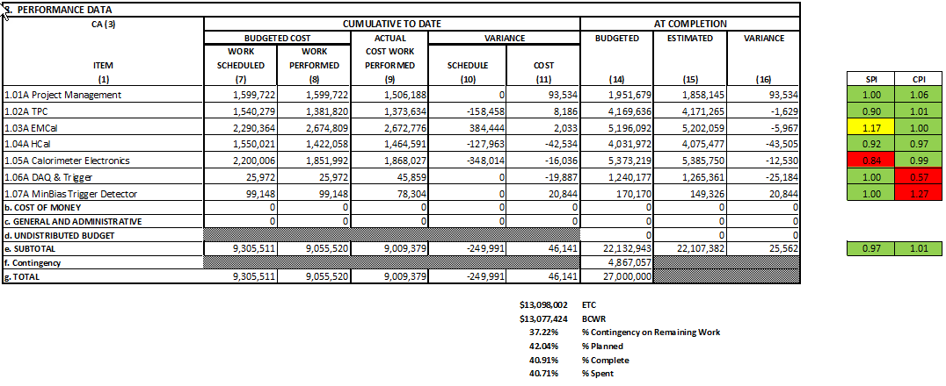
MIE: Cost Performance Report (CPR)
DOE SPI or CPI Value Thresholds
0.90 to 1.15
0.85 to 0.89 or 1.16 to 1.25
<0.85 or >1.25

Slide 9
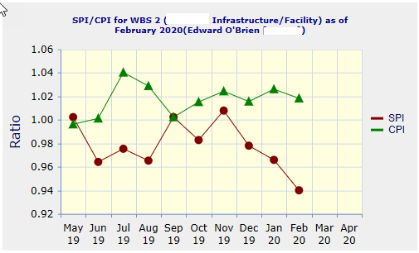
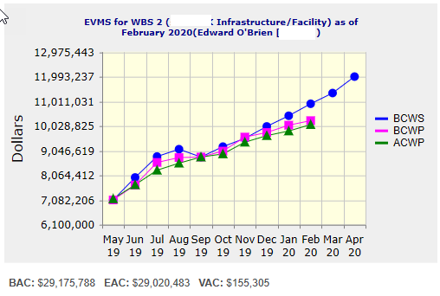
I&F: Performance Indices
Cumulative SPI | Cumulative CPI
0.94 | 1.02
Cumulative BCWS (Scheduled) | $10,917,190
Cumulative BCWP (Performed) | $10,245,157
Cumulative ACWP (Actual) | $10,086,131
DOE SPI or CPI Value Thresholds
0.90 to 1.15
0.85 to 0.89 or 1.16 to 1.25
<0.85 or >1.25

Slide 10
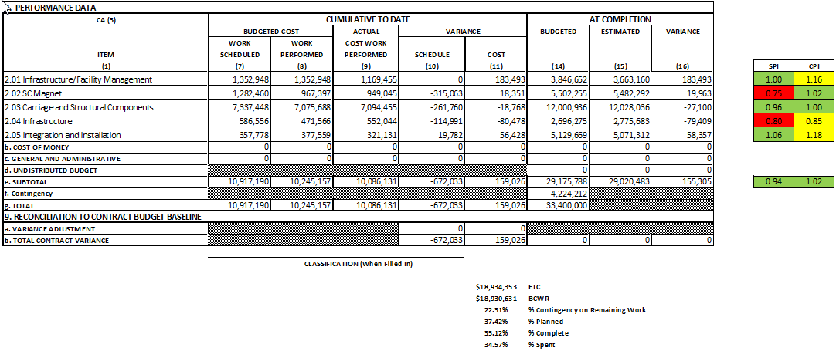
I&F: Cost Performance Report (CPR)
DOE SPI or CPI Value Thresholds
0.90 to 1.15
0.85 to 0.89 or 1.16 to 1.25
<0.85 or >1.25

Slide 11
MIE: Milestones Status
# | WBS | Milestone Name | Target Milestone Date | Forecast | Actual Finish | Variance (in work days) | Comments
1 | 1.01.01 | Approve Project Baseline and Construction PD2/3 | 30-Sep-19 | 20-Sep-19 A | 20-Sep-19 | 6
2 | 1.02.02.02 | Production Readiness Review - TPC Module Factories | 31-Dec-19 | 17-Dec-19 A | 17-Dec-19 | 8
3 | 1.03.02.03.02 | EMCal Preproduction Sector 0 Assembled | 31-Dec-19 | 25-Nov-19 A | 25-Nov-19 | 23
4 | 1.02.06.02 | Production Readiness Review - TPC DAM | 28-Feb-20 | 04-Feb-20 A | 4-Feb-20 | 16
5 | 1.05.02.03 | HCal Preproduction FEE Complete | 30-Apr-20 | 22-Jan-20 A | 22-Jan-20 | 70
6 | 1.05.02.01 | EMCal Electronics Preproduction Complete | 29-May-20 | 1-May-20 |  | 18
7 | 1.03.01.03.01 | EMCal W Powder Acquisition Complete | 30-Jun-20 | 8-Jun-20 |  | 15
8 | 1.03.02.03.03 | EMCal Production Readiness Review Blocks/Modules/Sectors Complete | 31-Jul-20 | 19-May-20 |  | 50
9 | 1.02.05.03 | SAMPA ASIC Performance Accepted | 30-Sep-20 | 28-Aug-20 |  | 21
10 | 1.05.01 | EMCal/HCal SiPM Sensor Procurement Complete | 30-Oct-20 | 28-Feb-20 A | 28-Feb-20 | 171
11 | 1.05.02.04 | HCal SiPM Boards Assembly Complete | 30-Nov-20 | 1-Jun-20 |  | 123
12 | 1.02.06.03 | TPC DAM Felix 2.0 Production Complete | 29-Jan-21 | 9-Feb-21 |  | -8
13 | 1.06.02.03 | Trigger LL1 Preproduction complete | 26-Feb-21 | 11-Dec-20 |  | 50
14 | 1.05.02.02 | EMCal SiPM Boards Production Complete | 31-Mar-21 | 30-Dec-20 |  | 61
15 | 1.04.04.02 | First Outer HCAL Sector and Splice Plates Ready to Install | 30-Apr-21 | 25-Aug-20 |  | 168
16 | 1.04.01 | Inner HCAL Support Structure Ready for Installation | 30-Apr-21 | 12-Feb-21 |  | 53
17 | 1.02.01.06 | GEM Production Complete | 31-May-21 | 12-Jan-21 |  | 96
18 | 1.03.01.03.01 | EMCal Scintillating Fiber Acquisition Complete | 31-May-21 | 1-Mar-21 |  | 64
19 | 1.06.01.03 | DAQ Production: DAQ Ready for Operation | 31-May-21 | 6-Aug-21 |  | -48
20 | 1.05.02.04 | HCal Electronics Complete: Production | 30-Jun-21 | 22-Dec-20 |  | 130
21 | 1.02.05.04 | TPC FEE Production Complete | 30-Jul-21 | 25-Jun-21 |  | 23
22 | 1.05.03.02 | Calorimeter Electronics Complete | 30-Jul-21 | 12-May-21 |  | 54
23 | 1.05.02.02 | EMCal Electronics Complete | 30-Jul-21 | 3-May-21 |  | 61
24 | 1.07 | MinBias Detector Ready to Install | 30-Sep-21 | 1-Oct-21 |  | -2
25 | 1.06.03.03 | GL1 Ready to Operate | 30-Sep-21 | 16-Sep-21 |  | 9
26 | 1.01.01 | Early Project Completion | 29-Oct-21 | 25-Oct-21* |  | 4
27 | 1.02.01.08 | TPC Ready to Install (Assembly Complete) | 29-Oct-21 | 13-Oct-21 |  | 11
28 | 1.02.06.03 | TPC DAM Production Complete | 29-Oct-21 | 15-Sep-21 |  | 30
29 | 1.03.02.03.03 | EMCal Ready to Install | 29-Oct-21 | 20-Oct-21 |  | 6
30 | 1.04.04.02 | Last Outer HCAL Sector Ready to Install | 29-Oct-21 | 1-Jun-21 |  | 104
31 | 1.06.02.04 | LL1 Trigger Production Complete | 29-Oct-21 | 16-Sep-21 |  | 29
32 | 1.06.02.04 | LL1 Ready to Operate | 29-Oct-21 | 16-Sep-21 |  | 29
33 | 1.01.01 | Approve Project Closeout PD-4 | 30-Dec-22 | 29-Dec-22* |  | 0

Slide 12
FY20 Milestones Status (FY20 PEMP notable)
WBS | Milestone Name | Target Milestone Date | Actual Finish | Variance (in work days)
1.01.01 | Approve Project Baseline and Construction PD2/3 | 30-Sep-19 | 20-Sep-19 | 6
1.02.02.02 | Production Readiness Review - TPC Module Factories | 31-Dec-19 | 17-Dec-19 | 8
1.03.02.03.02 | EMCal Preproduction Sector 0 Assembled | 31-Dec-19 | 25-Nov-19 | 23
1.02.06.02 | Production Readiness Review - TPC DAM | 28-Feb-20 | 7-Feb-20 | 14
1.05.02.03 | HCal Preproduction FEE Complete | 30-Apr-20 | 22-Jan -20 | 70
1.05.02.01 | EMCal Electronics Preproduction Complete | 29-May-20
1.03.01.03.01 | EMCal W Powder Acquisition Complete | 30-Jun-20
1.03.02.03.03 | EMCal Prod Readiness Review Blocks/Modules/Sectors Complete | 31-Jul-20
1.02.05.03 | SAMPA ASIC Performance Accepted | 30-Sep-20
Relies on the vendor keeping the schedule
Relies on the vendor keeping the schedule
OK if we are back to work by June 1
Unknown what the status is at USP and Lund

Slide 13
I&F: Milestones Status
# | WBS | Milestone Name | Target Milestone Date | Forecast | Actual Finish | Variance (in work days) | Comments
1 | 2.03.03 | Completion of Outer HCAL Sector Mechanical Structure Procurement | 30-Sep-19 | 03-Sep-19 A | 3-Sep-19 | 19
2 | 2.02.03.04.01 | Completed - (Controls Hardware) Power distribution drawings | 31-Oct-20 | 25-Aug-20 |  | 46
3 | 2.03.01 | Completed - Steel Track Modifications | 30-Nov-20 | 7-Dec-20 |  | -6
4 | 2.03.02 | Magnet Supports Released for Production (Milestone) | 31-Jan-21 | 23-Nov-20 |  | 44
5 | 2.04.02.01 | Magnet cryo, electrical and control structural support components Ready for Installation | 31-Mar-21 | 4-Dec-20 |  | 78
6 | 2.03.02 | IHCal Structural Support Components Ready for Installation | 31-Mar-21 | 25-Mar-21 |  | 3
7 | 2.05.04 | Outer HCal Sectors Ready for Installation | 30-Apr-21 | 25-Aug-20 |  | 168
8 | 2.03.01 | Carriage Cradle - Components Ready for Installation | 31-May-21 | 24-Feb-21 |  | 67
9 | 2.03.05 | CC Bridge, Mid Platforms & Access - Ready for Installation | 31-Oct-21 | 20-May-21 |  | 112
10 | 2.02.03.02.04.02 | Completed - Procure LN2 supply transfer line system - Phase 5 - Shipping - Delivery Acceptance | 30-Nov-21 | 2-Sep-21 |  | 57
11 | 2.05.05 | Completed - Install SC Magnet on Cradle | 30-Nov-21 | 17-Sep-21 |  | 47
12 | 2.04.02.06 | Assembly Hall Components Ready for Installation | 30-Nov-21 | 16-Sep-21 |  | 48
13 | 2.04.01.03 | Detector Electronics Racks and Rack generic support systems Components Ready for Installation | 30-Nov-21 | 4-Aug-21 |  | 78
14 | 2.04.01.05 | Detector Safety Subsystems Components Ready for Installation | 31-Dec-21 | 16-Sep-21 |  | 70
15 | 2.02.02 | Completed - Magnet and Solenoid Valvebox - Reinstall | 31-Jan-22 | 8-Nov-21 |  | 53
16 | 2.05.04 | Completed - Install Remainder of Outer HCal Sectors | 31-Jan-22 | 16-Nov-21 |  | 48
17 | 2.05.03 | Completed - Install platforms & access | 28-Feb-22 | 16-Dec-21 |  | 47
18 | 2.05.07 | Completed - Install EMCal Sectors | 31-Mar-22 | 6-Jan-22 |  | 57
19 | 2.05.03 | Completed - Install Pole Tips | 31-May-22 | 30-Mar-22 |  | 42
20 | 2.02.03.01.06 | RHIC Helium Interface - Installation complete | 30-Jun-22 | 4-May-22 |  | 39
21 | 2.02.03.04.03 | (Cryo Controls Hardware) Hardware Installed | 30-Jun-22 | 6-Apr-22 |  | 59
22 | 2.02.01.02 | Magnet is operational | 31-Jul-22 | 15-Jun-22 |  | 31
23 | 2.02.05.03 | Completed - Magnet Field Measurements: Map Magnetic Field of SC Magnet | 31-Aug-22 | 7-Jul-22 |  | 38
24 | 2.05.08 | Completed - Install TPC | 30-Sep-22 | 26-Jul-22 |  | 46
25 | 2.05.11 | Completed - Install Min Bias | 31-Oct-22 | 26-Aug-22 |  | 43
26 | 2.05.10 | Completed - Install MVTX | 30-Nov-22 | 4-Oct-22 |  | 36
27 | 2.05.12 | sPHENIX Ready for Operations | 30-Nov-22 | 12-Oct-22 |  | 31

Slide 14
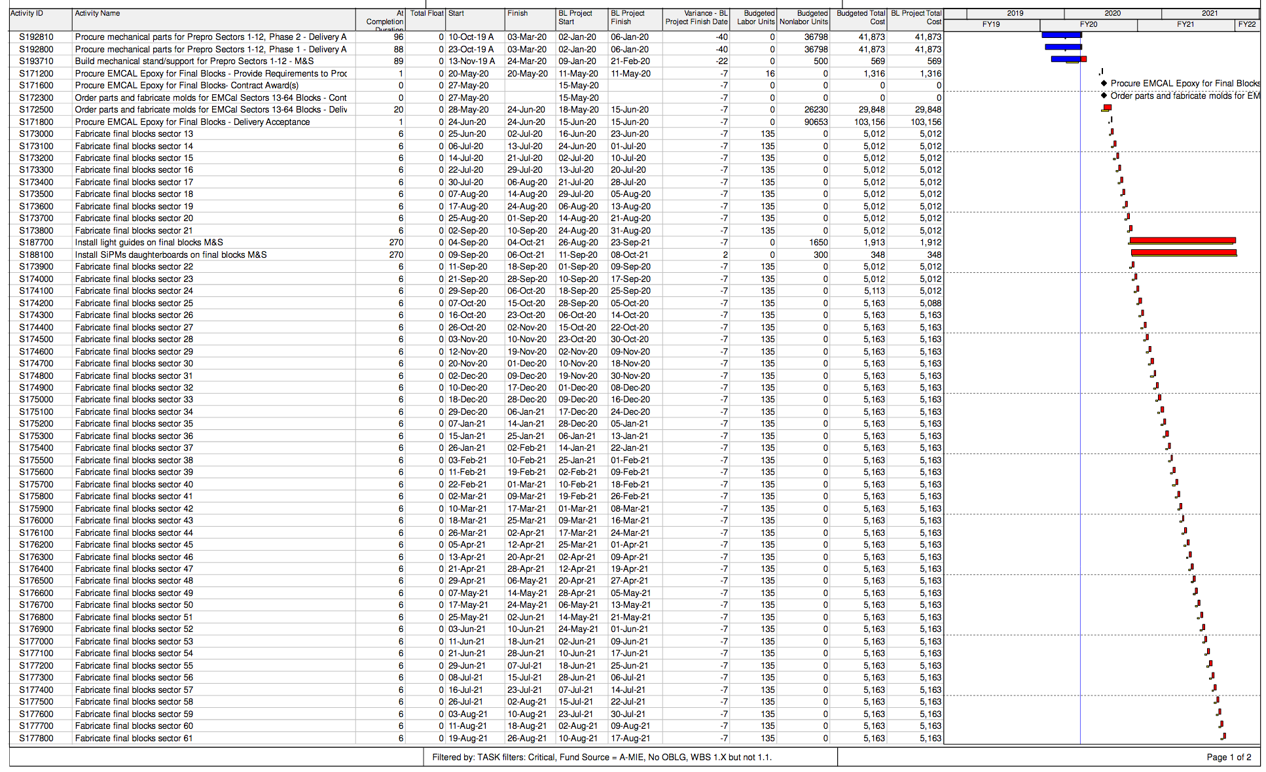
MIE: Detailed Critical Path
Critical path goes through
EMCal fabrication

Slide 15
Issues
The sPHENIX installation schedule must be carefully folded into any revised RHIC run plan. The number of weeks of access that we have to the 1008 IR can not be reduced if we are to stay on schedule for first collision with sPHENIX.

Slide 16
Summary
Activities have stopped at BNL and collaborating institutions due to the work- pause associated with the worldwide pandemic. sPHENIX design work, procurement, simulations, reviews, etc. will continue remotely. Will re-plan the project file (PCRs) if BNL and collaborating universities remain closed more than 4 weeks otherwise will take the schedule hit out of schedule contingency.
Prior to the work stoppage in March:
sPHENIX MIE continues to have good cost and schedule performance at summary level as measured by EV. Project End Date and Critical path remain unchanged.
We are working to correct the low SPI performance of the Calorimeter electronics.
First sPHENIX production detector component, Sector 1 OHCal is complete and taking cosmic ray data. EMCal Sector 1 is being assembled.
CD-3A components continue to arrive and orders for production components continue to be placed.
R&D and engineering design continues to advance.

Slide 17
Back Up

Slide 18
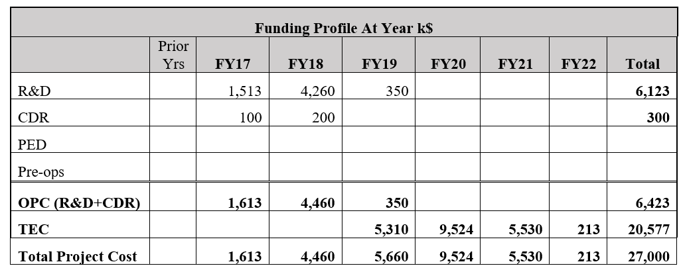
MIE Funding Profile
*
*We have received $8.2M as of the March fin plan

Slide 19
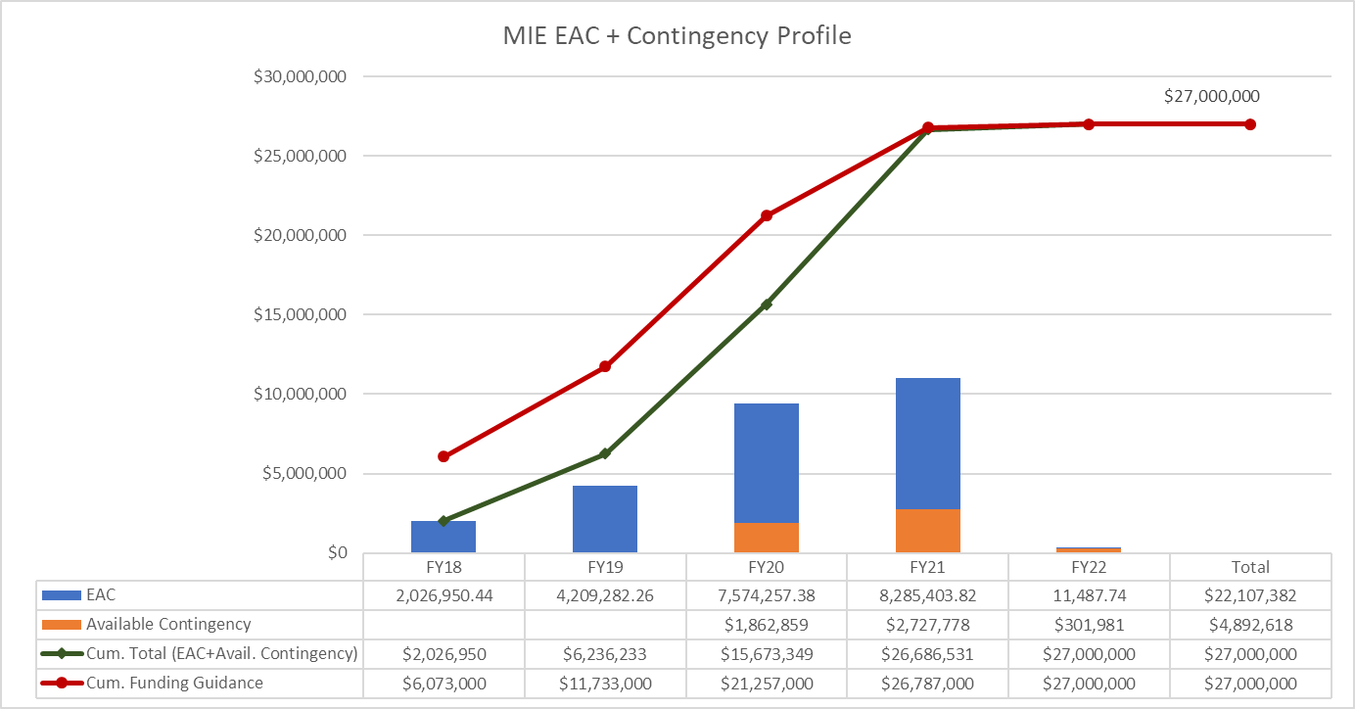
MIE: EAC and Contingency Profile

Slide 20
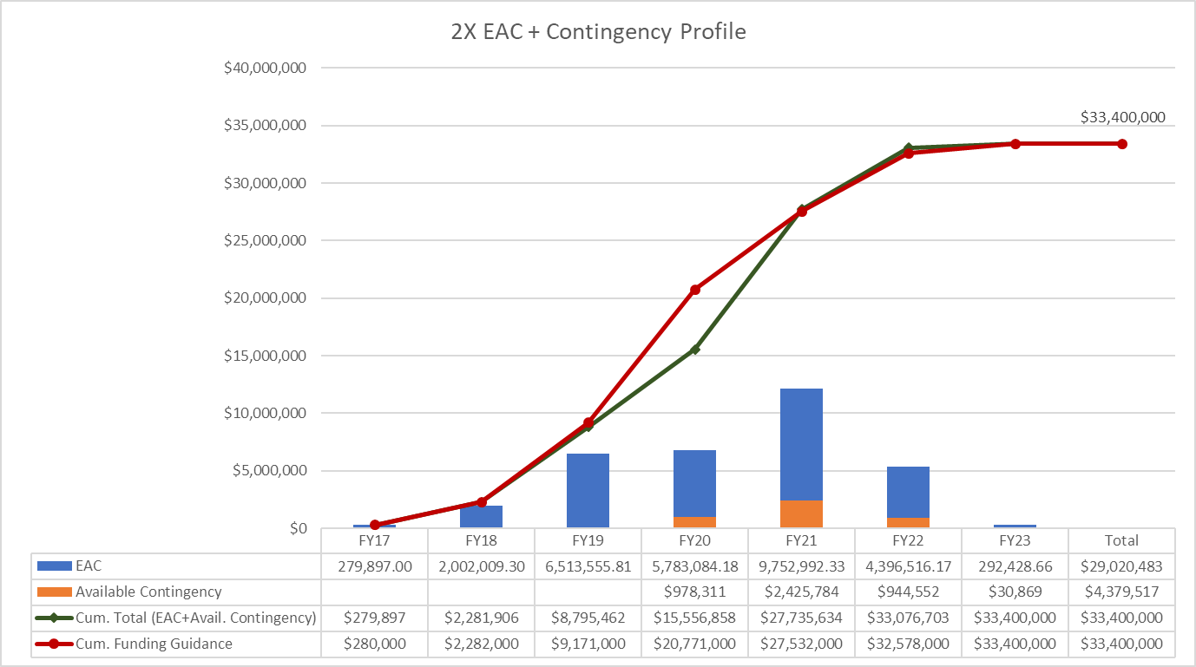
I&F: EAC and Contingency Profile

Slide 21
MIE: Baseline/Contingency Log

Slide 22
I&F: Baseline/Contingency Log

Slide 23
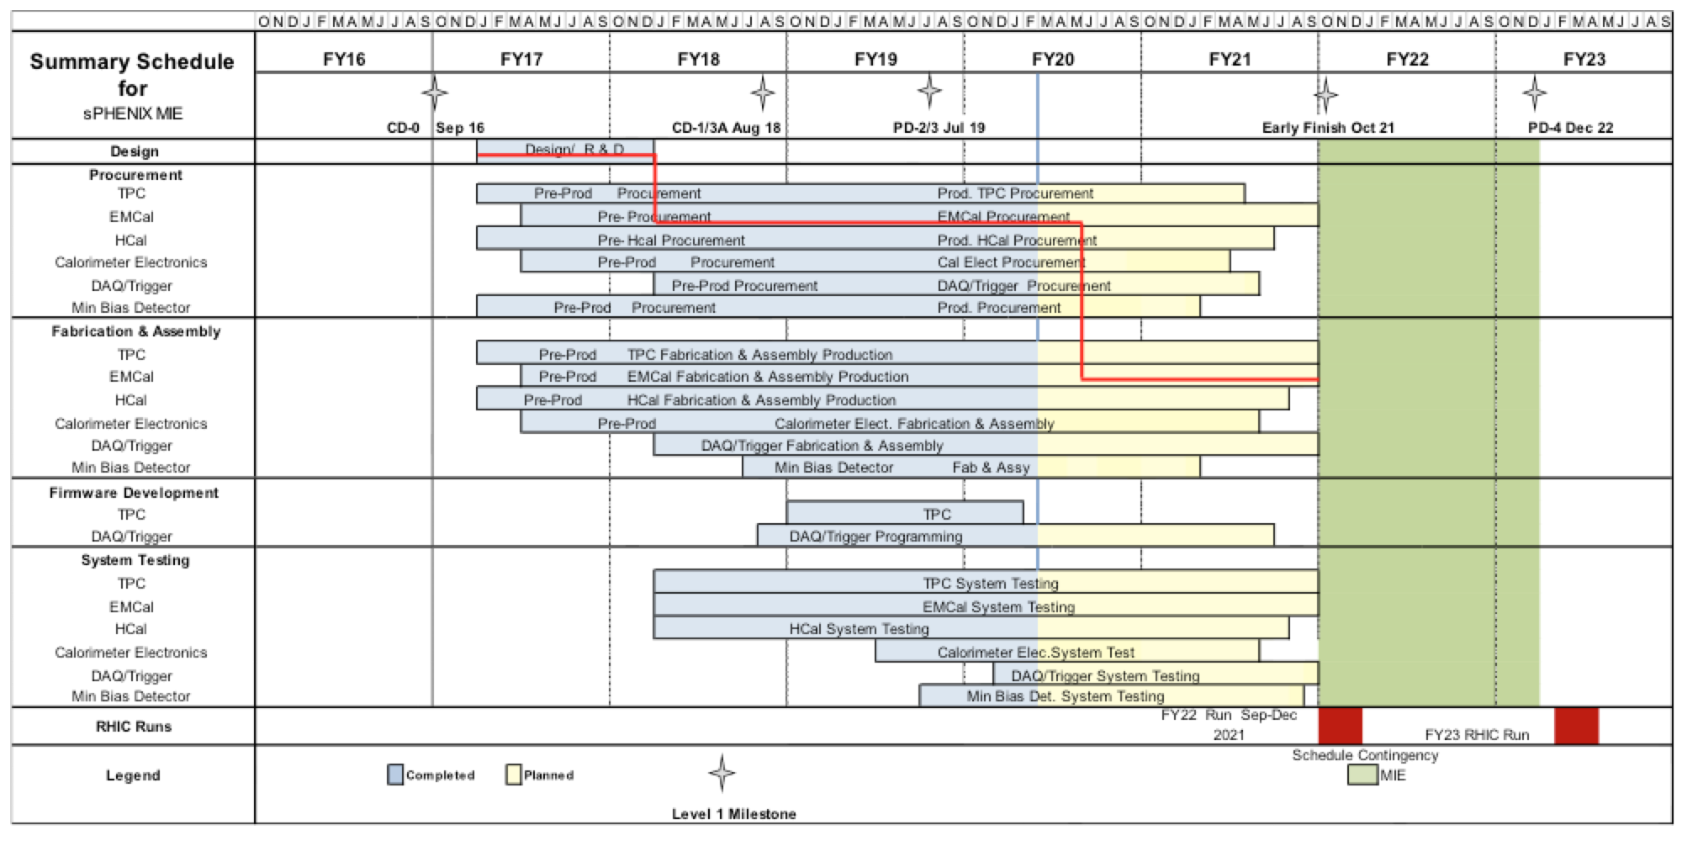
MIE: Summary Schedule

Slide 24
MIE + I&F Summary Schedule Upgrade

Slide 25
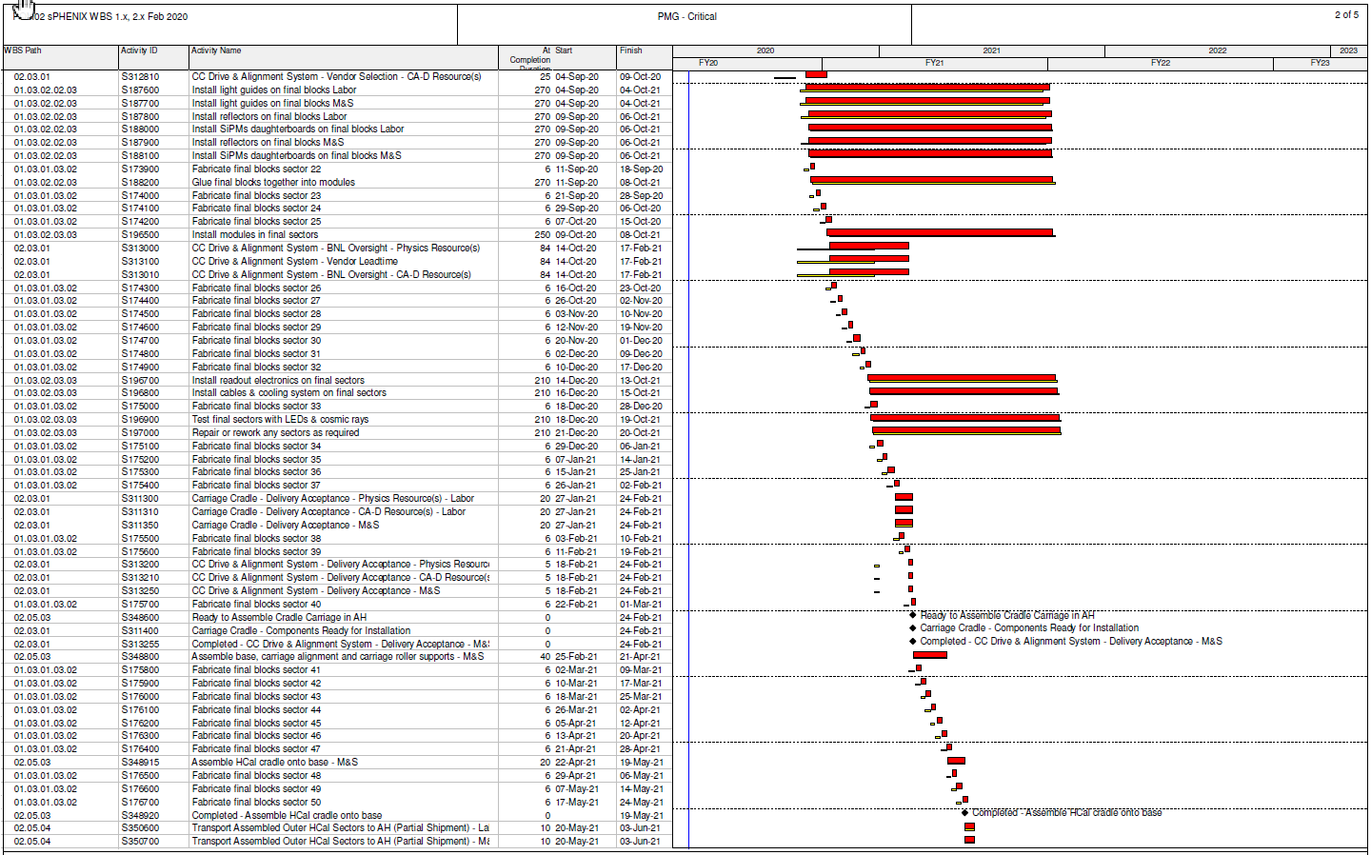
Combined Critical Path (1x, 2x and 3x )

Slide 26
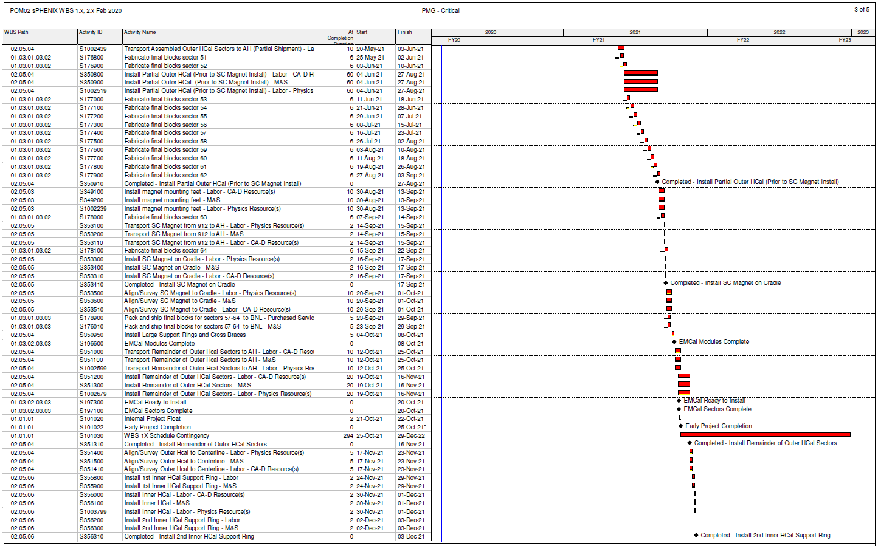
Combined Critical Path (1x, 2x and 3.X)

Slide 27
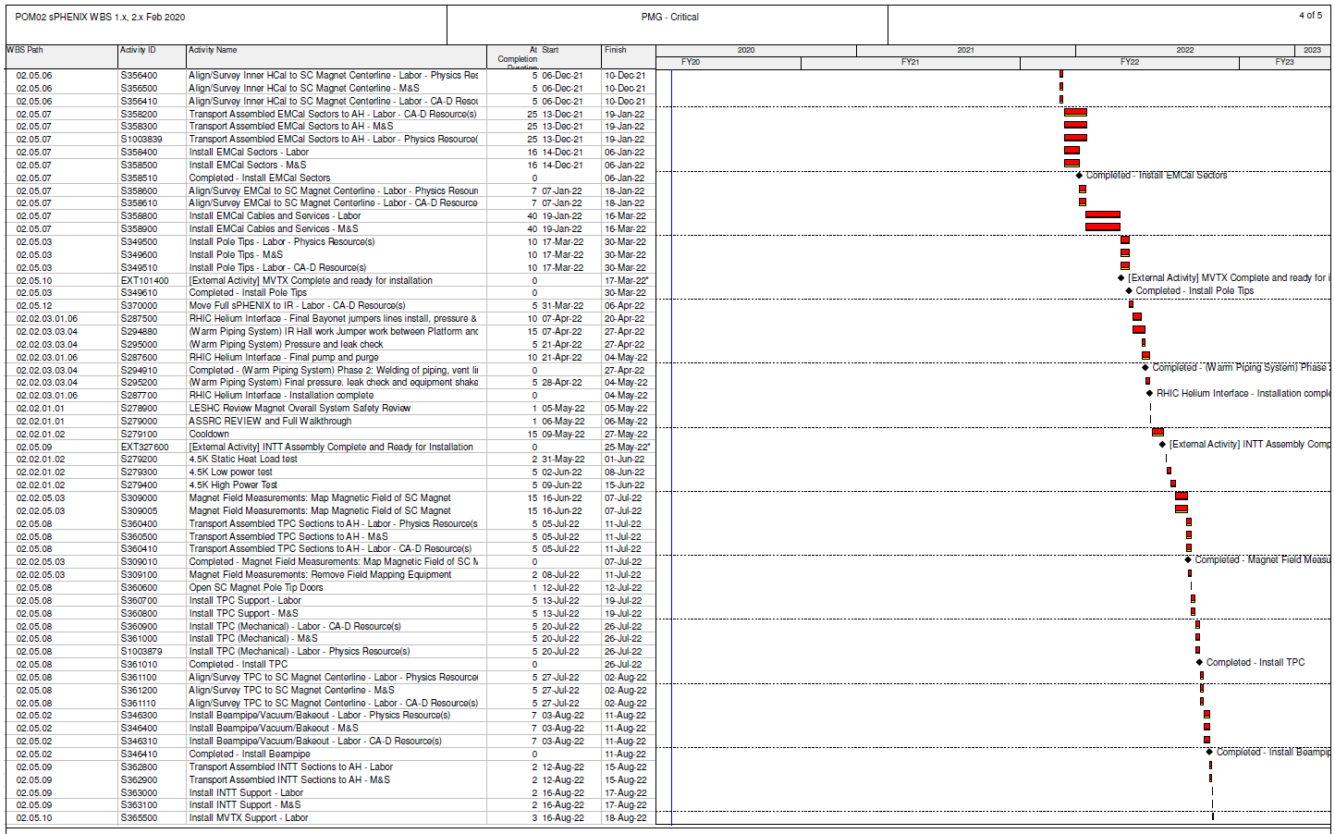
Combined Critical Path (1x, 2x and 3x )

Slide 28
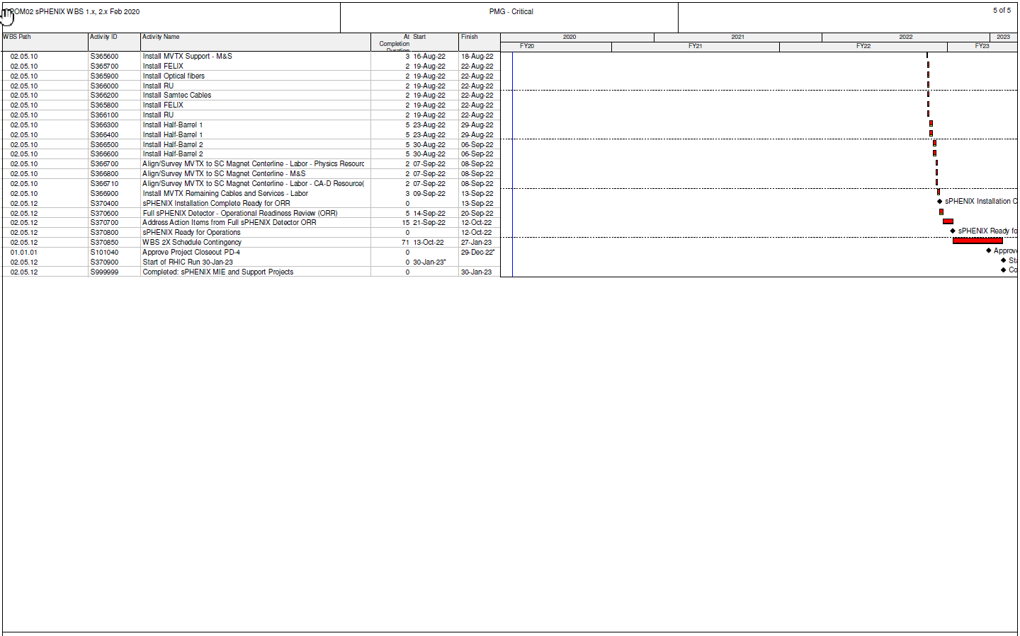
Combined Critical Path (1x, 2x and 3x )

Slide 29
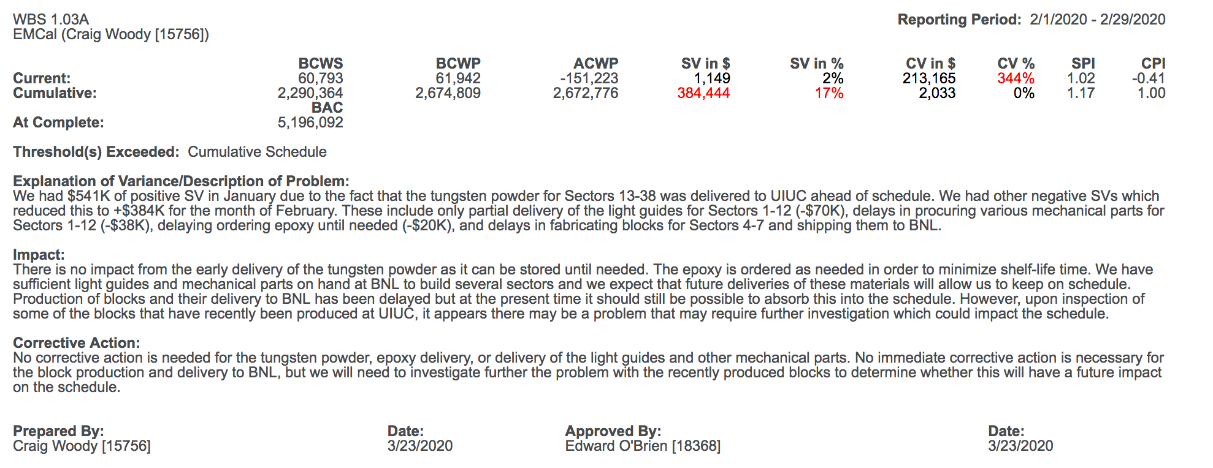
Variance Report - EMCal

Slide 30
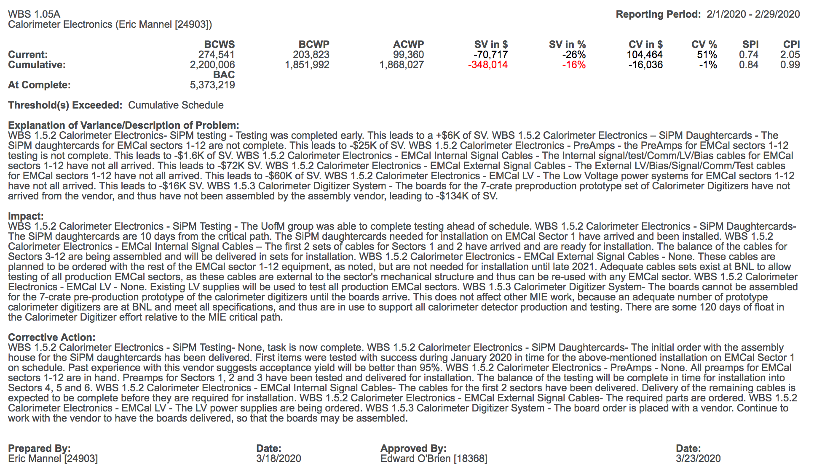
Variance Report – Calorimeter Electronics

Slide 31
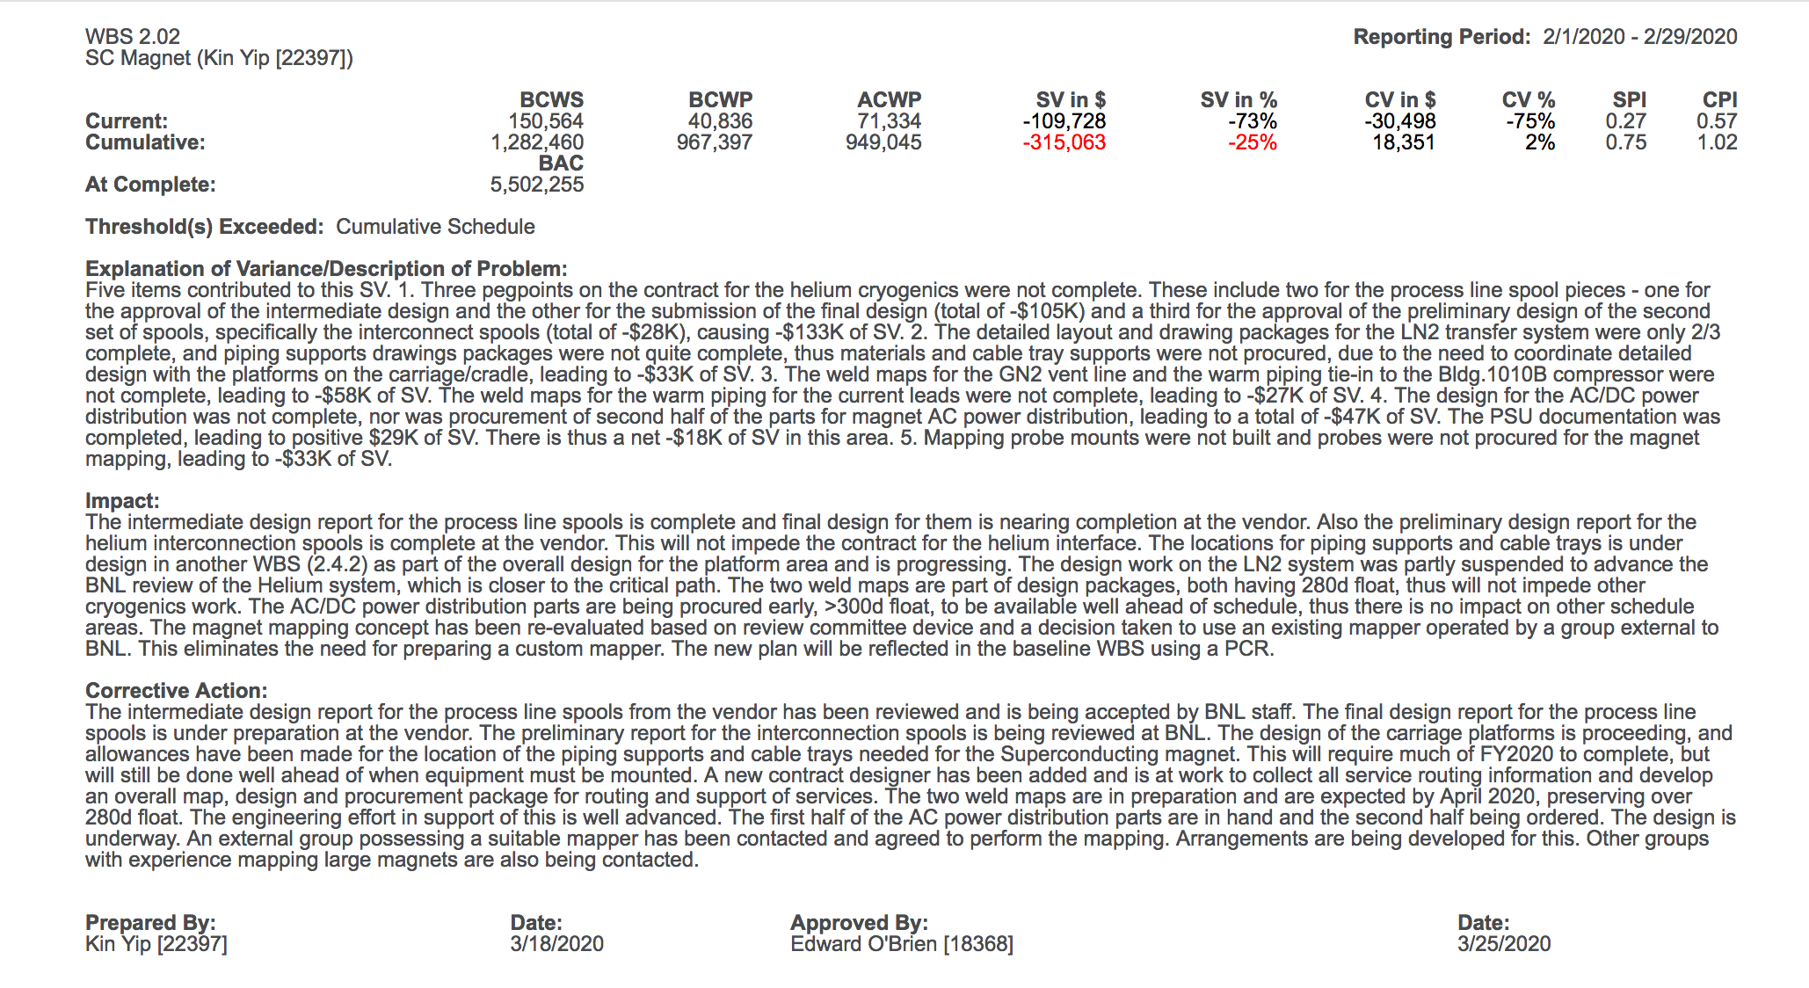
Variance Report – SC Magnet

Slide 32
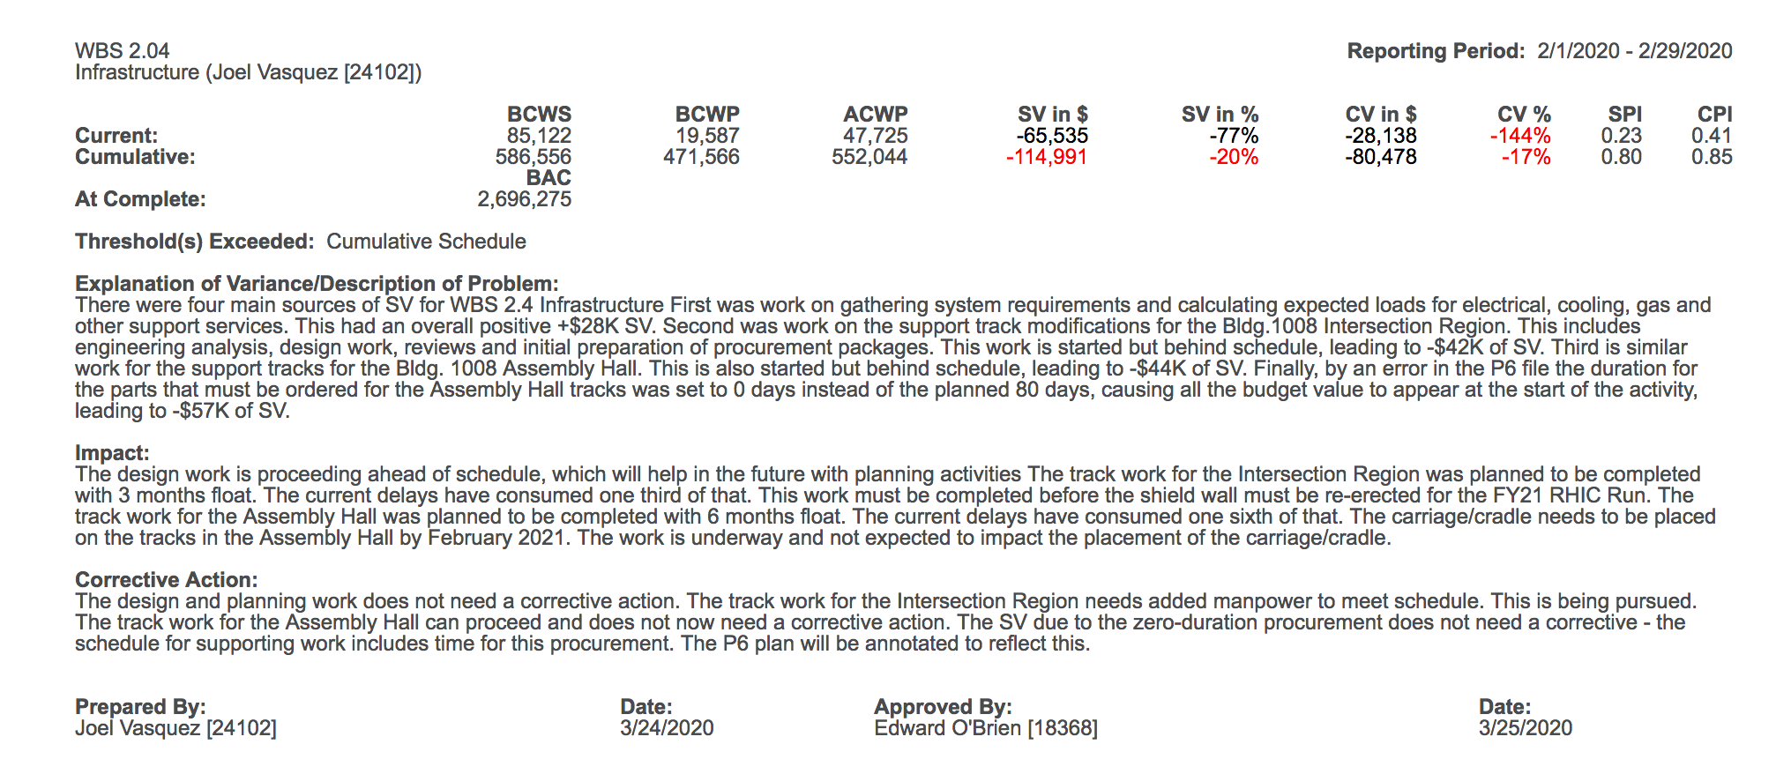
Variance Report - Infrastructure

Slide 33
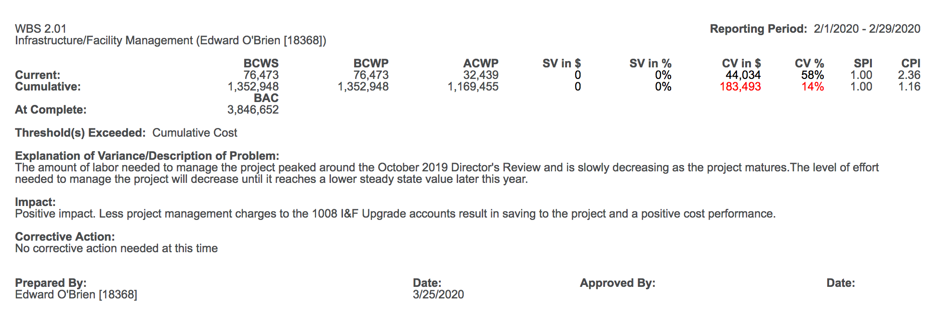
Variance Report -1008 I&F Management

